Slide 1

Presentation
Unit 7 – Lesson 1
Numbers within one thousand

Slide 2
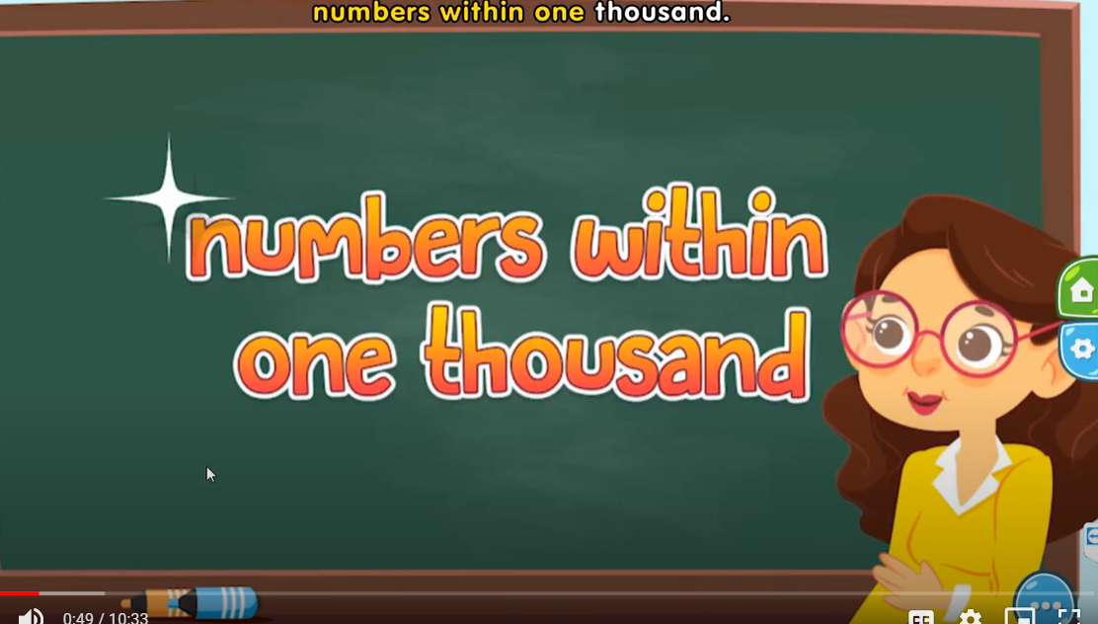
Numbers within one thousand

Slide 3

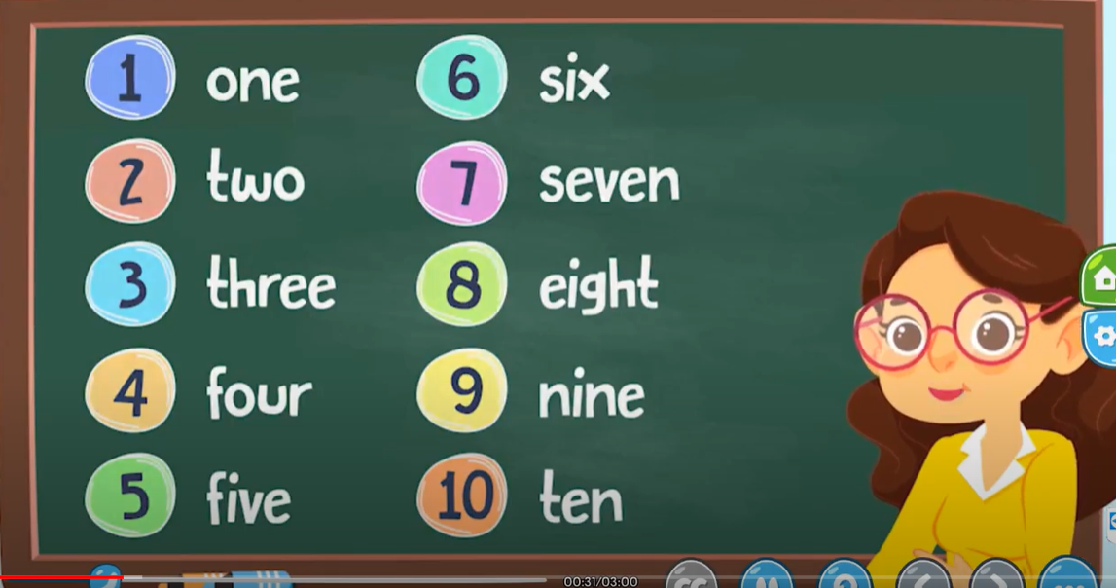
Numbers within one thousand

Slide 4
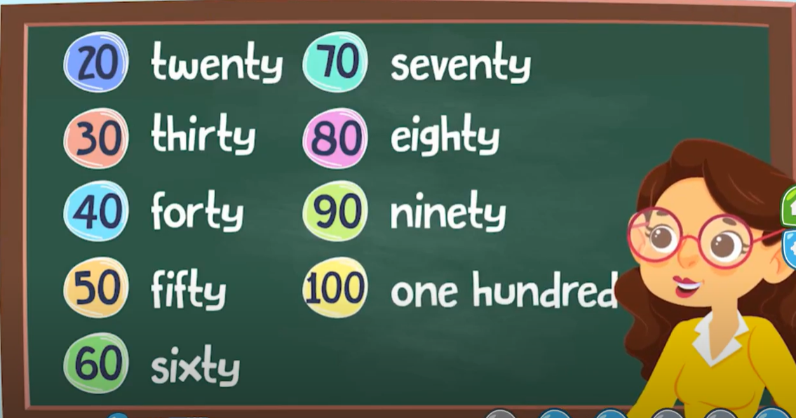
Numbers within one thousand

Slide 5
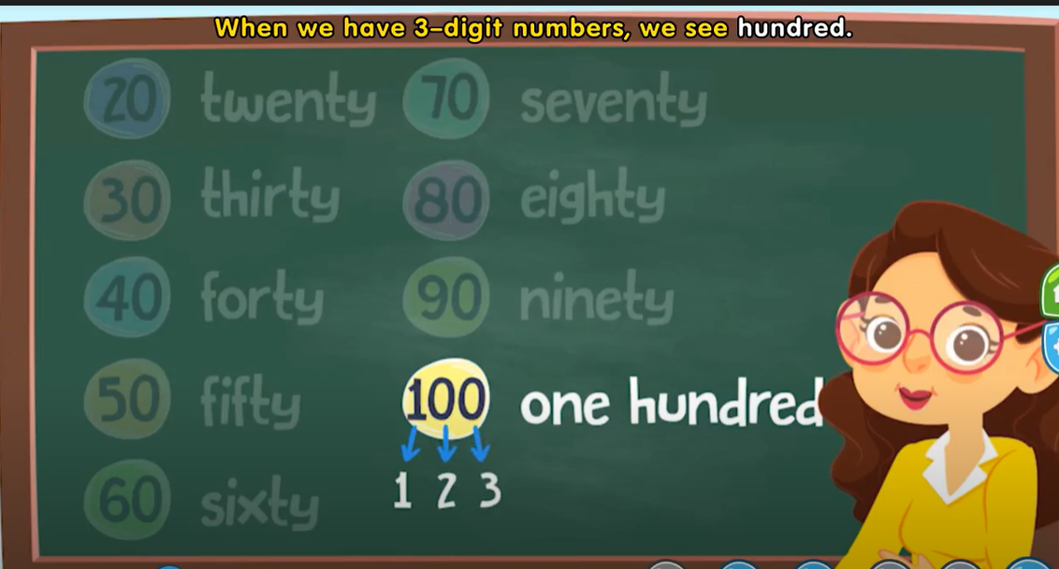
Numbers within one thousand

Slide 6
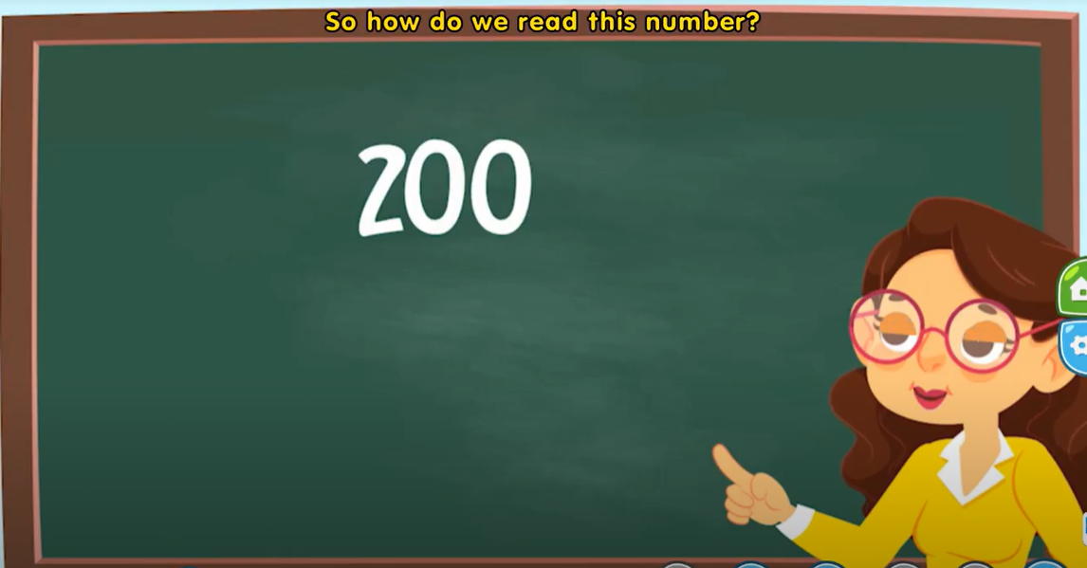


Numbers within one thousand

Slide 7
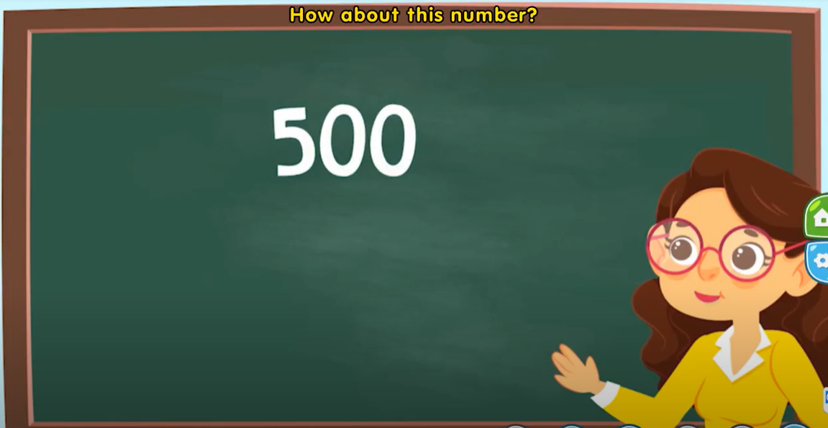


Numbers within one thousand

Slide 8
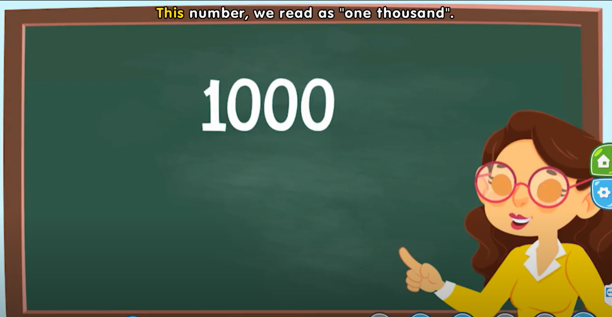

Numbers within one thousand

Slide 9
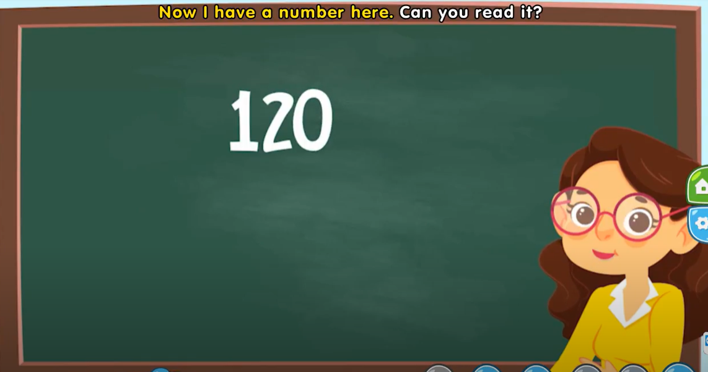
Numbers within one thousand

Slide 10
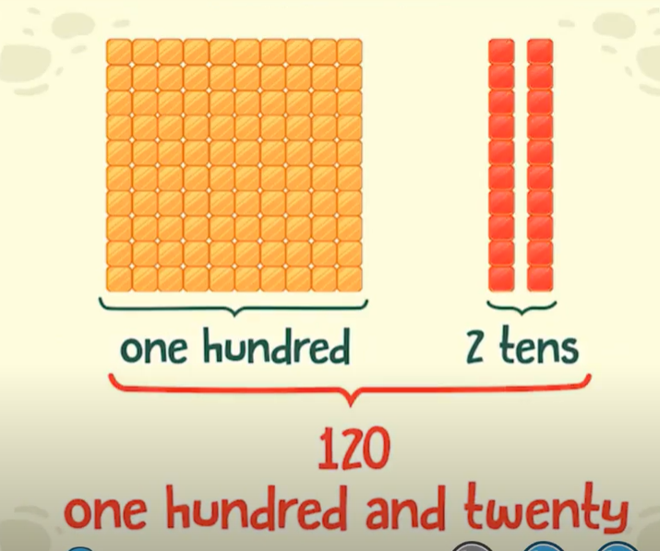
Numbers within one thousand

Slide 11
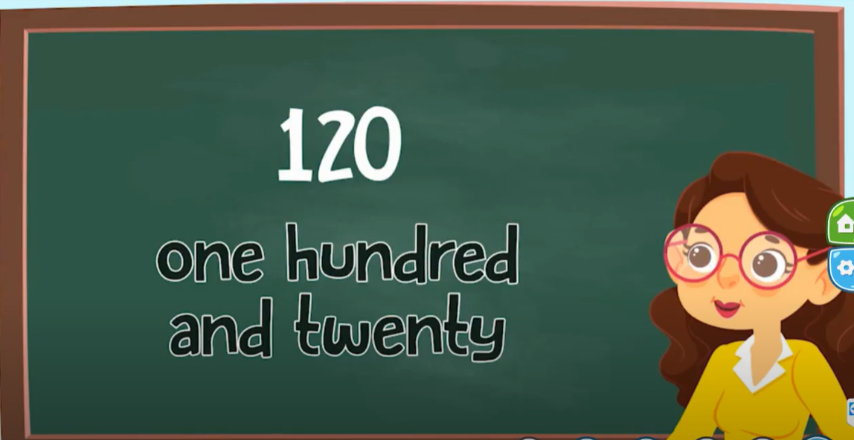
Numbers within one thousand

Slide 12
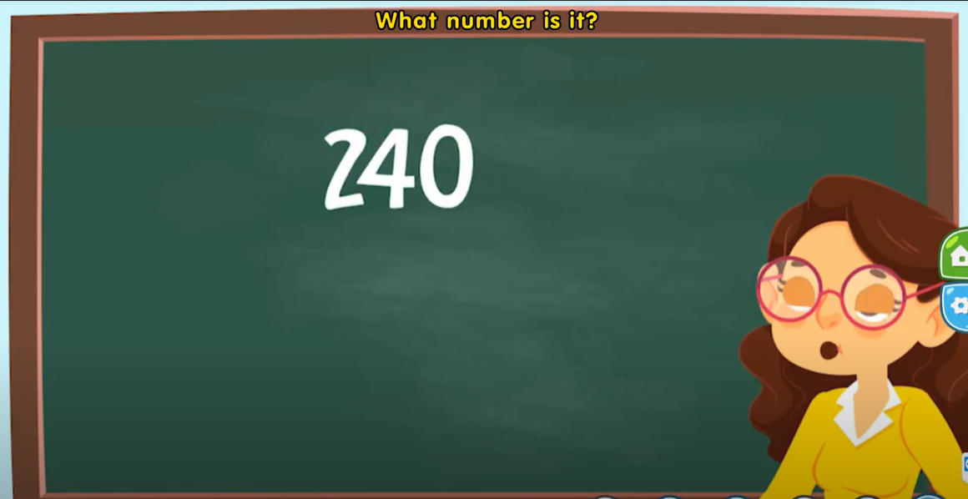
Numbers within one thousand

Slide 13
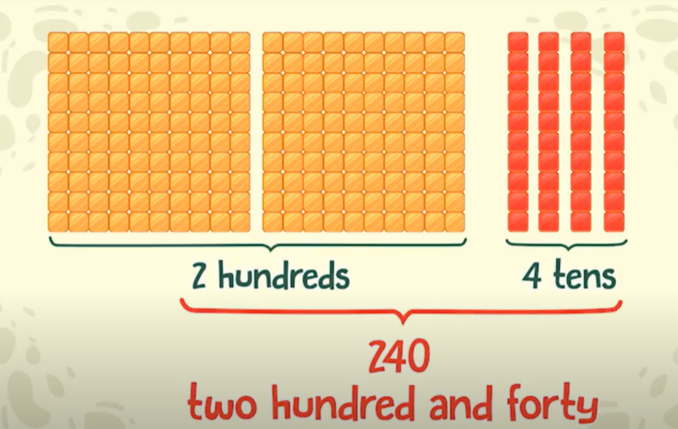
Numbers within one thousand

Slide 14
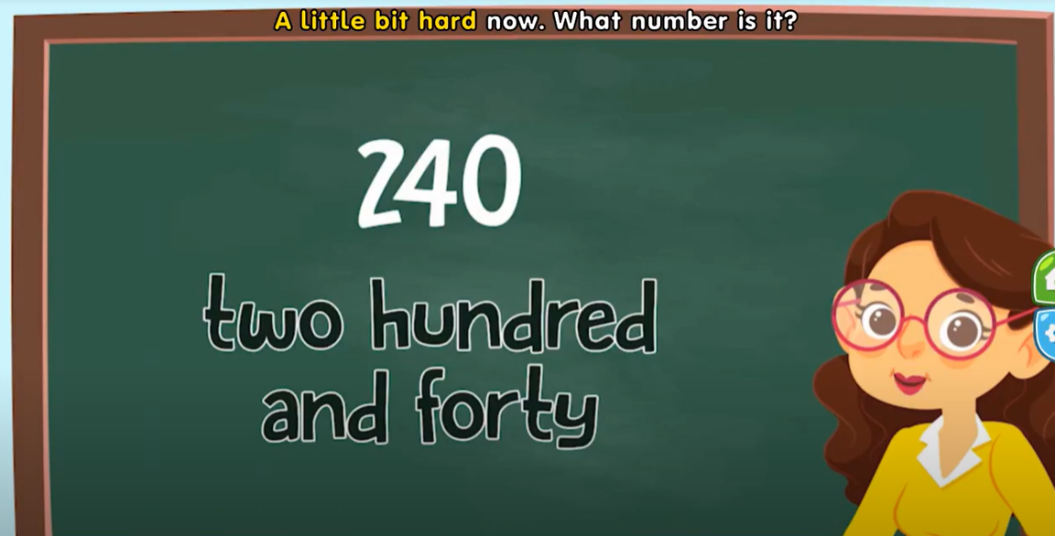
Numbers within one thousand

Slide 15
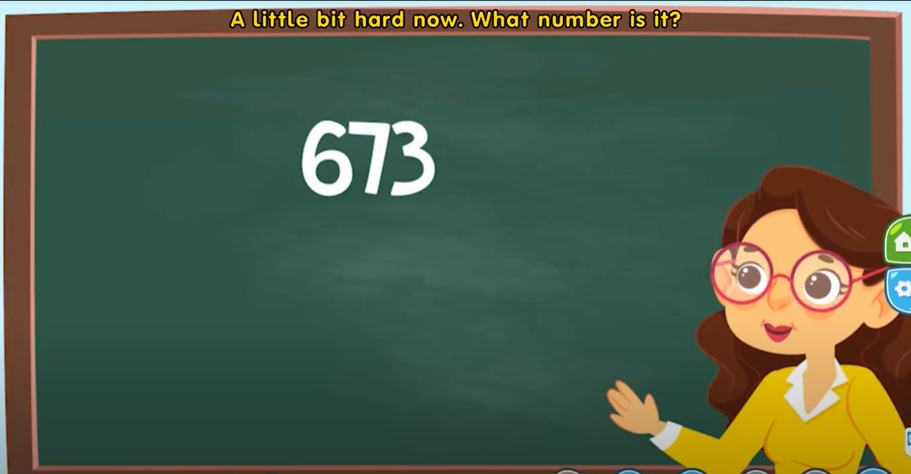
Numbers within one thousand

Slide 16
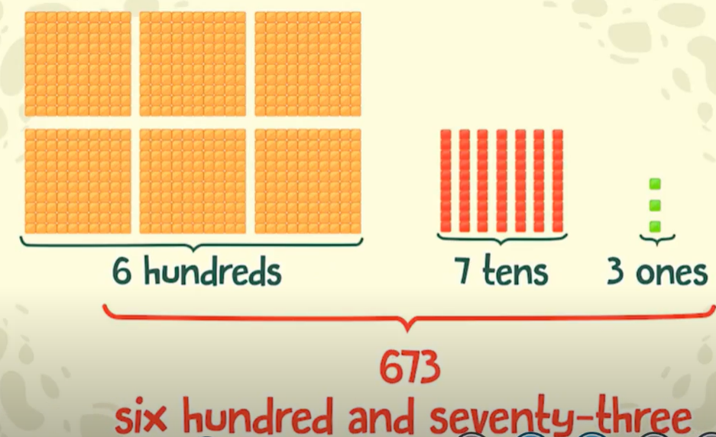
Numbers within one thousand

Slide 17
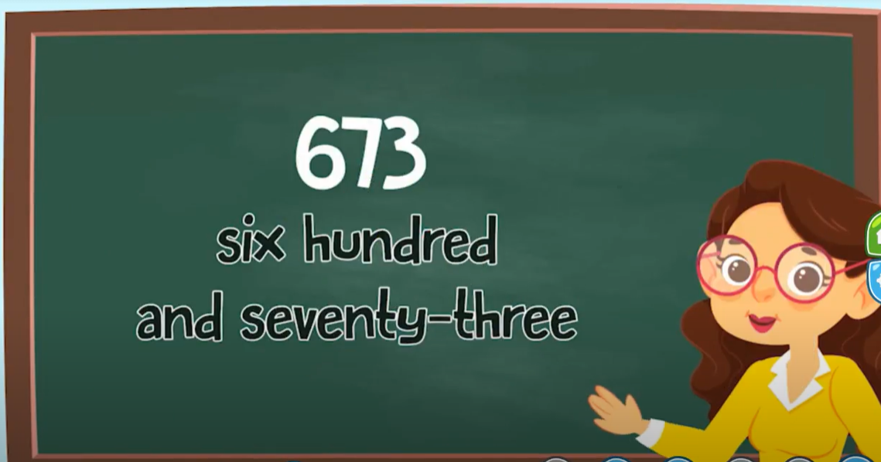
Numbers within one thousand

Slide 18
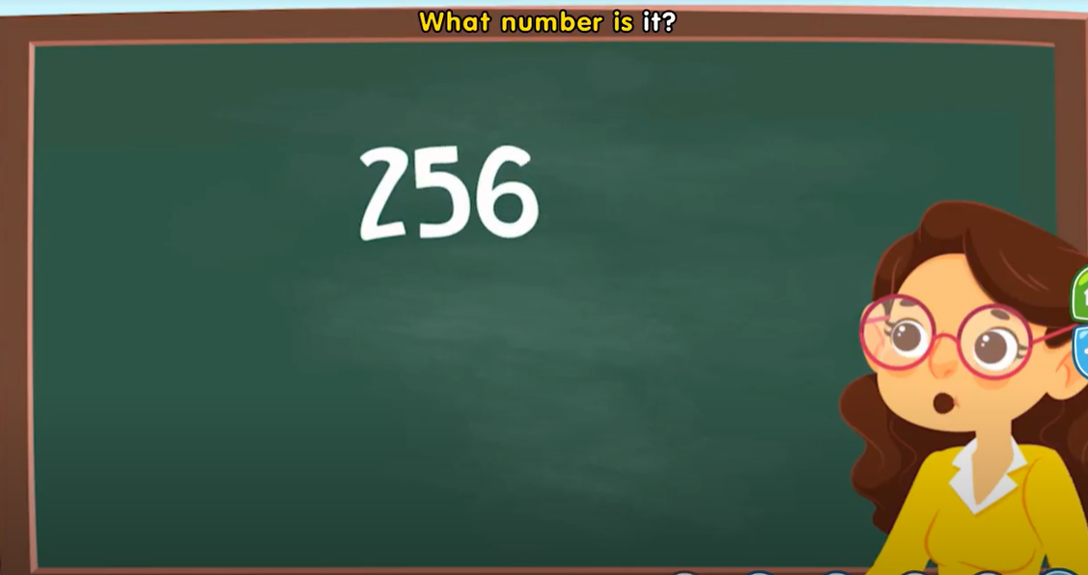
Numbers within one thousand

Slide 19
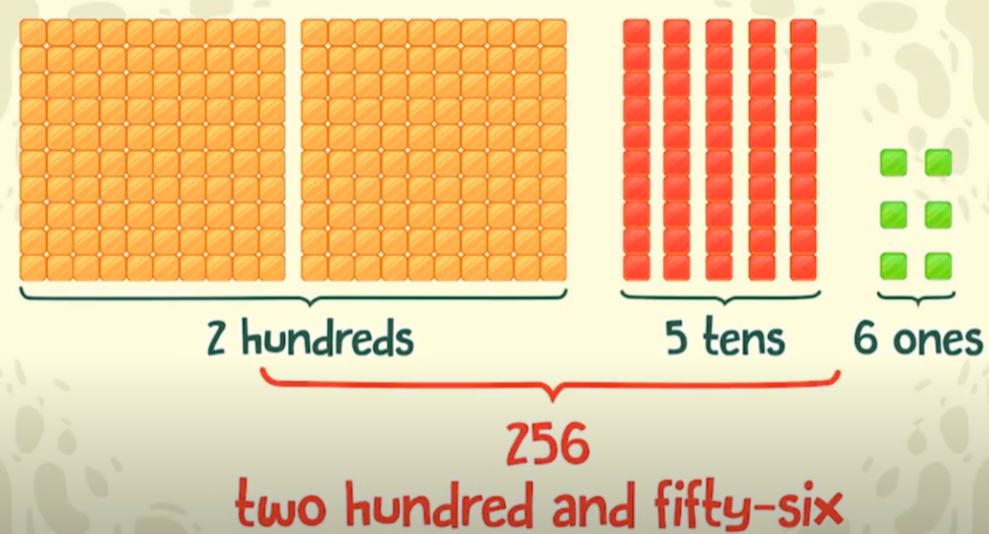
Numbers within one thousand

Slide 20
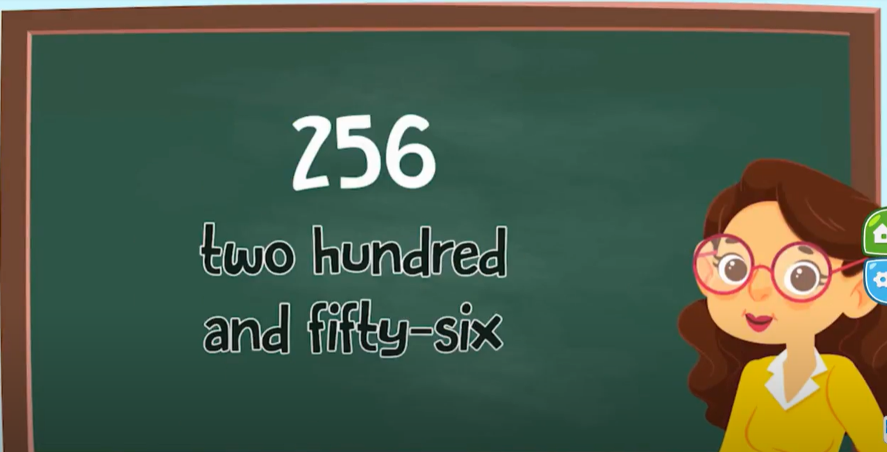
Numbers within one thousand

Slide 21
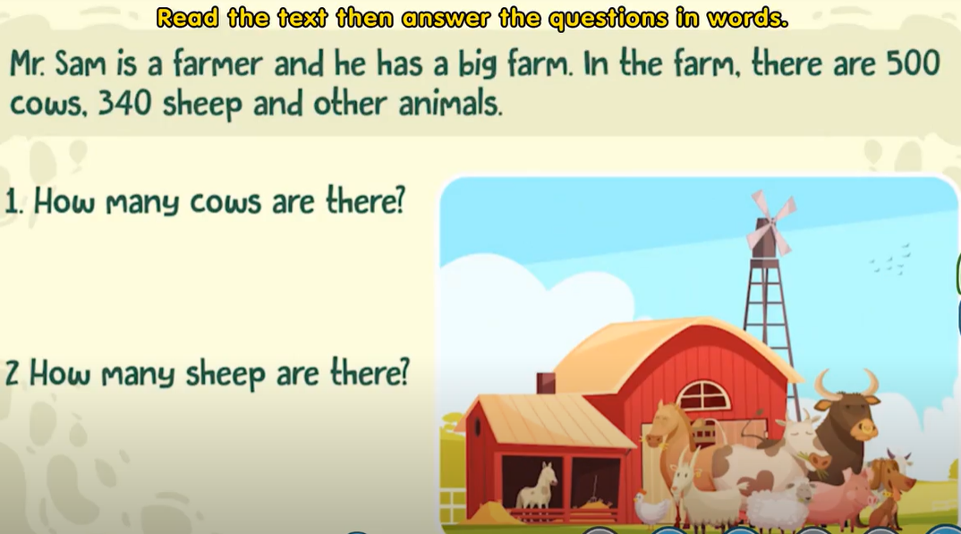
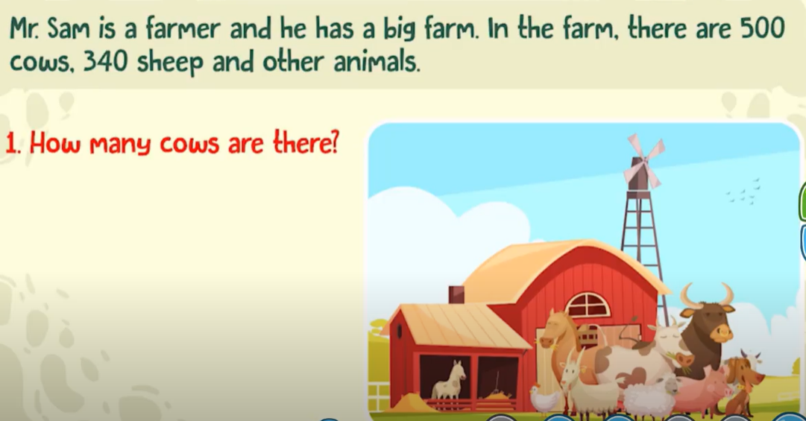


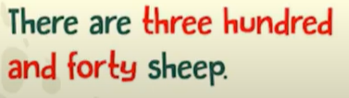
Numbers within one thousand

Slide 22
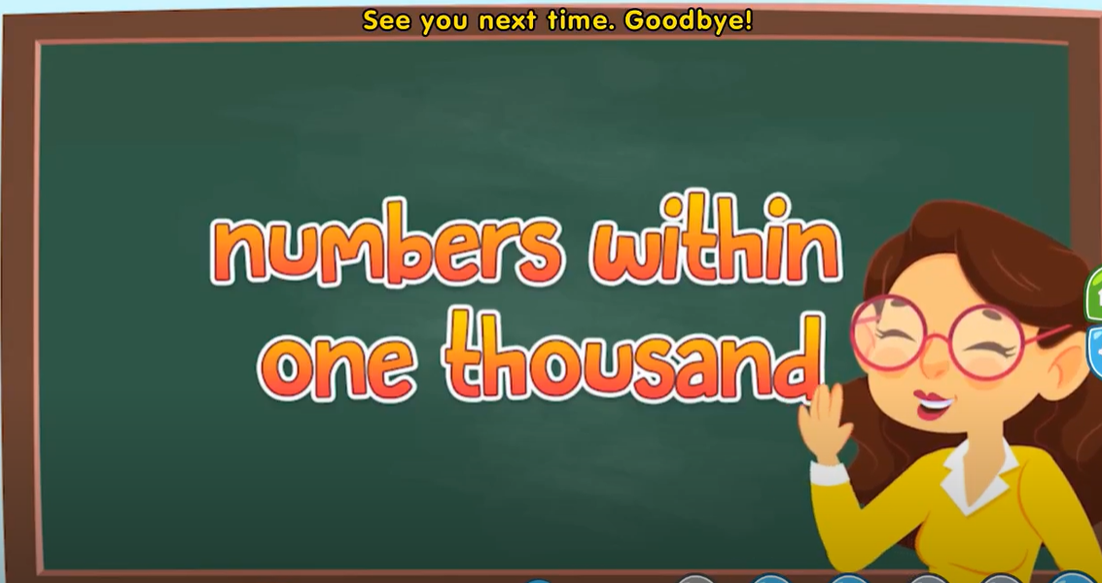
Numbers within one thousand

Slide 23
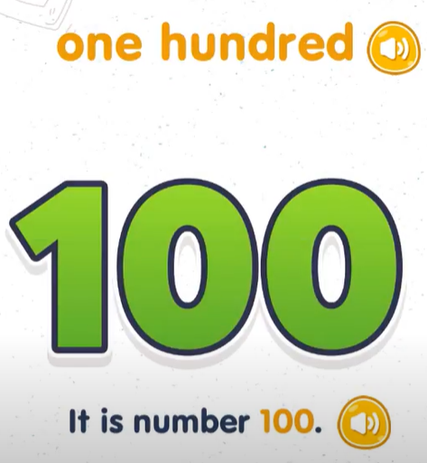
Numbers within one thousand

Slide 24
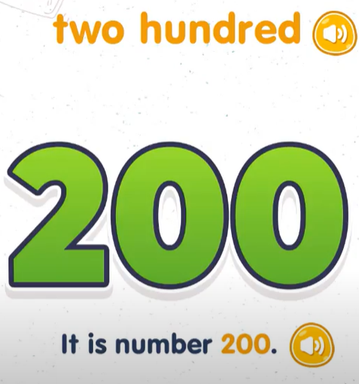
Numbers within one thousand

Slide 25
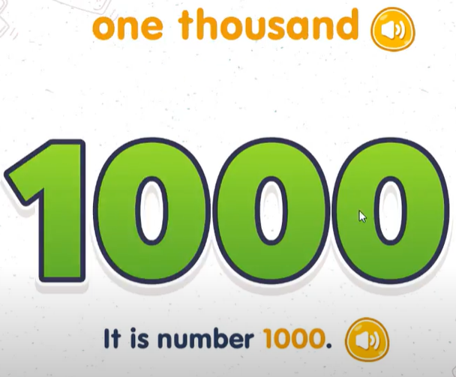
Numbers within one thousand

