Slide 1


GRADE 2 - SCIENCE
Unit 6: Bones and muscles
Review of unit 6

Slide 2
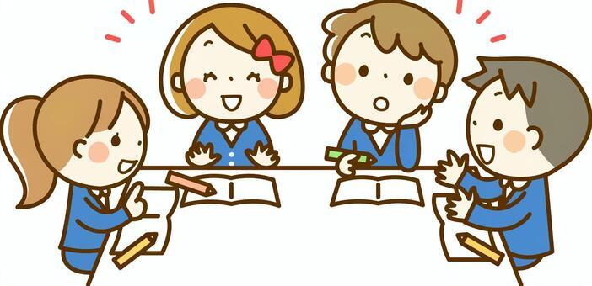
Group work
Students come to the board and use body language to explain the word. Others have to guess the words.

Slide 3
Science 2
Unit 6 - Review
1. Skeleton: bộ xương
2. Skull: hộp sọ
3. Rib cage: xương sườn
4. Spine: xương sống
5. Bone: xương
6. Joint: khớp
7. Muscle: cơ
8. Shape: hình dạng
9. Move: vận động

Slide 4
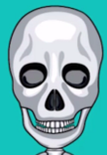
What bone is it?
skull
It’s the

Slide 5

What bone is it?
spine
It’s the

Slide 6
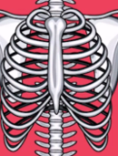
What bone is it?
rib cage
It’s the

Slide 7
The skull, the rib cage and the spine are bones in the skeleton.

Slide 8
The skeleton and muscles give the body shape and help it move.

Slide 9


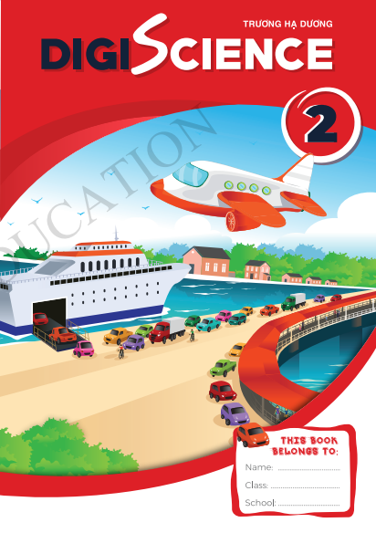
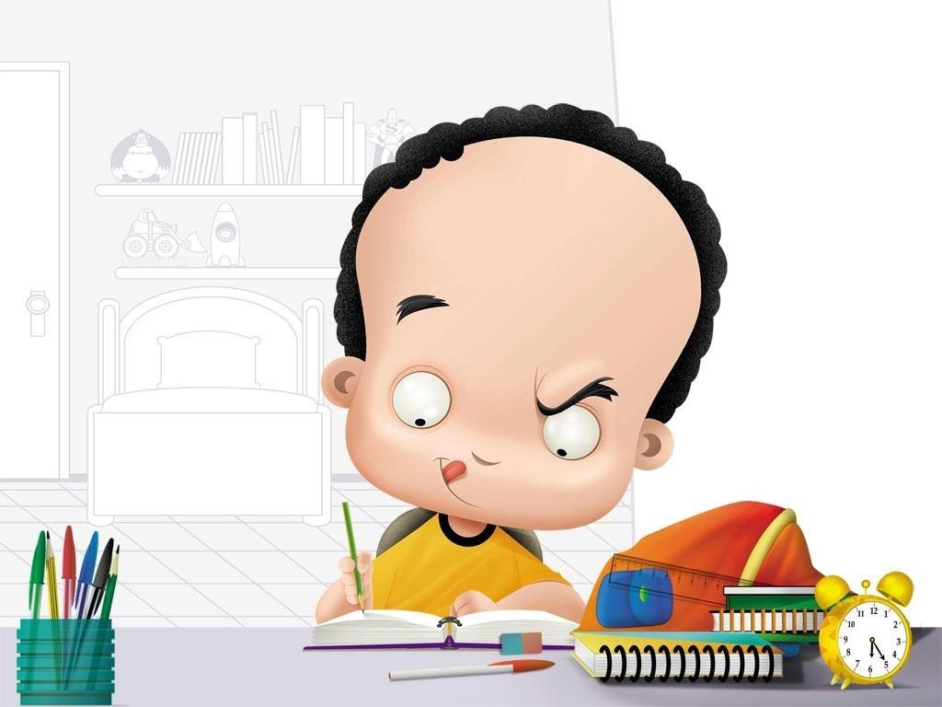
Do the exercises
Practice 3
Open your book Page 48, 49
5 minutes to finish
My Body

Slide 10


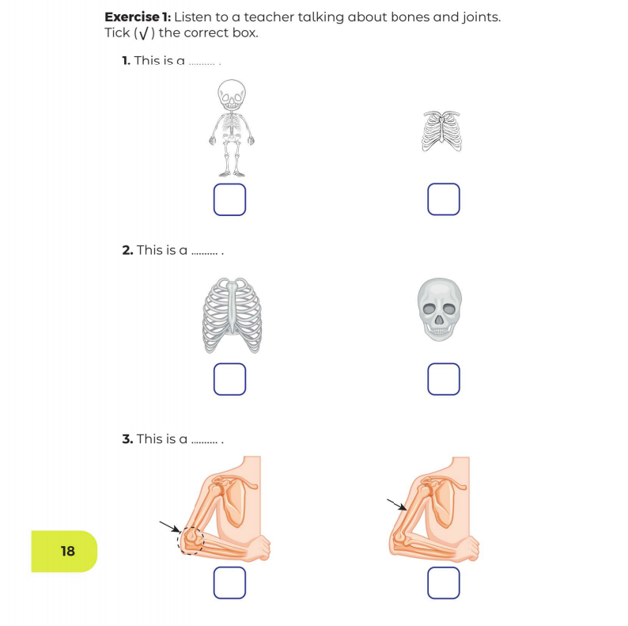


My Body

Slide 11
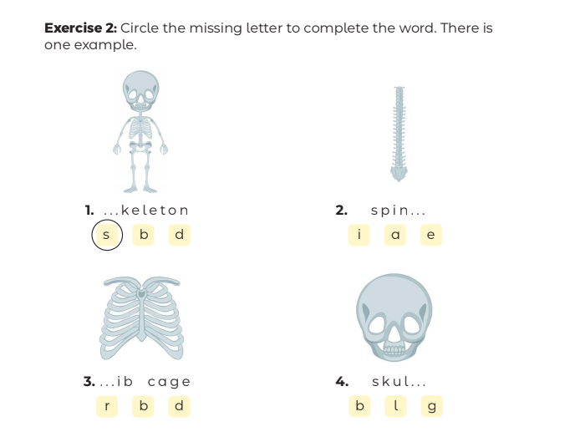

Practice 3
My Body

Slide 12
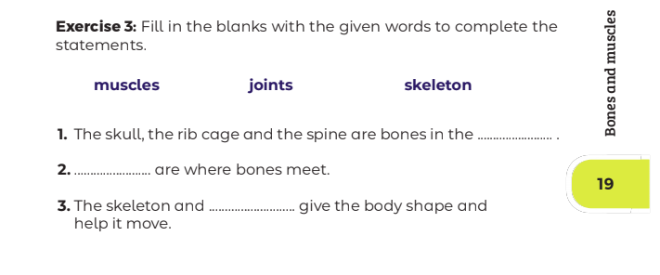
Practice 3
My Body
skeleton
Joints
muscles

