Slide 1


GRADE 2 – MATH
UNIT 6: DIVISION
LESSON 1 – DIVISION TABLE OF 2

Slide 2



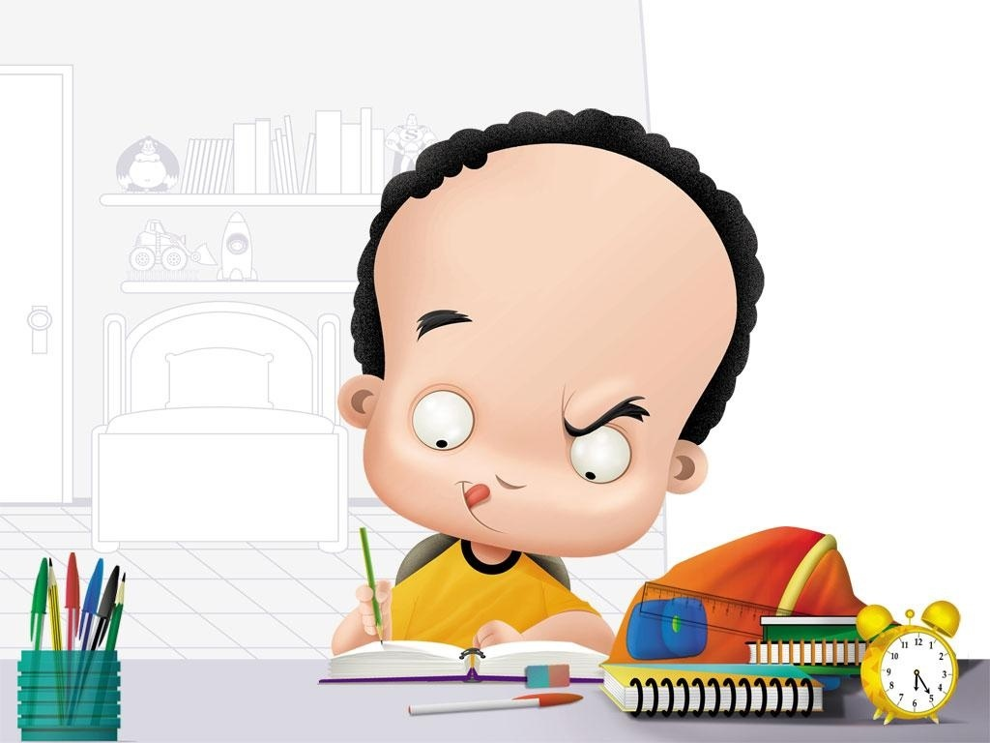
Do the exercises
Open your book Page 43, 44
5 minutes to finish
My Body

Slide 3
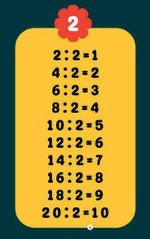
Group work
4 students/group
S1: Hello, everyone. We are group 1. Today, we will talk about the division table of two. S2: What is eighteen divided by two? S1: Eighteen divided by two equals nine. What is sixteen divided by two? S1: Sixteen divided by two equals eight. S3: What is fourteen divided by two? S4: Fourteen divided by two equals seven. What is twenty divided by two? S3: Twenty divided by two equals ten. Thank you for listening!

Slide 5
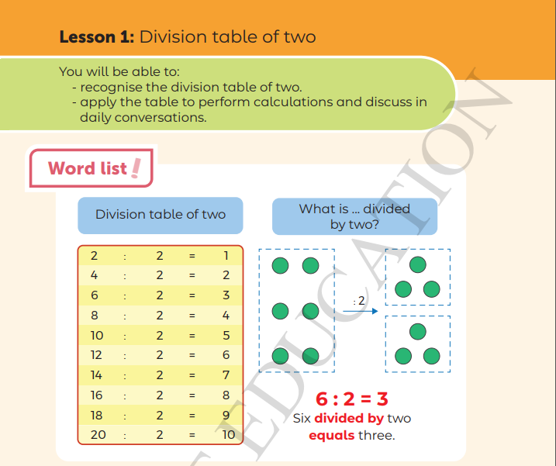


Slide 6

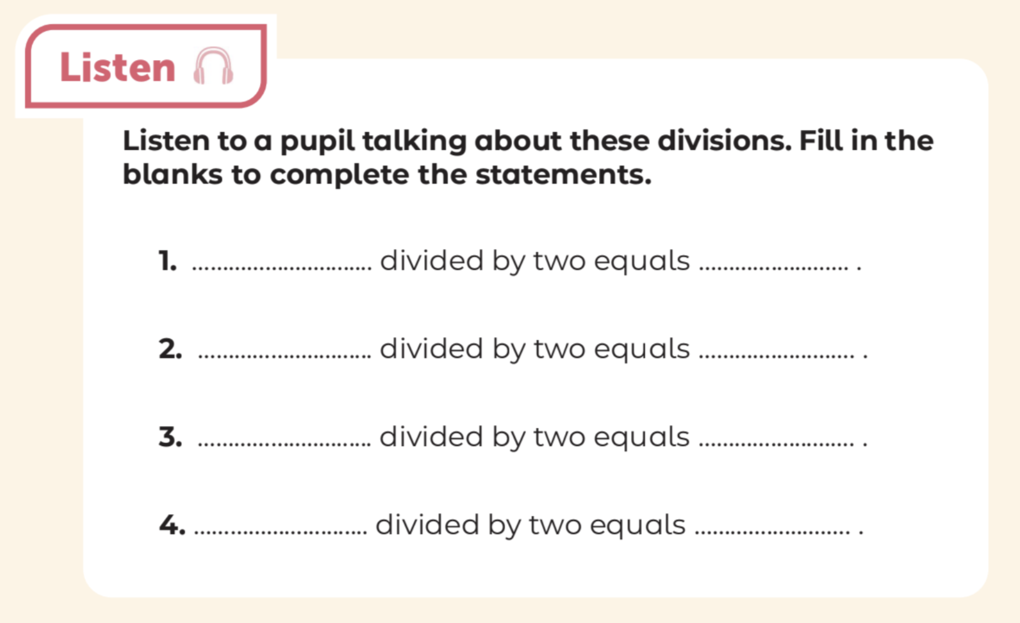


Do the exercises
Six
three
Eight
four
Twelve
six
Eighteen
nine

Slide 7
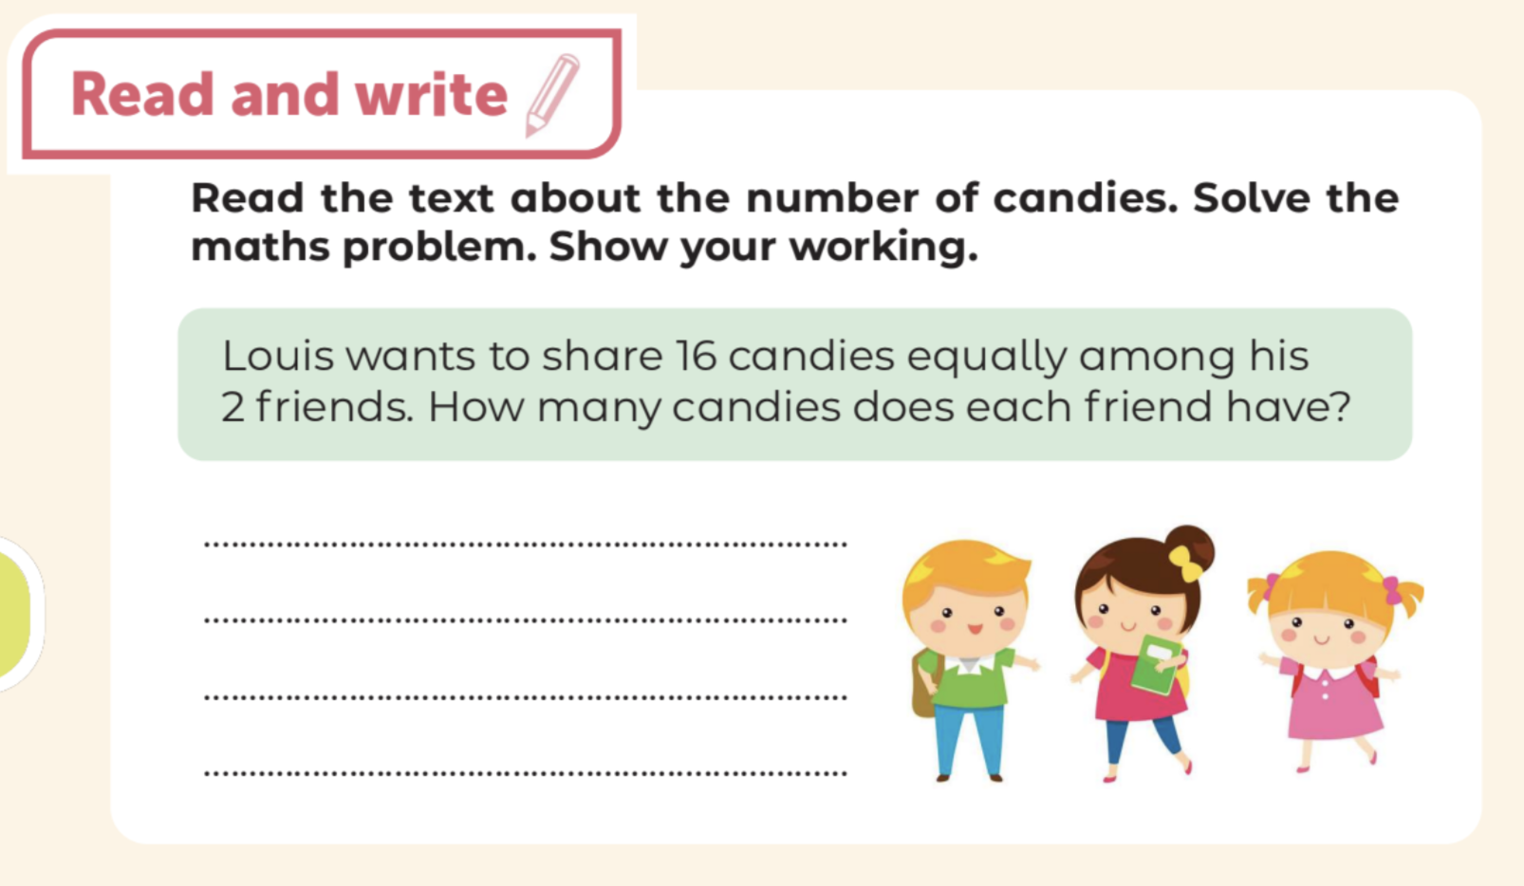
Do the exercises
The number of candies that each friend has is:
16 : 2 = 8 (candies)
Each friend has 8 candies.

Slide 8
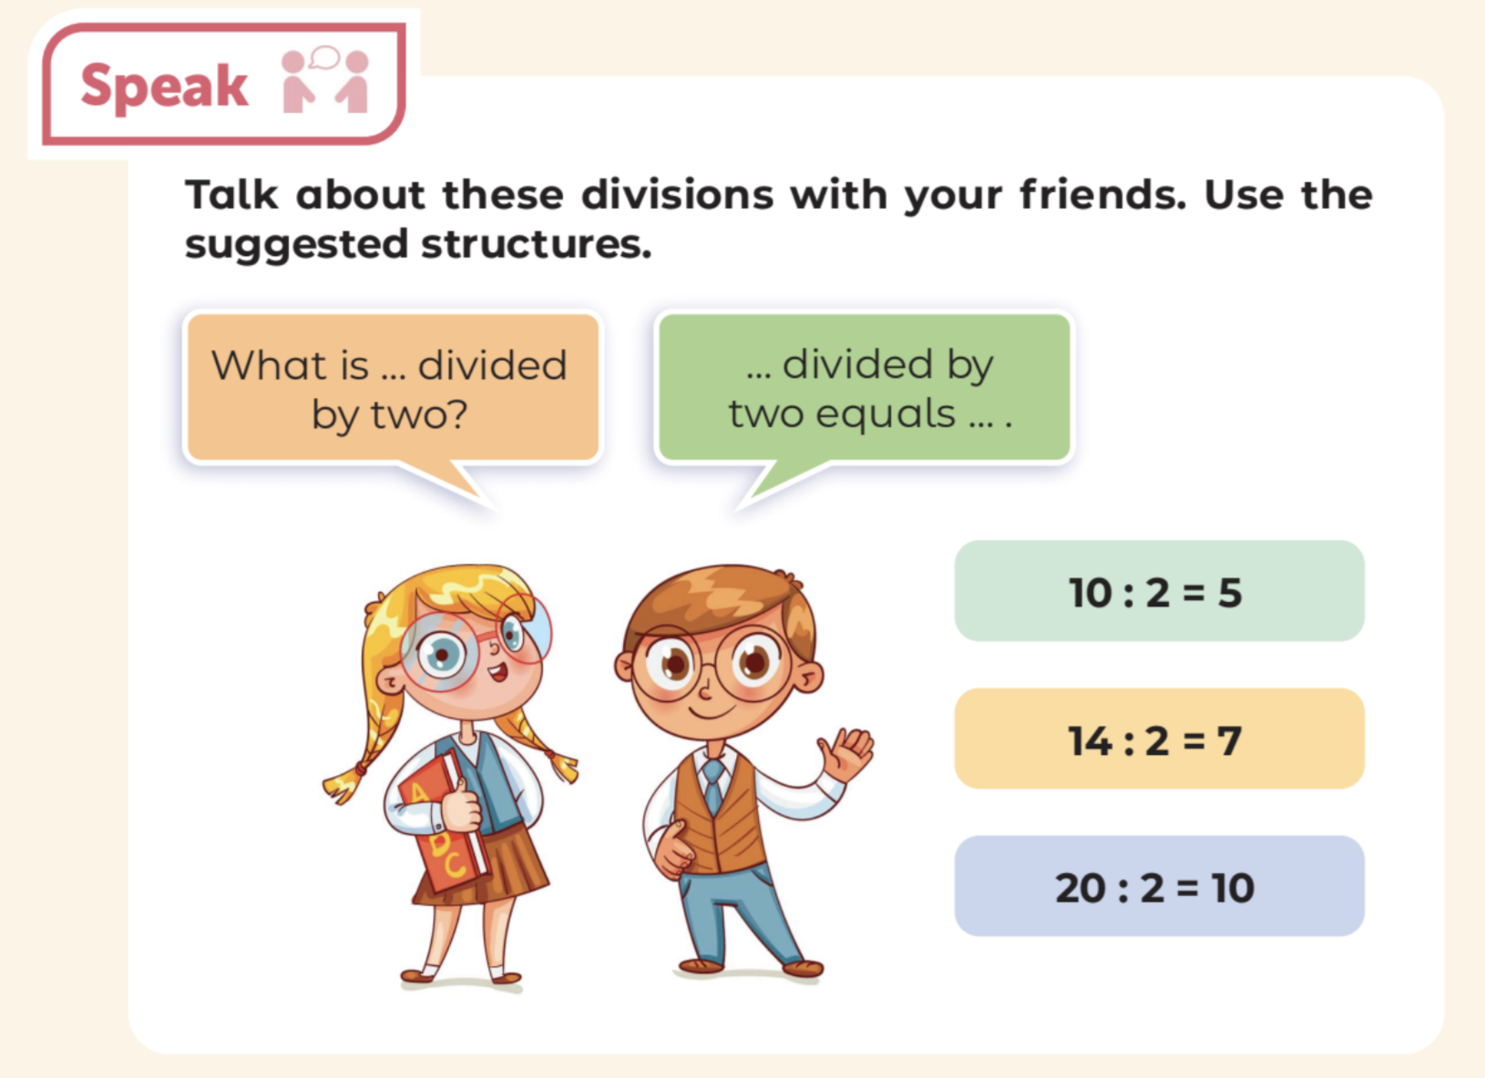
Do the exercises

