Slide 1





Workbook

Slide 2



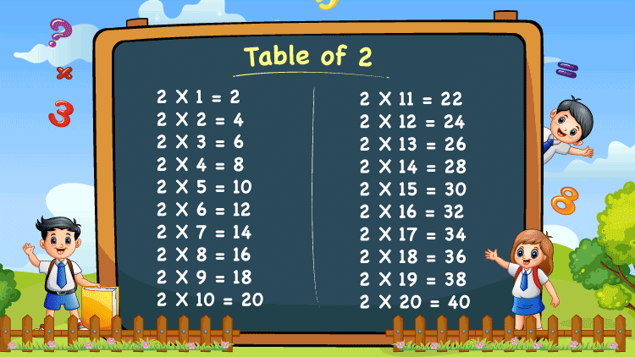
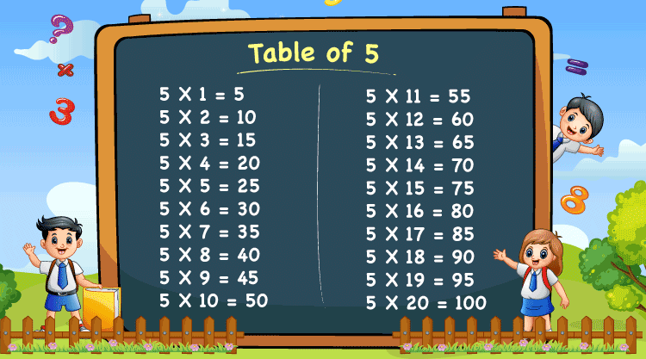
Group work
4 students/group
S1: Hello, everyone. We are group 1. Today, we will talk about the multiplication table of two and the multiplication table of five.
S2: There are five apples in a box. How many apples are in eight boxes?
S1: Eight multiplied by five equals forty. There are forty apples.
S1: There are five pupils in a team. How many pupils are in two teams?
S2: Two multiplied by five equals ten. There are ten pupils.
S3: A class has nine pupils in a team. How many pupils are in the five teams?
S4: Nine multiplied by five equals forty-five. There are forty-five pupils in the class.
S4: There are nine cookies in the box. How many cookies are in the two boxes?
S3: Nine multiplied by two equals eighteen. There are eighteen cookies.
Thank you for listening!

Slide 4

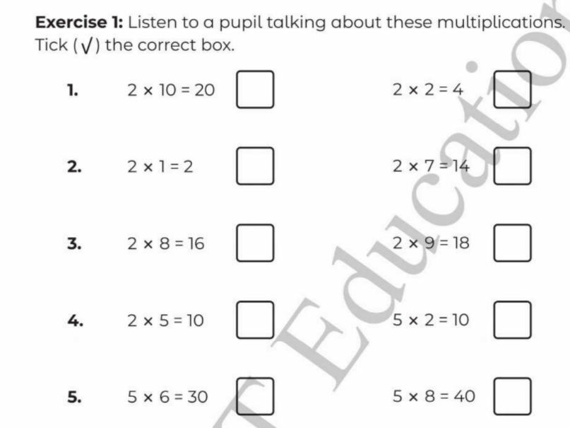



Slide 5
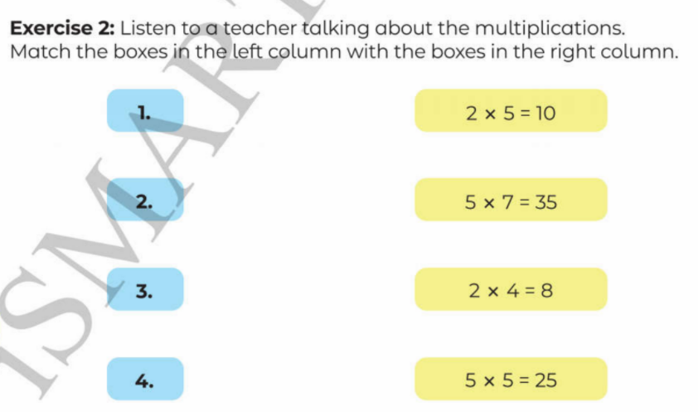

Slide 6
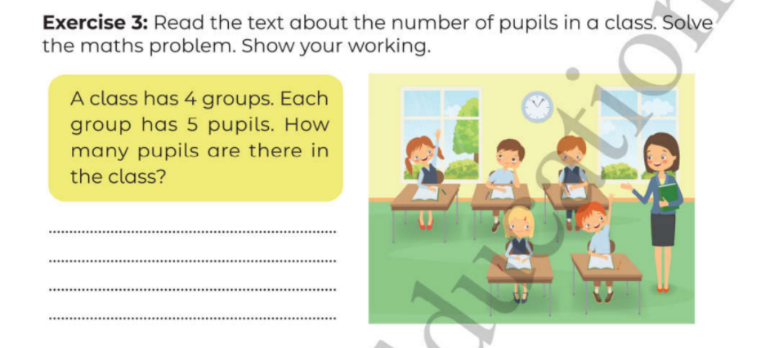

5 x 4 = 20 (pupils)
There are 20 pupils in the class.

Slide 7
