Slide 1

Presentation
Unit 7 – Lesson 1
Multiples of ten

Slide 2
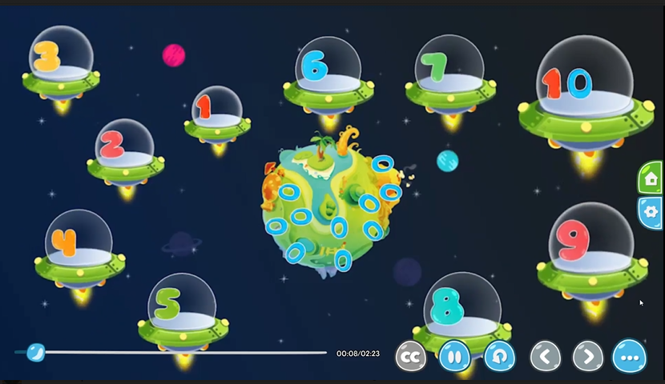
Multiples of ten
What numbers can you see?

Slide 3
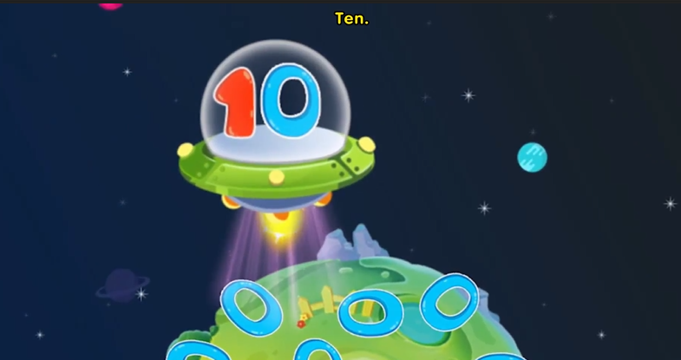
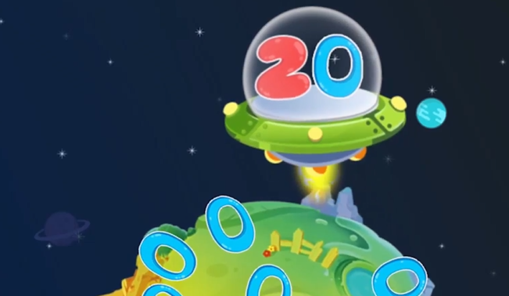
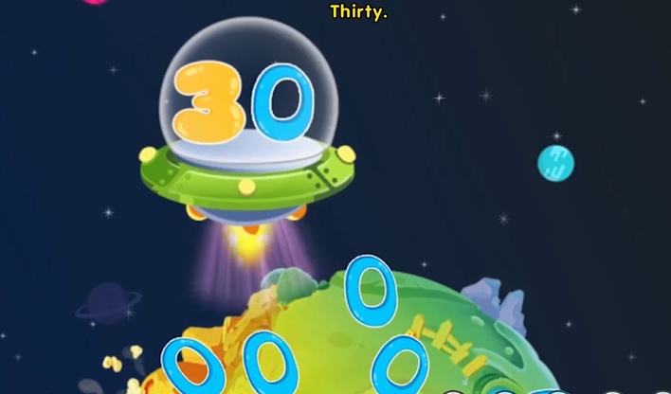
Multiples of ten
ten
twenty
It is number ….
thirty

Slide 4
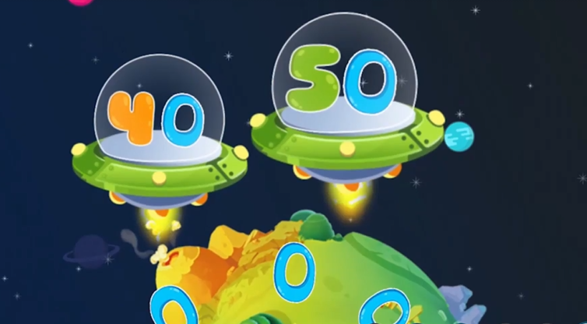
Multiples of ten
fourteen
fifteen

Slide 5

Multiples of ten
sixteen
seventeen
What number is it?

Slide 6
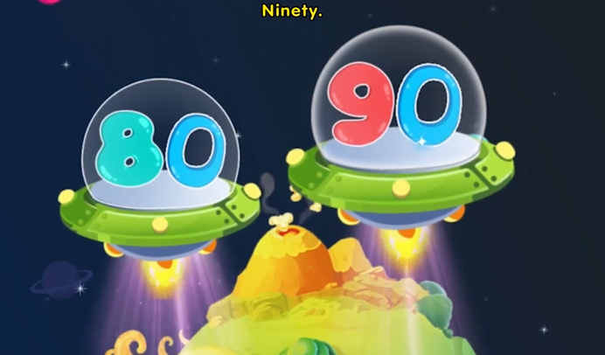
Multiples of ten
eighteen
nineteen

Slide 7
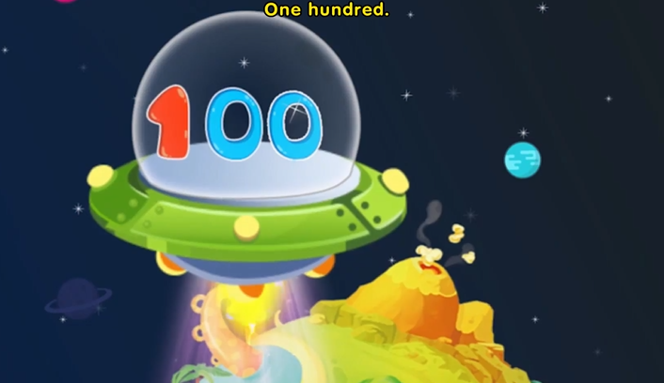
Multiples of ten
It is number one hundred

Slide 8
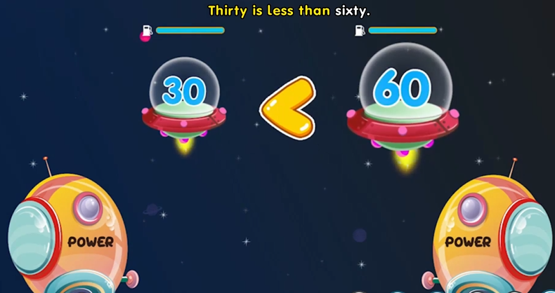
Multiples of ten
?
less

Slide 9
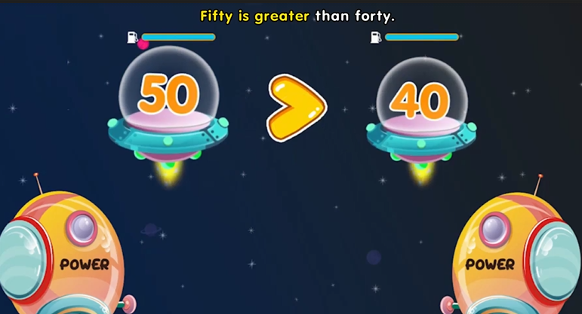
Multiples of ten
greater than

Slide 10
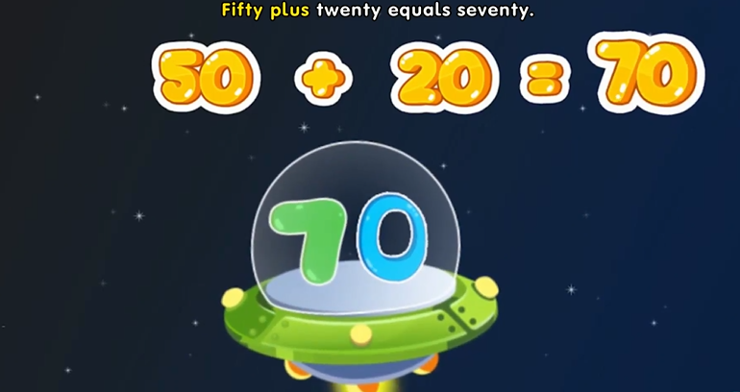
Multiples of ten

Slide 11
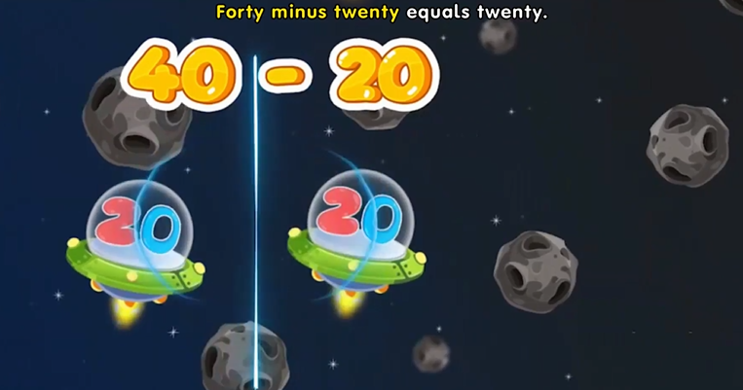
Multiples of ten

Slide 12
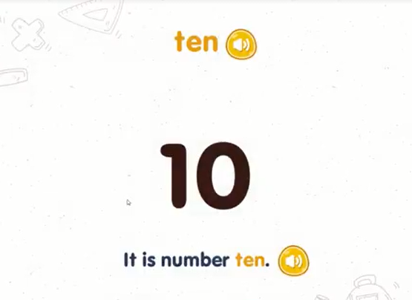
Multiples of ten

Slide 13
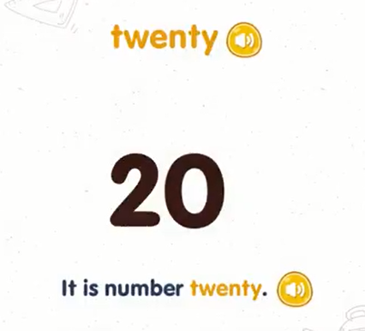
Multiples of ten

Slide 14
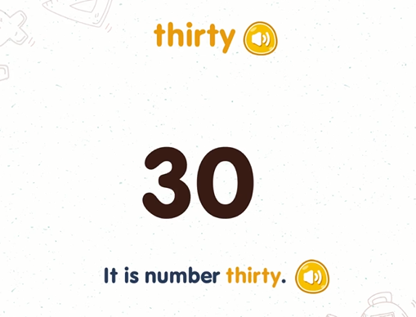
Multiples of ten

Slide 15
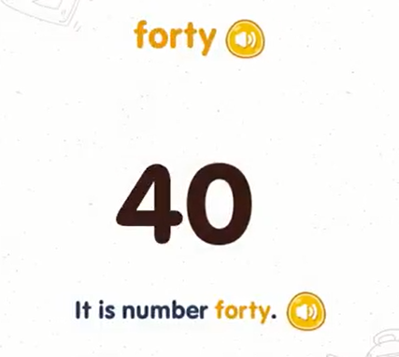
Multiples of ten

Slide 16
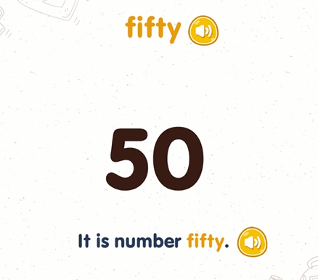
Multiples of ten

Slide 17
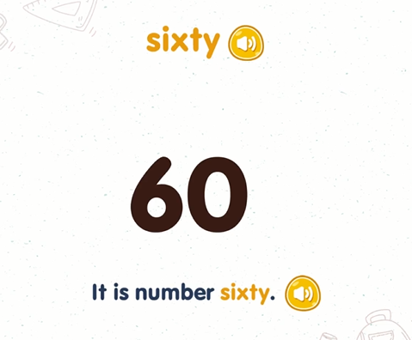
Multiples of ten

Slide 18
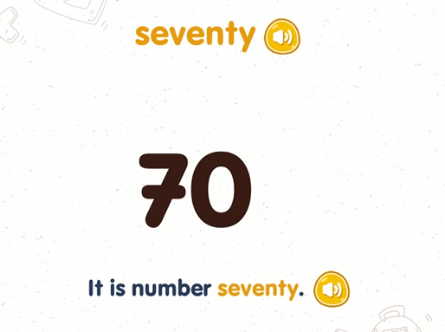
Multiples of ten

Slide 19
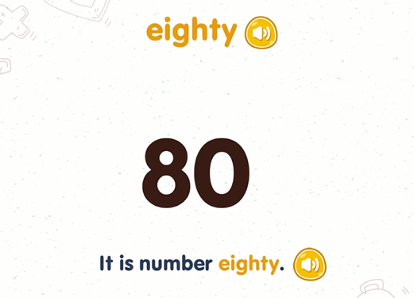
Multiples of ten

Slide 20
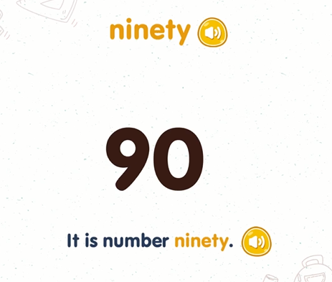
Multiples of ten

Slide 21
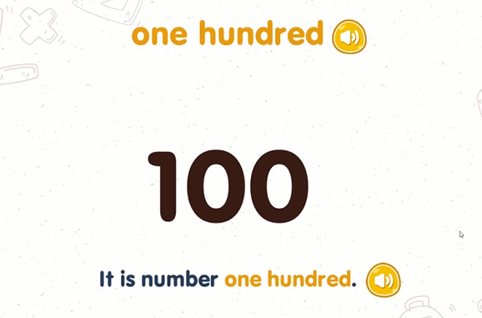
Multiples of ten

