Slide 1

Presentation
Unit 5 – Lesson 1
Multiplication table of two

Slide 2

Multiplication table of two

Slide 3
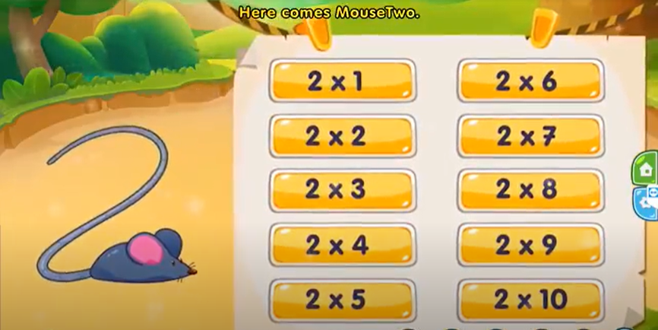
Multiplication table of two

Slide 4
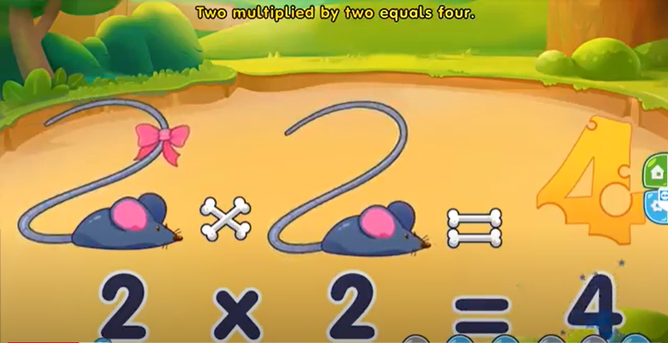
Multiplication table of two

Slide 5
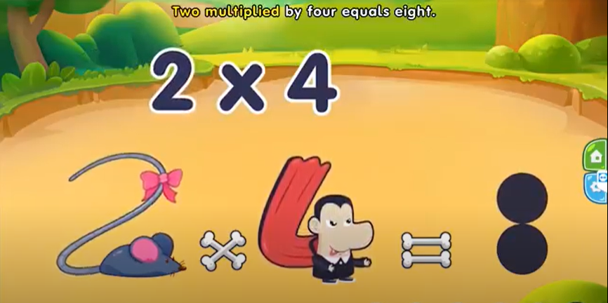

Multiplication table of two

Slide 6
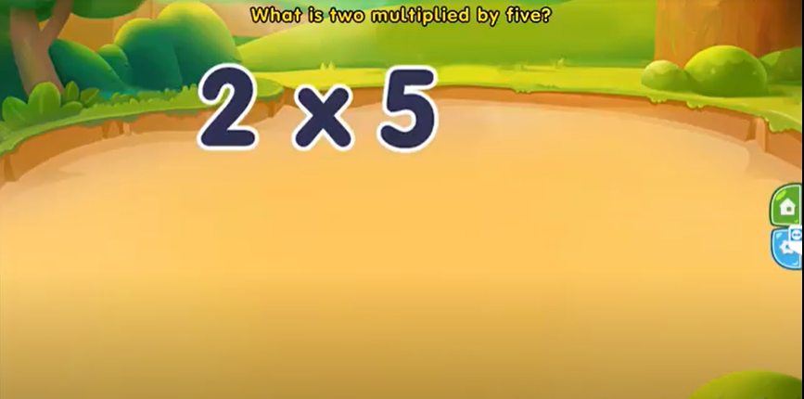
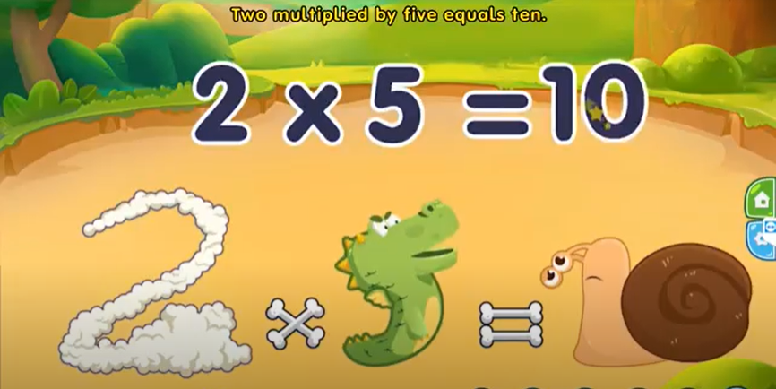
Multiplication table of two

Slide 7
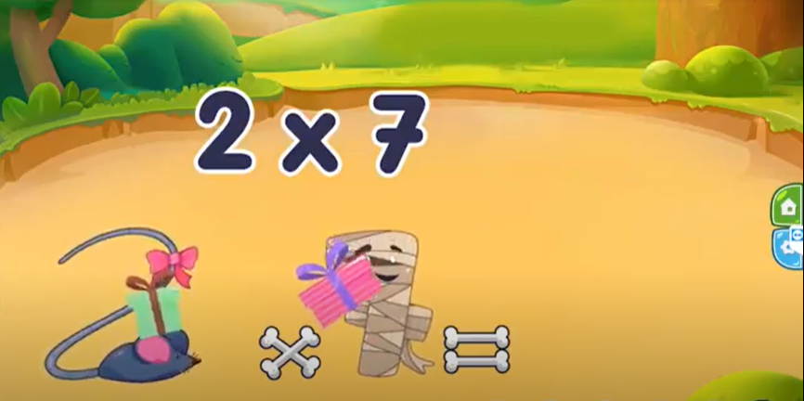
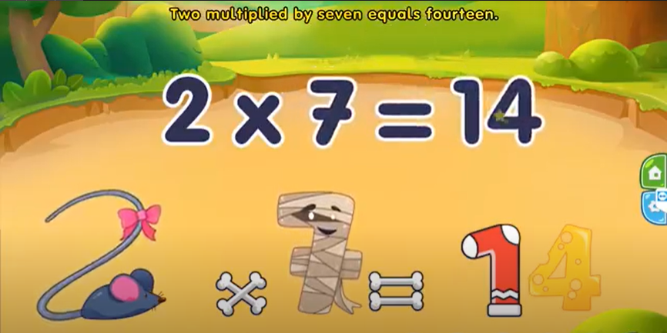
Multiplication table of two

Slide 8
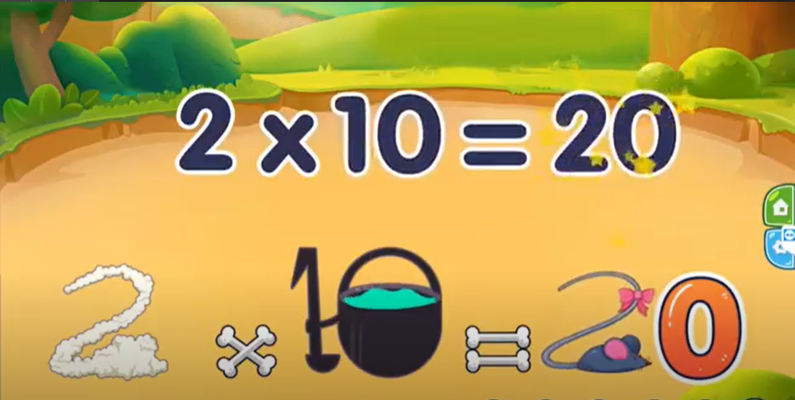
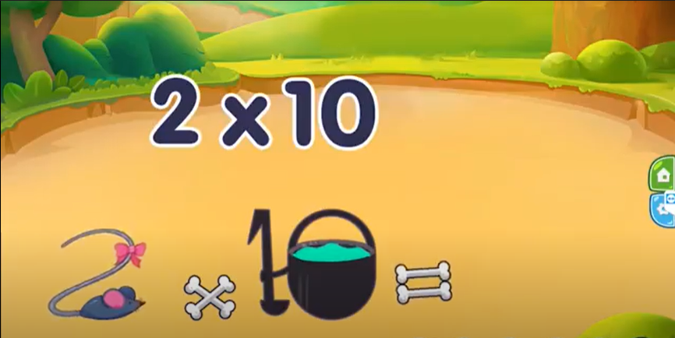
Multiplication table of two

Slide 9
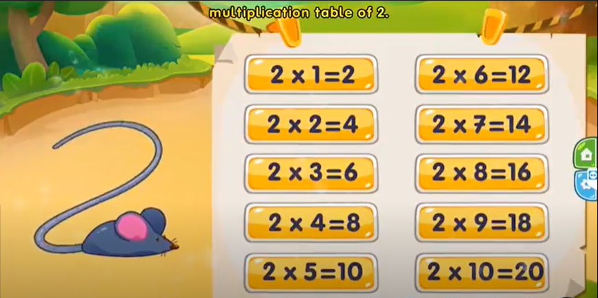
Multiplication table of two

Slide 10
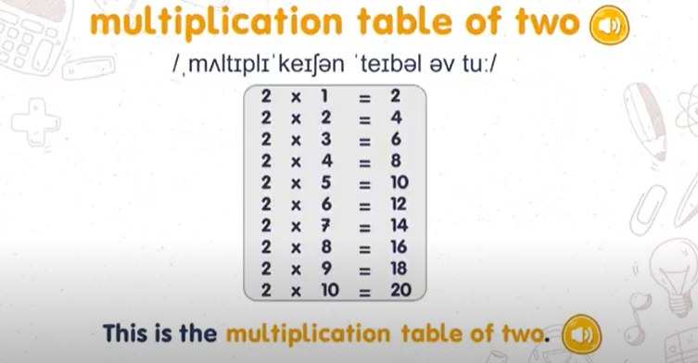
Multiplication table of two

Slide 11
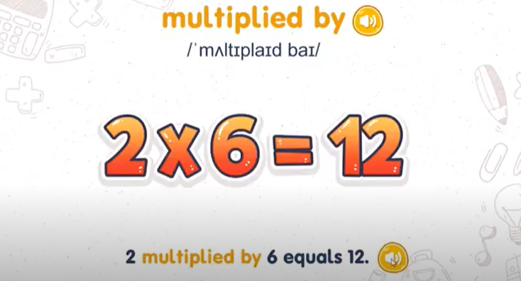
Multiplication table of two

