Slide 1


Warm up

Slide 2
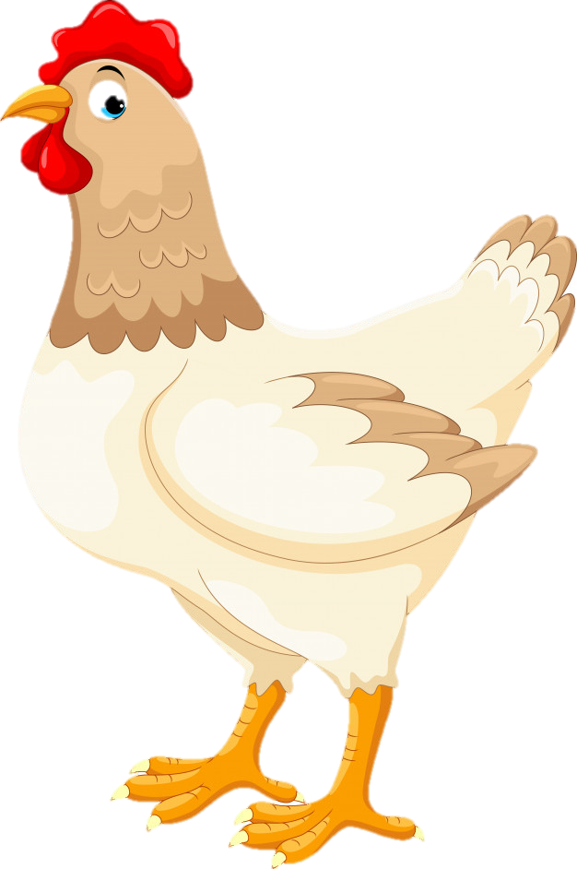
Warm up
4
6
+ 2 =
?

Slide 3
Warm up
6
8
+ 2 =
?

Slide 4
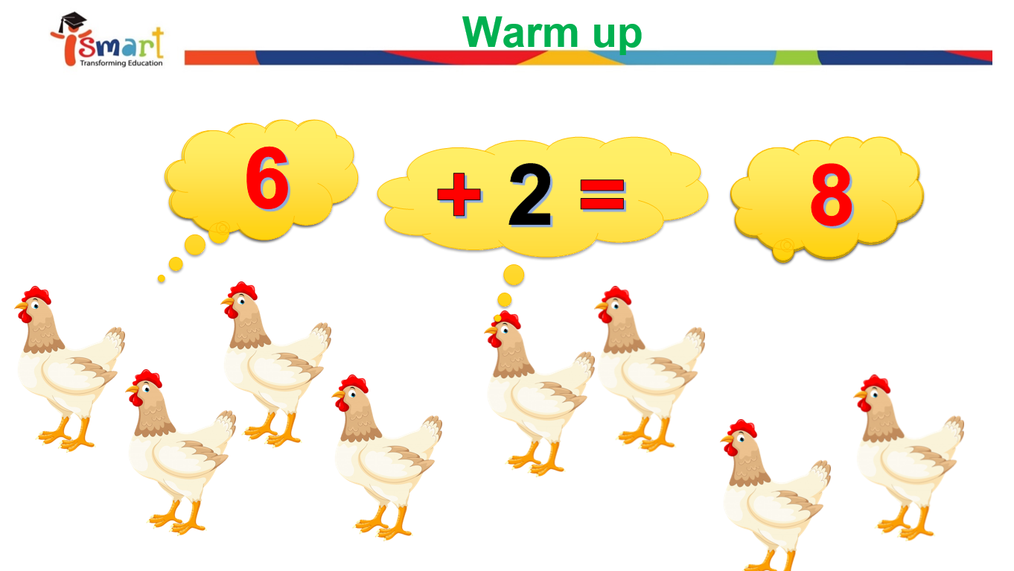
plus
addition

Slide 5

Presentation
Unit 5 – Lesson 1
Addition
Notes:
Our lesson today is “unit 5 lesson 1: addition”
Can you repeat after me: addition …and …plus (point to lesson name). Very good!

Slide 6
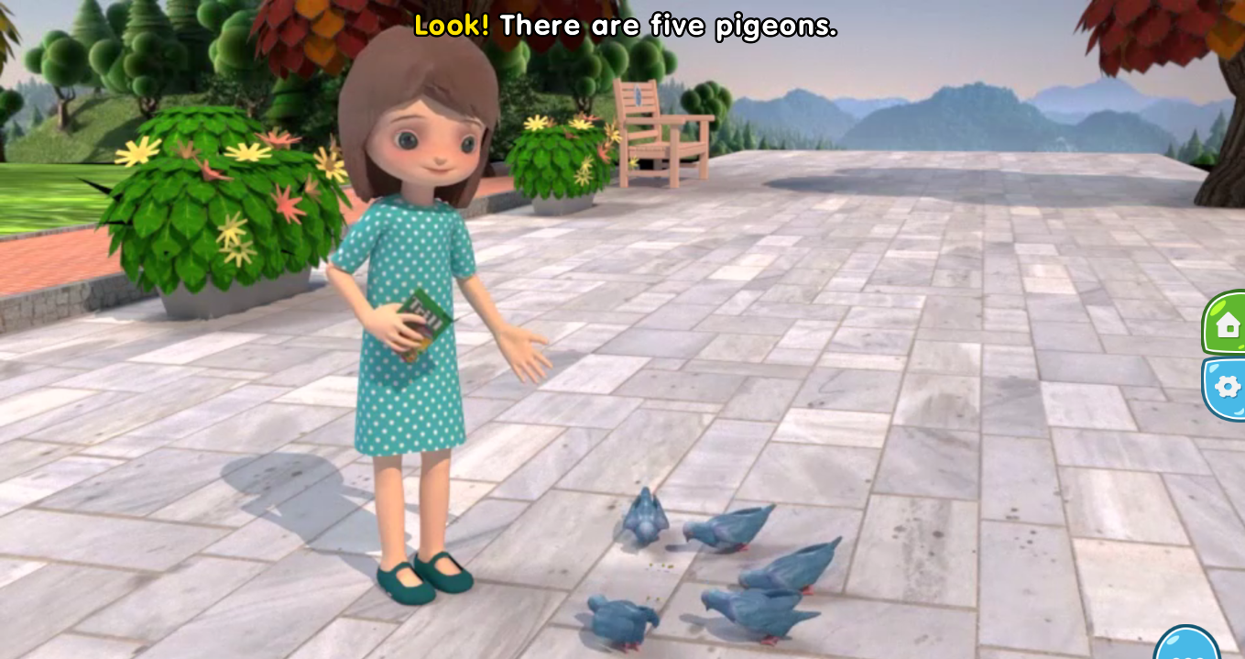
Addition
How many pigeons are there?
5
Notes:
Now, everyone, look! That’s An, right?
An is going to meet some friends. Let’s see who they are.
They are the pigeons.
How many pigeons are there? (Call 1 student)

Slide 7
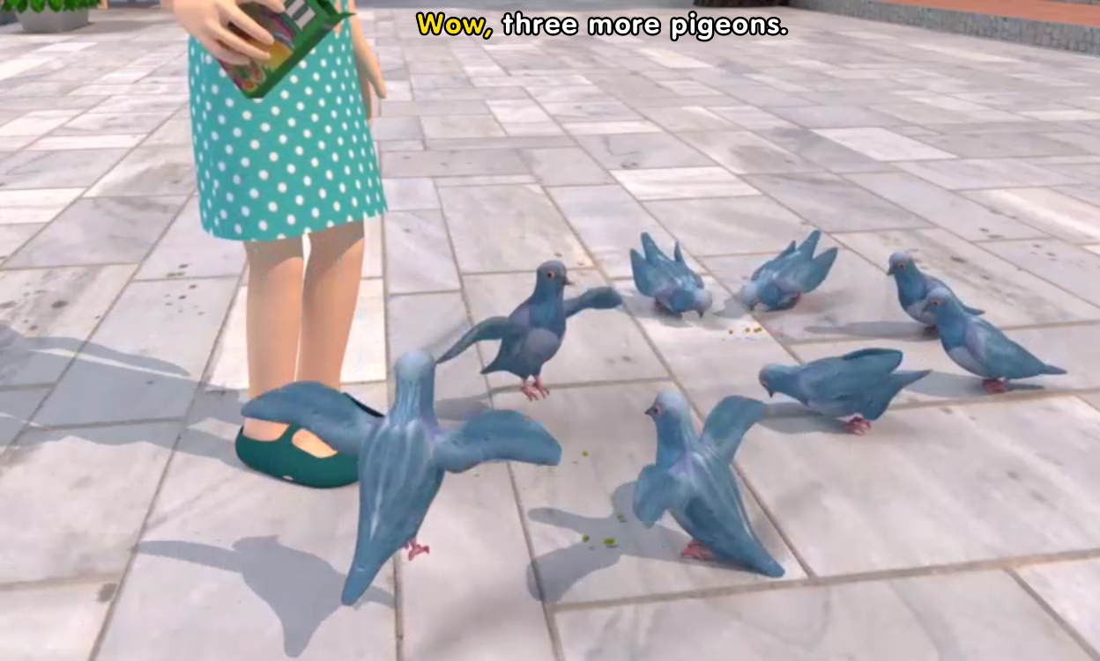
Addition
How many more pigeons?
3
Notes:
Look at the picture! How many more pigeons are there? (Call 1 student)
(Call 1 student) --- Very good!

Slide 8
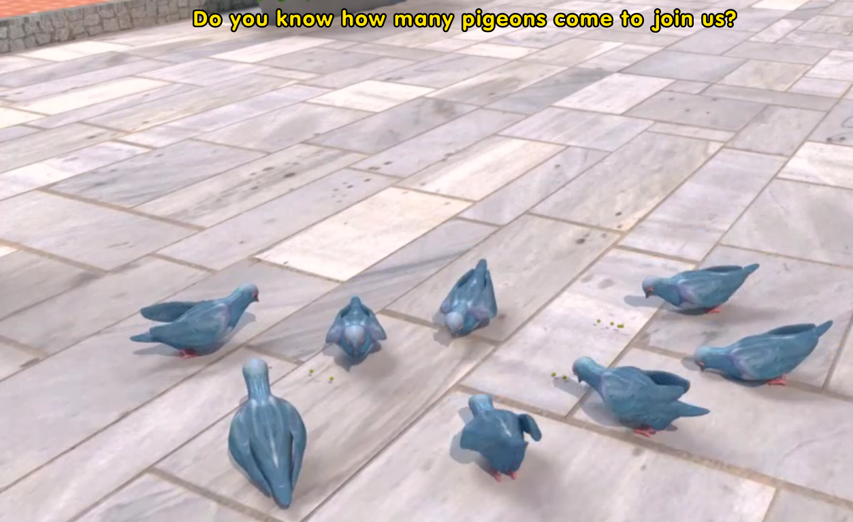
Addition
Notes:
How many pigeons are there in total?
(Call 1 student)

Slide 9
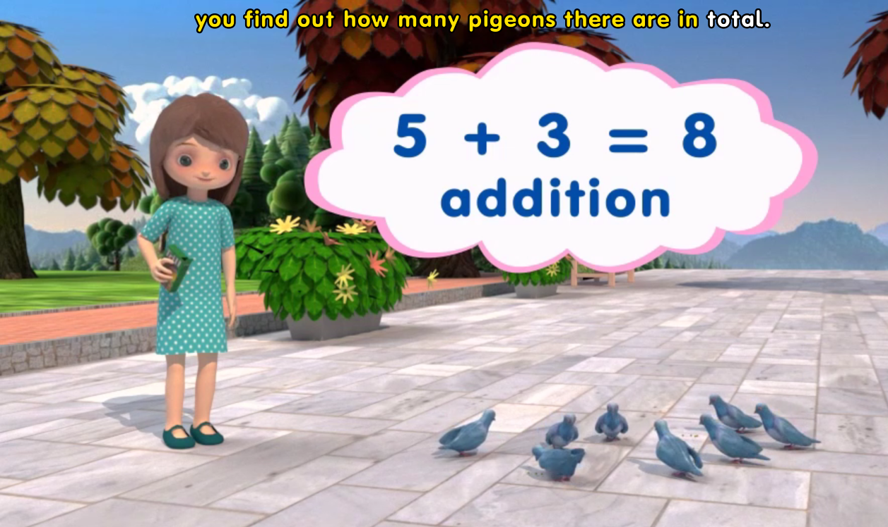
Half and Double
How many eggs does Grandpa have?

Slide 10
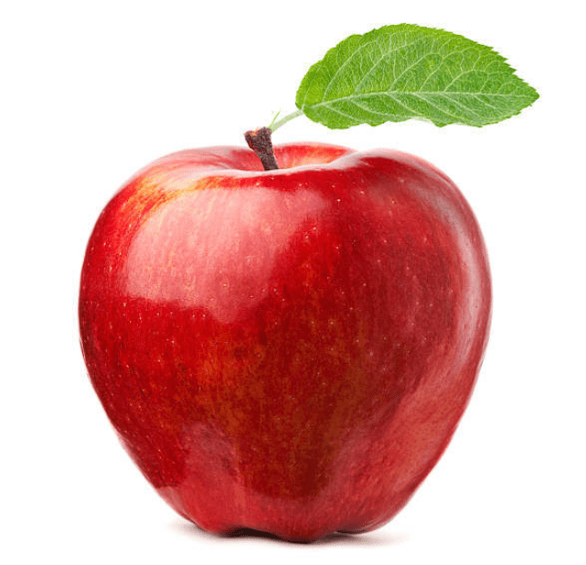
Addition
6
4 plus 2 equals …..
Notes:
Now, let’s make 1 example of addition
4 plus 2 equals……? (call a student)
Good job!

Slide 11
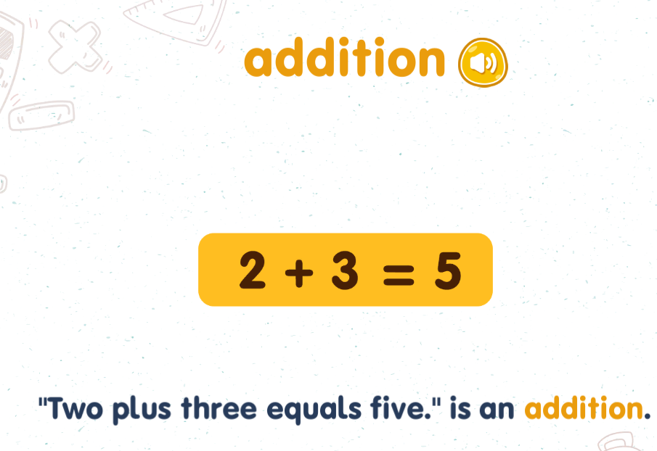
Addition
Notes:
Ok, Teacher has taught you about: Addition. Do you understand? Good
Let’s practice new words today. (practice individually, in group )

Slide 12
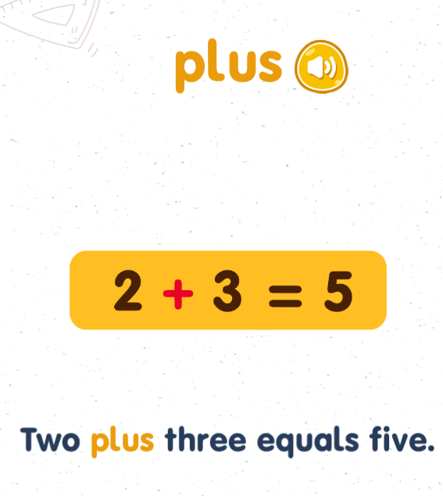
Addition
Notes:
(practice individually, in group )

