Slide 1











Unit 9:
HOLIDAYS AND TRAVEL
Fun time and Project – Part 1, 2

Slide 2



02
REVIEW

Slide 3
Review Vocabulary
Hang-man
_____ _____ _____ _____ _____ _____
F
L
I
G
H
T
A
B
C
D
E
F
G
H
I
J
K
L
M
N
O
P
Q
R
S
T
U
V
W
X
Y
Z

Slide 4
Review Vocabulary
Hang-man
_____ _____ _____ _____ _____ _____
B
R
I
D
G
E
A
B
C
D
E
F
G
H
I
J
K
L
M
N
O
P
Q
R
S
T
U
V
W
X
Y
Z

Slide 5
Review Vocabulary
Hang-man
_____ _____ _____ _____
S
I
L
K
A
B
C
D
E
F
G
H
I
J
K
L
M
N
O
P
Q
R
S
T
U
V
W
X
Y
Z

Slide 6
Review Vocabulary
Hang-man
_____ _____ _____ _____ _____ _____ _____ _____
V
I
L
L
A
G
E
R
A
B
C
D
E
F
G
H
I
J
K
L
M
N
O
P
Q
R
S
T
U
V
W
X
Y
Z

Slide 7



ODD ONE OUT
cut
put
take
set
Past Tense of the verbs:
cut – put – took – set
All of the verbs are irregular verbs, but ‘take’ is the only verb that changes in the past.
Why?

Slide 8
ODD ONE OUT
speak
listen
write
hear
Past Tense of the verbs:
spoke – listened – wrote – heard
‘listen’ is a regular verb.
Why?

Slide 9
ODD ONE OUT
have
clean
swim
stand
Past Tense of the verbs:
had – cleaned – swam - stood
‘clean’ is a regular verb.
Why?

Slide 10
03
PRACTICE

Slide 11





Find someone who
Name
Extra information
watched a movie last night
Minh
one of the
Star Wars movies
Did you watch a movie last night?
finished all their homework
yesterday
got up at 6 a.m. today
Yes, I did.
went to bed late last night
What movie did you watch?
played football last weekend
grew up in the city
I watched one of the Star Wars movies. I liked it very much.
took the bus to school this
morning
took a trip during the last
school holiday

Slide 12
04
PRODUCTION

Slide 13

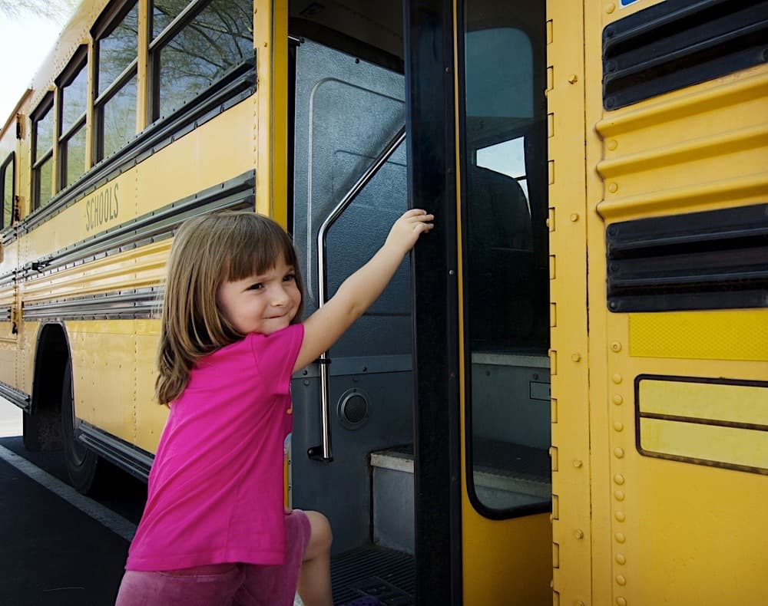





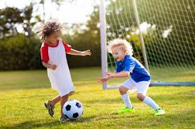
2. Let’s talk.
Talk about what you found in Activity 1.
Minh watched a movie last night. He watched one of the Star Wars movies, and he liked it very much.

Slide 14
05
WRAP UP & ASSESSMENT

