Slide 1


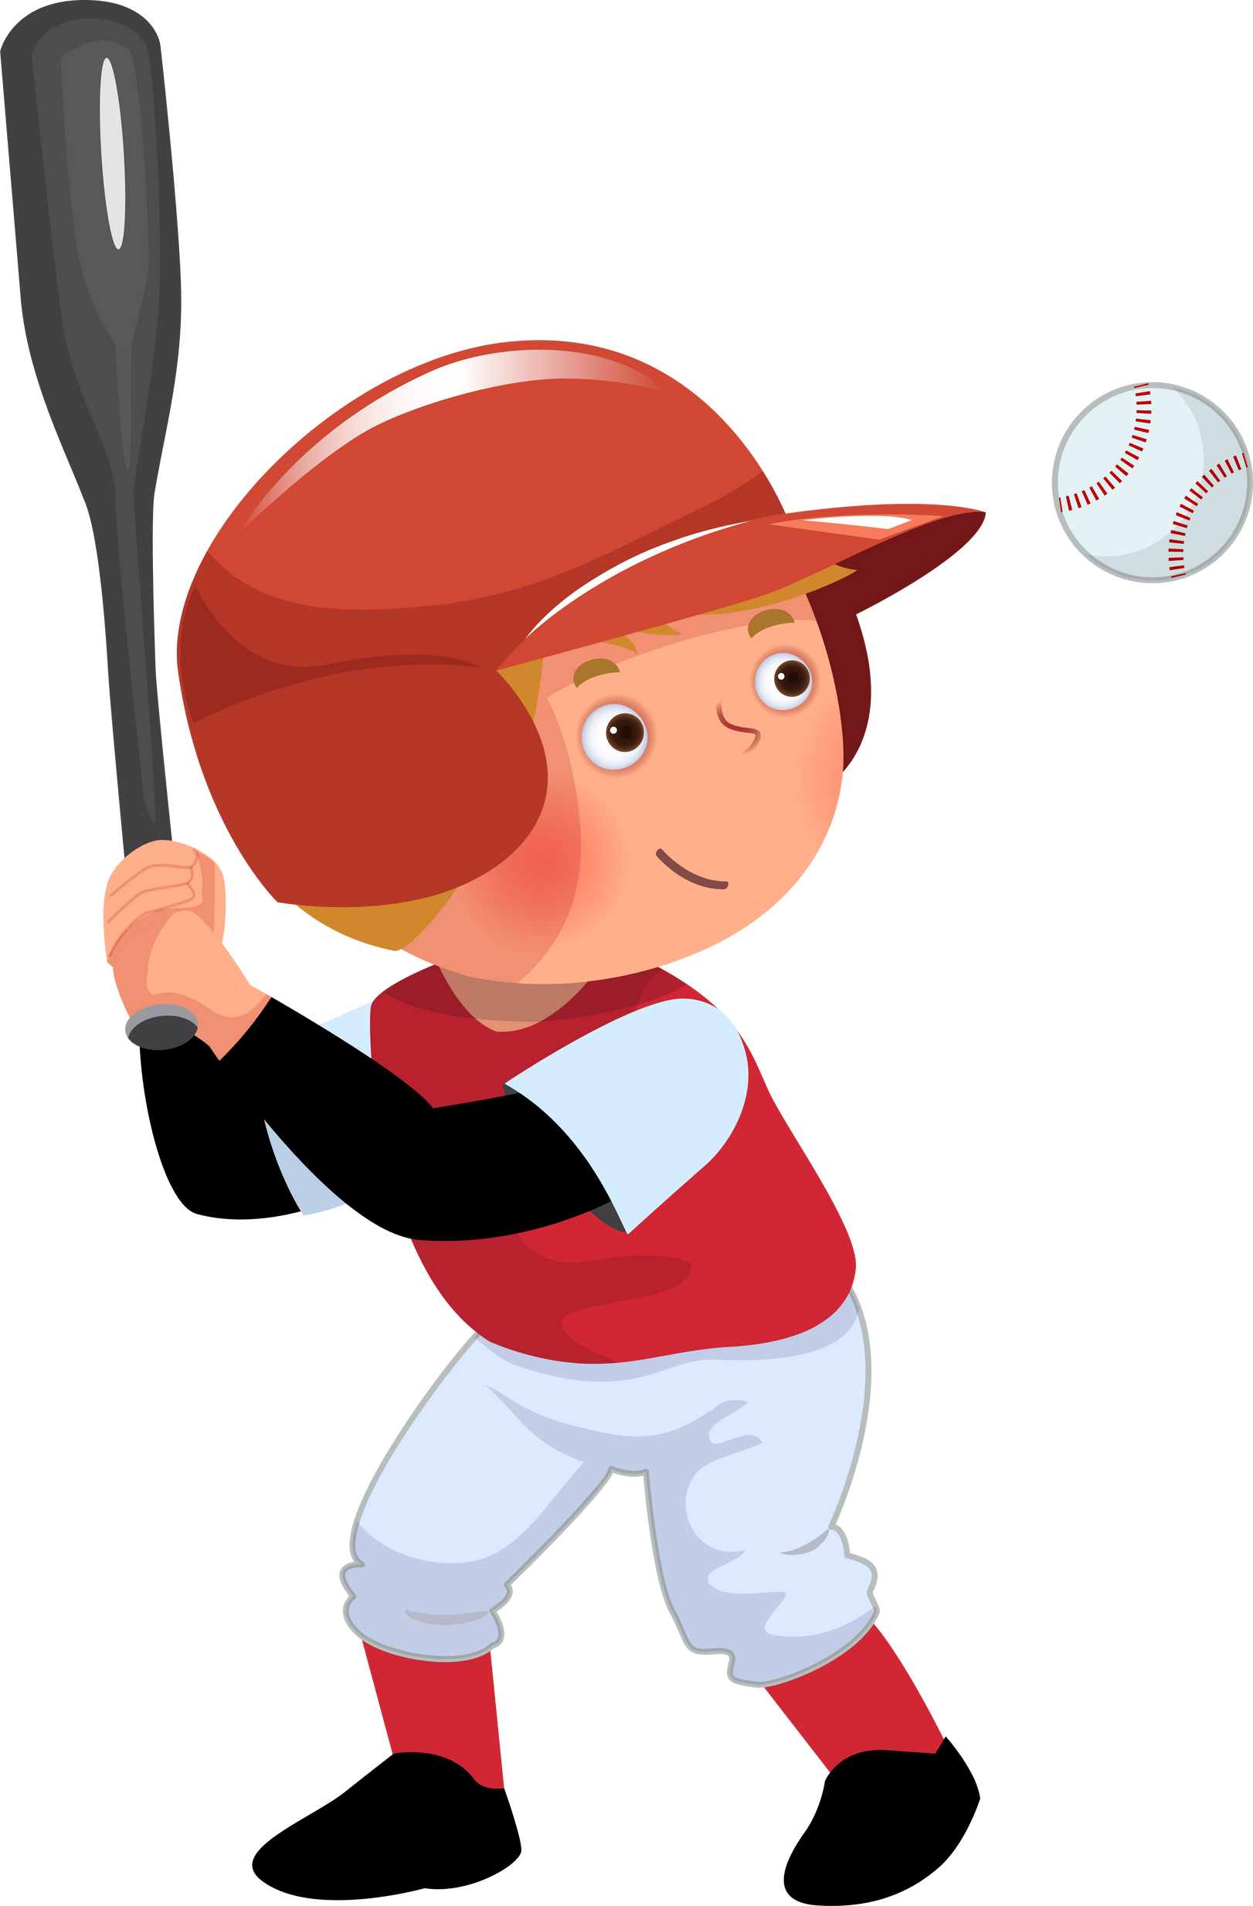
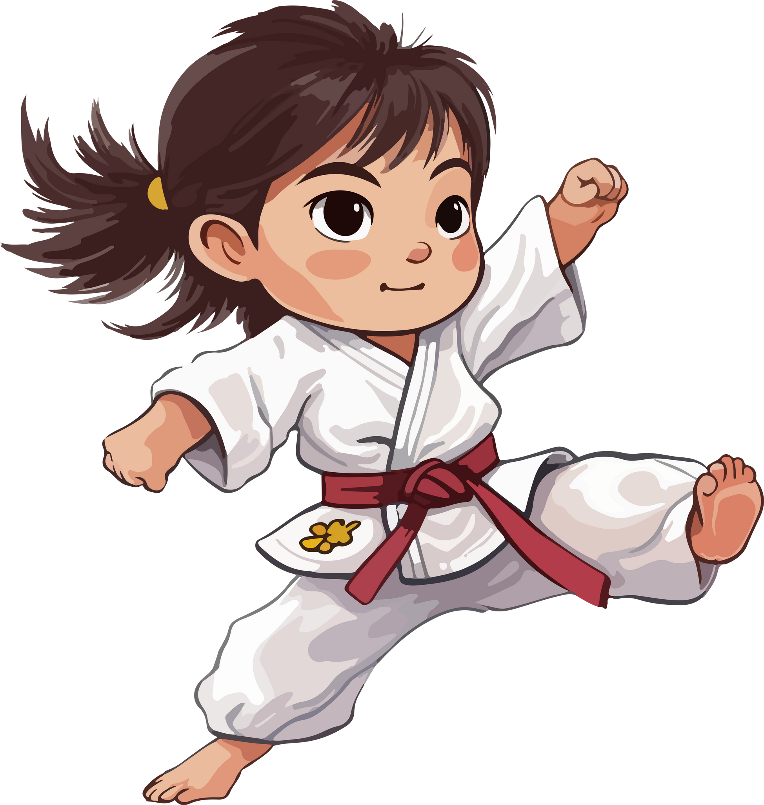
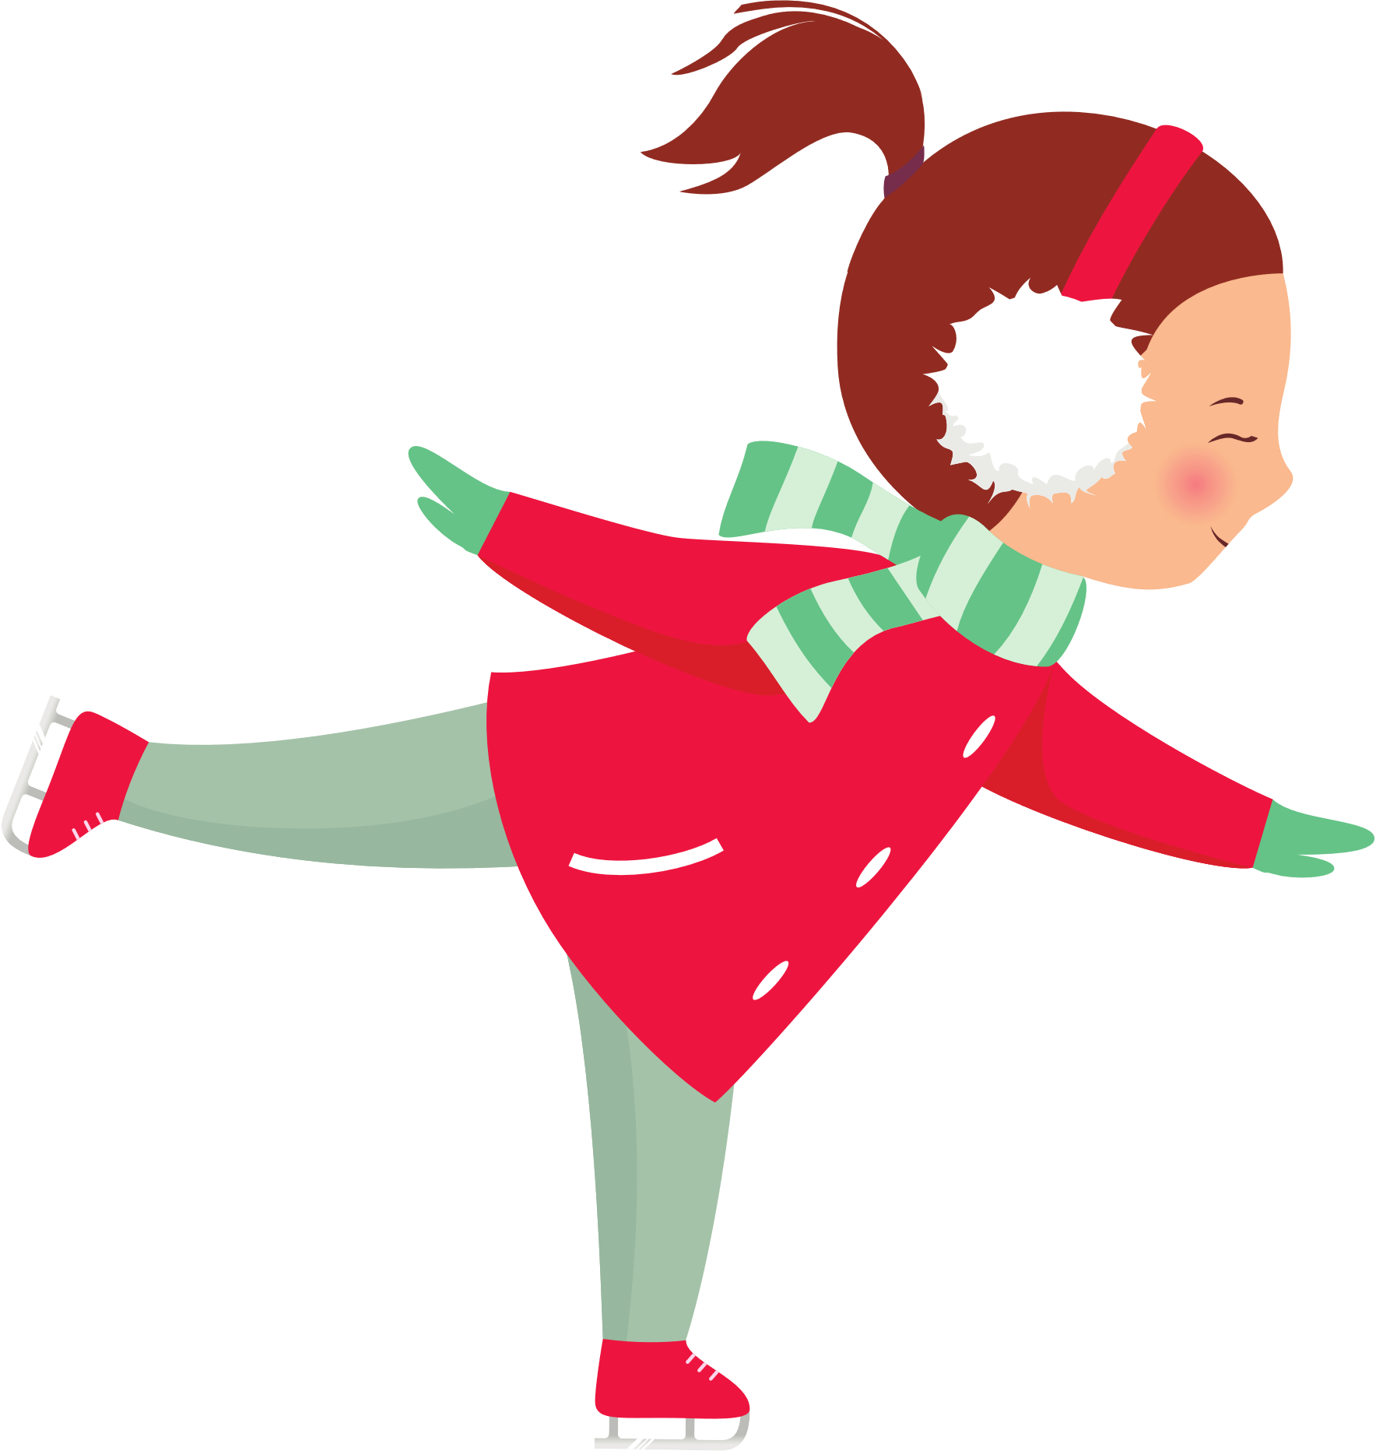
REVIEW 3
PART 1

Slide 2



1
WARM-UP

Slide 3
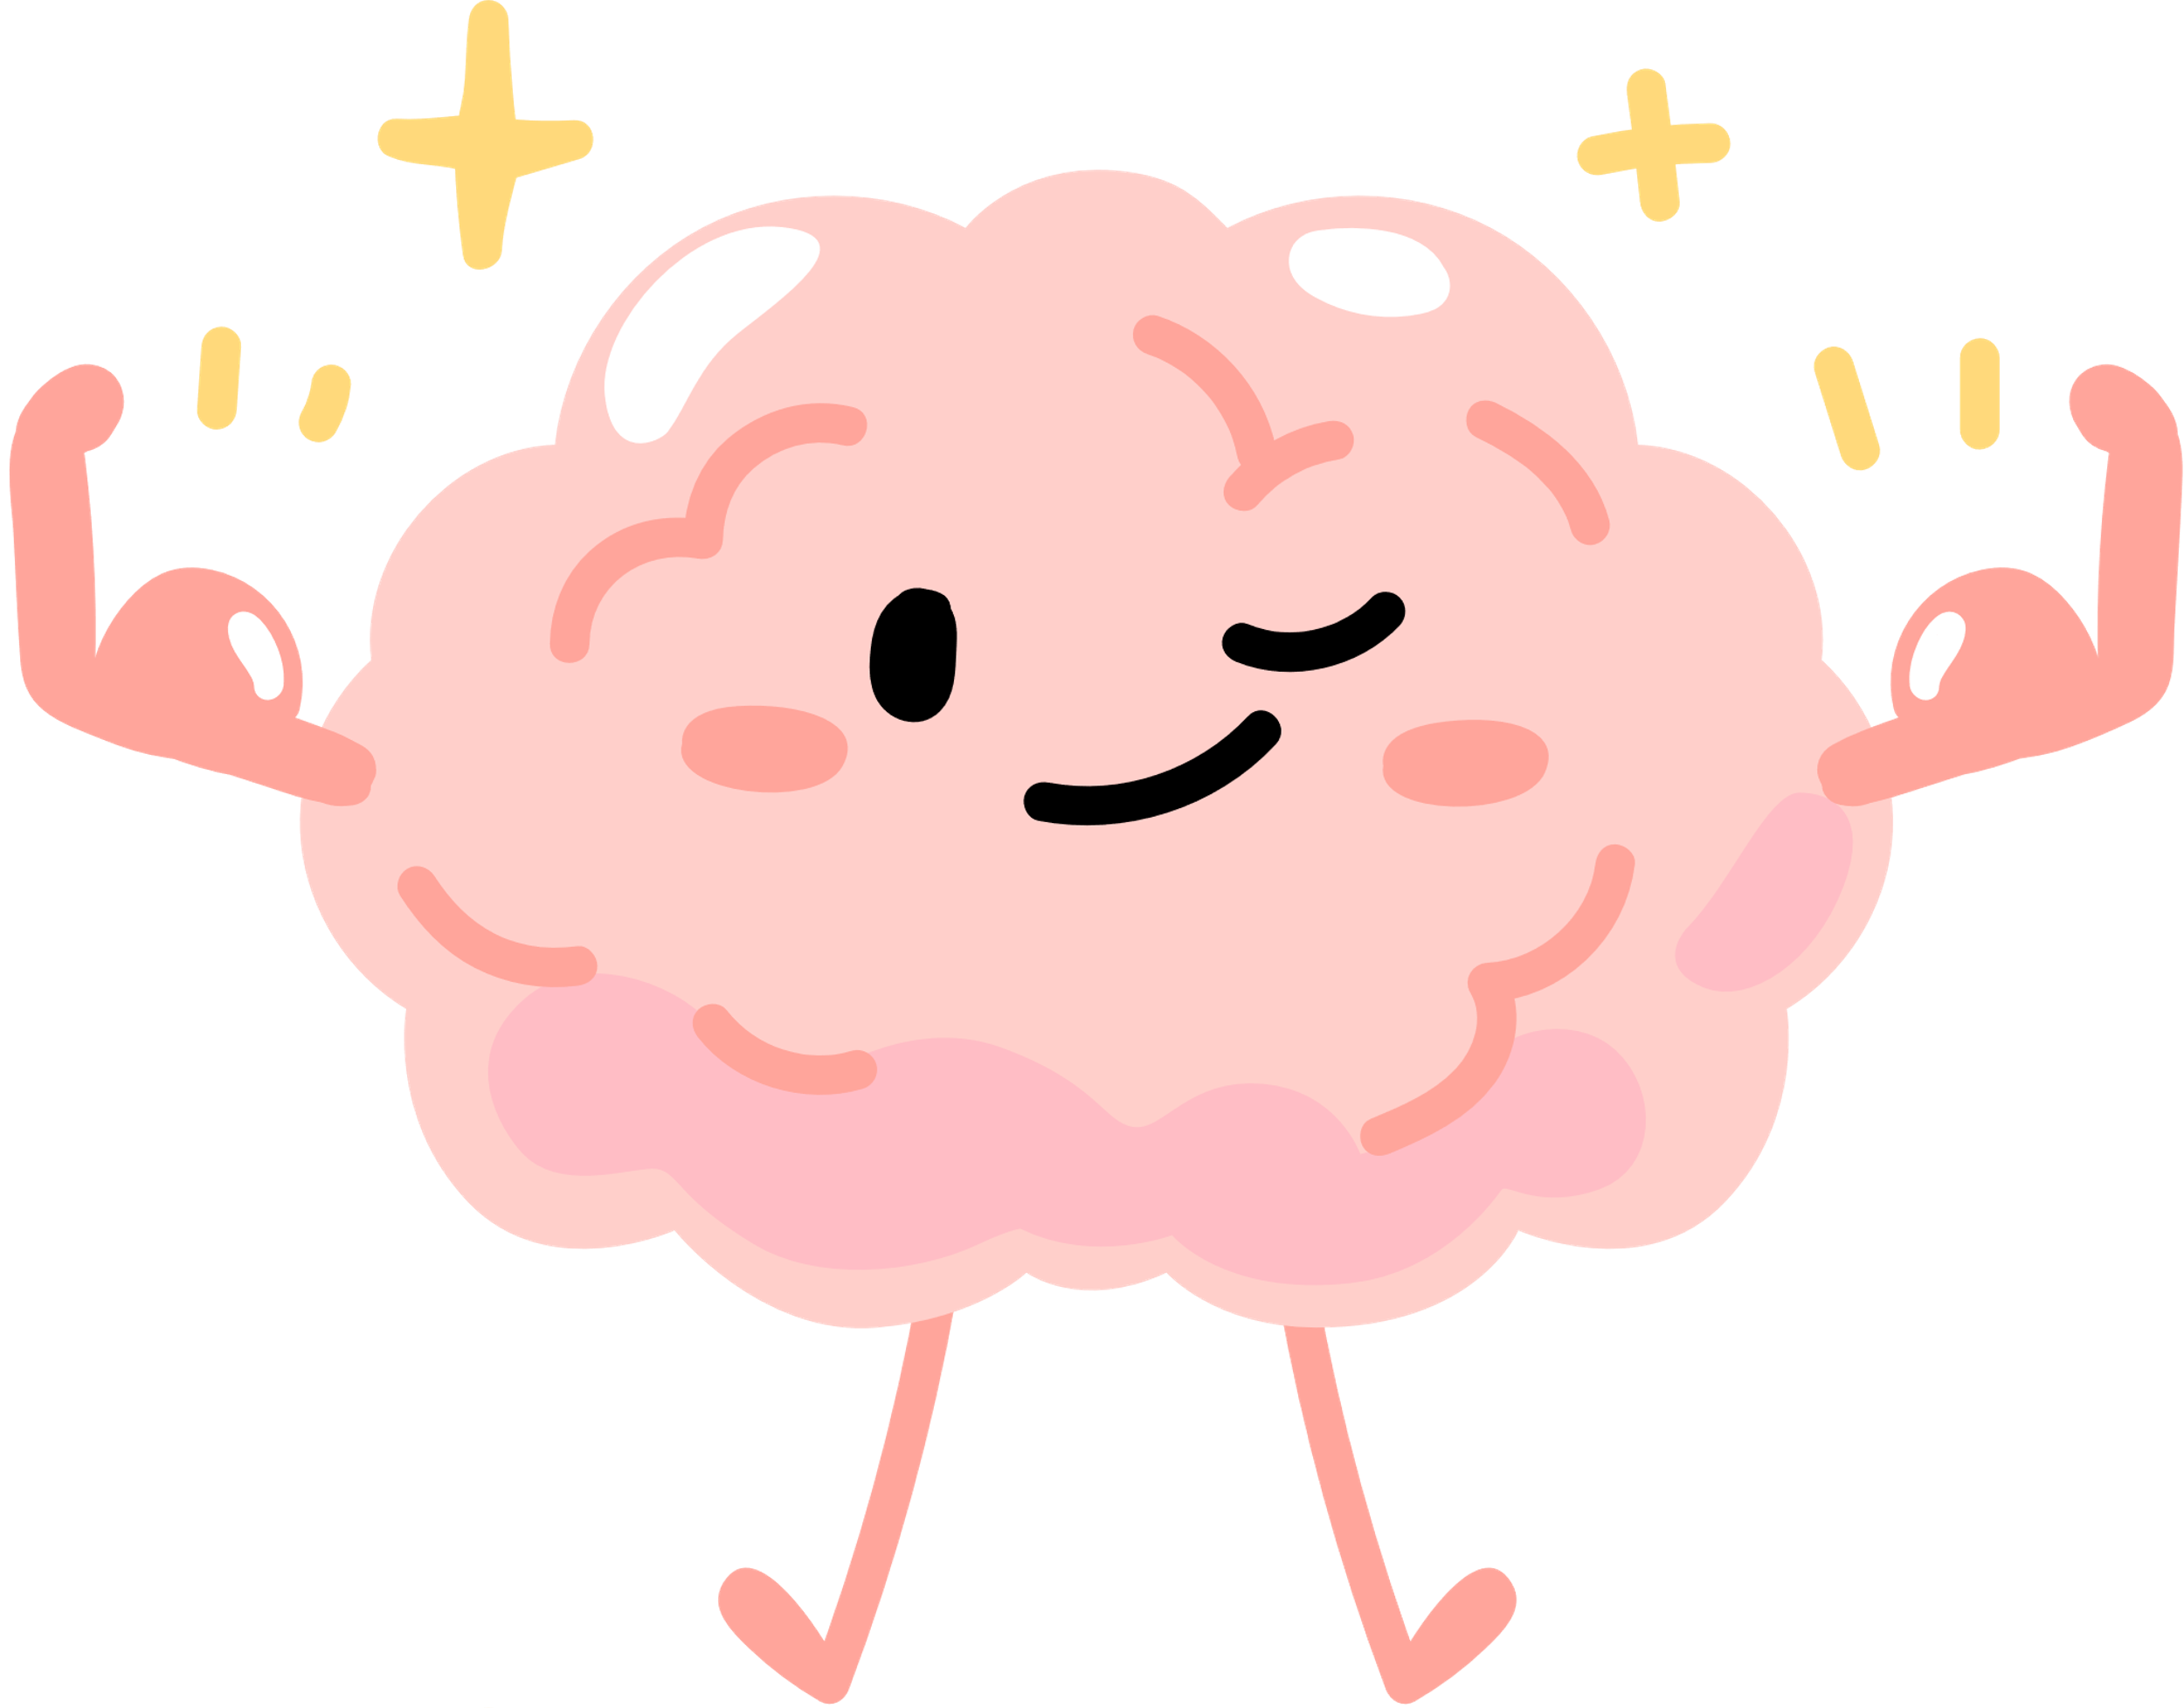




Look and read. Write the correct words.
you use me all the time. What am I?
you can't touch or see me with your hands. What am I?
mind
You use it to think.

Slide 4

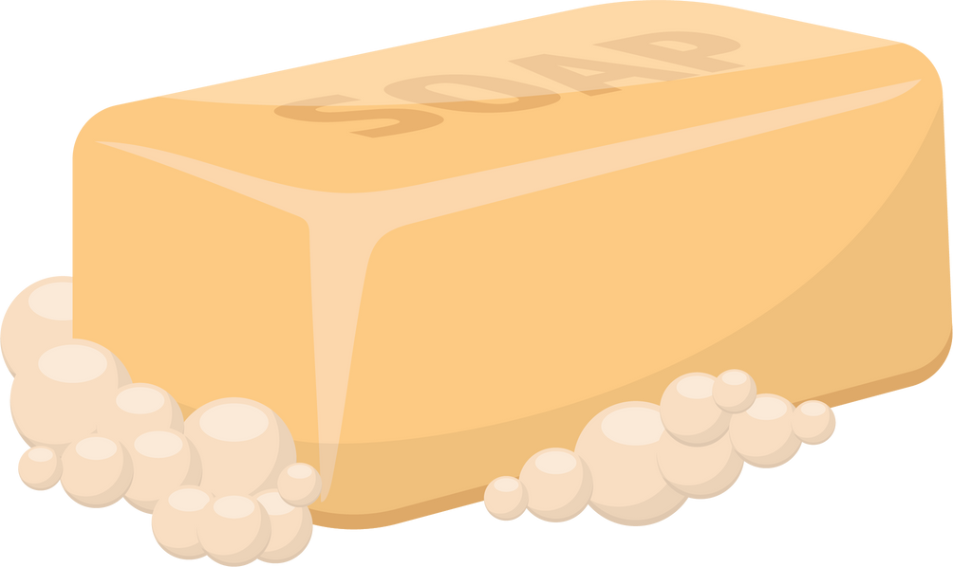
Look and read. Write the correct words.
I’m small, slippery, and found next to the sink. What am I?
When you rub me with water, I make lots of bubbles. What am I?
soap
It can be in different shapes. You use it to wash your hands or your body.

Slide 5
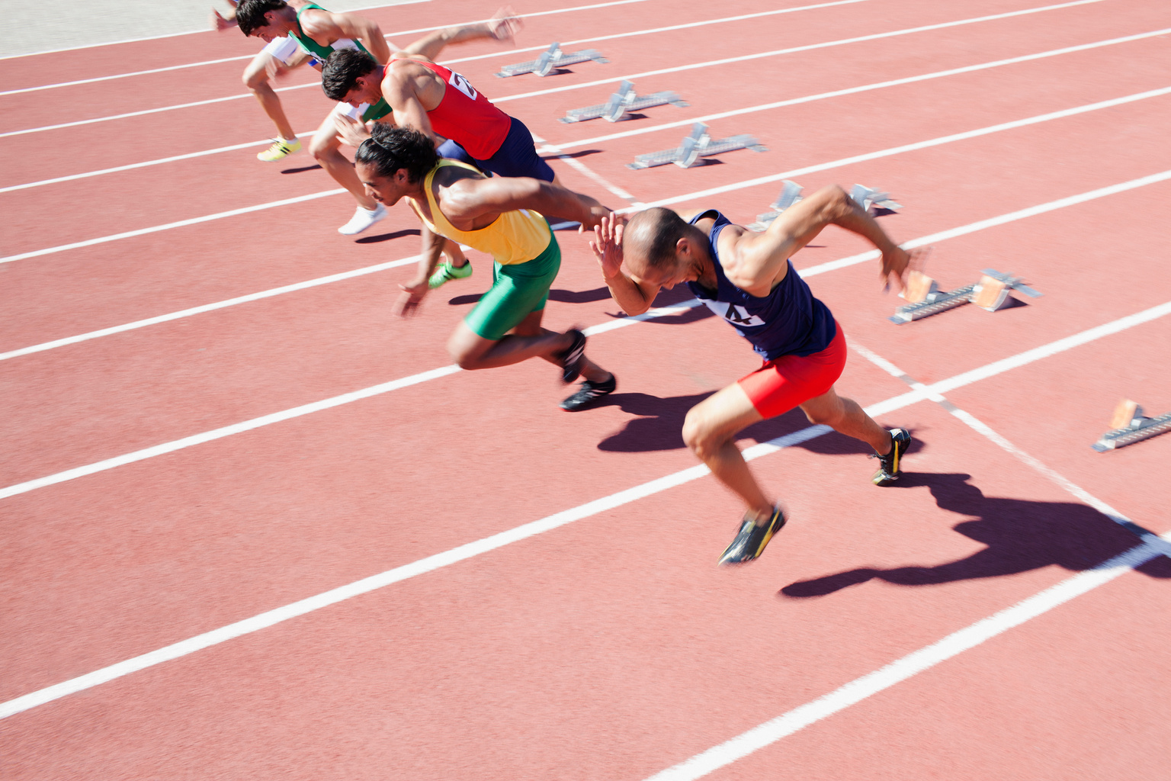

Look and read. Write the correct words.
where people show their skills to earn a medal or award?
It is a game or a race. Players or teams try to win or to have fun.
competition

Slide 6

Look and read. Write the correct words.
It is a soft cloth.
What do you use to wipe your hands or face?
You use it to dry your body after a bath.
towel

Slide 7
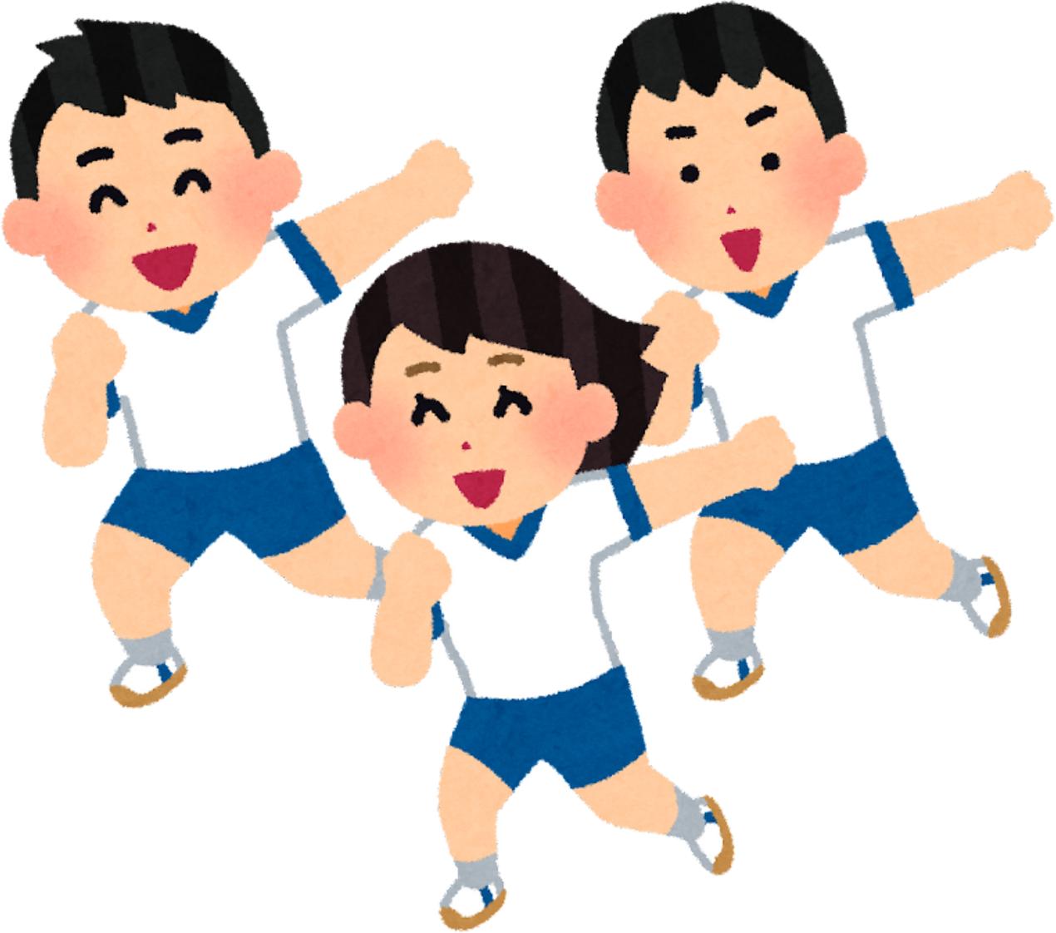
2
REVIEW

Slide 8



helmet

Slide 9

win

Slide 10
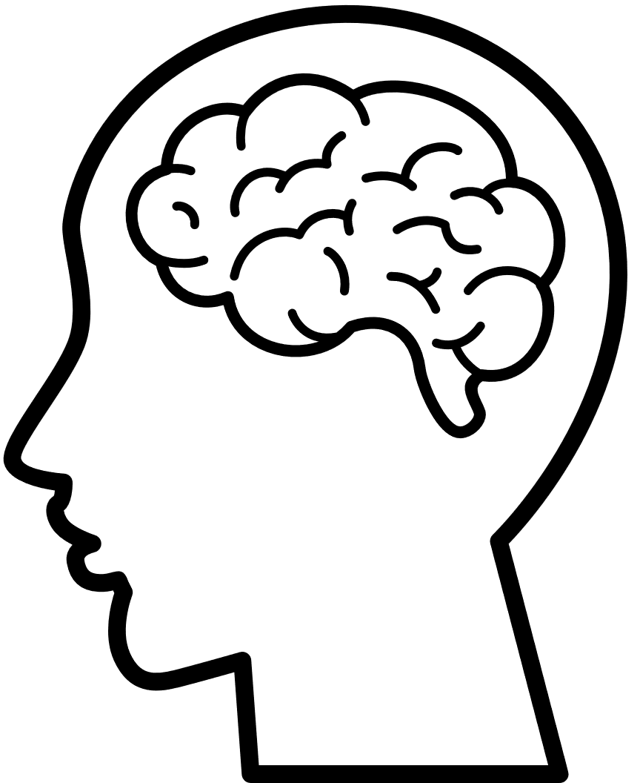
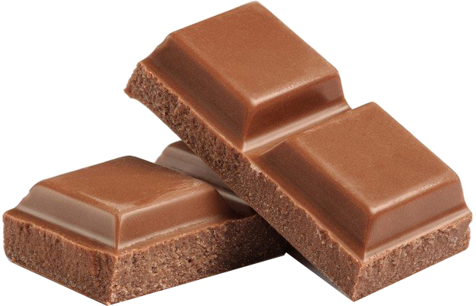
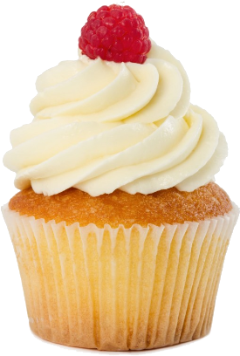
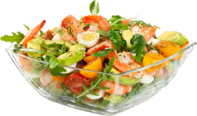
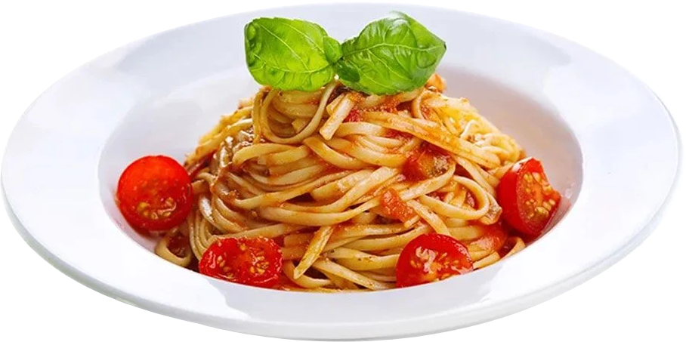
mind

Slide 11
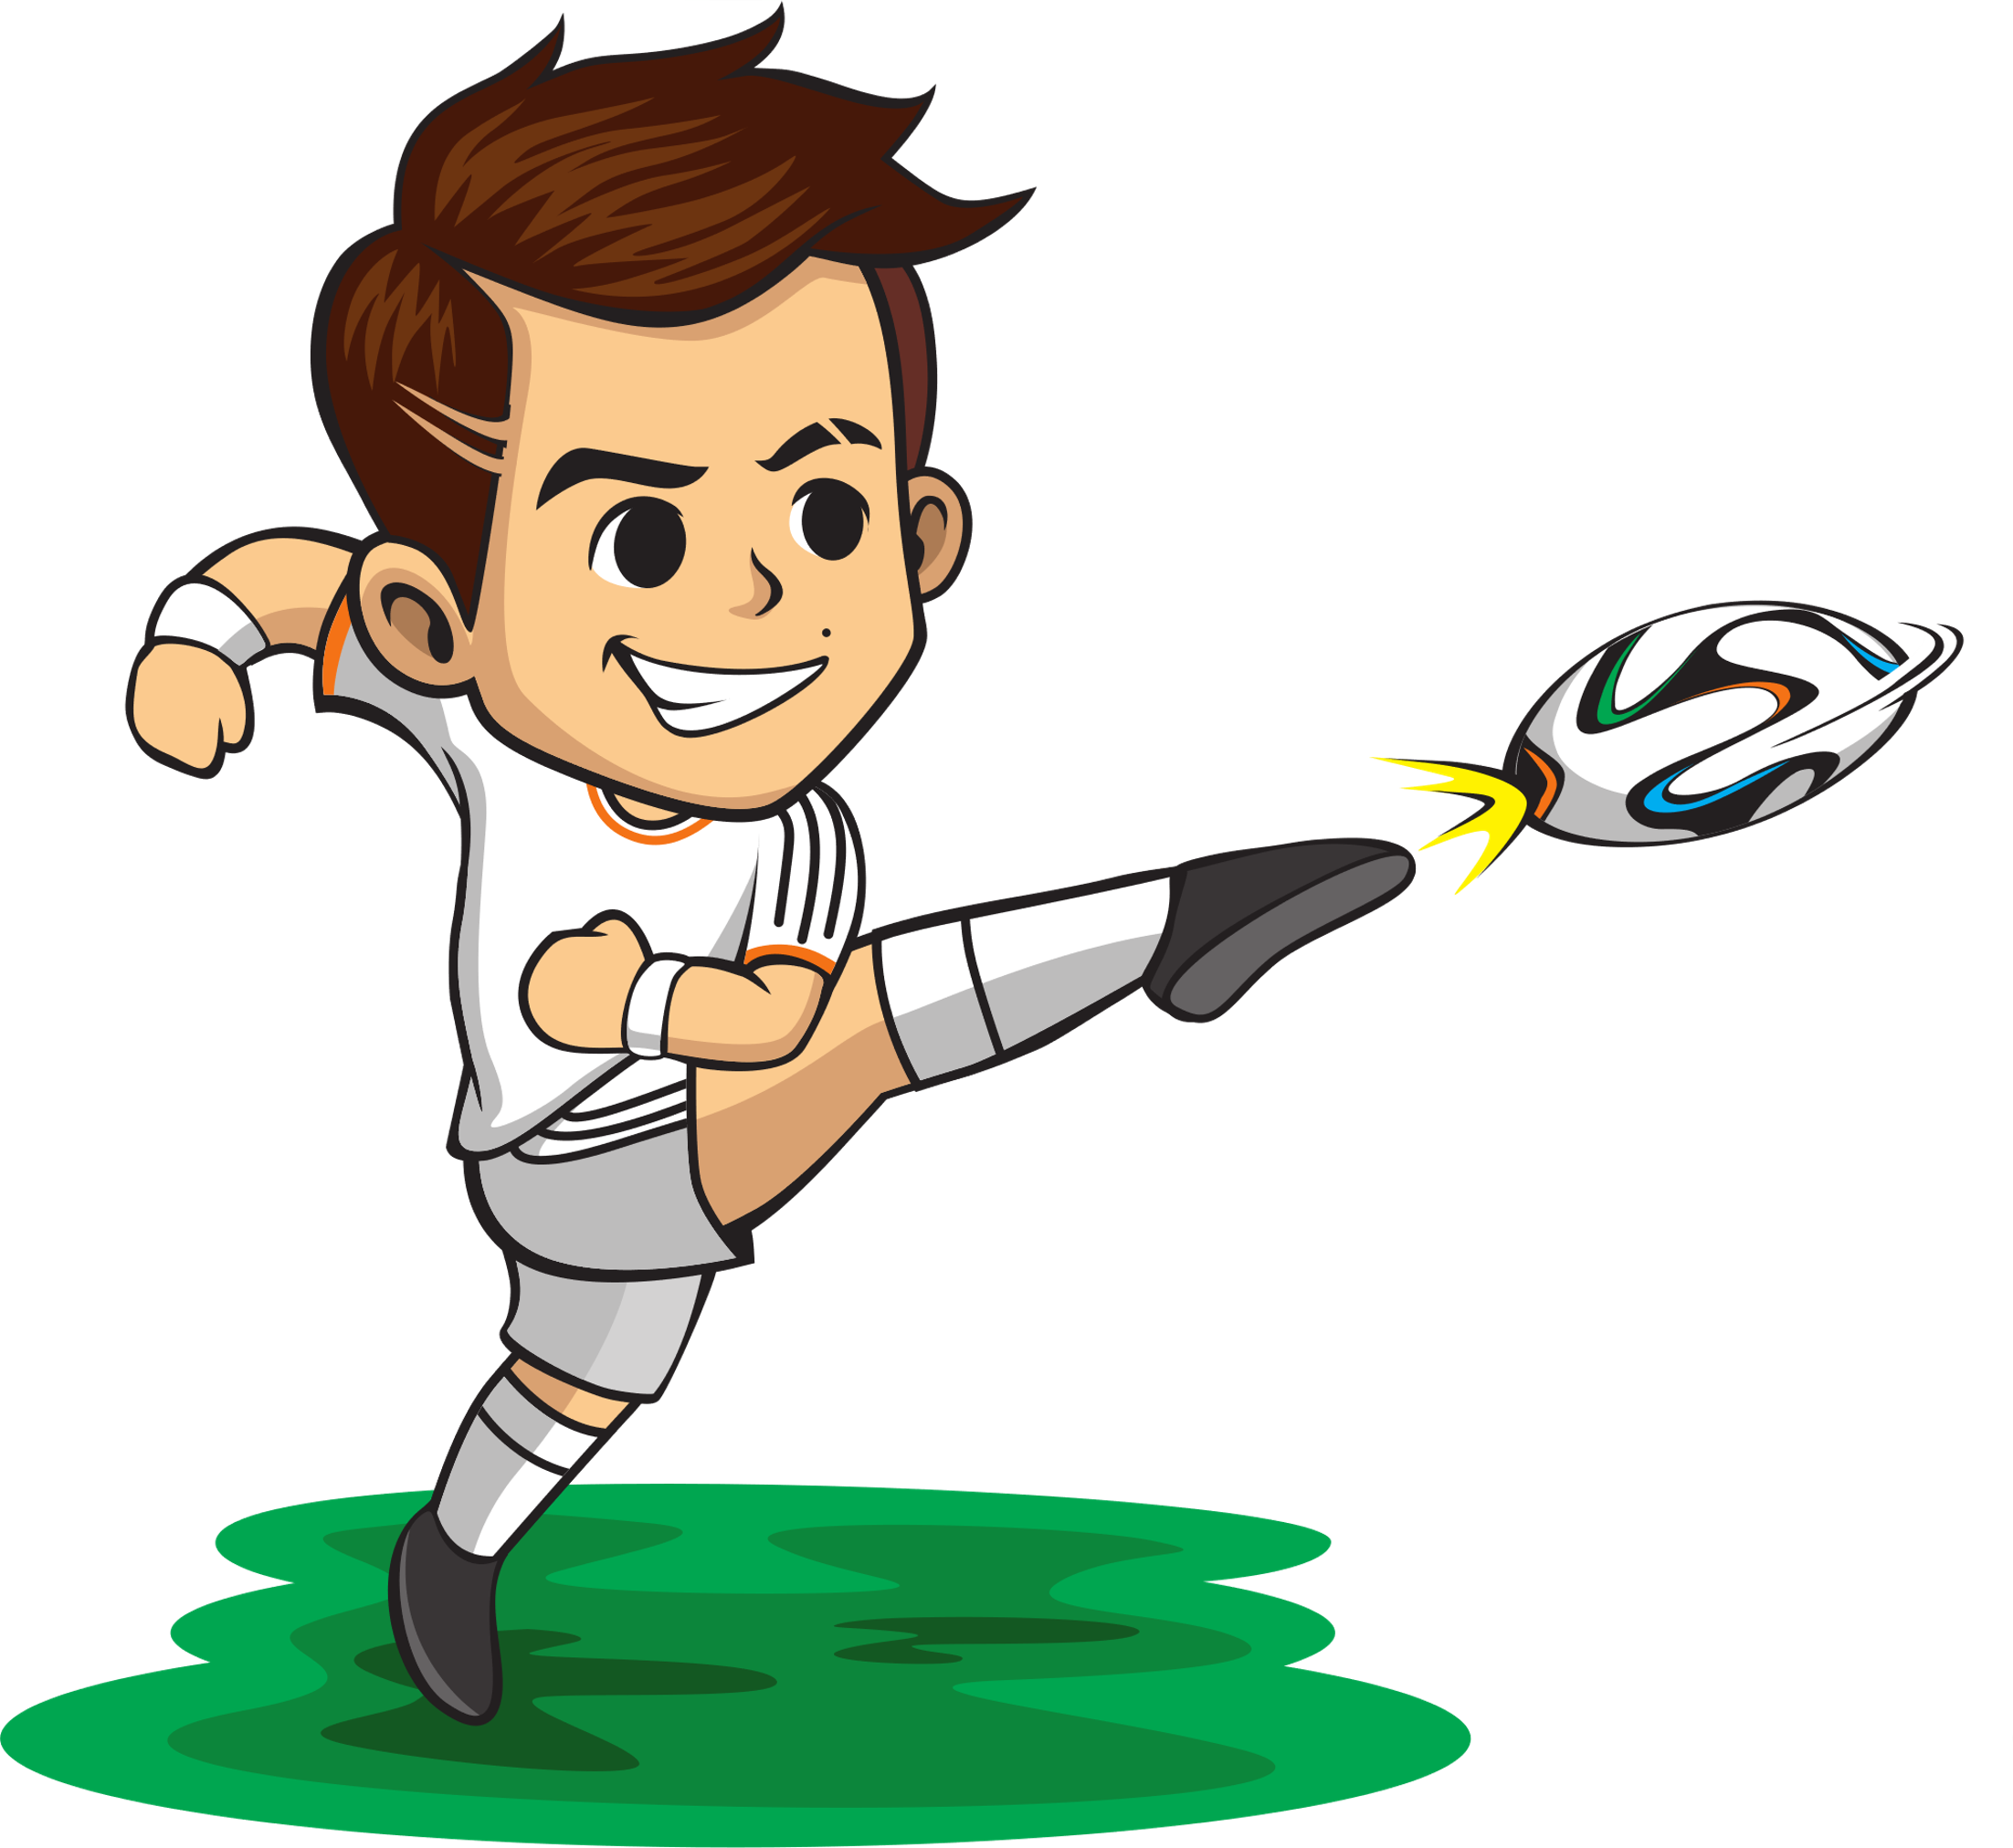
kick

Slide 12

Grammar: Present continuous
I am running now.
She / He is running now.
You / We / They are running now.

Slide 13
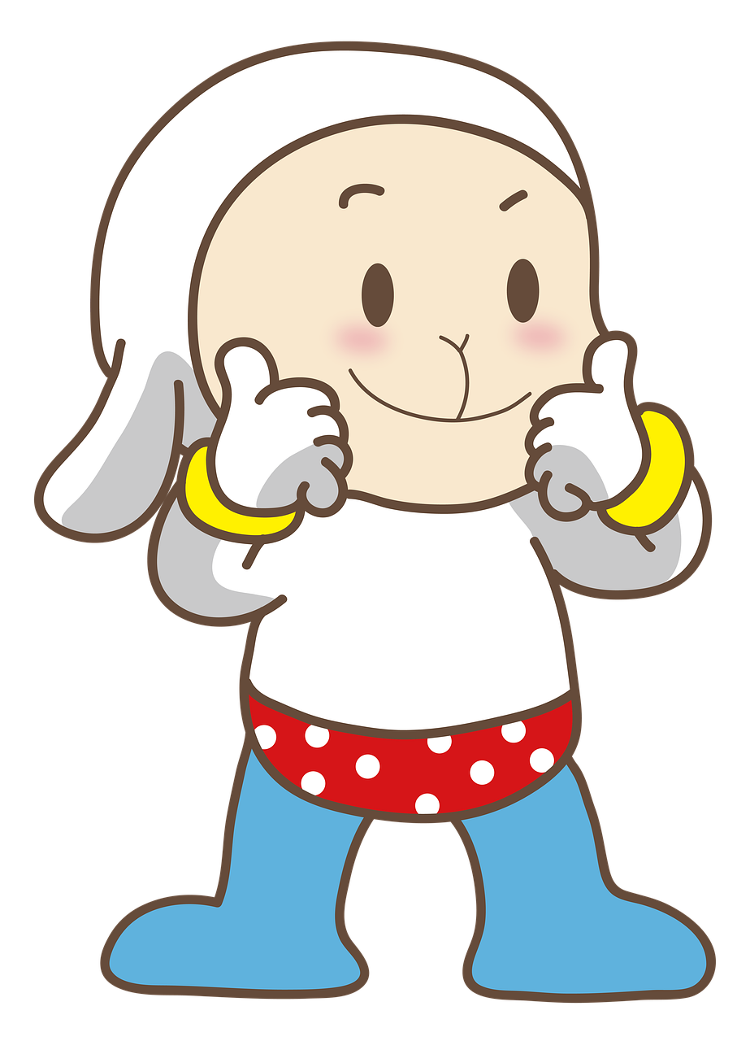
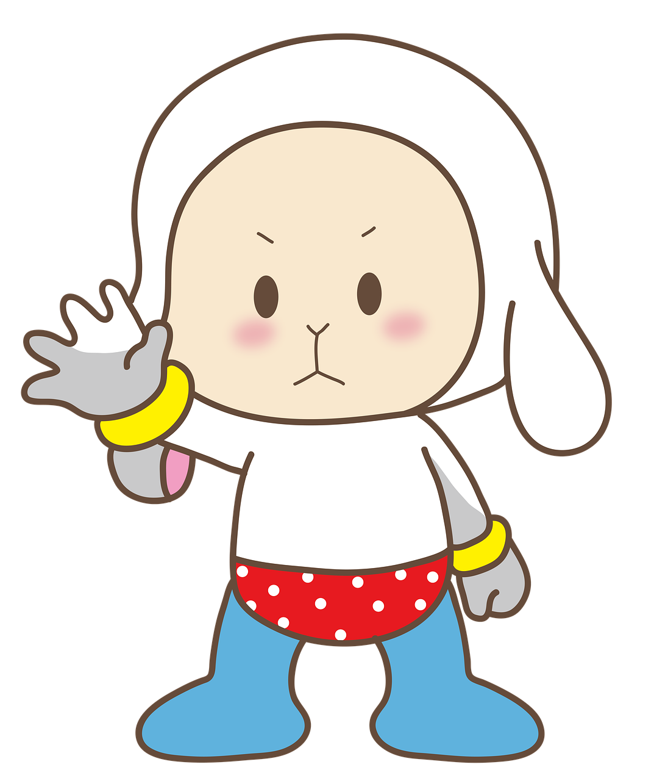
Should – Shouldn’t
We use should and shouldn’t to give advice or to talk about what we think is right or wrong.

Slide 14
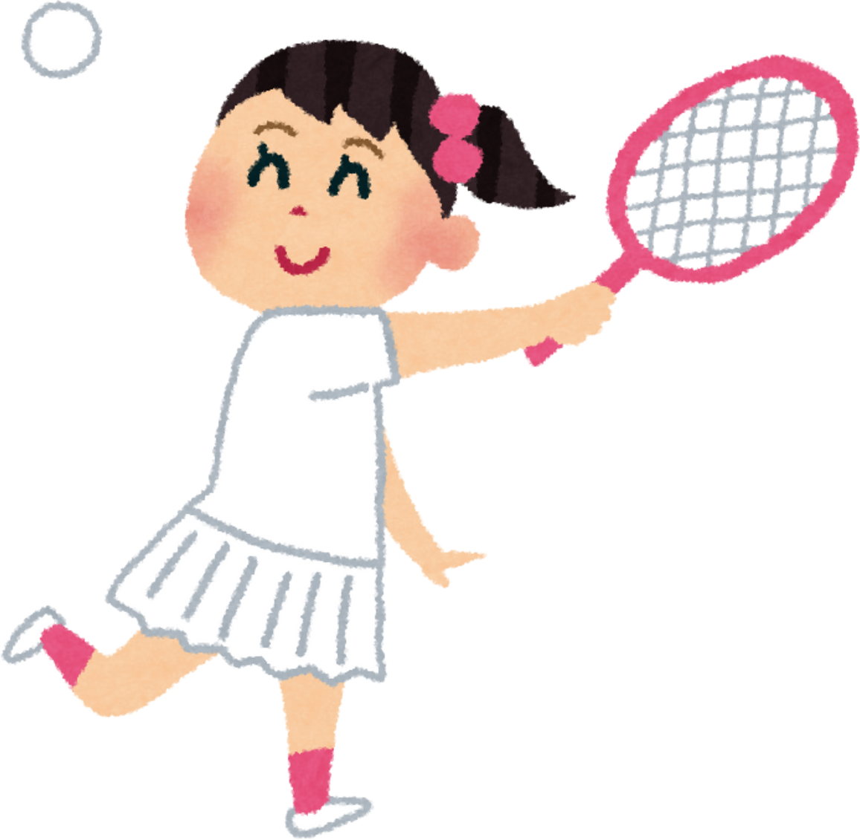
Adverbs of frequency
once a week, twice a week,
three times a week,
four times a week

Slide 15
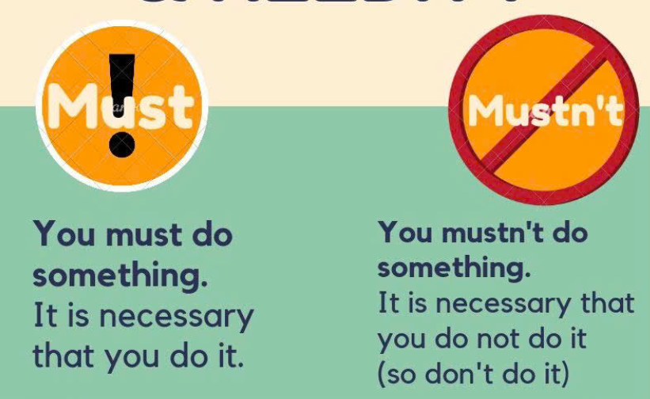

Slide 16
3
PRACTICE

Slide 17




Look and read. Write Yes or No.
You can run in here.

Slide 18

Look and read. Write Yes or No.
No food allowed
You mustn’t eat food here.

Slide 19


Look and read. Write Yes or No.
You shouldn’t drink coke or soda.
choose water as a drink

Slide 20
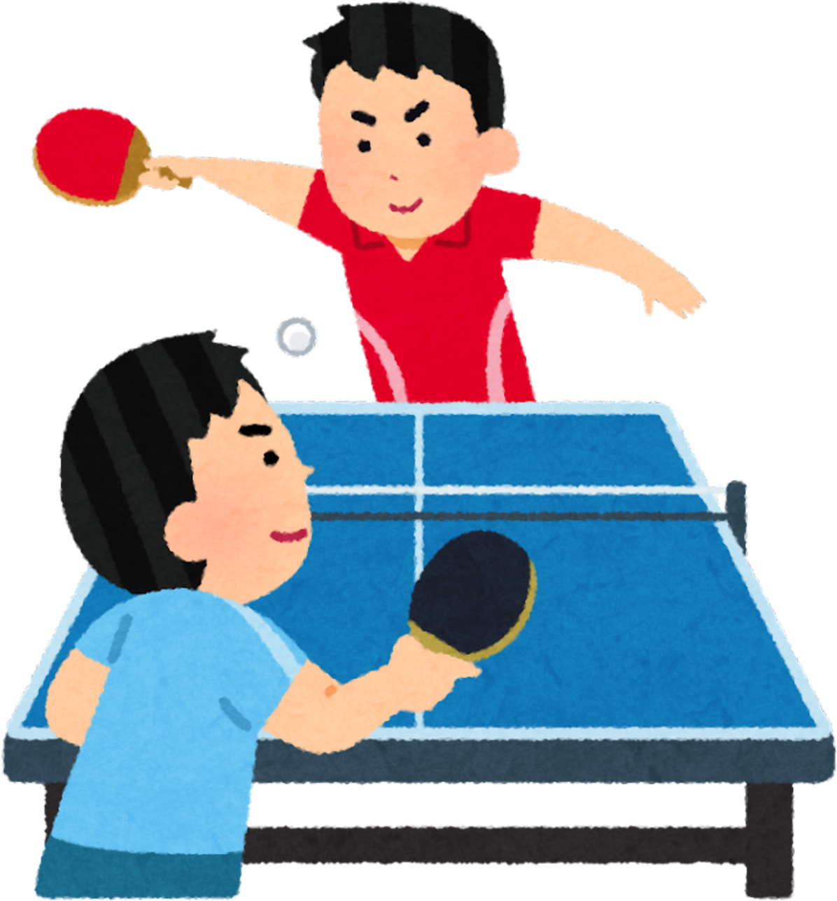
4
PRODUCTION

Slide 21
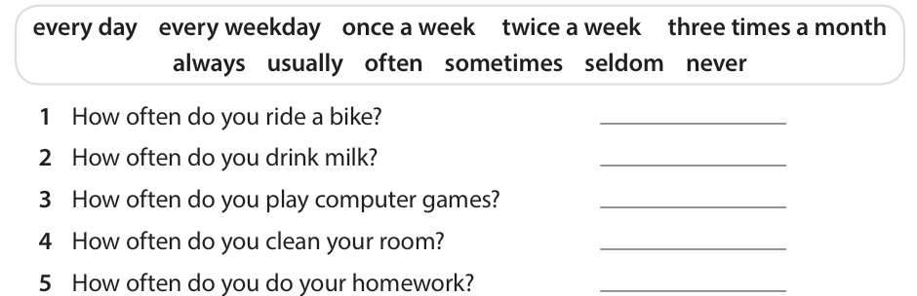
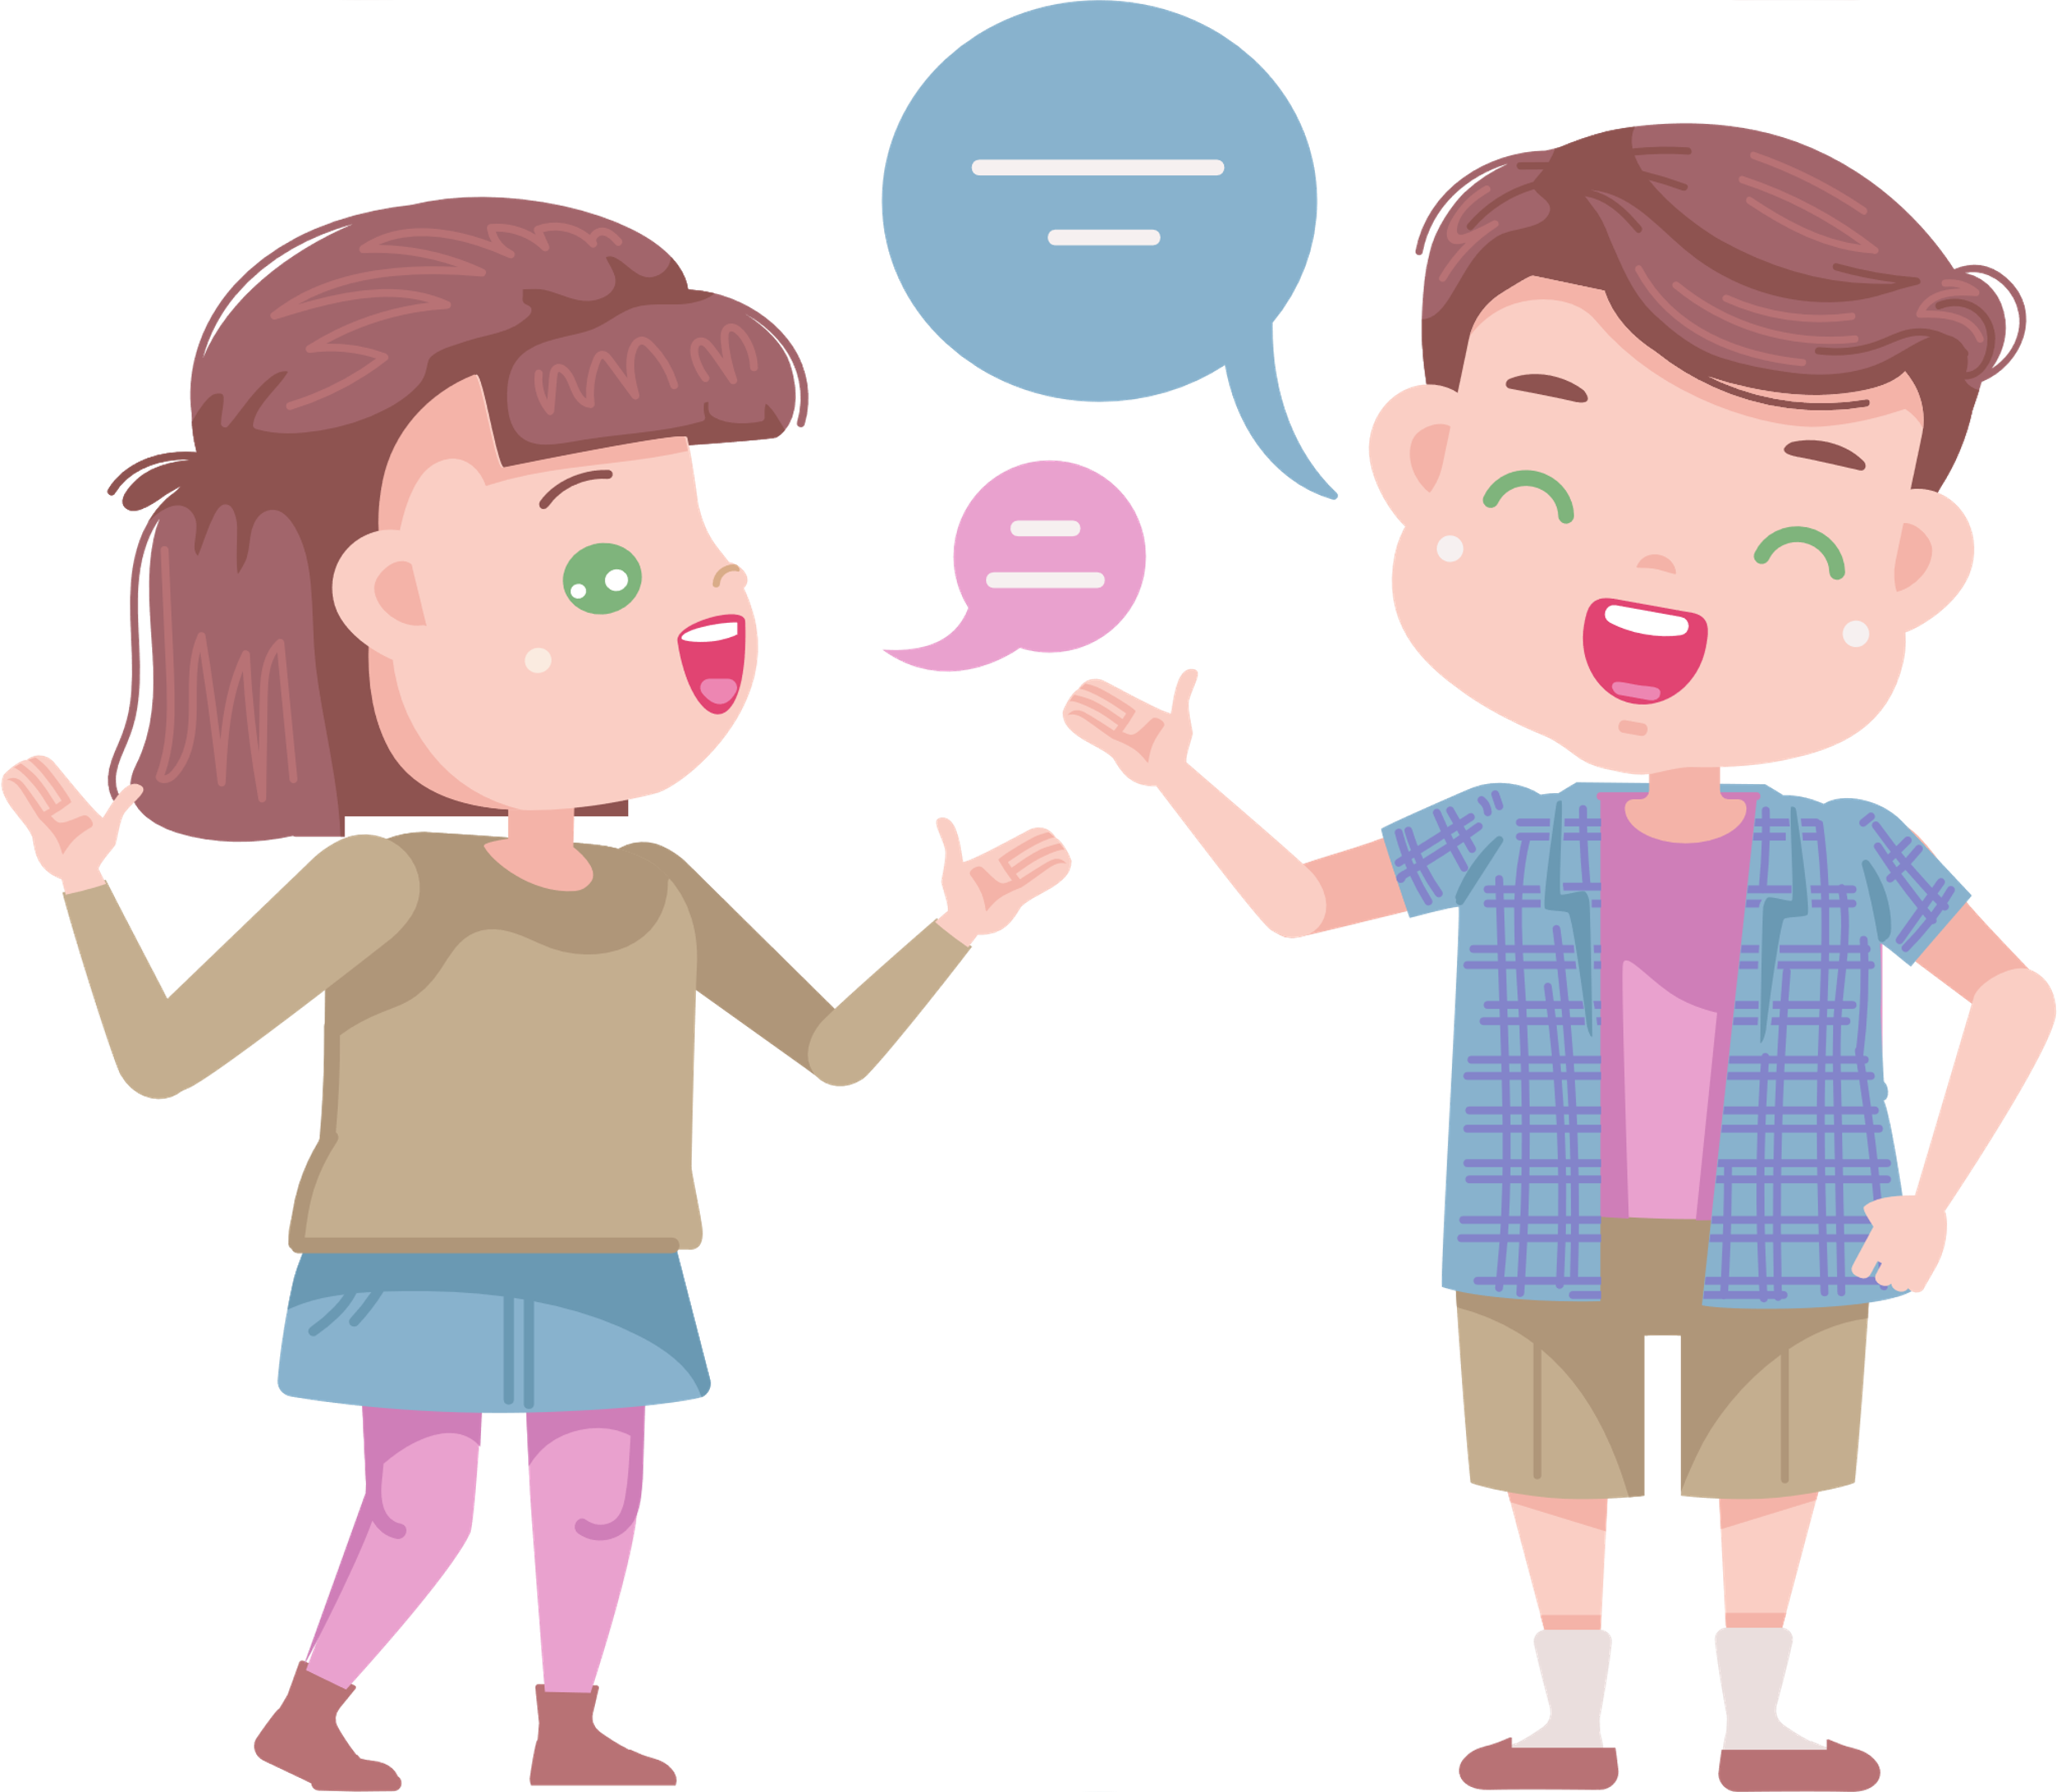
Write and say.
Write your answers using different time expressions. Then talk to your friend.

Slide 22
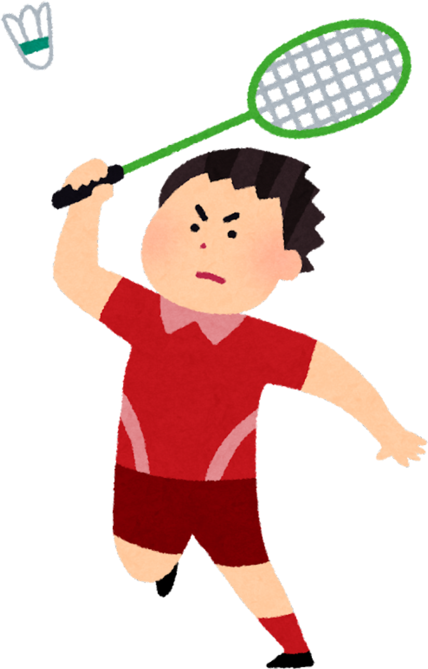
5
WRAP – UP & ASSESSMENT

Slide 23
Choose the correct option
The children ____ playing basketball.
do B. is C. are D. can
2. The athletes are _______ a race on the track.
cooking B. running C. painting D. dancing
3. Players _______ practice regularly to improve their skills.
are B should C.shouldn’t D. does
4. Players _______ wear helmets when playing hockey for safety.
Can B. mustn’t C. must are
5. She _______ goes swimming after school.
A. always B. once a week C. every day D. twice a week.

Slide 24

Review 1
What have we learnt today?
Vocabulary
Helmet, win, brain, kick, fast, race
Grammar
- Present continuous
- Should/ shouldn’t
- Adverbs of frequency
- Must / mustn’t
Review all target vocabulary and sentence patterns about sports in unit 7

