Slide 1





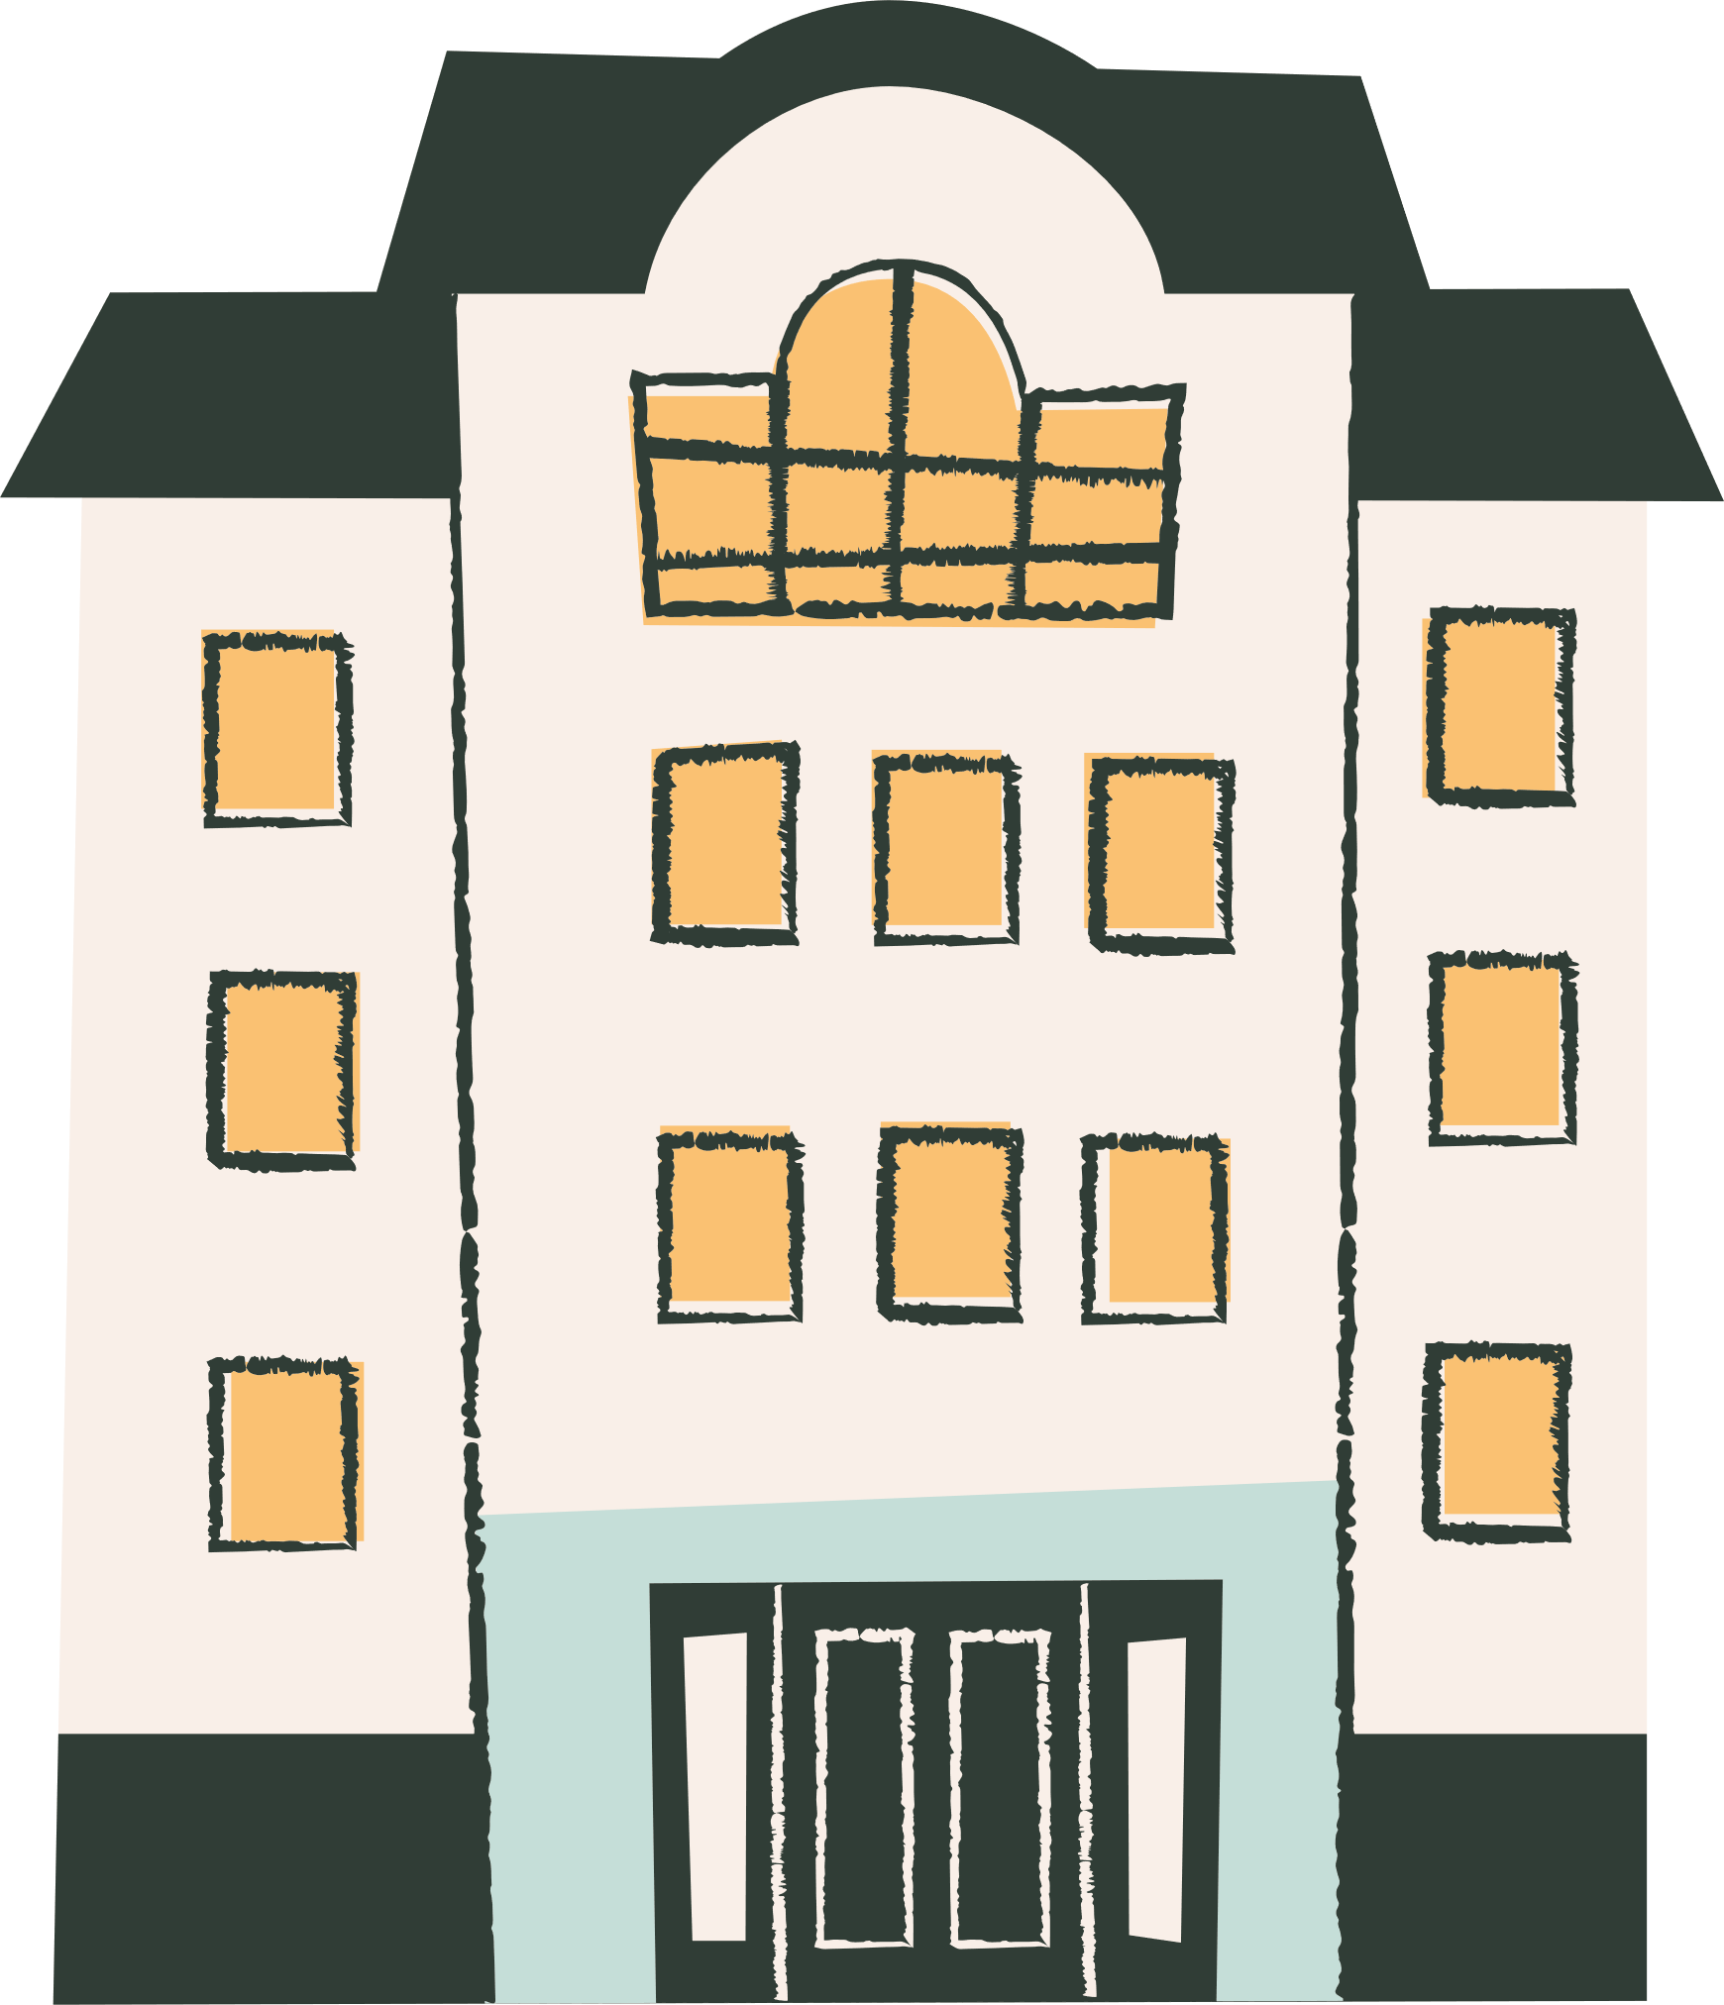
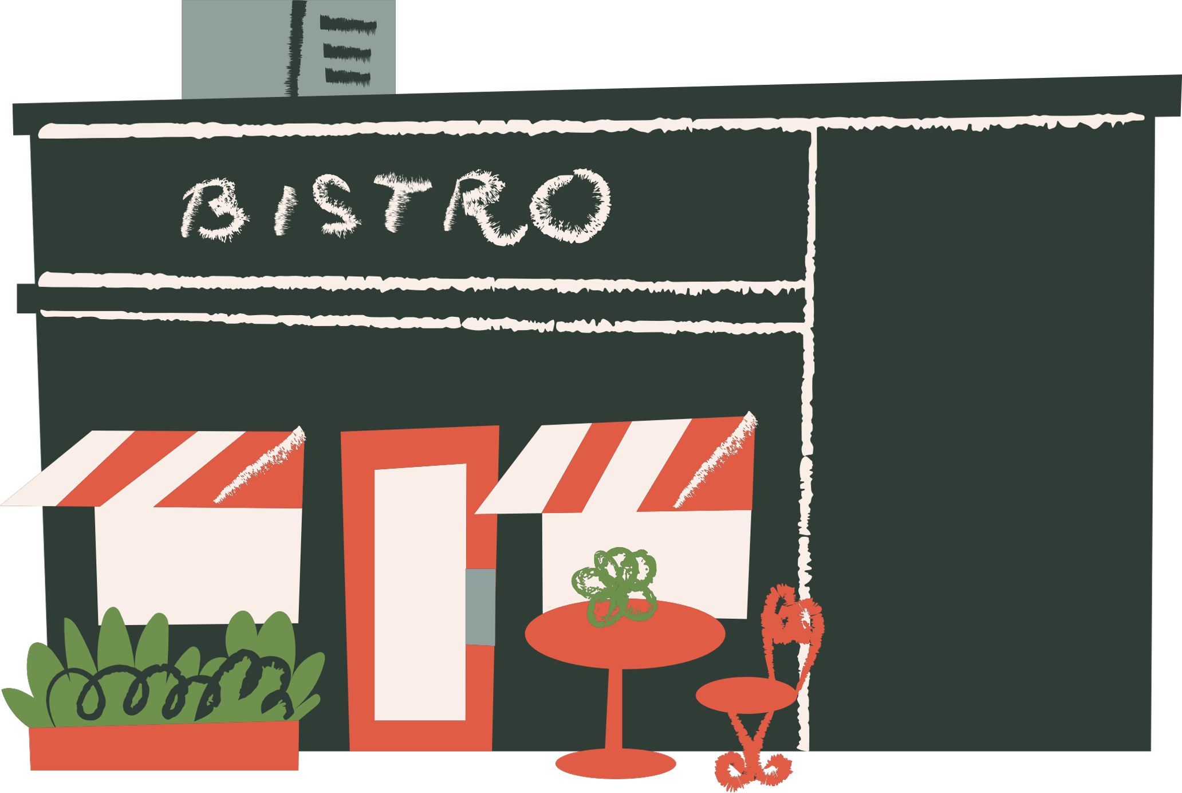
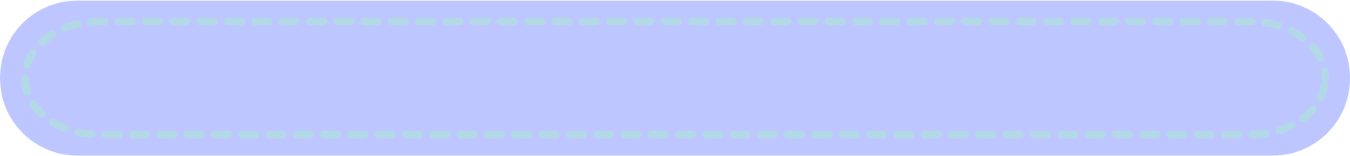

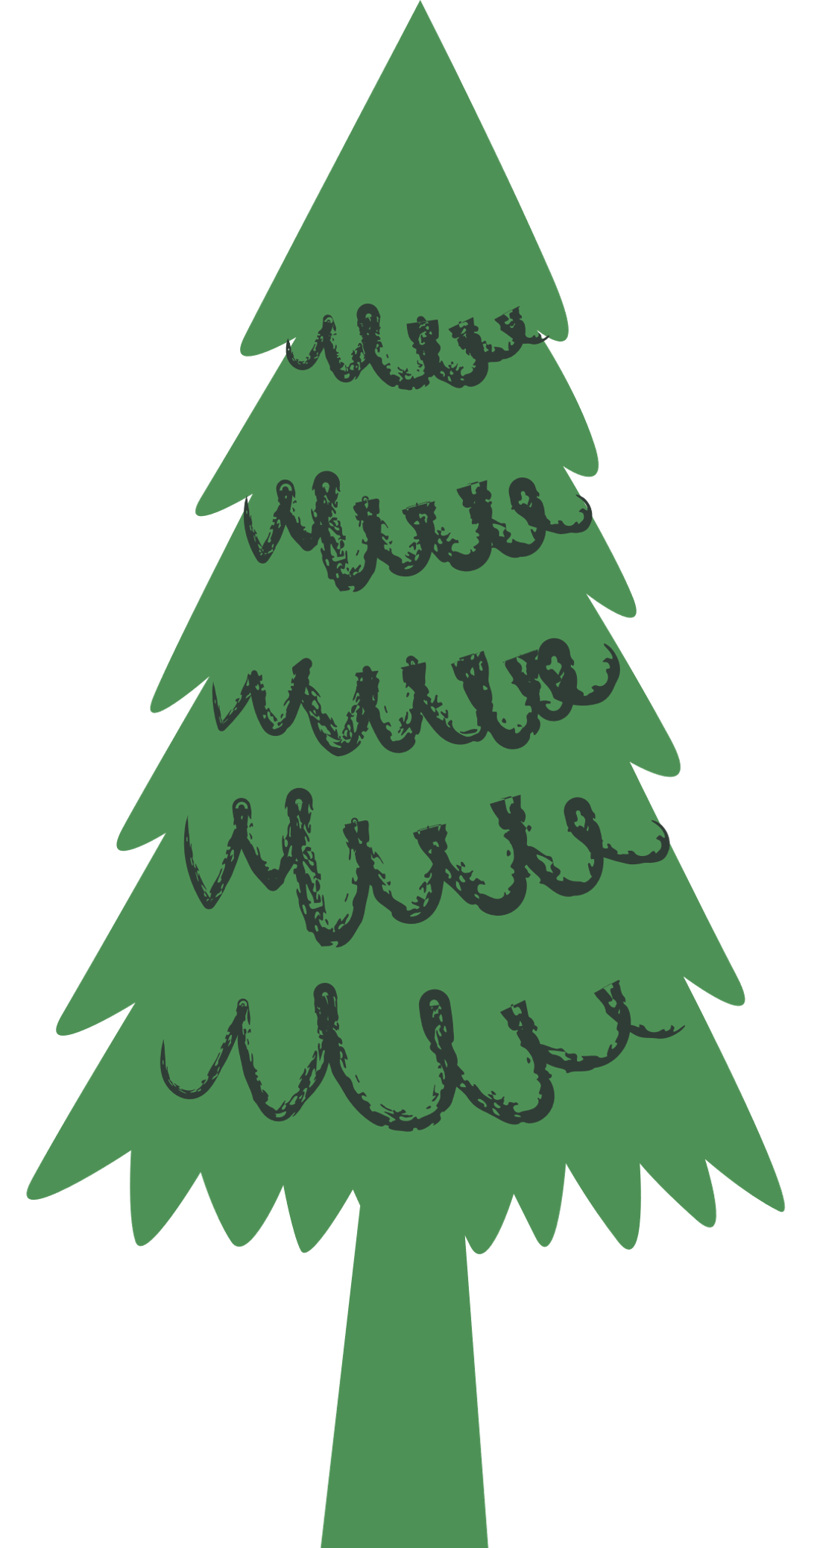

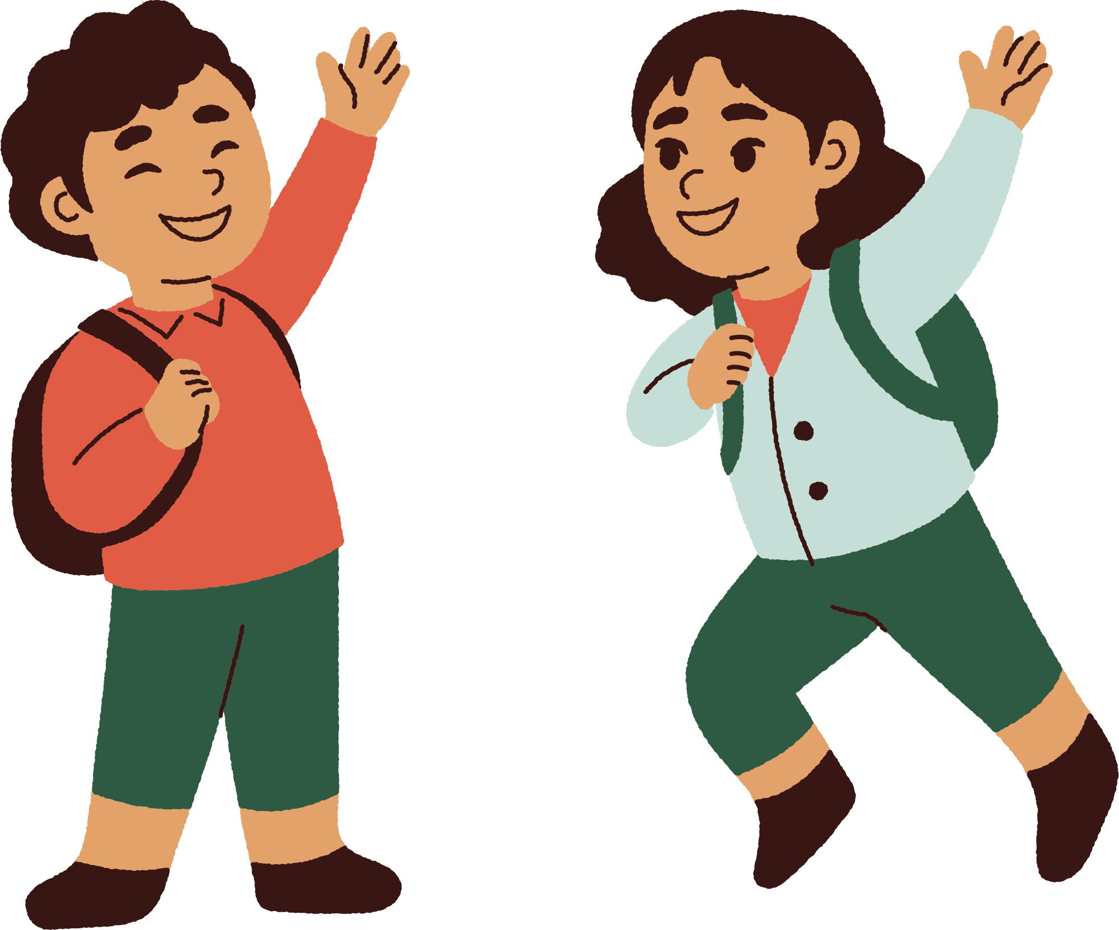



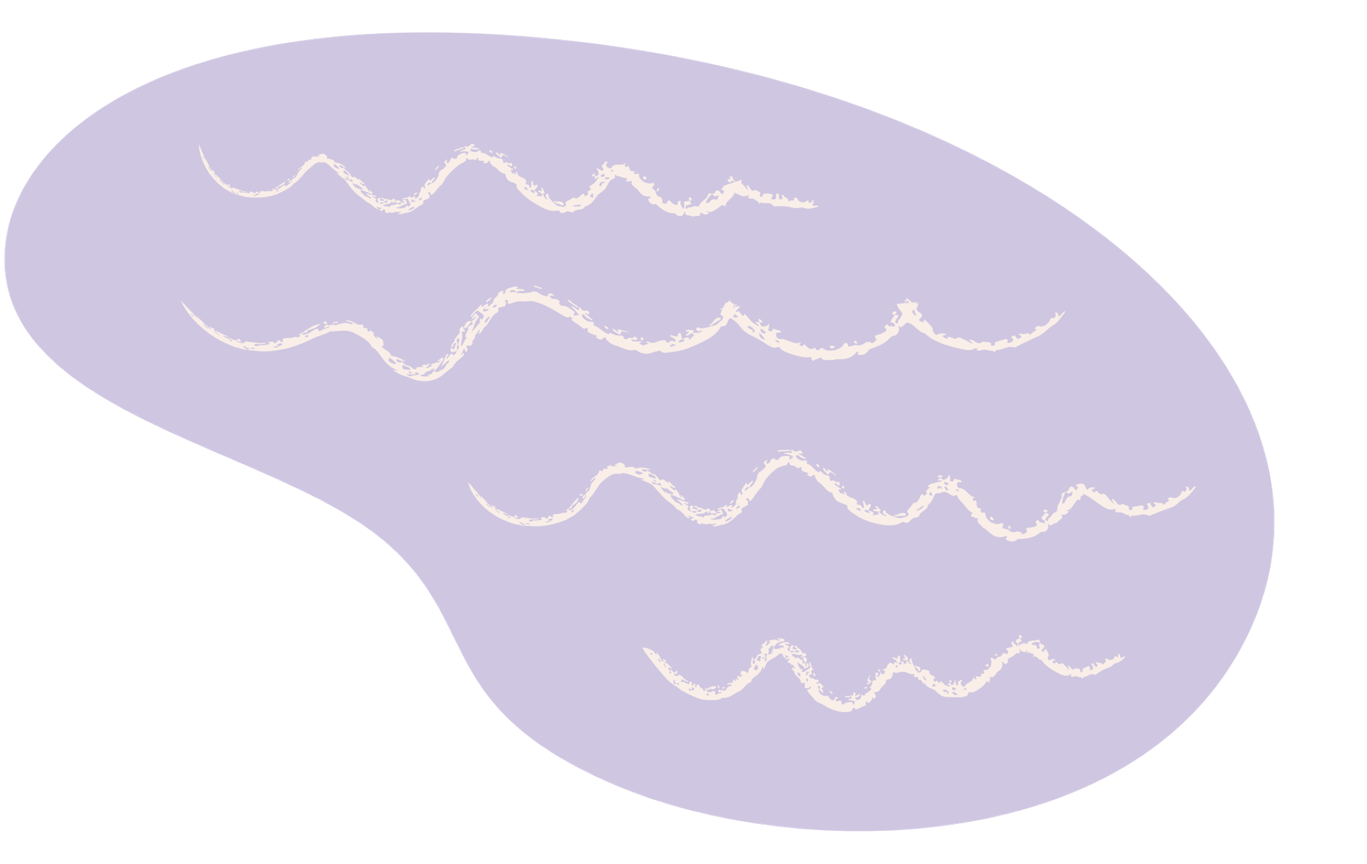
Unit 8
People and Places
LESSON 3
Activity 4, 5, 6

Slide 2



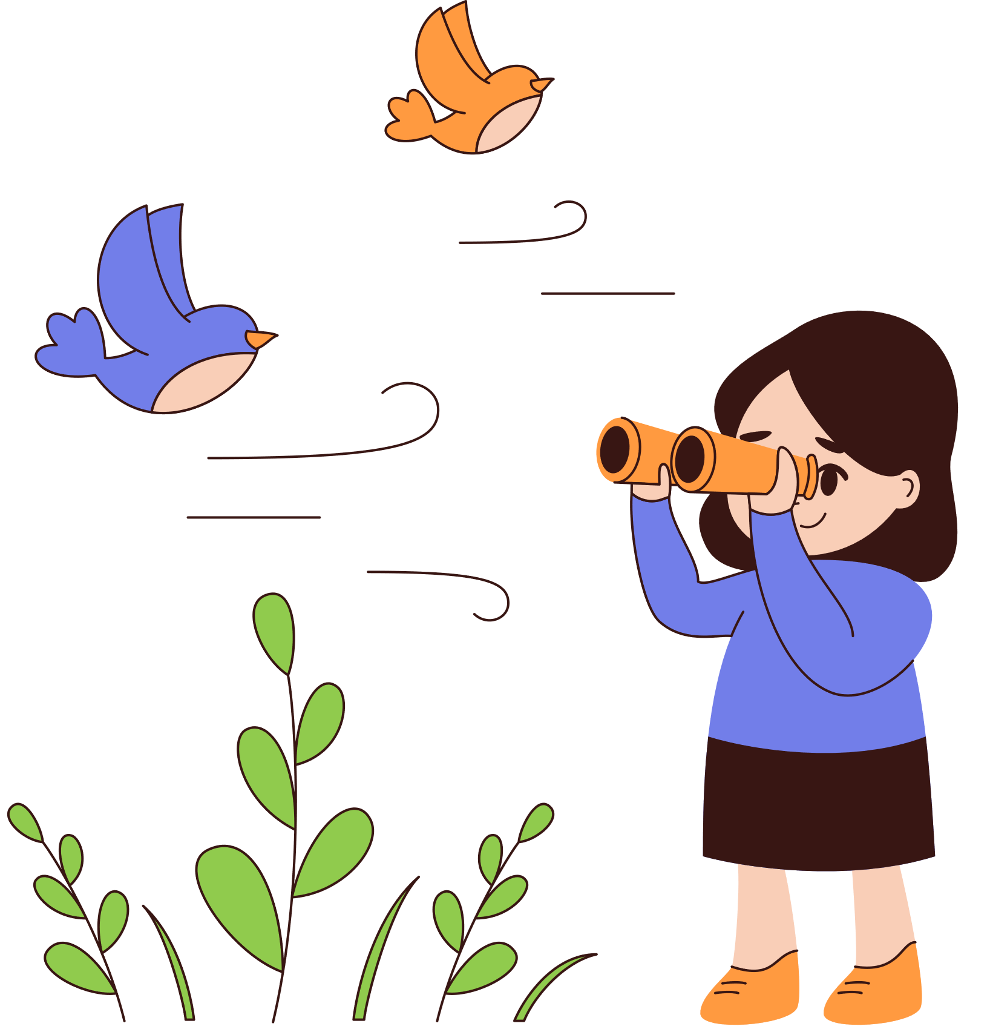

01
Warm-up

Slide 3

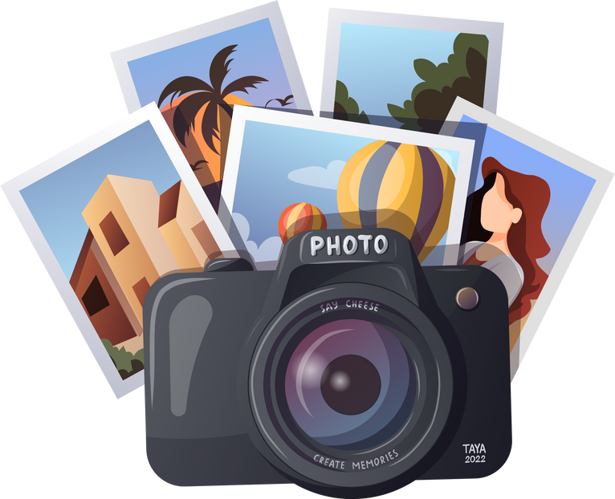
02
Presentation

Slide 4
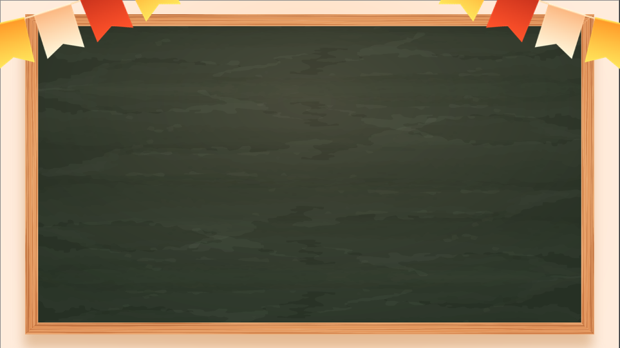
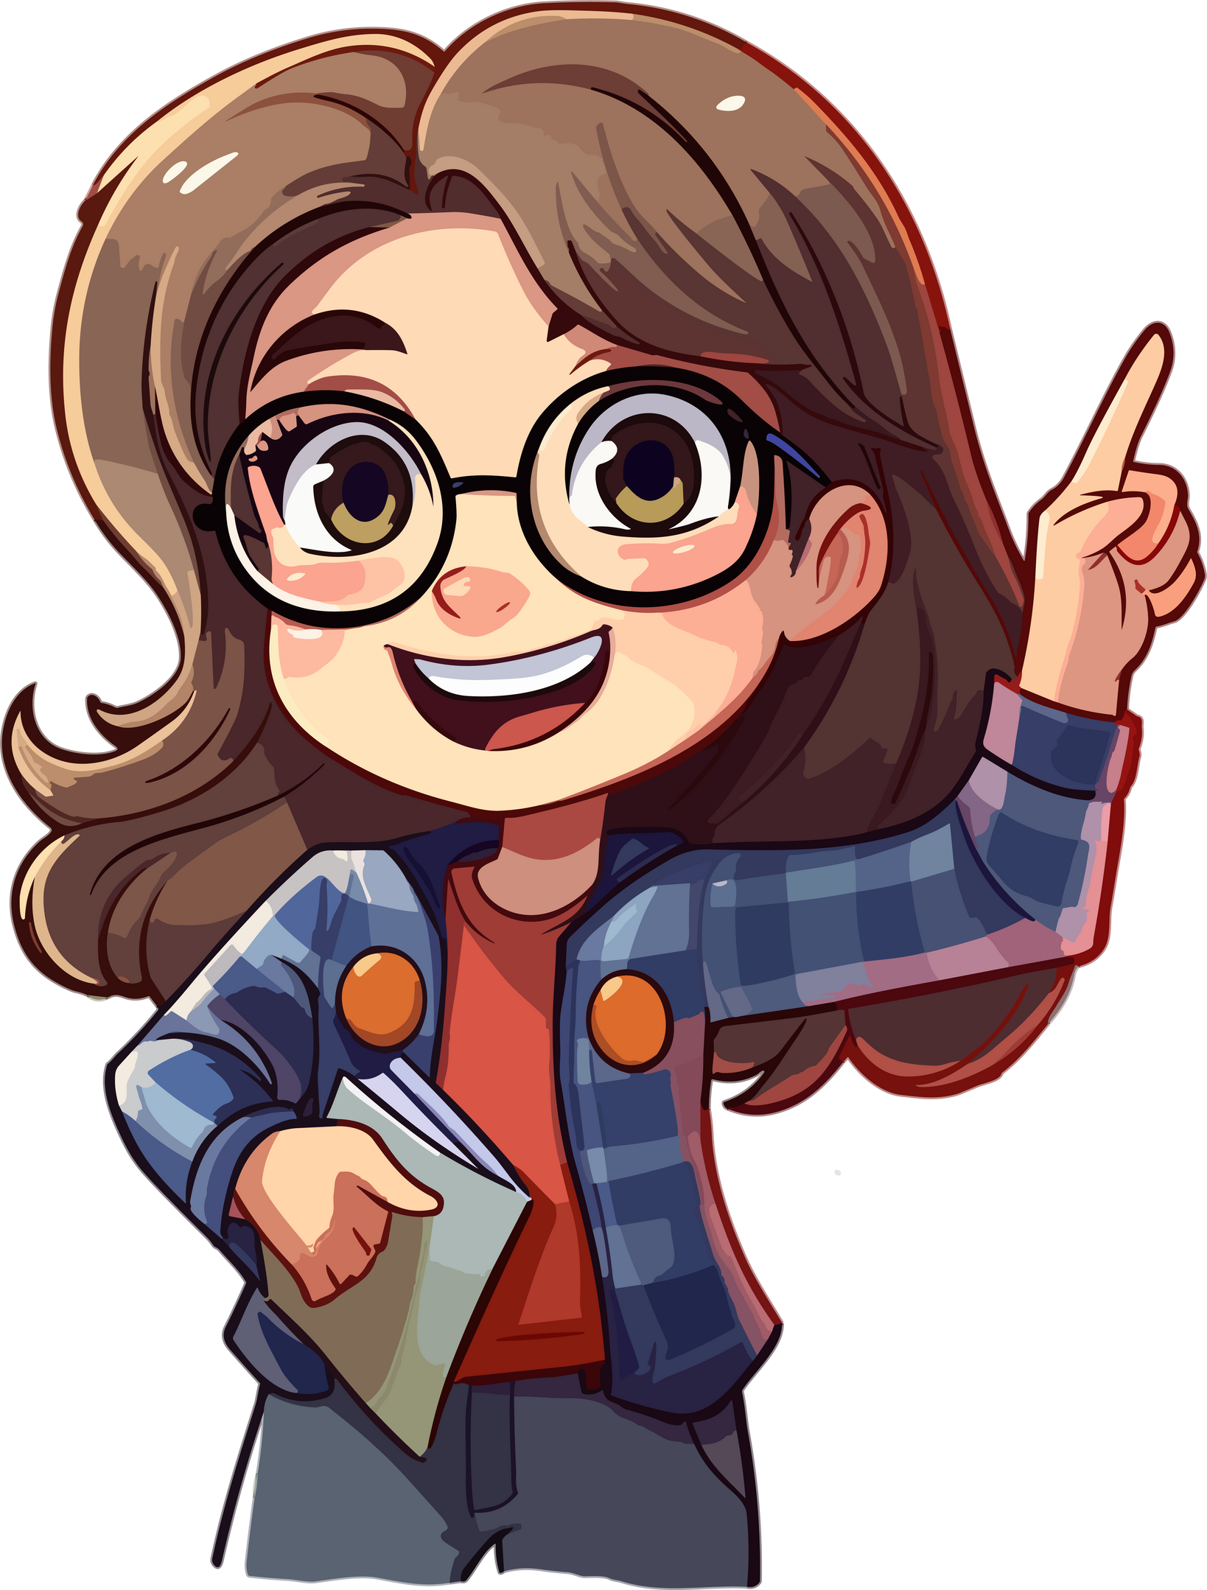
Conjunction
a word that connects words, phrases, and clauses in a sentence.
 | so | because
Type | coordinating conjunction: connects two or more elements of the same grammatical type | subordinating conjunction: joins elements of unequal grammatical standing
Usage | Shows result of an action | Shows the cause of an action

Slide 5
Conjunction
a word that connects words, phrases, and clauses in a sentence.
so | because
Clause of reason, so + clause of result. | 1. Clause of result + because + clause of reason. 2. Because + clause of reason, clause of result.
I wanted something to eat, so I looked for food in the fridge. | 1. I looked for food in the fridge because I wanted something to eat. 2. Because I wanted something to eat, I looked for food in the fridge.

Slide 6
4. Complete the sentences with because or so.
Then listen and check.
It’s Saturday, ______ we can go to the shops.
I don’t like big cities _________ they’re noisy!
Our house is big, ______ I’ve got my own bedroom.
I like Tom’s house _________ it’s got a great view.
People visit Barcelona _________ they want to see the Sagrada Familia.
so
because
so
because
because

Slide 7
03
Practice

Slide 8
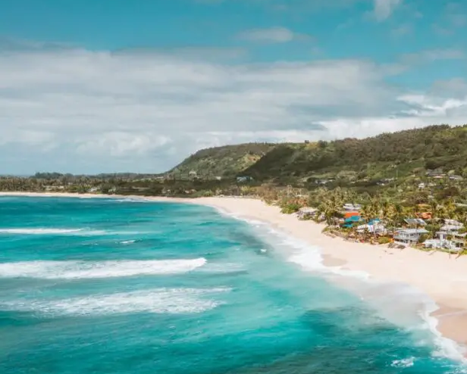
5. Read and complete the gaps with because or so.
My Favourite Place
My favourite place in my town is the beach. It isn’t a beautiful beach, but my friends and I have fun there. We don’t usually swim there (1) _________ the sea is very cold! We sometimes play volleyball on the beach. There’s also a café, (2) _________ we often have lunch there. The view is great (3) _________ it’s next to the sea.
because
so
because

Slide 9
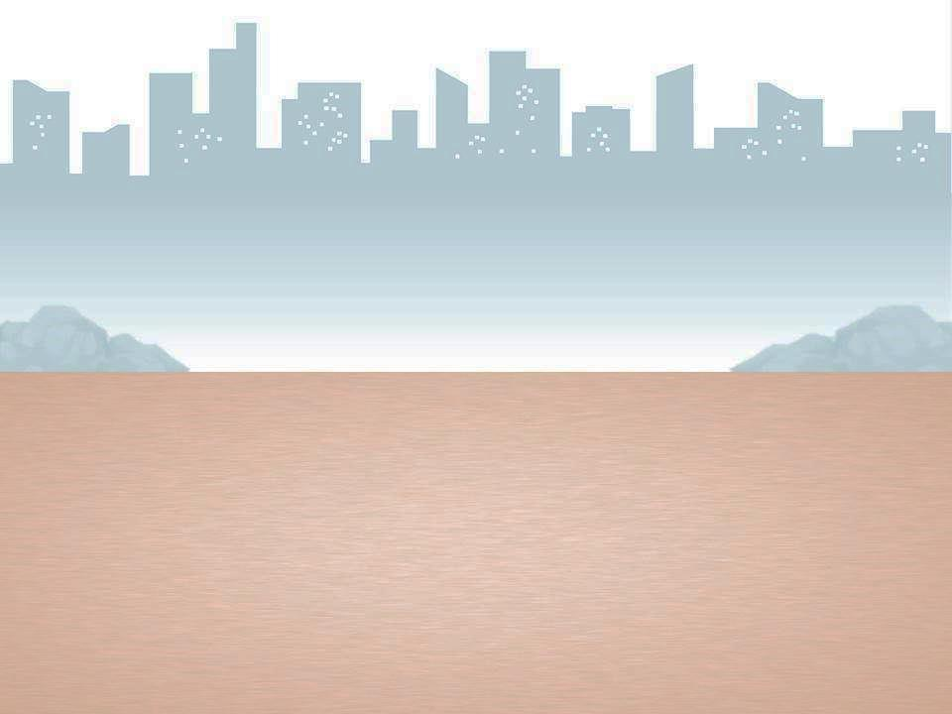
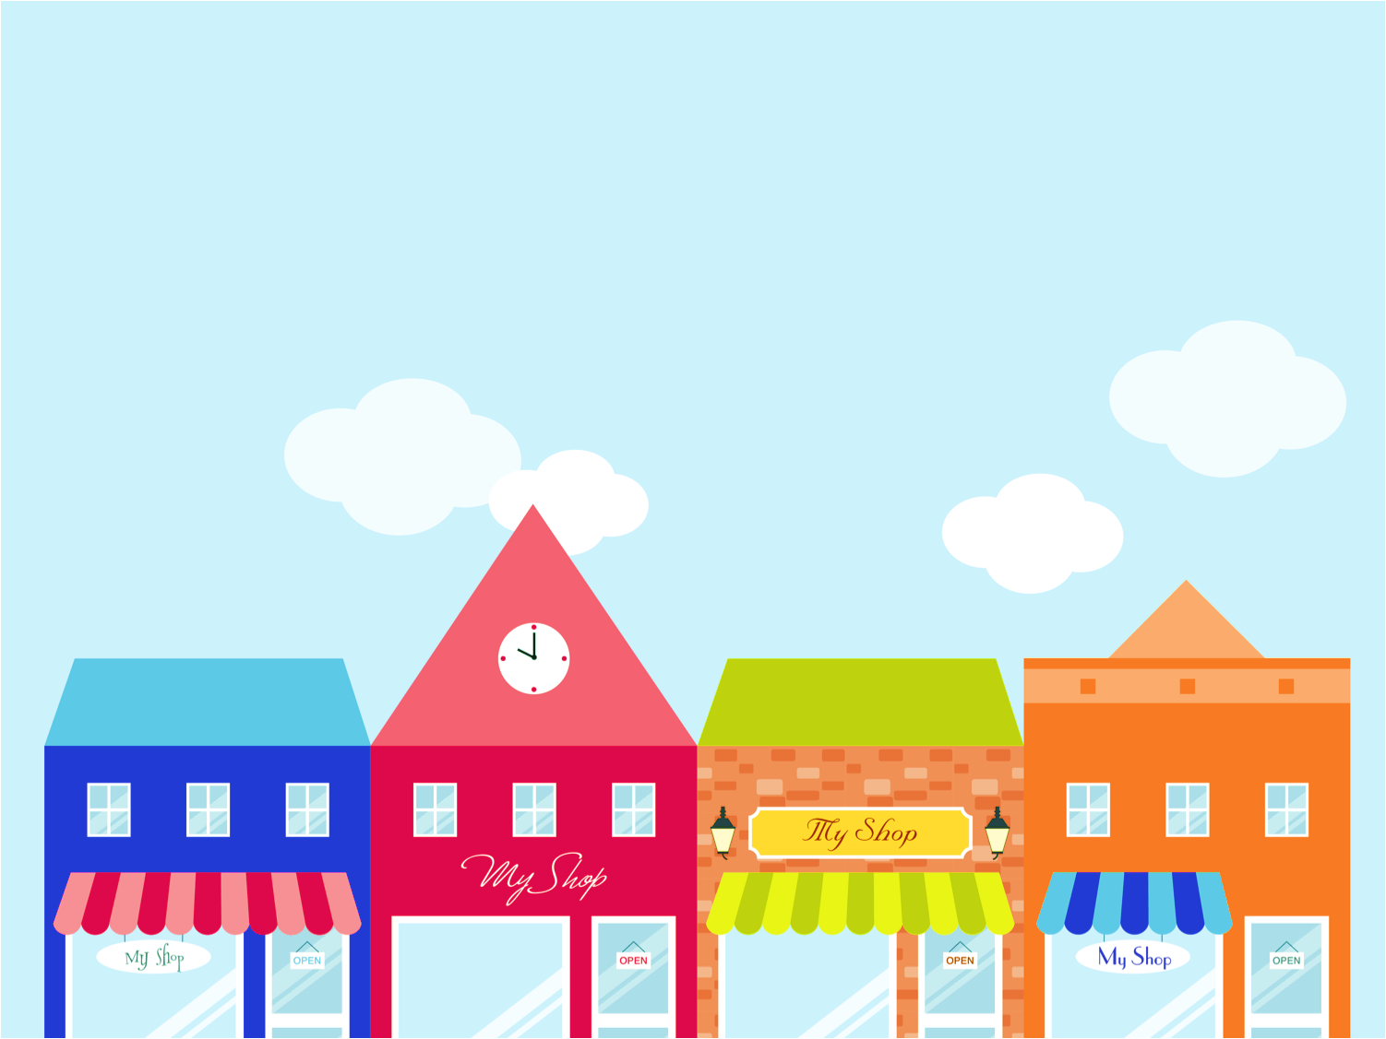
Game
Fill in the blank with the correct conjunction

Slide 10
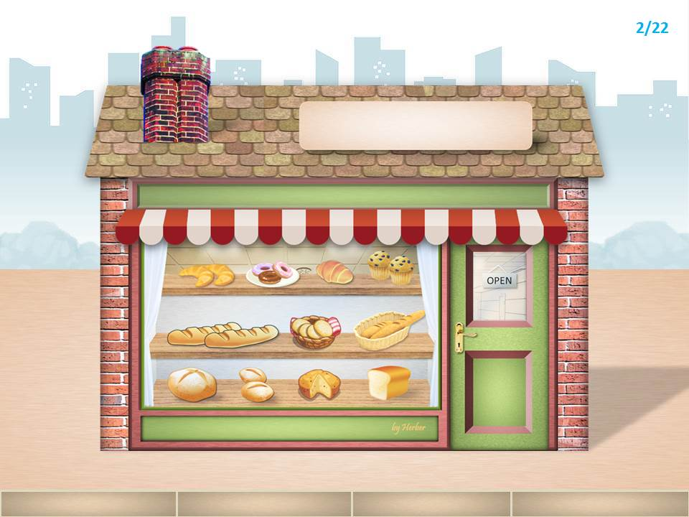
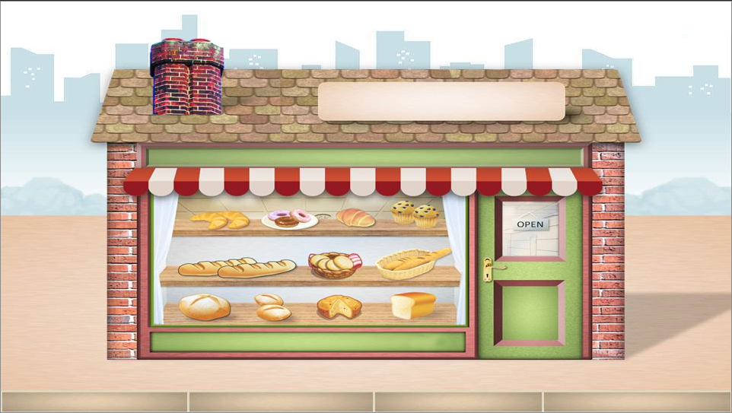
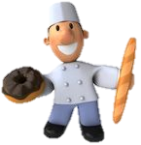
1. My uncle wants to buy some bread, _______ he goes to the bakery shop.
so
NEXT

Slide 11
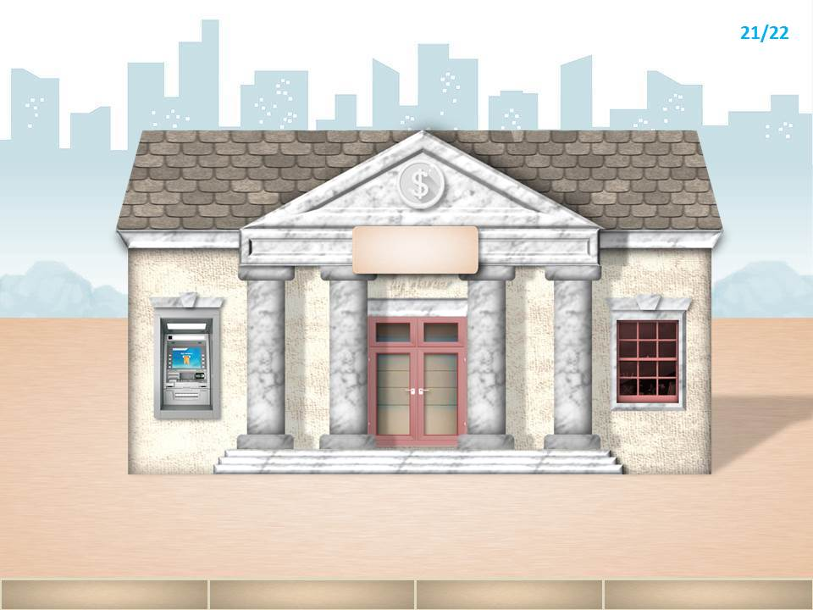
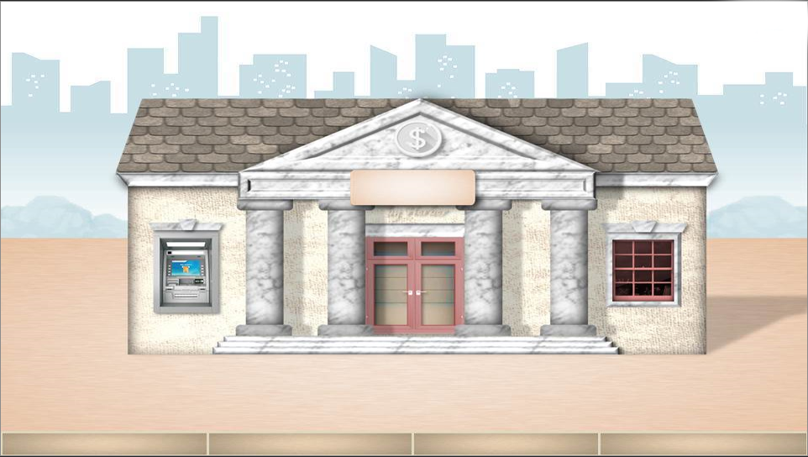

2. _______ my father wants to get some money, he goes to the bank.
Because
NEXT

Slide 12
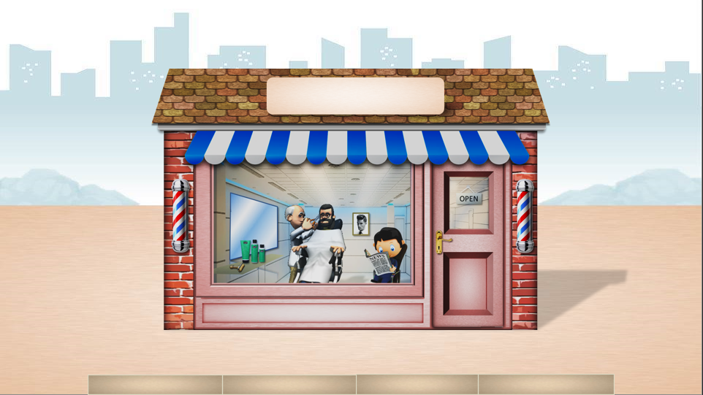
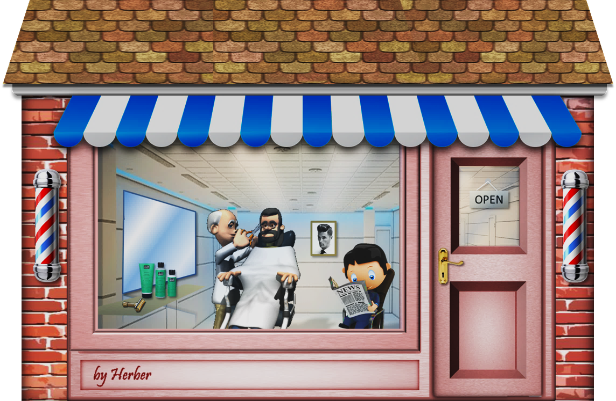

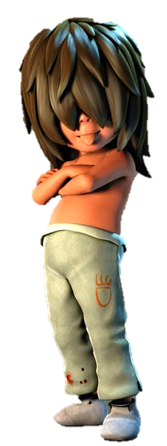



3. I go to the barber shop _____ I want to change my hairstyle.
because
NEXT

Slide 13
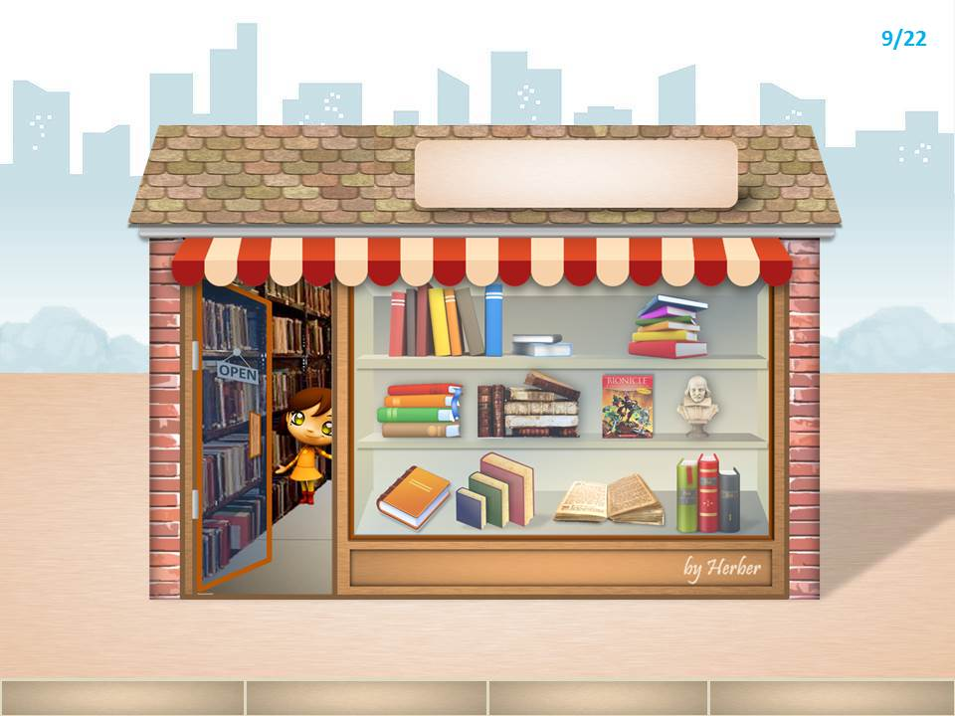

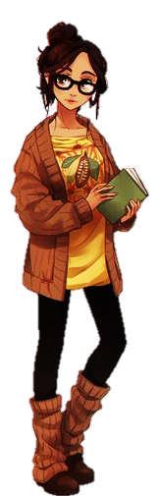
4. My sister loves books, _______ she often goes to the bookshop.
so
NEXT

Slide 14
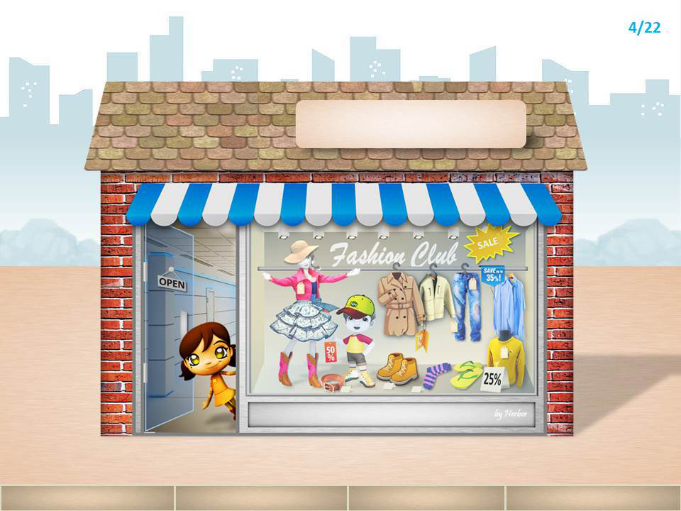

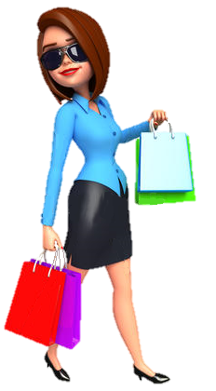
5. ________ my mom loves shopping, she often goes to the downtown store every weekend.
Because
NEXT

Slide 15
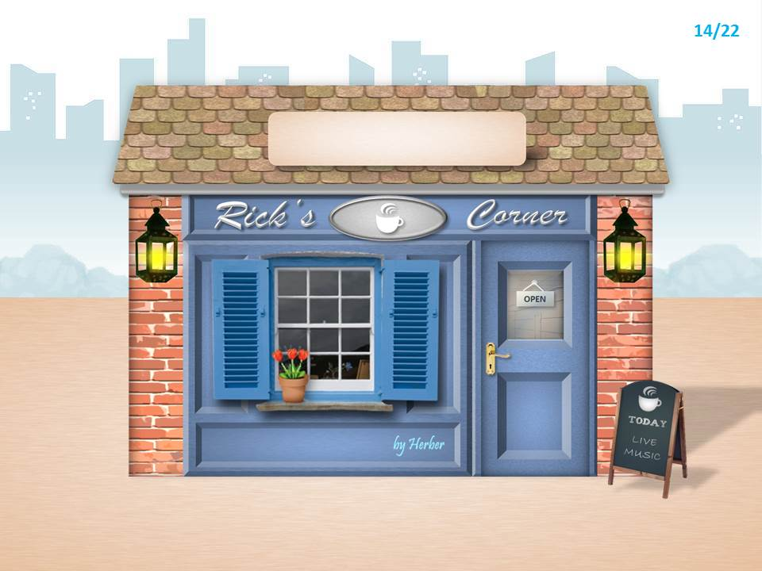
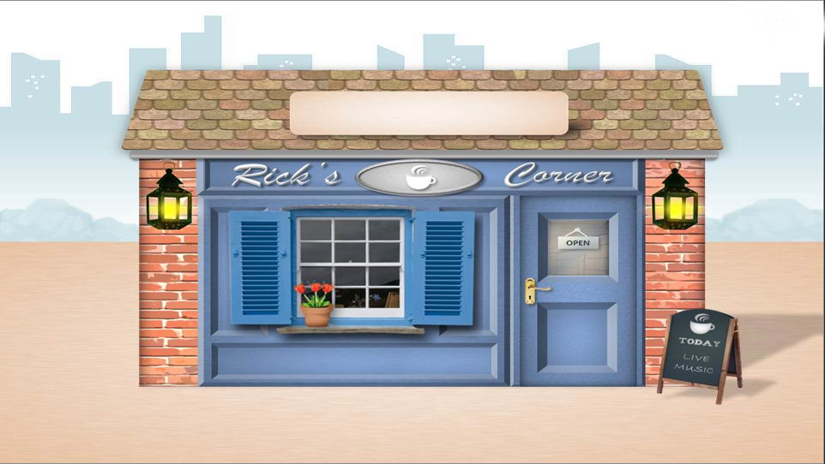
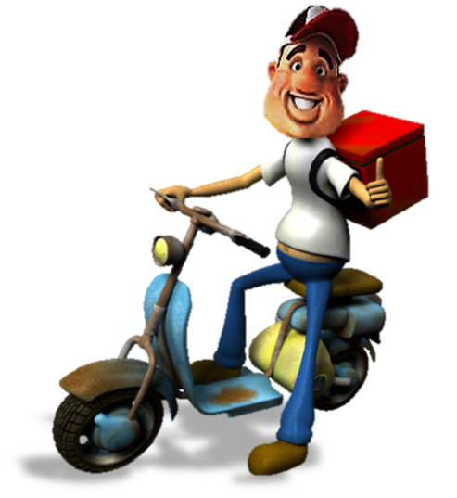
6. I go to the coffee shop _________ I want an Americano.
because
NEXT

Slide 16
04
Production

Slide 17
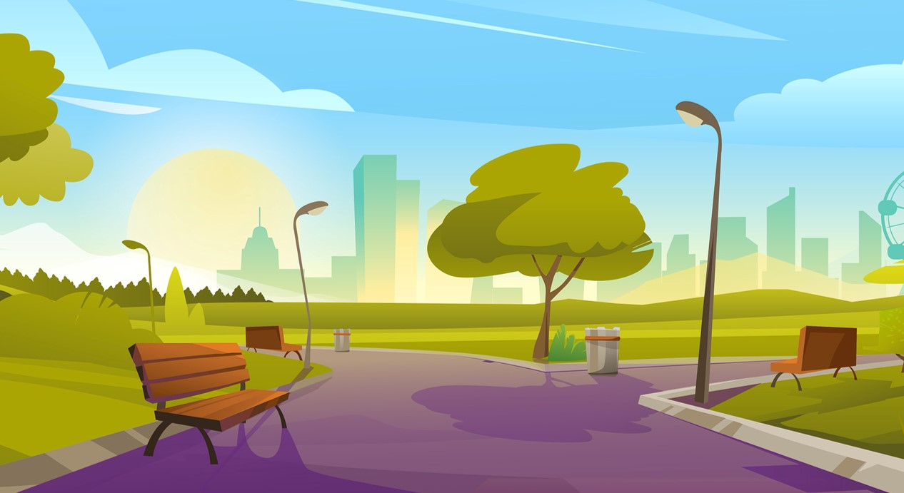
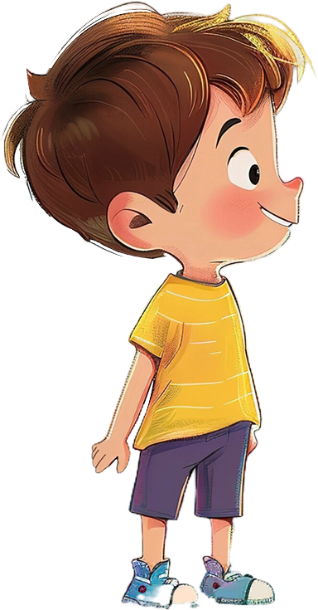
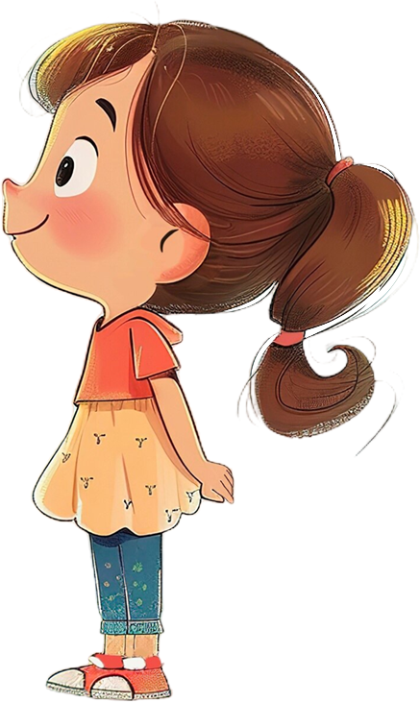
6 Write.
First, answer some questions below.
My favourite place is the park.
What’s your favourite place?
It’s big and green.
What’s it like?
It’s safe for kids to do sports.
What do you do there?
What other things are there in this place?
I often go cycling there.

Slide 18
6 Write.
In 30-40 words, write about your favourite place in your hometown. Use these questions to help you. Remember to use because and so.
What’s your favourite place?
My favourite place is the park next to my house. I like it because it is big and green. It is safe for kids to do sports in the park, so my friends and I often go cycling there.

Slide 19
05
Wrap-up &
Assessment

Slide 20
Fill in the blanks to complete sentences. Use so and because.
1. He was ill, __________ he stayed at home.
2. __________ he had a car accident, he was absent from the meeting.
3. I cannot buy this jacket __________ I haven’t got enough money.
4. __________ she was very tired, she went home early.
5. Jack wants to keep fit and stay healthy, ___ he goes running every day.
6. It is a hot and sunny day, ________ we are going to the beach.
7. We stayed at home __________ it was raining.
8. Lisa got up early __________ she had to study for the French test.
so
Because
because
Because
so
so
because
because

