Slide 1


Unit 9. Places in town
Lesson 2. Task 7, 8, 9

Slide 2



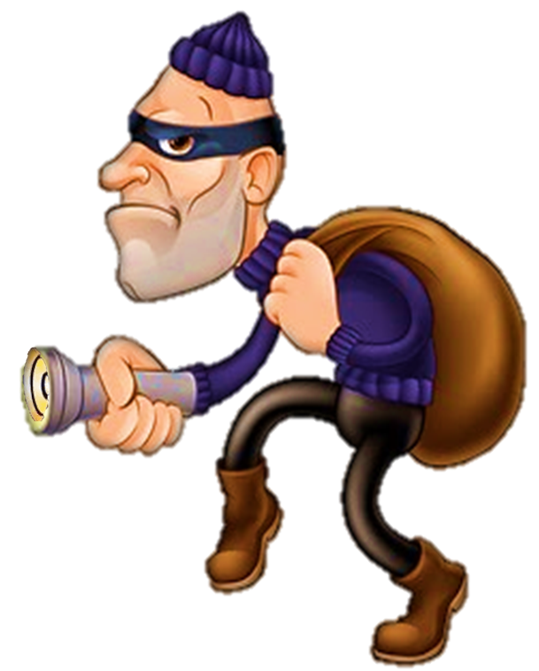
Where’s the thief?
Notes:
Explain the thief ( giải thích từ) -→ steal : ăn trộm

Slide 3
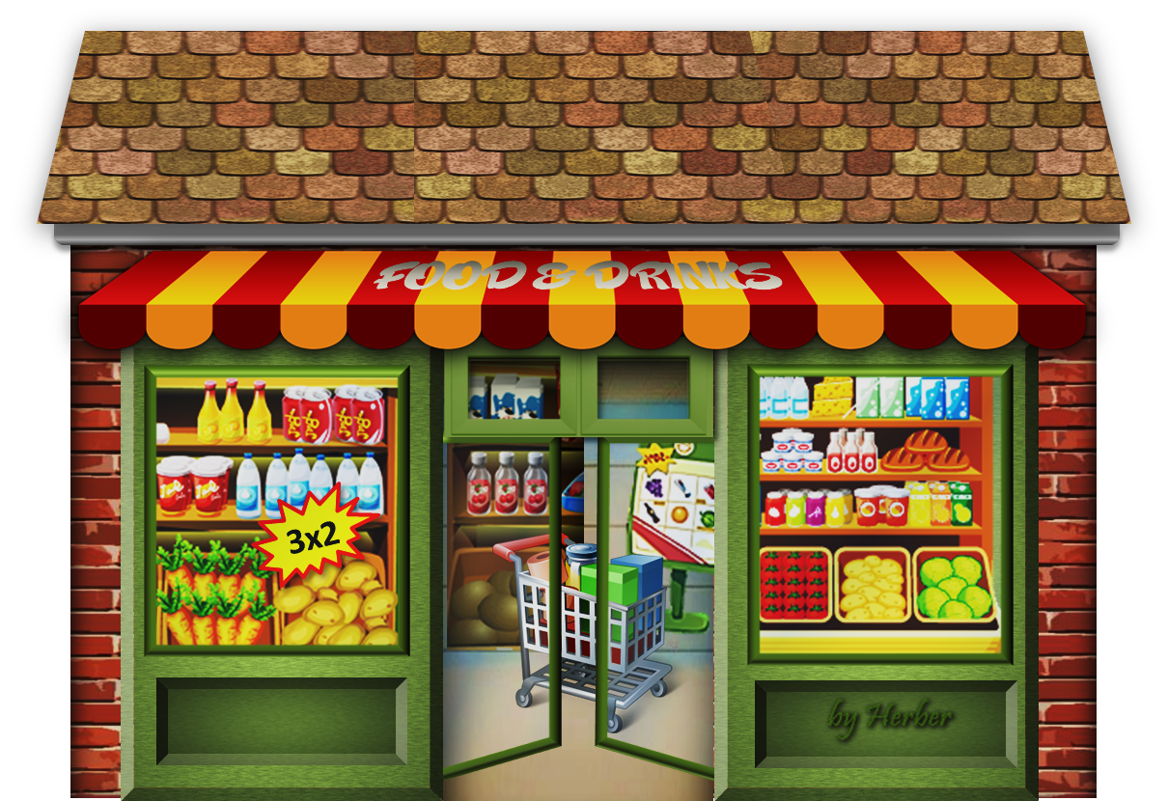
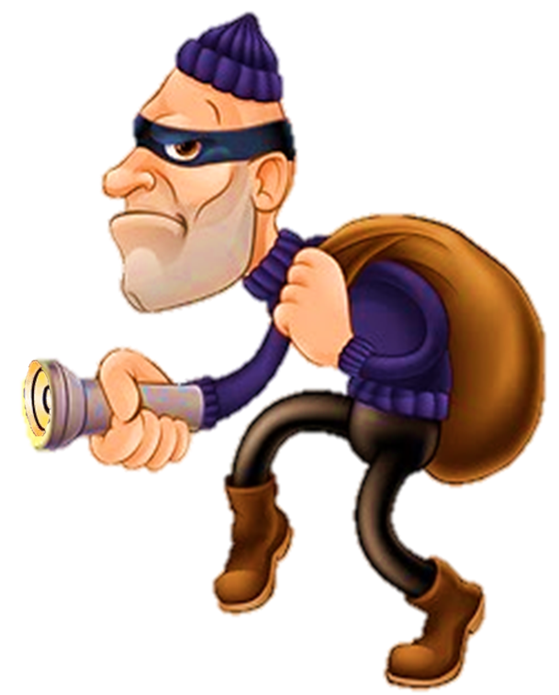

Where do we steal some foods and drinks ?

Slide 4

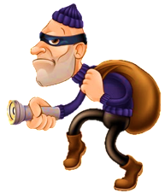
AT THE SUPERMARKET

Slide 5
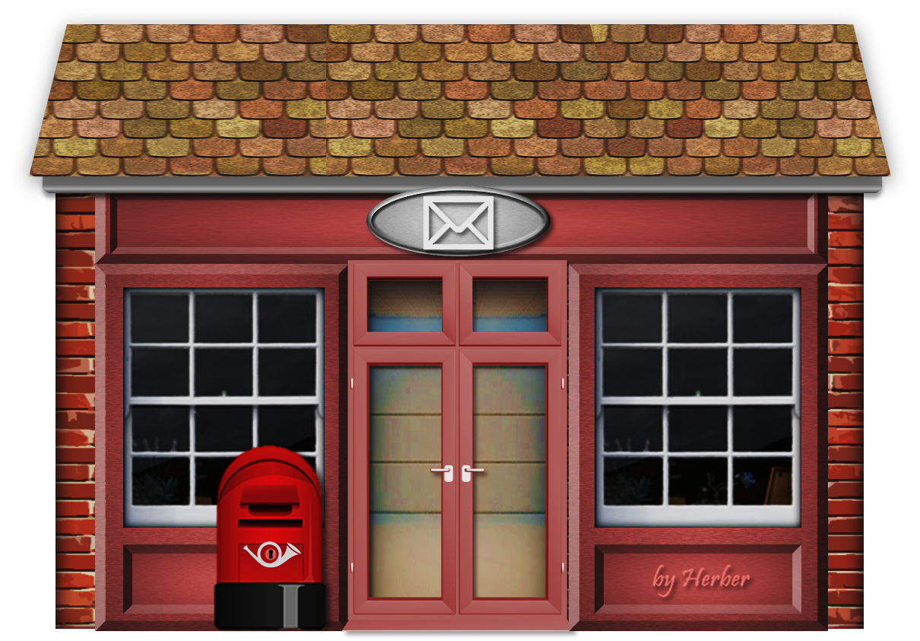
Where do we steal letters and parcels ?

Slide 6

AT THE POST OFFICE

Slide 7

Where do you steal paintings ?

Slide 8


AT THE MUSEUM

Slide 9
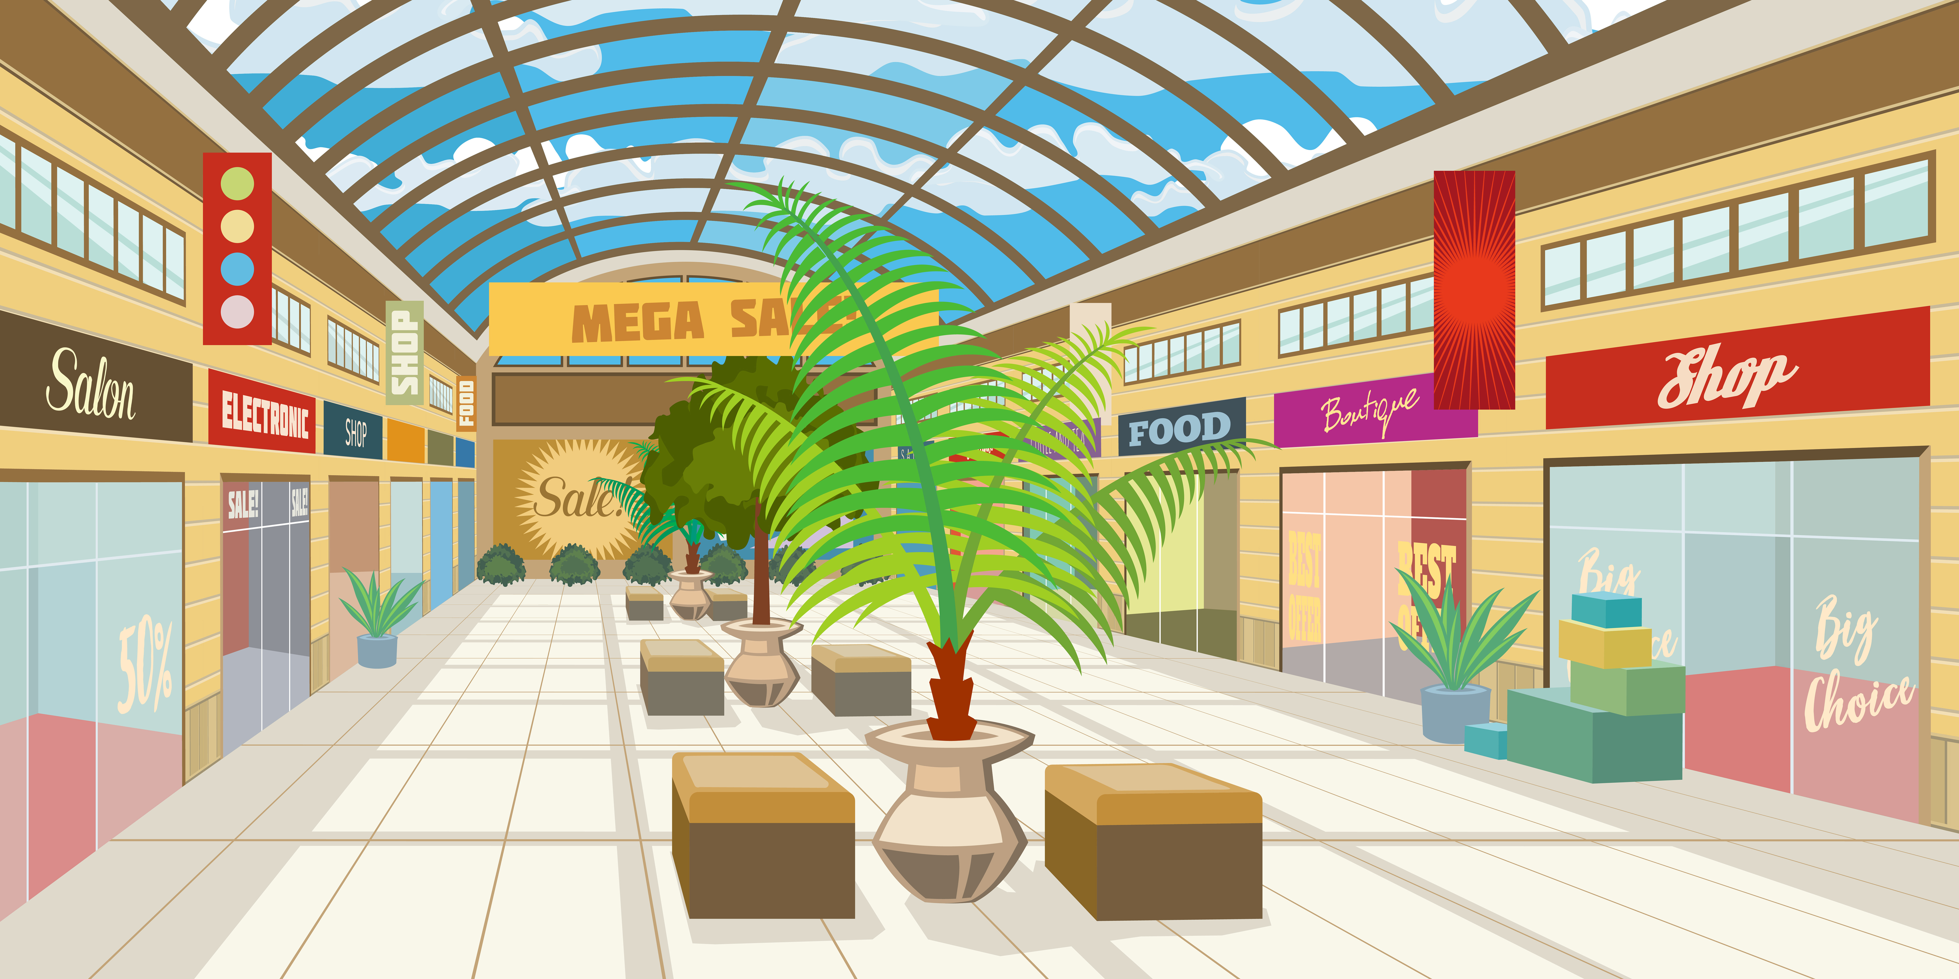
Where do we steal some clothes and shoes?

Slide 10

GOODBYE!

Slide 11
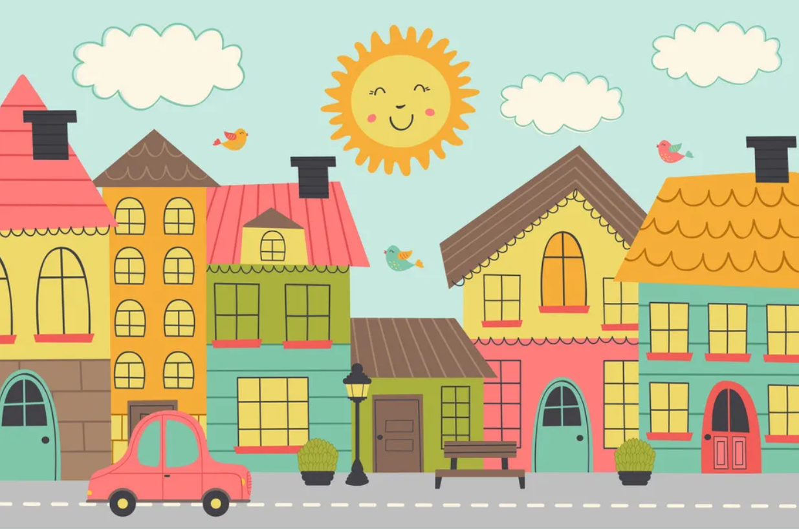



2
Practice

Slide 12
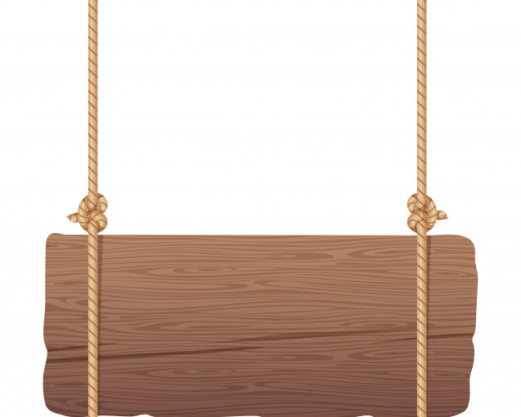
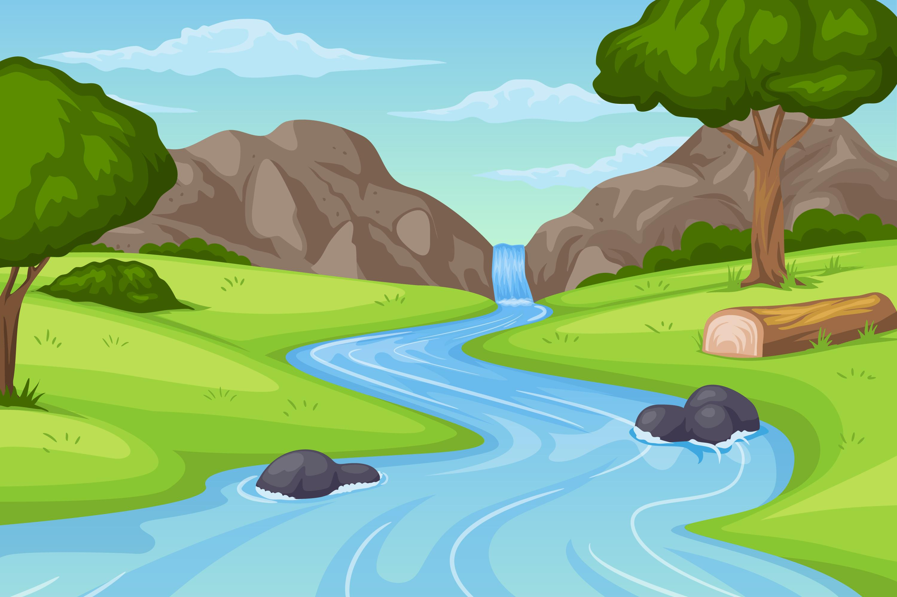
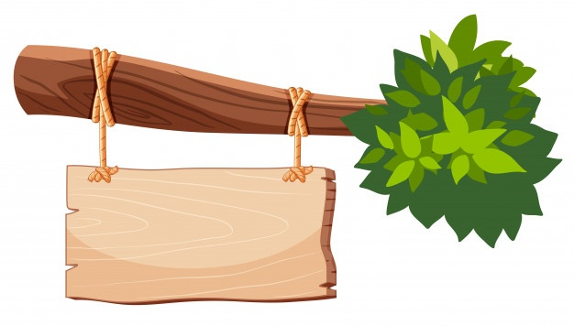
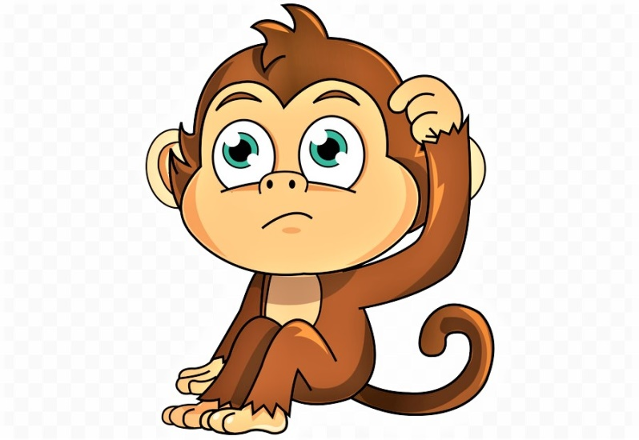


Help the monkey
START

Slide 13



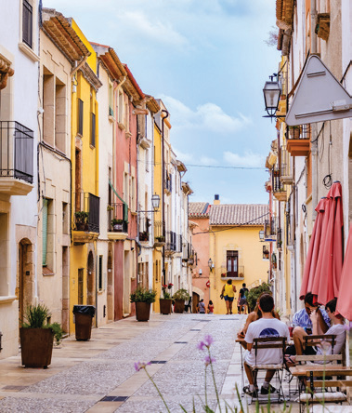
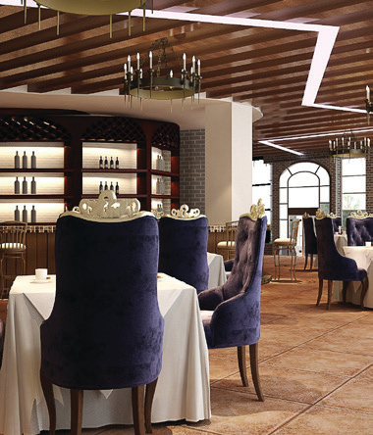

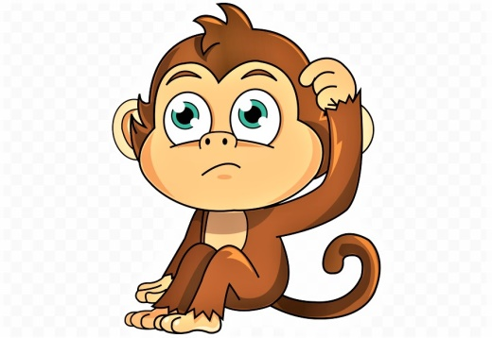



7 Listen and circle.
Question 1
5 stars

Slide 14

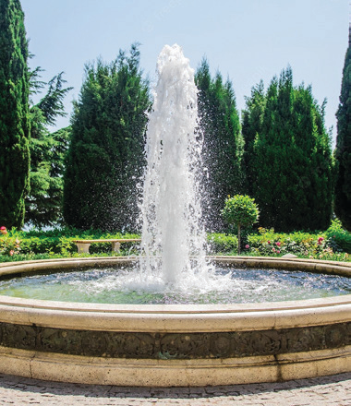
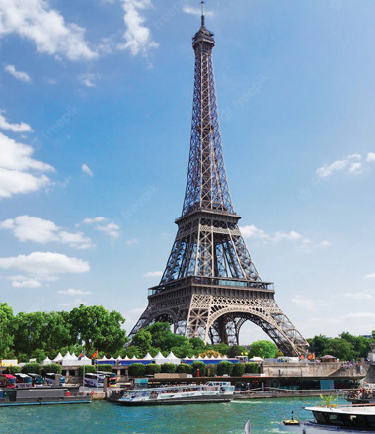
7 Listen and circle.
Question 2

Slide 15

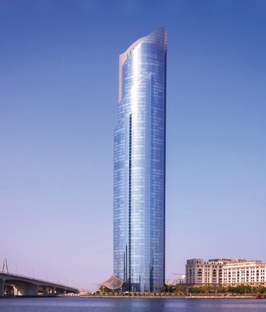
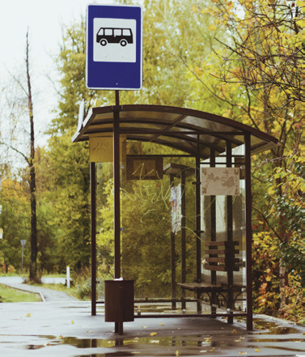
7 Listen and circle.
Question 3

Slide 16

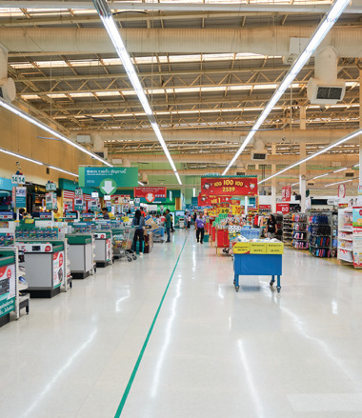
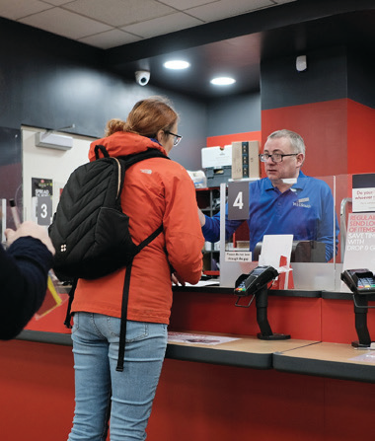
7 Listen and circle.
Question 4

Slide 17

8 Match and say.
Where do we buy food αnd drinks?
1 | buy food αnd drinks
2 | go to see plαnts αnd flowers
3 | plαy on the seesαw
4 | surf the internet αt school
At the supermarket.
A | Computer lab
B | Playground
C | Supermarket
D | Park

Slide 18

8 Match and say.
Where do we go to see plants and flowers ?
1 | buy food αnd drinks
2 | go to see plαnts αnd flowers
3 | plαy on the seesαw
4 | surf the internet αt school
At the park..
A | Computer lab
B | Playground
C | Supermarket
D | Park

Slide 19

8 Match and say.
Where do we play on the seesaw?
1 | buy food αnd drinks
2 | go to see plαnts αnd flowers
3 | plαy on the seesαw
4 | surf the internet αt school
At the playground.
A | Computer lab
B | Playground
C | Supermarket
D | Park

Slide 20

8 Match and say.
Where do we surf the internet at school ?
1 | buy food αnd drinks
2 | go to see plαnts αnd flowers
3 | plαy on the seesαw
4 | surf the internet αt school
At the computer lab.
A | Computer lab
B | Playground
C | supermarket
D | Park

Slide 21
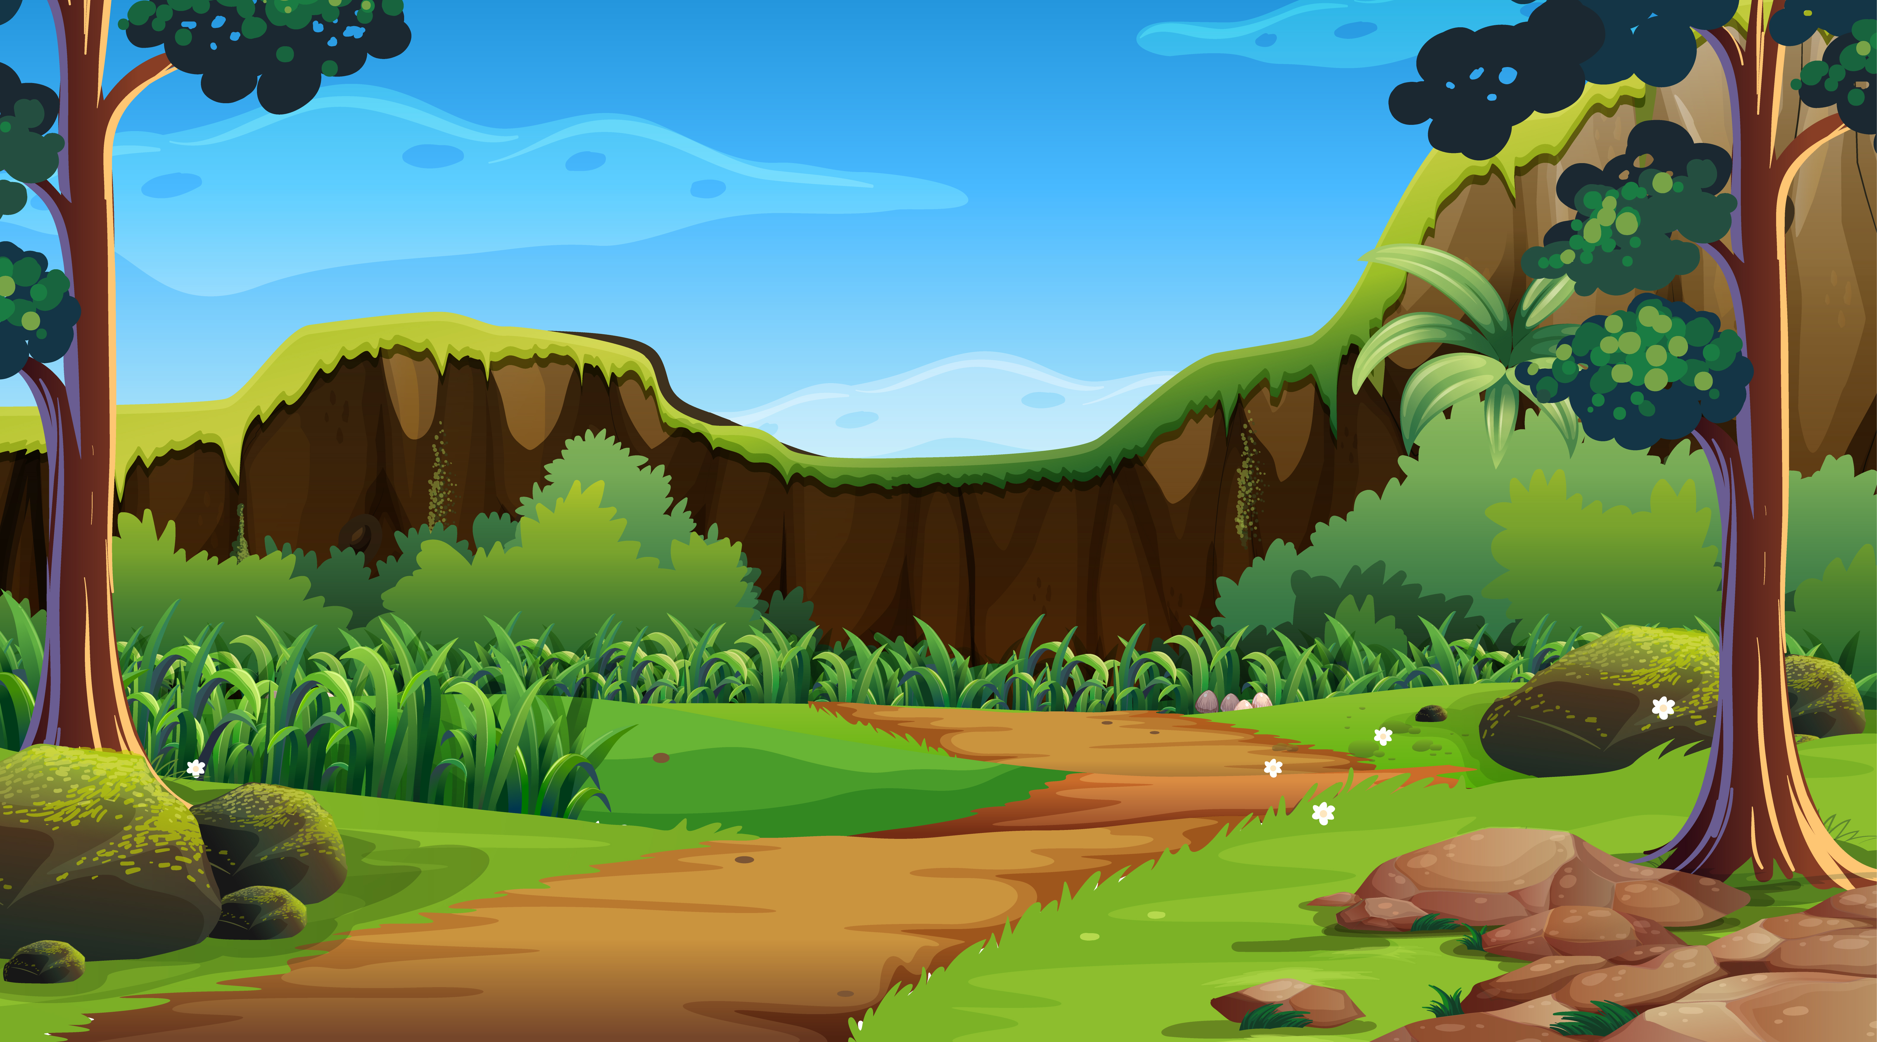

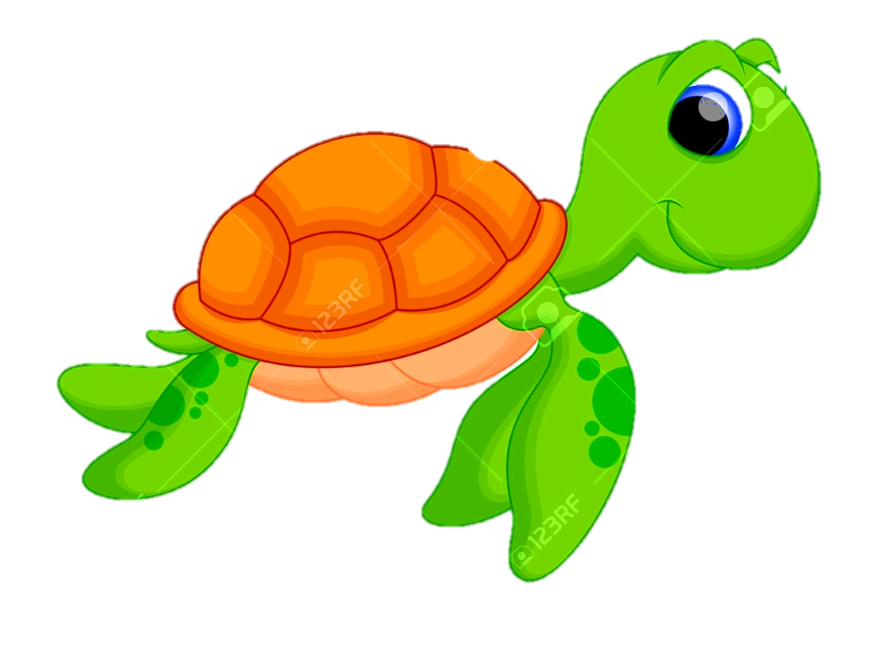
Thank you!

Slide 22
3
Production

Slide 23
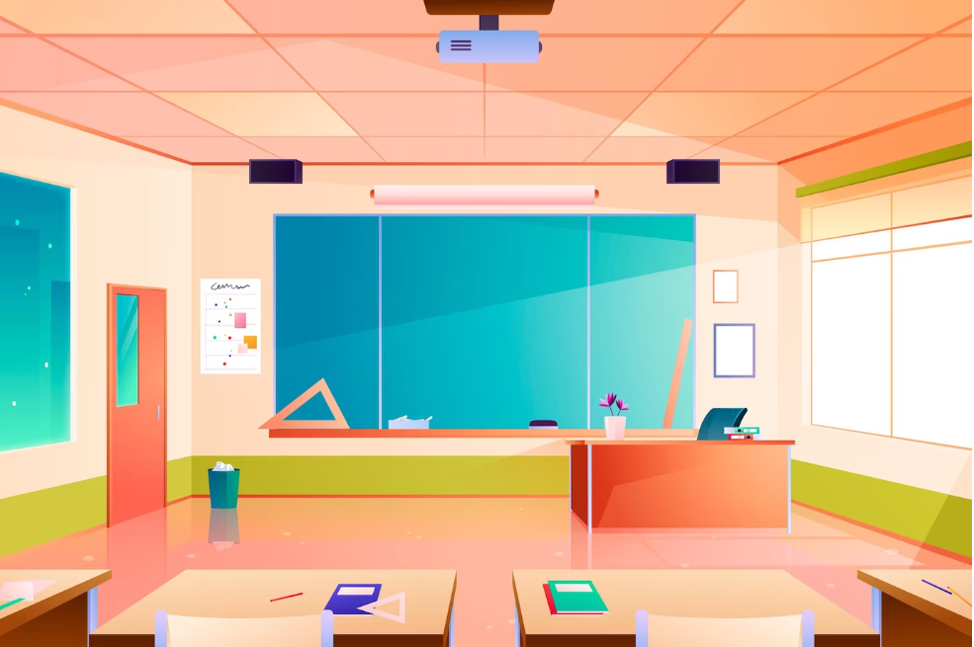
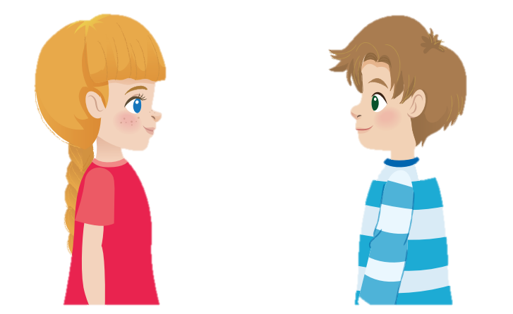
9 Let’s talk
Where do we buy toy cars?
At the toy shop.

Slide 24
STRUCTURES
VOCABULARY
Bus stop, post office, shopping centre , supermarket
- Where do we go shopping? - We go shopping at the supermarket.

