Slide 1




Unit 8 - Lesson 3 – Period 2

Slide 2











1 Warm-up
Unscramble the word

Slide 3



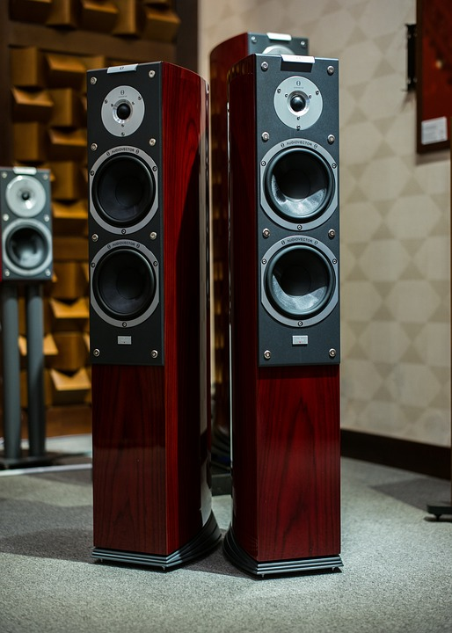

Question 1
SPEAKER
Reorder the letters to make the correct word.
SKEPAER
Answer
Next

Slide 4

Question 2
Reorder the letters to make the correct word.
PROJECTOR
PORJETCOR
Answer
Next

Slide 5

Question 3
COMPUTER
Reorder the letters to make the correct word.
COPUMTRE
Answer
Next

Slide 6
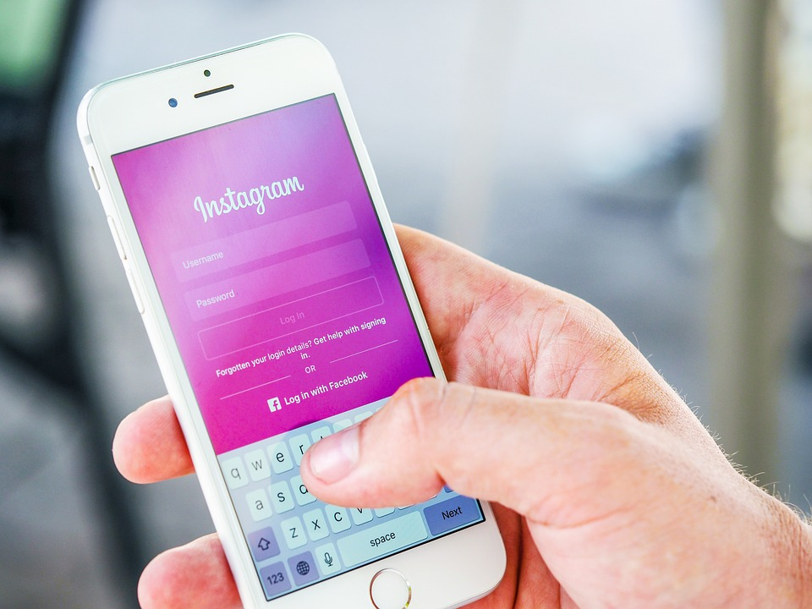
Question 4
PASSWORD
Reorder the letters to make the correct word.
PSSAOWRD
Answer
Next

Slide 7
2 Presentation
Task 4 Listen and repeat.

Slide 8



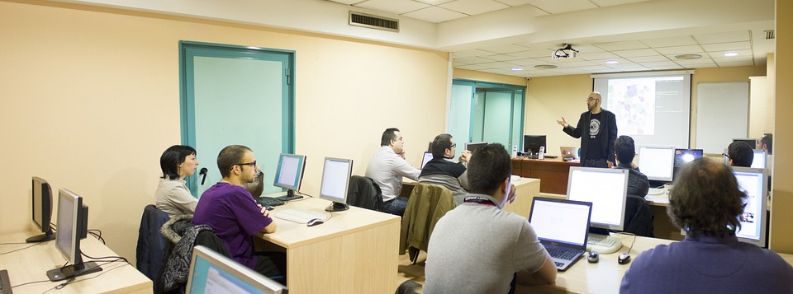



4
Listen and repeat.
1. Who can use the computer lab?
-Teachers and students can.

Slide 9
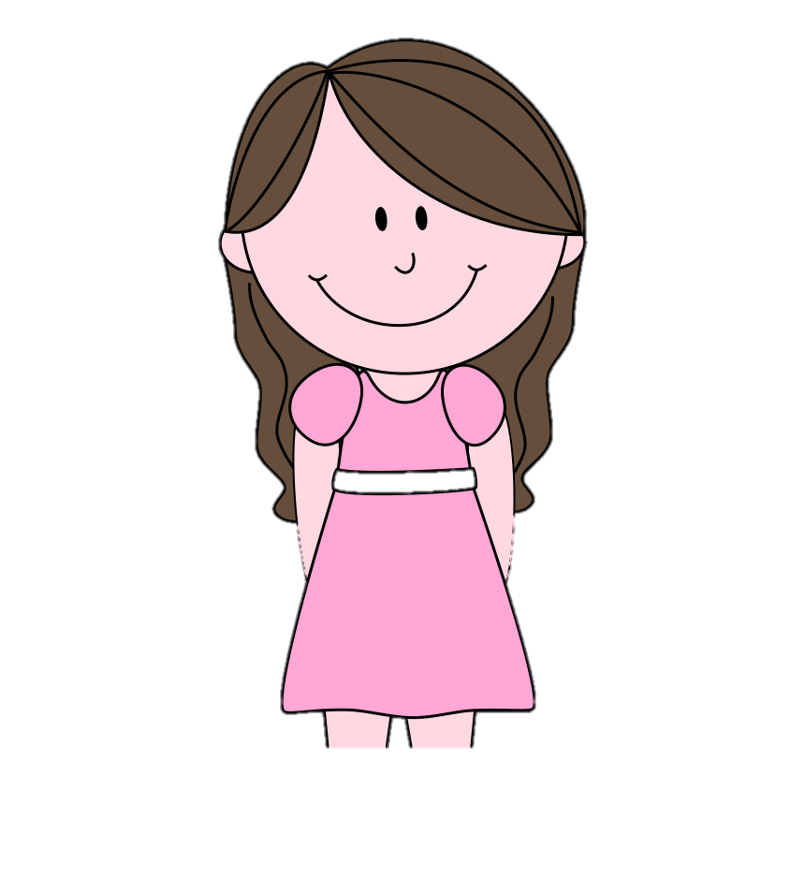
2. Who can change the password?
Teachers can.

Slide 10
3 Practice
Task 5 Match.
Ask and answer

Slide 11

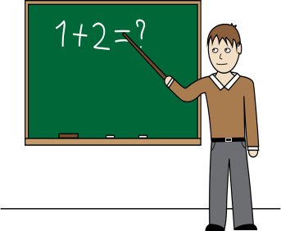


Teachers
Students
Use the speaker
Use the projector
Change the password
Use the speaker
Use the projector
Use the computer lab
Make phone calls
Surf the Internet
Use the computer lab

Slide 12




5
Match. Ask and answer.
1. Use the computer lab
Who can use the computer lab?
Teachers and students can.

Slide 13
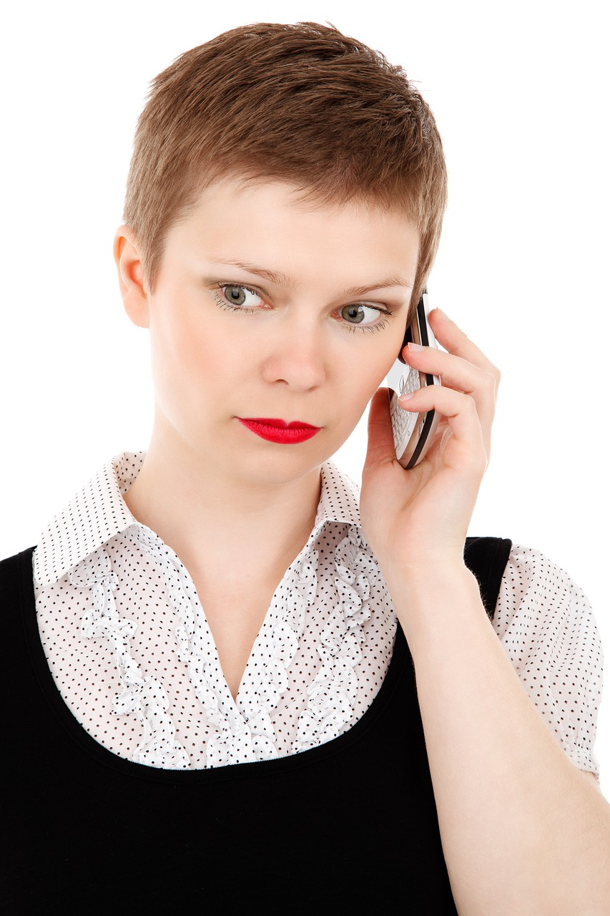
2. Make phone calls
Teachers can.
Who can make phone calls?

Slide 14
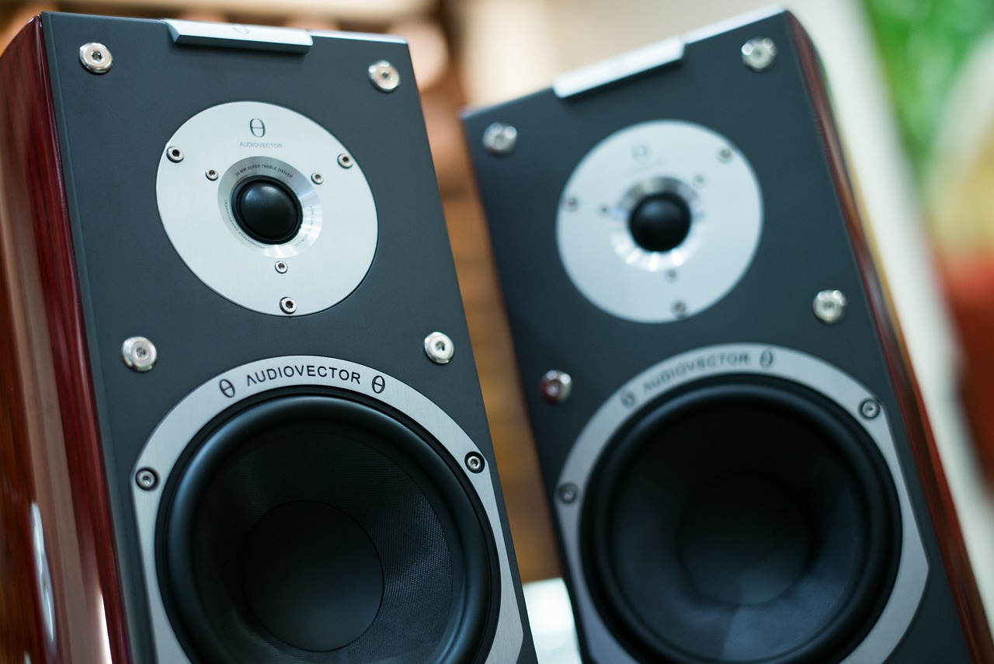
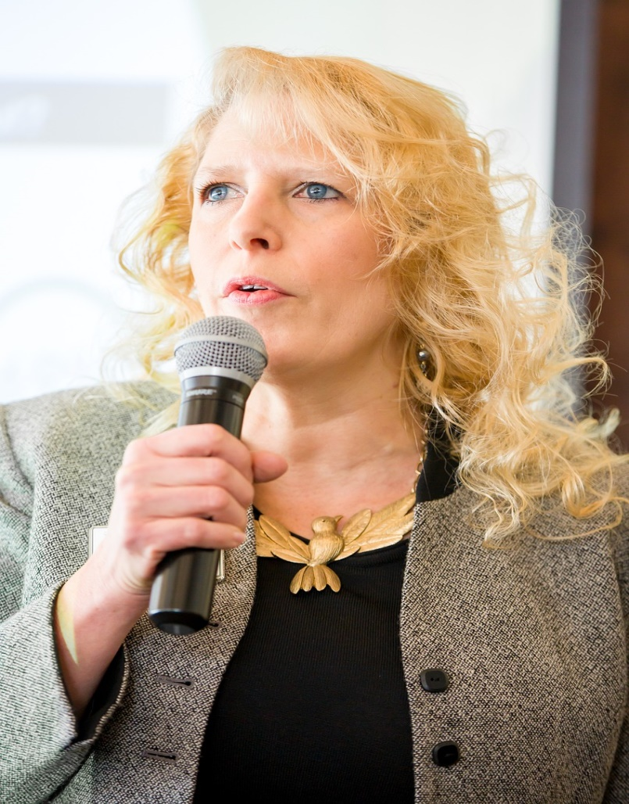


3. Use the speaker
Who can use the speaker?
Teachers and students can.

Slide 15
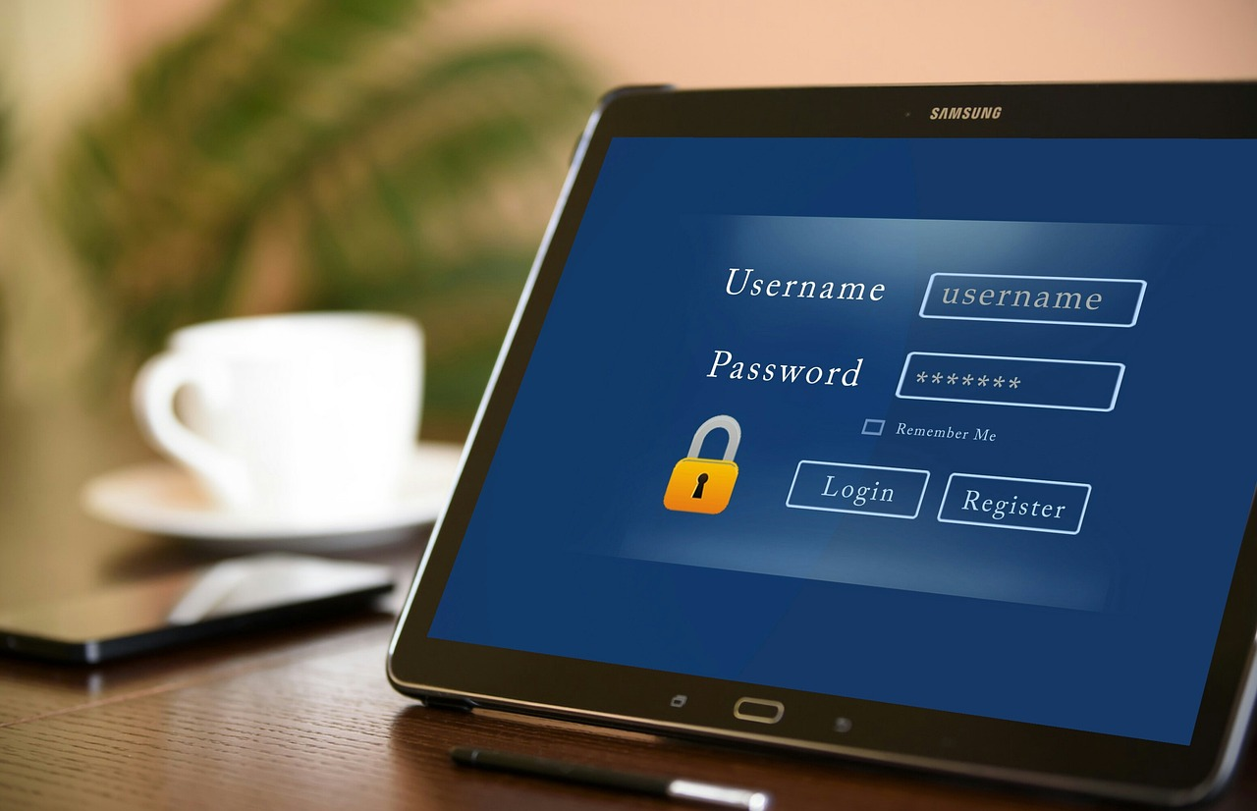
4 Change the password
Teachers can.
Who can change the password?

Slide 16

5. Use the projector
Who can use the projector?
Teachers and students can.

Slide 17

5. Surf the Internet
Who can surf the Internet?
Teachers can.

Slide 18


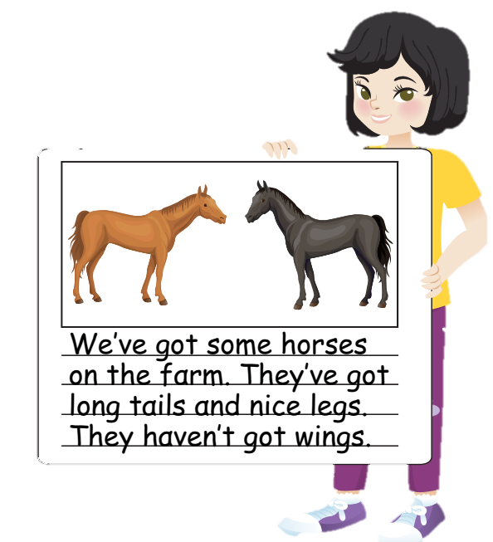


Let’s talk
We can …
We can’t …
✔
❌
We can use the speaker in the class.
We can’t use smartphone in class.

Slide 19
6 Wrap up

Slide 20

REMEMBER
VOCABULARY:
Use the computer lab
Use the speaker
Use the projector
Change the password
STRUCTURE:
We can …
We can’t …

