Slide 1




Unit 8 - Lesson 2 – Period 2

Slide 2

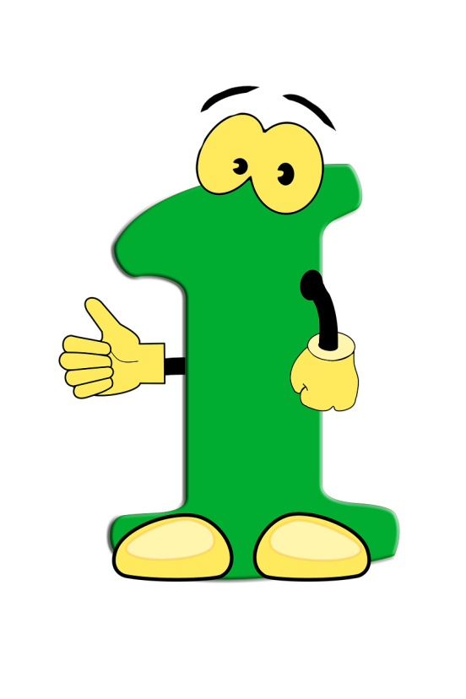

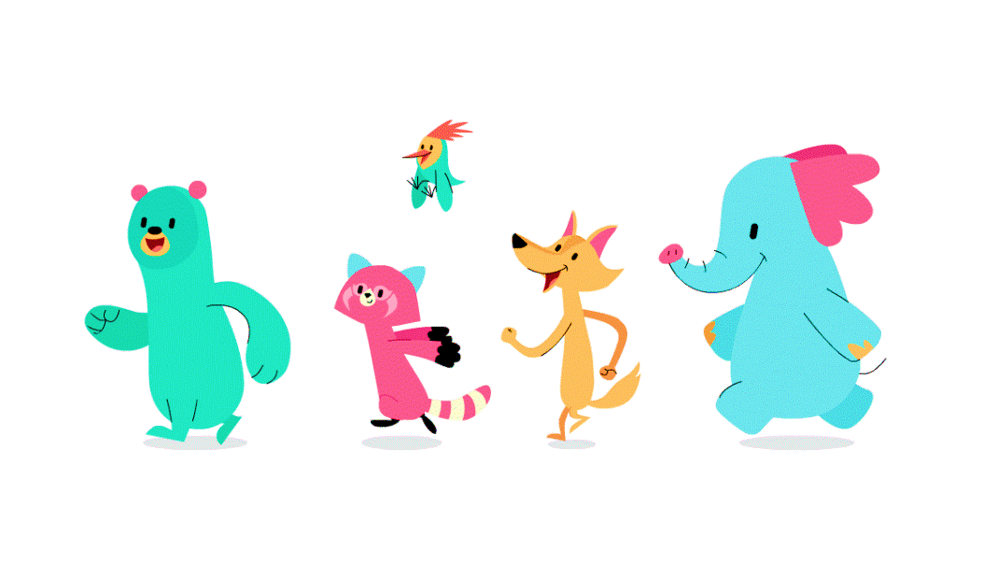


Warm up

Slide 3

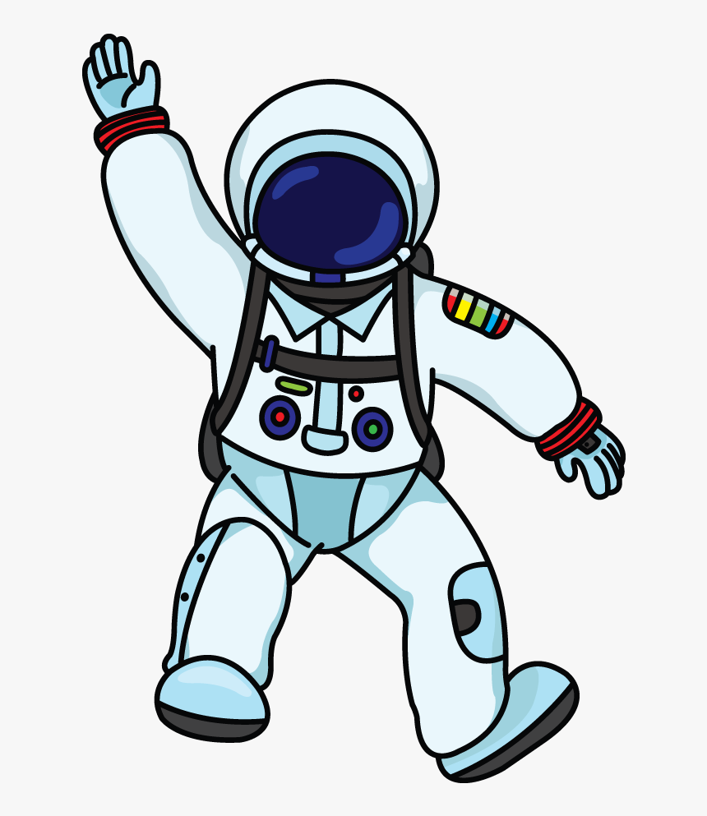



2
1
LUCKY STAR
3
4
Next
Notes:
Hs chọn số, trả lời câu hỏi để nhận điểm

Slide 4

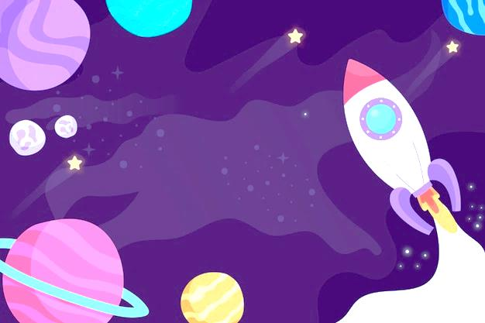
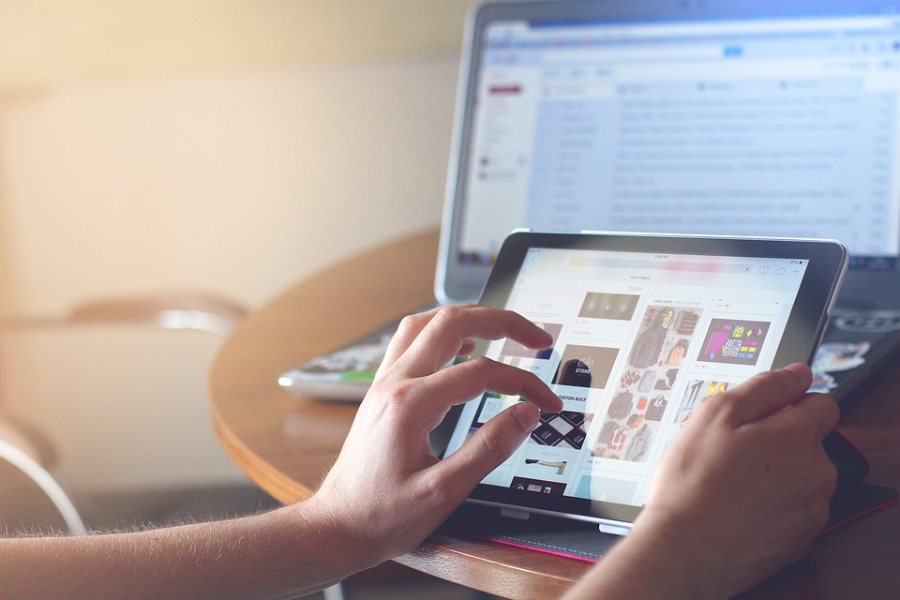

He____ uses the tablet.
never
sometimes
always
often
3
GO HOME

Slide 5
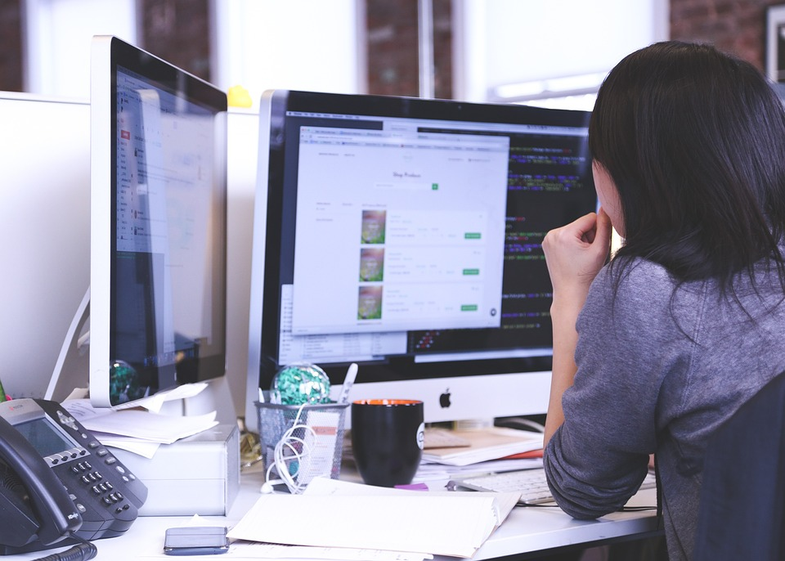
I sometimes________.
surf the Internet.
watch TV.
make videos.
write emails.
5
GO HOME

Slide 6
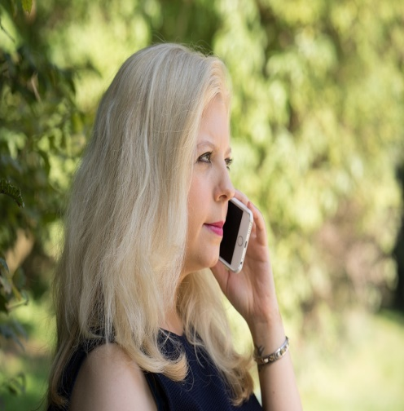
My dad makes phone calls.
True.
False.
5
GO HOME

Slide 7
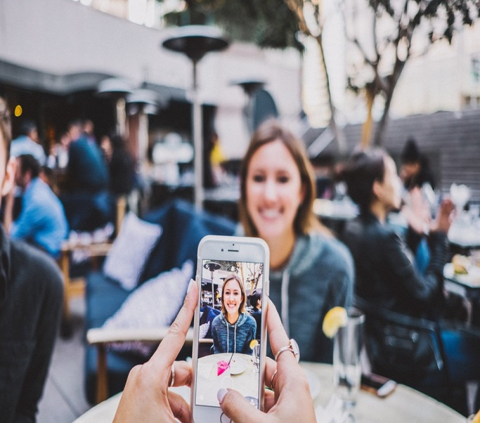
We can take photos on smart phones.
True.
False.
8
GO HOME

Slide 8

Presentation
4
Listen and repeat.

Slide 9


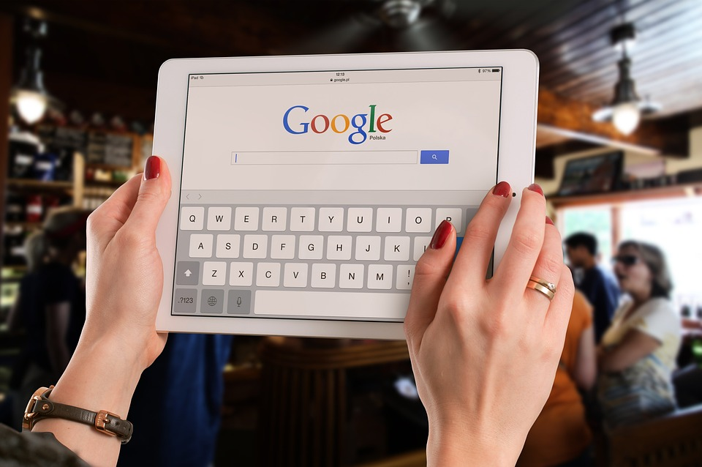
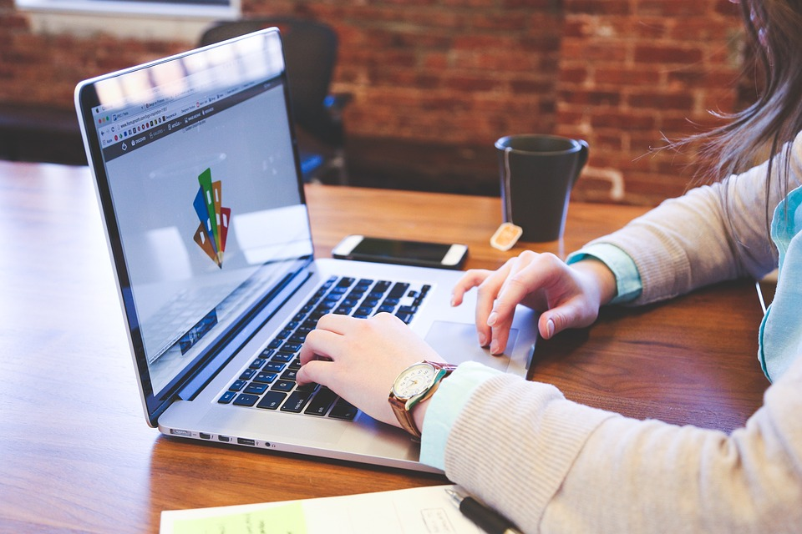
4
Listen and repeat.
2. Teacher, can we surf the Internet?
- No, you can’t.
✔
1. Teacher, can we use the tablet?
❌
- Yes, you can.

Slide 10

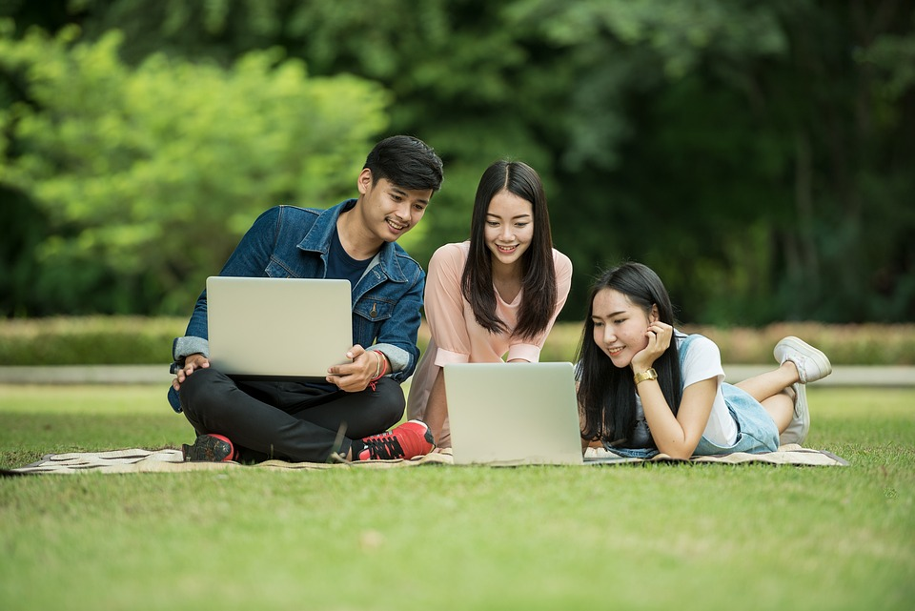
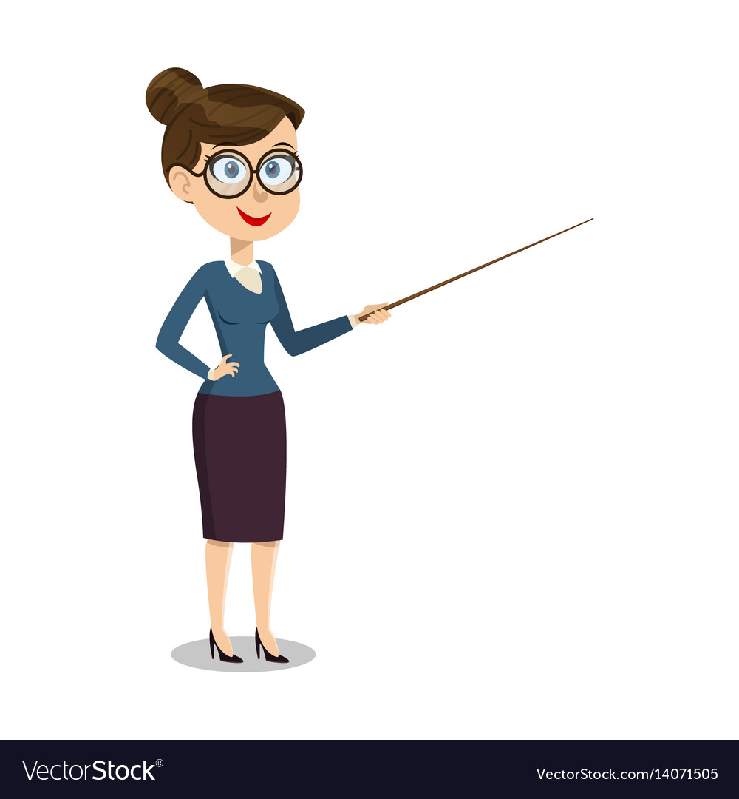


5
Look. Ask and answer.
Work in groups
✔
Teacher, can we work in groups?
Yes, you can.

Slide 11

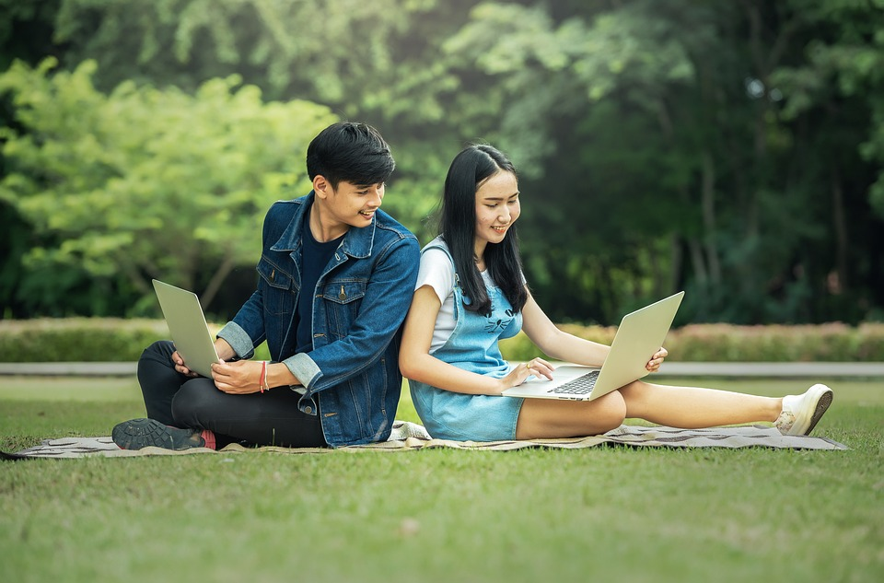

Work in pairs
✔
Teacher, can we work in pairs?
Yes, you can.

Slide 12
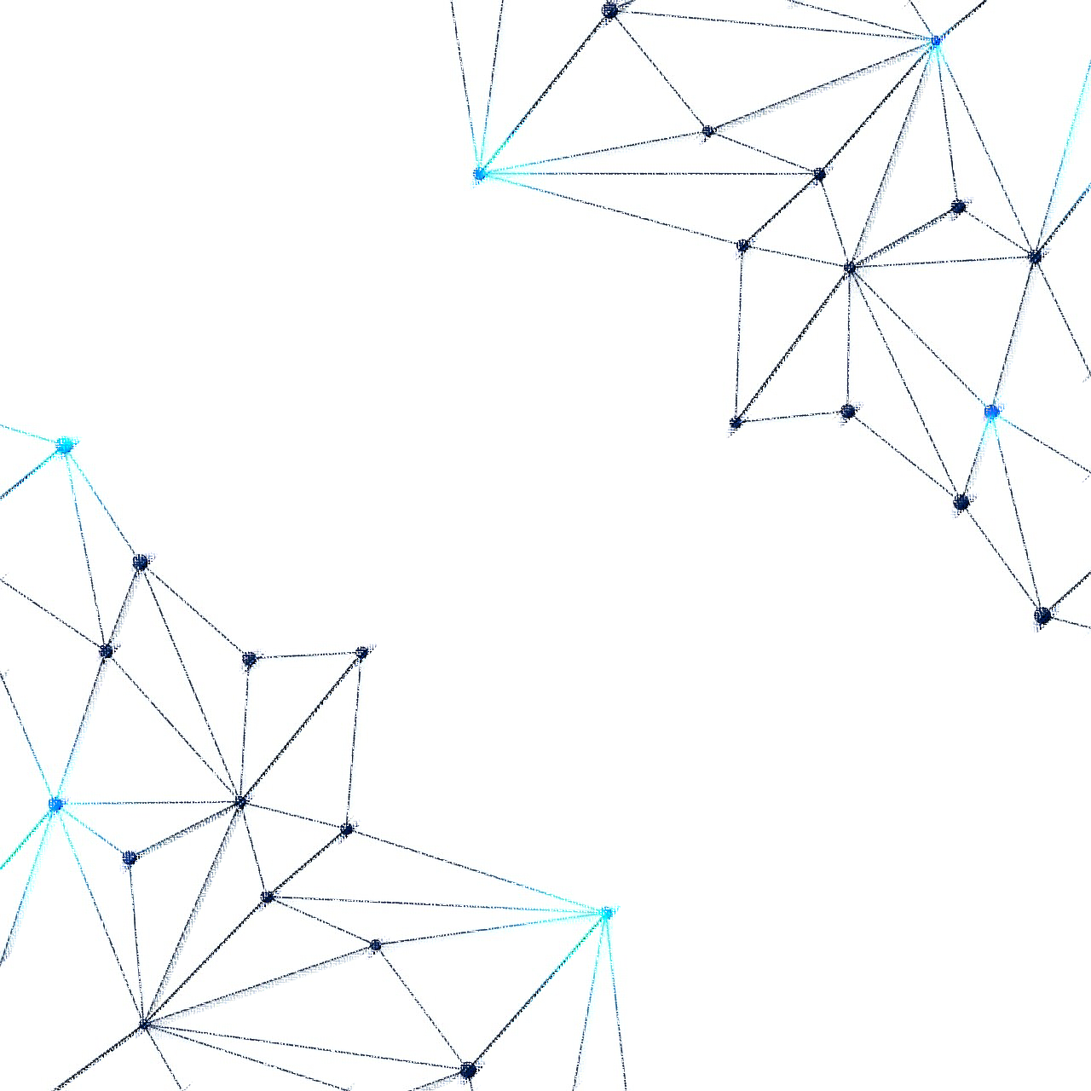
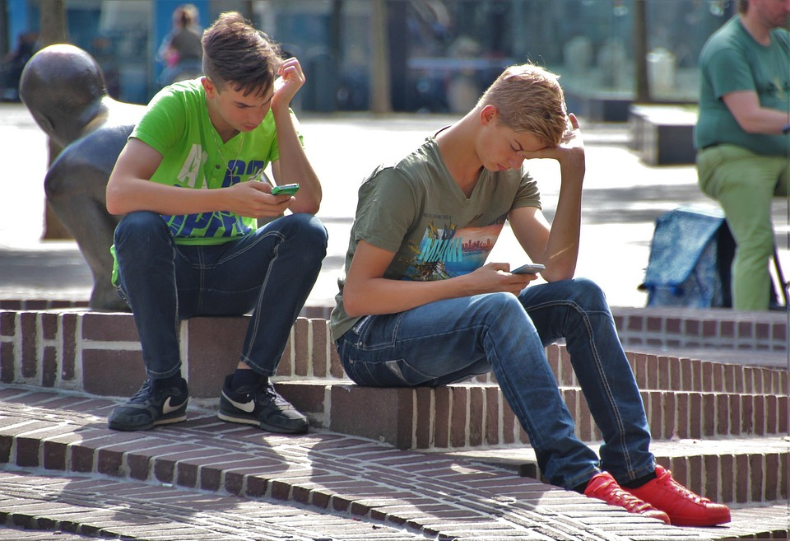
Use our smartphones
❌
Teacher, can we use our smartphones?
No, you can’t.

Slide 13

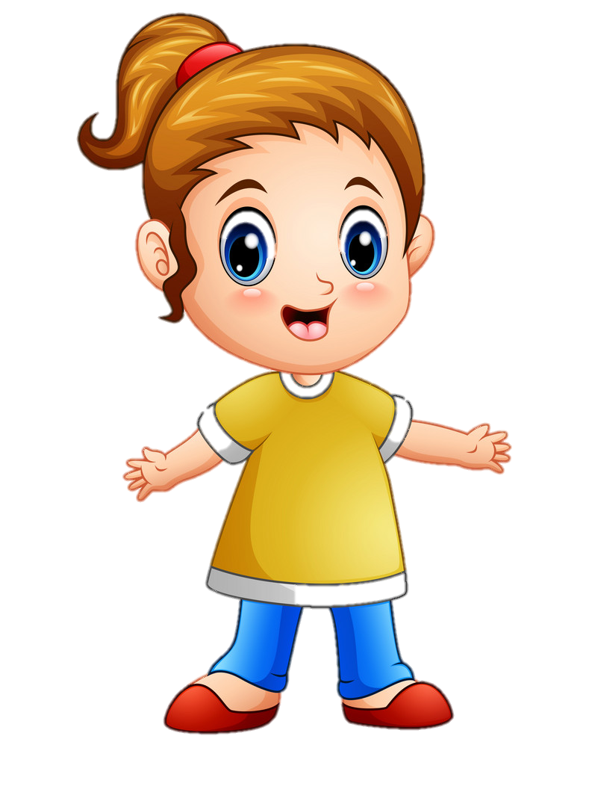
❌
Surf the Internet
Teacher, can we surf the Internet?
No, you can’t.

Slide 14
Use the tablet
❌
Teacher, can we use the tablet?
No, you can’t.

Slide 15

Production
6
Listen and chant.

Slide 16
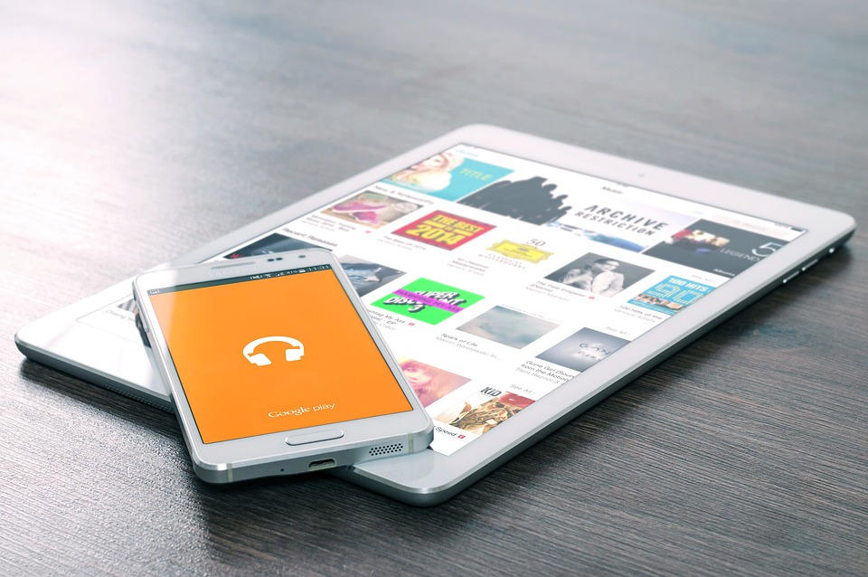


Tablet, tablet, tablet.
Can we use the tablet
in class?
Yes, you can.
Yes, you can.
Phone, phone, phone.
Can we use the phone in class?
No, you can’t.
No, you can’t.
16

Slide 17


Assessment

Slide 18
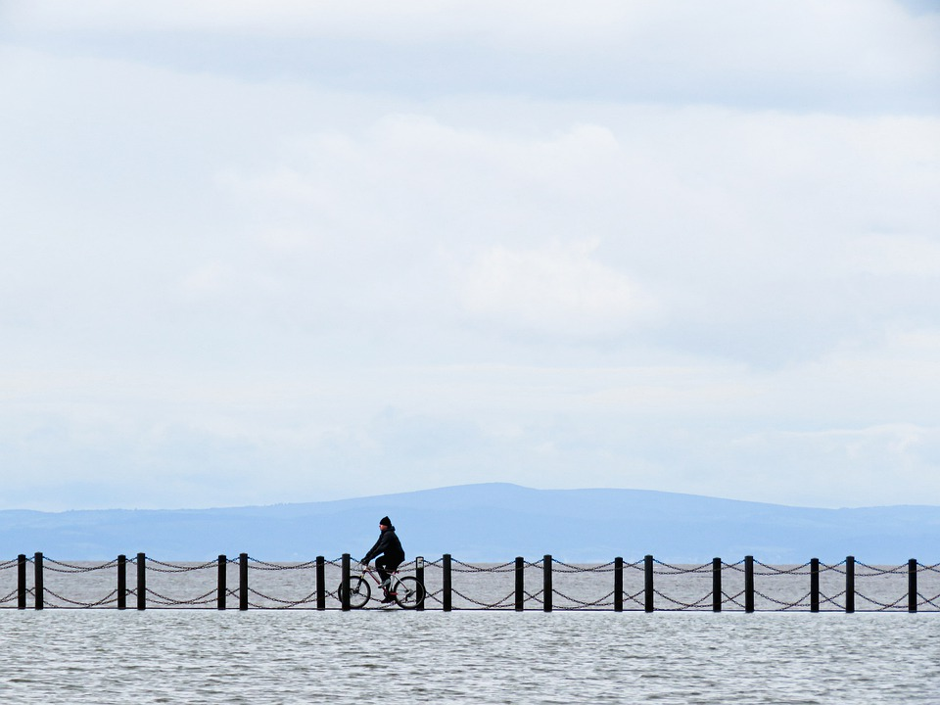
Order the words to make complete sentences
1. Can/use/the/we/phone/in/class?
Can we use the phone in class?
_________________________
2. He/emails/writes/sometimes/on/his/phone.
_______________________________
He sometimes writes emails on his phone.
3. We/can/the/Internet/surf.
We can surf the Internet.
____________________
4. Teacher,/we/take/can/photos?
Teacher, can we take photos?
_____________________

Slide 19
6 Wrap up

Slide 20
REMEMBER
VOCABULARY:
Surf the Internet
Use the tablet
Use the phone
STRUCTURE:
Teacher, can we use the tablet?
-Yes, you can.
-No, you can’t.
20

Slide 21




Thank you & goodbye!

