Slide 1


















Unit 8 - Lesson 1 – Period 1

Slide 2
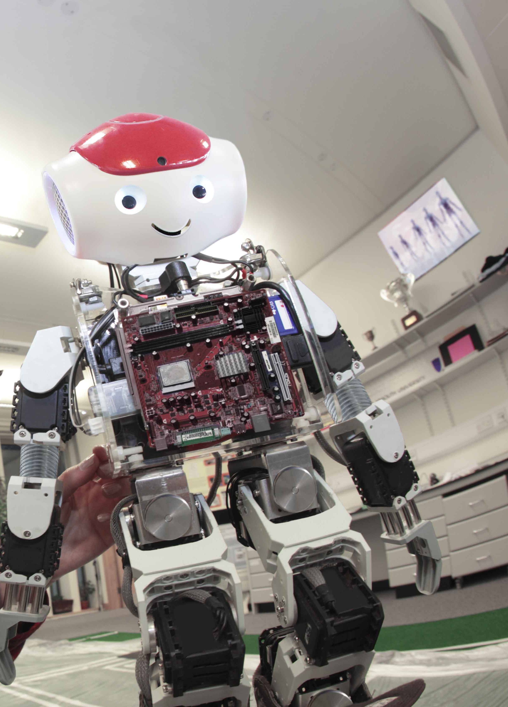

Look at the photo. Tick the body part that the robot hasn’t got.
legs
eyes
✔
✔
wings
hands

Slide 3
2 Presentation
Task 1 Listen and point.
Notes:
Dấu câu

Slide 4


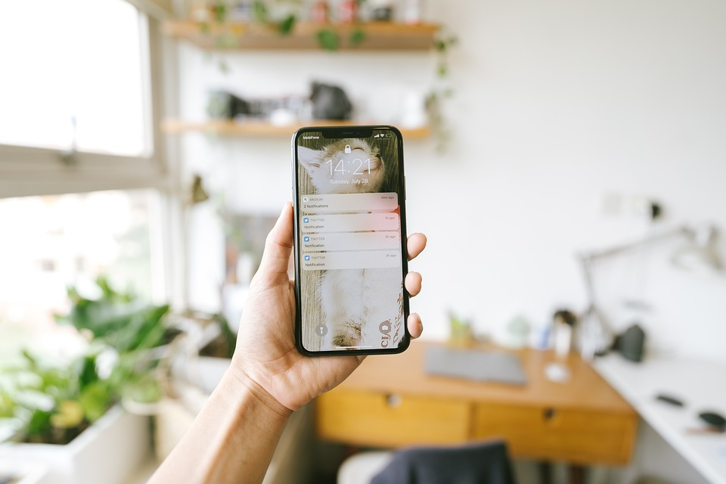

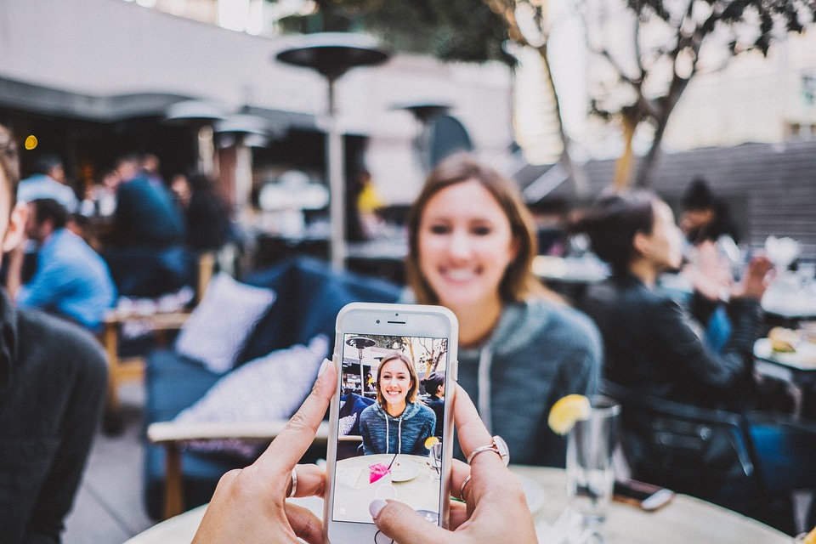
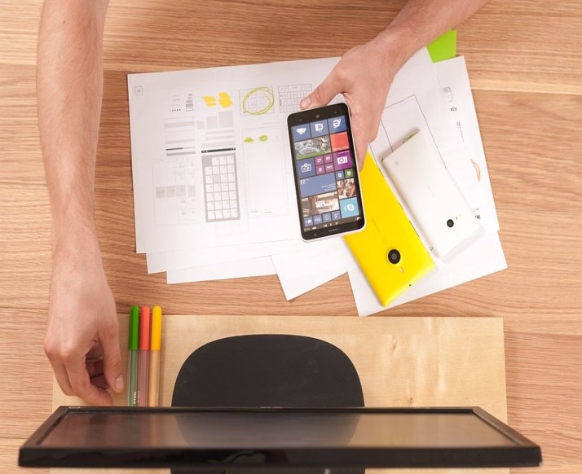
1 Listen and point. Repeat.
Make phone calls
Write emails
Smartphone
Make videos

Slide 5




2
Listen and read. Write.
It’s my new smartphone.
Whose phone is it? It’s nice!
Linh
Luna
Wow! What can you do on your smartphone?

Slide 6



3
Look. Ask and answer
What can we
do on a
smartphone/ computer?

Slide 7


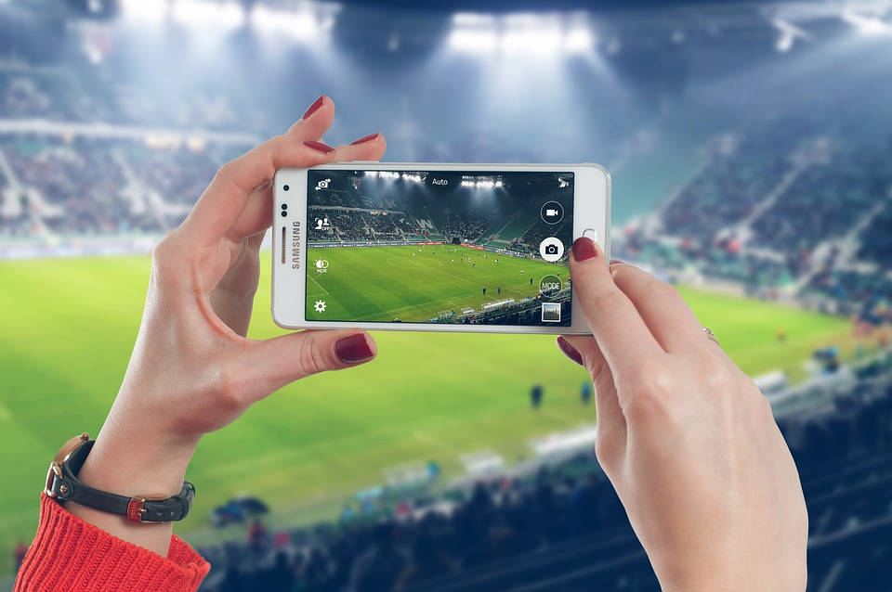
3
Look. Ask and answer.
We can
take photos.
What can we do on a smartphone?
BACK

Slide 8

3
Look. Ask and answer.
We can
learn English.
What can we do on a computer?
BACK

Slide 9
3
Look. Ask and answer.
We can make
phone calls.
What can we do on a smartphone?
BACK

Slide 10

3
Look. Ask and answer.
We can make
videos.
What can we do on a computer?
BACK

Slide 11
4 Production
Notes:
Xem video và thực hành gấp giấy tạo hình điện thoại

Slide 12






Matching Game
Take photos
Learn English
1
4
Smart phone
2
Write emails
Make phone calls
3
5

Slide 13
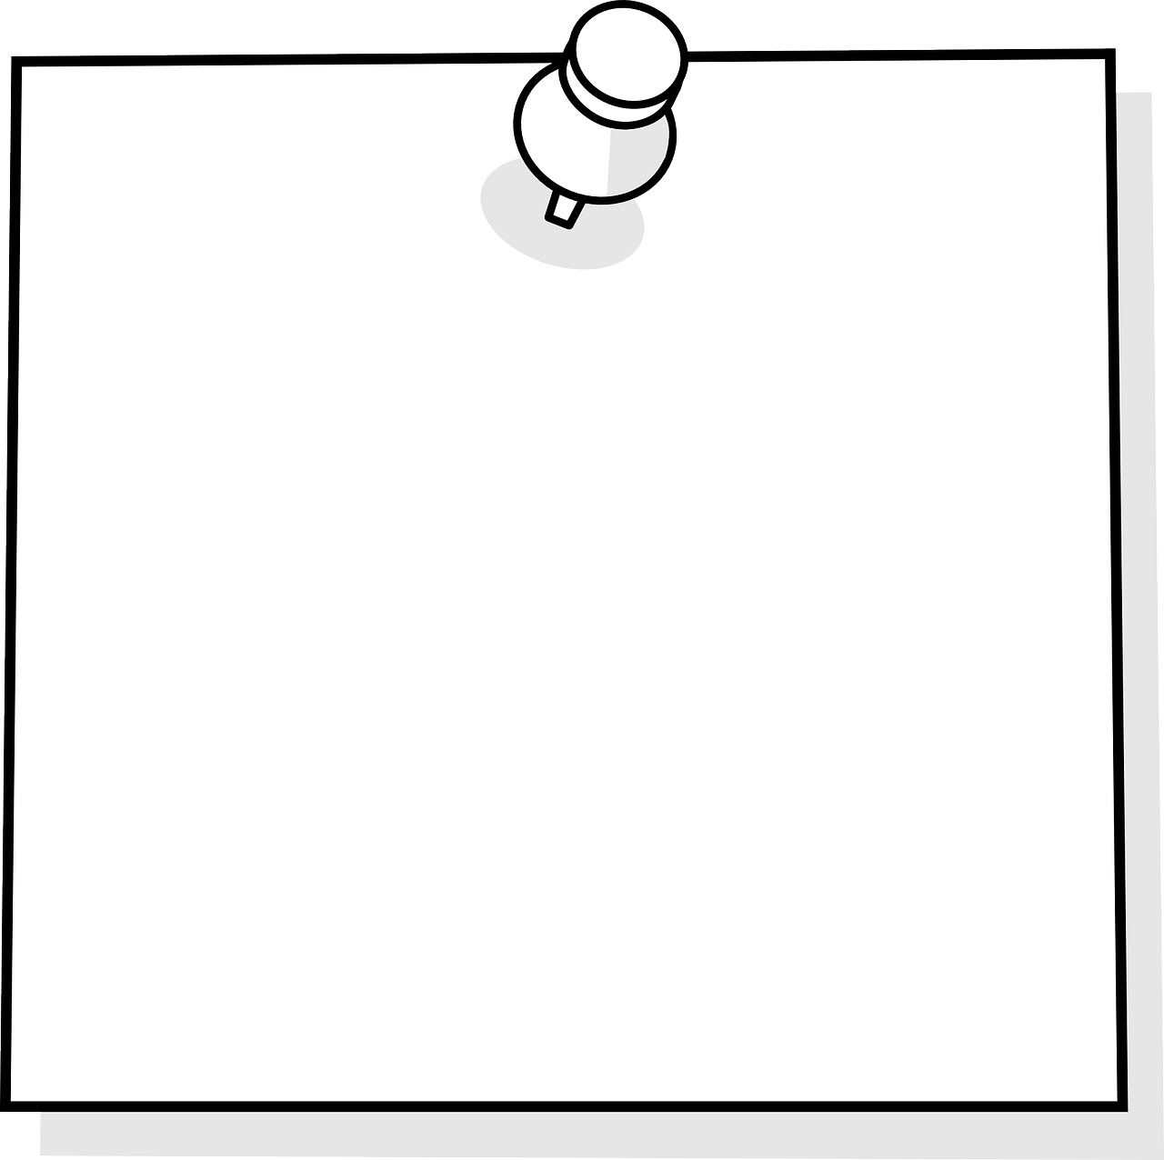
Vocabulary
Smartphone: Điện thoại thông minh
Make phone calls: Gọi điện
Make videos: Quay video
Take photos: Chụp ảnh
Learn English: học tiếng Anh
Write emails: Viết mail
Structure
I/we/they + can + V: có thể làm gì.

Slide 14




Thank you
& goodbye!

