Slide 1


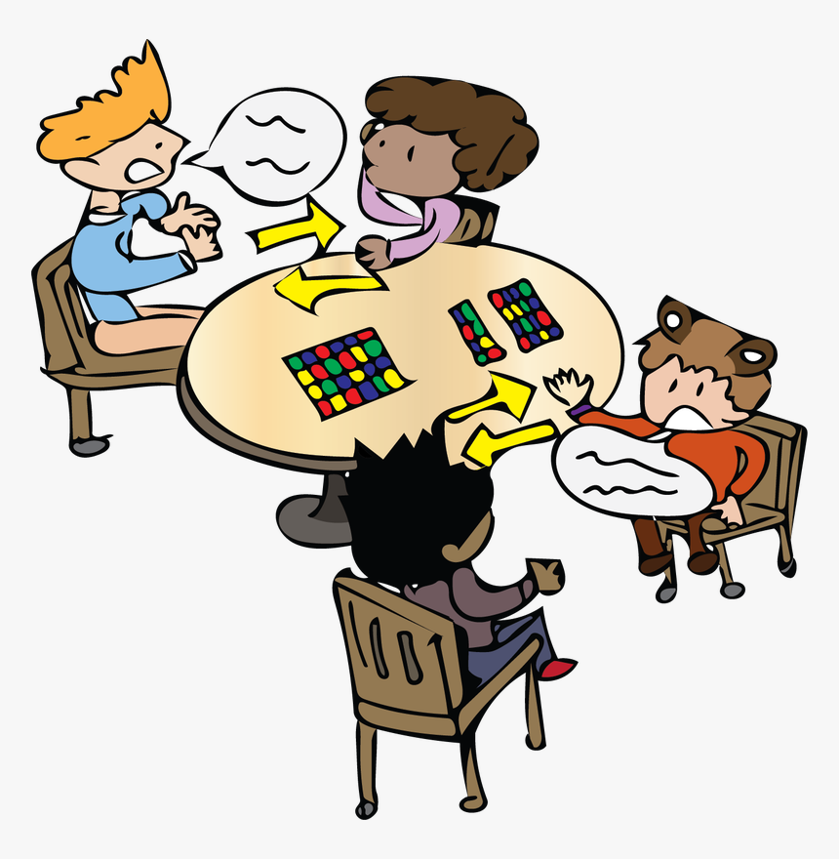
Unit
10
HOUSES IN THE FUTURE
LESSON 4: COMMUNICATION
1

Slide 2
LESSON 4: COMMUNICATION
LESSON 1: GETTING STARTED
WARM-UP
Game: BINGO
Task 1: Listen and read the conversations.
Task 2: Express your surprise.
EVERYDAY ENGLISH
Task 3: Read and tick.
Task 4: Interview your partner.
Task 5: Mini presentation.
HOUSES AND APPLIANCES IN THE FUTURE
CONSOLIDATION
Wrap-up
Homework

Slide 3
WARM-UP
- Make a table
- Fill out with household appliances.
WASHING
MACHINE
DISH
WASHER
SMART TV
BINGO
…

Slide 4

EVERYDAY ENGLISH
1
1
Listen and read the conversation.
DAVID | John! Hello!
JOHN | Oh, hi, David. Wow! Is that your computer? It looks great.
DAVID | Yes, it’s my new computer. My parents gave it to me for my birthday.
Oh, hi, David. Wow! Is that your computer? It looks great.
Point out the expressions of surprise
1. Wow! Is that + object?
2. It looks + adjective.

Slide 5



EVERYDAY ENGLISH
2
Express your surprise when you see your partner’s new watch, TV, mobile phone, etc.
Work in pairs.
3 mins
Express your surprise when you see your partner’s new watch, TV, mobile phone, etc.
Student A
Show new things
take turns
Student B
Express surprise

Slide 6


Wow! Is that your new watch? It’s really beautiful!
Designed by Jessica Lee

Slide 7
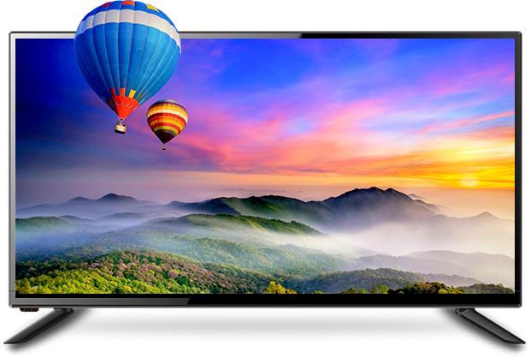
Look! You have a new TV, don’t you? It’s so amazing!
Designed by Jessica Lee

Slide 8
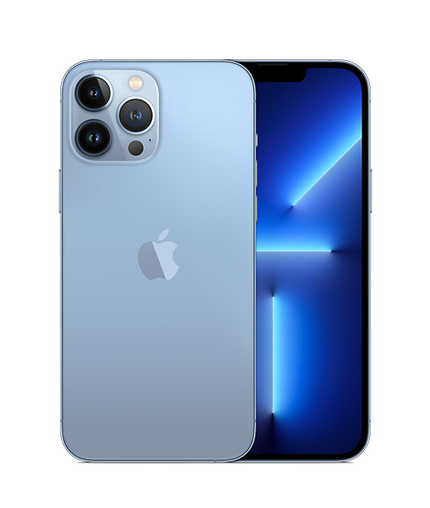
Wow! Look at this mobile phone! It’s fantastic!
Designed by Jessica Lee

Slide 9
HOUSES AND APPLIANCES IN THE FUTURE
3
Read the questions in the class survey below. Tick (√) Y (Yes) or N (No).
Questions | Y | N
1. Will you live in a hi-tech house?
2. Will your house be in space?
3. Will you have a lot of trees and flowers around your house?
4. Will you have a fridge that can cook your meals?
5. Will you have a robot that can look after your children?
6. Will you have a car that can fly?

Slide 10

HOUSES AND APPLIANCES IN THE FUTURE
4
Use the questions in Task 3 to interview your partner.
Example
You | Hi, Nam. Will you live in a hi-tech house in the future?
Nam | Yes, I will.
You | Will your house be in space?
Nam | Oh, no. It won’t.
You | So where will it be?
Nam | I’m not sure. It might be by the sea.

Slide 11
HOUSES AND APPLIANCES IN THE FUTURE
5
Tell the class about your interview.
Hello. I’d like to tell you about Nam’s house and appliances that will help him to do things in his house. His future house will be a UFO. It’ll be in space. He might have a robot to help him with his home. Thank you for listening.
Checking
Is the pronunciation correct?
Is the tense correct?
Is it full of ideas?

Slide 12

CONSOLIDATION
1
Wrap-up
What have we learnt in this lesson?
Everyday English: Expressing surprise
Do a survey

Slide 13

CONSOLIDATION
2
Homework
Do exercises in the workbook.

Slide 14






Website: hoclieu.vn
Fanpage: facebook.com/www.tienganhglobalsuccess.vn/

