Slide 1



Unit
11
OUR GREENER WORLD
LESSON 2: A CLOSER LOOK 2

Slide 2
LESSON 2: A CLOSER LOOK 1
WARM-UP
Game: Describe a picture
Task 1: Write a or an.
Task 2: Write a/an or the.
ARTICLES
Task 3: Write the correct form.
Task 4: Combine the sentences.
FIRST CONDITIONAL
PRODUCTION
Game: Fun matching
CONSOLIDATION
Wrap-up
Homework

Slide 3
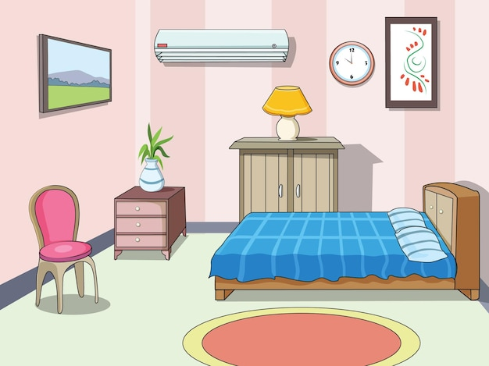
WARM-UP
GAME: DESCRIBE A PICTURE
Describe the picture using the structure “There is”
- There is a picture on the wall.
- There is an air-conditioner on the wall.
- There is a clock on the wall.
- There is a tree on the wardrobe.
- There is a chair near the wall.
- There is a bed in the room.
- There is a lamp on the table.

Slide 4
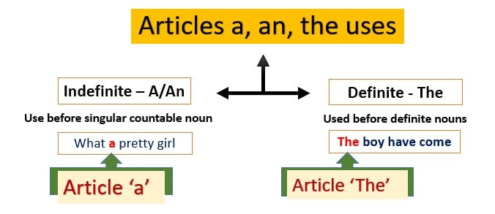


Slide 5
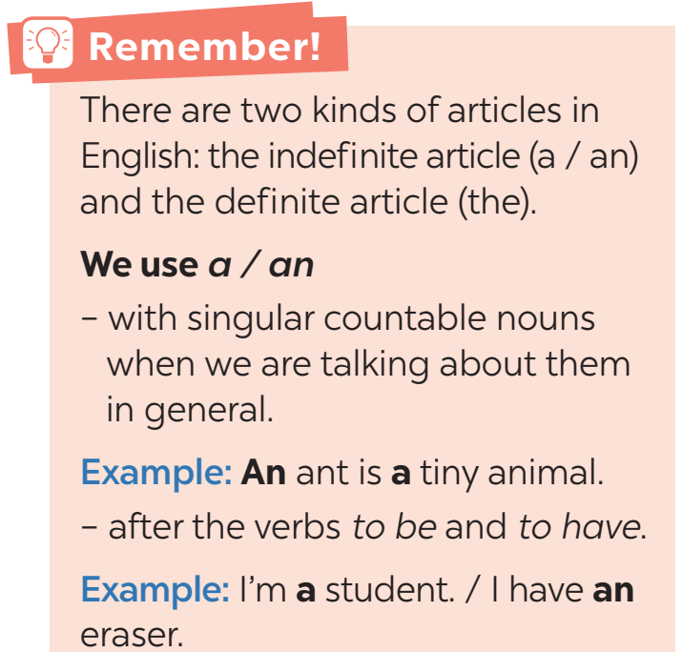
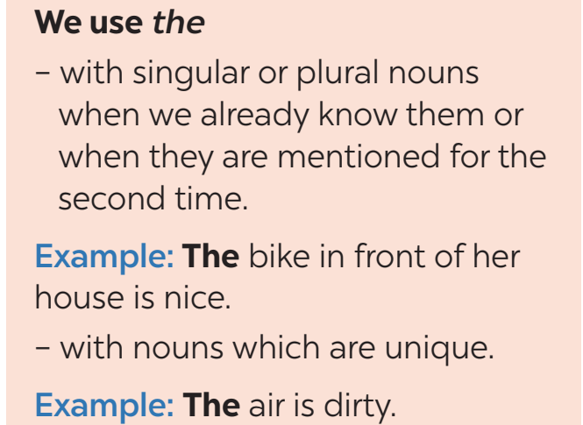
ARTICLES

Slide 6

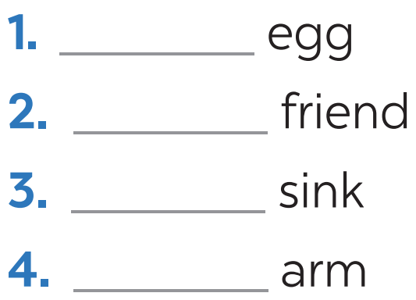
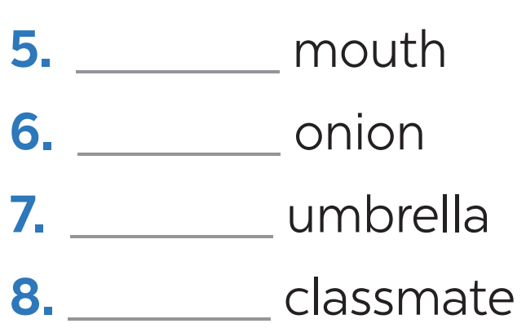
ARTICLES
Write a or an.
an
a
a
an
a
an
an
a

Slide 7

ARTICLES
Write a / an or the.
1. My father is _______ doctor.
2. _______ Sun keeps _______ Earth warm.
3. _______ dolphin is _______ intelligent animal.
4. I have _______ orange shirt too.
5. My brother likes _______ blue pen, not _______ red one.
a
The
the
A
an
an
the
the

Slide 8
FIRST CONDITIONAL
First conditional sentences describe things which are possible and likely to happen in the present or the future.
If + S + V (present simple),
If-clause
S + will / won’t + V (base form)
main clause
If you use less paper, you will save a lot of trees.
Example:

Slide 9

FIRST CONDITIONAL
Write the correct form of each verb in brackets.
is
1. If it (be) _______ sunny next week, we (go) _______ on a picnic.
2. If we (recycle) _______ more, we (help) _______ the Earth.
3. We (save) _______ a lot of trees if we (not waste) ____________ so much paper.
4. More people (have) ________ fresh water if we (use) _____ less water.
5. If the river (not be) ___________ dirty, there (be) _______ more fish.
will go
recycle
will help
will save
don’t waste
will have
use
isn’t / is not
will be

Slide 10

FIRST CONDITIONAL
Combine each pair of sentences below to make a first conditional sentence.
1.
The air isn’t fresh. People cough.
If the air isn't fresh, people will cough.
2.
The water is dirty. A lot of fish die.
If the water is dirty, a lot of fish will die.
3.
We cut down trees in the forest. There are more floods.
If we cut down trees in the forest, there will be more floods.

Slide 11
FIRST CONDITIONAL
Combine each pair of sentences below to make a first conditional sentence.
4.
There is too much noise. People don’t sleep.
If there is too much noise, people will not / won't sleep.
5.
There is no water. Plants die.
If there is no water, plants will die.

Slide 12


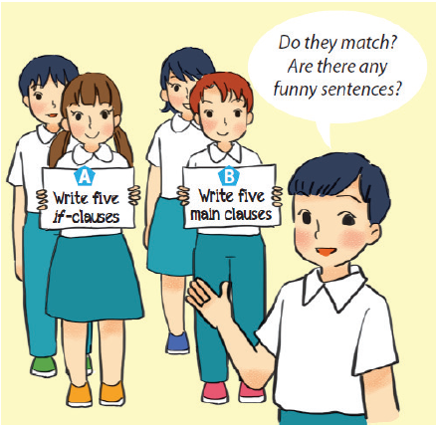
PRODUCTION
Fun matching
Work in groups, A and B.
Group A secretly writes five if-clauses on a sheet of paper.
Group B secretly writes five main clauses on another sheet of paper.
Match the if-clauses with the main clauses.
Do they match? Are there any funny sentences?

Slide 13

CONSOLIDATION
1
Wrap-up
What have we learnt in this lesson?
Grammar 1: Articles
Grammar 2: First conditional sentences

Slide 14

CONSOLIDATION
2
Homework
- Do exercises in the workbook.
- Make 3 sentences using the first conditional.

Slide 15






Website: hoclieu.vn
Fanpage: facebook.com/www.tienganhglobalsuccess.vn/

