Slide 1
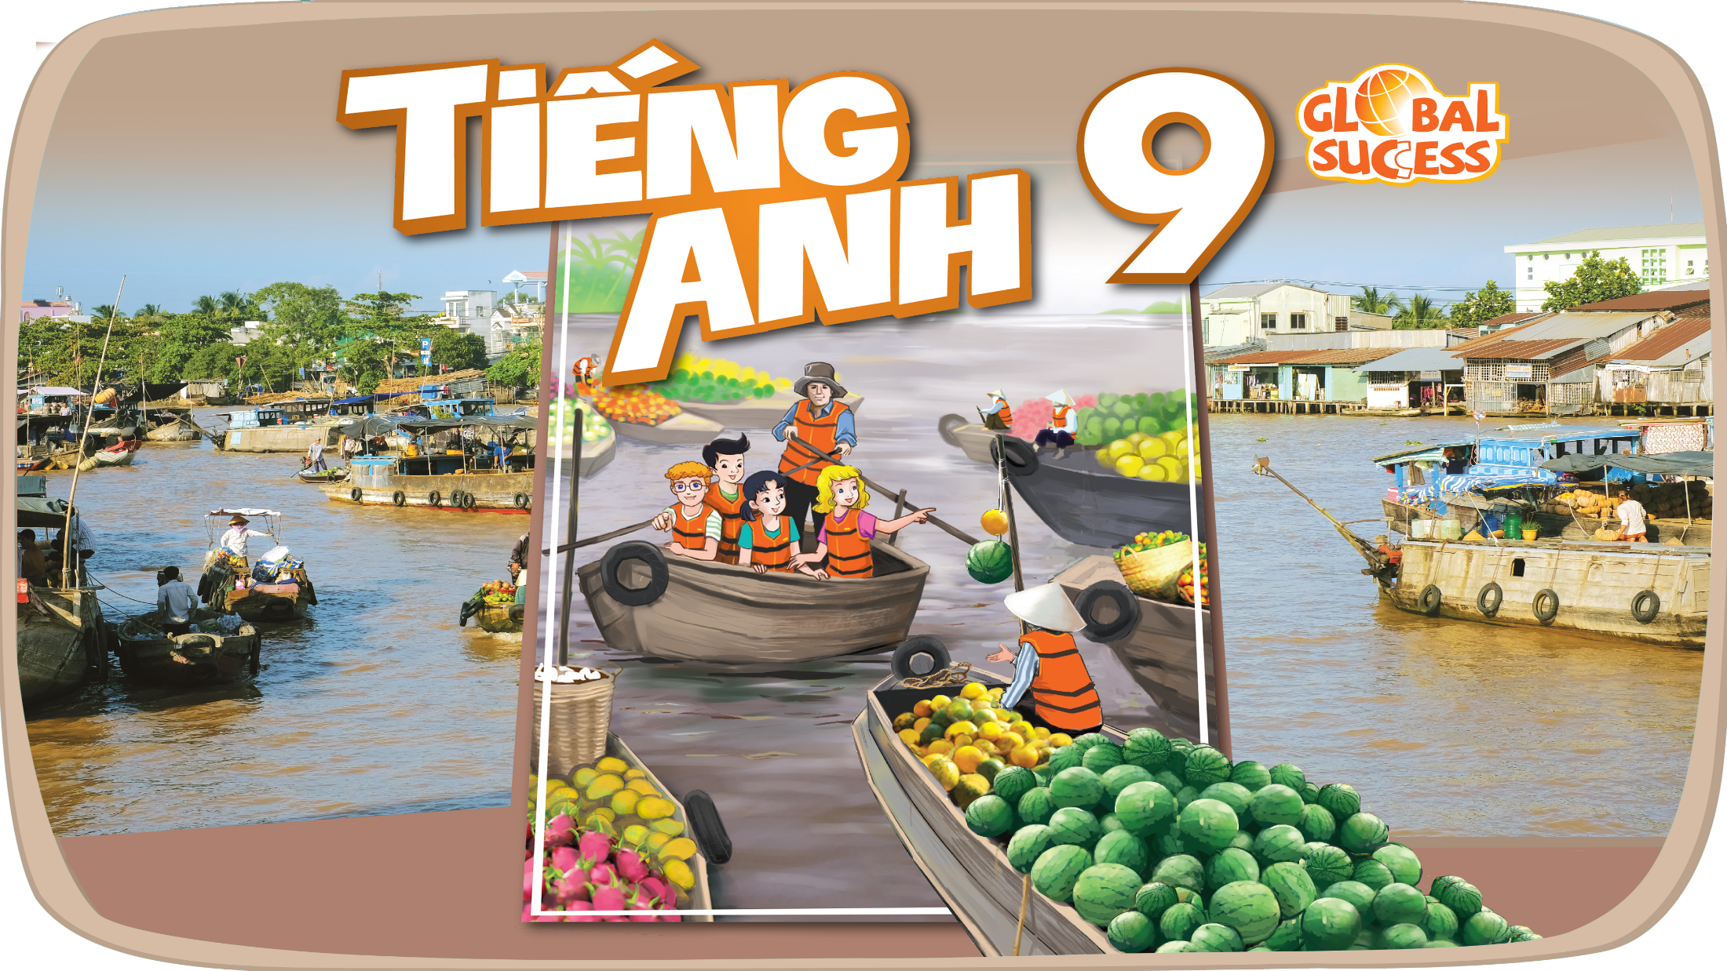

Slide 2
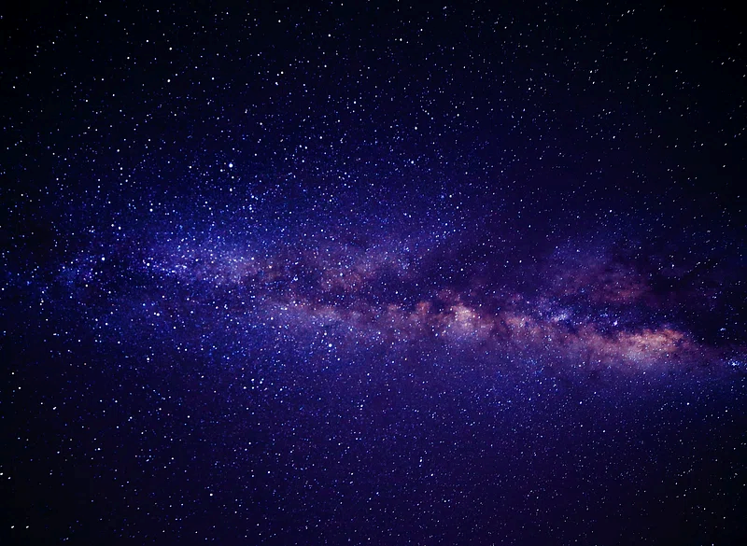
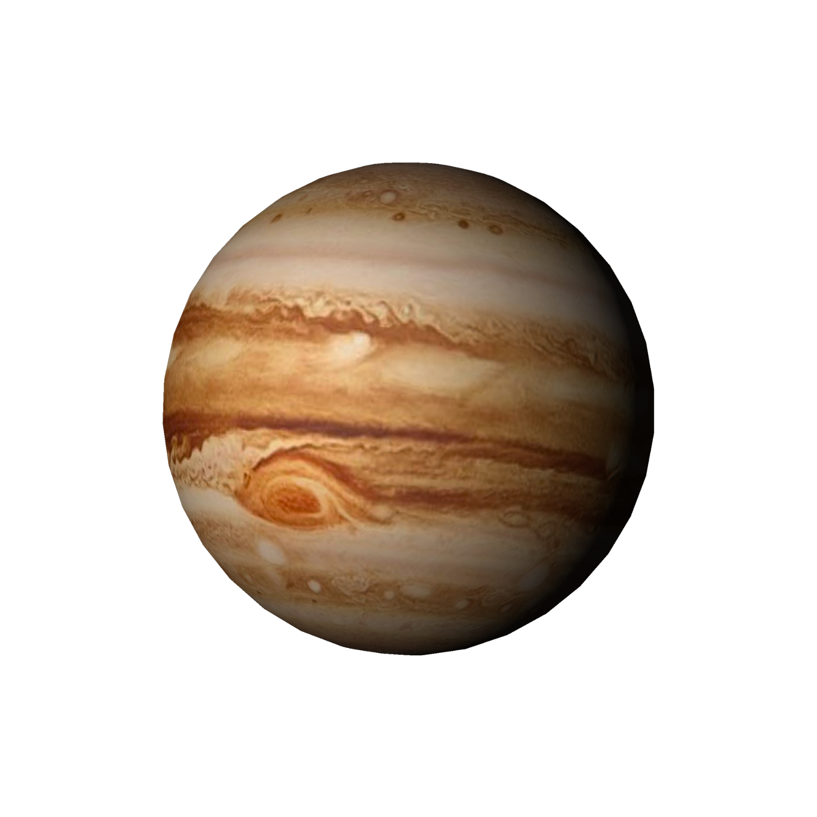
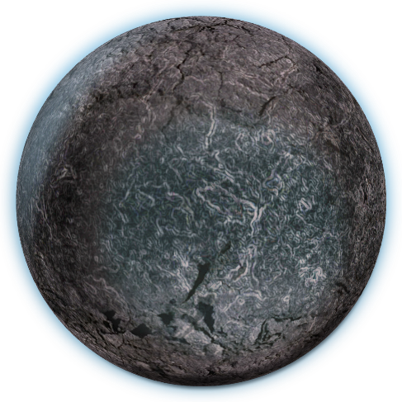
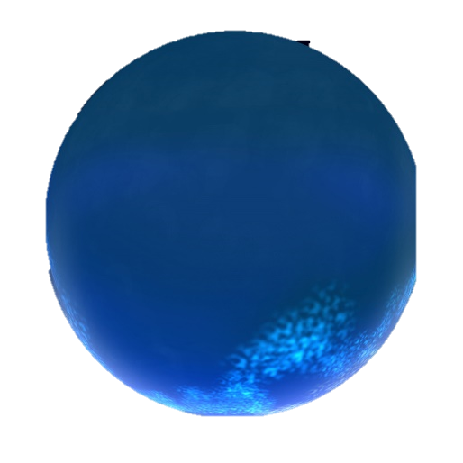
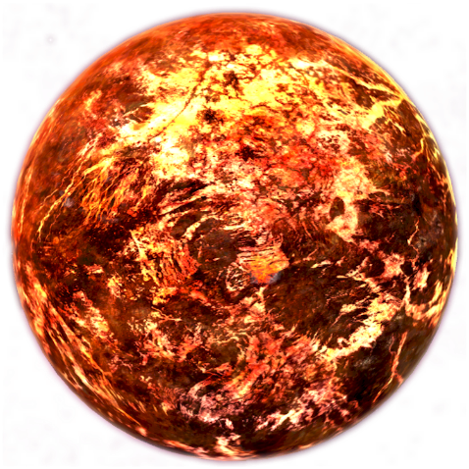
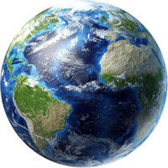


Unit
10
PLANET EARTH
LESSON 7: LOOKING BACK & PROJECT

Slide 3



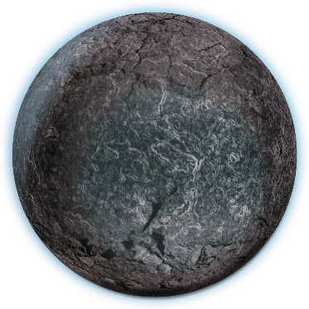
Unit
10
PLANET EARTH
LESSON 7: LOOKING BACK
& PROJECT

Slide 4

LESSON 7: LOOKING BACK & PROJECT
LESSON 1: GETTING STARTED
WARM-UP
Brainstorming
Task 1: Fill in the table with words and phrases about habitats.
Task 2: Complete the passage, using the words and phrases in the box.
VOCABULARY
Task 3: Complete each sentence (1-5) with a non-defining relative clause (A-E).
Task 4: Combine the two sentences into one, using a non-defining relative clause.
GRAMMAR
PROJECT
Our flora and fauna
Wrap-up
Homework
CONSOLIDATION

Slide 5
WARM-UP
BRAINSTORMING
- Work in teams.
Habitats | Actions to protect habitats
- There are slips of paper with words / phrases /
short sentences to stick to either of the columns
(Habitats / Actions to protect habitats).
- The group having more correct
answers is the winner.

Slide 6
WARM-UP
BRAINSTORMING
Habitats | Actions to protect habitats

Slide 7
nature reserves habitat loss ecological balance
food chain climate change
VOCABULARY
1
Fill in the table with words and phrases about habitats.
Types of habitats | Things in a habitat
poles | flora and fauna
grassland, water bodies, landforms, forests, oceans, seas, rivers, lakes, ponds ...
plants and animals, humans, air, light, heat, water …
Earth’s habitats are various and many are threatened. Each habitat includes living things, non-living things, and the surrounding environment. The relations of all living things and their environment in a habitat make up the habitat’s ecology. (1) ____________ or changes in population of plants and animals can cause changes to the natural (2) ___________ and the ecology. That means to maintain a(n) (3) ____________, we shouldn’t cause changes to the climate and the plants and animals of any habitat. In many countries, people have built (4) ____________ to keep endangered plants and animals safe. People should also avoid activities that may cause pollution and (5) ______.

Slide 8
VOCABULARY
2
Complete the sentences, using words and phrases from the box.
nature reserves habitat loss ecological balance
food chain climate change
Earth’s habitats are various and many are threatened. Each habitat includes living things, non-living things, and the surrounding environment. The relations of all living things and their environment in a habitat make up the habitat’s ecology.
(1) ______________ or changes in population of plants and animals can cause changes to the natural (2) __________ and the ecology. That means to maintain a(n) (3) _________________, we shouldn’t cause changes to the climate and the plants and animals of any habitat. In many countries, people have built
(4) ______________ to keep endangered plants and animals safe. People should also avoid activities that may cause pollution and (5) ___________.
Climate change
food chain
ecological balance
natural reserves
habitat loss

Slide 9
GRAMMAR
3
Complete each sentence (1-5) with a non-defining relative clause (A-E).
A. who is considered the God of Thunder
B. which are large and extremely dry areas
C. whose work in geology is considered very important
D. which is the oldest national park in Viet Nam
E. which attract many tourists worldwide
E
1. The Alps are a well-known mountain range, ______.
2. Deserts on Earth, ______, hardly get any rain.
3. People used to believe that Thor, ______, causes storms and lightning.
4. We spent time trekking, bird-watching, and kayaking in Cuc Phuong, _____.
5. James Hutton, ______, was one of the first scientists to study geology.
B
A
D
C

Slide 10
GRAMMAR
4
Combine the two sentences into one, using a non-defining relative clause.
4
1. Boreal forests cover vast areas in Canada, Alaska, and Russia. They are also called Taiga.
Boreal forests, which are also called Taiga, cover vast areas in Canada, Alaska, and Russia.
2. Polar bears are endangered animals. Their natural habitat is the Arctic.
Polar bears, whose natural habitat is the Arctic, are endangered animals.

Slide 11
GRAMMAR
4
Combine the two sentences into one, using a non-defining relative clause.
3. Julie Arblaster focuses on studying climate change. She is an Australian scientist.
Julie Arblaster, who is an Australian scientist, focuses on studying climate change.
4. Antarctica is Earth’s least populated continent. It is surrounded by the Southern Ocean.
Antarctica, which is surrounded by the Southern Ocean, is Earth’s least populated continent.

Slide 12
GRAMMAR
4
Combine the two sentences into one, using a non-defining relative clause.
5. The natural world is the world of living things. Living things include plants and animals scientist.
The natural world is the world of living things, which include plants and animals.

Slide 13
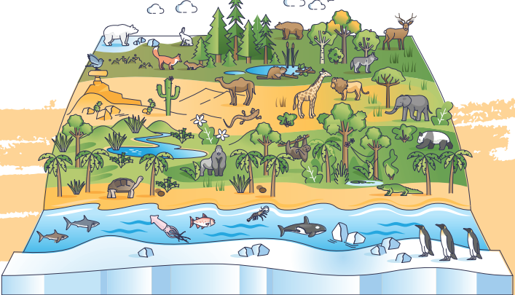
PROJECT
Our flora
and fauna

Slide 14

PROJECT
PRESENTATION

Slide 15
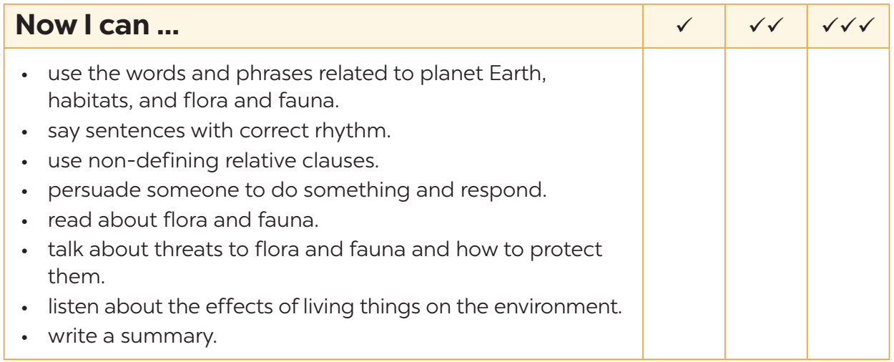
NOW I CAN…
Complete the self-assessment table.

Slide 16

CONSOLIDATION
1
Wrap-up
What have we learnt in this lesson?
Review the vocabulary and grammar of Unit 10.
Apply what they have learnt (vocabulary and grammar) into practice through a project.

Slide 17

CONSOLIDATION
2
Homework
- Prepare for the next lesson.

Slide 18

Website: hoclieu.vn
Fanpage: facebook.com/tienganhglobalsuccess.vn/

