Slide 2
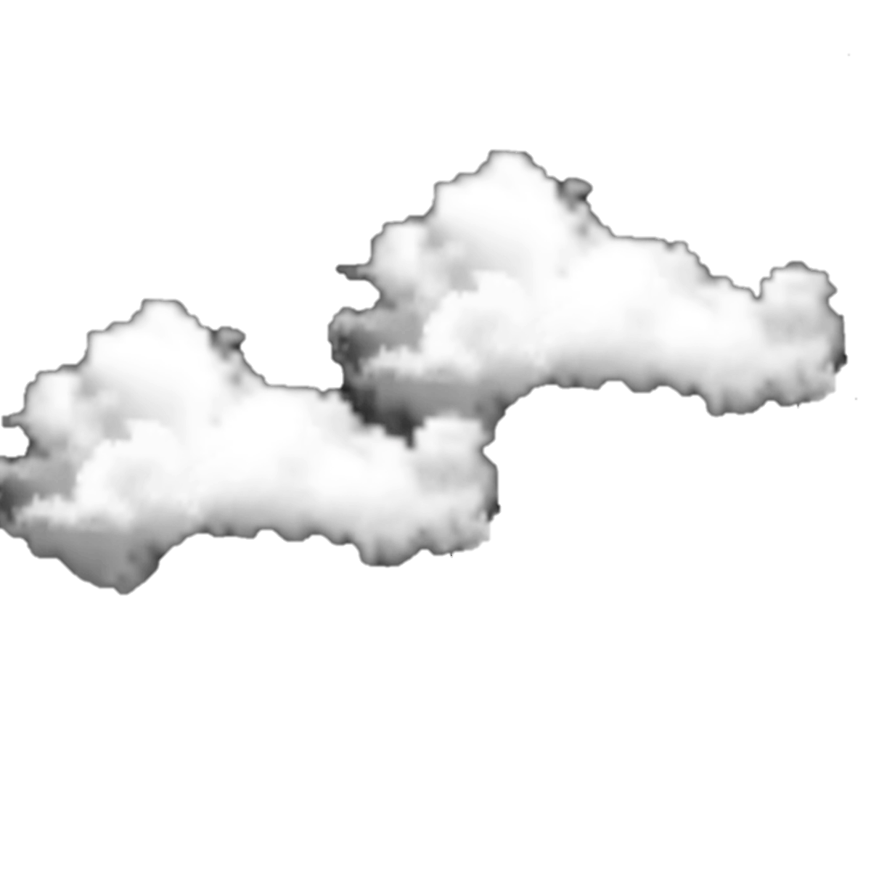
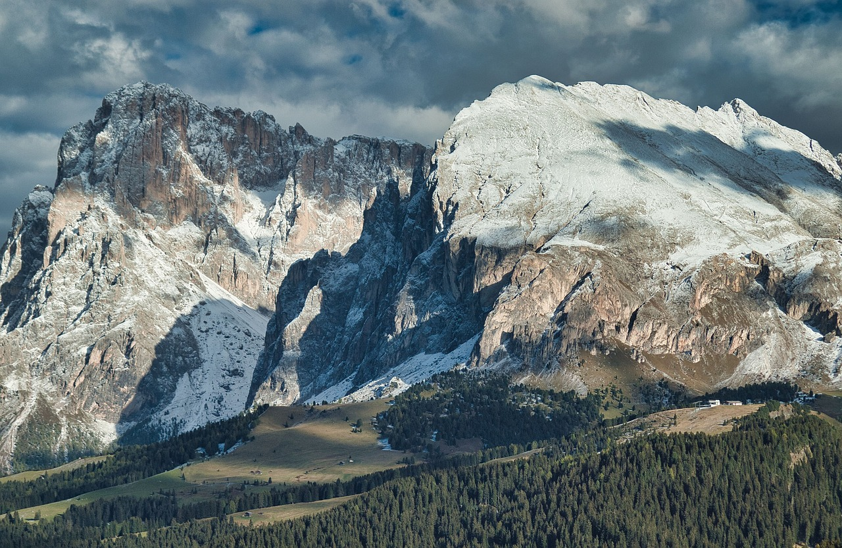



Unit
7
NATURAL WONDERS
LESSON 5: SKILLS 1

Slide 3

Unit
7
NATURAL WONDERS OF THE WORLD
LESSON 5: SKILLS 1

Slide 4
LESSON 5: SKILLS 1
WARM-UP
Option 1: Brainstorming
Option 2: Mountain Chain Reaction
Task 1: Work in groups. Look at the picture and answer the questions.
Task 2: Read the text and match the highlighted words with their meanings or explanations.
Task 3: Read the text again and choose the correct answer to each question.
READING
Task 4: Work in pairs. Ask and answer about the Great Barrier Reef, using the facts below. Then prepare a short talk about it.
Task 5: Work in groups. Introduce the Great Barrier Reef to the class.
SPEAKING
CONSOLIDATION
Wrap-up
Homework

Slide 5

WARM-UP
OPTION 1
Brainstorming

Slide 6
WARM-UP
OPTION 1
Questions:
- What beauty spots/ landscapes/ natural wonders you know?
Brainstorming
-Have you ever heard of or read about the Dolomites?

Slide 7
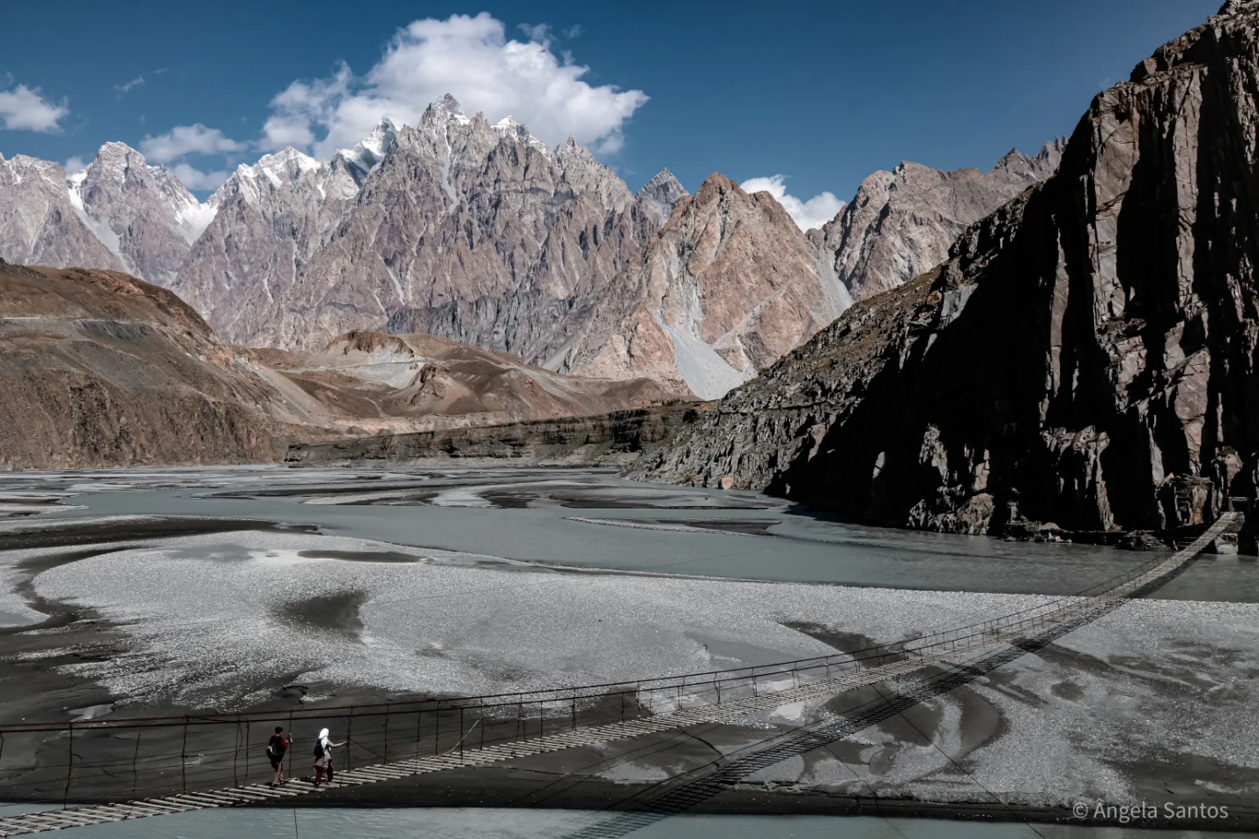
WARM-UP
OPTION 2
Mountain Chain Reaction

Slide 8
WARM-UP
OPTION 2
- Shout out words associated with mountains.
Information:
- landscape, weather, activities and emotions.
Mountain Chain Reaction

Slide 9
WARM-UP
OPTION 2
Suggested answers
Landscape: peak, valley, cliff, …
Weather: cold, windy, sunny, foggy, …
Activities: hiking, climbing, camping, bird watching, taking photos, ….
Emotions: peace, excitement, adventure, freedom,…
Mountain Chain Reaction

Slide 10

VOCABULARY
majestic (adj)
beautiful, powerful
/məˈdʒestɪk/
E.g. The majestic Montana scenery will leave you breathless.
uy nghi, tráng lệ

Slide 11
VOCABULARY
occur (v)
happen (especially unexpected events)
/əˈkɜː/
E.g. I hope this never occurs again, but I'm prepared if it does.
xảy ra

Slide 12
VOCABULARY
New words | Pronunciation | Meaning
1. majestic (adj) | /məˈdʒestɪk/ | uy nghi, tráng lệ
2. occur (v) | /əˈkɜː/ | xảy ra

Slide 13
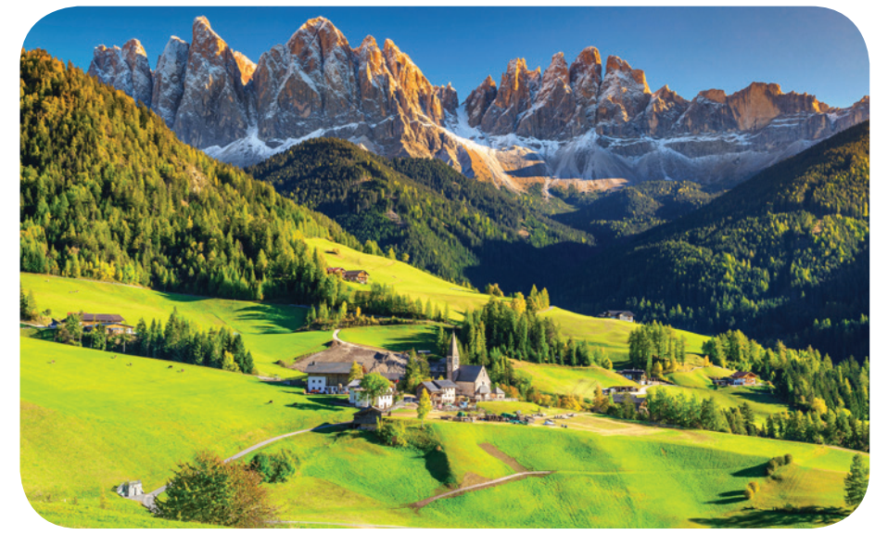
READING
1
Work in groups. Look at the
picture and answer the questions.
Questions:
1
1/ What do you see in the picture?
Beautiful nature: snow-covered mountains, forests, green grass, nice houses at the foot of the mountain, …
2/ What activities do you think visitors can do there?
Cycling, walking, climbing mountains, skiing, trekking, taking pictures, camping, …

Slide 14
READING
The Dolomites – Paradise at Your Feet
If you haven’t decided on where to travel this holiday, consider the Dolomites!
The Dolomites are a mountain range in Italy. It was recognised as a UNESCO World Heritage Site in 2009. The Dolomites are part of the Alps, stretching from the Adige River to the Piave River valley. This mountain range has a total area of about 141,900 hectares. It has 18 peaks over 3,000 metres high. It is easy to get access to most parts of the Dolomites.
The Dolomites are a majestic site. They are widely regarded as being among the most attractive mountain landscapes in the world. There are steep rocky cliffs, sharp peaks, narrow and deep valleys, and white snow on the mountain top. Their natural scenery attracts tourists from many parts of the world.
The Dolomites are a popular place for winter skiing, mountain climbing, hiking, and cycling any time of the year. An annual bicycle race covering seven mountain passes on the Dolomites occurs in the first week of July. So do not hesitate to book a tour to the Dolomites to see and do these things for yourself!

Slide 15
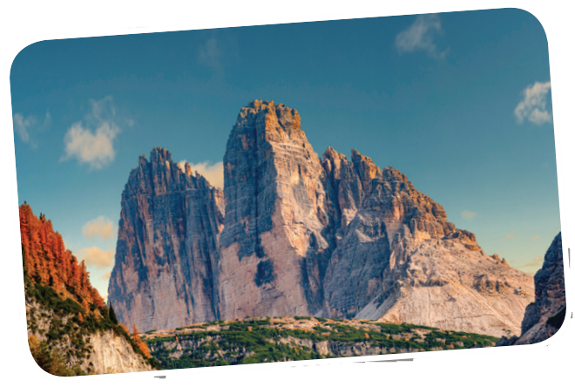
The Dolomites – Paradise at Your Feet
If you haven’t decided on where to travel this holiday, consider the Dolomites!
The Dolomites are a mountain range in Italy. It was recognised as a UNESCO World Heritage Site in 2009. The Dolomites are part of the Alps, stretching from the Adige River to the Piave River valley. This mountain range has a total area of about 141,900 hectares. It has 18 peaks over 3,000 metres high. It is easy to get access to most parts of the Dolomites.
The Dolomites are a majestic site. They are widely regarded as being among the most attractive mountain landscapes in the world. There are steep rocky cliffs, sharp peaks, narrow and deep valleys, and white snow on the mountain top. Their natural scenery attracts tourists from many parts of the world.
READING
Words | Meaning/Explanation
1. consider | a. impressive, magnificent | 1.
2. peaks | b. happens | 2.
3. majestic | c. to think about something carefully | 3.
4. occurs | d. pointed tops, mountains | 4.
c
d
a
b

Slide 16
READING
3
Read the text again and choose the correct answer to each question.
1. According to the text, the Dolomites are a ______.
A. river
C. mountain range
B. work of art
D. valley
2. The word “hesitate” in the last sentence of the text is closest in meaning to ______
A. be unhappy
C. hurry
B. be indecisive
D. decide

Slide 17
READING
3
Read the text again and choose the correct answer to each question.
3. Which of the following is NOT true, according to the text?
A. The Dolomites are in Italy.
B. You can get access to the Dolomites easily.
C. The Dolomites are a World Heritage Site.
D. You can cycle in the Dolomites only in July.

Slide 18
READING
3
Read the text again and choose the correct answer to each question.
4. This text is probably taken from ______.
A. a travel brochure
B. a science journal
C. a novel
D. an arts magazine

Slide 19
SPEAKING
World Heritage Site (1981)
4
Work in pairs. Ask and answer about the Great Barrier Reef, using the facts below. Then prepare a short talk about it.
Location: the Coral Sea, Australia
- Work in pairs.
Total area: about 334,400 km2
- One asks questions, and the other answers, then they swap roles.
Over 400 different types of corals
Tourists’ activities: coral watching, sailing, scuba diving

Slide 20

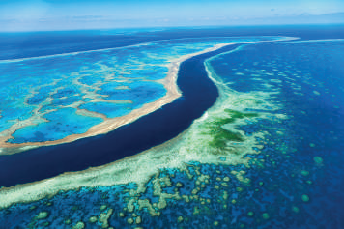
SPEAKING
World Heritage Site (1981)
Examples:
A: When did the Great Barrier Reef become a World Heritage Site?
B: In 1981.
A: Where is it located?
B: In the Coral Sea, Australia.…
Location: the Coral Sea, Australia
Total area: about 334,400 km²
Over 400 different types of corals
Tourists’ activities: coral watching, sailing, scuba diving

Slide 21
SPEAKING
5
Work in groups. Introduce the Great Barrier Reef to the class.
- Look at the sentences given, and think how to continue the talk, and what to say.
- Work in groups to use the answers in 4 and the vocabulary learnt in the unit to talk about the Great Barrier Reef.

Slide 22
SPEAKING
Suggested answer:
The Great Barrier Reef is a World Heritage Site. It was recognised by UNESCO in 1981. It’s located in the Coral Sea, Australia. The total area of this reef is about 334,400 km². There are over 400 different types of corals living in the site. When you come here, you can take part in a lot of activities: coral watching, sailing, scuba diving, and so on. The Great Barrier Reef is the world's biggest single living structure. But this natural wonder is now in danger, and it needs much effort to protect it from damage.

Slide 23

CONSOLIDATION
1
Wrap-up
What have we learnt in this lesson?
Read for specific information about the Dolomites - a travel destination.
Talk about the Great Barrier Reef.

Slide 24

CONSOLIDATION
2
Homework
- Do exercises in the workbook.

Slide 25
Website: hoclieu.vn
Fanpage: facebook.com/tienganhglobalsuccess.vn/

