Slide 2
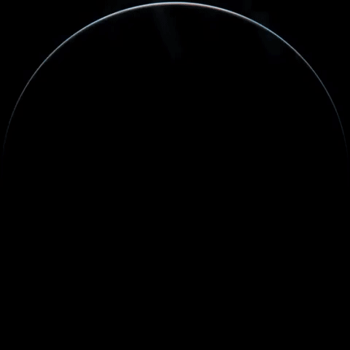


Unit
10
PLANET EARTH
LESSON 5: SKILLS 1

Slide 3
LESSON 5: SKILLS 1
WARM-UP
Option 1: Brainstorm
Option 2: Predator-Prey Chain Challenge
Task 1: Tick (√) the things that show the roles of plants and animals.
Task 2: Read the passage and choose the correct answer A, B, C, or D.
Task 3: Read the passage again and fill in the diagram.
READING
Task 4: Work in pairs. Discuss the threats to plants and animals and how we can protect them. You can use the ideas from the reading or your own ideas.
Task 5: Report the results of your discussion to the class.
SPEAKING
CONSOLIDATION
Wrap-up
Homework

Slide 4

WARM-UP
OPTION 1
Brainstorming

Slide 5
WARM-UP
OPTION 1
- Work in groups to shouts out the name of a habitat.
Desert
- The other groups should say a sentence, telling about the feature of that habitat.
- A habitat name can be reused, but the features mentioned later must be different from the one(s) previously mentioned.
Limited water
- The group that can name a correct feature gets one point and the right to shout another habitat name or lose turn if this group cannot mention any feature.

Slide 6
WARM-UP
OPTION 1
Example:
Desert
Limited water

Slide 7
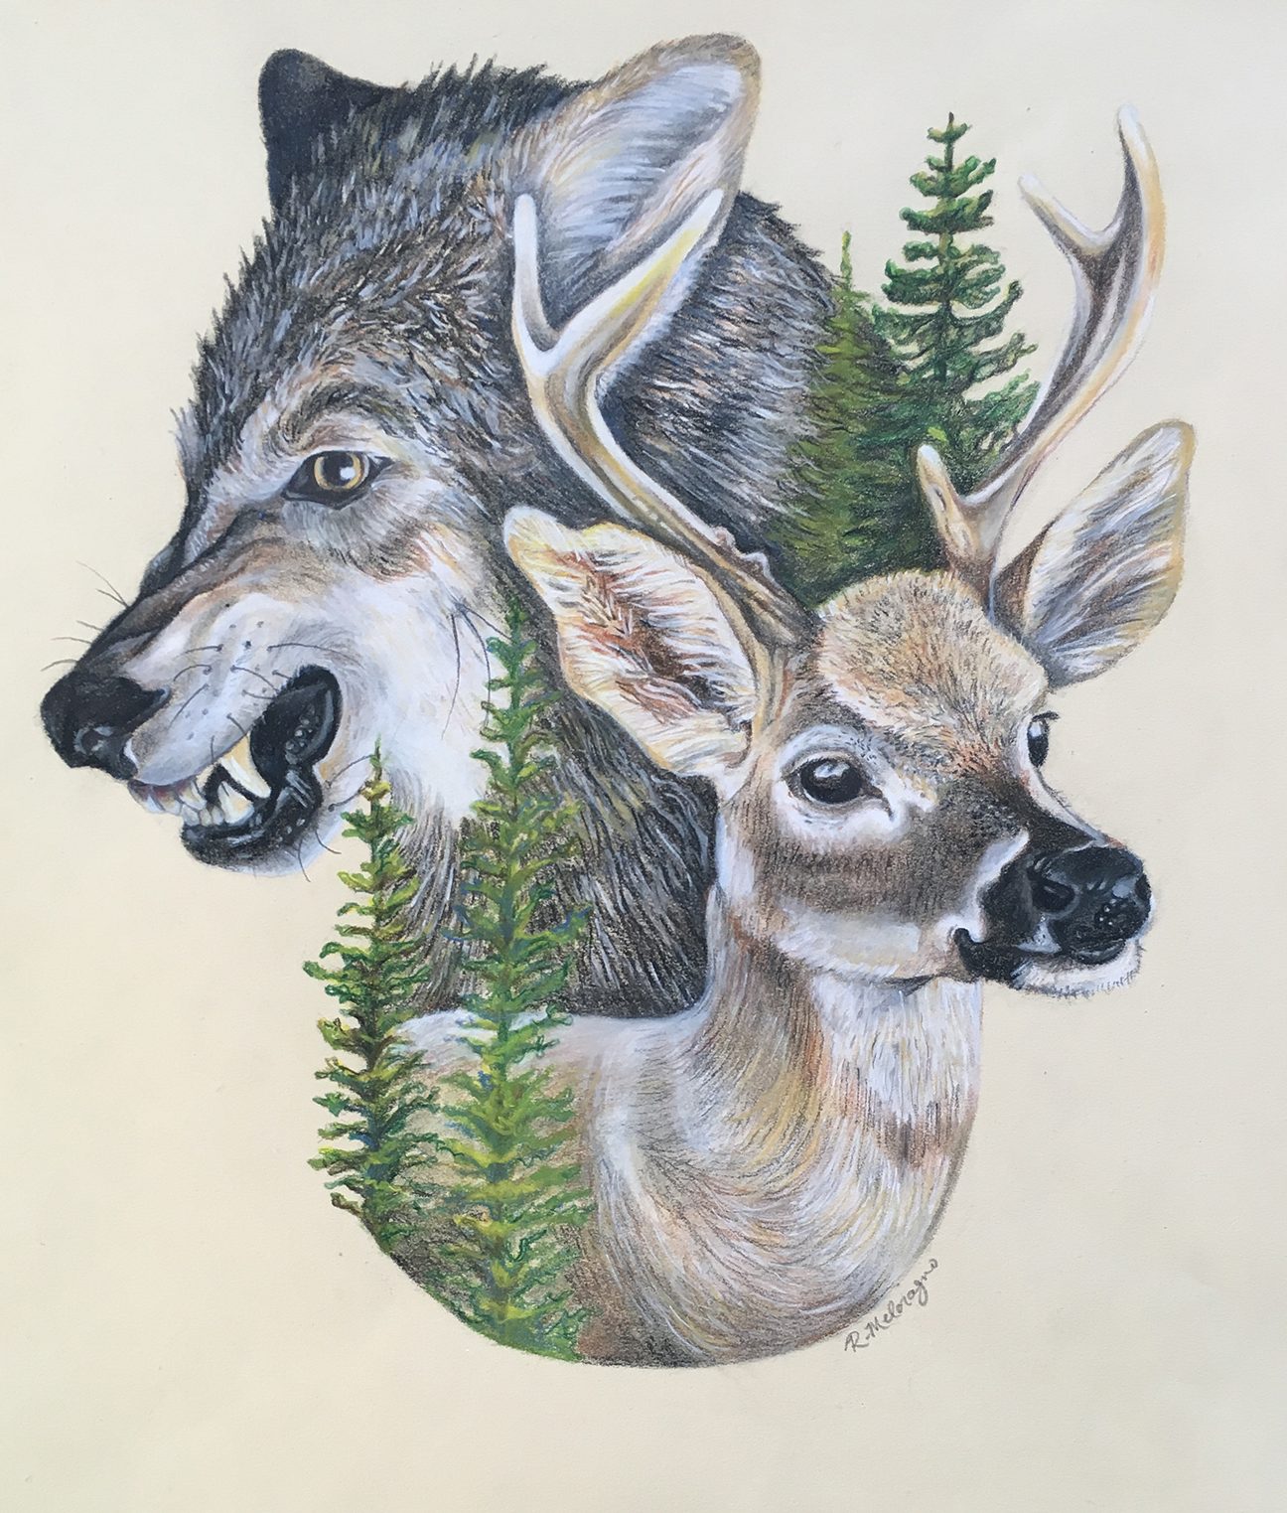
WARM-UP
OPTION 2
Predator-Prey Chain Challenge

Slide 8
WARM-UP
OPTION 2
Predator-Prey Chain Challenge
- Work in groups to represent different organisms in a food chain.
- Acts out their roles (standing, crouching, etc.).
Example:
grass -> grasshopper -> frog -> snake
- Discuss the roles each organism plays in the chain and how disruptions can affect the ecosystem.

Slide 9
WARM-UP
OPTION 2
Suggested answer:
Predator-Prey Chain Challenge.
Overall, each organism plays a vital role in maintaining the balance of the ecosystem. Any disruption can have cascading effects, impacting the populations of other organisms and potentially causing widespread damage. Understanding these interconnected relationships is crucial for conservation efforts and maintaining healthy ecosystems.

Slide 10

READING
1
Tick (√) the things that show the roles of plants and animals.
1. providing sources of food
2. causing habitat loss
3. keeping the ecological balance
4. making Earth beautiful

Slide 11
READING
2
Read the passage and choose the correct answer A, B, C, or D.
1. What is the passage mainly about?
A. The beauty of plants and animals.
B. How plants and animals protect the environment.
C. The wonder of plants and animals.
D. The natural food chain.
2. The author mentions ______ significant roles
plants and animals play.
A. two B. three C. four D. five
1. What is the word ‘significance’ in paragraph 1 closest in meaning to?
A. consequence B. threats C. importance
2. What is the word ‘fascinating’ in paragraph 1 closest in meaning to?
A. charming B. interesting C. ideal
3. What is the word ‘release’ in paragraph 2 closest in meaning to?
A. let out B. set free C. throw
4. What does the word “their” in paragraph 3 refer to?
A. of the flora and fauna B. of plants C. of animals
5. What do you think the paragraph after the last one would be about?
A. Problems wildlife face
B. Measures to protect wildlife
C. Importance of wildlife

Slide 12
READING
3. Which of the following do plants provide humans?
A. Oxygen. B. Aquatic environment.
C. Carbon dioxide. D. Habitat loss.
4. Which action does NOT preserve plants and animals?
A. Planting more trees. B. Raising awareness.
C. Building nature reserves. D. Hunting animals
5. The word “appreciate” means ______.
A. protect the qualities of B. recognise the wonder of
C. learn more about D. be aware of
1. What is the word ‘significance’ in paragraph 1 closest in meaning to?
A. consequence B. threats C. importance
2. What is the word ‘fascinating’ in paragraph 1 closest in meaning to?
A. charming B. interesting C. ideal
3. What is the word ‘release’ in paragraph 2 closest in meaning to?
A. let out B. set free C. throw
4. What does the word “their” in paragraph 3 refer to?
A. of the flora and fauna B. of plants C. of animals
5. What do you think the paragraph after the last one would be about?
A. Problems wildlife face
B. Measures to protect wildlife
C. Importance of wildlife

Slide 13
EXTRA ACTIVITY
1. What is the word ‘fascinating’ in paragraph 1 closest in meaning to?
A. charming B. interesting C. ideal
2. What is the word ‘significance’ in paragraph 1 closest in meaning to?
A. consequence B. threats C. importance
3. What is the word ‘release’ in paragraph 2 closest in meaning to?
A. let out B. set free C. throw
4. What does the word “their” in paragraph 3 refer to?
A. of the flora and fauna B. of plants C. of animals
5. What do you think the paragraph after the last one would be about?
A. Problems wildlife face B. Measures to protect wildlife
C. Importance of wildlife

Slide 14
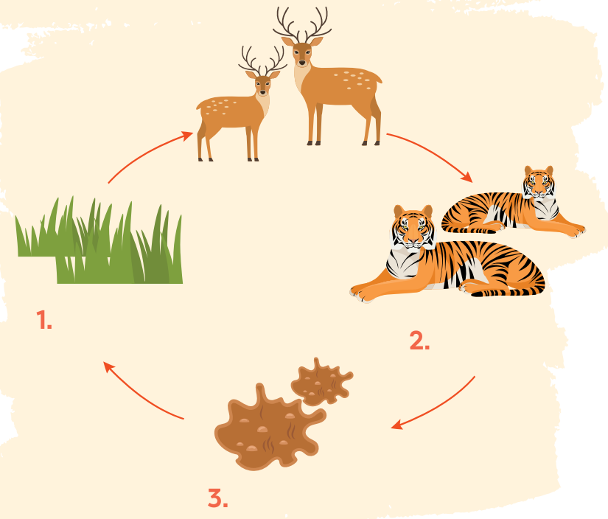
READING
3
Read the passage again and fill in the diagram.
animals (prey)
plants
animals (predator)
droppings

Slide 15
TRANSITION FROM READING TO SPEAKING
- The habitats are under threats and thus we have to take actions soon.
- Read the passage in 2 again and find two threats to plants and animals, and two actions
- In Activity 4 in SPEAKING, we will discuss the threats to plants and animals and what people should do to protect them.

Slide 16
SPEAKING
4
Work in pairs. Discuss the threats to plants and animals and how we can protect them. You can use the ideas from the reading or your own ideas.
- What do you think is the first / second / third most significant threat to the environment?
- I think the / second / threat is ...
- What do you think humans should do to deal with the situation?
- The first thing humans can / should do is ...

Slide 17
SPEAKING
4
Work in pairs. Discuss the threats to plants and animals and how we can protect them. You can use the ideas from the reading or your own ideas.
Threats | Actions
- habitat loss | - buiding nature reserves
- deforestation
- stop hunting
- pollution
- stop cutting down forests
- climate change
- plant more trees
- global warming
- raise people’s awareness

Slide 18
SPEAKING
5
Report the result of your discussion to the class.
- Work to practice reporting.
- Use the sample in their books to
report the threats and actions.
- You can use the notes you made in 4.

Slide 19
SPEAKING
Example:
There are many threats to the flora and fauna. First, they face habitat loss. For example, when a river is polluted, the water habitat cannot be suitable for water species. Many other animals and plants suffer from deforestation because people cut down trees and clear the forests. Global warming is another threat to a large number of animals because when the temperature is too extreme, many animals may die out.
We can do several things to preserve their habitats. We should build natural reserves to preserve endangered animals and plants. People should also stop hunting and cutting down forests. If possible, people should start planting more trees. Above all, governments should have policies to raise people’s awareness of the protection of natural habitats.

Slide 20

CONSOLIDATION
1
Wrap-up
What have we learnt in this lesson?
Read for main idea and specific about role of plant and animals.
Talk about threats to flora and fauna and how to protect them.

Slide 21

CONSOLIDATION
2
Homework
- Do exercises in the workbook.

Slide 22
Website: hoclieu.vn
Fanpage: facebook.com/tienganhglobalsuccess.vn/

