Slide 2
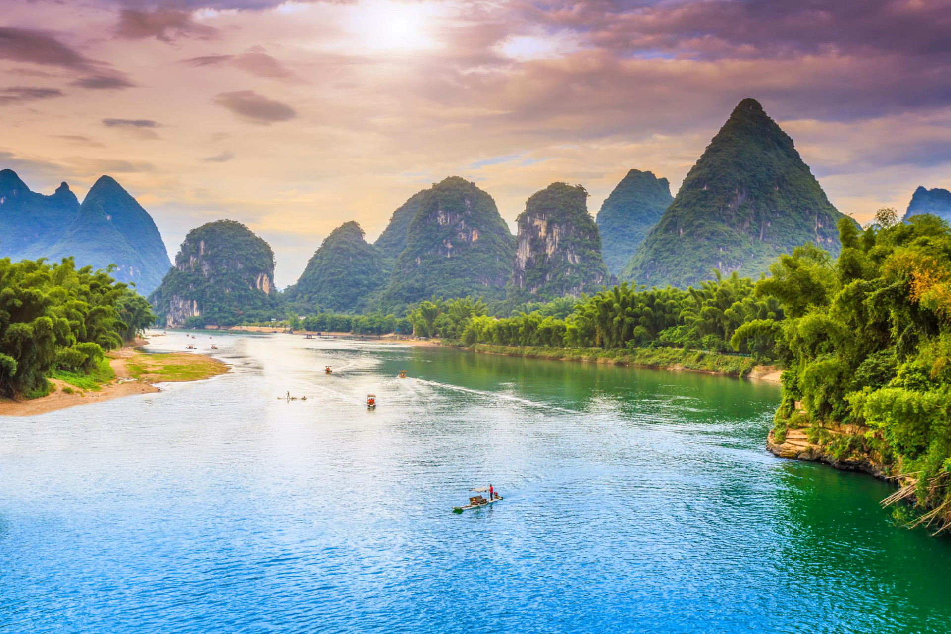


NATURAL WONDERS
7
Unit
LESSON 4: COMMUNICATION

Slide 3

Unit
7
NATURAL WONDERS OF THE WORLD
LESSON 4: COMMUNICATION

Slide 4
LESSON 4: COMMUNICATION
LESSON 1: GETTING STARTED
WARM-UP
Option 1: Review
Option 2: Can I? game
Task 1: Listen and read the conversations. Pay attention to the highlighted parts.
Task 2: Work in pairs. Make similar conversations to ask for permission and respond in the following situations.
EVERYDAY ENGLISH
Task 3: Write each natural wonder under the correct picture.
Task 4: Mai, Phong and Mark are talking about the natural wonders they have visited. Read and decide which wonder in 3 each of them is talking about.
Task 5: Work in groups. Discuss and decide which place in 3 and 4 your group wants to visit. Explain the reasons why you want to visit it. Plan the things you want to do there.
NATURAL WONDERS AND TOURISM
CONSOLIDATION
Wrap-up
Homework

Slide 5

WARM-UP
OPTION 1
REVIEW

Slide 6
WARM-UP
OPTION 1
- Some Ss make Yes / No questions, and other Ss change them into reported speech.
Example:
A: “Is it possible to travel around the world in 80 days?”
B: She asked if it was possible to travel around the world in 80 days.

Slide 7
WARM-UP
OPTION 1
- Some Yes / No questions:
Is it possible to travel the world without flying?
Is the Amazon rainforest the largest rainforest in the world?
Is it possible to protect the world’s natural wonders for future generations?

Slide 8
WARM-UP
OPTION 2
Can I? game

Slide 9
WARM-UP
OPTION 2
How to play:
- Work in teams.
- One team takes turn to asking the questions on the board, while the other team responds.
- Each team receives points for asking and responding politely and respectfully. The team with the most points will win.

Slide 10
WARM-UP
OPTION 2
Questions:
Can I borrow your pen?
Can I use your phone to make a call?
Can I use your computer?
Can I try your jacket?
Can I take a picture of you?
Can I visit you this weekend?
Can I ……………..?

Slide 11

EVERYDAY ENGLISH
1
Listen and read the conversations below. Pay attention to the highlighted parts.
Anne: Can I watch a horror film, Mum?
Anne’s Mum: No, dear, you can’t. It’s late now.
Tourist: May we come in and have a look around the temple?
Guard: Sure. But be careful. It’s very dark inside.

Slide 12
EVERYDAY ENGLISH
Structures:
Ask for permission:
Can I + bare V……………..?
May we + bare V……………?
Respond:
No, dear, you can’t.
Sure.

Slide 13
EVERYDAY ENGLISH
2
Work in pairs. Make similar conversations to ask for permission and respond in the following situations.
1. You ask your friend for permission to borrow a book on the Galápagos Islands.
2. You ask your teacher for permission to submit your project after the deadline.
1. You ask your friend for permission to borrow a book on the Galápagos Islands
2. You ask your teacher for permission to submit your project after the deadline.

Slide 14
EVERYDAY ENGLISH
Suggested dialogues:
May I submit my project after the deadline, Miss?
Can I borrow / Can you lend me a book on the Galápagos Islands?
Sure. But please look after it carefully.

Slide 15
EVERYDAY ENGLISH
Suggested dialogues:
May I submit my project after the deadline, Miss?
I’m afraid you can’t.

Slide 16
Transition from Everyday English to Natural wonders and tourism
- Name some natural wonders / tourist attractions of Viet Nam.
Suggested answers:
Ha Long Bay, Cuc Phuong National Park, Dong Van Plateau, Ban Gioc Waterfall, Son Doong Cave, Cu Lao Cham Island, Con Dao Island, etc.
- Say how you can ask for permission and respond when you want to enter one of these tourist attractions.

Slide 17
NATURAL WONDERS AND TOURISM
3
Write each natural wonder under the correct picture.
- Look at the pictures and answer questions.
Questions:
What is it in each picture?
Where is it?
What is special about it?
- Work in pairs to do the task.
2. Sanjay from New Delhi
Once, it was easy to say which country a person was from because people wore their own traditional costumes. Now, trends, comfort, and style are more important. More people are wearing western clothes like jeans and T-shirts instead.

Slide 18
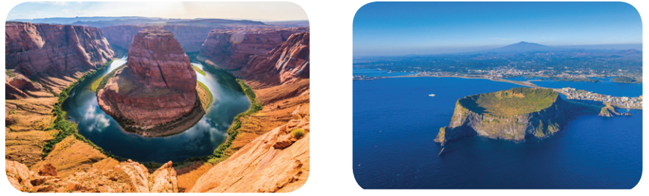
NATURAL WONDERS AND TOURISM
3
Write each natural wonder under the correct picture.
Ha Long Bay
Jeju Island
Grand Canyon
The Sahara Desert
1. _________________
2. _________________
Grand Canyon
Jeju Island

Slide 19
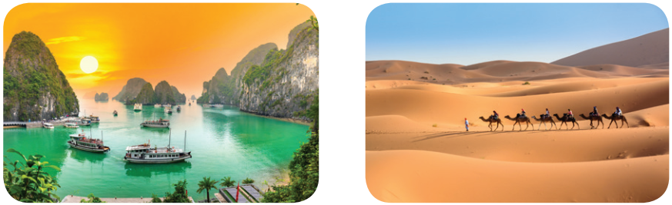
NATURAL WONDERS AND TOURISM
3
Write each natural wonder under the correct picture.
Ha Long Bay
Jeju Island
Grand Canyon
The Sahara Desert
3. _________________
Ha Long Bay
The Sahara Desert
4. _________________

Slide 20
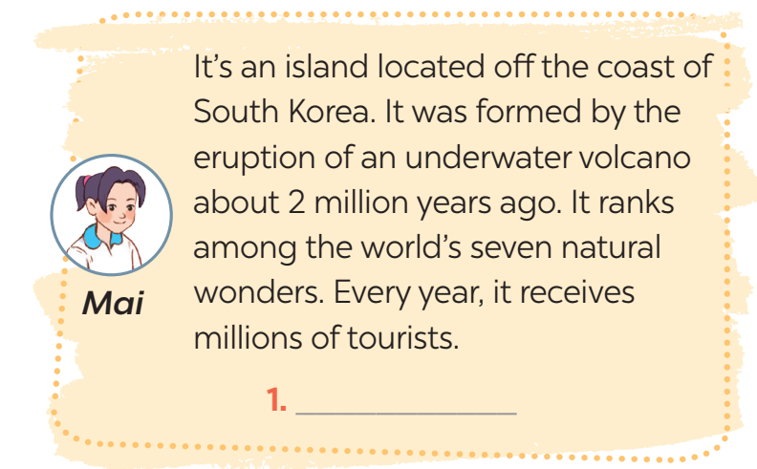

NATURAL WONDERS AND TOURISM
4
Mai, Phong and Mark are talking about the natural wonders they have visited. Read and decide which wonder in 3 each of them is talking about.
Jeju Island

Slide 21
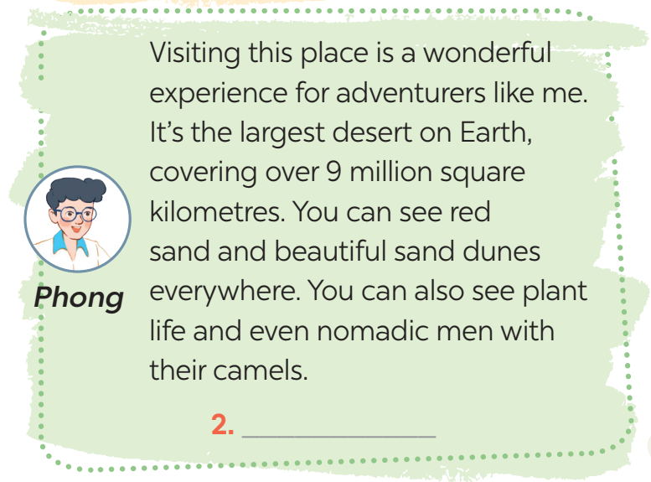
NATURAL WONDERS AND TOURISM
4
Mai, Phong and Mark are talking about the natural wonders they have visited. Read and decide which wonder in 3 each of them is talking about.
Sahara Desert

Slide 22
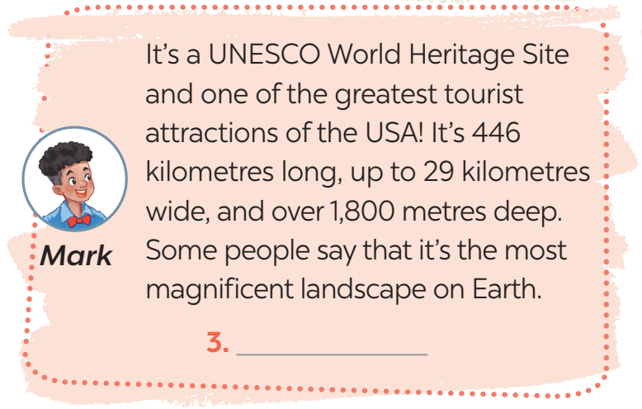
NATURAL WONDERS AND TOURISM
4
Mai, Phong and Mark are talking about the natural wonders they have visited. Read and decide which wonder in 3 each of them is talking about.
Grand Canyon

Slide 23
NATURAL WONDERS AND TOURISM
Facts:
Ha Long Bay:
- Location: Quang Ninh Province
- World Natural Heritage Site (1994)
- Main features: About 2,000 islands and islets, beautiful caves, blue water …
- Visitors’ activities: exploring floating villages, cruising the bay, kayaking, enjoying delicious seafood …
Jeju Island
- Location: Korea
- Created by a series of volcanic activities
- Contains a natural World Heritage Site: the Jeju Volcanic Island and Lava Tubes
- Contains Mount Hallasan, the tallest mountain in Korea
Sahara Desert
- Location: Africa
- Largest desert on Earth(9L million km2)
- Sand dunes of different colours
- Natural oases – diversified flora
Grand Canyon
- Location: Arizona, USA
- 446 km long, 29 km wide
- Carved by the Colorado River
- First national park in the USA

Slide 24
Ha Long Bay:
- Location: Quang Ninh Province
- World Natural Heritage site (1994)
- Main features: About 2,000 islands and islets, beautiful caves, blue water …
- Visitors’ activities: exploring floating villages, cruising the bay, kayaking, enjoying delicious sea food …
Jeju Island
- Location: Korea
- Created by a series of volcanic activities
- Contains a natural World Heritage Site: the Jeju Volcanic Island and Lava Tubes
- Contains Mount Hallasan, the tallest mountain in Korea
NATURAL WONDERS AND TOURISM
Facts:
Sahara Desert
- Location: Africa
- Largest desert on Earth (9 million km²)
- Sand dunes of different colours
- Natural oases – diversified flora
Grand Canyon
- Location: Arizona, USA
- 446 km long, 29 km wide
- Carved by the Colorado River
- First national park in the USA
Hey everyone, I’m super excited to tell you why I’m keen on visiting Ha Long Bay. It’s in Quang Ninh Province, and not only it’s beautiful but it’s also a World Natural Heritage site!
Imagine over 2,000 islands and islets rising from crystal-clear blue water, like giants in the sea. Caves filled with secrets and history await exploration.
There’s even more! Floating villages where people live their lives right on the water, and incredibly fresh seafood that practically jumps onto your plate.
Seriously, Ha Long Bay sounds like an adventure playground, and I can’t wait to experience it all for myself! Who’s with me?

Slide 25
NATURAL WONDERS AND TOURISM
Suggested answer:
Hey everyone, I’m super excited to tell you why I’m keen on visiting Ha Long Bay. It’s in Quang Ninh Province, and not only it’s beautiful but it’s also a World Natural Heritage Site!
Imagine over 2,000 islands and islets rising from crystal-clear blue water, like giants in the sea. Caves filled with secrets and history await exploration.
There’s even more! Floating villages where people live their lives right on the water, and incredibly fresh seafood that practically jumps onto your plate.
Seriously, Ha Long Bay sounds like an adventure playground, and I can’t wait to experience it all for myself! Who’s with me?

Slide 26

CONSOLIDATION
1
Wrap-up
What have we learnt in this lesson?
Know how to ask for permission and respond.
Talk about natural wonders and tourism.

Slide 27

CONSOLIDATION
2
Homework
- Do exercises in the workbook.

Slide 28
Website: hoclieu.vn
Fanpage: facebook.com/tienganhglobalsuccess.vn/

