Slide 1
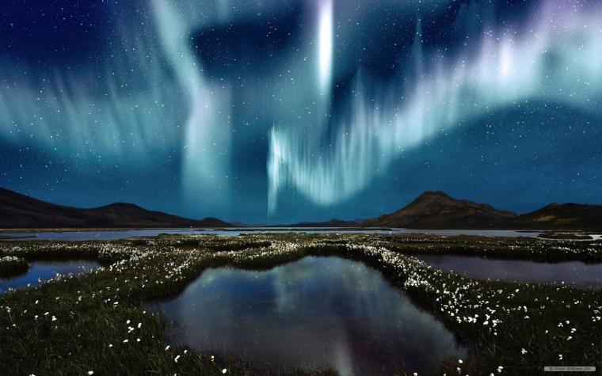


Unit
12
LESSON 2: A CLOSER LOOK 1

Slide 2
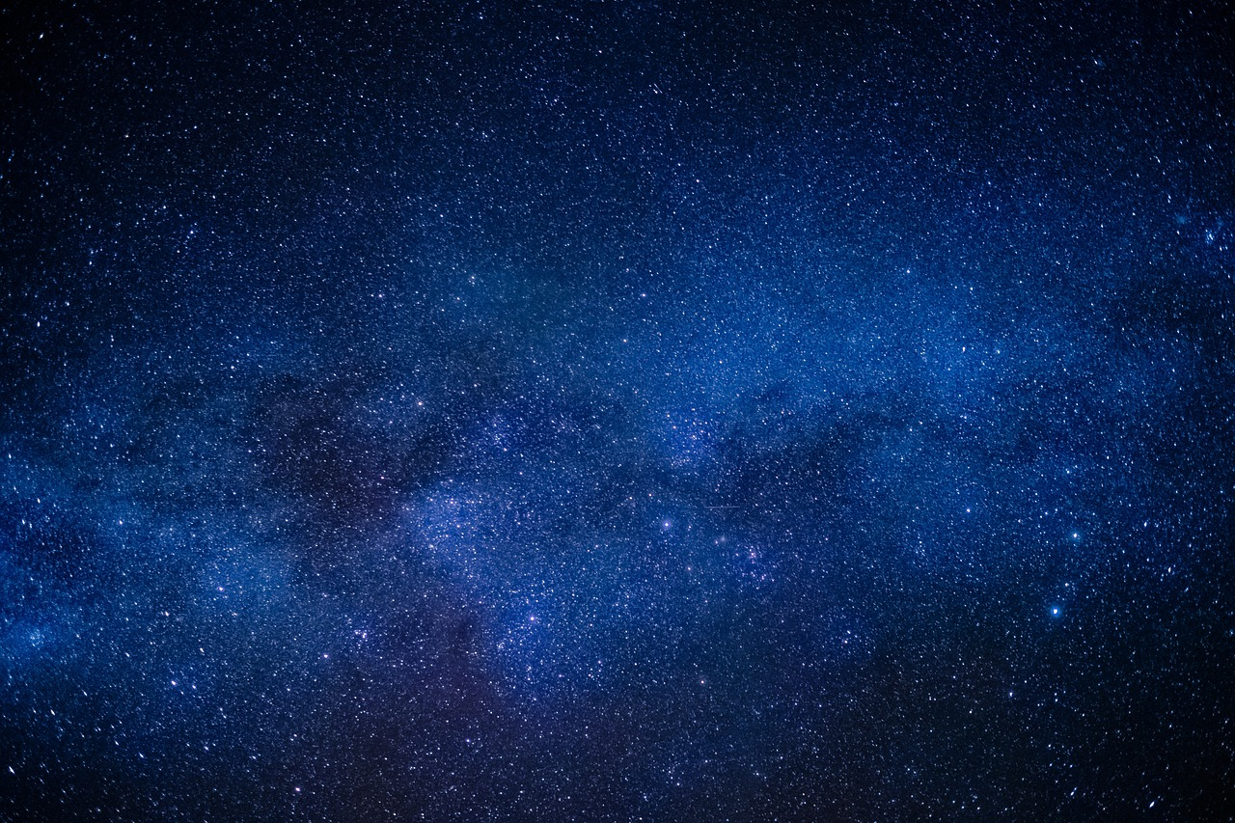

Unit
10
PLANET EARTH
LESSON 2: A CLOSER LOOK 1

Slide 3
Unit
10
PLANET EARTH
LESSON 2: A CLOSER LOOK 1

Slide 4
LESSON 2: A CLOSER LOOK 1
LESSON 2: A CLOSER LOOK 1
WARM-UP
Option 1: Brainstorm
Option 2: Wordly word chain.
Vocabulary
Task 1: Write a word or phrase from the box under each picture.
Task 2: Complete each sentence with a word or phrase from 1.
Task 3: Choose the correct answer A, B, C, or D.
VOCABULARY
Task 4: Listen to the sentences and pay attention to the bold syllables. Does the speaker place stress on them?
Task 5: Circle the stressed syllables in the sentences. Listen, check, and repeat.
PRONUNCIATION
CONSOLIDATION
Wrap-up
Homework

Slide 5

WARM-UP
OPTION 1
Brainstorming

Slide 6
WARM-UP
OPTION 1
- There are some strips of paper with words / phrases.
- Work in groups to stick the words / phrases to the right pictures.
Brainstorming
- The group with most correct answers wins.

Slide 7
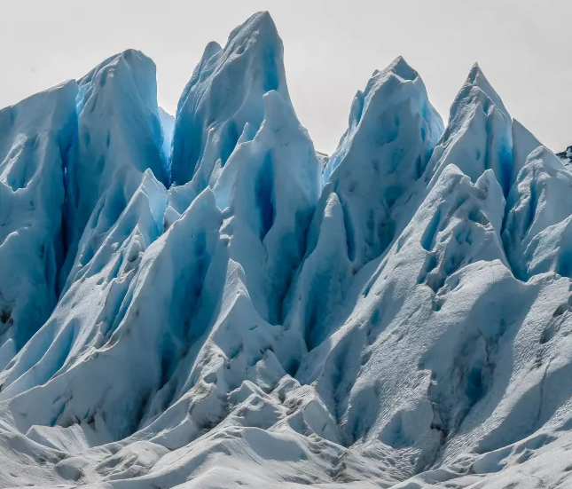
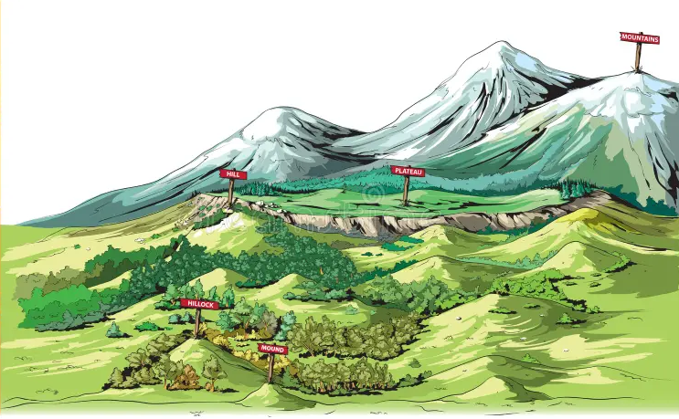
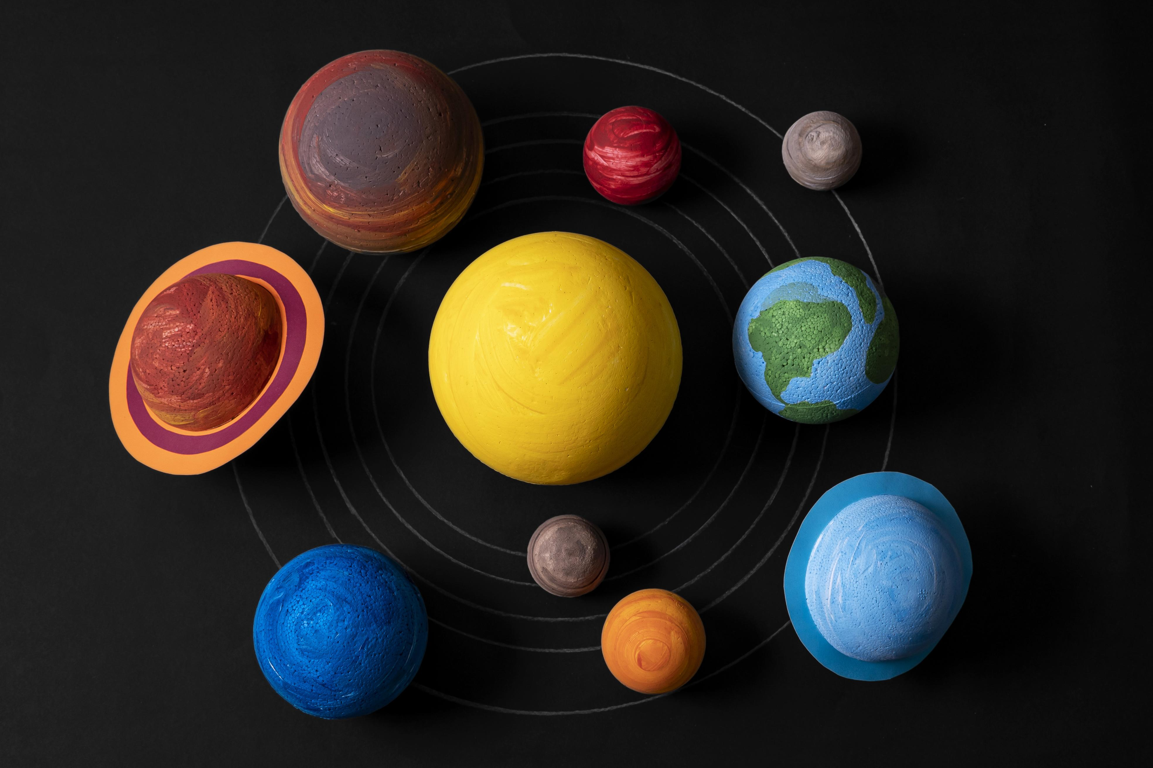
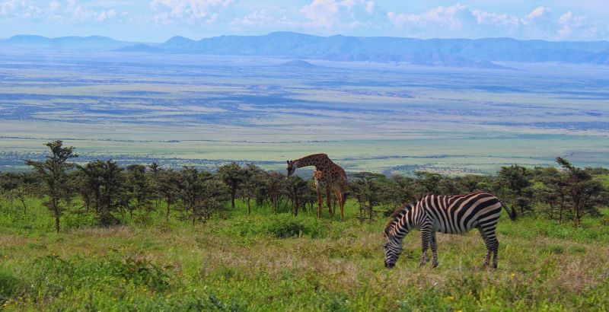
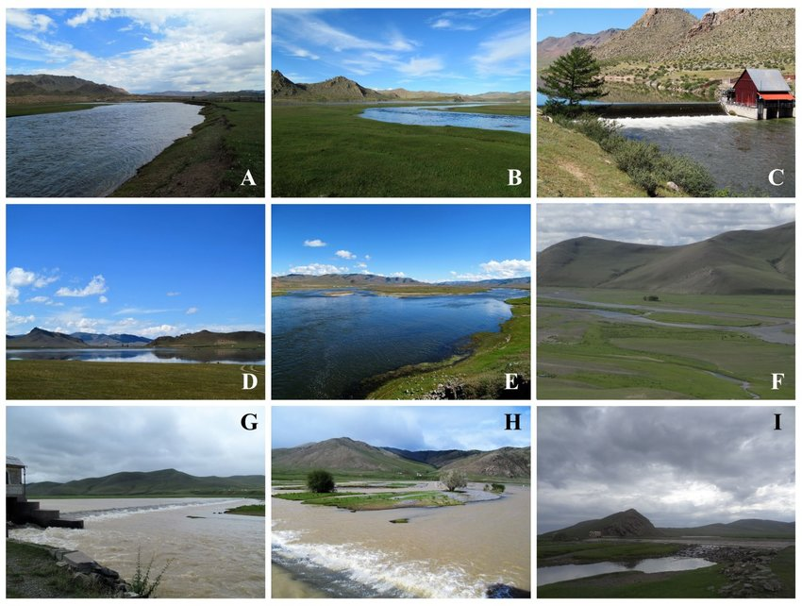
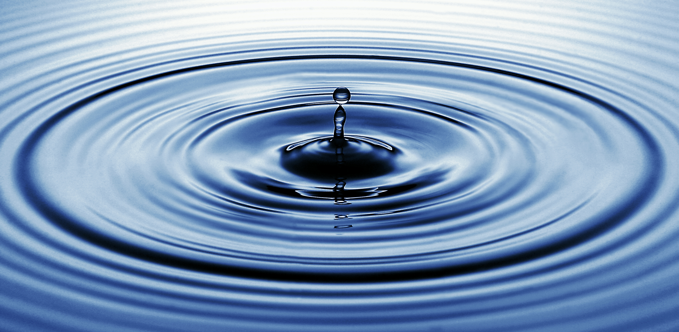
WARM-UP
OPTION 1
Pictures:

Slide 8
WARM-UP
OPTION 2
Wordly word chain

Slide 9
WARM-UP
OPTION 2
Wordly word chain
- Start with a nature-related word like “Earth”.
- Write another word related to it. The next one writes something connected to that.
Example: Earth -> water -> wave
- Continue creating a chain of words linked to Earth’s elements and processes.

Slide 10
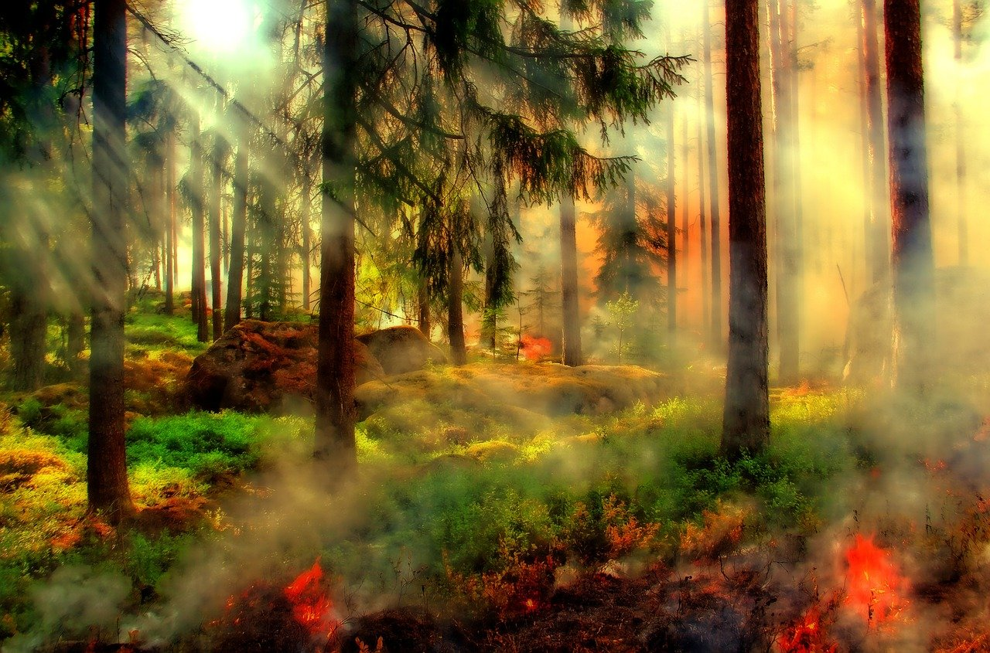

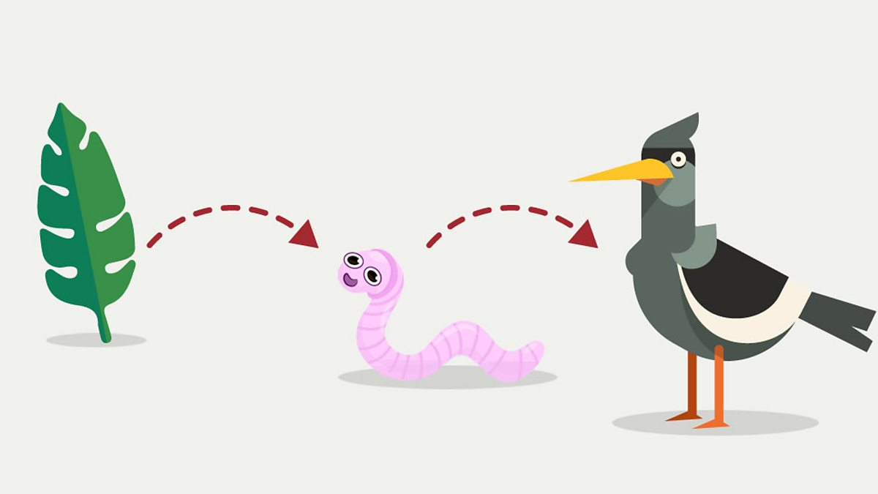
VOCABULARY
nature reserve (n)
/ˈneɪtʃə rɪzɜːv/
khu bảo tồn thiên nhiên

Slide 11

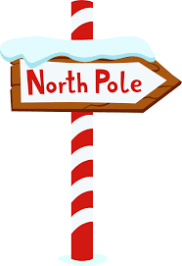
VOCABULARY
food chain (n)
/ˈfuːd tʃeɪn/
chuỗi thức ăn

Slide 12
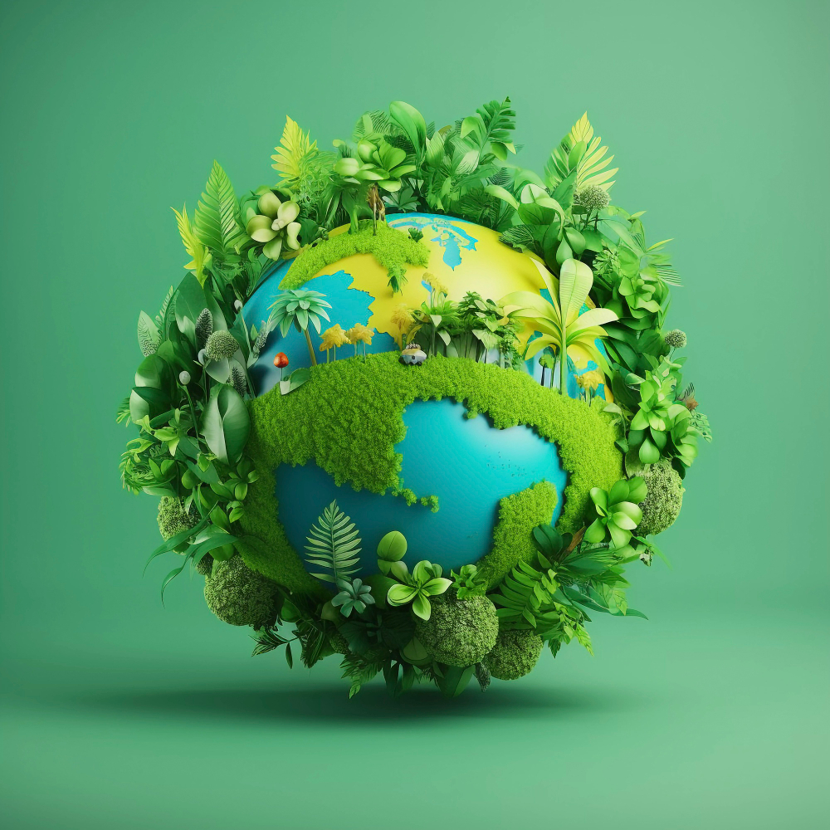
VOCABULARY
pole (n)
/pəʊl/
cực (Bắc / Nam)

Slide 13
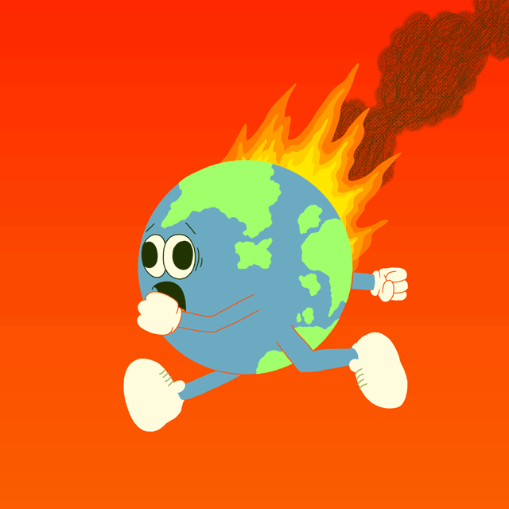
VOCABULARY
ecological balance
/ˌiːkəˈlɒdʒɪkl ˈbæləns/
cân bằng sinh thái

Slide 14
VOCABULARY
climate change (n)
/ˈklaɪmət tʃeɪndʒ/
biến đổi khí hậu

Slide 15
VOCABULARY
New words | Pronunciation | Meaning
1. nature reserve (n) | /ˈneɪtʃə rɪzɜːv/ | khu bảo tồn thiên nhiên
2. food chain (n) | /ˈfuːd tʃeɪn/ | chuỗi thức ăn
3. pole (n) | /pəʊl/ | cực (Bắc / Nam)
4. ecological balance | /ˌiːkəˈlɒdʒɪkl ˈbæləns/ | cân bằng sinh thái
5. climate change (n) | /ˈklaɪmət tʃeɪndʒ/ | biến đổi khí hậu

Slide 16
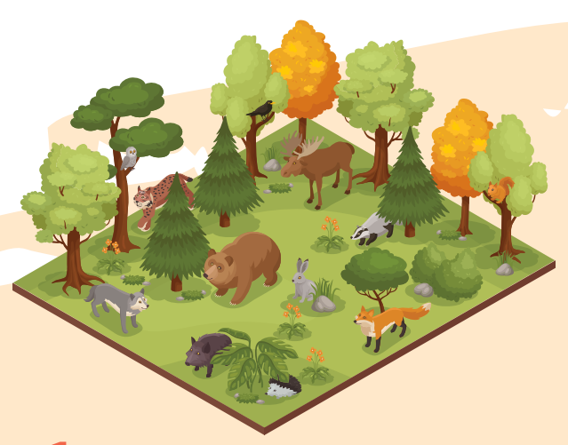
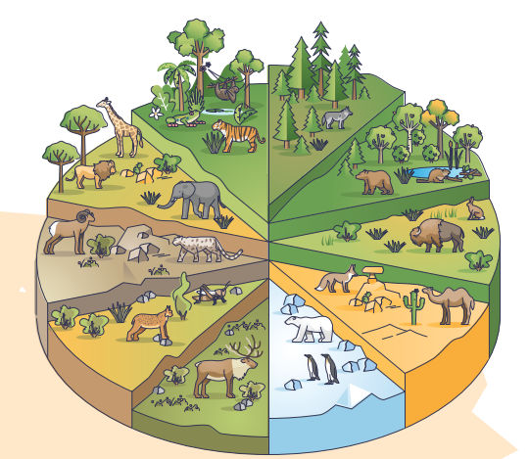
VOCABULARY
1
Write a word or phrase from the box under each picture.
habitats
flora and fauna
grassland
nature reserves
food chain
poles

Slide 17
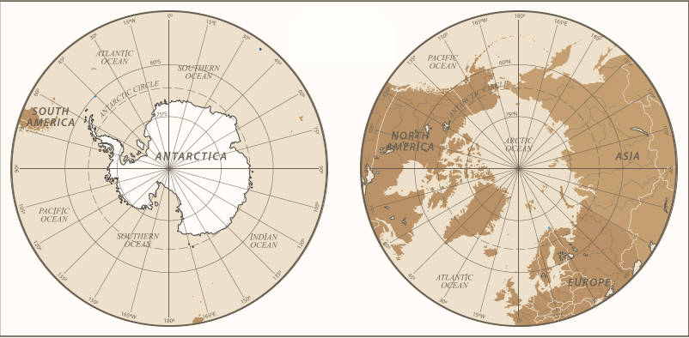
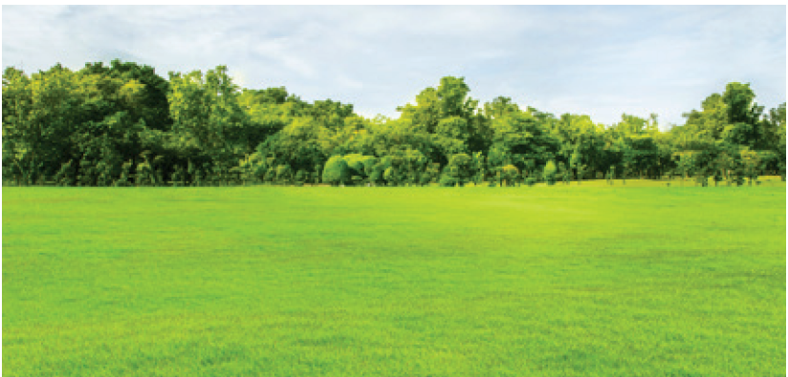
VOCABULARY
1
Write a word or phrase from the box under each picture.
habitats
flora and fauna
grassland
nature reserves
food chain
poles

Slide 18
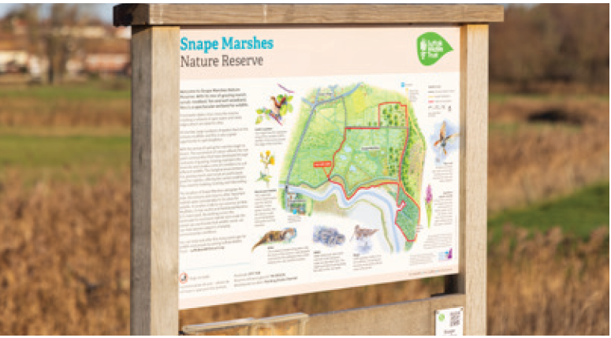
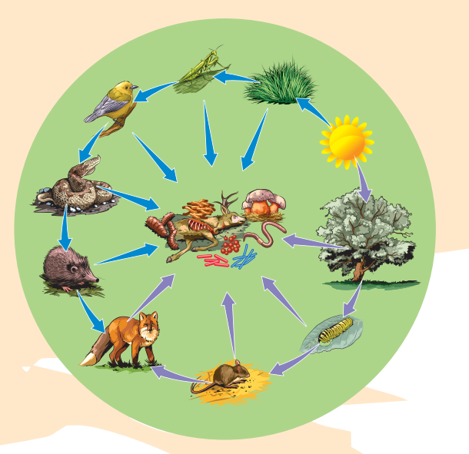
VOCABULARY
1
Write a word or phrase from the box under each picture.
habitats
flora and fauna
grassland
nature reserves
food chain
poles

Slide 19
VOCABULARY
2
Complete each sentence with a word or phrase from 1.
1. In a __________, some animals eat other animals and become food for a third group of animals.
food chain
grassland
2. A _________ is often wide and its plants are mostly grass and flowers
3. Areas of land to protect animals and plants are called ______________.
nature reserves
4. The North and South _____ are both extremely cold and icy.
poles
5. Natural ________ for pandas are bamboo forests.
habitats

Slide 20
VOCABULARY
3
Choose the correct answer A, B, C, or D.
1. When humans use a natural habitat for farming and housing, they cause ______.
A. climate change
C. habitat loss
B. global warming
D. ecological balance
2. When Earth’s average temperature increases, we face _____.
A. ecological balance
C. pollution
B. global warming
D. protection

Slide 21
VOCABULARY
3
Choose the correct answer A, B, C, or D.
3. Each of us can lend a hand to ____ the natural environment.
A. hunt
C. preserve
B. change
D. pollute
4. We can keep a(n) ____ by stopping hunting and cutting down trees.
A. ecological balance
C. climate change
B. habitat loss
D. nature reserve

Slide 22








VOCABULARY
3
Choose the correct answer A, B, C, or D.
5. One way to ______ Mother Earth is by planting more trees.
A. keep
C. provide
B. harm
D. protect

Slide 23

PRONUNCIATION
When we speak English, we place stress on certain syllables in a sentence. The combination of stressed and unstressed syllables produces rhythm in spoken English.
1. Earth is the third planet from the Sun.
2. Oceans, seas, rivers, and lakes are water bodies.
3. The North and South poles are extremely cold and icy.
4. Do moonquakes last up to half an hour?
5. Preserving natural resources is very important.

Slide 24
PRONUNCIATION
4
Listen to the sentences and pay attention to the bold syllables. Does the speaker place stress on them?
1. Earth is the third planet from the Sun.
2. Oceans, seas, rivers, and lakes are water bodies.
3. The North and South poles are extremely cold and icy.
4. Do moonquakes last up to half an hour?
5. Preserving natural resources is very important.

Slide 25
PRONUNCIATION
5
Circle the stressed syllables in the sentences. Listen, check, and repeat.
1. We’re doing a study on climate change.
2. What is the distance from Earth to Mars?
3. They’ll have a discussion on natural habitats.
4. Plants provide us with food, oxygen, and energy.
5. Our school organised various activities on Earth Day.

Slide 26

CONSOLIDATION
1
Wrap-up
What have we learnt in this lesson?
Use the lexical items related to the topic Planet Earth;
Have the right rhythm in sentences.

Slide 27

CONSOLIDATION
2
Homework
- Do exercises in the workbook.

Slide 28
Website: hoclieu.vn
Fanpage: facebook.com/tienganhglobalsuccess.vn/

