Slide 2
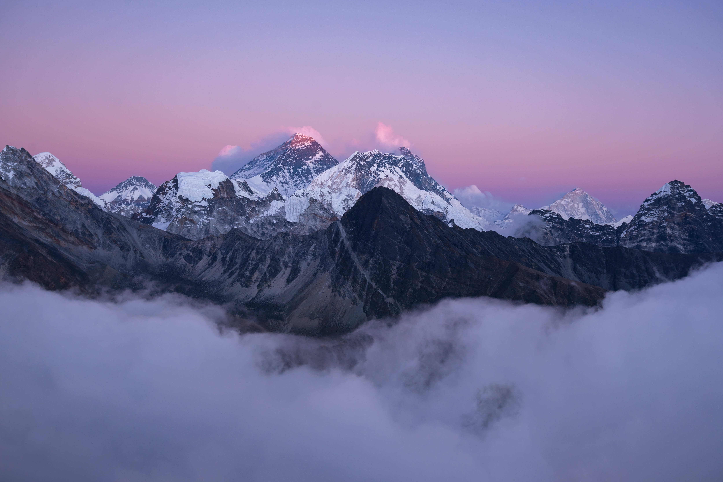


Unit
7
NATURAL WONDERS OF THE WORLD
LESSON 1: GETTING STARTED
Meeting on the corridor

Slide 3
LESSON 1: GETTING STARTED
LESSON 1: GETTING STARTED
WARM-UP
Option 1: Think!
Option 2: Create a Travel Brochure
PRESENTATION
Vocabulary
Task 1: Listen and read.
Task 2: Read the conversation again and tick (√) T (True) or F (False) for each sentence.
Task 3: Complete each sentence with a word or a phrase from the box.
Task 4: Underline the correct answer to complete each sentence.
PRACTICE
PRODUCTION
Task 5: Natural Wonders Knowledge
CONSOLIDATION
Wrap-up
Homework

Slide 4

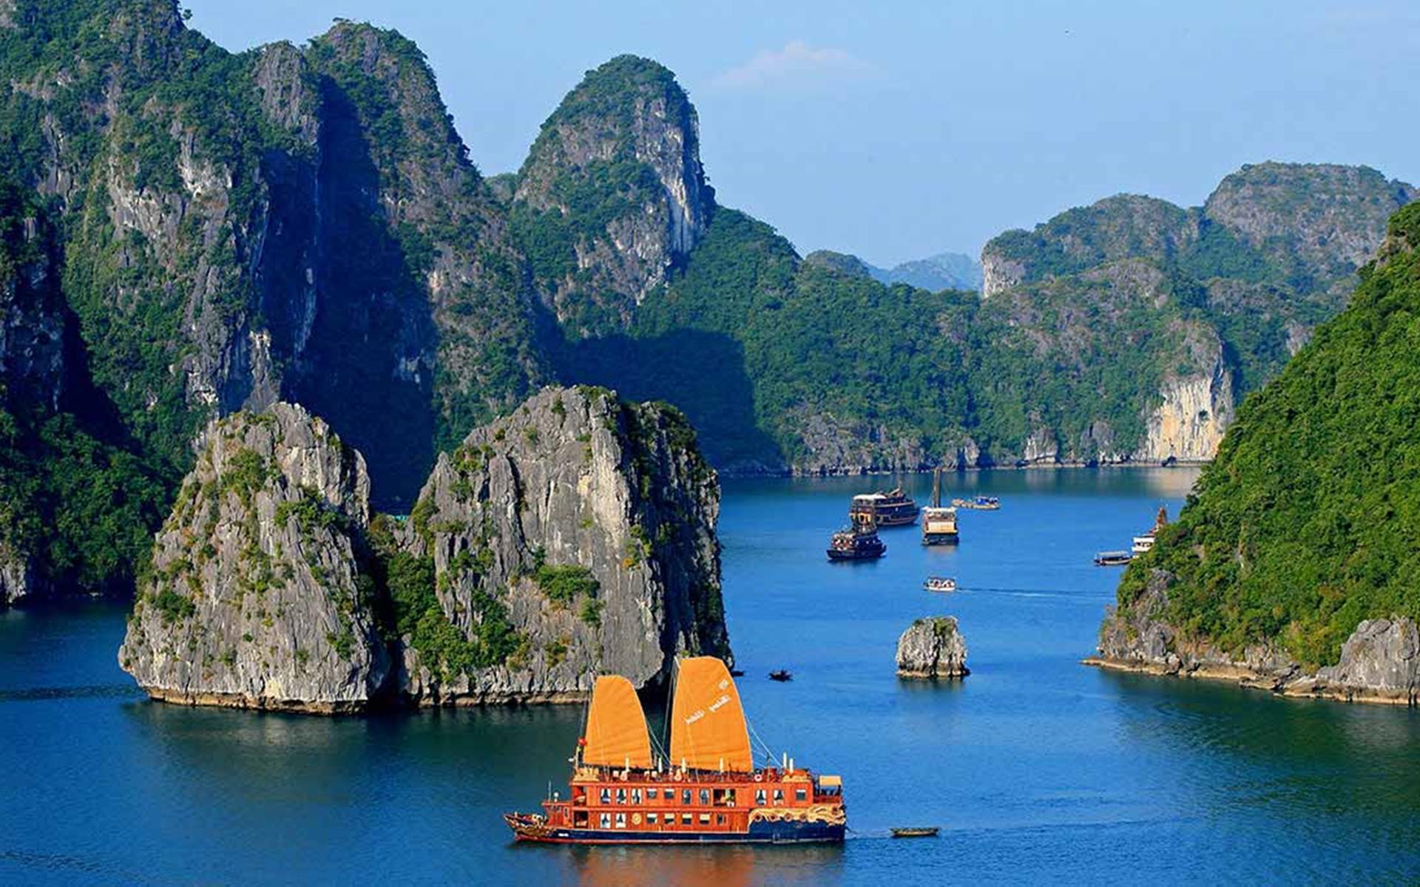
WARM-UP
OPTION 1
Questions:
What are the most beautiful places in your country?
Where are they?
Are they natural or man-made? …
THINK

Slide 5
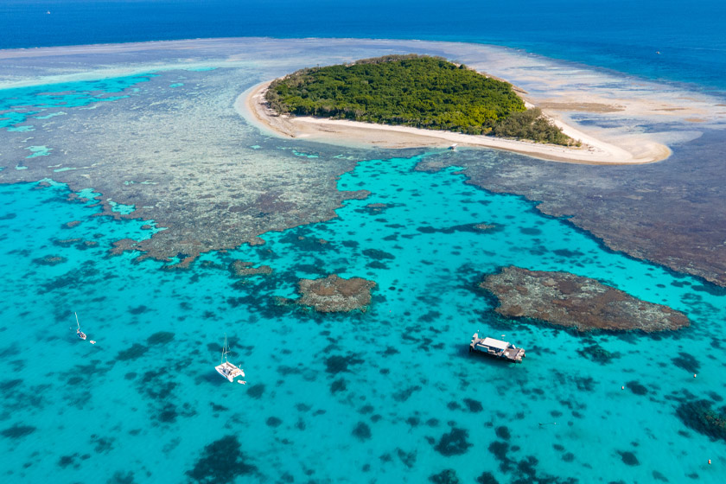
WARM-UP
OPTION 1
HA LONG BAY

Slide 6
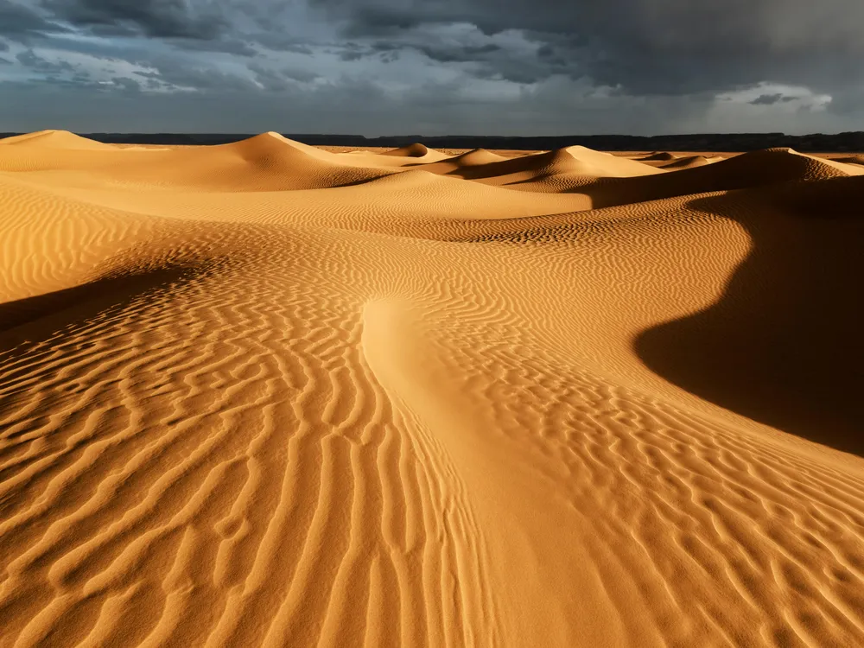
WARM-UP
OPTION 1
GREAT BARRIER
REEF

Slide 7
WARM-UP
OPTION 1
SAHARA DESERT

Slide 8

WARM-UP
OPTION 2
CREATE
TRAVEL
BROCHURE

Slide 9
WARM-UP
OPTION 2
- Work in groups.
- Each group chooses a beautiful place you like.
- Use the information you find to create a travel brochure for that place.
Information in brochures:
- Location
- Climate
- Why someone should visit
CREATE
TRAVEL
BROCHURE

Slide 10

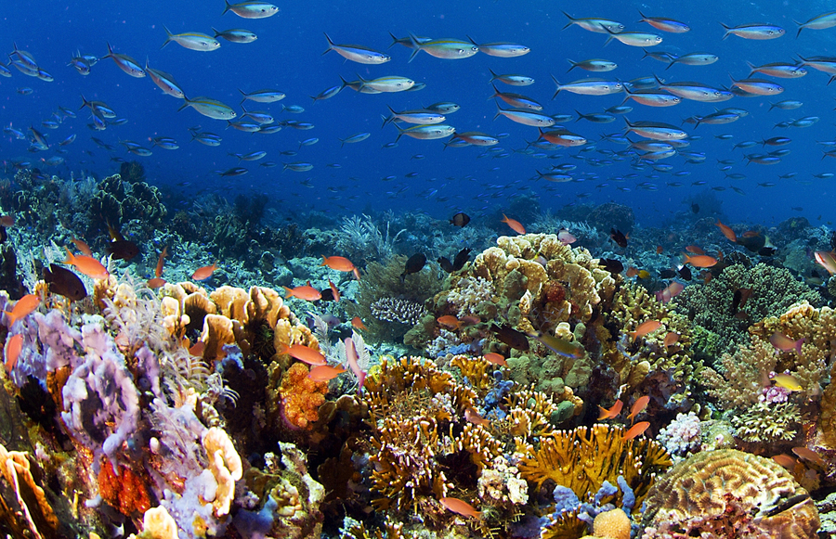
PRESENTATION
crazy (adj)
about smb/sth
like smb/sth very much
E.g. I was crazy about baseball when I was seven.
/ˈkreɪzi/
thích mê

Slide 11
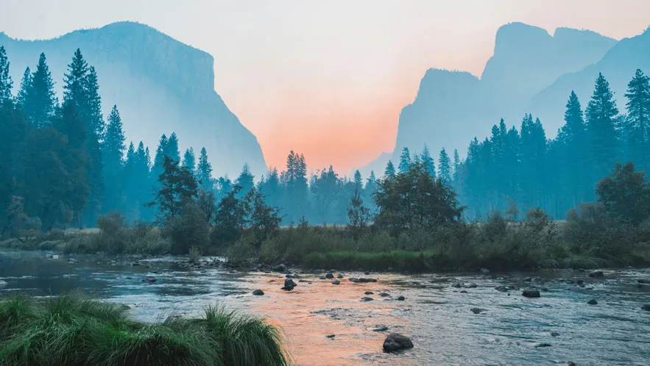
PRESENTATION
a substance like rock, formed in the sea by groups of particular types of small animal, often used in jewelry.
coral (n, adj)
/ˈkɒrəl/
san hô

Slide 12
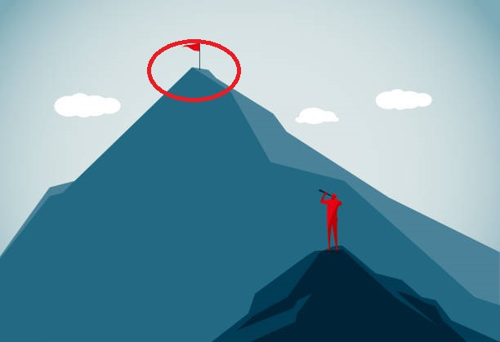
PRESENTATION
a view or picture of the countryside, or the art of making such pictures.
landscape (n)
/ˈlændskeɪp/
phong cảnh

Slide 13
PRESENTATION
peak (n)
the highest point
/piːk/
đỉnh, đỉnh núi

Slide 14
PRESENTATION
charming (adj)
pleasant and attractive
/ˈtʃɑːmɪŋ/
E.g. What a charming street this is.
đẹp

Slide 15

PRESENTATION
able to be maintained or continued
sustainable (adj)
/səˈsteɪnəbl/
E.g. The website encourages sustainable fashion through swapping.
bền vững

Slide 16
PRESENTATION
location (n)
a place or position
/ləʊˈkeɪʃn/
địa điểm,
nơi chốn

Slide 17
PRESENTATION
possess (v)
to have or own sth
/pəˈzes/
E.g. I don't possess a single DVD. (= I don't have even one DVD).
có, sở hữu

Slide 18
PRESENTATION
New words | Pronunciation | Meaning
1. crazy (adj) about smb/sth | /ˈkreɪzi/ | thích mê
2. coral (n, adj) | /ˈkɒrəl/ | san hô
3. landscape (n) | /ˈlændskeɪp/ | phong cảnh
4. peak (n) | /piːk/ | đỉnh, đỉnh núi

Slide 19
PRESENTATION
New words | Pronunciation | Meaning
5. charming (adj) | /ˈtʃɑːmɪŋ/ | đẹp
6. sustainable (adj) | /səˈsteɪnəbl/ | bền vững
7. location (n) | /ləʊˈkeɪʃn/ | địa điểm, nơi chốn
8. possess (v) | /pəˈzes/ | có, sở hữu

Slide 20
PRACTICE
- Answer the questions:
+ Have you ever been to Ha Long Bay?
+ Do you know that it is a famous natural wonder of the world?
+ Have you heard of / read about other wonders: Mount Everest, the Dead Sea, …?

Slide 21
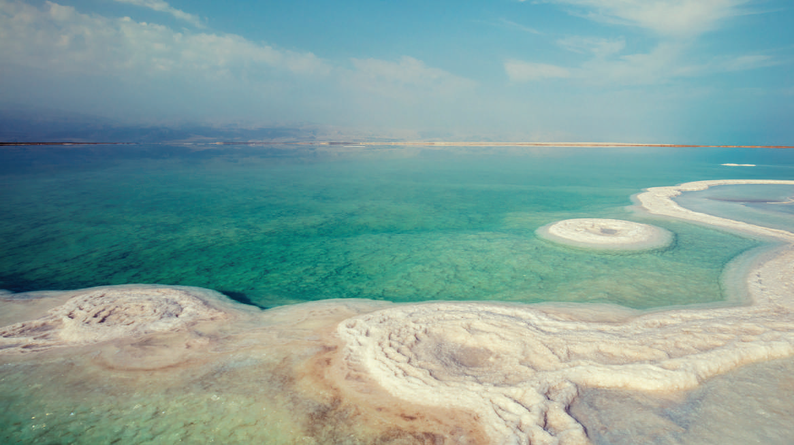
PRACTICE
Look at the pictures on page 72 and answer:
What is the conversation between Lan and Tom about?

Slide 22

PRACTICE
Task 1: Listen and read.
Lan: Hi, Tom. I hear that you’ve won second prize in the Natural Wonders Contest. Congratulations!
Tom: Thanks, Lan. I like exploring the wonders of nature. I’m crazy about them.
Lan: What did you talk about in the contest?
Tom: I talked about some natural wonders like Mount Everest, the Great Barrier Reef, and the Dead Sea.
Lan: Wonderful! I’m interested in them too.
Tom: Well, you know our planet has so many beautiful landscapes, from snow-covered peaks to charming rivers, lakes, and other natural places that we can’t help admiring. So that’s what I talked about.

Slide 23
PRACTICE
Task 1: Listen and read.
Lan: Oh yeah … And what else did you mention?
Tom: Well, I mentioned the risk of us, humans, destroying natural wonders, and I suggested ways to preserve them and support sustainable development.
Lan: Sounds interesting. Do you want to visit any of these places?
Tom: The host also asked me if I wanted to visit those places, and I answered that I wanted to see two of them: the Grand Canyon and Ha Long Bay.
Lan: I’d love to visit them too.

Slide 24
PRACTICE
Questions:
1. Which prize did Tom win?
2. Which natural wonders did Tom talk about?
3. Which risks did Tom mention?
4. Where will Tom visit?
The second prize in the Natural Wonders Contest
Mount Everest, the Great Barrier Reef, and the Dead Sea
Humans, destroying natural wonders
The Grand Canyon and Ha Long Bay.
 | T | F
1. Tom took part in the Natural Wonders Contest.
2. Lan is not keen on natural wonders.
3. Tom suggested ways to preserve natural wonders.
4. Tom asked the host if he wanted to go to Ha Long Bay.

Slide 25

PRACTICE
2
Read the conversation again and tick (√) T (True) or F (False) for each sentence.
 | T | F
1. Tom took part in the Natural Wonders Contest.
2. Lan is not keen on natural wonders.
3. Tom suggested ways to preserve natural wonders.
4. Tom asked the host if he wanted to go to Ha Long Bay.

Slide 26
PRACTICE
3
Complete each sentence with a word or a phrase from the box.
explore
couldn’t help
landscape
support
development
1. A __________ is everything you can see in a large area of land, especially in the countryside.
4. Environmentalists strongly ______________ measures to save these heritage trees.
2. It was risky for him to climb the peak, but we ____________ admiring his courage.
5.Sustainable ________________ goals will guide us to create a more sustainable future for all.
3.The best way to _______ the Trang An Landscape Complex is by boat.

Slide 27
PRACTICE
3
Complete each sentence with a word or a phrase from the box.
explore
couldn’t help
landscape
support
development
1. A _____________________ is everything you can see in a large area of land, especially in the countryside.
4. Environmentalists strongly __________ measures to save these heritage trees.
2. It was risky for him to climb the peak, but we ______________ admiring his courage.
5. Sustainable _____________ goals will guide us to create a more sustainable future for all.
3.The best way to _____________ the Trang An Landscape Complex is by boat.

Slide 28
PRACTICE
4
Underline the correct answer to complete each sentence.
1. Charles is crazy / interested about football. He follows all the World Cup matches.
2. When you go to Mui Ne, you can see the unique location / landscape of a desert.
3. The children were very eager to explore/ possess the surrounding countryside.
4. Can you suggest / discover ways of boosting our local tourism?
5. Tourism develops / contributes millions of dollars to our country’s economy.

Slide 29

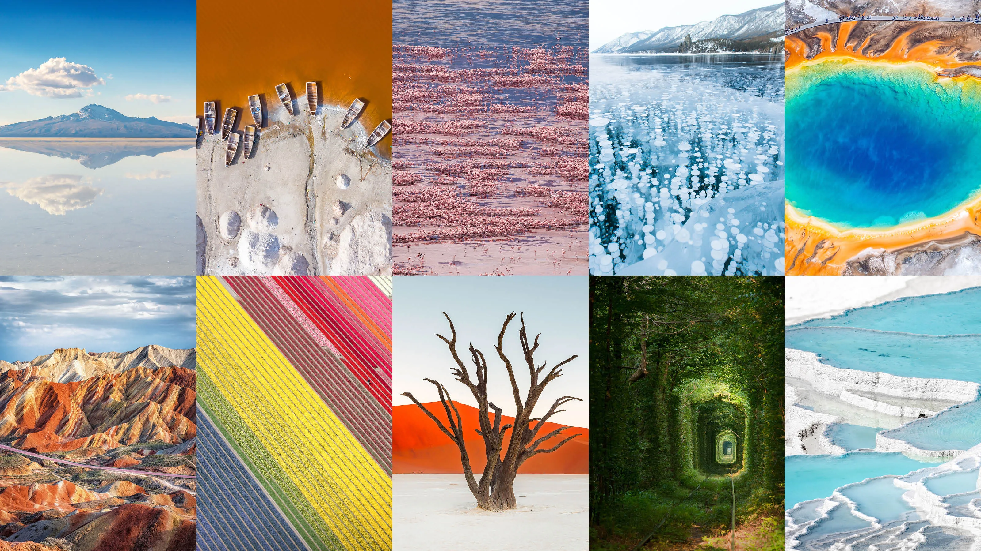
PRODUCTION
5
Natural Wonders Knowledge.
Work in groups. List some natural wonders and say where they are located. The group that has the most correct answers wins.

Slide 30
PRODUCTION
Suggested answers:
- The Grand Canyon, USA
- The Great Barrier Reef, Australia
- Ha Long Bay, Viet Nam
- Northern Lights, Arctic and Antartic

Slide 31

CONSOLIDATION
1
Wrap-up
What have we learnt in this lesson?
Use the words related to the topic Natural wonders of the world;
Gain vocabulary to talk about natural wonders.

Slide 32

CONSOLIDATION
2
Homework
- Do exercises in the workbook.

Slide 33
CONSOLIDATION
2
Homework
- Prepare for the Project of the unit.
- Open the book p. 81, look at the picture and say what the topic of the project is.
- Work in groups to design a poster.
- Show and present the poster in Lesson 7 – Looking back and Project.

Slide 34
CONSOLIDATION
2
Homework
Collecting information and pictures (searching the Internet, reading books / magazines, brainstorming ideas, etc. about a natural wonder: its location, its special features / attractions, threats to its existence, and ways / plans to preserve it.
Step 1
Organising ideas and visuals, and designing the posters .
Step 2
Practising explaining your posters and answering questions about the content
Step 3

Slide 35
Website: hoclieu.vn
Fanpage: facebook.com/tienganhglobalsuccess.vn/

