Slide 2
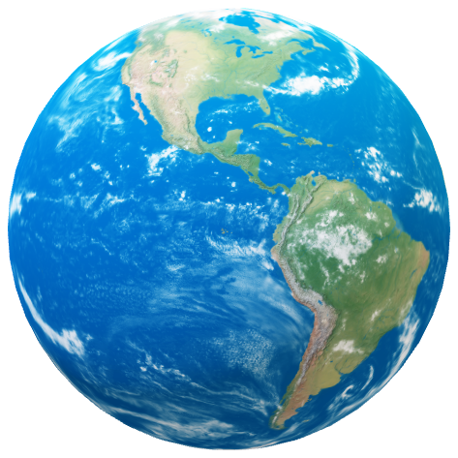
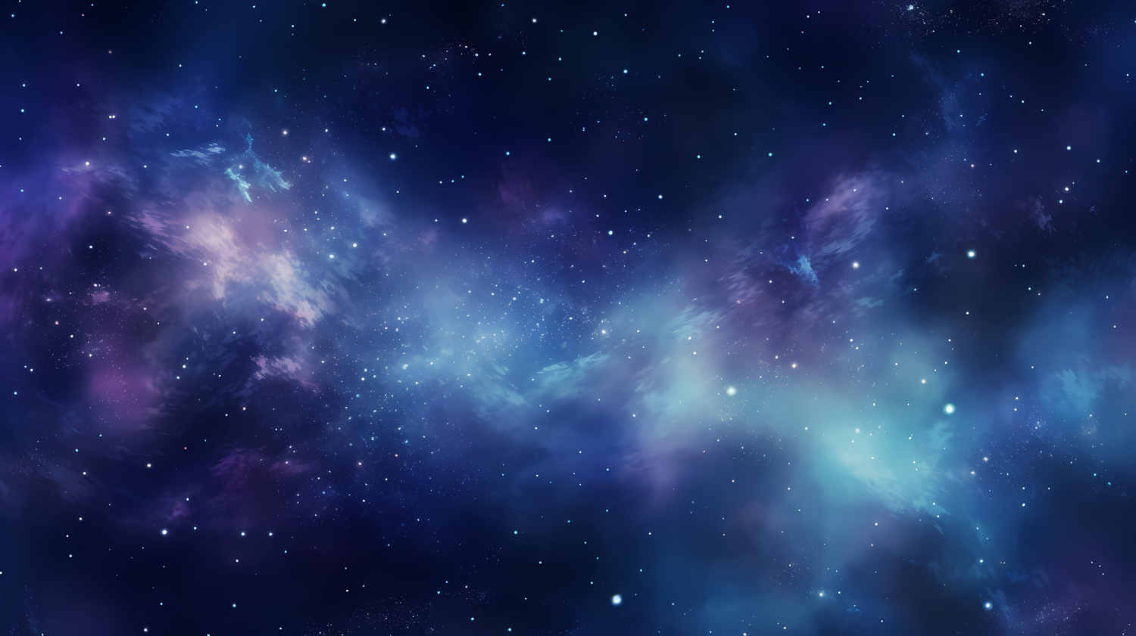


Unit
10
PLANET EARTH
PLANET EARTH
PLANET EARTH
LESSON 1: GETTING STARTED
In a science club

Slide 3
Unit
10
PLANET EARTH
PLANET EARTH
PLANET EARTH
LESSON 1: GETTING STARTED
In a science club

Slide 4
LESSON 1: GETTING STARTED
LESSON 1: GETTING STARTED
WARM-UP
Option 1: Think!
Option 2: Making a Solar System picture.
PRESENTATION
Vocabulary
Task 1: Listen and read.
Task 2: Read the conversation again and tick T (True) or F (False) for each sentence.
Task 3: Write a word or phrase from the box under the correct picture.
Task 4: Complete each sentence with a word or phrase from 3.
PRACTICE
PRODUCTION
Task 5: Quiz: Work in groups. Answer the following questions.
CONSOLIDATION
Wrap-up
Homework

Slide 5

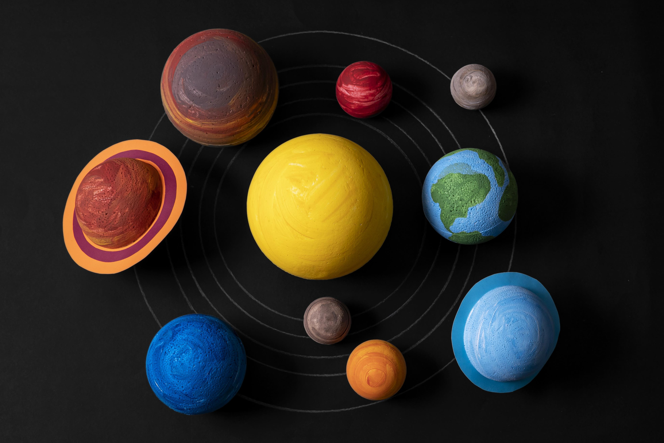
WARM-UP
OPTION 1
- Work in 2 groups to play games.
- There are 2 sets of names of planets.
- The two groups to stick the names of planets on the position from the Sun outward.
THINK

Slide 6
Jupiter
Mars
WARM-UP
OPTION 1
Saturn
Earth
Neptune
Uranus
Mercury
Venus

Slide 7
WARM-UP
OPTION 1
Jupiter
Mars
HA LONG BAY
Saturn
Earth
Mercury
Uranus
Neptune
Venus

Slide 8
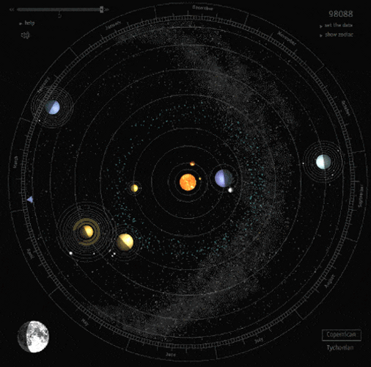
WARM-UP
OPTION 2
Making a Solar System picture

Slide 9
WARM-UP
OPTION 2
- There are large sheets of paper and art supplies.
- Work together to create a picture about the solar system by showing your creativity and understanding of planetary features.
Making a Solar System picture

Slide 10
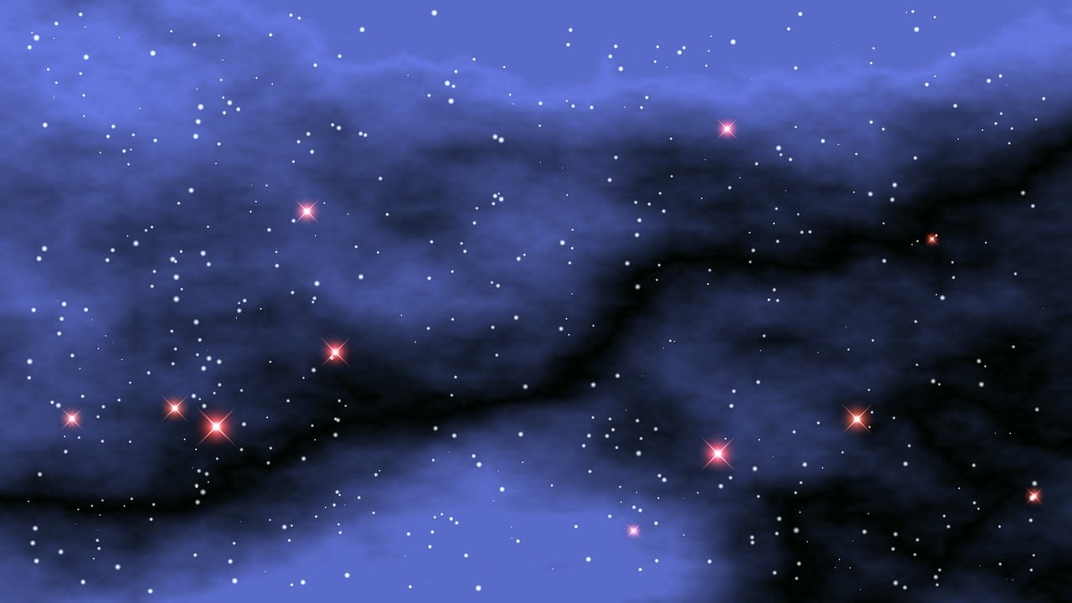

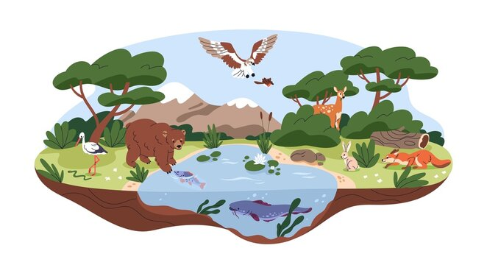
PRESENTATION
outer space (n)
/ˌaʊtə ˈspeɪs/
ngoài vũ trụ

Slide 11
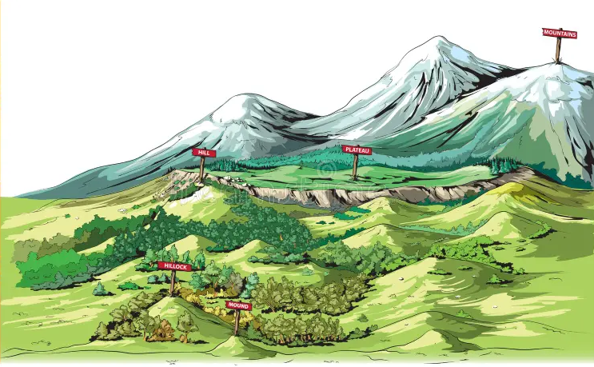
PRESENTATION
habitat (n)
/ˈhæbɪtæt/
môi trường sống của động thực vật

Slide 12

PRESENTATION
landform (n)
/ˈlændfɔːm/
dạng địa hình, địa mạo

Slide 13
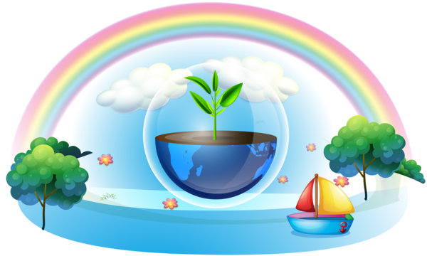
PRESENTATION
essential (adj)
/ɪˈsenʃl/
vô cùng quan trọng

Slide 14
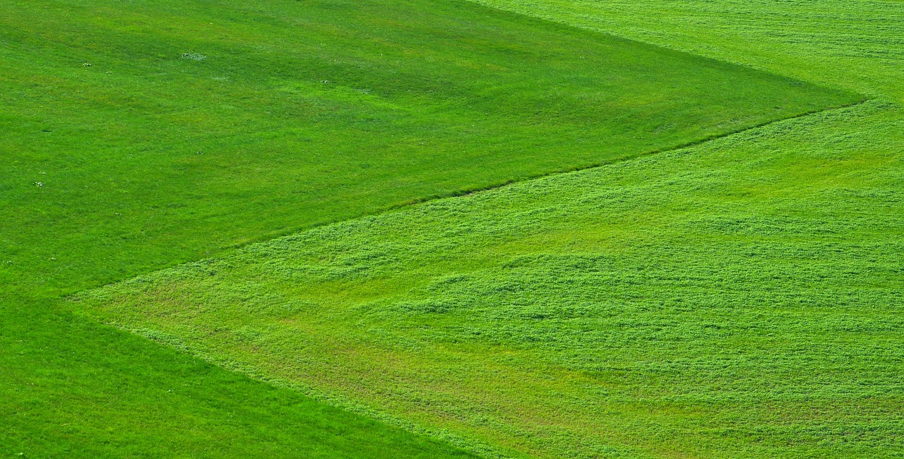
PRESENTATION
preserve (v)
/prɪˈzɜːv/
bảo tồn

Slide 15
PRESENTATION
grassland (n)
/ˈɡrɑːslænd/
khu vực đồng cỏ

Slide 16
PRESENTATION
New words | Pronunciation | Meaning
1. outer space (n) | /ˌaʊtə ˈspeɪs/ | ngoài vũ trụ
2. habitat (n) | /ˈhæbɪtæt/ | môi trường sống của động thực vật
3. landform (n) | /ˈlændfɔːm/ | dạng địa hình, địa mạo
4. essential (adj) | /ɪˈsenʃl/ | vô cùng quan trọng
5. preserve (v) | /prɪˈzɜːv/ | bảo tồn
6. grassland (n) | /ˈɡrɑːslænd/ | khu vực đồng cỏ

Slide 17
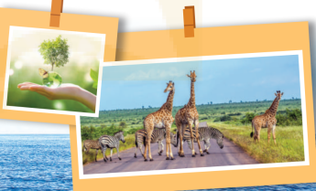
PRACTICE
- Look at the heading In a science club, the conversation and the pictures. Then, answer these questions:
Questions:
1. What can you see in the
pictures?
2. What do you think Mr An,
Nick and Lan are talking about?

Slide 18

PRACTICE
1
Listen and read.
President: Hi, welcome to our science club. Our topic today is planet Earth. Our guest is Mr An, an earth scientist.
Mr An: Hi everybody. Pleased to meet you. I’m looking forward to answering your questions about our planet.
Lan: Mr An, where’s Earth in the Solar System?
Mr An: There are eight planets in the Solar System, and Earth is the third from the Sun, after Mercury and Venus. It’s also the fifth largest in our system.
Nick: Is it also called the Blue Planet?
Mr An: Right. From the outer space it looks blue because water covers more than 70 per cent of it.
Lan: Is it the only planet that has liquid water?

Slide 19
PRACTICE
1
Listen and read.
Mr An: Exactly. Without it, there wouldn’t be living things, like humans, or the flora and fauna of your habitat.
Nick: How about the role of air, light and heat? How do they affect Earth?
Mr An: Well, water bodies and landforms, which are main areas on Earth, together with air, light, and heat, provide essential habitats for plants and animals.
Nick: It’s fascinating to observe and study these habitats.
Mr An: Yes. However, they are being destroyed by pollution. We should all help out to preserve them. …

Slide 20
PRACTICE
- Look at these questions again:
Questions:
1. What can you see in the pictures?
2. What do you think Mr An, Nick and Lan are talking about?
Suggested answers:
1. We can see the giraffes, a globe, plants and sea / ocean.
2. They are talking about Earth, it’s another name, its living things and non-living things.

Slide 21

PRACTICE
2
Read the conversation again and tick (√) T (True) or F (False) for each sentence.
 | T | F
1. The students are asking about the Solar System.
2. Another name for Earth is the Blue Planet.
3. Water covers four fifths of Earth.
4.Water bodies and landforms are essential habitats for plants and animals.
5. Mr An thinks pollution is threatening the habitats of plants and animals.

Slide 22
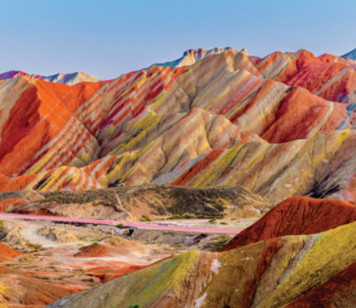
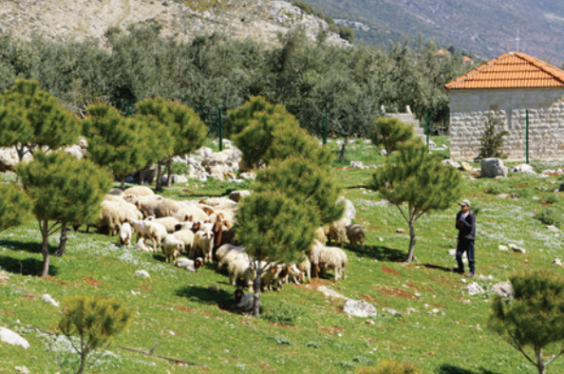
PRACTICE
3
Write a word or phrase from the box under the correct picture.
liquid water
flora and fauna
Solar System
landforms
water bodies
outer space

Slide 23
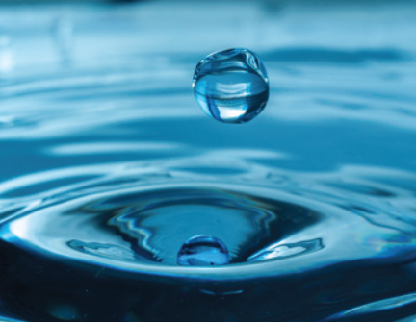
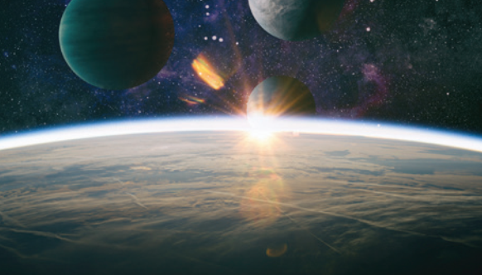
PRACTICE
3
Write a word or phrase from the box under the correct picture.
liquid water
flora and fauna
Solar System
landforms
water bodies
outer space

Slide 24
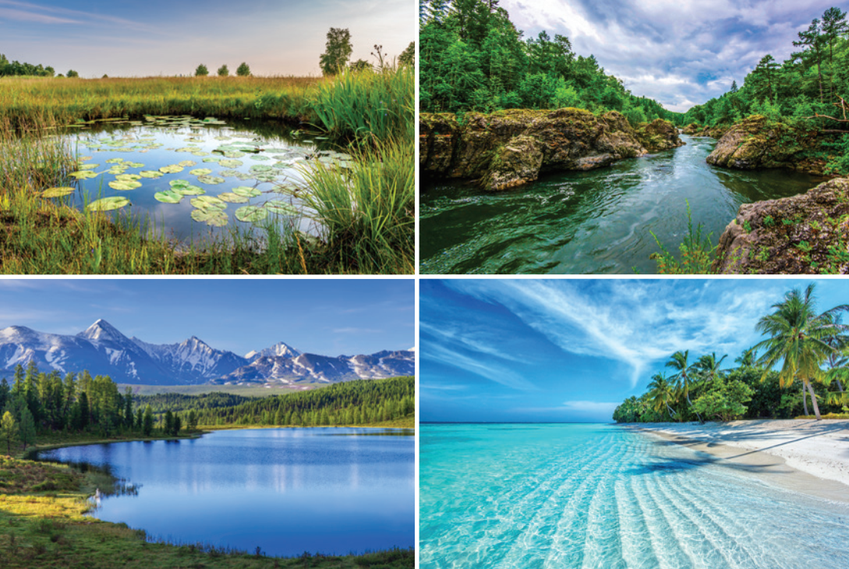
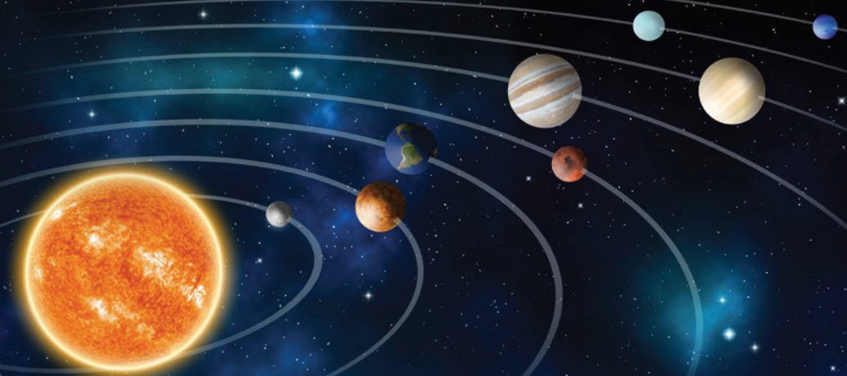
PRACTICE
3
Write a word or phrase from the box under the correct picture.
liquid water
flora and fauna
Solar System
landforms
water bodies
outer space

Slide 25
PRACTICE
4
Complete each sentence with a word or phrase from 3.
Flora and fauna
1. ______________ refer to the plants and animals of a particular place.
2. Oceans, seas, rivers, and lakes are different types of ____________ on Earth.
water bodies
3. There are eight planets in the ____________.
solar system
4. The Soviet Union launched Sputnik 1 into ____________ in 1957.
outer space
5. Some examples of __________ include mountains, grassland, and deserts.
landforms

Slide 26
FURTHER PRACTICE
5
QUIZ: Work in groups. Answer the following questions.
1. 7 (Asia, Africa, North America, South America, Europe, Australia and Antarctica)
2. 5 (Arctic, Atlantic, Indian, Pacific, and Southern)
3. 1
4. 1. Oxygen (O2), medical use, 2. Nitrogen (N2): fire suppression, provides an inert atmosphere 3. Helium (He): balloons, medical equipment 4. Argon (Ar): welding, provides an inert atmosphere for materials 5. Carbon dioxide (CO2): carbonated soft drinks …
5. Mars
1. How many continents are there on Earth?
2. How many oceans are there on Earth?
3. How many moons orbit Earth?
4. Which gas is essential for life on Earth?
5. Which planet has conditions similar to those on Earth?

Slide 27
1. How many continents are there on Earth?
2. How many oceans are there on Earth?
3. How many moons orbit Earth?
4. Which gas is essential for life on Earth?
5. Which planet has conditions similar to those on Earth?
PRODUCTION
Suggested answers:
1. 7 (Asia, Africa, North America, South America, Europe, Australia, and Antarctica)
2. 5 (Arctic, Atlantic, Indian, Pacific, and Southern Oceans)
3. 1
4. 1. Oxygen (O2), medical use; 2. Nitrogen (N2): fire suppression, provides an inert atmosphere; 3. Helium (He): balloons, medical equipment; 4. Argon (Ar): welding, provides an inert atmosphere for materials; 5. Carbon dioxide (CO2): carbonated soft drinks …
5. Mars

Slide 28

CONSOLIDATION
1
Wrap-up
What have we learnt in this lesson?
Use the words related to the topic Planet Earth;
Gain vocabulary about planet Earth and habitats.

Slide 29

CONSOLIDATION
2
Homework
- Do exercises in the workbook.
- Start prepare for the Unit project.

Slide 30
Website: hoclieu.vn
Fanpage: facebook.com/tienganhglobalsuccess.vn/

