Slide 1
UNIT 8: FILMS
Lesson 5: Skills 1

Slide 2
OBJECTIVES
Reading
read for specific information about one's favourite film
Speaking
talk about a film
Notes:
;;

Slide 3
01
Reading

Slide 4

1. Work in pairs. Discuss the following questions.
Do you like fantasies?
Why or why not?

Slide 5

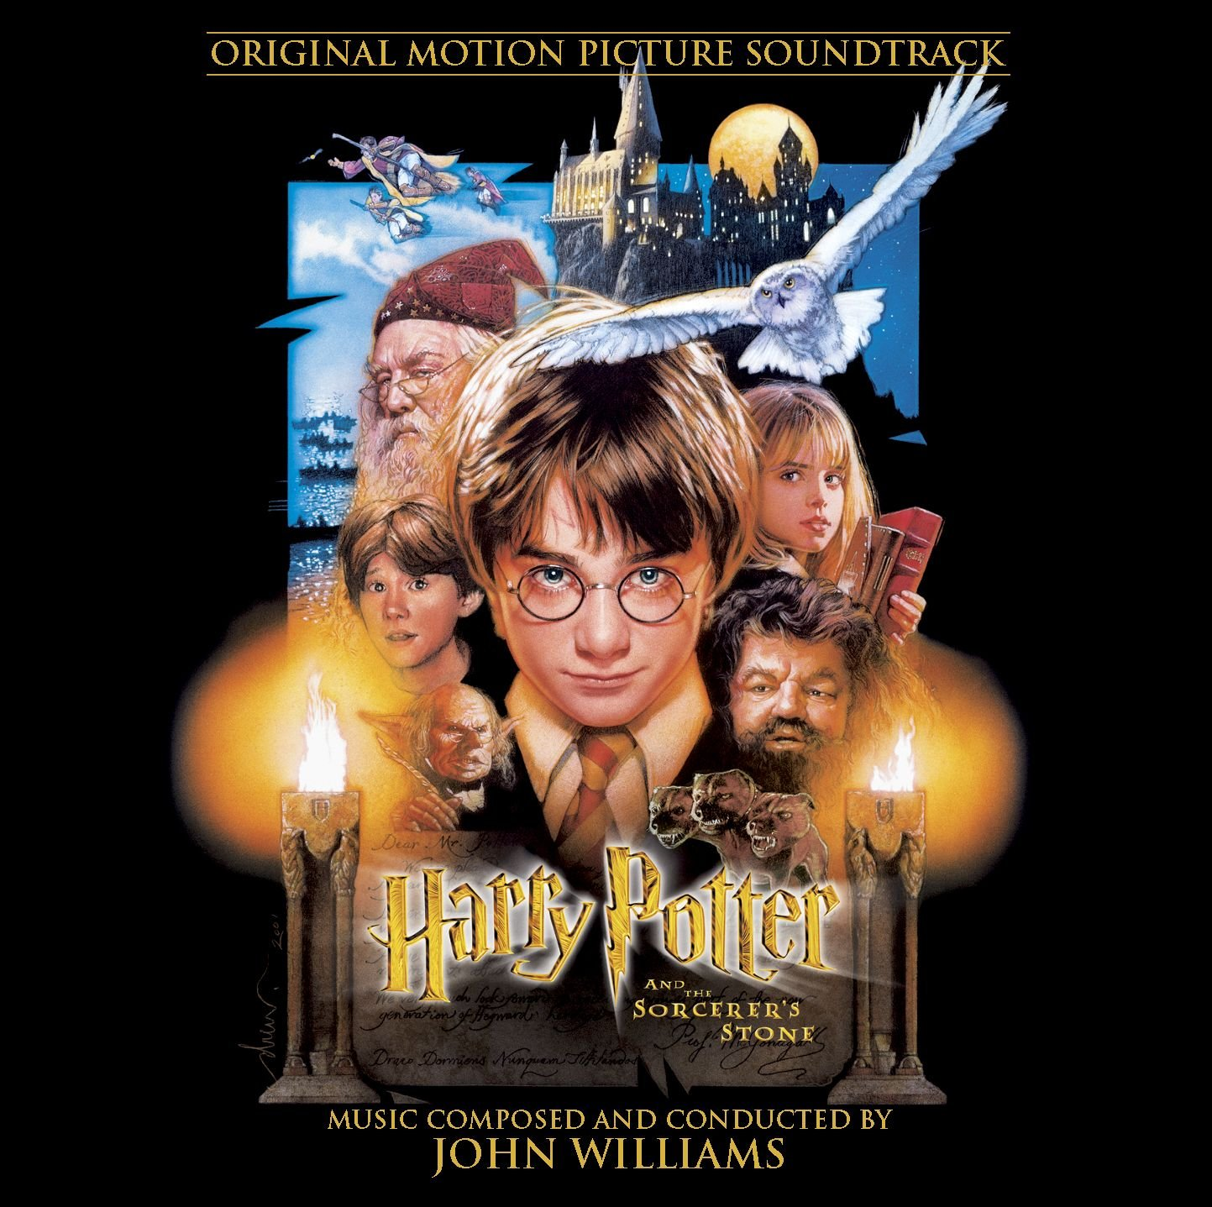
Watch closely and guess the name of the movie.

Slide 6
2. Read the film review of Harry Potter and the Sorcerer's Stone on Mark's blog. Match the words with their meanings.
Mon, Apr 20th
Harry Potter and the Sorcerer’s Stone is a fantasy. Its director is Chris Columbus. It is the first of the Harry Potter film series.
Daniel Radcliffe is one of the stars in the film.
The film tells the story of Harry Potter. He’s a powerful wizard. He is a student at a school for wizards and learns about himself, his family, and the bad things happening around him.
The film received a lot of good reviews. People say it’s a must-see for teens. I agree because the story is gripping and the acting is excellent. The music is also amazing.
Although Harry Potter and the Sorcerer’s Stone is a little frightening at times, it is very interesting and full of action. Go and see it if you can.
Posted by Mark at 5.30 p.m.
1. series
a. something that is so good that you think others should see it
2. wizard
b. related films that tell stories about the same characters
3. must-see
c. very exciting or interesting
4. gripping
d. a man who has magical powers

Slide 7

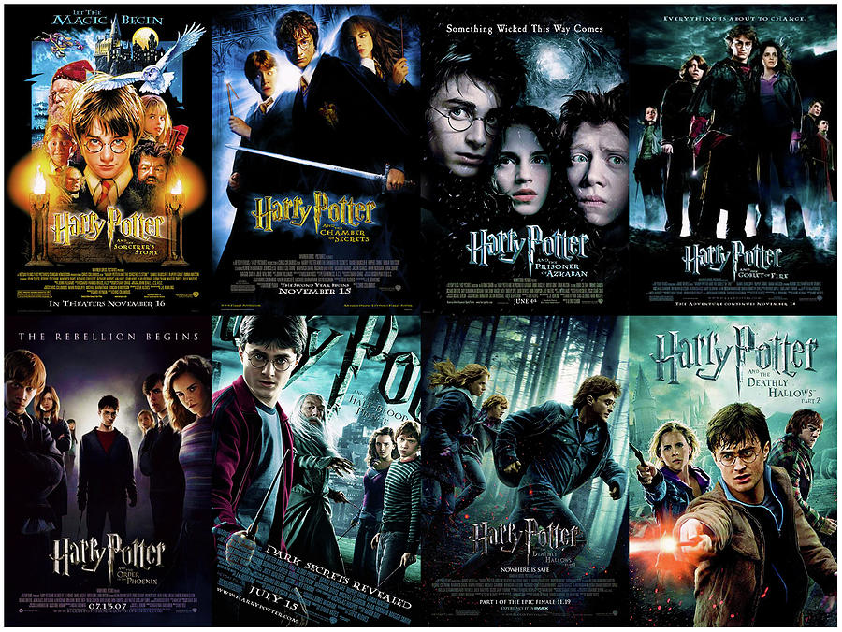
2. Read the film review of Harry Potter and the Sorcerer's Stone on Mark's blog. Match the words with their meanings.
Mon, Apr 20th
Harry Potter and the Sorcerer’s Stone is a fantasy. Its director is Chris Columbus. It is the first of the Harry Potter film series.
Daniel Radcliffe is one of the stars in the film.
The film tells the story of Harry Potter. He’s a powerful wizard. He is a student at a school for wizards and learns about himself, his family, and the bad things happening around him.
The film received a lot of good reviews. People say it’s a must-see for teens. I agree because the story is gripping and the acting is excellent. The music is also amazing.
Although Harry Potter and the Sorcerer’s Stone is a little frightening at times, it is very interesting and full of action. Go and see it if you can.
Posted by Mark at 5.30 p.m.
Mon, Apr 20th
Harry Potter and the Sorcerer’s Stone is a fantasy. Its director is Chris Columbus. It is the first of the Harry Potter film series.
Daniel Radcliffe is one of the stars in the film.
The film tells the story of Harry Potter. He’s a powerful wizard. He is a student at a school for wizards and learns about himself, his family, and the bad things happening around him.
The film received a lot of good reviews. People say it’s a must-see for teens. I agree because the story is gripping and the acting is excellent. The music is also amazing.
Although Harry Potter and the Sorcerer’s Stone is a little frightening at times, it is very interesting and full of action. Go and see it if you can.
Posted by Mark at 5.30 p.m.
1. series
series (n) /'siəri:z/
a. something that is so good that you think others should see it
2. wizard
b. related films that tell stories about the same characters
3. must-see
c. very exciting or interesting
4. gripping
d. a man who has magical powers

Slide 8
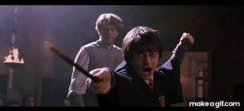
2. Read the film review of Harry Potter and the Sorcerer's Stone on Mark's blog. Match the words with their meanings.
Mon, Apr 20th
Harry Potter and the Sorcerer’s Stone is a fantasy. Its director is Chris Columbus. It is the first of the Harry Potter film series.
Daniel Radcliffe is one of the stars in the film.
The film tells the story of Harry Potter. He’s a powerful wizard. He is a student at a school for wizards and learns about himself, his family, and the bad things happening around him.
The film received a lot of good reviews. People say it’s a must-see for teens. I agree because the story is gripping and the acting is excellent. The music is also amazing.
Although Harry Potter and the Sorcerer’s Stone is a little frightening at times, it is very interesting and full of action. Go and see it if you can.
Posted by Mark at 5.30 p.m.
Mon, Apr 20th
Harry Potter and the Sorcerer’s Stone is a fantasy. Its director is Chris Columbus. It is the first of the Harry Potter film series.
Daniel Radcliffe is one of the stars in the film.
The film tells the story of Harry Potter. He’s a powerful wizard. He is a student at a school for wizards and learns about himself, his family, and the bad things happening around him.
The film received a lot of good reviews. People say it’s a must-see for teens. I agree because the story is gripping and the acting is excellent. The music is also amazing.
Although Harry Potter and the Sorcerer’s Stone is a little frightening at times, it is very interesting and full of action. Go and see it if you can.
Posted by Mark at 5.30 p.m.
1. series
a. something that is so good that you think others should see it
wizard (n) /'wizəd/
2. wizard
b. related films that tell stories about the same characters
3. must-see
c. very exciting or interesting
4. gripping
d. a man who has magical powers

Slide 9

2. Read the film review of Harry Potter and the Sorcerer's Stone on Mark's blog. Match the words with their meanings.
Mon, Apr 20th
Harry Potter and the Sorcerer’s Stone is a fantasy. Its director is Chris Columbus. It is the first of the Harry Potter film series.
Daniel Radcliffe is one of the stars in the film.
The film tells the story of Harry Potter. He’s a powerful wizard. He is a student at a school for wizards and learns about himself, his family, and the bad things happening around him.
The film received a lot of good reviews. People say it’s a must-see for teens. I agree because the story is gripping and the acting is excellent. The music is also amazing.
Although Harry Potter and the Sorcerer’s Stone is a little frightening at times, it is very interesting and full of action. Go and see it if you can.
Posted by Mark at 5.30 p.m.
Mon, Apr 20th
Harry Potter and the Sorcerer’s Stone is a fantasy. Its director is Chris Columbus. It is the first of the Harry Potter film series.
Daniel Radcliffe is one of the stars in the film.
The film tells the story of Harry Potter. He’s a powerful wizard. He is a student at a school for wizards and learns about himself, his family, and the bad things happening around him.
The film received a lot of good reviews. People say it’s a must-see for teens. I agree because the story is gripping and the acting is excellent. The music is also amazing.
Although Harry Potter and the Sorcerer’s Stone is a little frightening at times, it is very interesting and full of action. Go and see it if you can.
Posted by Mark at 5.30 p.m.
must-see (n) /ˈmʌstˈsiː/
1. series
a. something that is so good that you think others should see it
5 Star Review!
Go see it!
2. wizard
b. related films that tell stories about the same characters
3. must-see
c. very exciting or interesting
4. gripping
d. a man who has magical powers

Slide 10
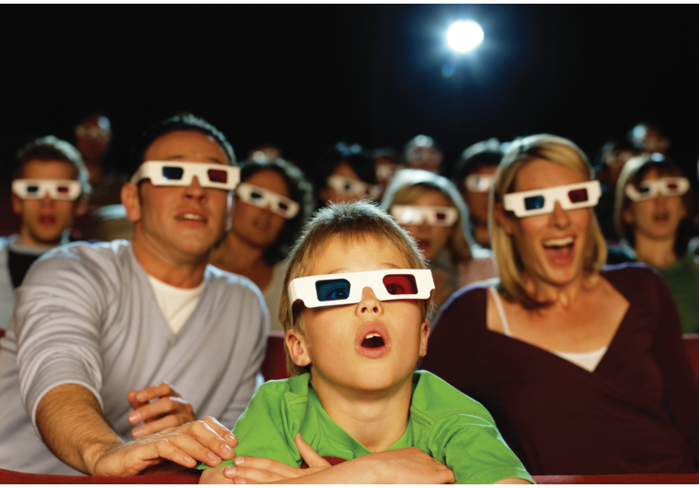
2. Read the film review of Harry Potter and the Sorcerer's Stone on Mark's blog. Match the words with their meanings.
Mon, Apr 20th
Harry Potter and the Sorcerer’s Stone is a fantasy. Its director is Chris Columbus. It is the first of the Harry Potter film series.
Daniel Radcliffe is one of the stars in the film.
The film tells the story of Harry Potter. He’s a powerful wizard. He is a student at a school for wizards and learns about himself, his family, and the bad things happening around him.
The film received a lot of good reviews. People say it’s a must-see for teens. I agree because the story is gripping and the acting is excellent. The music is also amazing.
Although Harry Potter and the Sorcerer’s Stone is a little frightening at times, it is very interesting and full of action. Go and see it if you can.
Posted by Mark at 5.30 p.m.
Mon, Apr 20th
Harry Potter and the Sorcerer’s Stone is a fantasy. Its director is Chris Columbus. It is the first of the Harry Potter film series.
Daniel Radcliffe is one of the stars in the film.
The film tells the story of Harry Potter. He’s a powerful wizard. He is a student at a school for wizards and learns about himself, his family, and the bad things happening around him.
The film received a lot of good reviews. People say it’s a must-see for teens. I agree because the story is gripping and the acting is excellent. The music is also amazing.
Although Harry Potter and the Sorcerer’s Stone is a little frightening at times, it is very interesting and full of action. Go and see it if you can.
Posted by Mark at 5.30 p.m.
gripping (adj) /'gripiη/
1. series
a. something that is so good that you think others should see it
2. wizard
b. related films that tell stories about the same characters
3. must-see
c. very exciting or interesting
4. gripping
d. a man who has magical powers

Slide 11
3. Read Mark's blog again and answer the questions.
Mon, Apr 20th
Harry Potter and the Sorcerer’s Stone is a fantasy. Its director is Chris Columbus. It is the first of the Harry Potter film series.
Daniel Radcliffe is one of the stars in the film.
The film tells the story of Harry Potter. He’s a powerful wizard. He is a student at a school for wizards and learns about himself, his family, and the bad things happening around him.
The film received a lot of good reviews. People say it’s a must-see for teens. I agree because the story is gripping and the acting is excellent. The music is also amazing.
Although Harry Potter and the Sorcerer’s Stone is a little frightening at times, it is very interesting and full of action. Go and see it if you can.
Posted by Mark at 5.30 p.m.
1. What kind of film is Harry Potter and the Sorcerer's Stone?
2. Who is Daniel Radcliffe?
3. What is the film about?
4. What do people say about the film?

Slide 12
3. Read Mark's blog again and answer the questions.
Mon, Apr 20th
Harry Potter and the Sorcerer’s Stone is a fantasy. Its director is Chris Columbus. It is the first of the Harry Potter film series.
Daniel Radcliffe is one of the stars in the film.
The film tells the story of Harry Potter. He’s a powerful wizard. He is a student at a school for wizards and learns about himself, his family, and the bad things happening around him.
The film received a lot of good reviews. People say it’s a must-see for teens. I agree because the story is gripping and the acting is excellent. The music is also amazing.
Although Harry Potter and the Sorcerer’s Stone is a little frightening at times, it is very interesting and full of action. Go and see it if you can.
Posted by Mark at 5.30 p.m.
Mon, Apr 20th
Harry Potter and the Sorcerer’s Stone is a fantasy. Its director is Chris Columbus. It is the first of the Harry Potter film series.
Daniel Radcliffe is one of the stars in the film.
The film tells the story of Harry Potter. He’s a powerful wizard. He is a student at a school for wizards and learns about himself, his family, and the bad things happening around him.
The film received a lot of good reviews. People say it’s a must-see for teens. I agree because the story is gripping and the acting is excellent. The music is also amazing.
Although Harry Potter and the Sorcerer’s Stone is a little frightening at times, it is very interesting and full of action. Go and see it if you can.
Posted by Mark at 5.30 p.m.
1. What kind of film is Harry Potter and the Sorcerer's Stone?
2. Who is Daniel Radcliffe?
3. What is the film about?
4. What do people say about the film?
It is a fantasy.

Slide 13
3. Read Mark's blog again and answer the questions.
Mon, Apr 20th
Harry Potter and the Sorcerer’s Stone is a fantasy. Its director is Chris Columbus. It is the first of the Harry Potter film series.
Daniel Radcliffe is one of the stars in the film.
The film tells the story of Harry Potter. He’s a powerful wizard. He is a student at a school for wizards and learns about himself, his family, and the bad things happening around him.
The film received a lot of good reviews. People say it’s a must-see for teens. I agree because the story is gripping and the acting is excellent. The music is also amazing.
Although Harry Potter and the Sorcerer’s Stone is a little frightening at times, it is very interesting and full of action. Go and see it if you can.
Posted by Mark at 5.30 p.m.
1. What kind of film is Harry Potter and the Sorcerer's Stone?
2. Who is Daniel Radcliffe?
3. What is the film about?
4. What do people say about the film?
Daniel Radcliffe is one of the stars in the film.
It is a fantasy.
He is one of the stars in the film.

Slide 14
3. Read Mark's blog again and answer the questions.
Mon, Apr 20th
Harry Potter and the Sorcerer’s Stone is a fantasy. Its director is Chris Columbus. It is the first of the Harry Potter film series.
Daniel Radcliffe is one of the stars in the film.
The film tells the story of Harry Potter. He’s a powerful wizard. He is a student at a school for wizards and learns about himself, his family, and the bad things happening around him.
The film received a lot of good reviews. People say it’s a must-see for teens. I agree because the story is gripping and the acting is excellent. The music is also amazing.
Although Harry Potter and the Sorcerer’s Stone is a little frightening at times, it is very interesting and full of action. Go and see it if you can.
Posted by Mark at 5.30 p.m.
Mon, Apr 20th
Harry Potter and the Sorcerer’s Stone is a fantasy. Its director is Chris Columbus. It is the first of the Harry Potter film series.
Daniel Radcliffe is one of the stars in the film.
The film tells the story of Harry Potter. He’s a powerful wizard. He is a student at a school for wizards and learns about himself, his family, and the bad things happening around him.
The film received a lot of good reviews. People say it’s a must-see for teens. I agree because the story is gripping and the acting is excellent. The music is also amazing.
Although Harry Potter and the Sorcerer’s Stone is a little frightening at times, it is very interesting and full of action. Go and see it if you can.
Posted by Mark at 5.30 p.m.
1. What kind of film is Harry Potter and the Sorcerer's Stone?
2. Who is Daniel Radcliffe?
3. What is the film about?
4. What do people say about the film?
It is a fantasy.
He is one of the stars in the film.
It’s about Harry Potter, a powerful
wizard. He is a student at a school for wizards and learns about himself, his family, and the bad things happening around him.

Slide 15
3. Read Mark's blog again and answer the questions.
Mon, Apr 20th
Harry Potter and the Sorcerer’s Stone is a fantasy. Its director is Chris Columbus. It is the first of the Harry Potter film series.
Daniel Radcliffe is one of the stars in the film.
The film tells the story of Harry Potter. He’s a powerful wizard. He is a student at a school for wizards and learns about himself, his family, and the bad things happening around him.
The film received a lot of good reviews. People say it’s a must-see for teens. I agree because the story is gripping and the acting is excellent. The music is also amazing.
Although Harry Potter and the Sorcerer’s Stone is a little frightening at times, it is very interesting and full of action. Go and see it if you can.
Posted by Mark at 5.30 p.m.
Mon, Apr 20th
Harry Potter and the Sorcerer’s Stone is a fantasy. Its director is Chris Columbus. It is the first of the Harry Potter film series.
Daniel Radcliffe is one of the stars in the film.
The film tells the story of Harry Potter. He’s a powerful wizard. He is a student at a school for wizards and learns about himself, his family, and the bad things happening around him.
The film received a lot of good reviews. People say it’s a must-see for teens. I agree because the story is gripping and the acting is excellent. The music is also amazing.
Although Harry Potter and the Sorcerer’s Stone is a little frightening at times, it is very interesting and full of action. Go and see it if you can.
Posted by Mark at 5.30 p.m.
1. What kind of film is Harry Potter and the Sorcerer's Stone?
2. Who is Daniel Radcliffe?
3. What is the film about?
4. What do people say about the film?
It is a fantasy.
He is one of the stars in the film.
It’s about Harry Potter, a powerful
wizard. He is a student at a school for wizards and learns about himself, his family, and the bad things happening around him.
People say it’s a must-see for teens

Slide 16
02
Speaking

Slide 17
4. Look at the table. Work in pairs. Ask and answer questions about the film Kungfu Boy.
Film’s name | Kungfu Boy
Director | John Stevenson
Type of film | Comedy
Main actor / actress | Bruce Wane
Main content | About a very big boy who saves his town and becomes a hero
Reviews | Funny and interesting
Time | 4.30 p.m and 8.30 p.m daily
Place | Ngoc Khanh Cinema
Film’s name | Kungfu Boy
How about seeing a film this evening?
That’s a great idea. What film shall we see?
Kungfu Boy.
What kind of film is it?
…
Notes:
A: How about seeing a film this evening?
B: That’s a great idea. What film shall we see?
A: Kungfu Boy.
B: What kind of film is it?
A: __________________

Slide 18
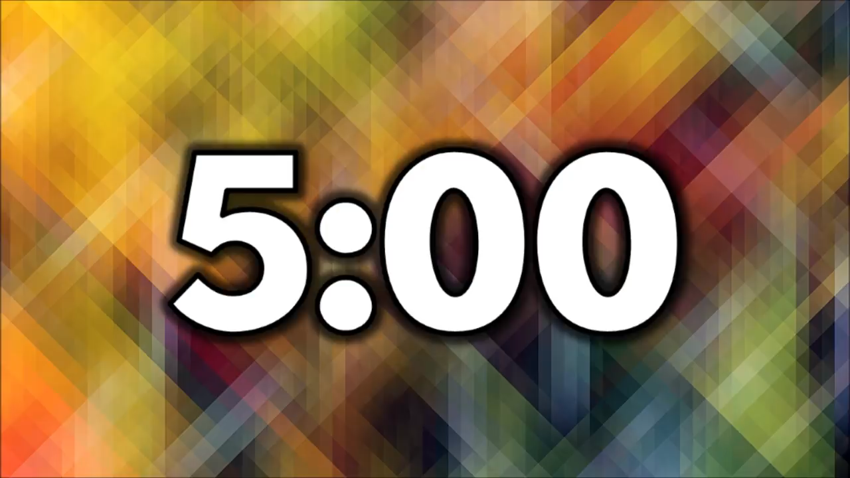

5.
Work in groups.
5 minutes.
Take turns to talk about the film Kungfu Boy.
Example:
Kungfu Boy is on at … at … p.m.
It’s (an) … about …
Kungfu Boy is a comedy directed by John Stevenson. Bruce Wane is the main actor in this film. It's about a very big boy who saves his town and becomes a hero. People say that it's a must-see because it's very funny and interesting. It's at 4.30 p.m. and 8.30 p.m. daily at Ngoc Khanh Cinema. Let's go to see it!

Slide 19
Wrap up
Choose the correct answers.
1. What is the film in the text?
A. Maleficent B. Harry Potter
2. What information can you talk about a film?
A. Your favorite character B. Soundtracks
C. Film’s name D. Director
E. Type of film F. Main actor / actress
G. Main content H. Reviews
I. Time K. Place

Slide 20
Thanks for your attention

