Slide 1
OBJECTIVES
After this lesson, students will be able to:

Slide 2
UNIT 8: FILMS
Lesson 3: A closer look 2

Slide 3
OBJECTIVES
After this lesson, students will be able to:
practise using the connectors: although/ though and however in contexts
understand the use of the connectors: although/ though and however

Slide 4

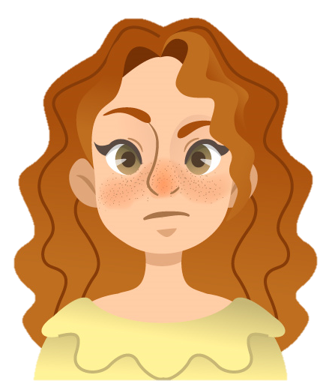



Mary likes coffee
><
?
she doesn’t like tea
Mary likes coffee
although/though
she doesn’t like tea.
Although/Though
Mary likes coffee,
she doesn’t like tea.
→ although/ though connect 2 contrasting ideas in the same sentence

Slide 5
1. Combine the two sentences, using although/ though.
She watched the film twice. She didn’t understand the film.
→ Although / Though she watched the film twice, she didn’t understand it.
→ She didn’t understand the film although / though she watched it twice.
1. The questions were very difficult. He solved them easily.
→
2. He was a great actor. He never played a leading role in a film.
→
3. They spent a lot of money on the film. The film wasn’t a big success.
→
4. The film was a comedy. I didn’t find it funny at all.
→
5. We played well. We couldn’t win the match.
→

Slide 6
1. Combine the two sentences, using although/ though.
1. The questions were very difficult. He solved them easily.
→
→
2. He was a great actor. He never played a leading role in a film.
→
→
3. They spent a lot of money on the film. The film wasn’t a big success.
→
→
He solved the questions easily although/though they were very difficult.
Although/though THE QUESTIONS were very difficult, he solved theM easily.
He never played a leading role in a film although/though he was a great actor.
Although/ Though he was a great actor, he never played a leading role in a film.
The film wasn’t a big success although/though they spent a lot of money on it.
Although/ Though they spent a lot of money on the film, it wasn’t a big success.

Slide 7
1. Combine the two sentences, using although/ though.
4. The film was a comedy. I didn’t find it funny at all.
→
→
5. We played well. We couldn’t win the match.
→
→
I didn’t find the film funny at all although/though it was a comedy.
Although/ Though the film was a comedy, I didn’t find it funny at all.
We couldn’t win the match although/though we played well.
Although/ Though we played well, we couldn’t win the match.

Slide 8
Mary likes coffee
><
?
she doesn’t like tea
Mary likes coffee.
However,
she doesn’t like tea.
→ However connect 2 contrasting ideas in two sentences. We normally put a comma (,) after it.

Slide 9
2. Complete the sentences, using although/ though or however.
1. _________________ the acting in the film was good, I didn’t like its story.
2. I felt really tired. _____________, I went to see the film.
3. I really enjoyed the new film ________________ most of my friends didn’t like it.
4. He studied hard for the exam. ______________, he failed it.
5. Mai speaks English very well _______________ her native language is Vietnamese.
Although/Though
.
However
,
although/though
.
However
,
although/though

Slide 10
3. Use your own ideas to complete the following sentences.
1. I don’t really like the film though ______. 2. He felt very well. However, ______. 3. The film was a great success. However, ______. 4. Although it rained all day, ______. 5. The music in the film was terrible. However, ______.

Slide 11
4. Choose the correct answer (A, B, or C) to complete each sentence.
1. Mary overslept this morning ______ she went to bed early last night.
A. although B. because C. so
2. ______ the sun is shining, it isn’t very warm.
A. Because B. However C. Though
3. I don’t like running, ______ I like swimming.
A. but B. so C. however
4. ______ the film was exciting, Jim fell asleep in the cinema.
A. However B. Because C. Although
5. The story of the film is silly. ______, many people still enjoyed it.
A. However B. Though C. But
contrasting ideas, same sentence
contrasting ideas, same sentence
,
contrasting ideas, same sentence, (,) before
contrasting ideas, same sentence
.
,
contrasting ideas, two sentences

Slide 12

5. Game – Chain story with although/ though and however
- Work in group.
- 5 minutes
- Write a story using although/ though and however.
Though we went shopping, we didn’t buy anything.
…
Although it rained yesterday, we went shopping.
…
Notes:
A: Although/ Though it rained yesterday, we went shopping. B: Although/ Though we went shopping, we didn’t buy anything.
C: ________________

Slide 13
SHOW TIME!
Share your story with the whole class.

Slide 14
Decide if these statements are True or False. If it is False, correct it.
WRAP UP
1. We use although/ though or because to connect 2 contrasting ideas.
2. although/ though connect 2 contrasting ideas in the same sentences.
3. However connect 2 contrasting ideas in one sentence.
4. We normally put a comma (,) after however.
F
however
T
two sentences
F
T

Slide 15
THE END
Thank you for your attention.
Please keep this slide for attribution

