Slide 1

Adjectives to describe films
Groups of 6
Think of the adjectives with the given words.
The fastest is the winner.
mazing
nteresting
A __________
I __________
oring
oving
B __________
M __________
unny/ Frightening
cary
F __________
S __________

Slide 2
Unit 8: Films
Lesson 2: A closer look 1

Slide 3
Objectives
After this lesson, students will be able to:
Vocabulary
Use adjectives to describe films
Pronunciation
Pronounce the sounds /ɪə/ and /eə/ correctly

Slide 4
01
Vocabulary

Slide 5

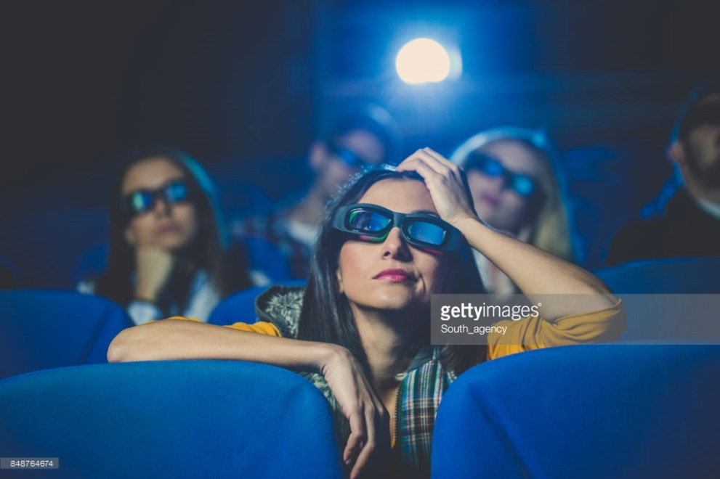
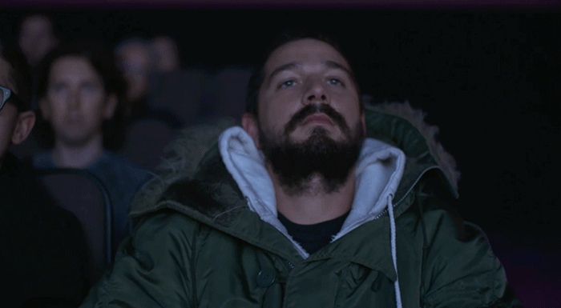
Adjectives to describe films
dull (adj) /dʌl/
= boring
buồn tẻ, chán, đơn điệu

Slide 6
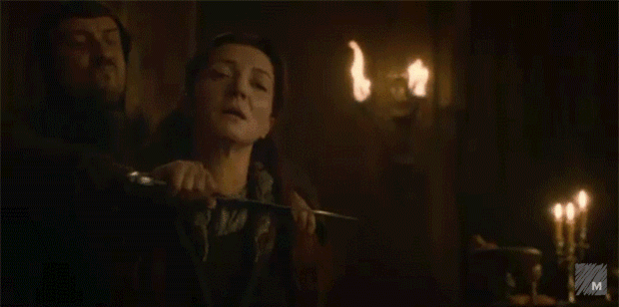
Adjectives to describe films
violent (adj) /'vaiələnt/
hung dữ; bạo lực, mãnh liệt

Slide 7
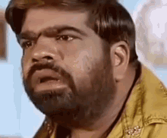
Adjectives to describe films
confusing (adj)
/kən'fju:ziŋ/
khó hiểu, gây bối rối

Slide 8

Adjectives to describe films
shocking (adj)
/'∫ɒkiŋ/
gây choáng váng, làm sửng sốt

Slide 9
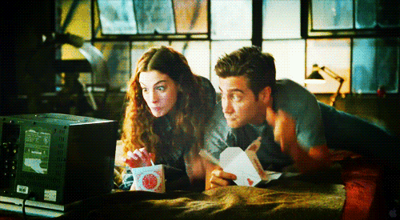
Adjectives to describe films
enjoyable (adj)
/in'dʒɔiəbl/
thú vị, thích thú

Slide 10
Adjectives to describe films
dull (adj) /dʌl/
buồn tẻ, chán, đơn điệu
violent (adj) /'vaiələnt/
hung dữ; bạo lực, mãnh liệt
confusing (adj)
/kən'fju:ziŋ/
khó hiểu, gây bối rối
shocking (adj)
/'∫ɒkiŋ/
gây choáng váng, làm sửng sốt
enjoyable (adj)
/in'dʒɔiəbl/
thú vị, thích thú

Slide 11
1 (p.84) Match the following adjectives with their meanings.
1. dull
a. difficult to understand, not clear
2. violent
b. not interesting or exciting
3. confusing
c. giving pleasure
4. shocking
d. containing lots of fighting and killing
5. enjoyable
e. very surprising and difficult to believe

Slide 12
2 (p.84) Complete the following sentences, using the adjectives in ex1.
1. I found the film A Polluted Planet hard to believe. It’s a very _________ documentary.
2. The film was so _________ that we almost fell asleep.
3. I think you will enjoy Our Holiday. It’s quite _________ .
4. There were too many fights in the film. It was too _________ .
5. I didn’t really understand the film. It was very _________ .
dull
1. I found the film A Polluted Planet hard to believe. It’s a very _________ documentary.
2. The film was so _________ that we almost fell asleep.
3. I think you will enjoy Our Holiday. It’s quite _________ .
4. There were too many fights in the film. It was too _________ .
5. I didn’t really understand the film. It was very _________ .
shocking
violent
dull
confusing
enjoyable
shocking
violent
enjoyable
confusing

Slide 13
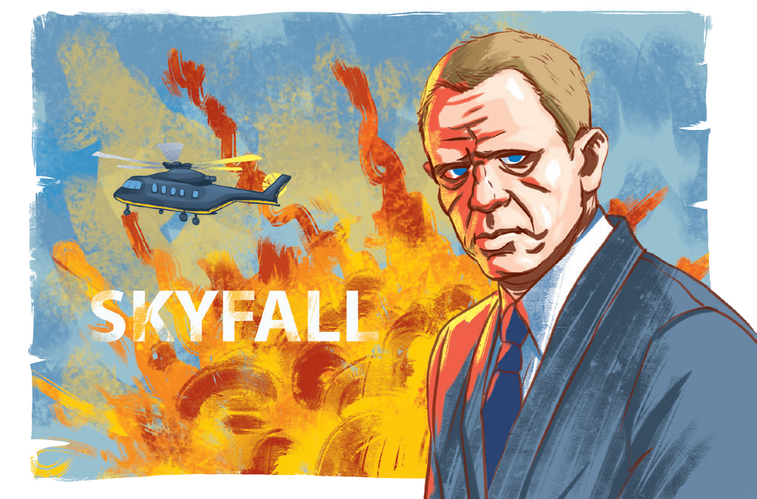
3 (p.84) Work in pairs. Ask and answer questions about a film you saw recently.
Example:
What film did you see recently?
Skyfall.
What do you think of it?
It’s too violent.

Slide 14
02
Pronunciation

Slide 15


Listen and repeat the following words. Pay attention to the underlined parts.
Can you recognize the sounds in the underlined parts?
chair
here
/eə/
/ɪə/

Slide 16
4 (p.84) Listen and repeat the words. Pay attention to the sounds /ɪə/ and /eə/.
/ɪə/ | /eə/
idea pier really fear ear | nightmare their share hair chair

Slide 17

5 (p.84) Listen, paying attention to the underlined words.
Game: Broken telephone
/ɪə/ and /eə/
1. Is there a cinema near here?
2. There’s a chair under the stairs.
3. Put your earphones near here.
4. I don’t care about your idea.
5. Our aeroplane is up there, in the air.

Slide 18
Wrap up
After this lesson, students have been able to:
Vocabulary
Use adjectives to describe films
Pronunciation
Pronounce the sounds /ɪə/ and /eə/ correctly

Slide 19
Thanks for your attention!
Please keep this slide for attribution

