Slide 1
https://en.islcollective.com/video-lessons/odd-food-out-game

Slide 2
ODD ONE OUT

Slide 3
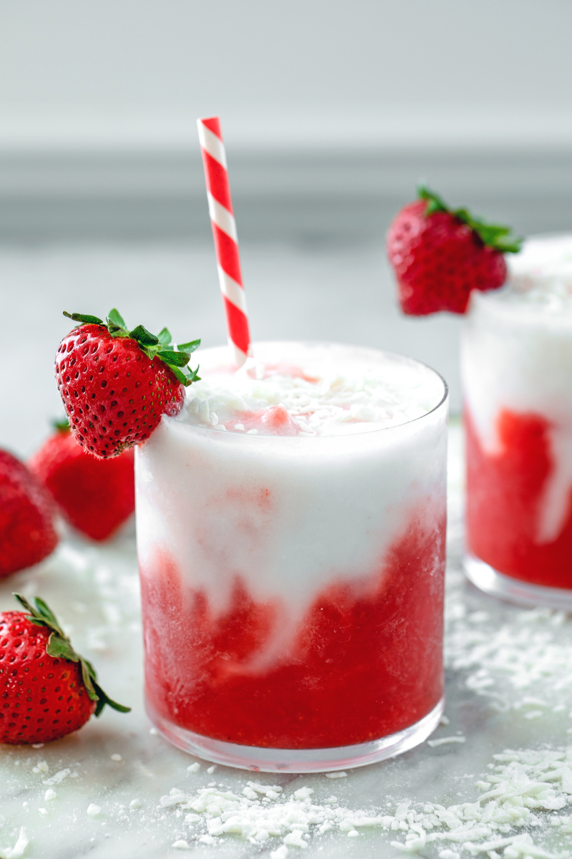
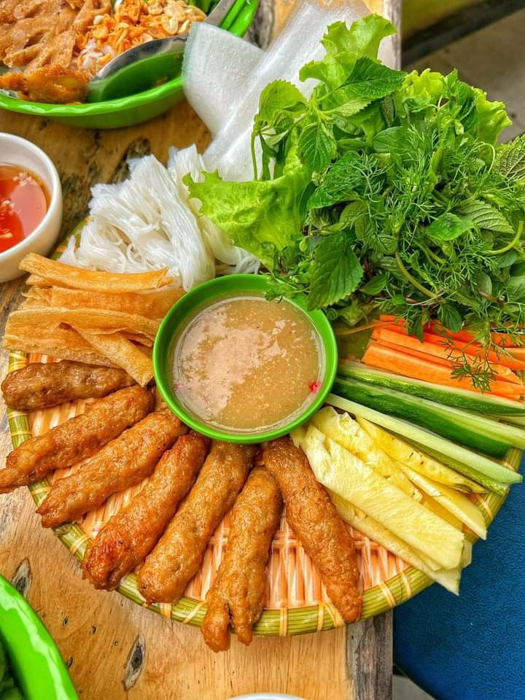
UNIT 5 FOOD AND DRINK
LESSON 1. GETTING STARTED
AT A VIETNAMESE RESTAURANT

Slide 4
Objectives
By the end of this lesson, Ss will be able to gain:
An overview about the topic.
Vocabulary to talk about Food and Drink.
How to order food and drink at a restaurant

Slide 5
VOCABULARY

Slide 6
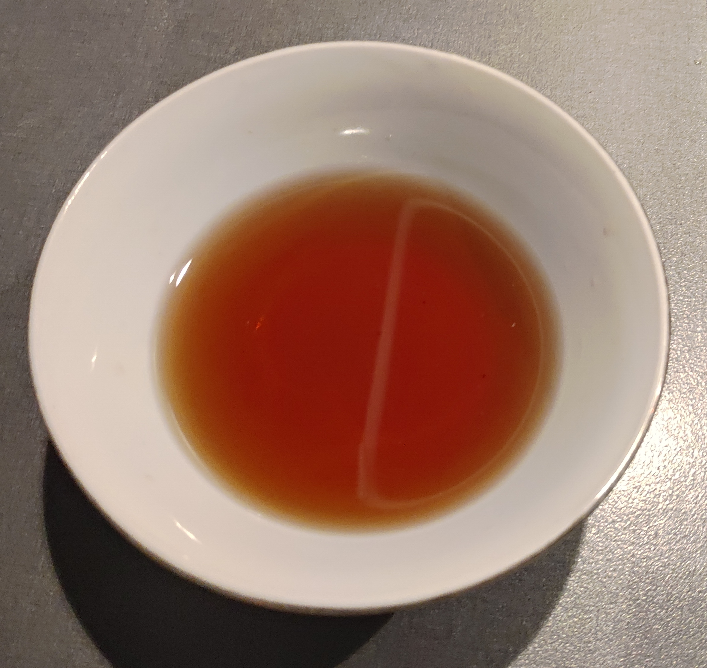

Vocabulary
fish sauce (n.p)
/fɪʃ/ /sɔːs/
nước mắm

Slide 7
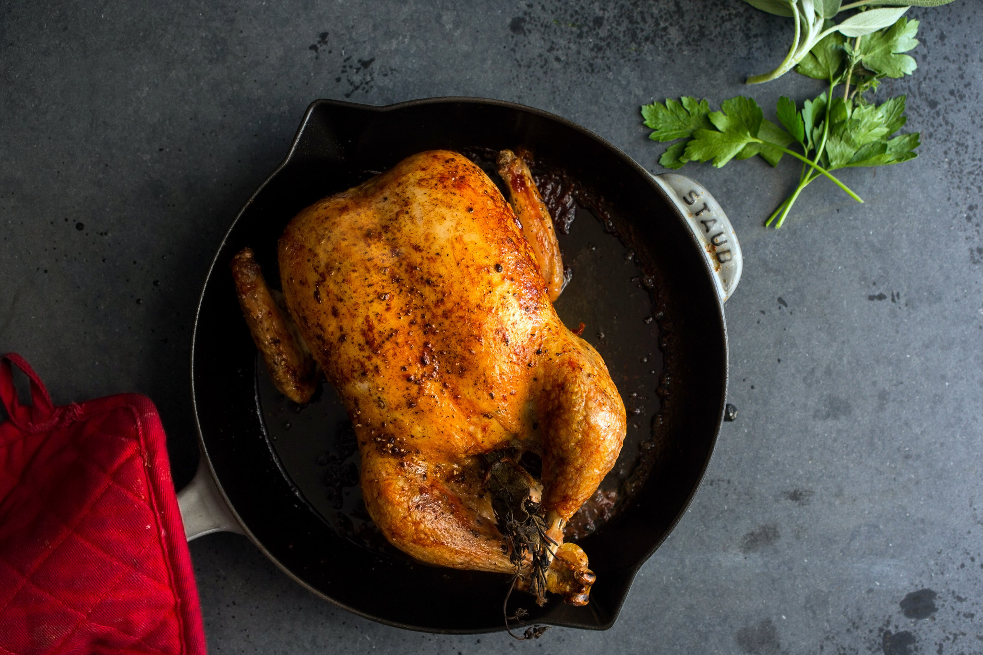
Vocabulary
roast chicken (n)
/rəʊst ˈʧɪkɪn/
gà quay

Slide 8
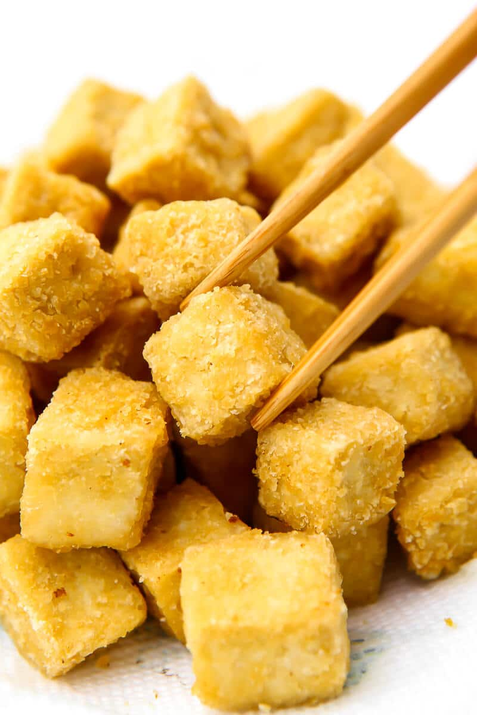
Vocabulary
fried tofu (n)
/fraɪd ˈtəʊfuː/
đậu rán

Slide 9
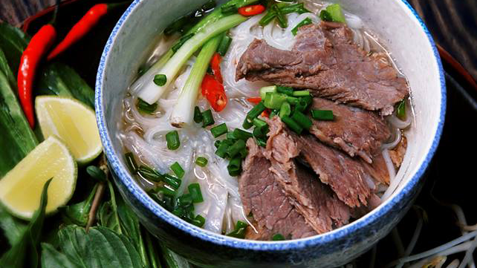
Vocabulary
beef noodle soup (n.p)
/biːf/ /ˈnuːdl/ /suːp/
phở bò

Slide 10
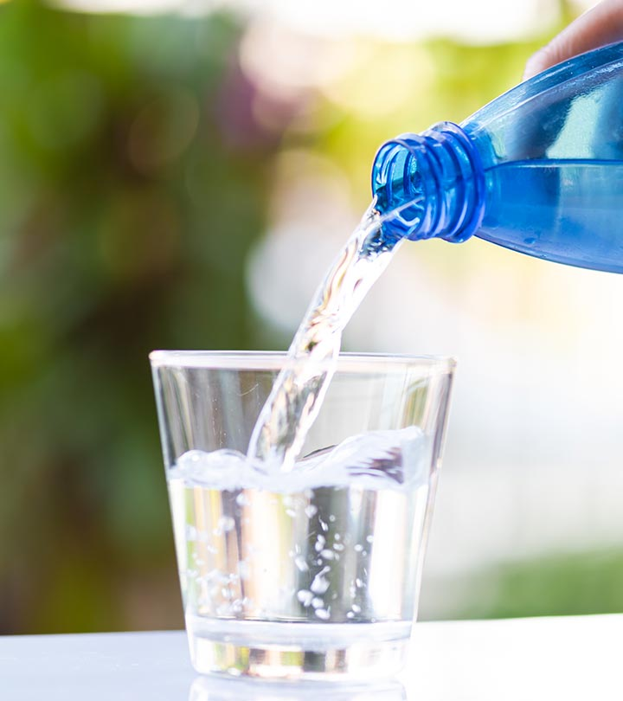
Vocabulary
mineral water (n)
/ˈmɪnərəl/ /ˈwɔːtə/
nước khoáng

Slide 11
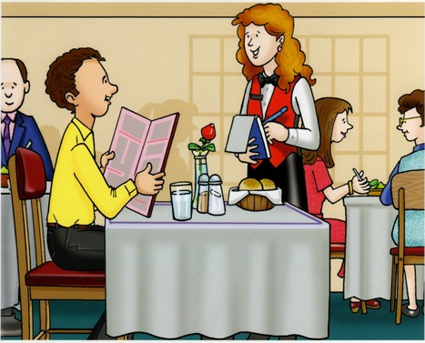
Vocabulary
gọi món
order (v):
/ˈɔːdə(r)/

Slide 12
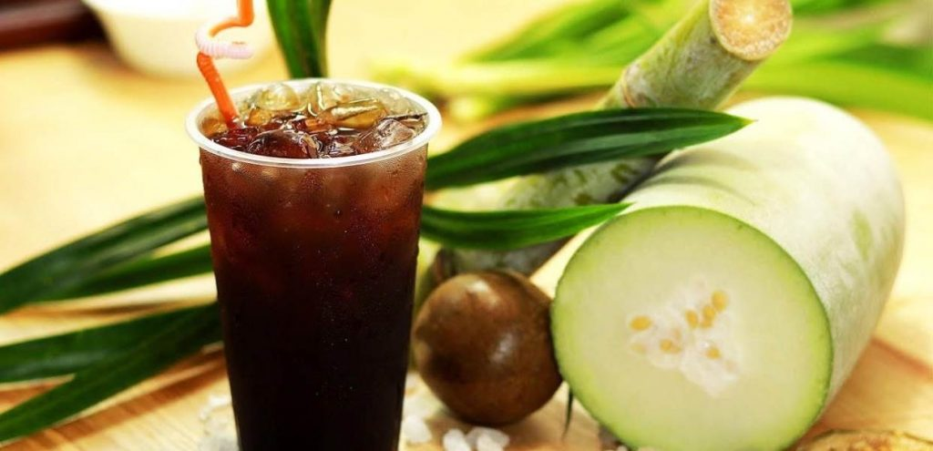
Vocabulary
winter melon juice (n.p)
/ˈwɪntə ˈmɛlən ʤuːs /
nước ép bí đao

Slide 13
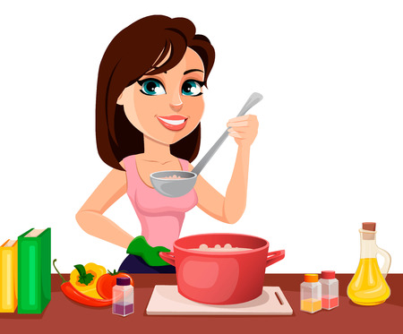
Vocabulary
Example:
She is preparing for her dinner.
prepare for (v.p)
/prɪˈpeə fɔː/
chuẩn bị cho

Slide 14

Vocabulary
New words | Pronunciation | Meaning
fish sauce (n.p) | /fɪʃ/ /sɔːs/ | Nước mắm
roast chicken (n) | /rəʊst ˈʧɪkɪn/ | Gà quay
fried tofu (n) | /fraɪd ˈtəʊfuː/ | Đậu rán
beef noodle soup (n.p) | /biːf/ /ˈnuːdl/ /suːp/ | phở bò
mineral water (n) | /ˈmɪnərəl/ /ˈwɔːtə/ | Nước khoáng
prepare for (v.p) | /prɪˈpeə fɔː/ | Chuẩn bị cho

Slide 15
RECAP
CAN YOU REPEAT SOME WORDS / PHRASES FOLLOWING THE TOPIC?

Slide 16
Waiter: Good evening. What can I get you today?
Mark's mum: We'd like rice with some pork cooked in fish sauce. Oh, could we also have an order of roast chicken and fried vegetables?
Mark: And I'd like some fried tofu and spring rolls too.
Waiter: OK. Would you like any canh chua? It's a kind of Vietnamese soup. We often have it with rice.
Mark's dad: Let me see ... I think we'll try some canh.
Waiter: With shrimp or fish?
Mark's dad: With shrimp, please.
Waiter: Would you like anything to drink? We have a lot of drinks: juice, lemonade, green tea, mineral water, ...
Mark's mum: Mineral water for me, green tea for my husband, and juice for my children.
Waiter: What kind of juice would you like?
Mark's sister: Do you have winter melon juice?
Waiter: Let me see. Er, yes. How many cans would you like?
Mark's sister: One ... No, wait, two please. By the way, how much is a can of winter melon juice?
Mark: The menu says it's 10,000 dong.
Waiter: That's right. I'll be right back with your order.
1- LISTEN AND READ

Slide 17

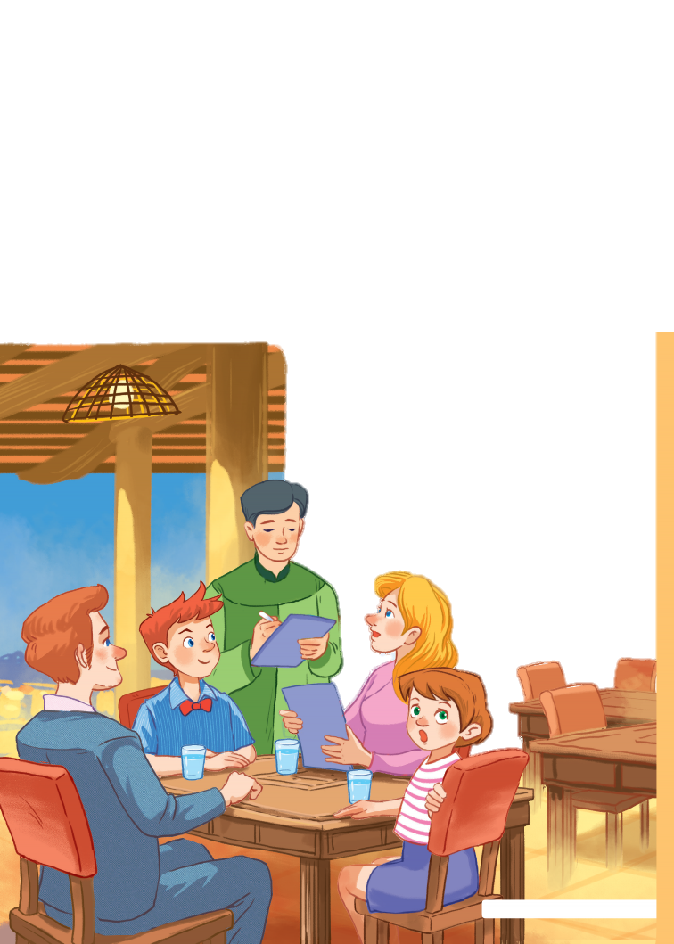
2- What is Mark’s family doing?
Ordering food for dinner.
Preparing for their dinner.
Talking about their favourite food.

Slide 18
Listen and read
Waiter: Good evening. What can I get you today?
Mark's mum: We'd like rice with some pork cooked in fish sauce. Oh, could we also have an order of roast chicken and fried vegetables?
Mark: And I'd like some fried tofu and spring rolls too.
Waiter: OK. Would you like any canh? It's a kind of Vietnamese soup. We often have it with rice.
Mark's dad: Let me see ... I think we'll try some canh.
Waiter: With shrimp or fish?
Mark's dad: With shrimp, please.
Waiter: Would you like anything to drink? We have a lot of drinks: juice, lemonade, green tea, mineral water, ...
Mark's mum: Mineral water for me, green tea for my husband, and juice for my children.
Waiter: What kind of juice would you like?
Mark's sister: Do you have winter melon juice?
Waiter: Let me see. Er, yes. How many cans would you like?
Mark's sister: One ... No, wait, two please. By the way, how much is a can of winter melon juice?
Mark: The menu says it's 10,000 dong.
Waiter: That's right. I'll be right back with your order.
3. Find the words and phrases
about food and drink.
food
rice,
pork,
fish sauce,
roast chicken,
fried vegetables,
fried tofu,
spring rolls,
soup,
shrimp,
fish.
drink
juice,
lemonade,
green tea,
mineral water,
winter melon juice.

Slide 19
4- CHOOSE THE CORRECT OPTION FOR EACH QUESTION https://quizizz.com/admin/quiz/635b361cc78829001d5b00fa/unit-5-food-and-drink-getting-started

Slide 20

1- Mark’ s family is……………………..
A. At a Vietnamese restaurant
B. In the kitchen
C. At a wedding party
D. In the living room

Slide 21
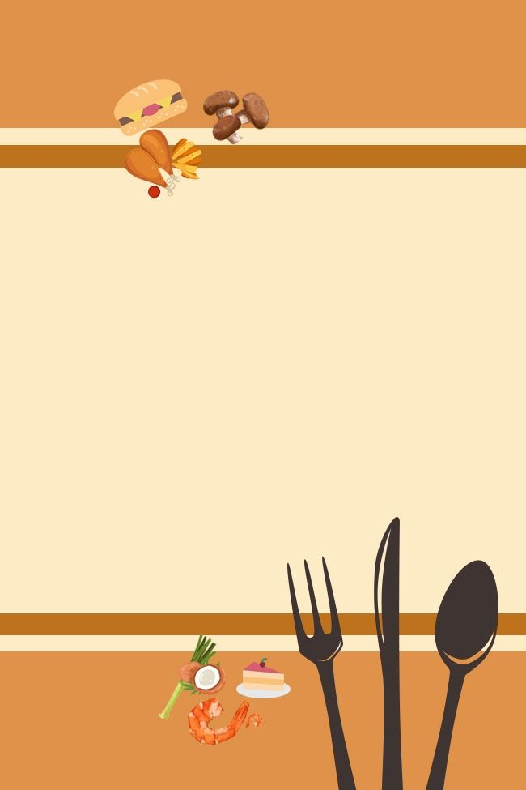
2- Mark wants fried tofu and ………………….for dinner.
A. Fish
B. Beef
Mark: And I’d like some fired tofu and spring rolls too.
C. Spring rolls
D. Green tea

Slide 22
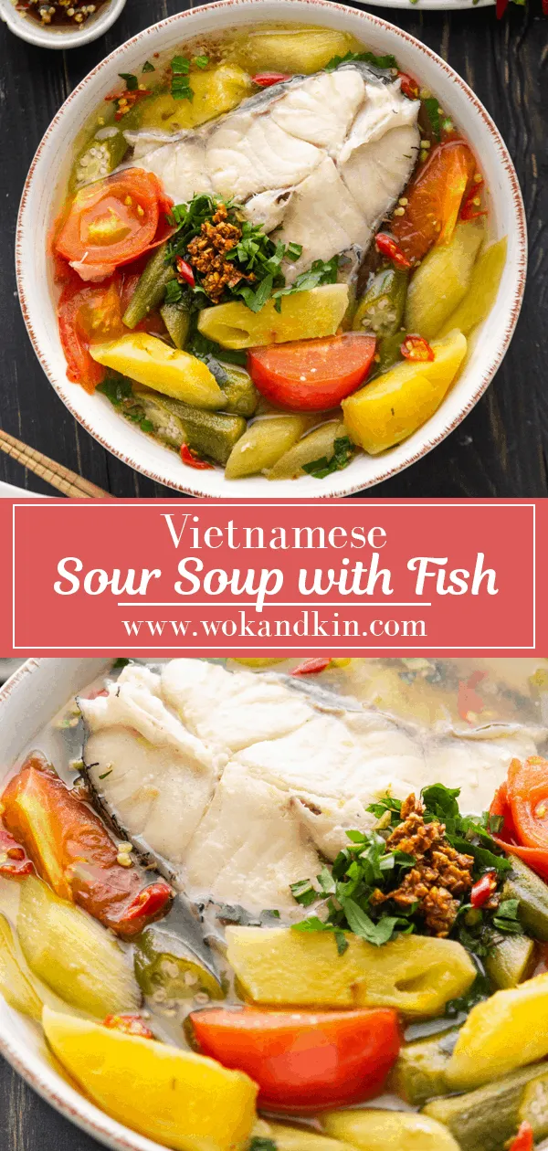
3- They order canh chua.
A. True
B. False
Mark’s dad: I think we will try some canh chua

Slide 23
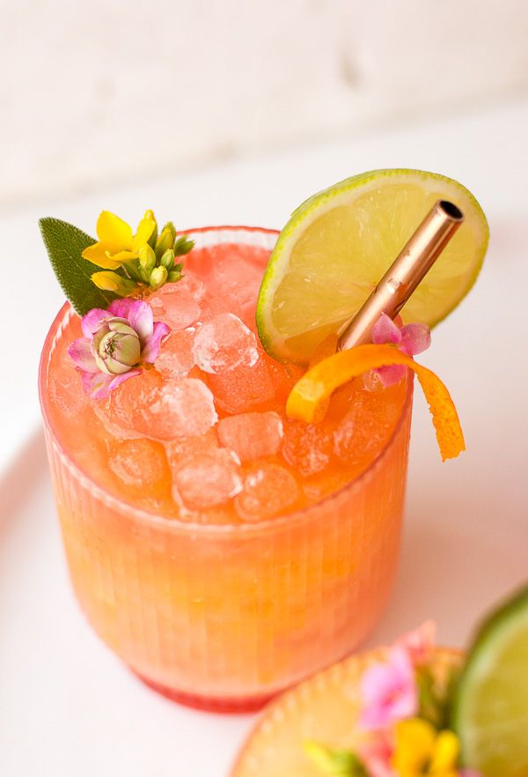
4-What kind of drink does Mark’s mother want?
A. Mineral water
B. Green tea
C. juice
D. beer
Mark’s mum:
Mineral water for me….

Slide 24
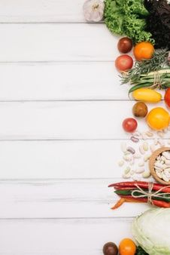
5- How much is a can of winter melon juice?
A. 20,000 dong
B. 10,000 dong
The menu says it’s 10,000 dong.
C. 30,000 dong
D. 40,000 dong

Slide 25
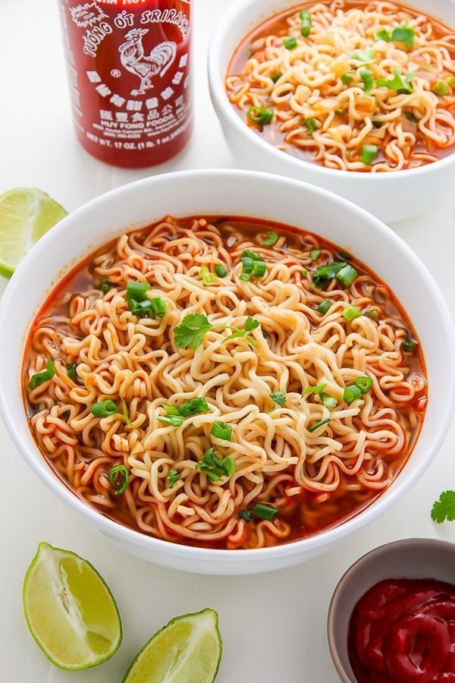
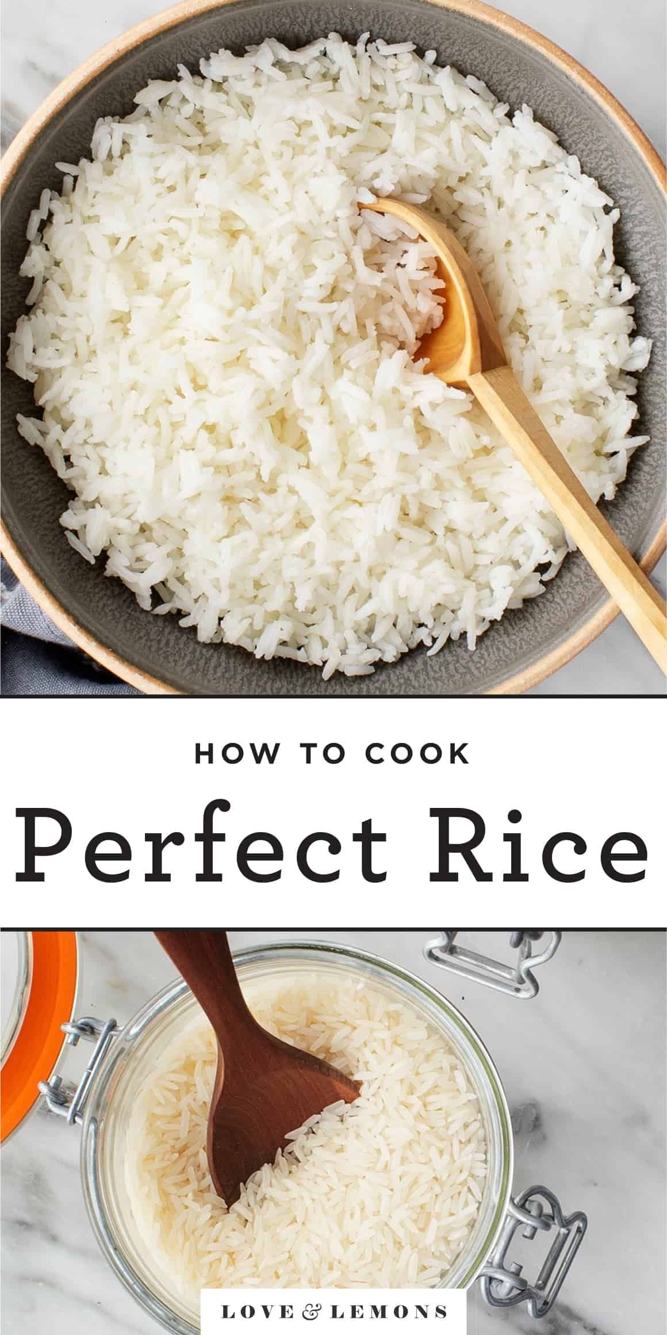
6- Mark’s family would like ……with some pork cooked
in fish saurce.
A. rice
B. noodles
Mark’s mum:
We’d like rice with some pork cooked in fish sauce.

Slide 26

7- Who says “ Would you like canh chua?”
A. Mark’s mum
B. The waiter
WAITER:
OK, Would you like canh chua?
C. Mark’s dad
D. Mark

Slide 27


8- Does Mark’s Dad order shirmp or fish?”
A. shrimp
Mark’dad: With shrimp, please.
B. fish

Slide 28
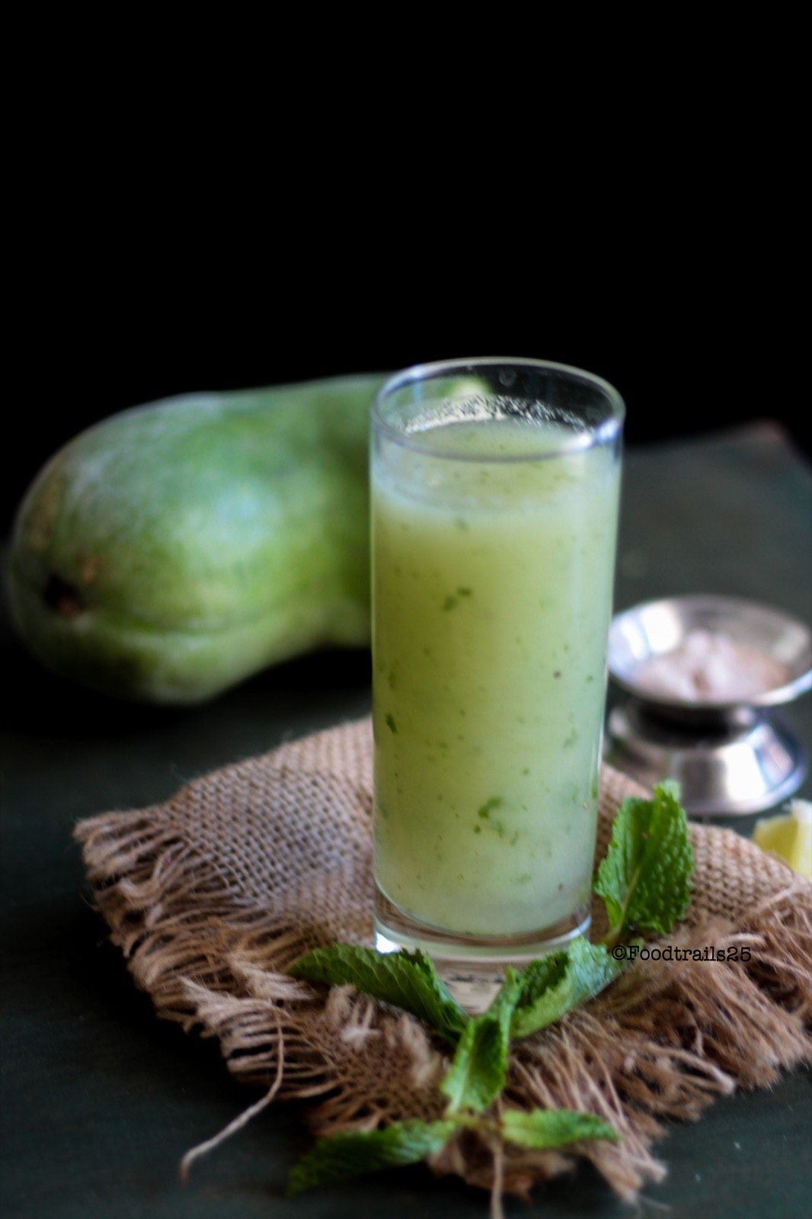
9- How many cans of winter melon juice would Mark’s sister like?
A. One
B. Two
C. Three
D. Four
Mark’s sister:
One, no wait, two please.

Slide 29
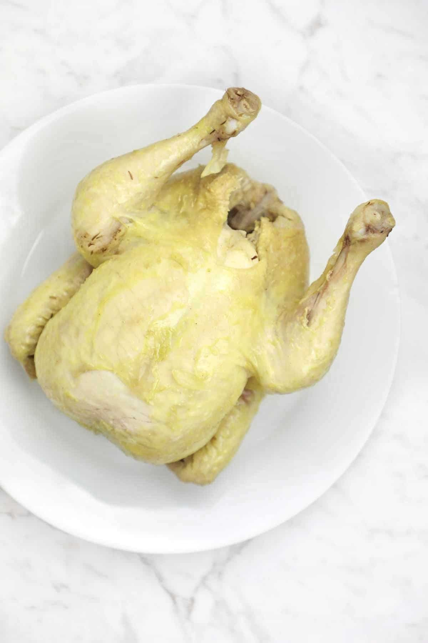
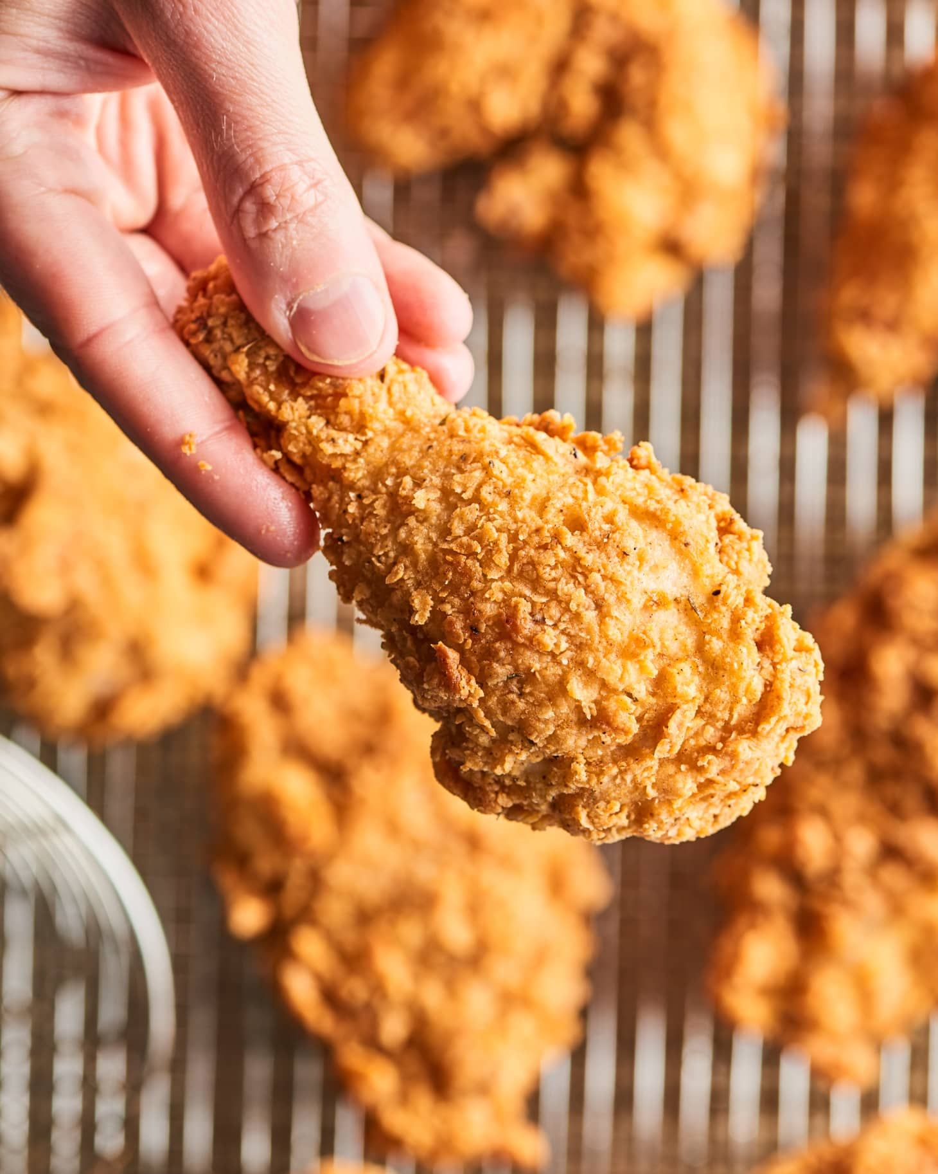
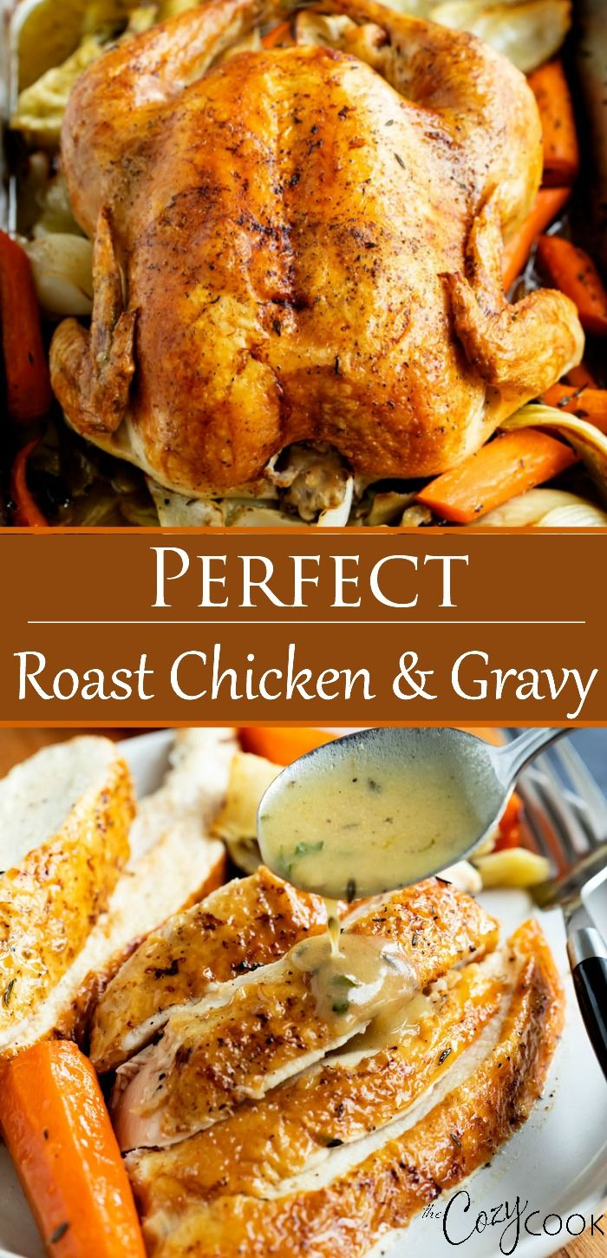
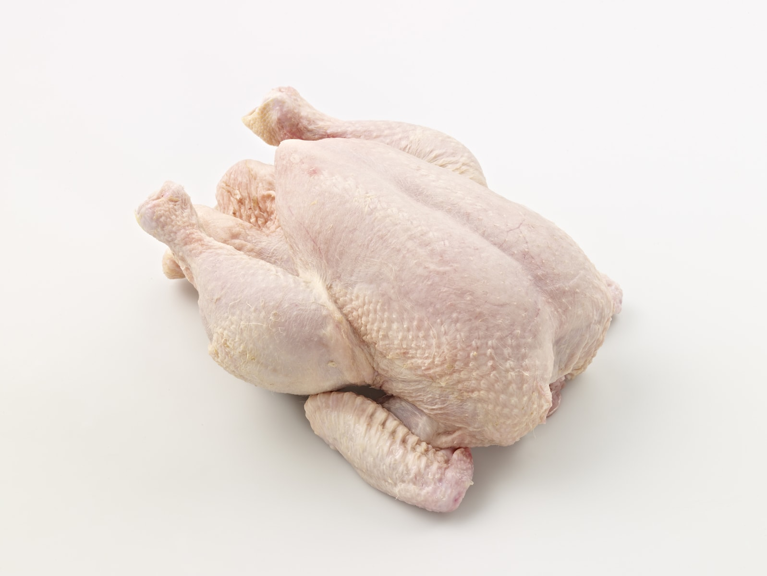
10- They order …………………….chicken.
A. boiled
Mark’s mother:
Could we also have an order of roast chicken….?
B. fried
C. roast
D. raw

Slide 30
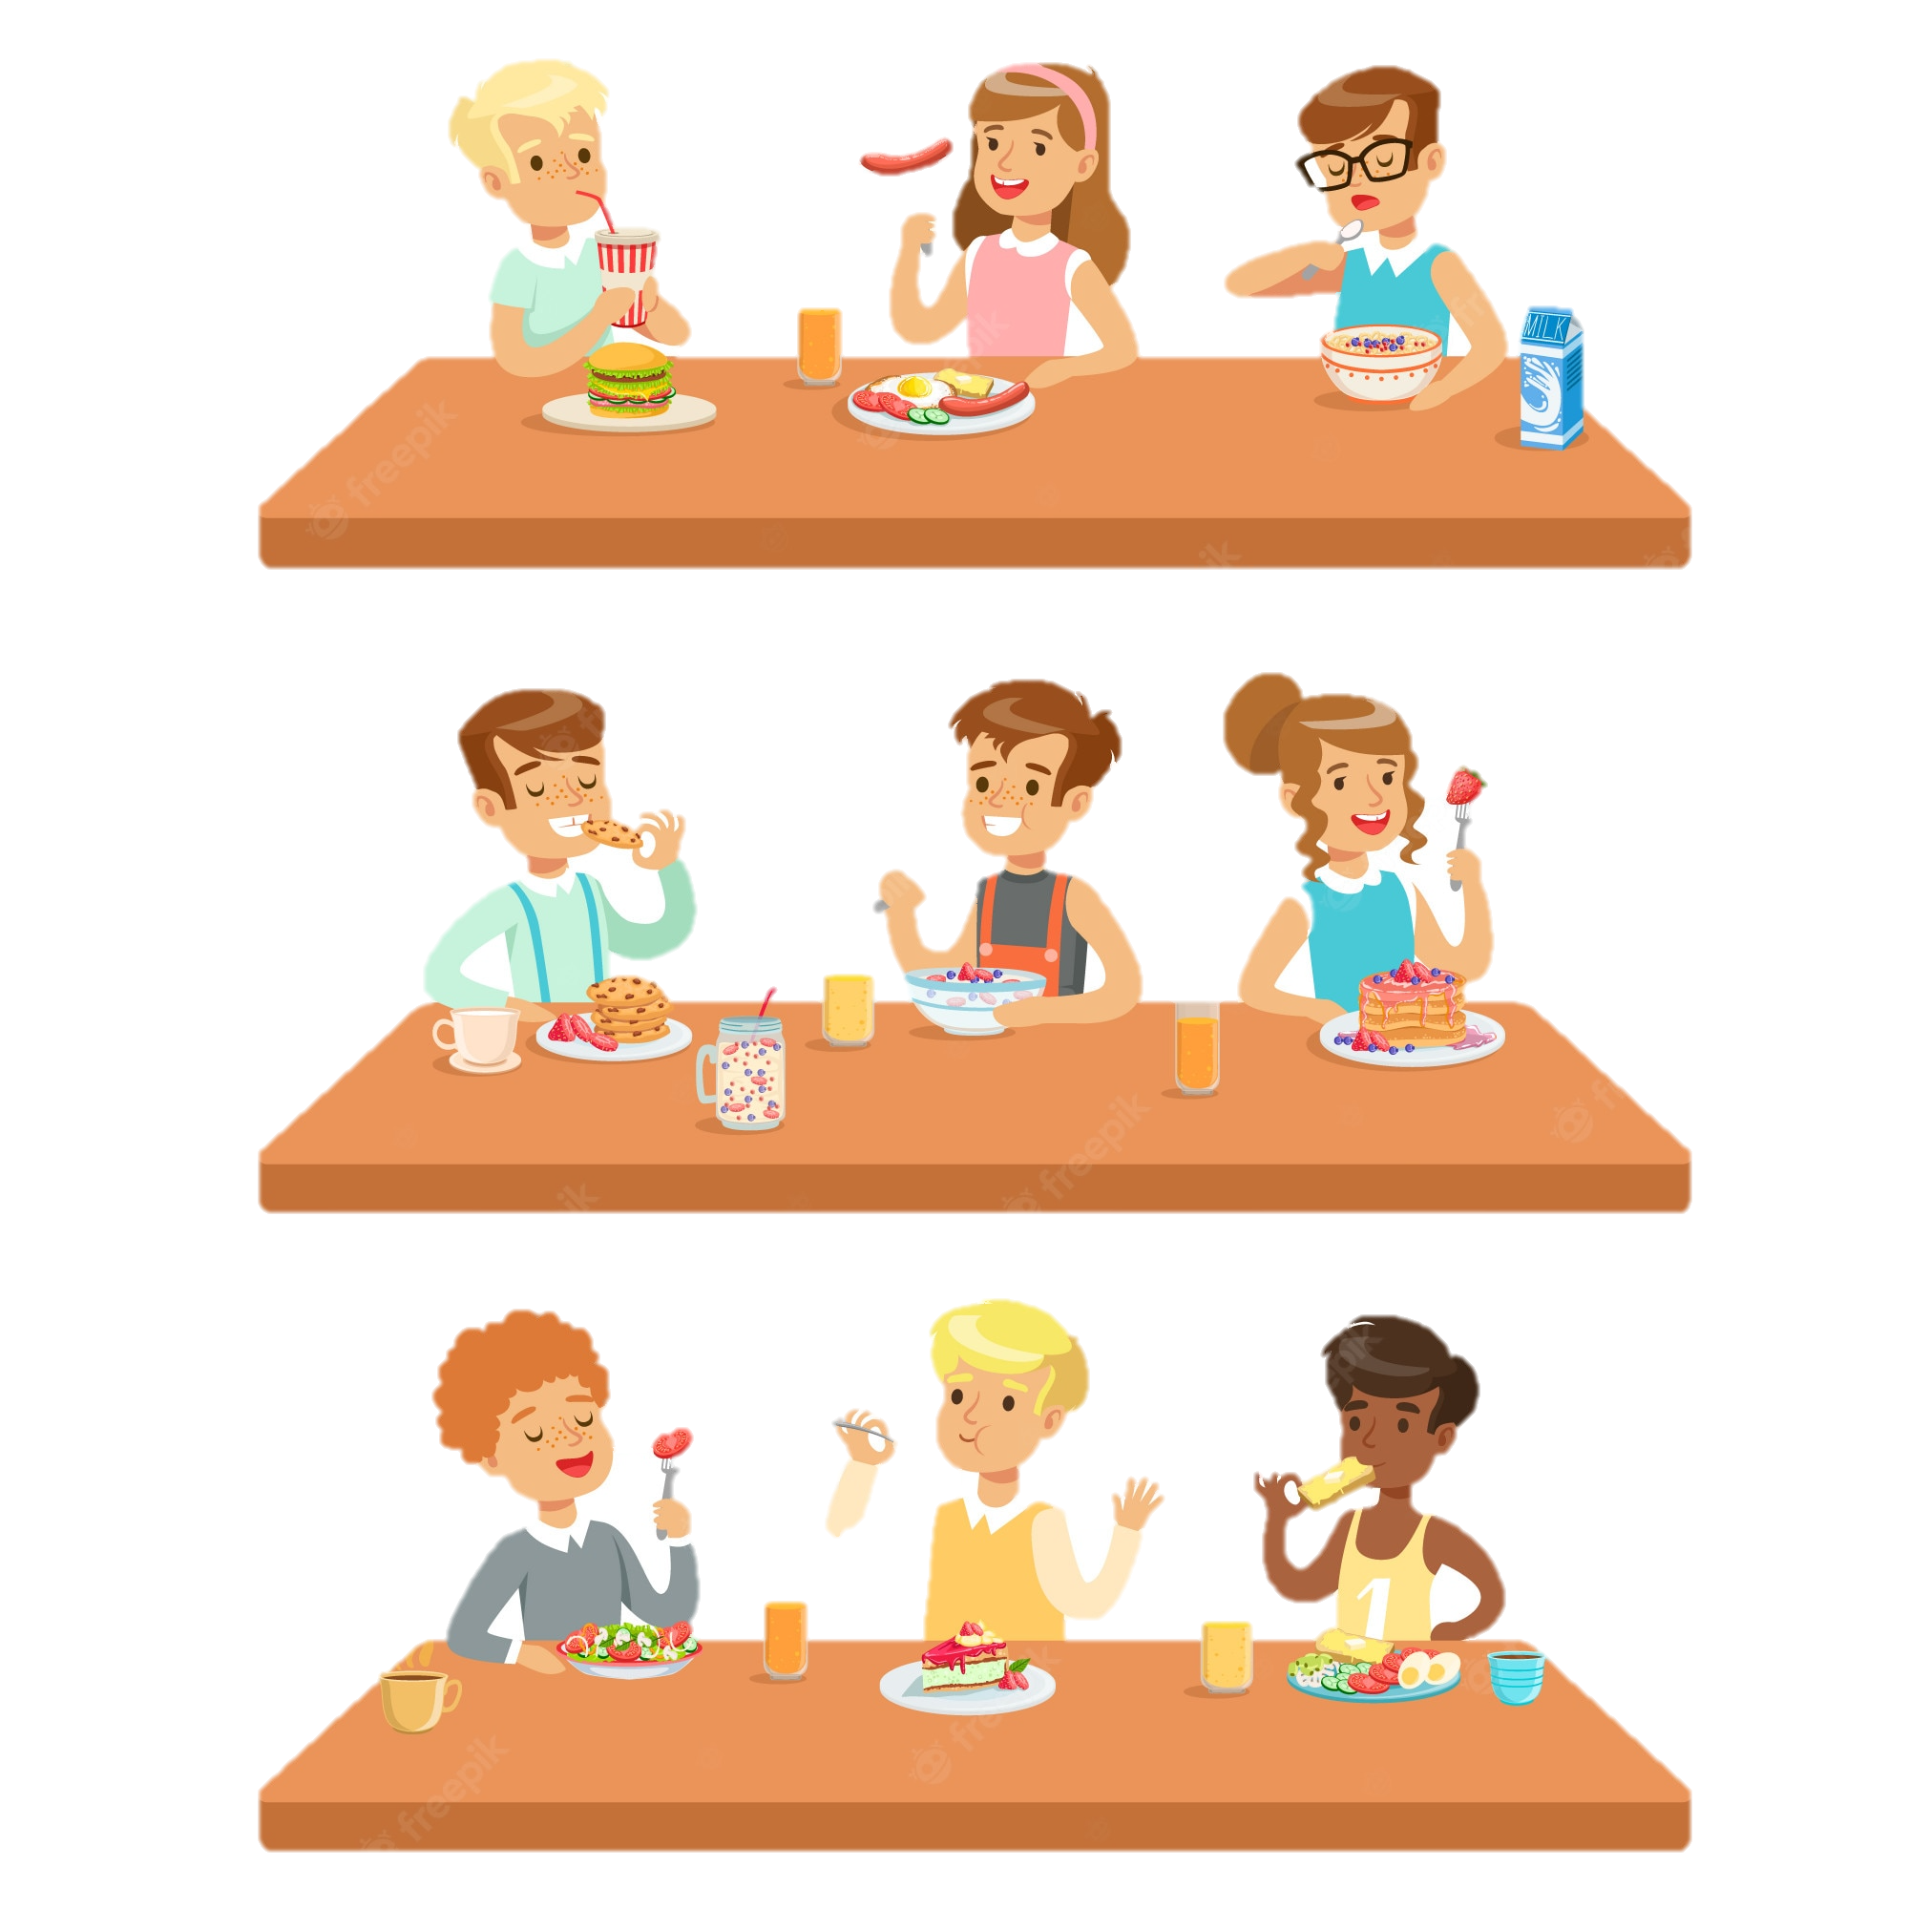
Ex 5. (p 51) Work in pairs.
Ask your partner about his or her favourite food and drink.
Example:
A: What's your favourite food?
B: It's pho bo - beef noodle soup.
A: When do you usually have it?
B: In the morning.
Structure:
A: What's your favourite food/drink?
B: It’s + name of food/drink.
A: When do you usually have it?
B: Time.

Slide 31
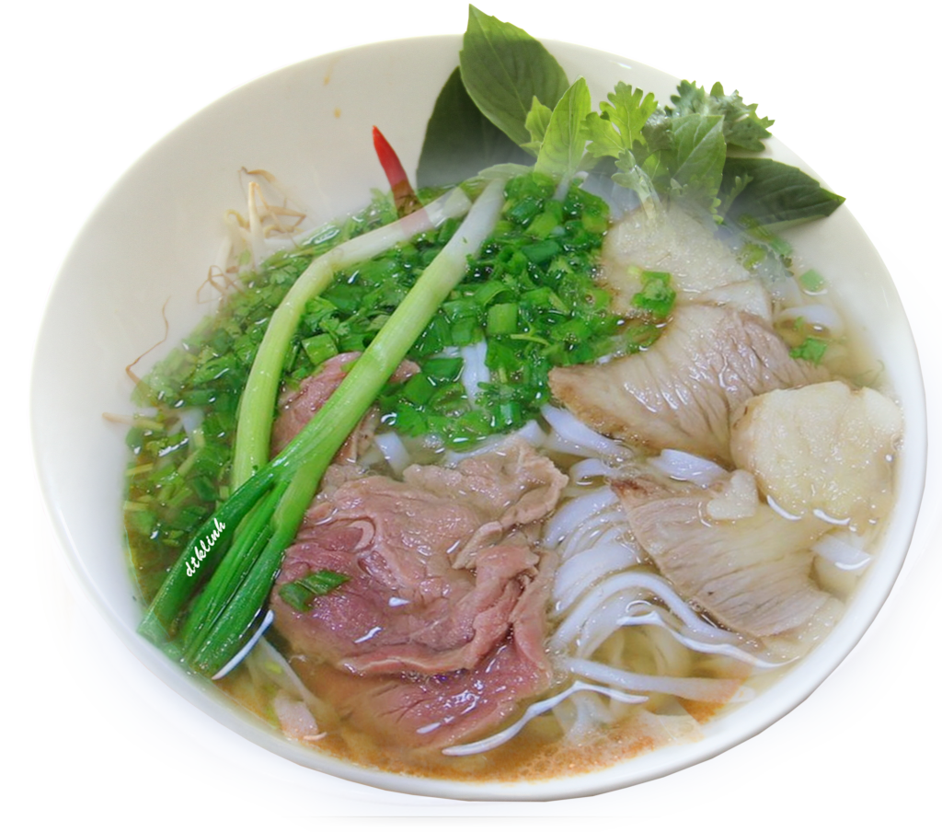


Example:
A: What's your favourite food?
B: It's pho bo - beef noodle soup.
A: When do you usually have it?
B: In the morning.

Slide 32
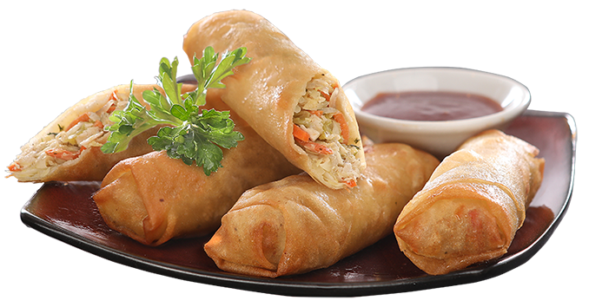

Slide 34
Did you go to a restaurant in the past?
Where and when?
What food and drink did you have there?

Slide 35
Would you like…………?
- used when offering something or inviting someone:
STRUCTURE
Example:
Would you like a drink?
Would you like to join us for dinner tonight?
Would you like me to take you in the car?

Slide 36
S would like: used to say politely that you want something
Example:
I think I'd like the soup for my starter.

Slide 37

AT A RESTAURANT
https://www.youtube.com/watch?v=bgfdqVmVjfk&t=14s

Slide 38

Home-link
Prepare the vocabulary for the next lesson: A closer look 1.
Prepare for the Project lesson.

Slide 39



Slide 40
Thank you!

Slide 41
Waiter : Hello, how can I help you?
Daddy: Hello I would like a table for four
Waiter: of course, please follow me. Here is a table for four
Daddy: Thank you. Could you give us a menu please?
Water: Yes, of course. Here you are.
Daddy: Thank you.
Waiter: Can I get you anything to drink?
Daddy:………………….for me.
Mommy: I would like………………
Daughter: I will have………………….
Brother: I will have……………………
Waiter : Great, I will be right back
Waiter: Are you ready to order?
Daddy: Yes, we are
Waiter : what would you like ?
Mommy: for starter , I would like………..and for main course, I would like…………………
Daddy:…………………….
Daugheter :………………………..
Sister :…………………………….
Waiter : Excellent. I will be right back.
What would you like?
I would like …………….
DRINK
Water
Mineral water
Orange juice
Coca-Cola
Apple juice
STARTER
Spring rolls
Salad
Fish and chips
French onion soup
Vegetables soup
Chicken soup
Chicken and mushroom pie
MAIN COURSES
Roast chicken
Grilled Fish
Crab
Roast beef with vegetables
Lamp
DESSERT
Apple pie
Fruit salad

