Slide 1
How do you save energy?

Slide 2
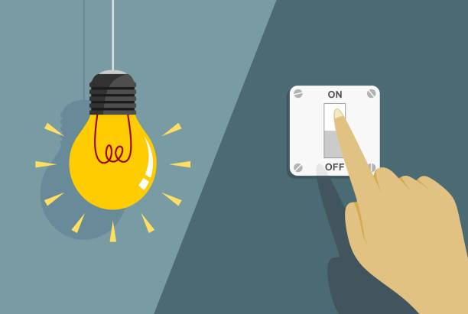
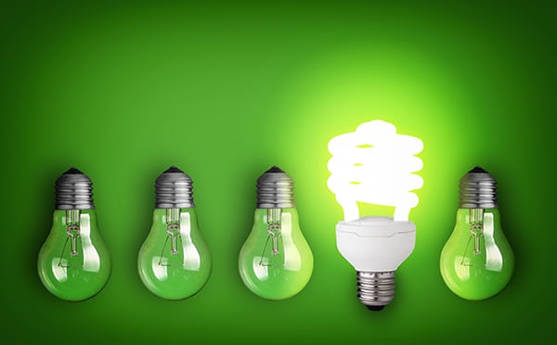
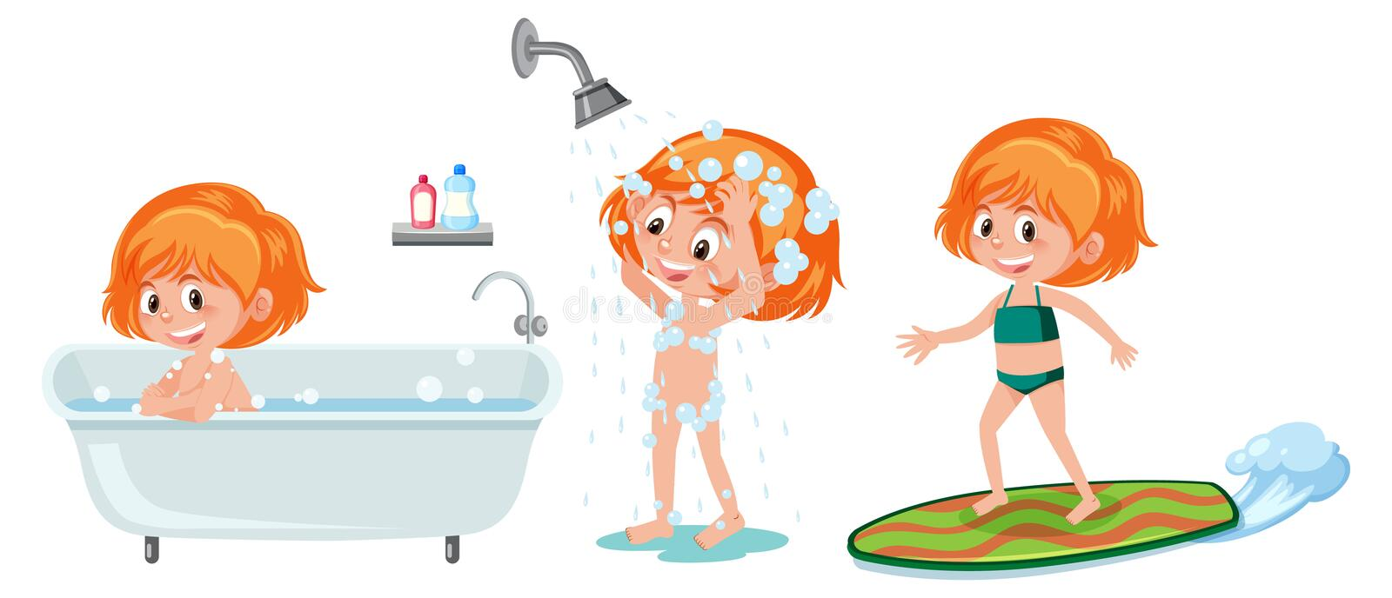

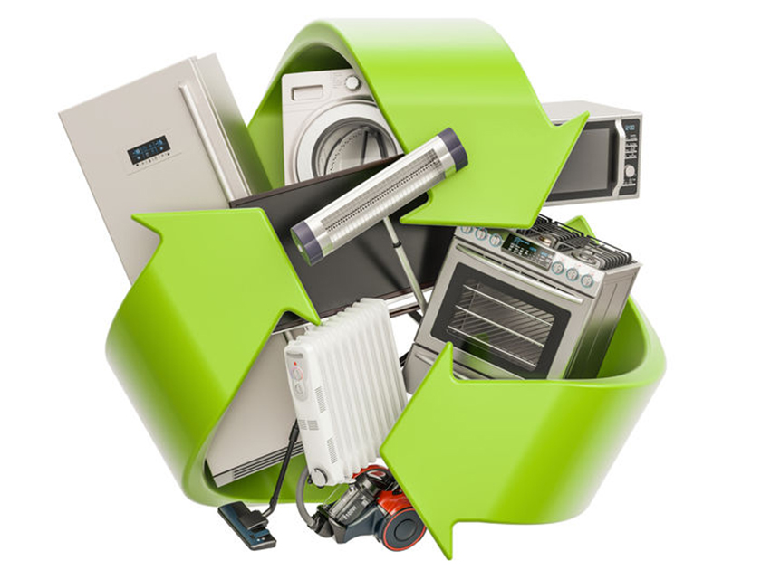
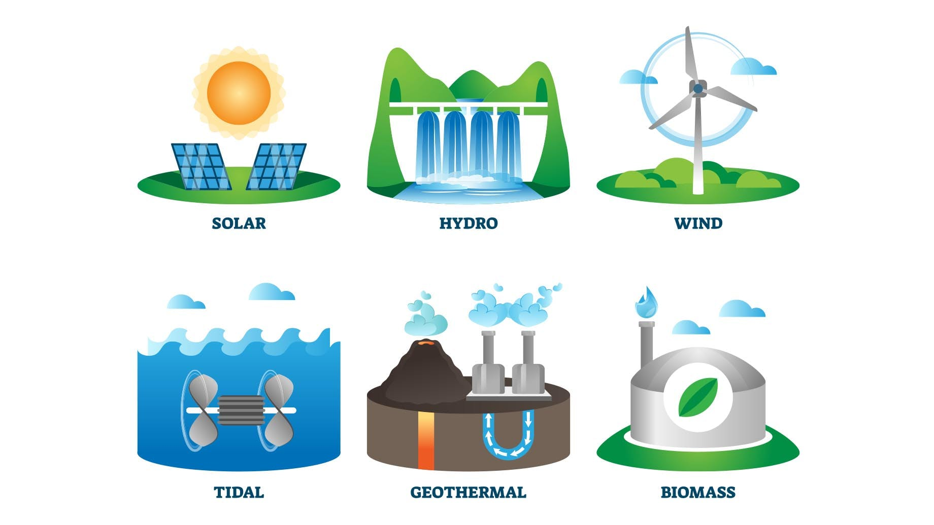
Match the phrases under the pictures
Turn off the light
Use shower instead of bath
Recycle old appliances
Use smart technology
Use renewable energy
Use energy-saving bulbs

Slide 3
Unit 10
Energy sources
Lesson 5. Skills 1

Slide 4
OBJECTIVES
By the end of this lesson, the students will be able to:
- Read for specific information about types of energy sources.
- Talk about the advantages and disadvantages of different energy sources.

Slide 5
Reading

Slide 6
PRE-READING - VOCABULARY
Example:
Our company mainly produces goods for export.
produce (v)
= to make things to be sold, especially in large quantities
/prəˈdjuːs/
Sản xuất

Slide 7
PRE-READING - VOCABULARY
Example:
Oil is limited.
limited (a)
= not very great in amount or extent
/əˈveɪləbl/
Bị hạn chế

Slide 8
PRE-READING - VOCABULARY
Example:
We have plenty of wind energy available.
available (a)
= that you can get, buy or find
/əˈveɪləbl/
Có sẵn

Slide 9
PRE-READING - VOCABULARY
Example:
We run out of fuel.
run out (v)
= to use up or finish a supply of something
/rʌn aʊt/
Cạn kiệt

Slide 10
CHECKING - VOCABULARY
Match the words with their meanings.
produce (v) /prəˈdjuːs/:
Có sẵn
limited (a) /əˈveɪləbl/:
Cạn kiệt
available (a) /əˈveɪləbl/:
Bị hạn chế
run out (v) /rʌn aʊt/:
Sản xuất

Slide 11
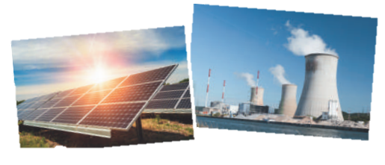
Ex 1. (p 110) Discussion. Look at the pictures and answer the following questions.
1. What are the main energy sources in Viet Nam?
→They are hydro energy and energy from coal.
2. What type(s) of energy sources will we use in the future?
→ We will use solar energy and wind energy.

Slide 12
Ex 2. (p110). Read the text and choose the best option (A, B, or C) to complete the sentences.
Hello, class. Today I'd like to tell you about
two energy sources. They are non-renewable sources and renewable sources.
Non-renewable sources are coal, oil and
natural gas. We can use these sources to produce energy. They are cheap and easy to use. People use them a lot. But they are very limited and will run out soon. Renewable sources come from the sun, wind or water. When energy comes from the sun, we call it solar energy. Wind energy comes from the wind, and hydro energy comes from water. Renewable sources are available, clean and safe to use. But they are expensive to produce.
In the future we will rely more on renewable energy sources. They are better for the environment and they will not run out.
Hello, class. Today I'd like to tell you about
two energy sources. They are non-renewable sources and renewable sources.
Non-renewable sources are coal, oil and
natural gas. We can use these sources to produce energy. They are cheap and easy to use. People use them a lot. But they are very limited and will run out soon. Renewable sources come from the sun, wind or water. When energy comes from the sun, we call it solar energy. Wind energy comes from the wind, and hydro energy comes from water. Renewable sources are available, clean and safe to use. But they are expensive to produce.
In the future we will rely more on renewable energy sources. They are better for the environment and they will not run out.
1. Non – renewable sources are
cheap and _________.
A. available
B. easy to use
C. expensive
Non – renewable sources are
cheap and _________.
A. available
B. easy to use
C. expensive

Slide 13
Ex 2. (p110). Read the text and choose the best option (A, B, or C) to complete the sentences.
Hello, class. Today I'd like to tell you about
two energy sources. They are non-renewable sources and renewable sources.
Non-renewable sources are coal, oil and
natural gas. We can use these sources to produce energy. They are cheap and easy to use. People use them a lot. But they are very limited and will run out soon. Renewable sources come from the sun, wind or water. When energy comes from the sun, we call it solar energy. Wind energy comes from the wind, and hydro energy comes from water. Renewable sources are available, clean and safe to use. But they are expensive to produce.
In the future we will rely more on renewable energy sources. They are better for the environment and they will not run out.
Hello, class. Today I'd like to tell you about
two energy sources. They are non-renewable sources and renewable sources.
Non-renewable sources are coal, oil and
natural gas. We can use these sources to produce energy. They are cheap and easy to use. People use them a lot. But they are very limited and will run out soon. Renewable sources come from the sun, wind or water. When energy comes from the sun, we call it solar energy. Wind energy comes from the wind, and hydro energy comes from water. Renewable sources are available, clean and safe to use. But they are expensive to produce.
In the future we will rely more on renewable energy sources. They are better for the environment and they will not run out.
2. _________come from the sun, wind or water.
A. Renewable sources
B. All energy sources
C. Non-renewable sources
2. _________come from the sun, wind or water.
A. Renewable sources
B. All energy sources
C. Non-renewable sources

Slide 14
Ex 2. (p110). Read the text and choose the best option (A, B, or C) to complete the sentences.
Hello, class. Today I'd like to tell you about
two energy sources. They are non-renewable sources and renewable sources.
Non-renewable sources are coal, oil and
natural gas. We can use these sources to produce energy. They are cheap and easy to use. People use them a lot. But they are very limited and will run out soon. Renewable sources come from the sun, wind or water. When energy comes from the sun, we call it solar energy. Wind energy comes from the wind, and hydro energy comes from water. Renewable sources are available, clean and safe to use. But they are expensive to produce.
In the future we will rely more on renewable energy sources. They are better for the environment and they will not run out.
Hello, class. Today I'd like to tell you about
two energy sources. They are non-renewable sources and renewable sources.
Non-renewable sources are coal, oil and
natural gas. We can use these sources to produce energy. They are cheap and easy to use. People use them a lot. But they are very limited and will run out soon. Renewable sources come from the sun, wind or water. When energy comes from the sun, we call it solar energy. Wind energy comes from the wind, and hydro energy comes from water. Renewable sources are available, clean and safe to use. But they are expensive to produce.
In the future we will rely more on renewable energy sources. They are better for the environment and they will not run out.
3. When energy comes from water, we call it_________.
A. wind energy
B. solar energy
C. hydro energy
3. When energy comes from water, we call it_________.
A. wind energy
B. solar energy
C. hydro energy

Slide 15
Ex 2. (p110). Read the text and choose the best option (A, B, or C) to complete the sentences.
Hello, class. Today I'd like to tell you about
two energy sources. They are non-renewable sources and renewable sources.
Non-renewable sources are coal, oil and
natural gas. We can use these sources to produce energy. They are cheap and easy to use. People use them a lot. But they are very limited and will run out soon. Renewable sources come from the sun, wind or water. When energy comes from the sun, we call it solar energy. Wind energy comes from the wind, and hydro energy comes from water. Renewable sources are available, clean and safe to use. But they are expensive to produce.
In the future we will rely more on renewable energy sources. They are better for the environment and they will not run out.
Hello, class. Today I'd like to tell you about
two energy sources. They are non-renewable sources and renewable sources.
Non-renewable sources are coal, oil and
natural gas. We can use these sources to produce energy. They are cheap and easy to use. People use them a lot. But they are very limited and will run out soon. Renewable sources come from the sun, wind or water. When energy comes from the sun, we call it solar energy. Wind energy comes from the wind, and hydro energy comes from water. Renewable sources are available, clean and safe to use. But they are expensive to produce.
In the future we will rely more on renewable energy sources. They are better for the environment and they will not run out.
4. Renewable energy sources are better for_______.
A. the environment
B. our cars
C. hydro energy
4. Renewable energy sources are better for_______.
A. the environment
B. our cars
C. hydro energy

Slide 16
Ex 3. (p 110) Underline the keywords
Hello, class. Today I'd like to tell you about two energy sources. They are non-renewable sources and renewable sources.
Non-renewable sources are coal, oil and natural gas. We can use these sources to produce energy. They are cheap and easy to use. People use them a lot. But they are very limited and will run out soon.
Renewable sources come from the sun, wind or water. When energy comes from the sun, we call it solar energy. Wind energy comes from the wind, and hydro energy comes from water. Renewable sources are available, clean and safe to use. But they are expensive to produce.
In the future we will rely more on renewable energy sources. They are better for the environment and they will not run out.
1. How many energy sources are there? What are they?
2. What do non-renewable sources include?
3. What are the advantages of renewable energy?
4. What will we rely more on in the future?
1. How many energy sources are there? What are they?
2. What do non-renewable sources include?
3. What are the advantages of renewable energy?
4. What will we rely more on in the future?

Slide 17
Ex 3. (p 110) Read the text again and answer the questions.
1. How many energy sources are there? What are they?
→ There are two energy sources. They are non-renewable sources and renewable sources.
2. What do non-renewable sources include?
→ Non-renewable sources are coal, oil and natural gas
3. What are the advantages of renewable energy?
→ Renewable sources are available, clean and safe to use.
4. What will we rely more on in the future?
→ In the future, we will rely more on renewable energy sources.
Today I'd like to tell you about two energy sources. They are non-renewable sources and renewable sources.
Non-renewable sources are coal, oil and natural gas.
Renewable sources are available, clean and safe to use.
In the future we will rely more on renewable energy sources.

Slide 18

Speaking
What are the advantages of renewable energy sources?
Can you add more?

Slide 19


Ex 4. (p 110) Work in groups. Discuss and put the following words or phrases in the appropriate columns.
run out expensive cheap limited
easy to use safe to use available good for the environment
ADVANTAGES
DISADVANTAGES
cheap
run out
available
expensive
easy to use
limited
safe to use
good for the environment

Slide 20
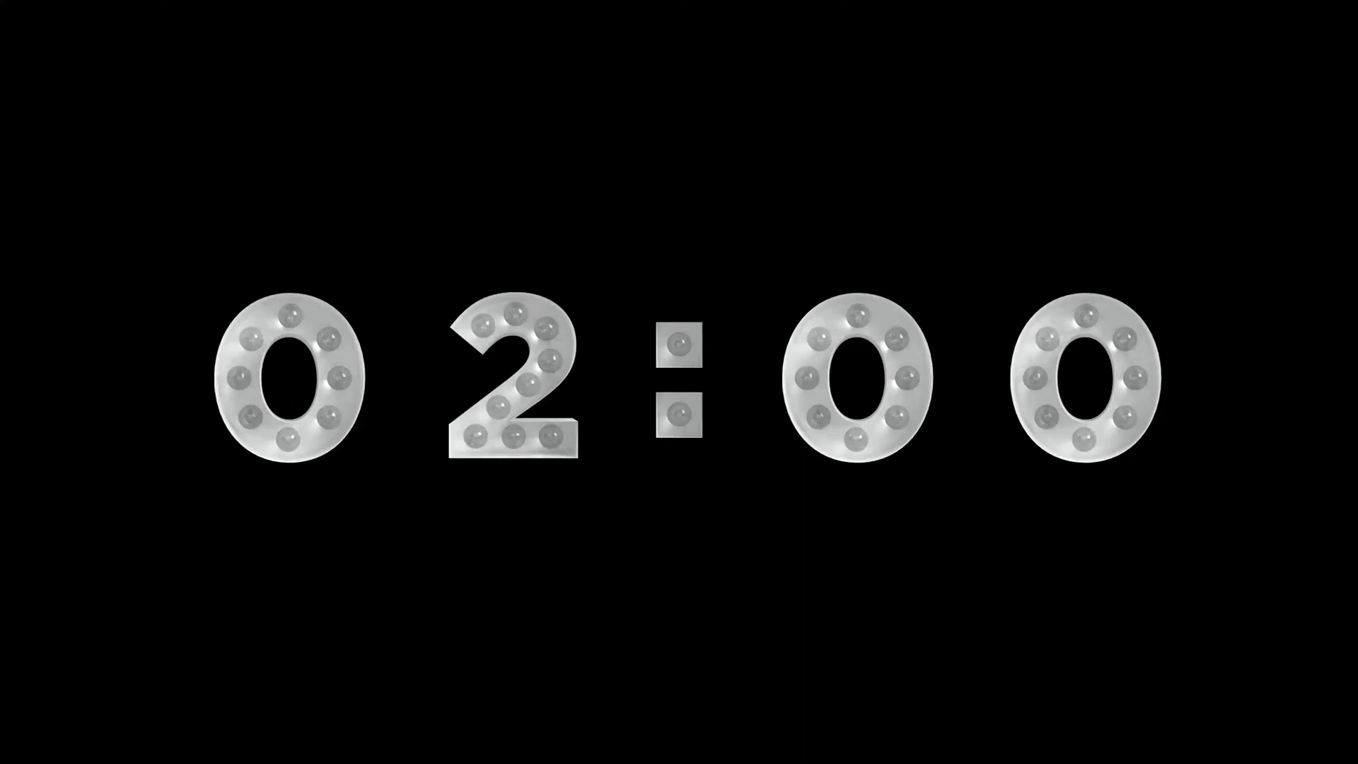
Ex 5. (p 110) Work in pairs.
Rules:
Base on the information from Ex 2,3, the vocabulary in Ex 4 and the example in Ex 5.
Ask and answer questions about the advantages and disadvantages of different energy sources.
Prepare in 2 minutes.
Example:
A: What are the advantages of hydro energy?
B: It's available, clean and safe to use.
A: What are its disadvantages?
B: It's expensive to produce.

Slide 21
WHAT HAVE YOU LEARNT TODAY?
R
E
C
A
P
CIRCLE THE CORRECT ANSWERS
01
How many energy sources are there?
A. Two
A. Two
B. One
C. Four

Slide 22
WHAT HAVE YOU LEARNT TODAY?
R
E
C
A
P
CIRCLE THE CORRECT ANSWERS
02
What do non-renewable sources include?
A. coal, oil
A.
coal, oil
B. wind
C. natural gas
C. natural gas

Slide 23
WHAT HAVE YOU LEARNT TODAY?
R
E
C
A
P
CIRCLE THE CORRECT ANSWERS
03
What is the disadvantages of oil?
A. easy to use
B. limited
B.
limited
C.
run out
C.
run out

Slide 24
THANK YOU

