Slide 1
Notes:
Nhấn vào answer để biết đáp án

Slide 2
Q
What do you use to light the bulb?
A
Electricity
Answer
Next

Slide 3


Q
How does the boat float on the water?
A
Wind
Answer
Next

Slide 4
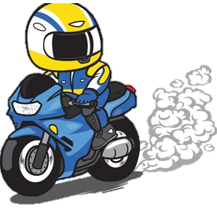
Q
We should use public transport instead of motorbikes to avoid _____ pollution.
A
Air
Answer
Next

Slide 5

Q
Turn off the faucet when you don’t use ________.
A
Water
Answer
Next

Slide 6
What is the topic today?

Slide 7
Unit 10.
Energy sources
LESSON 1. GETTING STARTED

Slide 8
Objectives
1
Overview
About the topic “Energy sources”.
Definition
3
Energy meaning
Renewable sources
2
Vocabulary
About types of energy.

Slide 9

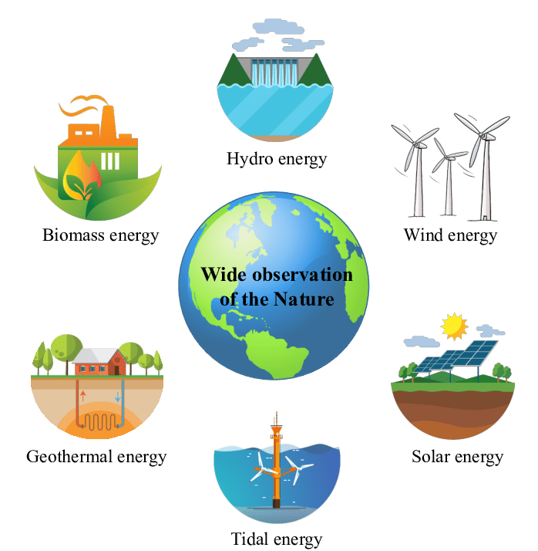
energy source (n)
1
/ˈenədʒi sɔːs/
3
Nguồn năng lượng
2
Notes:
Click vào tranh để nghe phát âm từ

Slide 10
renewable (a)
1
/rɪˈnjuːəbl/
3
Có thể tái tạo được
2
Notes:
Click vào tranh để nghe phát âm từ

Slide 11
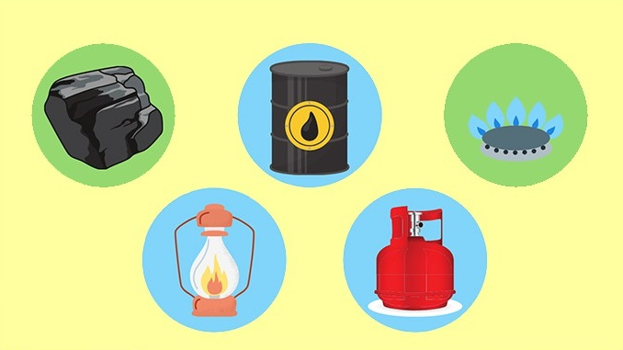

non-renewable (a)
1
/nɒn rɪˈnjuːəbl/
3
Không thể tái tạo được
2
Notes:
Click vào tranh để nghe phát âm từ

Slide 12
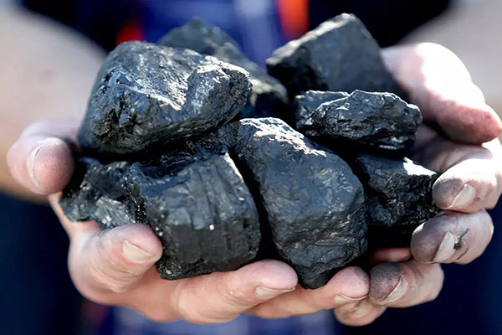
coal (n)
1
/kəʊl/
3
Than đá
2
Notes:
Click vào tranh để nghe phát âm từ

Slide 13

run out of (v)
1
/rʌn aʊt/
3
Cạn kiệt
2
Notes:
Click vào tranh để nghe phát âm từ

Slide 14

replace (v)
/rɪˈpleɪs/
Thay thế
Notes:
Click vào tranh để nghe phát âm từ

Slide 15

do a project on (v)
/duː ə ˈprɒʤɛkt ɒn /
Thực hiện một dự án
Notes:
Click vào tranh để nghe phát âm từ

Slide 16
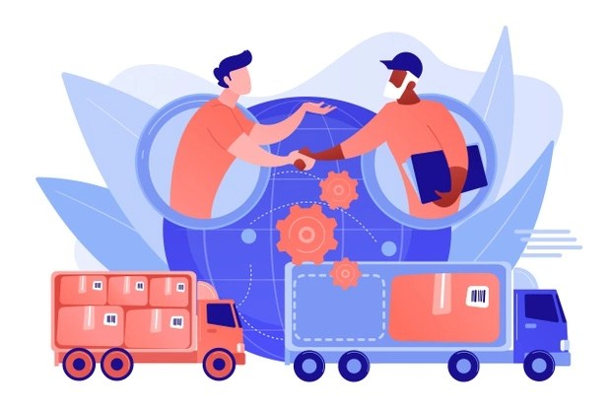
provide sb with sth (v)
/prəˈvaɪd ˈsʌmbədi wɪð ˈsʌmθɪŋ/
Cung cấp cho ai cái gì
Notes:
Click vào tranh để nghe phát âm từ

Slide 17
VOCABULARY
New words | Pronunciation | Meaning
energy sources (n) | /ˈsaɪkl/ | nguồn năng lượng
coal (n) | /ˈtræfɪk dʒæm/ | than đá
renewable (adj) | /krɒs ðə rəʊd/ | có thể tái tạo được
non-renewable (a) | /nɒn rɪˈnjuːəbl/ | không thể tái tạo được
run out of (phr v) | /ˈrʌʃ aʊə(r)/ | cạn kiệt
provide sb with sth (phr v) | /prəˈvaɪd ˈsʌmbədi wɪð ˈsʌmθɪŋ/ | cung cấp cái gì cho ai
replace (v) | /rɪˈpleɪs/ | thay thế
do a project on (v) | /duː ə ˈprɒʤɛkt ɒn / | thực hiện một dự án

Slide 18

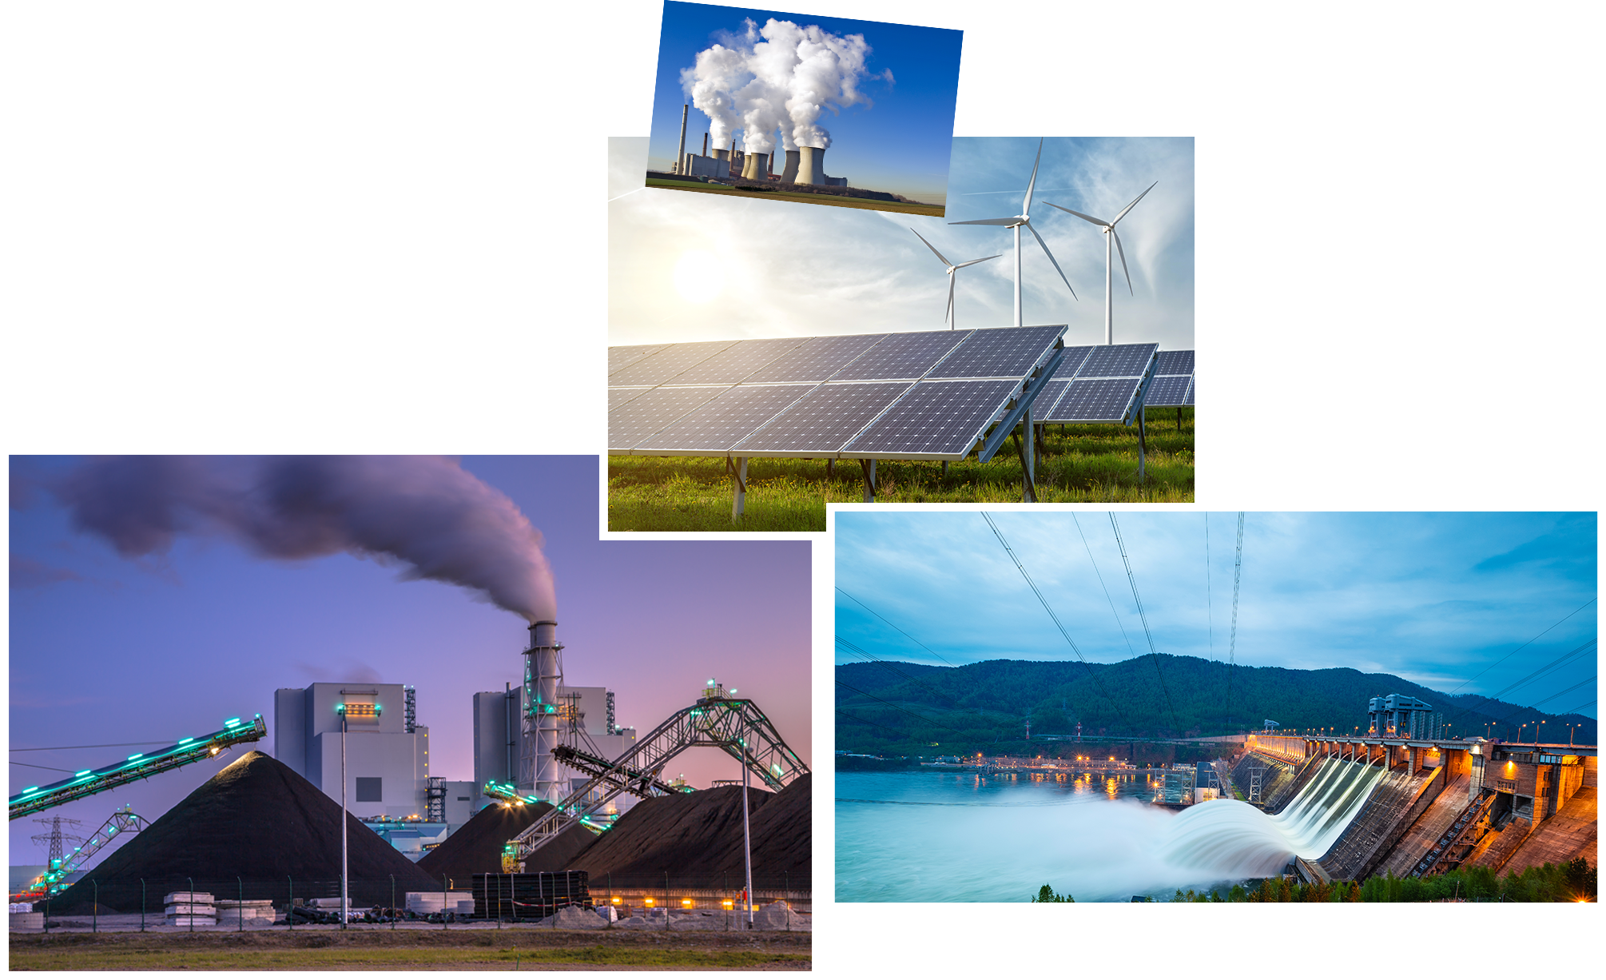
Ex 1. (p 104) Listen and repeat.
Lan: Hi, Dad.
Mr Tan: Lan, what are you doing? It's pretty late now.
Lan: I'm doing a project on energy sources. But I don't quite understand what energy is.
Mr Tan: Well, it's power that we use to provide us with light, heat or electricity.
Lan: Oh. Where does it come from?
Mr Tan: It comes from many different sources like coal, oil, natural gas.... We call them non-renewable sources.
Lan: Can it come from the sun, wind or water too?
Mr Tan: Yes, it can. We call those types of energy renewable sources because we cannot run out of them. Renewable means we can easily replace them.
Lan: I get it now.
Mr Tan: You know, some types of energy are cheap and easy to use, but others are more expensive and harder to find…

Slide 19
Ex 2. (p 105) What are Lan and her father talking about?
Lan: I'm doing a project on energy sources. But I don't quite understand what energy is.
A
Energy
Mr Tan: It comes from many different sources like coal, oil, natural gas.... We call them non-renewable sources.
Lan: Can it come from the sun, wind or water too?
Mr Tan: Yes, it can. We call those types of energy renewable sources because we cannot run out of them. Renewable means we can easily replace them.
B
Sources
C
Energy sources
Notes:
What are they?

Slide 20
Ex 3. (p 105) Read conversation again and answer these questions.
1
What is Lan doing?
Lan: I'm doing a project on energy sources. But I don't quite understand what energy is.
→ She is doing a project on energy sources.
2
Lan: I'm doing a project on energy sources. But I don't quite understand what energy is.
Tan: Well, it's power that we use to provide us with light, heat or electricity.
What does energy mean?
→ It’s power that we use to provide us with light, heat or electricity.
3
Where does energy come from?
Lan: Oh. Where does it come from?
Mr Tan: It comes from many different sources like coal, oil, natural gas.... We call them non-renewable sources.
→ It comes from many different sources like coal, oil, natural gas,…
4
What are renewable sources?
Mr Tan: Yes, it can. We call those types of energy renewable sources because we cannot run out of them. Renewable means we can easily replace them.
→ Renewable sources means the sources we cannot run out of them.

Slide 21
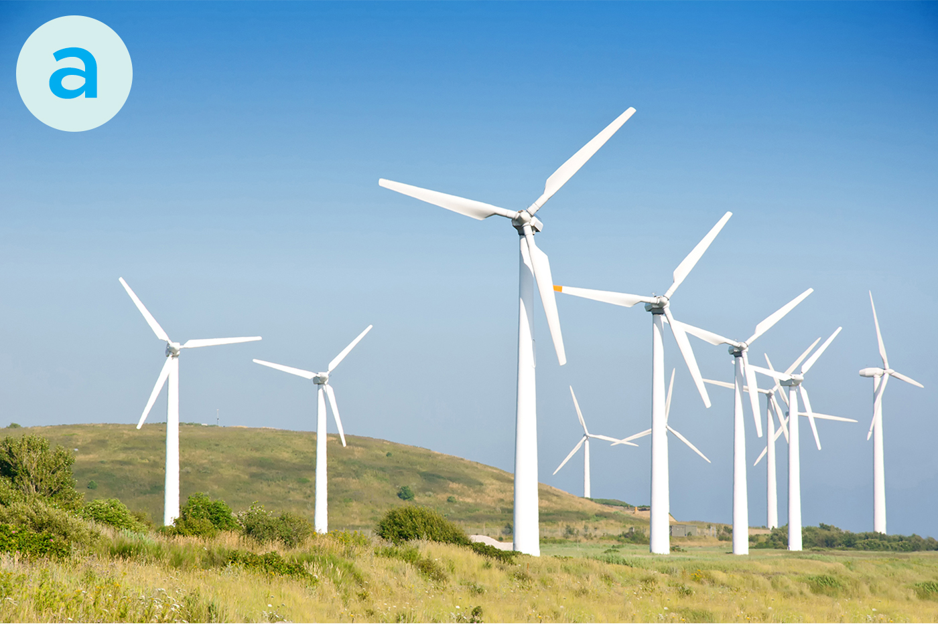
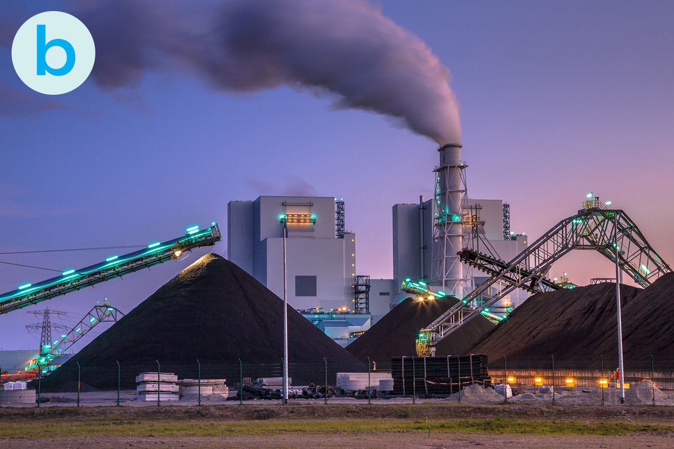
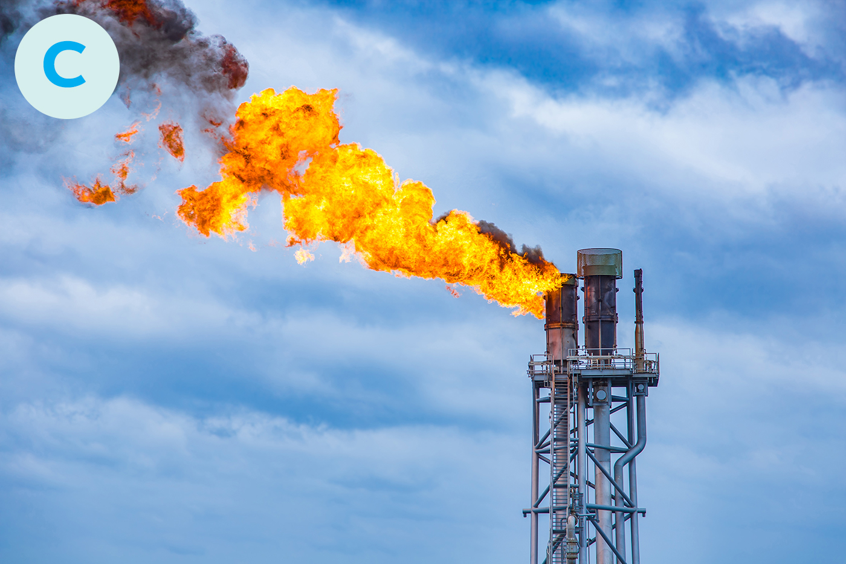
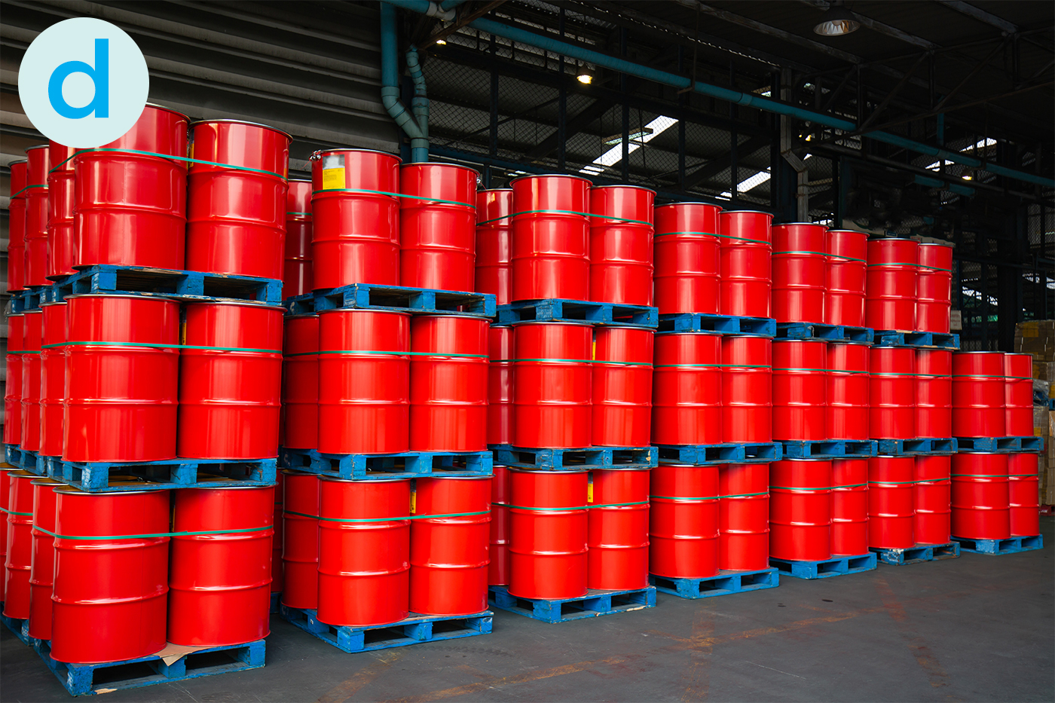
Ex 4. (p 105) Match the words / phrases in the box with the correct pictures.
1. Oil
2. Wind energy
3. Coal
4. Natural gas
2
3
4
1

Slide 22
Ex 5. (p 105) Complete each of the sentences with the correct word from the conversation.
01
power
Energy is __________ that we use to provide us with light, heat or electricity.
Lan: I'm doing a project on energy sources. But I don't quite understand what energy is.
Tan: Well, it's power that we use to provide us with light, heat or electricity.
sun
02
When energy comes from the________ , wind and water, we call it renewable energy.
Lan: Can it come from the sun, wind or water too?
03
renewable
When energy comes from wind, we call it ______________ energy.
Lan: Can it come from the sun, wind or water too?
Mr Tan: Yes, it can. We call those types of energy renewable sources because we cannot run out of them.
04
run
We cannot ________ out of renewable energy.
Mr Tan: Yes, it can. We call those types of energy renewable sources because we cannot run out of them.
05
cheap
Some types of energy are _____________ and easy to use.
Mr Tan: You know, some types of energy are cheap and easy to use.

Slide 23
What sources of energy are renewable?
R
E
C
A
P
Wind
02
Water
Sun
01
04

Slide 24
What sources of energy are non-renewable?
Coal
2
>>
>>
Oil
1
3
Natural gas

Slide 25
Thank you!
65%
4
35%

