Slide 1
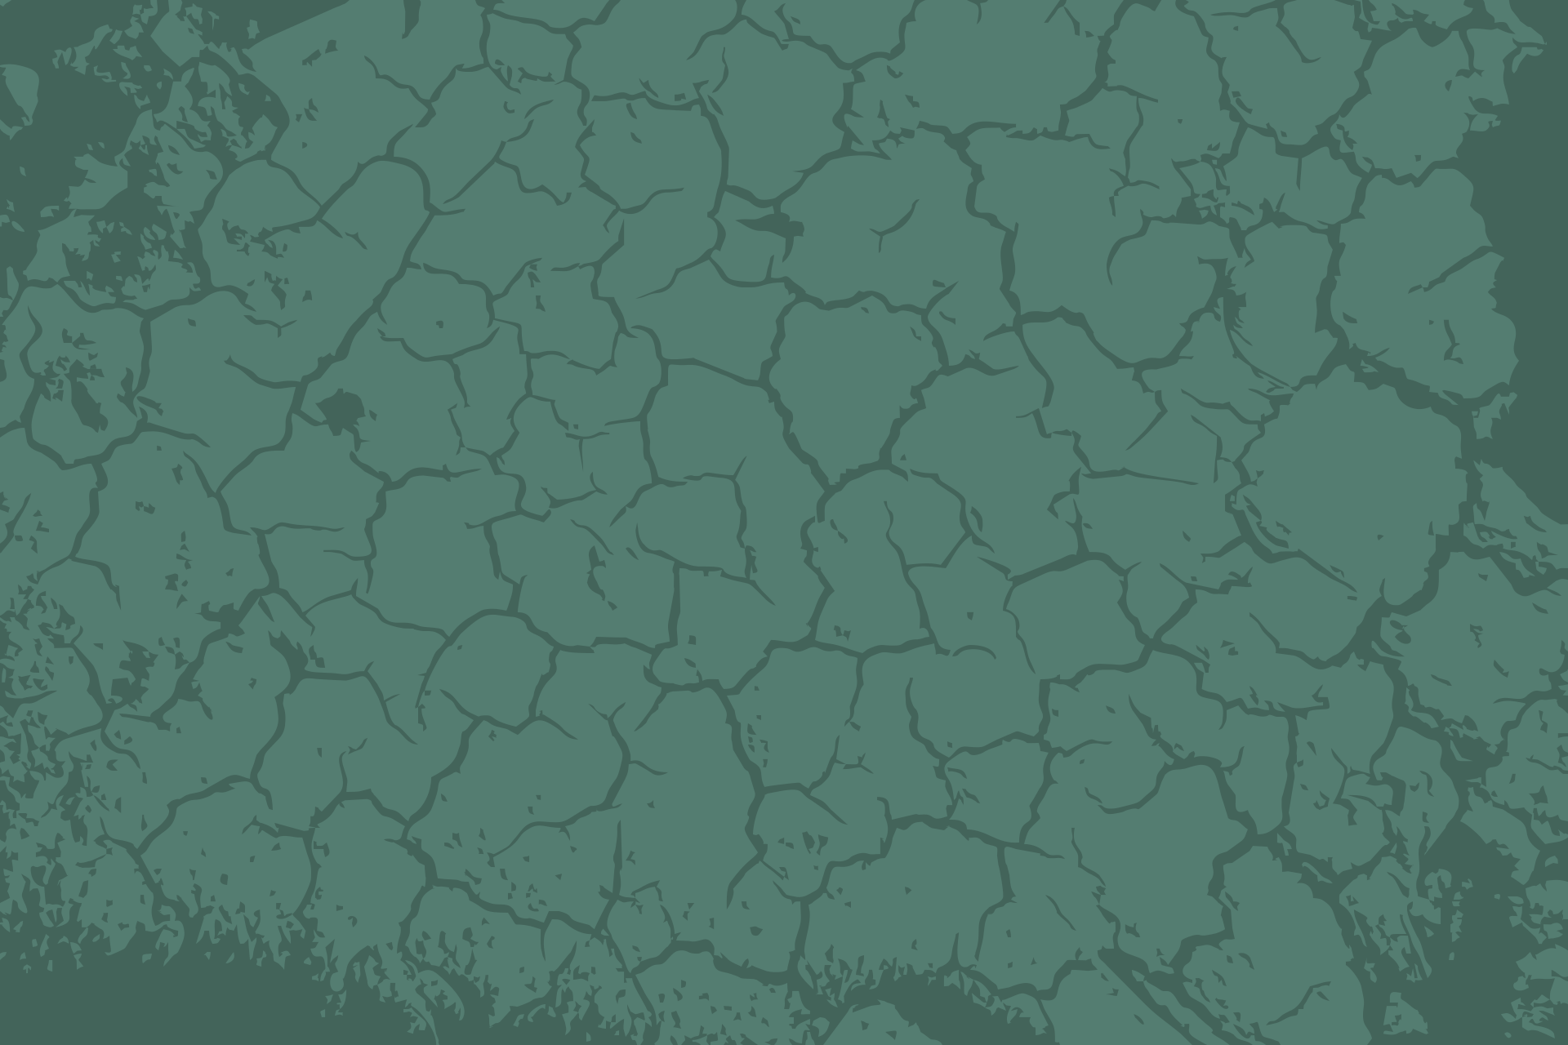
WELCOME TO OUR CLASS!

Slide 2
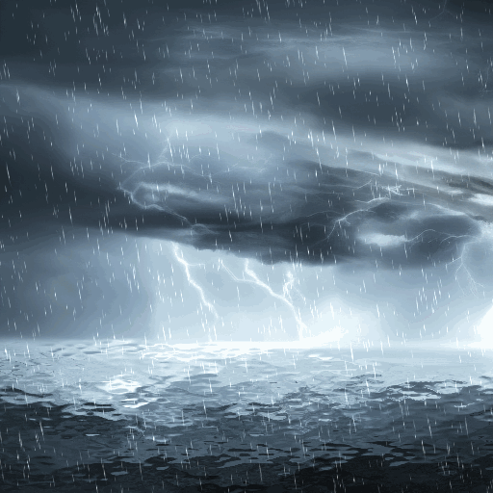
BRAINSTORMING
1. What is this natural disaster?
2. What should people do before, during, and after this natural disaster?
1
2
3

Slide 3

Unit 9:
NATURAL DISASTERS
Lesson 6: Skills 2

Slide 4
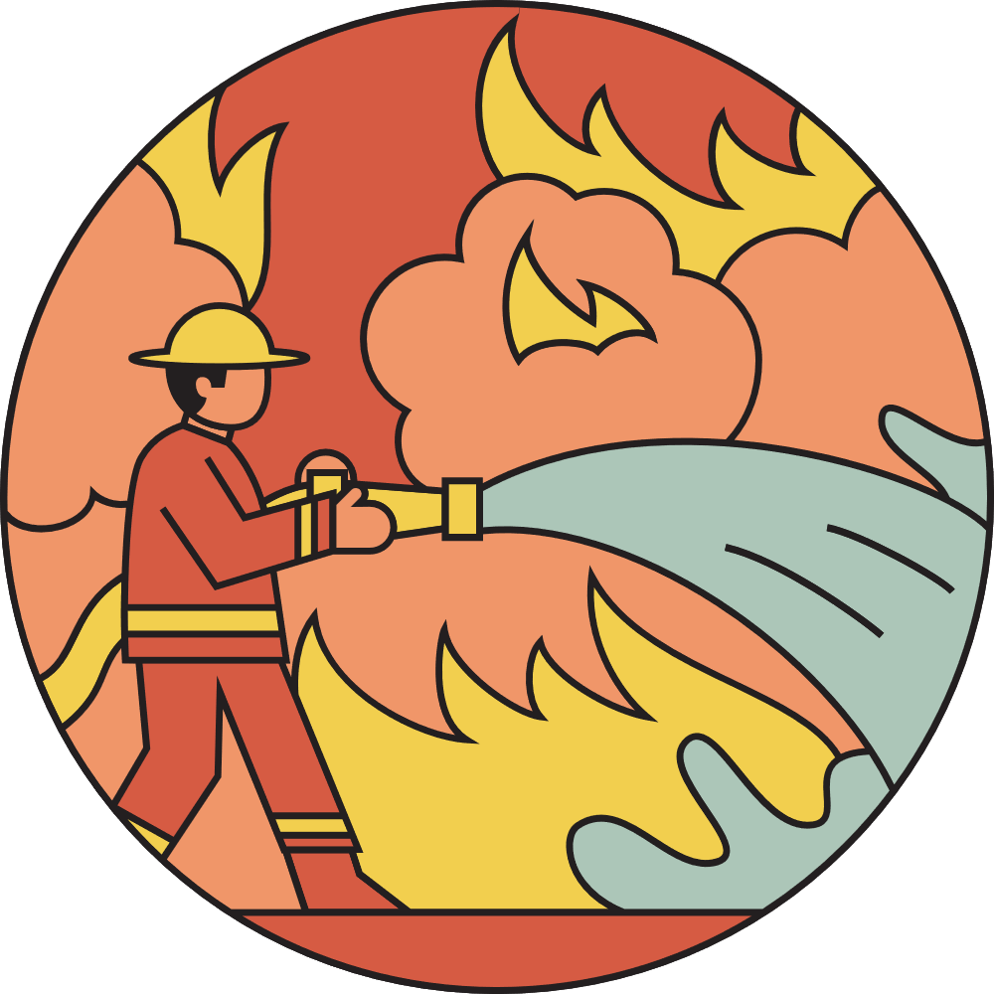
VOCABULARY

Slide 5
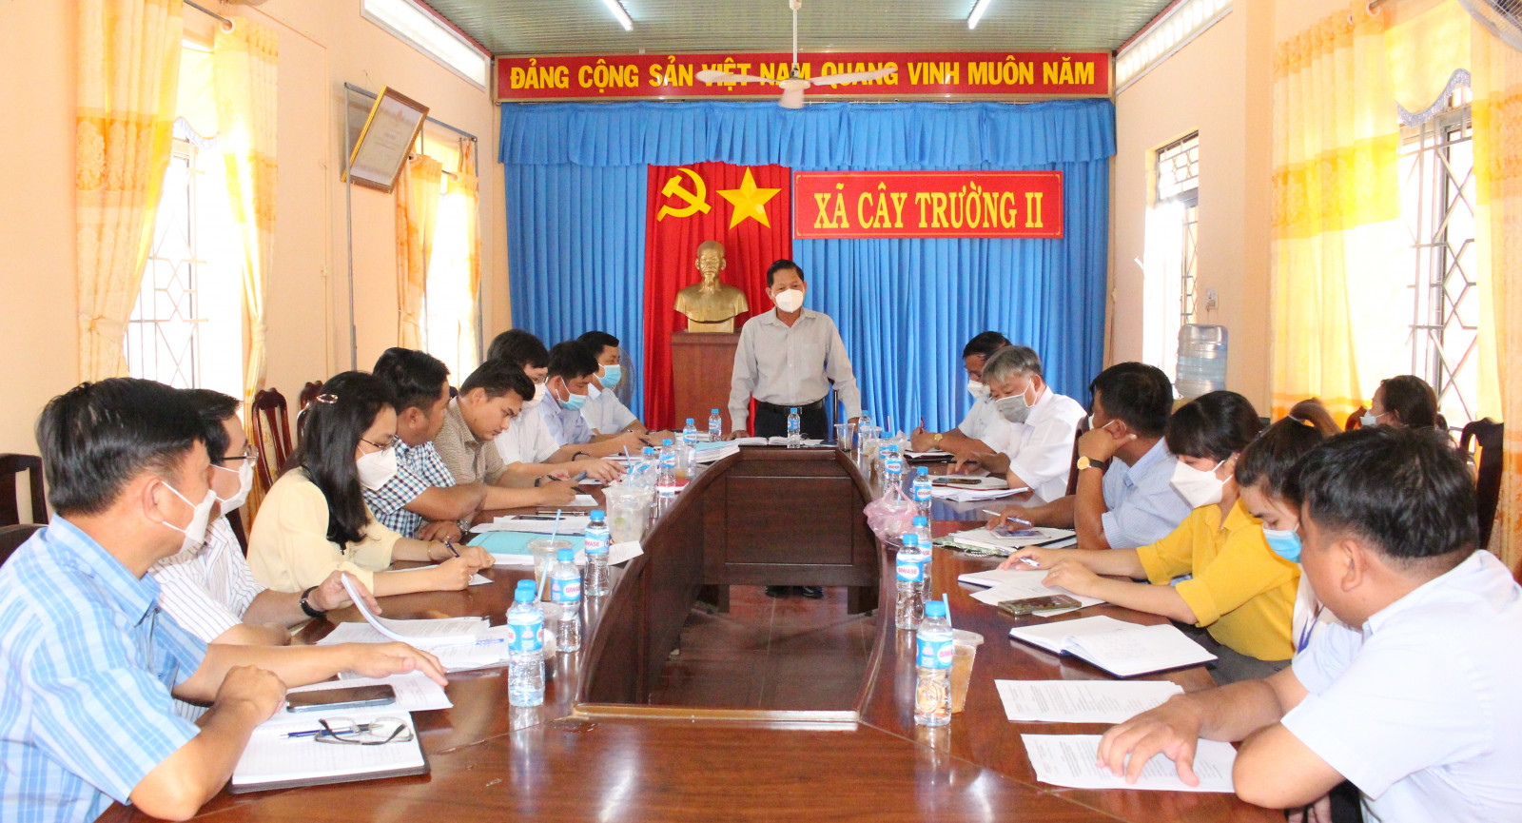

VOCABULARY
authority (n)
/ɔːˈθɒrəti/
chính quyền

Slide 6
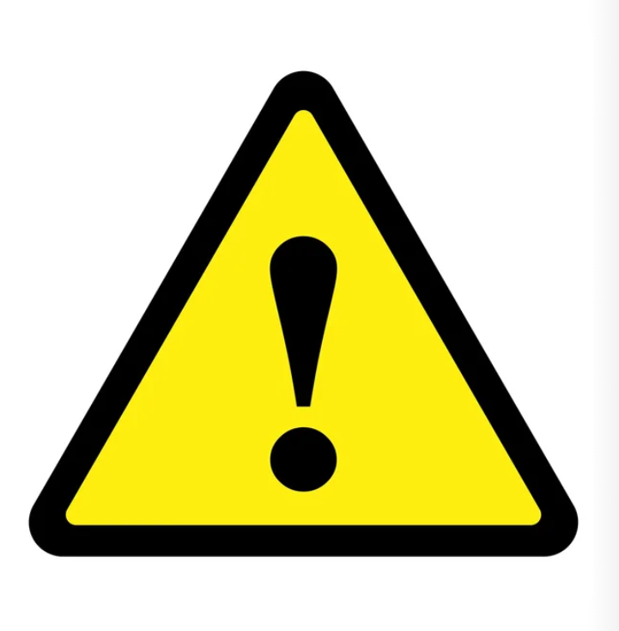
VOCABULARY
warn (v)
/wɔːn/
cảnh báo

Slide 7
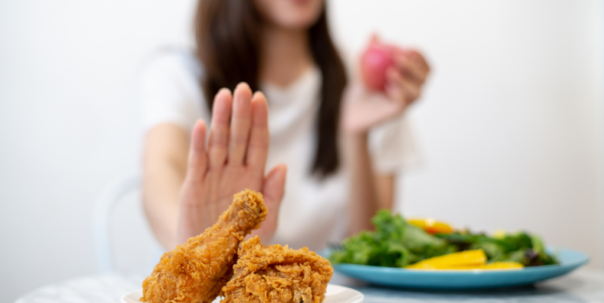
VOCABULARY
avoid (v)
/əˈvɔɪd/
tránh, tránh xa

Slide 8
VOCABULARY
1. authority (n) | /ɔːˈθɒrəti/ | chính quyền
2. warn (v) | /wɔːn/ | cảnh báo
3. avoid (v) | /əˈvɔɪd/ | tránh, tránh xa

Slide 9
LISTENING

Slide 10
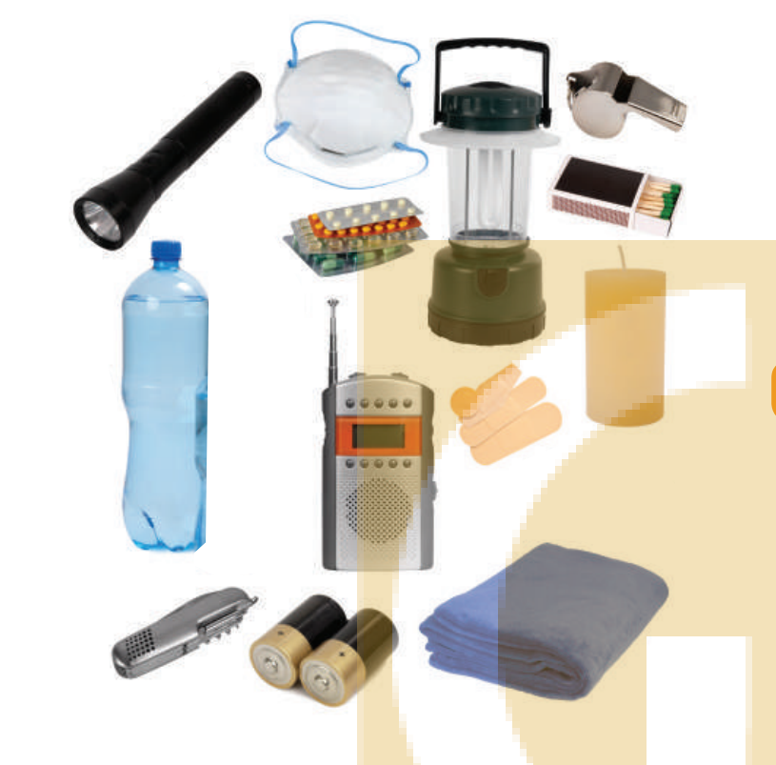

1. Work in pairs. Look at the picture and answer the questions.
What can you see in the picture?
2. When do we need these things?

Slide 11
2. Listen to a broadcast. Put the activities (1-6) in the correct column.
Before a storm | During a storm | After a storm
Listen to instructions from local authorities
2. Prepare an emergency kit
3. Stay inside the house
4. Keep away from dangerous areas
5. Avoid windows and glass doors
6. Strengthen houses

Slide 12
2. Listen to a broadcast. Put the activities (1-6) in the correct column.
Before a storm
Listen to instructions from local authorities
2. Prepare an emergency kit
3. Stay inside the house
4. Keep away from dangerous areas
5. Avoid windows and glass doors
6. Strengthen houses
2. Prepare an emergency kit
6. Strengthen houses

Slide 13
2. Listen to a broadcast. Put the activities (1-6) in the correct column.
During a storm
Listen to instructions from local authorities
2. Prepare an emergency kit
3. Stay inside the house
4. Keep away from dangerous areas
5. Avoid windows and glass doors
6. Strengthen houses
3. Stay inside the house
5. Avoid windows and glass doors

Slide 14
2. Listen to a broadcast. Put the activities (1-6) in the correct column.
After a storm
Listen to instructions from local authorities
2. Prepare an emergency kit
3. Stay inside the house
4. Keep away from dangerous areas
5. Avoid windows and glass doors
6. Strengthen houses
1. Listen to instructions from local authorities
4. Keep away from dangerous areas

Slide 15
Look at the answers again
Before a storm | During a storm | After a storm
2. Prepare an emergency kit 6. Strengthen houses | 3. Stay inside the house 5. Avoid windows and glass doors | 1. Listen to instructions from local authorities 4. Keep away from dangerous areas

Slide 16


3. Listen again and tick () T (True) or F (False) for each sentence.
 | T | F
1. The broadcast is on TV.
2. You should bring flowerpots and rubbish bins into the house.
3. Right after the storm, you can leave your home.
4. The local authority may warn you about dangerous places.

Slide 17
WRITING

Slide 18
4. Work in pairs. Discuss what you should do before, during, and after a flood. Write your ideas in the columns.
Before a storm | During a storm | After a storm
Prepare an emergency kit. …. | Stay inside a safe and high place. …. | Avoid moving water. …..

Slide 19

5. Write instructions (80-100 words) about things to do before, during, and after a flood.
Start as follows:
Here are the things you should do before, during, and after a flood.
Before:
-
During:
-
After:
-

Slide 20
Suggested answers:
Here are the things you should do before, during, and after a flood.
Before:
- Prepare an emergency kit.
- Listen to local radio.
- Protect your valuables in waterproof containers. Place them above potential water levels.
During:
- Stay inside a safe and high place.
- Follow the routes specified by officials.
- Time permitting, leave a note informing others when you left and where you went.
After:
- Avoid moving water.
- Emergency workers will be assisting people in flooded areas.
- Return home only when authorities indicate it is safe.

Slide 21
WRAP UP
In this lesson, you have:
learnt new words related to natural disasters.
known more about things to do before, during, and after a storm.
written instructions about things to do before, during, and after a flood.

Slide 22
HOMEWORK
Learn by heart all the words.
Do exercises in the workbook.
Prepare for Lesson 7 – Looking back + project.

Slide 23
THANK YOU!
I HOPE YOU LEARN SOMETHING NEW TODAY!

