Slide 1






WELCOME TO OUR CLASS!

Slide 2


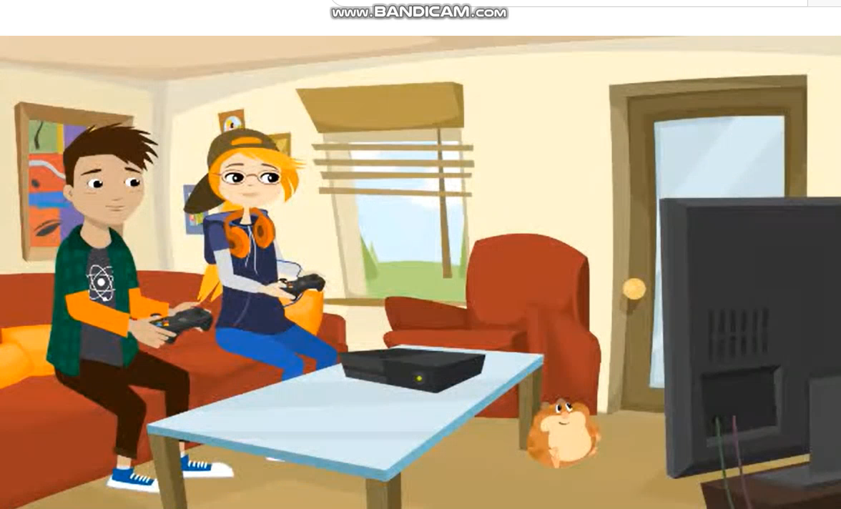


Watch a video and write down adverbs of frequency

Slide 3
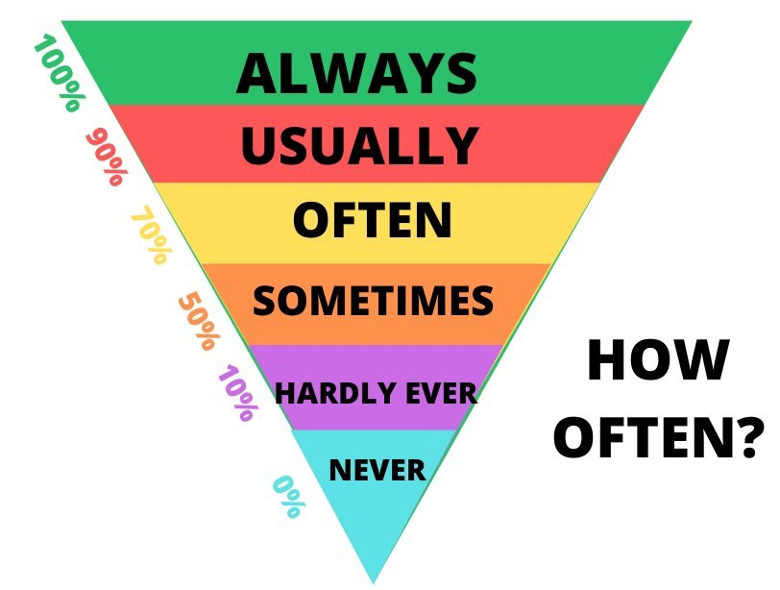
Adverbs of frequency

Slide 4
Unit 8:
SHOPPING
Lesson 3: A Closer Look 2

Slide 5


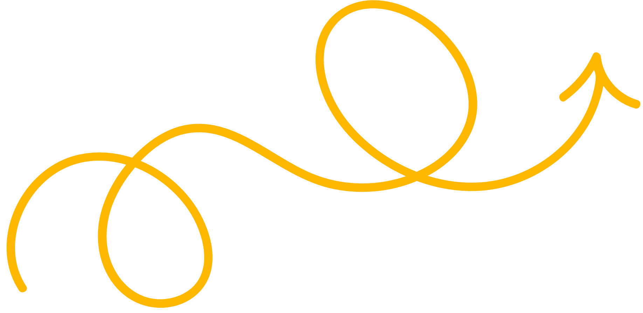
ADVERBS OF FREQUENCY

Slide 6
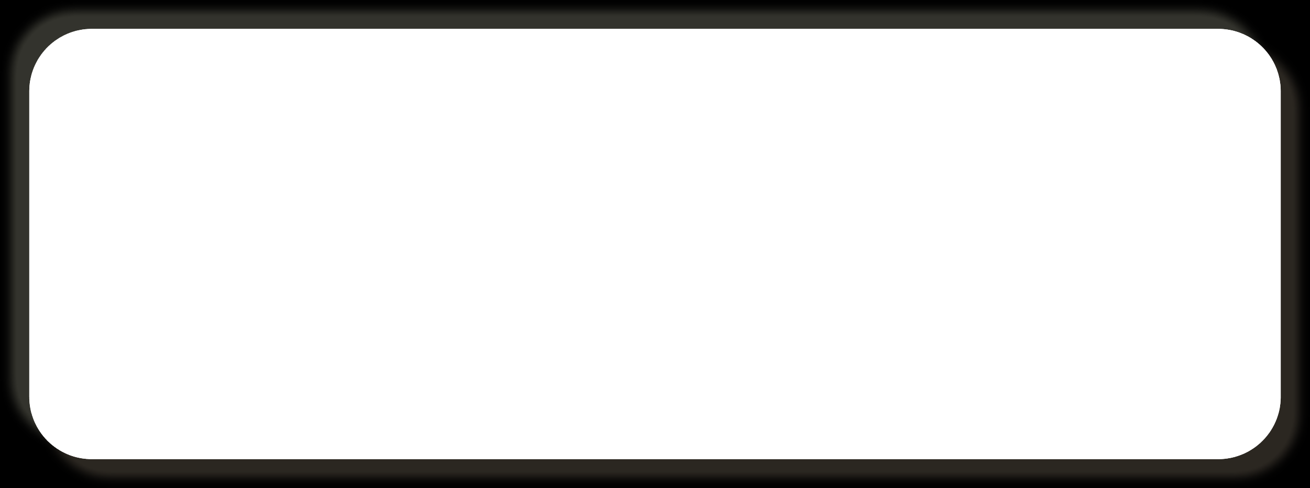

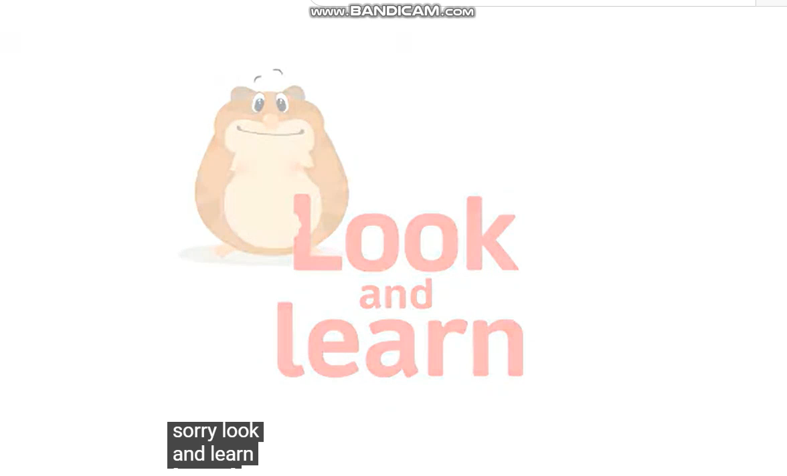

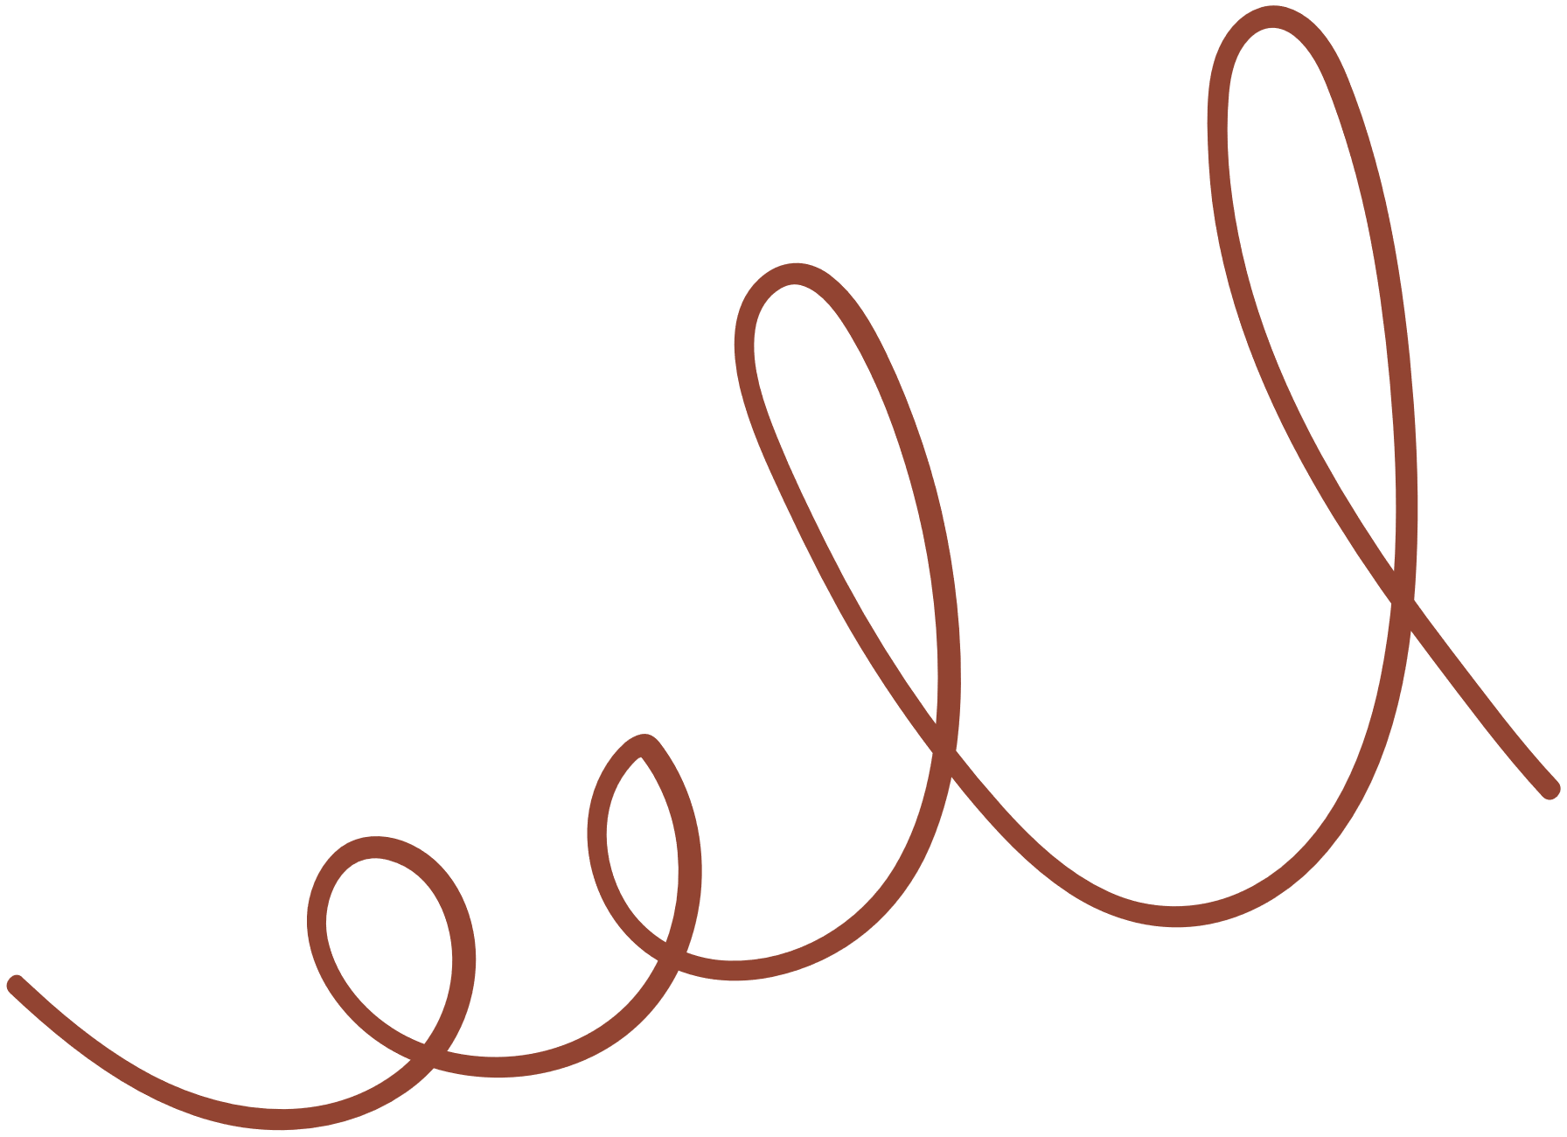
Look and learn

Slide 7



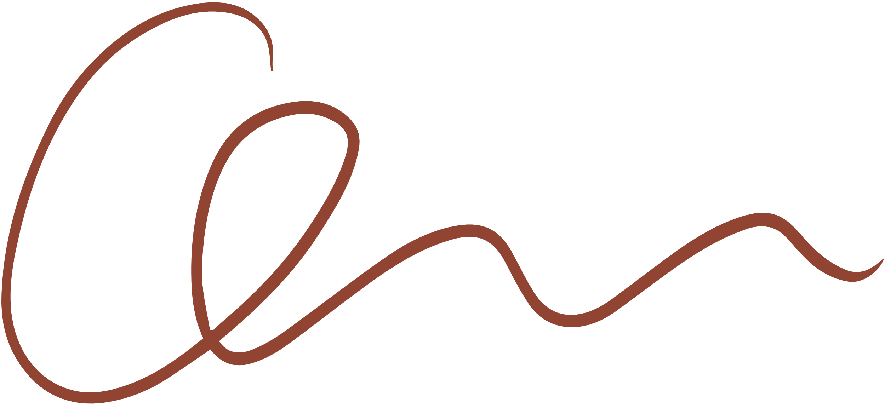
1. Complete the sentences with the adverbs of frequency from the box.
always
often
sometimes
rarely
never
My mother __________ shops at the supermarket. She never shops anywhere else.
I ___________ buy things online, just once or twice a year. I prefer to shop at the shopping mall.
You can _________ bargain at a supermarket because the prices are fixed.
How_________ do you return things you buy online?
I don’t often buy things at the dollar store. My mother only takes me there ___________.

Slide 8

2. Read the schedule of the field trip for the grade 8 students tomorrow, and underline the verbs in the sentences. Then answer the questions.
Field trip to the Double Dragon Chocolate Factory. 30 February
9:00 | The bus leaves.
10:00 | Students arrive at the factory
10:10 | Students watch a documentary introducing the factory.
10:30 | The tour of the factory starts.
12:10 | Students return to school to write the trip reports.
Present simple
What tense are the verbs in the sentences?
Are the sentences about habits or future activities?
Future activities

Slide 9



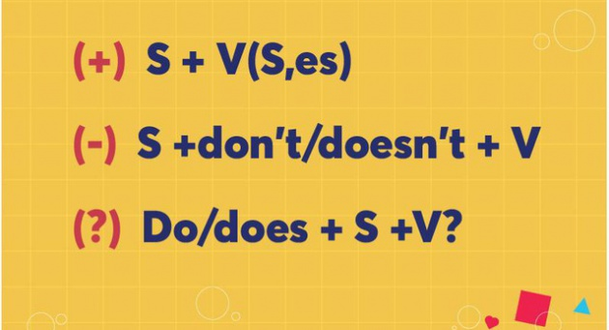

Form of present simple

Slide 10


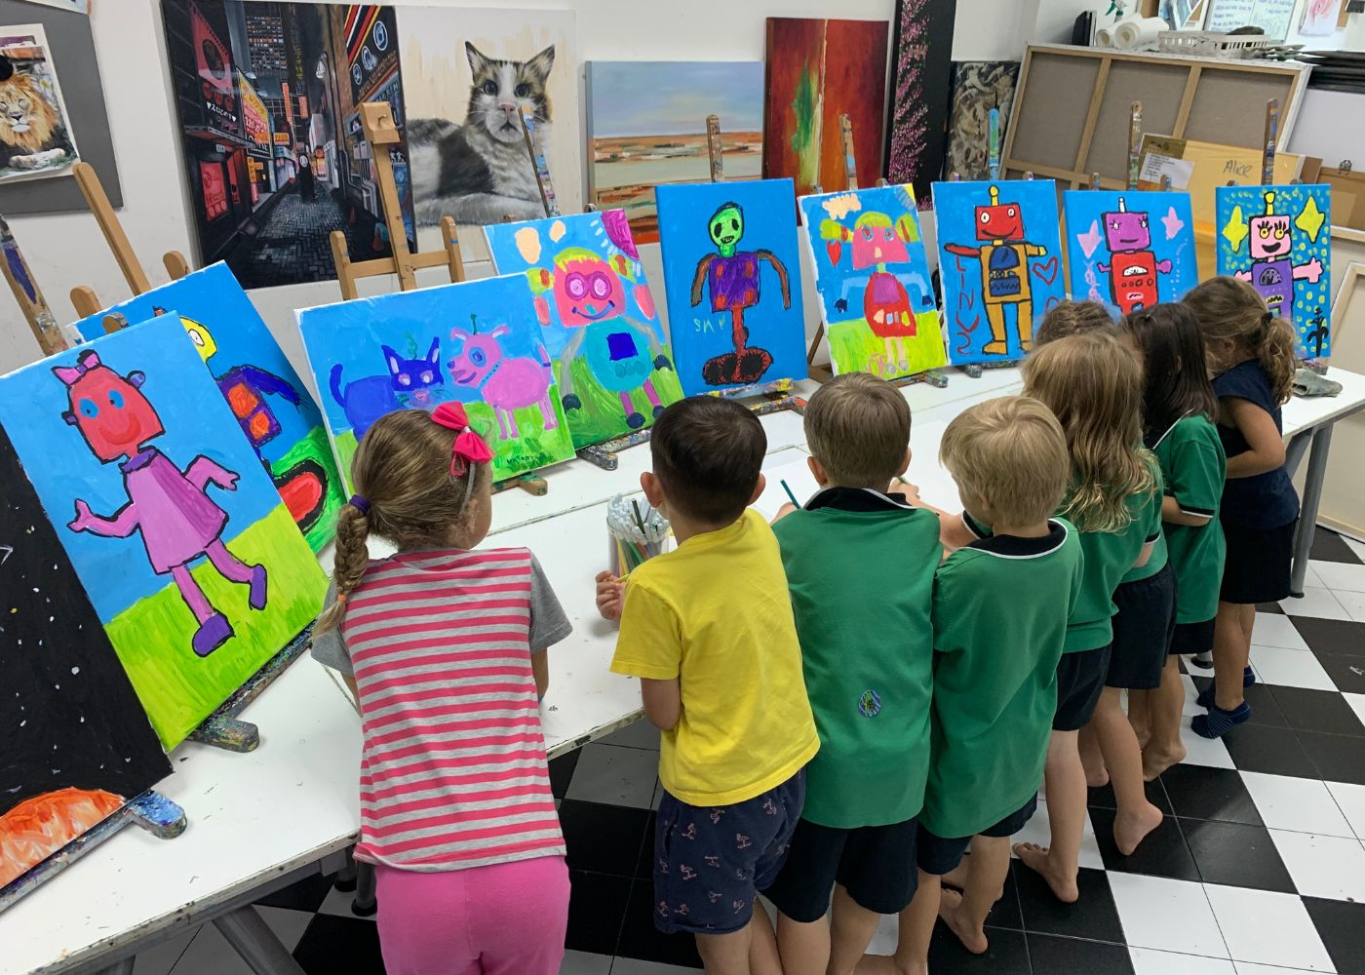
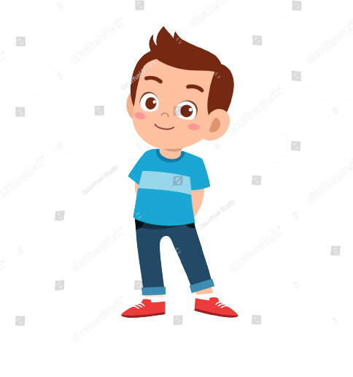
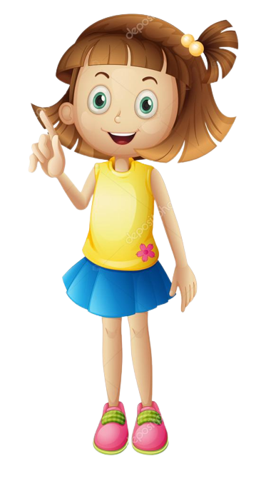


Present simple for future events
We use the present simple with a future meaning to talk about timetables or schedules.
The train leaves at 10 a.m., so we still have a lot of time.
I have to go now. My art lesson starts at one o’clock.

Slide 11


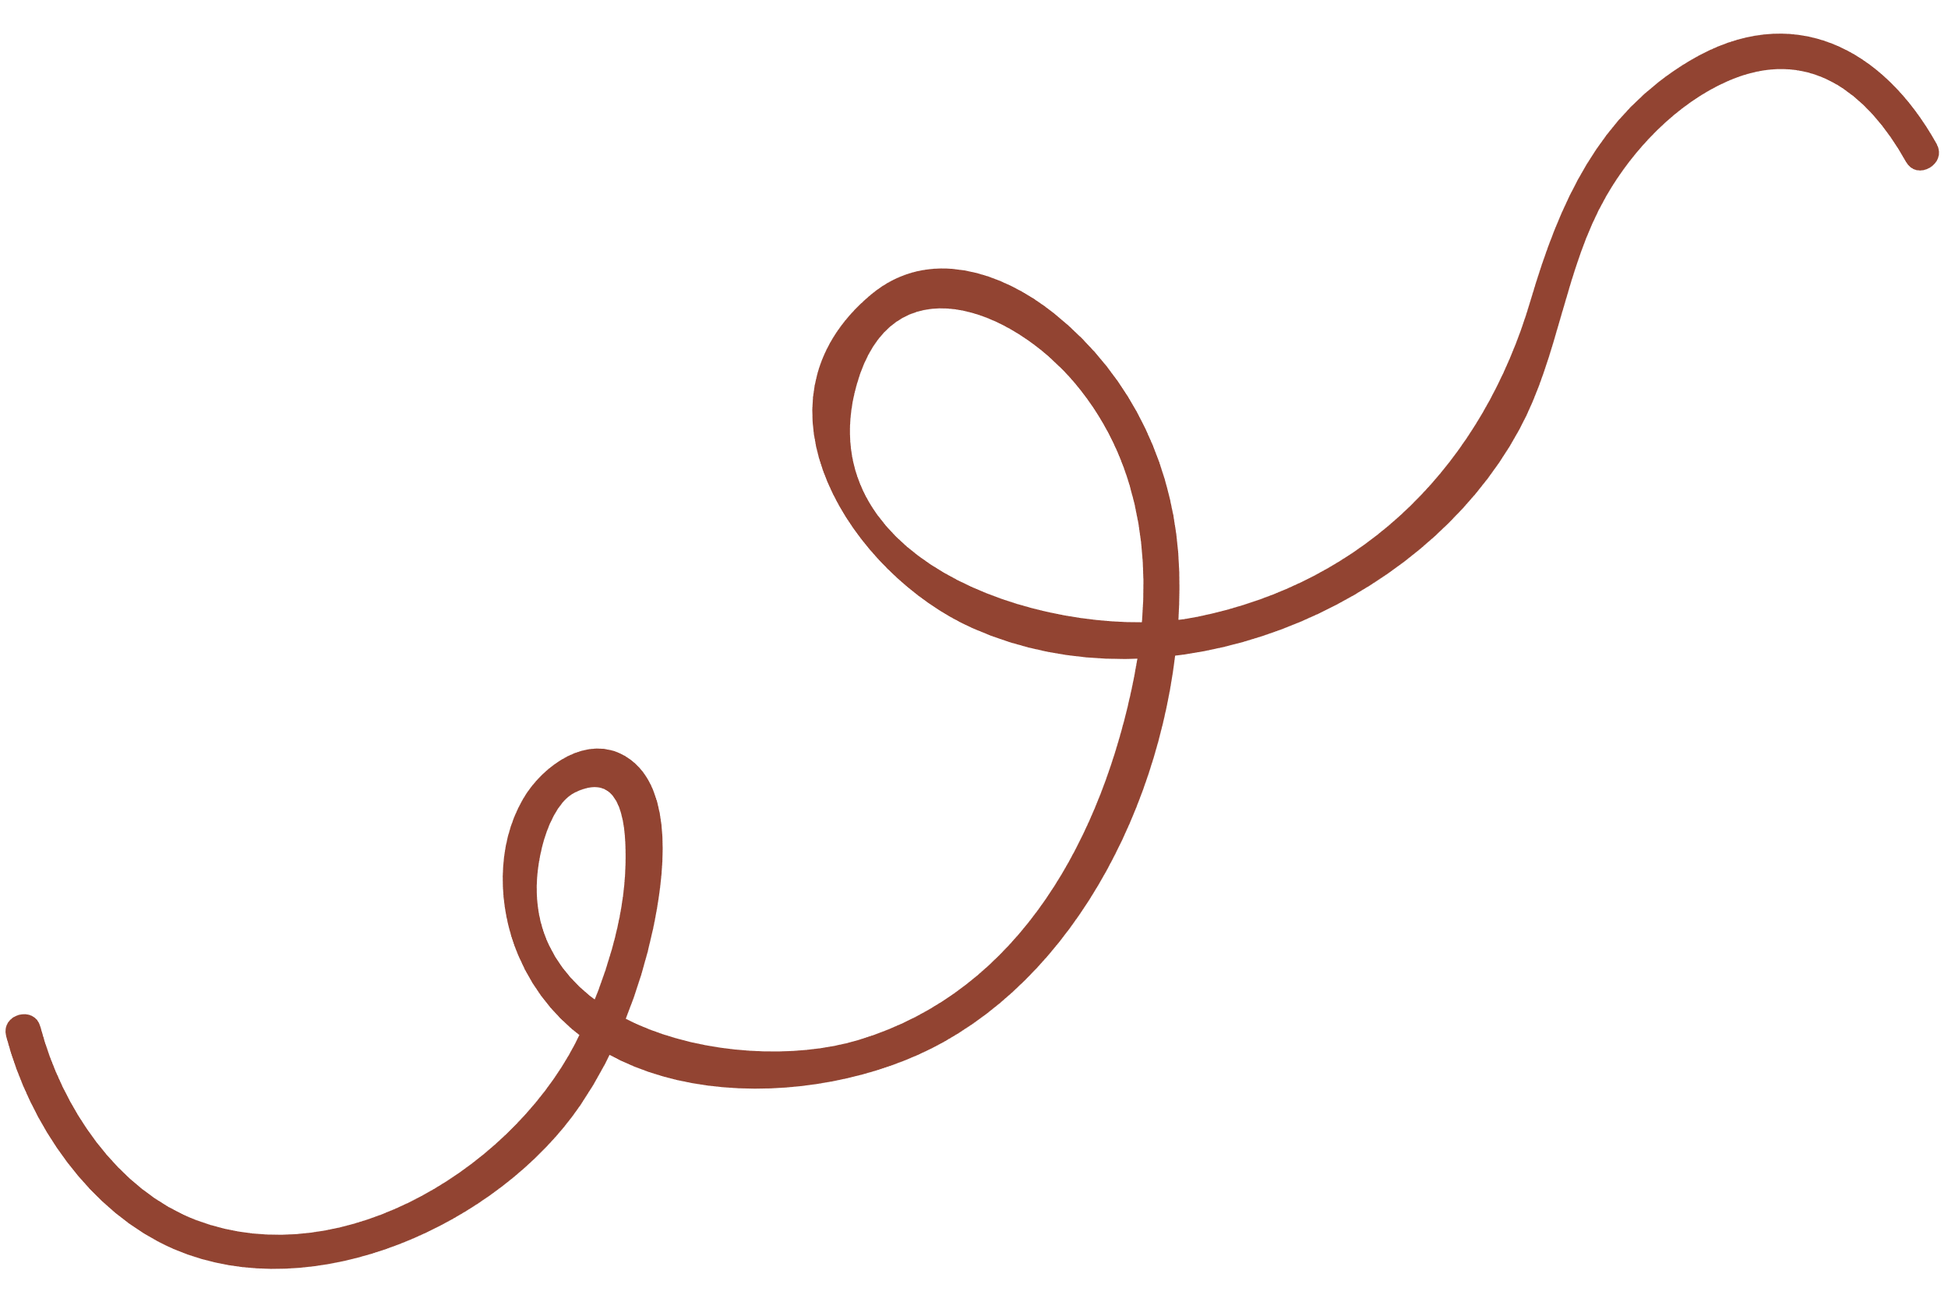

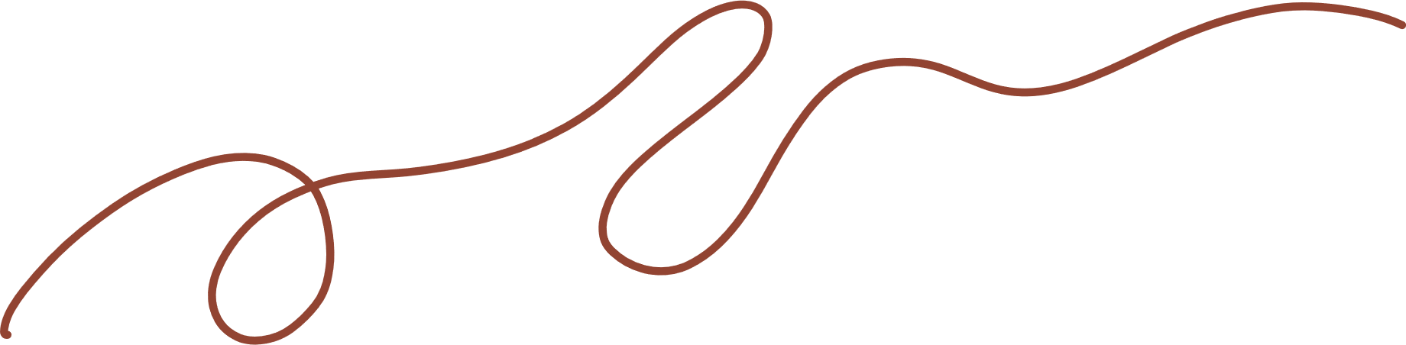
3. Write A next to a sentence if it relates to a timetable, schedule or plan, and B if it is an unplanned future action.
1. We’ll go to Costco to return this suitcase.
2. Look! We have a whole afternoon for shopping on the second day of our tour.
3. The summer sales end next Sunday.
4. Listen to the announcement. The train doesn’t leave till 12:00.
5. I’m too busy today, so we’ll go shopping on Tuesday.
B
A
A
A
B

Slide 12



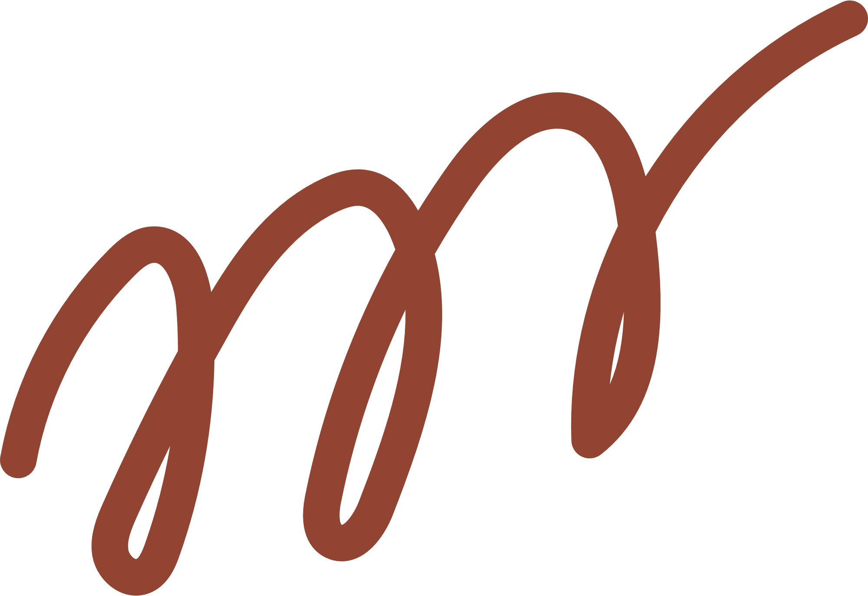
4. Choose the correct answer to complete each sentence.
The supermarket in my neighbourhood opens/ will open longer hours than the one in yours.
Don’t worry. I make/will make a shopping list, and you just give it to the shop owner.
We don’t buy/ won’t buy a birthday cake this year. We can bake one at home.
The bus schedule says that there is/ will be a bus to Aeon at 10:05.
Look at the advertisement. Does/ Will the big sale start next Friday?

Slide 13



5. In pairs, ask and answer to check planning events for the community fair next month.
Community Fair 01 April
Time | Events
01 March | Preparing for the fair
03 March | Calling for volunteers
01 April | - 8:30: Opening - 11:00: Holding food competition
02 April | Cleaning up by volunteers.
Example: A: When do we start preparing for the fair?
B: We start on the first of March.

Slide 14
Wrap-up
What have we learned in this lesson?
Reviewing adverbs of frequency
Present simple for future uses.

Slide 15



THANK YOU
For Your Attention

