Slide 1













UNIT 12
LIFE ON OTHER PLANETS

Slide 2






LESSON 1: GETTING STARTED
A thrilling science fiction novel

Slide 3


WARM - UP

Slide 4
WARM - UP
Science and Technology
Write on the board the list of future technology you expect to see in the future in 2 minutes.

Slide 5



Answer the questions:
LIFE ON OTHER PLANETS
1. Where and how fast do you think we can travel with those new technologies?
2. Can we travel to other planets with those technologies?

Slide 6
Answer the questions:
1. What one word would you use to describe the Earth?
Love, round, colourful, living, blue, beautiful....
The one-word game

Slide 7
Answer the questions:
2. What one word would you use to describe the space?
The one-word game
Enchanted, limitless, magical, immense, vast, dangerous...

Slide 8
Answer the questions:
3. What one word would you use to describe the alien?
Unreal, mysterious, exotic, friendly, threatening.
The one-word game

Slide 9
VOCABULARY

Slide 10



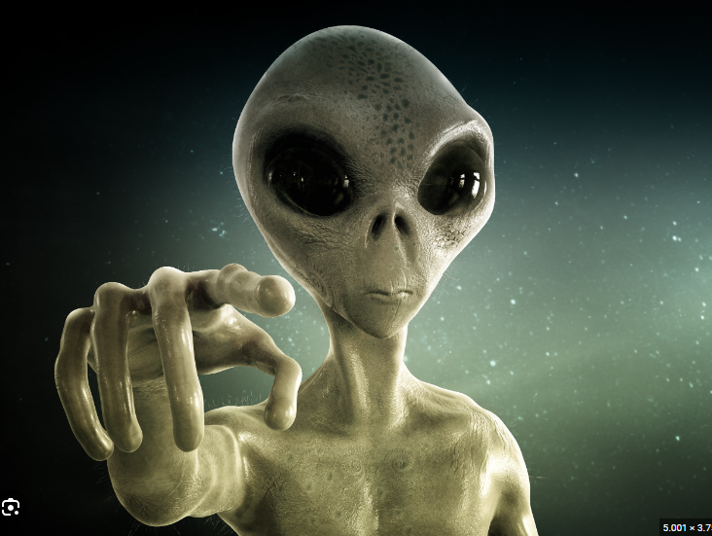



Alient (n)
/ˈeɪliən/
người ngoài hành tinh

Slide 11
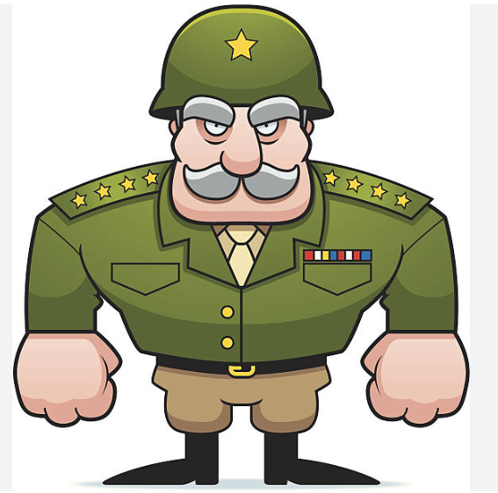
commander (n)
/kəˈmɑːndə/
người chỉ huy, người cầm đầu

Slide 12

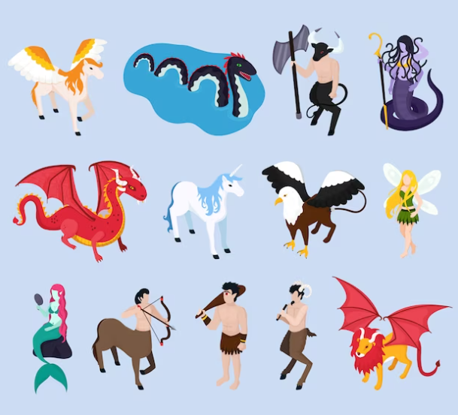



creature (n)
/ˈkriːtʃə/
sinh vật

Slide 13
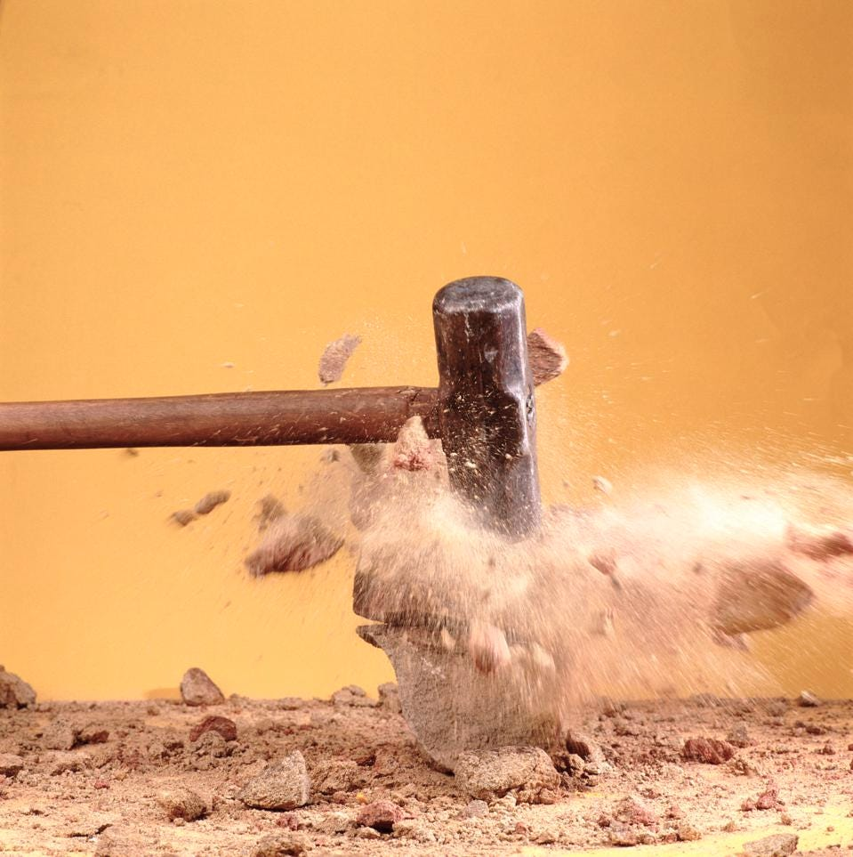
destroy (v)
/dɪˈstrɔɪ/
hủy diệt/ tàn phá

Slide 14
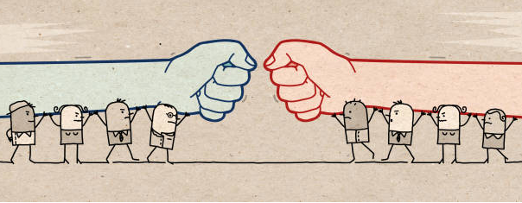
oppose (v)
/əˈpəʊz/
chiến đấu, đánh lại ai

Slide 15
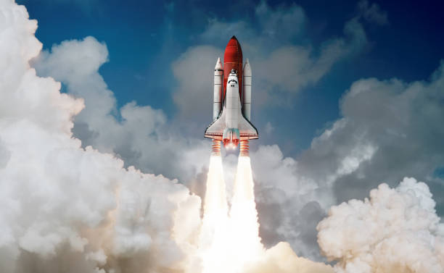
spaceship (n)
/ˈspeɪsʃɪp/
phi thuyền

Slide 16
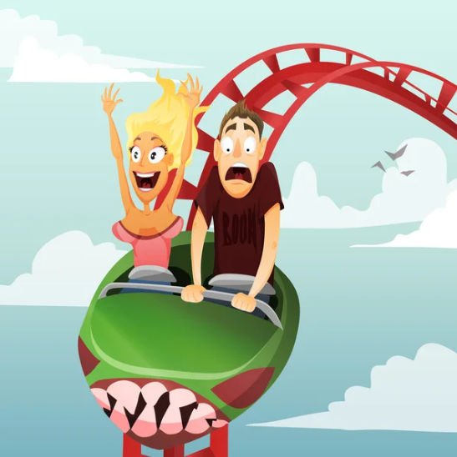
thrilling (adj)
/ˈθrɪlɪŋ/
kịch tính

Slide 17
VOCABULARY
New words | Pronunciation | Meaning
1. alien (n) | /ˈeɪliən/ | người ngoài hành tinh
2. commander (n) | /kəˈmɑːndə/ | người chỉ huy, người cầm đầu
3. creature (n) | /ˈkriːtʃə/ | sinh vật
4. destroy (v) | /dɪˈstrɔɪ/ | hủy diệt/ tàn phá
5. oppose (v) | /əˈpəʊz/ | chiến đấu, đánh lại ai
6. spaceship (n) | /ˈspeɪsʃɪp/ | phi thuyền
7. thrilling (adj) | /ˈθrɪlɪŋ/ | kịch tính

Slide 18



LISTEN AND READ

Slide 19

1. LISTEN AND READ
Mai: What book are you reading, Nick?
Nick: A journey back to Soduka. I’m on the last page.
Mai: That’s a science fiction book, isn’t it? What’s it about?
Nick: Yes, it is. It’s about four creatures Titu, Kaku, Hub, and Barb. They’re travelling back to Soduka, a planet like Earth. Along the way they have to land on Earth because their spaceship breaks down. They meet Tommy and become friends with him.
Mai: What happens next?
Nick: Tommy helps the four creatures repair their spaceship, so they can travel back to their home planet. But their commander forces them to return to Earth to destroy it. Tommy and the four creatures try to oppose the commander.
Mai: Sounds thrilling!
Nick: Tommy and the four creatures manage to stop the commander from destroying Earth.
Mai: So it has a happy ending! What do you think about the possibility of aliens attacking Earth?
Nick: I’m not sure about it. But I’m starting to think about it. I sometimes ask myself what we would do if aliens took over our planet.

Slide 20
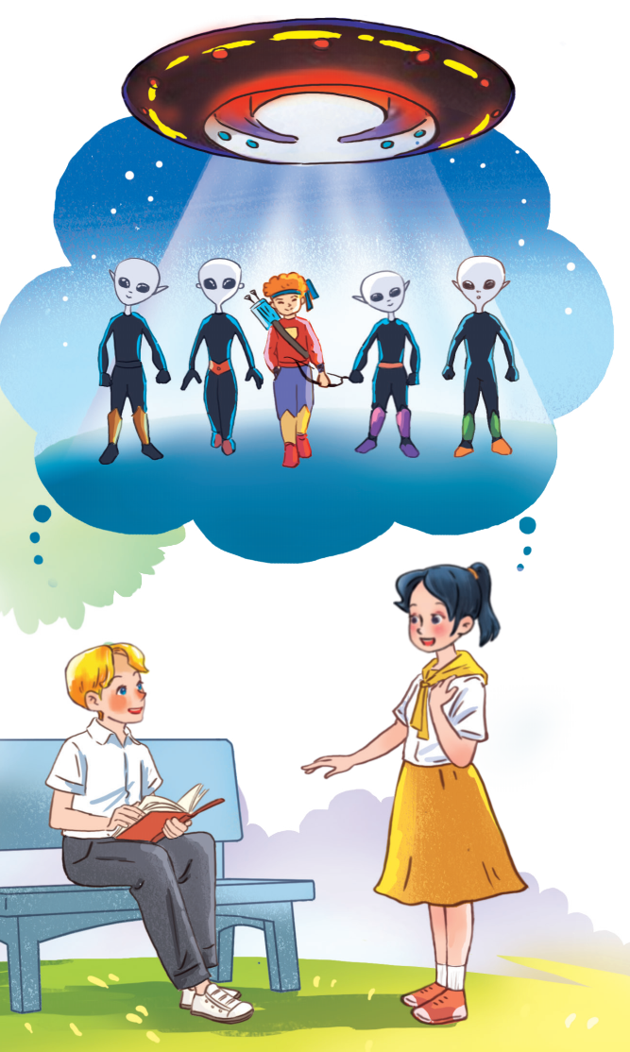

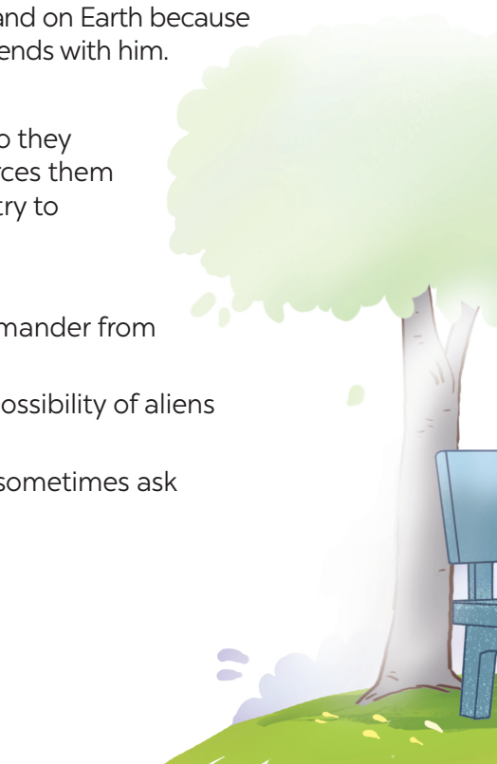
PRACTICE
1. What are Nick and Mai talking about?
2. Who do you think the men in black are?
3. Where do you think the men in black are from?
They are talking about aliens creatures from another planet.
They are aliens / creatures from another planet.
Another planet.

Slide 21
PRACTICE
4. Where do you think the boy standing between the four men is from?
5. What do you think the object above the men is?
He is from Earth.
It is a spaceship / flying saucer / UFO.

Slide 22
2. Read the conversation again and tick T (True) or F (False).
Statements | T | F
1. Soduka is a planet that is very diﬀerent from Earth.
2. Titu, Kaku, Hub, and Barb have to land on Earth because their spaceship breaks down.
3. Tommy helps the four creatures make a new spaceship so that they can return to Soduka.
4. The four creatures travel to Earth again to visit Tommy.
5. The novel makes Nick and Mai think about the possibility that Earth might be attacked by aliens.

Slide 23


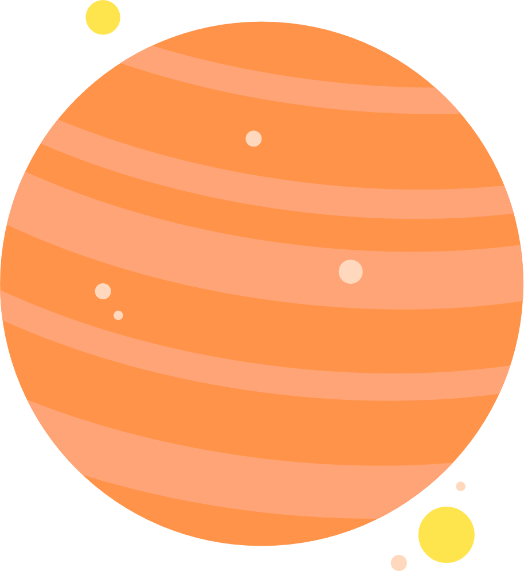

GAMES

Slide 24


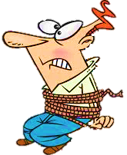
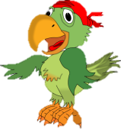

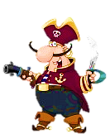
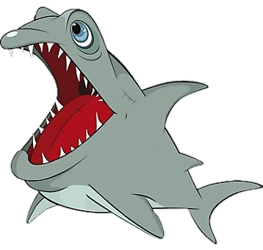


Slide 25
Click on the right option to save Peter
TRUE
FALSE
NEXT
1. Soduka is a planet that is very diﬀerent from Earth.

Slide 26
Click on the right option to save Peter
TRUE
FALSE
NEXT
2. Titu, Kaku, Hub, and Barb have to land on Earth because their spaceship breaks down.

Slide 27
Click on the right option to save Peter
TRUE
FALSE
NEXT
3. Tommy helps the four creatures make a new spaceship so that they can return to Soduka.

Slide 28
Click on the right option to save Peter
TRUE
FALSE
NEXT
4. The four creatures travel to Earth again to visit Tommy.

Slide 29
Click on the right option to save Peter
TRUE
FALSE
NEXT
5. The novel makes Nick and Mai think about the possibility that Earth might be attacked by aliens.

Slide 30

CHECK AGAIN
2. Read the conversation again and tick T (True) or F (False).
Statements | T | F
1. Soduka is a planet that is very diﬀerent from Earth.
2. Titu, Kaku, Hub, and Barb have to land on Earth because their spaceship breaks down.
3. Tommy helps the four creatures make a new spaceship so that they can return to Soduka.
4. The four creatures travel to Earth again to visit Tommy.
5. The novel makes Nick and Mai think about the possibility that Earth might be attacked by aliens.

Slide 31
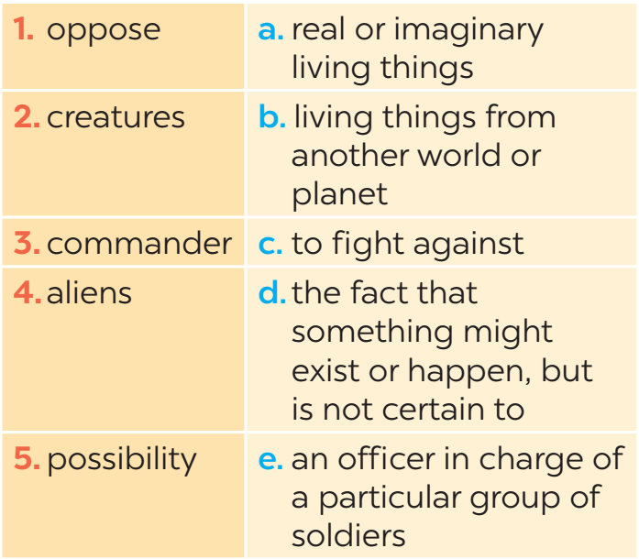
3. Match the words (1 - 5) with their definitions (a - e).

Slide 32





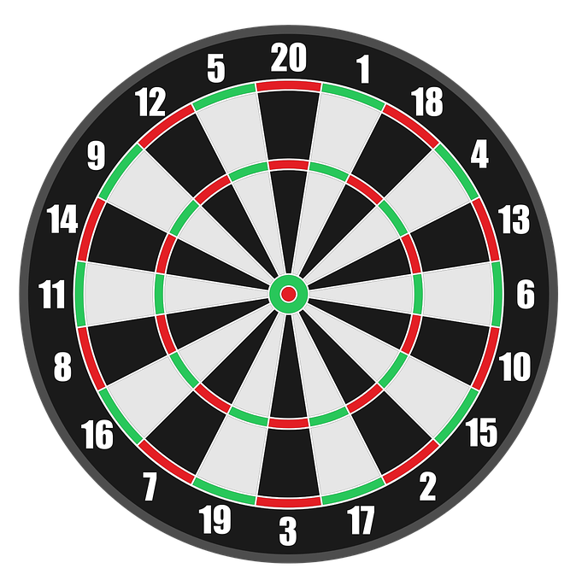

Luật chơi: Bạn có 5s để suy nghĩ và
trả lời các câu hỏi.
Trả lời đúng, mũi tiêu tương ứng trúng đích bạn nhận được điểm tương ứng vị trí mũi tiêu.
Trả lời sai, mũi tiêu rơi xuống hoặc không trúng đích và không có điểm.
PLAY

Slide 33
Real or imaginary living things
What does it mean?
+18
Oppose
creatures
commander
aliens
Next
Abc.xyz789

Slide 34
Living things from another world or planet.
What does it mean?
+18
aliens
Oppose
commander
possibility
Next
Abc.xyz789

Slide 35
To fight against
What does it mean?
+18
oppose
aliens
commander
possibility
Next
Abc.xyz789

Slide 36
The fact that something might exist or happen, but is not certain to
What does it mean?
+18
possibility
aliens
commander
oppose
Next
Abc.xyz789

Slide 37
An officer in charge of a particular group of soldiers
What does it mean?
+18
commander
aliens
aliens
oppose
Next
Abc.xyz789

Slide 38
CHECK AGAIN
3. Match the words (1 - 5) with their definitions (a - e).

Slide 39
PRACTICE
4. Complete the sentences with the words in task 3.
1. There is a _________ that we might visit Mars in the near future.
2. The main character in the film is a boy who makes friends with some _____ from a planet.
3. Dogs are more social ________ than cats.
4. These soldiers were punished because they didn’t obey their __________.
5. Some people _______ sending spaceships to explore other planets.
possibility
aliens
creatures
commander
oppose

Slide 40
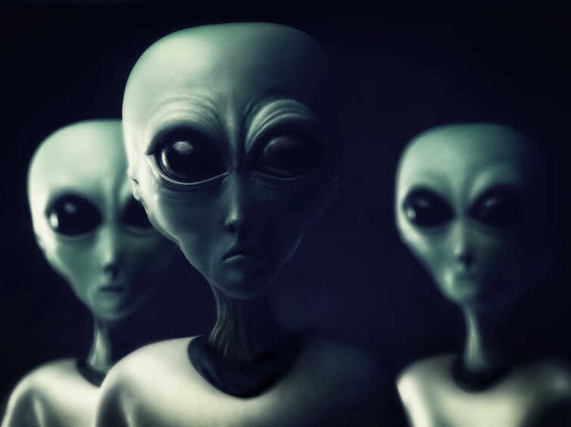
PRODUCTION
5. Work in groups. Discuss the following questions. Then report your group’s answers to the class.
Do you believe that there is life on other planets? Why / Why not?

Slide 41

HOMEWORK
- Learn the new words by heart.
- Make sentences with new words.
- Start preparing for the Project of the unit.

Slide 42



THANK YOU!
CÔNG THÀNH_TRỌNG QUYỀN

