Slide 1
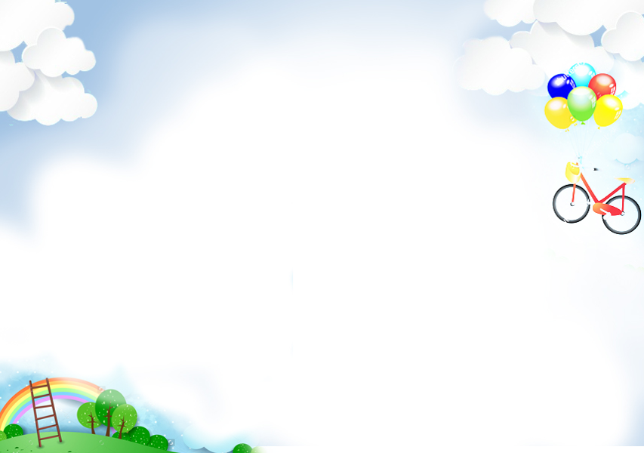

Slide 2

The man ______ taught us science last year was Mr. Nam.
WARM-UP

Slide 3
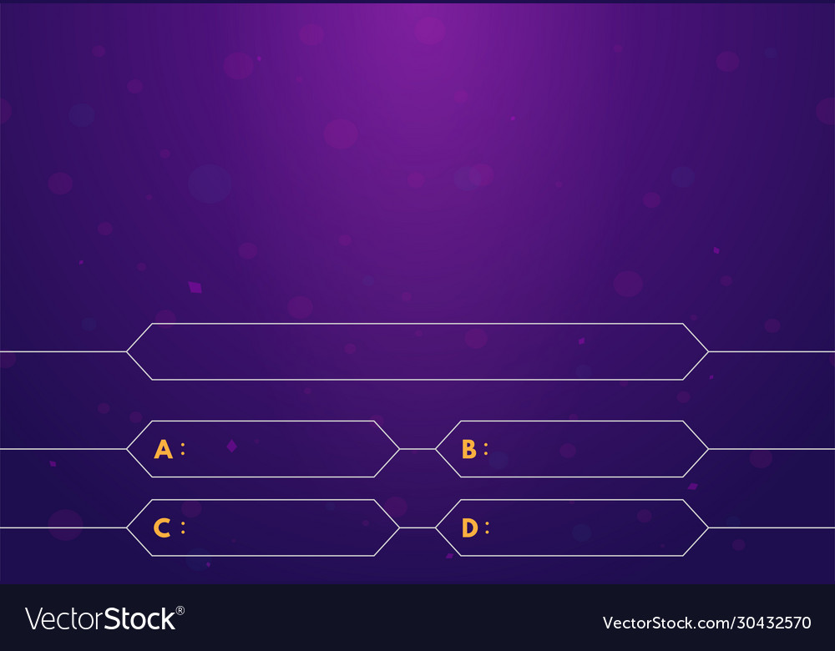
WARM-UP
The man ______ taught us science last year was Mr. Nam.
when
what
which
who
We are playing a game ______ was designed by our teacher.

Slide 4
The man ______ taught us science last year was Mr. Nam.
WARM-UP
We are playing a game ______ was designed by our teacher.
who
where
which
how
The woman ______ we visited last summer is my former English teacher.

Slide 5
We are playing a game ______ was designed by our teacher.
WARM-UP
The woman ______ we visited last summer is my former English teacher.
which
who
when
whose

Slide 6
The woman ______ we visited last summer is my former English teacher.
WARM-UP
We are learning about the planet ______ has green trees and living things.
where
who
which
whose

Slide 7
We are learning about the planet ______ has green trees and living things.
WARM-UP
I go to the school ______ my mother went to when she was small.
where
how
who
which

Slide 8
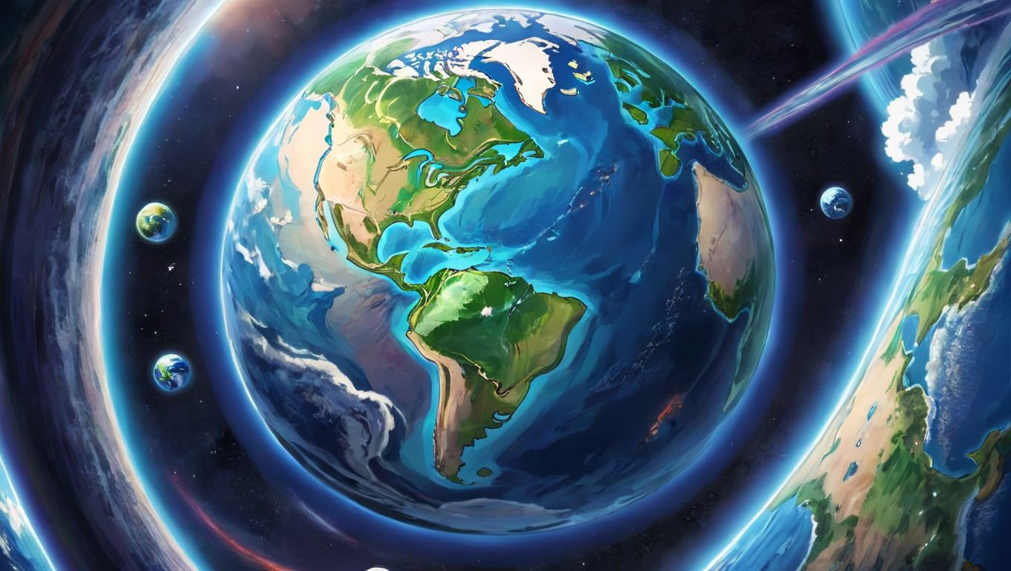


Unit
10
CAREER CHOICES
LESSON 3: A CLOSER LOOK 2

Slide 9
Unit
10
PLANET EARTH
LESSON 3: A CLOSER LOOK 2

Slide 10

PRESENTATION
– We use non-defining relative clauses to add extra information.
Example: Earth, which is the third planet from the Sun, depends much on the Sun for its energy.
– If we remove the non-defining relative clause, the sentence still makes sense.
Example: Earth depends much on the Sun for its energy.
– We use comma(s) with non-defining relative clauses.
– Relative pronouns cannot be omitted in non-defining relative clauses

Slide 11
grammar
Non-defining relative clauses
(Mệnh đề quan hệ không xác định)
Chúng ta sử dụng mệnh đề quan hệ không xác định để bổ sung thêm thông tin.
Example: Earth, which is the third planet from the Sun, depends much on the Sun for its energy.
Nếu bỏ mệnh đề quan hệ không xác định thì câu vẫn có nghĩa.
Example: Earth depends much on the Sun for its energy.
Chúng ta sử dụng dấu phẩy với mệnh đề quan hệ không xác định.
Đại từ quan hệ không được lược bỏ trong mệnh đề quan hệ không xác định.

Slide 12
PRESENTATION
1
Complete the sentences with correct relative pronouns.
1. Planet Earth, ______ is also called the Blue Planet, is covered with water and land.
which
who
2. Peter Molnar, ______ has done many studies on climate change, is one of the best-known Earth scientists.
whose
3. Neil Armstrong, ______ trip to the moon marked a giant leap for mankind, was the first to walk on the moon.
4. Suoi Thau, ______ is in Ha Giang, is one of the most gorgeous grasslands in Viet Nam.
which
which
5. People often do green things to protect Earth on the Earth Day, ______ is celebrated on 22nd April.

Slide 13
PRACTICE
2
Underline the relative clauses. Tick (√) if the relative clause can be omitted.
1. ______ The second planet from the Sun is Venus, which is sometimes called the Earth’s sister.
√
√
2. ______ The ocean, which is the body of salt water, contains 97% of Earth’s water.
3. ______ Landforms make up the areas which include mountains, hills, plains, and plateaus

Slide 14
PRACTICE
2
Underline the relative clauses. Tick (√) if the relative clause can be omitted.
√
4. ______ One of the world’s most famous Earth scientists is James Hutton, who is a British geologist.
√
5. ______ Arctic Ocean ice and water make up a habitat for polar bears, whose main food is seals.

Slide 15
3
Complete each sentence with a non-defining relative clause (A-E).
1. Mars, ______, is very much similar to Earth.
B
A. which is a Germanic word
B. which is also called the Red Planet
C. whose radius is nearly 4 million miles
D. who explained ecological balance to us
E. which has a large collection of animals,
birds and reptiles, and unique plants
2. Earth, ______, is the fifth largest planet in our solar system.
C
3. The name of our planet, _____, simply means “the ground”.
A
E
4. Cat Ba National Park, ______, is one of the most famous tropical rainforests in Viet Nam.
5. We were interested in the talk by Mr An, ______.
D

Slide 16
4
Combine the two sentences into one, using a non-defining relative clause.
1. The Moon is Earth's only natural satellite. Its surface is dark.
2. Moonquakes are much weaker than Earthquakes. Moonquakes can last up to half an hour.
3. Mars has mountains and canyons on its surface. It is a rocky planet like Earth.
4. Venus is considered the twin sister of Earth. Venus has a similar size and structure as Earth.
5. We should protect rivers and lakes. Rivers and lakes provide humans with their main sources of fresh water.

Slide 17
4
Combine the two sentences into one, using a non-defining relative clause.
1. The Moon is Earth’s only natural satellite. Its surface is dark.
_____________________________________________________.
The Moon, whose surface is dark, is Earth's only natural satellite.
2. Moonquakes are much weaker than Earthquakes. Moonquakes can last up to half an hour.
_____________________________________________________
_____________________________________________________.
Moonquakes, which can last up to half an hour, are much weaker than Earthquakes.
3. Mars has mountains and canyons on its surface. It is a rocky planet like Earth.
Like Earth, Mars is a rocky planet, which has mountains and canyons on its surface.
__________________________________________________.
Venus, which has similar size and structure with Earth, is considered twin sister of Earth.
_____________________________________________________
_____________________________________________________.

Slide 18
4
Combine the two sentences into one, using a non-defining relative clause.
4. Venus is considered the twin sister of Earth. Venus has a similar size and structure as Earth.
Venus, which has similar size and structure with Earth, is considered twin sister of Earth.
5. We should protect rivers and lakes. Rivers and lakes provide humans with their main sources of fresh water.
We should protect rivers and lakes, which provide humans with their main sources of fresh water.
__________________________________________________________________________________________________________.
Venus, which has similar size and structure with Earth, is considered twin sister of Earth.
_____________________________________________________
_____________________________________________________.

Slide 19
EXTRA ACTIVITIES
Find the mistakes in the sentences and correct them.
when
1. Earth Day is the day where people celebrate the wonder of Earth.
x
2. Polar habitats, what include the North and the South Poles, are extremely cold.
x
which
3. The Pacific Ocean, that is the largest and deepest one on Earth, is being polluted.
which
x
4. Earth planet, where has a solid and active surface, has various habitat types.
which
x
5. Climate change has caused the changes in the colour of the Oceans, what is so worrying.
which
x

Slide 20
PRODUCTION
Work in two groups. Take turns to say aloud one the places in the table. The other group explains or gives more information about it. The team that has the most corrected sentences wins.
5
- Work independently and prepare for your performance.
-Take turns to say aloud one of the places (the Nile, Pacific Ocean, Viet Nam, the Sahara, Mount Fansipan) and the other explains or gives more information about the places.
Example:
The Nile
The Nile, which is the longest river, flows into the Mediterranean Sea.

Slide 21
PRODUCTION
PLACE | FEATURE | FEATURE
The Nile | longest river | flows into the Mediterranean Sea
Pacific Ocean | covers 30% of planet surface | largest ocean
Viet Nam | has the shape of letter S | has a long coastline
The Sahara | largest desert | has almost no rainfall
Mount Fansipan | highest peak in Viet Nam | also called the ‘Roof of Indochina’

Slide 22

PRODUCTION
Work in two groups. Take turns to say aloud one the places in the table. The other group explains or gives more information about it. The team that has the most corrected sentences wins.
5
Viet Nam, which has the shape of letter S, has a long coastline.
Viet Nam

Slide 23
PRODUCTION
Work in two groups. Take turns to say aloud one the places in the table. The other group explains or gives more information about it. The team that has the most corrected sentences wins.
5
The Sahara
The Sahara, which is the largest desert, has almost no rainfall.

Slide 24

CONSOLIDATION
What have we learnt in this lesson?
Use non-defining relative clauses.

Slide 25


Homework
- Do exercises in the workbook.
- Prepair lesson 4 - communication.

Slide 26




Slide 27


