Slide 1




WAVES
& WAVE PROPERTIES
Unit Review Quiz

Slide 2








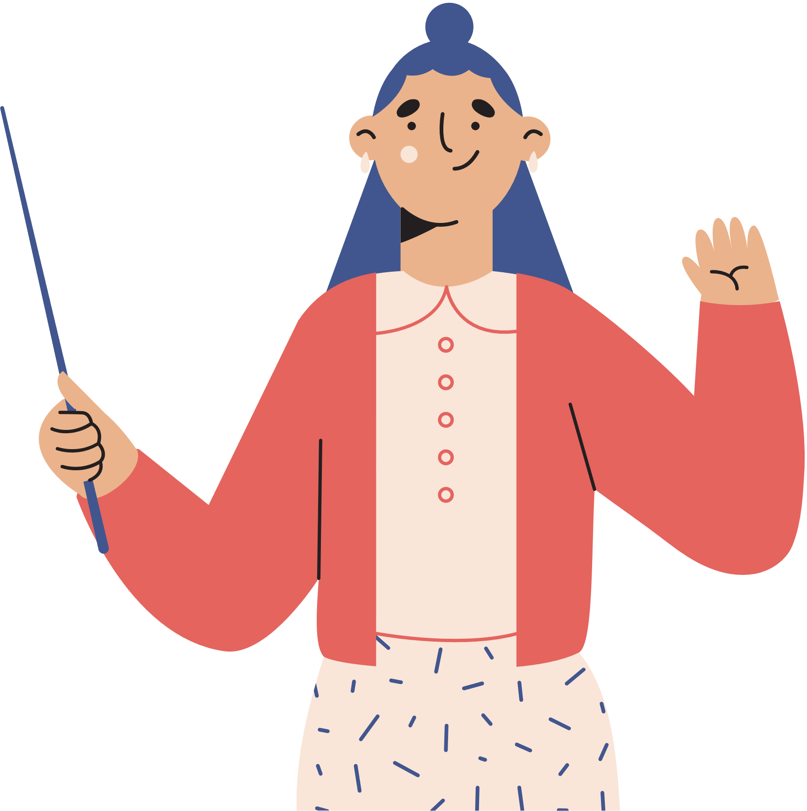




UNIT 11
SCIENCE AND TECHNOLOGY
LESSON 2: A CLOSER LOOK 1

Slide 3







WARM - UP
RULE:
Work in 2 teams.
Receive the pictures of things and strips of paper with the phrases.
Stick the phrases to the right pictures.
The team with the most correct answers wins.

Slide 4






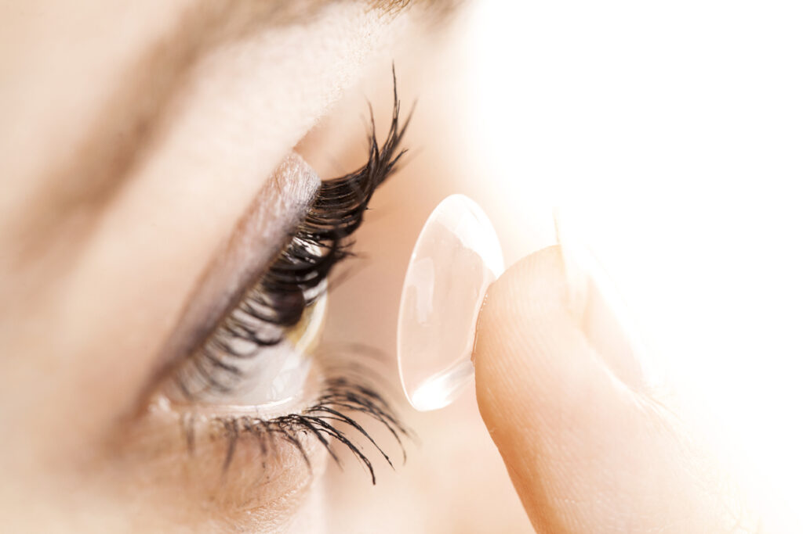




WARM - UP
GAME: LABELLING
Computer screen
Breakout rooms
Robot teacher
Online class
3D contact lenses
Connection

Slide 5



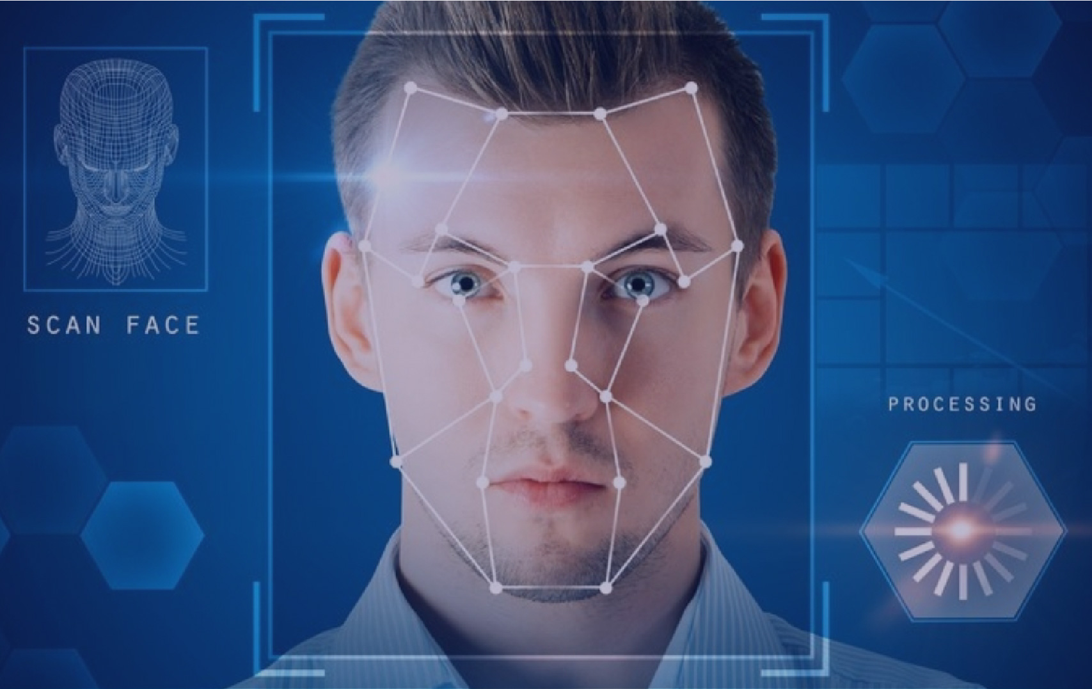



VOCABULARY
face recognition (n)
/feɪsˌrekəɡˈnɪʃn/
công nghệ nhận diện gương mặt

Slide 6

VOCABULARY
experiment (n)
/ɪkˈsperɪmənt/
thí nghiệm

Slide 7
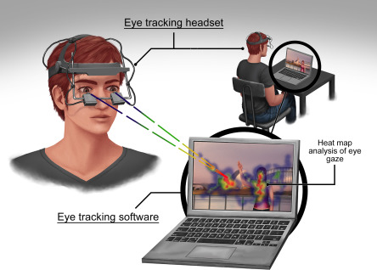
VOCABULARY
eye-tracking (n)
/ˈai ˌtrækɪŋ/
công nghệ dõi
(cử động) mắt

Slide 8
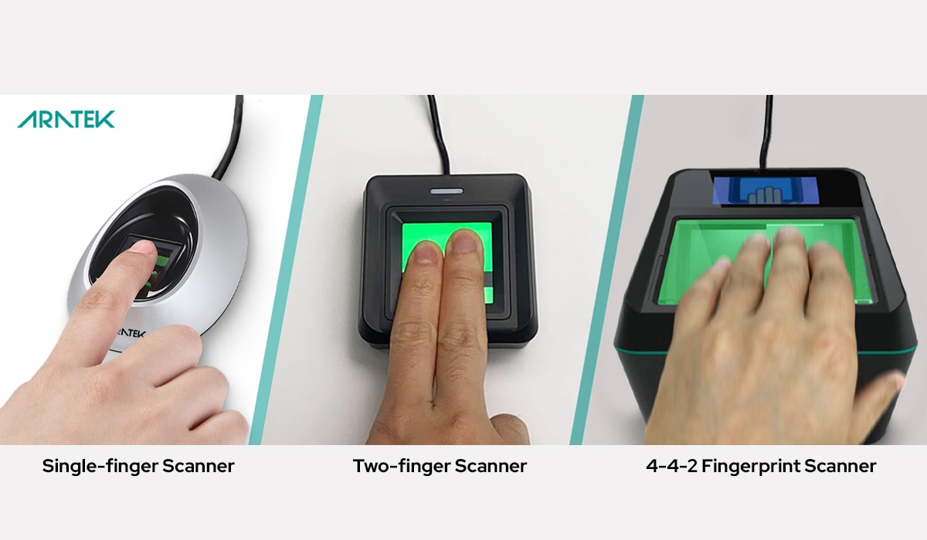
VOCABULARY
fingerprint scanner (n)
/ˈfɪŋɡəprɪnt ˈskænə/
máy quét vân tay

Slide 9

VOCABULARY
digital communication (n)
/ˈdɪdʒɪtl kəˌmjuːnɪˈkeɪʃn/
giao tiếp kỹ thuật số

Slide 10
VOCABULARY
New words | Pronunciation | Meaning
1. face recognition (n) | /feɪsˌrekəɡˈnɪʃn/ | công nghệ nhận diện gương mặt
2. experiment (n) | /ɪkˈsperɪmənt/ | thí nghiệm
3. eye tracking (n) | /ˈai ˌtrækɪŋ/ | công nghệ dõi (cử động) mắt
4. fingerprint scanner(n) | /ˈfɪŋɡəprɪnt ˈskænə/ | máy quét vân tay
5. digital communication (n) | /ˈdɪdʒɪtl kəˌmjuːnɪˈkeɪʃn/ | giao tiếp kỹ thuật số

Slide 11
VOCABULARY
2. Choose the option that best completes each phrase.
1.
invent
A. a device
B. a new area
2.
discover
A. a chemical element
B. a technology
3.
create
A. the weather
B. a medicine
4.
develop
A. a planet
B. a technology

Slide 12
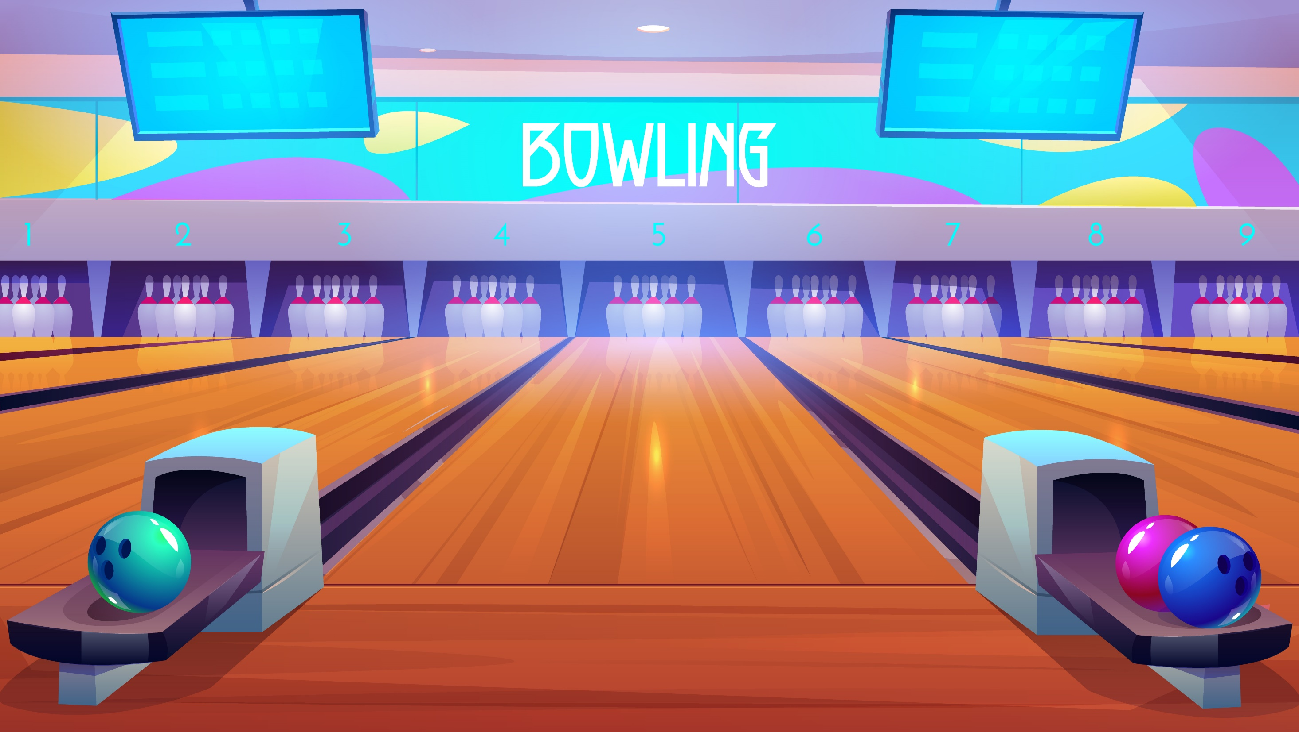
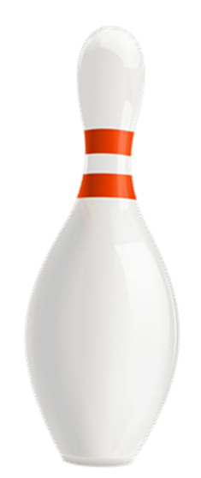



Slide 13
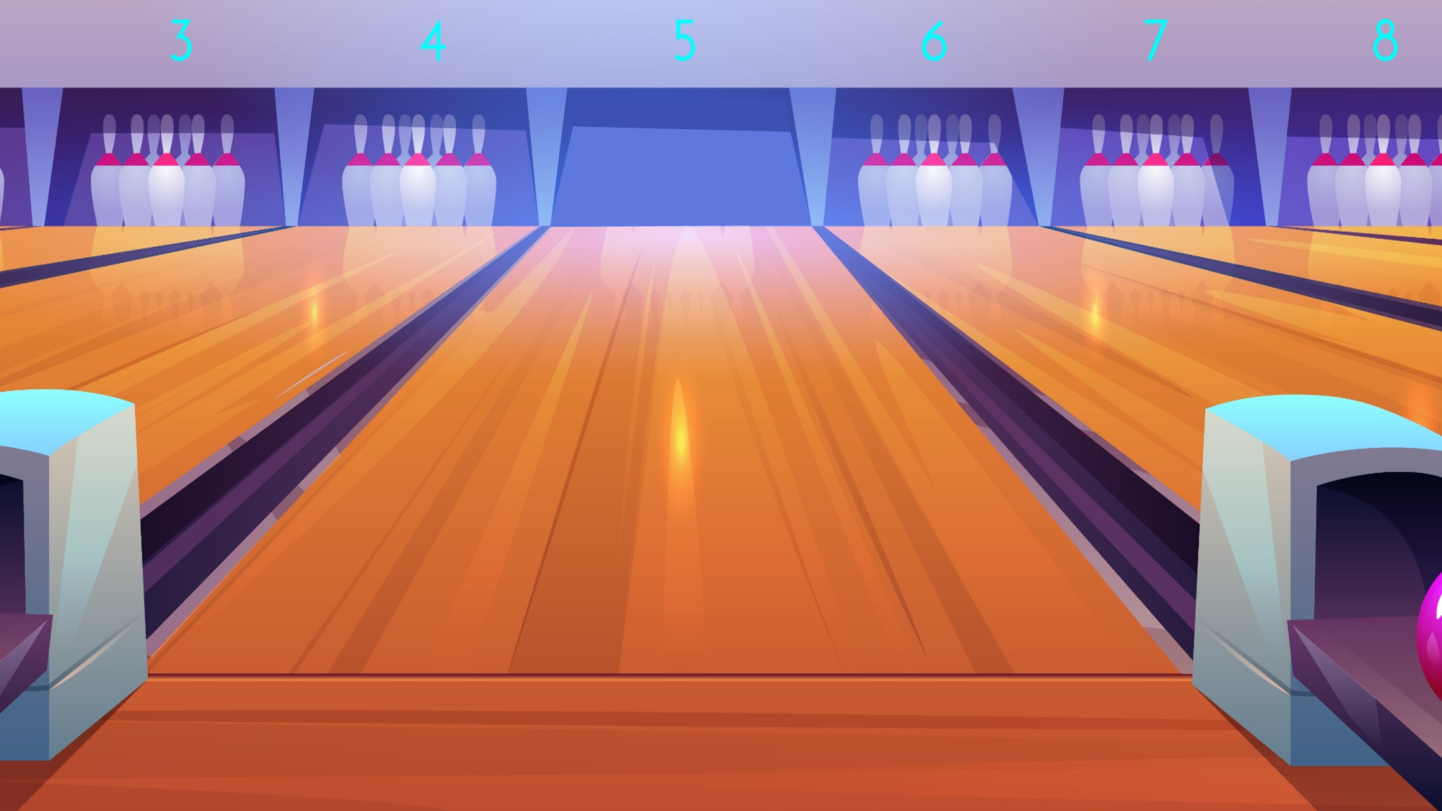



A. a device
1. Choose the option that best completes this word.
B. a new area
invent
Next

Slide 14
A. a chemical element
2. Choose the option that best completes this word.
B. a technology
discover
Next

Slide 15
2. Choose the option that best completes this word.
A. the weather
B. a medicine
create
Next

Slide 16
2. Choose the option that best completes this word.
A. a planet
B. a technology
develop
Next

Slide 17
Check again
2. Choose the option that best completes each phrase.
1.
invent
A. a device
B. a new area
2.
discover
A. a chemical element
B. a technology
3.
create
A. the weather
B. a medicine
4.
develop
A. a planet
B. a technology

Slide 18
VOCABULARY
3. Complete the sentences with the words and phrases from the box.
invented
created
experiments
discovered
fingerprint scanner
1. Marie Curie and Pierre Curie __________ radium and polonium.
2. Thomas Edison _________ the light bulb in 1880.
3. Sarah Gilbert is the creator of a vaccine. She ______ it in 2020.
4. Scientists have carried out many __________ to find a cure for cancer.
5. Scan your finger on this _______________ to check attendance, please.

Slide 19








Slide 20
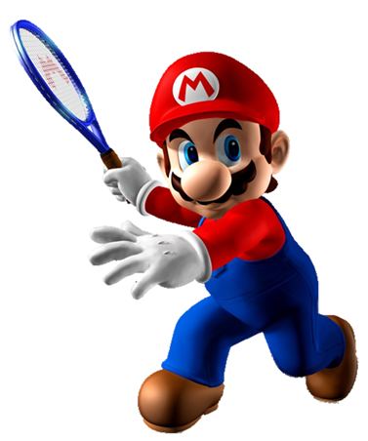
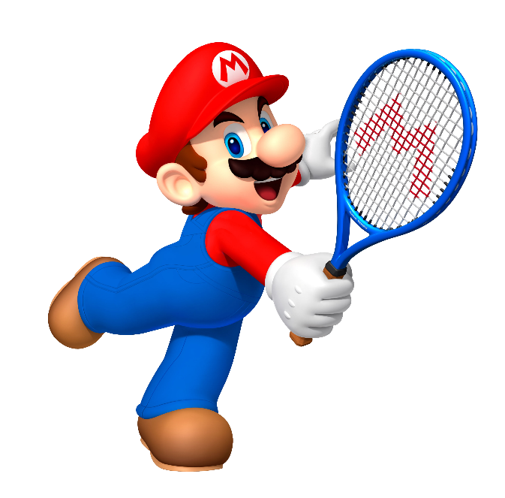


discovered
invented
1. Marie Curie and Pierre Curie __________ radium and polonium.
experiments

Slide 21
fingerprint scanner
invented
2. Thomas Edison _________ the light bulb in 1880.
experiments

Slide 22
fingerprint scanner
invented
3. Sarah Gilbert is the creator of a vaccine. She ______ it in 2020.
created

Slide 23
experiments
invented
4. Scientists have carried out many __________ to find a cure for cancer.
discovered

Slide 24
created
invented
5. Scan your finger on this _______________ to check attendance, please.
fingerprint scanner

Slide 25
Check again
3. Complete the sentences with the words and phrases from the box.
invented
created
experiments
discovered
fingerprint scanner
1. Marie Curie and Pierre Curie __________ radium and polonium.
2. Thomas Edison _________ the light bulb in 1880.
3. Sarah Gilbert is the creator of a vaccine. She ______ it in 2020.
4. Scientists have carried out many __________ to find a cure for cancer.
5. Scan your finger on this _______________ to check attendance, please.

Slide 26


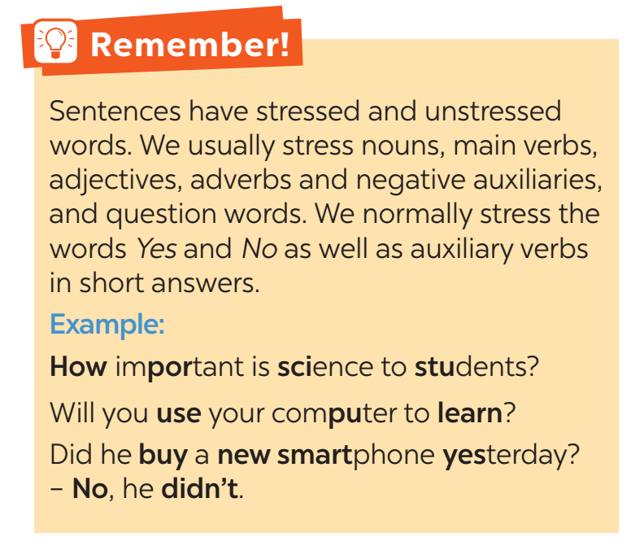


middle
end

Slide 27



4. Listen and repeat the sentences. Pay attention to the bold syllables.
1. I don’t have a computer.
2. Do you call her every day? – No, I don’t.
3. They are not familiar with that new computer.
4. Did you lend her your laptop? – Yes, I did.
5. Who do you work with on Sundays?

Slide 28
5. Listen and repeat the sentences. How many stressed words are there in each sentence?
1. He is an inventor.
2. We won’t have a robot teacher next year.
3. She likes learning online.
4. Was she checking attendance when you came?
- No, she wasn’t.
5. What did he invent?
1. He is an inventor.
2. We won’t have a robot teacher next year.
3. She likes learning online.
4. Was she checking attendance when you came?
- No, she wasn’t.
5. What did he invent?
→ 1 stressed words
→ 6 stressed words
→ 3 stressed words
→ 6 stressed words
→ 2 stressed words

Slide 29




Wrap - up
What have we learnt in this lesson?
words and phrases related to new technologies
new verb phrases that are used to talk about inventions, discoveries, creation, and development
sentences stress

Slide 30







homework
Learn the new words and phrases by heart.
Do the exercises in the workbook.

Slide 31





thank you!
do you have any question for me?

