Slide 1
ANSWER MY QUESTIONS
Do you think human can live on Mars and other planets in the solar system?
Are you sure about it?
If you aren’t sure about something, what can you do?
Express uncertainty

Slide 2
Unit 12: Life on other planet
Lesson 4: Communication

Slide 3
OBJECTIVES
By the end of the lesson, students will be able to:
express uncertainty in English.
get some knowledge about three planets in the solar system

Slide 4
Everyday English
01
Expressing uncertainty

Slide 5

Ex 1. Listen and read the conversations. Pay attention to the highlighted sentences.
1
Nick: Do you think Mars may support life?
Mark: I’m not sure about it. Scientists are trying to find life there.
I’m not sure about it.
2
Mary: Do you think Ann will win tomorrow?
Tommy: I doubt it. She injured her arm in a match last week.
I doubt it.

Slide 6

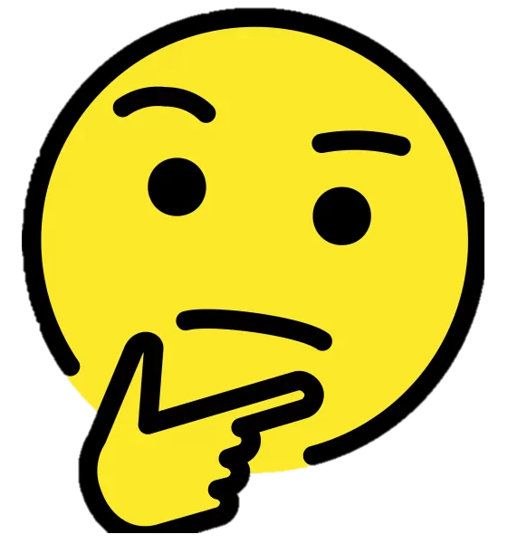
EXPRESSING UNCERTAINTY
I’m not sure about it.
I doubt it.
Can you add more ways to express uncertainty?

Slide 7
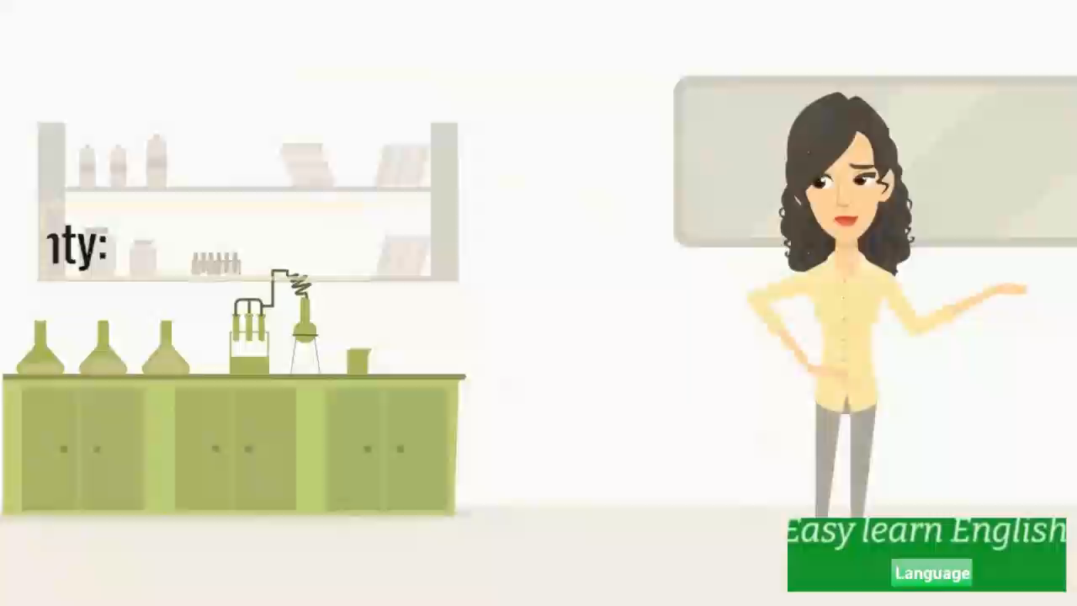
Watch and take notes.

Slide 8
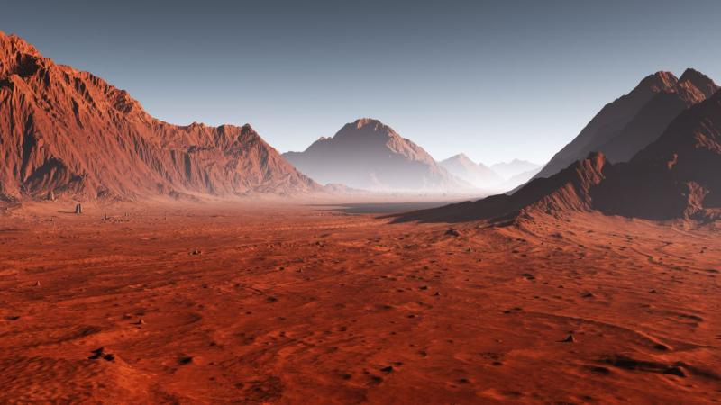

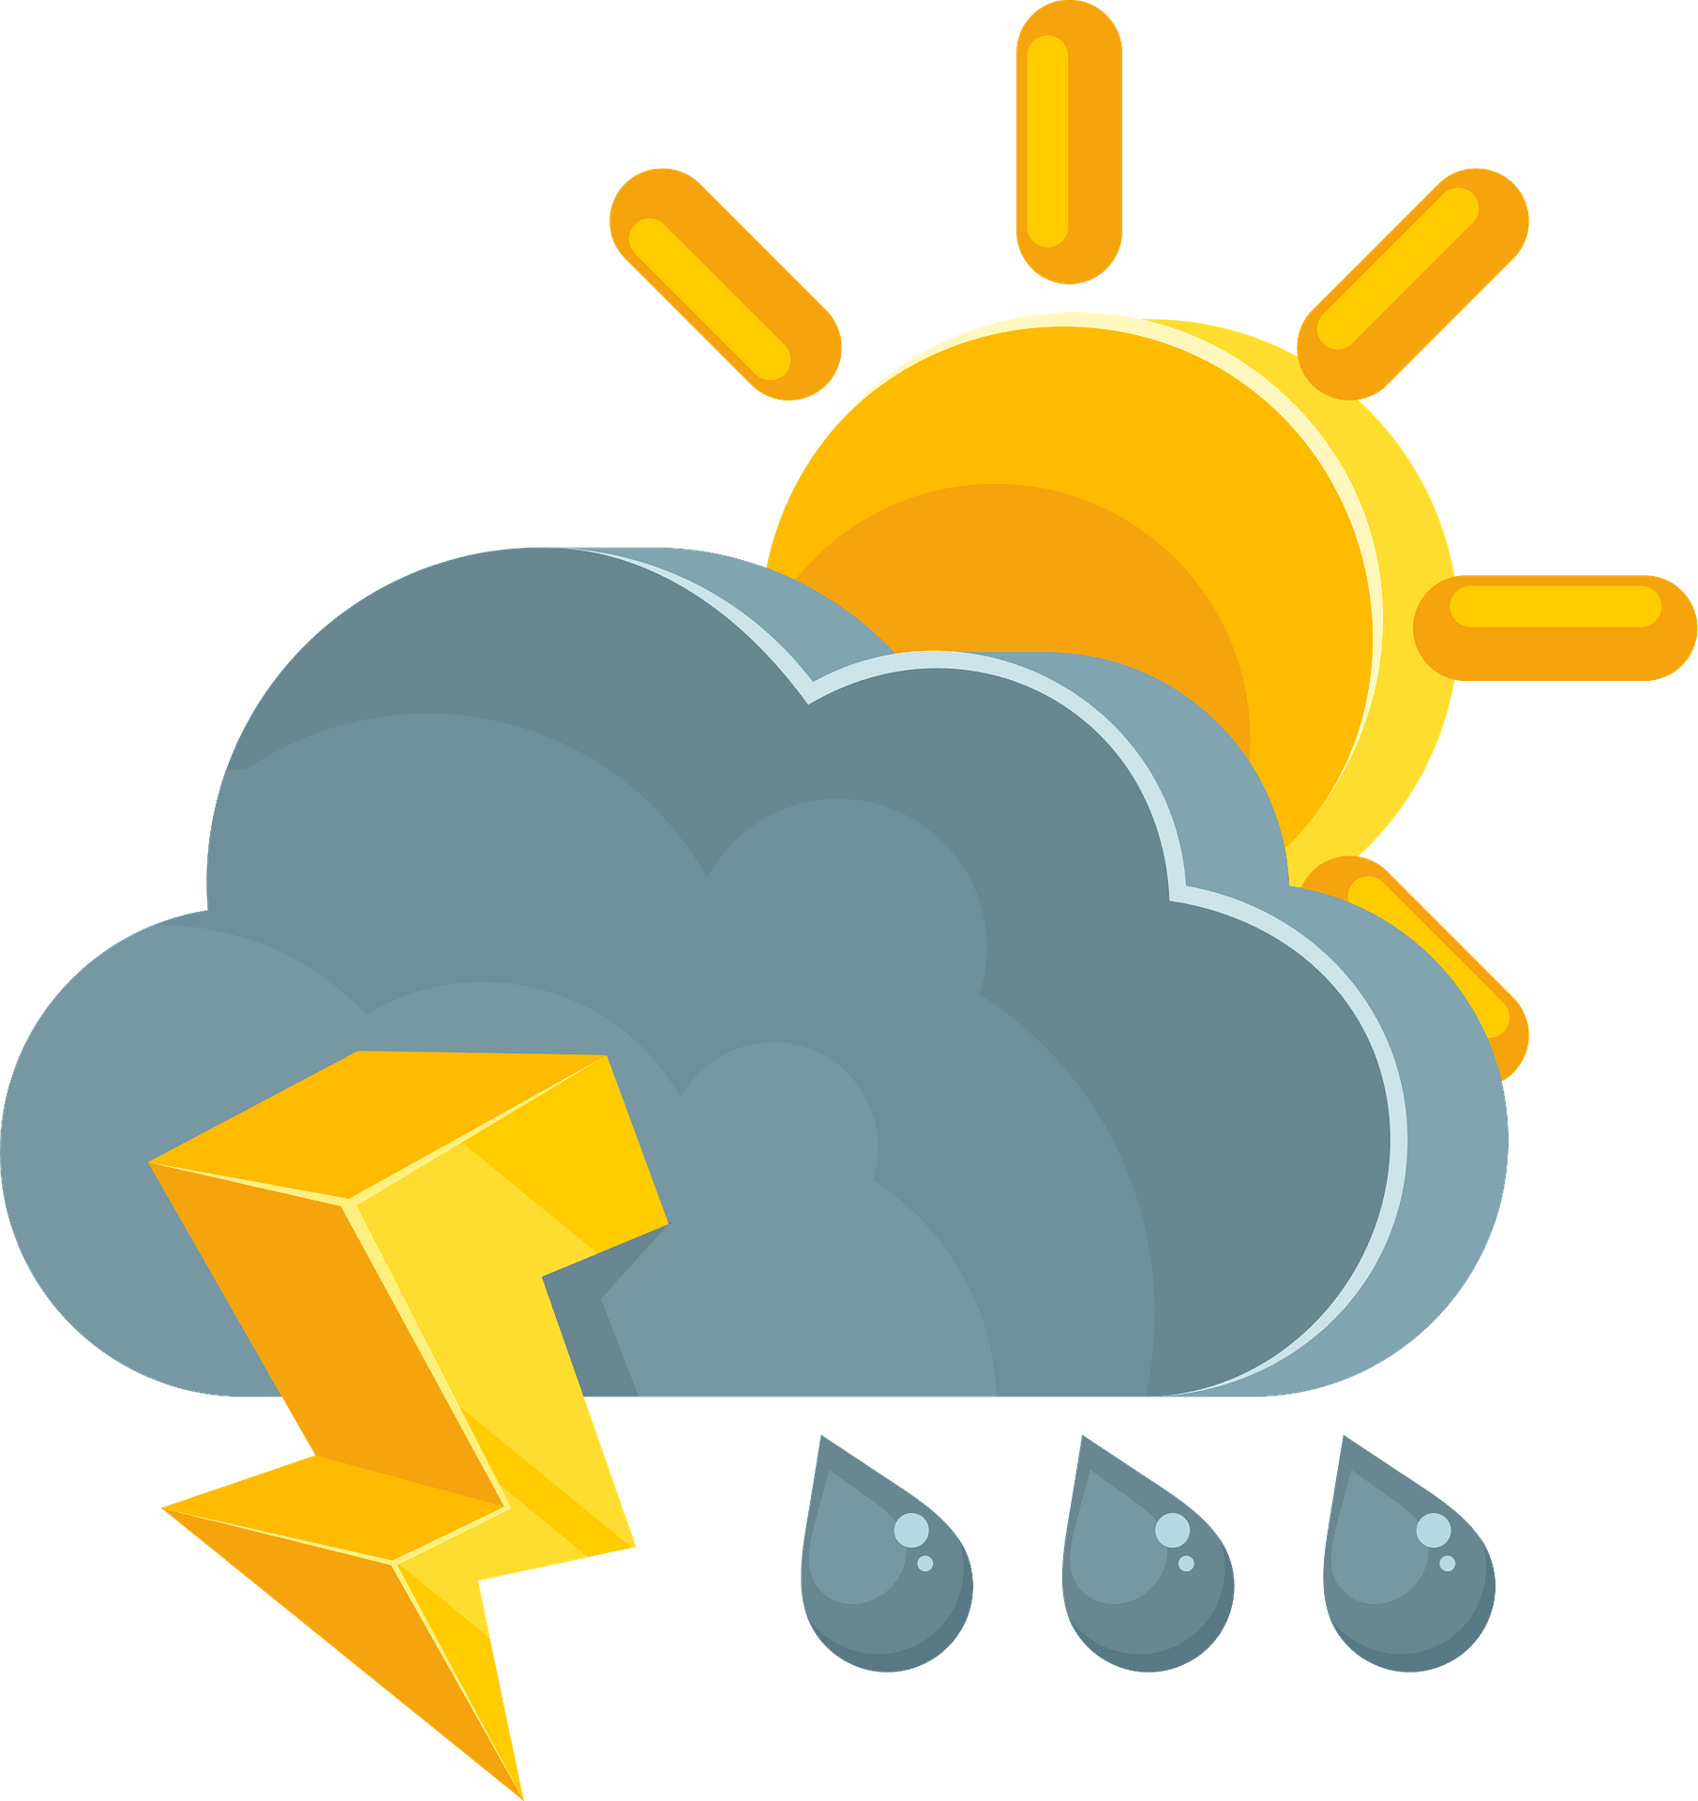
Ex 2. Work in pairs. Make similar conversations with the following situations.
1. You are not sure about the possibility of water on Mars.
2. You doubt that one of your friends will get a good mark on the English test.
3. You are not sure if the weather will be fine tomorrow.

Slide 9
Ex 2. Work in pairs. Make similar conversations with the following situations.
Suggested answers:
1. You are not sure about the possibility of water on Mars.
A: Do you think Mars may have water?
B: I’m not sure about it. We haven’t seen water here yet.

Slide 10
Ex 2. Work in pairs. Make similar conversations with the following situations.
Suggested answers:
2. You doubt that one of your friends will get a good mark on the English test.
A: Do you think C will get good marks on the English test?
B: I doubt it. Because she/he is not such a hard-working person.

Slide 11
Ex 2. Work in pairs. Make similar conversations with the following situations.
Suggested answers:
3. You are not sure if the weather will be fine tomorrow.
A: Do you think the weather will be fine tomorrow?
B: It’s very unlikely/ I’m not certain about it. It’s still raining heavily today. The weather forecast said it could rain through the weekend.

Slide 12
How many planets in the solar system?
8 planets.
Do you think people can live on other planets?

Slide 13
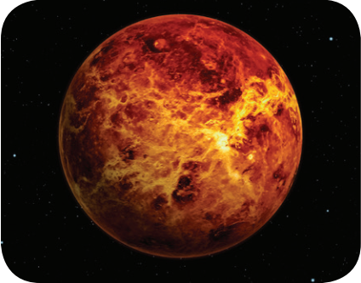
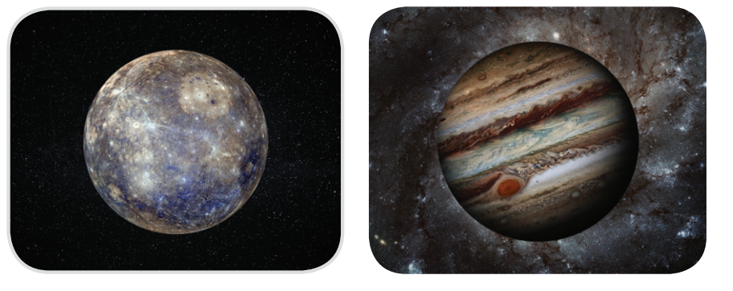
Ex 4. Can you write the names of three planets?
Venus
Mercury
Jupiter
1. _______
2. _______
3. _______

Slide 14
02
THREE PLANETS IN THE SOLAR SYSTEM

Slide 15
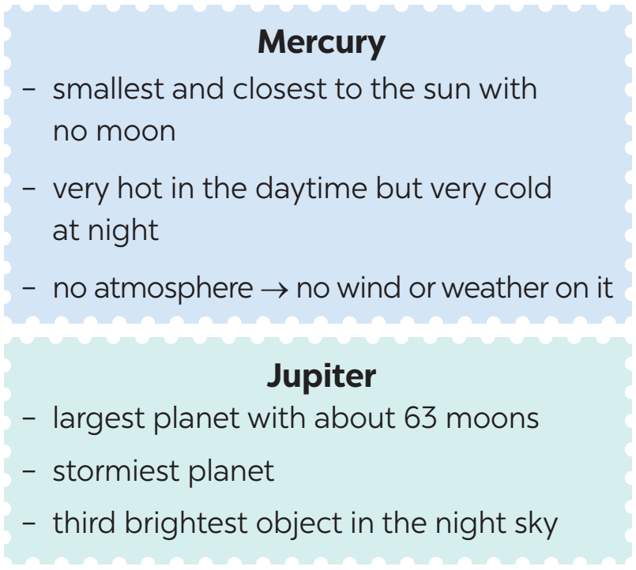
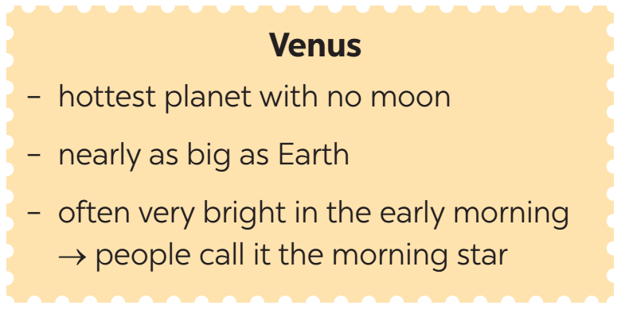
Ex 3. Read the information below and answer questions that follow.
Mercury
- smallest and closest to the sun with no moon.
- very hot in the daytime but very cold at night
- no atmosphere → no wind or weather on it
Venus
- hottest planet with no moon
- nearly as big as Earth
- often very bright in the early morning → people call it the morning star
Jupiter
- largest planet with about 63 moons
- stormiest planet
- third brightest object in the night sky

Slide 16
Ex 3. Read the information below and answer questions that follow.
Mercury
- smallest and closest to the sun with no moon.
- very hot in the daytime but very cold at night
- no atmosphere → no wind or weather on it
1. What planets have no moon?
2. What planet is similar in size to Earth?
3. What planet is the smallest and closest to the sun?
4. What planet is called the morning star?
5. What is the largest and stormiest planet?
planets
no moon
Mercury and Venus
Venus
- hottest planet with no moon
- nearly as big as Earth
- often very bright in the early morning → people call it the morning star

Slide 17
Ex 3. Read the information below and answer questions that follow.
1. What planets have no moon?
2. What planet is similar in size to Earth?
3. What planet is the smallest and closest to the sun?
4. What planet is called the morning star?
5. What is the largest and stormiest planet?
Venus
- hottest planet with no moon
- nearly as big as Earth
- often very bright in the early morning → people call it the morning star
Mercury and Venus
similar in size
Earth
Venus

Slide 18
Ex 3. Read the information below and answer questions that follow.
1. What planets have no moon?
2. What planet is similar in size to Earth?
3. What planet is the smallest and closest to the sun?
4. What planet is called the morning star?
5. What is the largest and stormiest planet?
Mercury
- smallest and closest to the sun with no moon.
- very hot in the daytime but very cold at night
- no atmosphere → no wind or weather on it
Mercury and Venus
Venus
smallest
closest to the
sun
Mercury

Slide 19
Ex 3. Read the information below and answer questions that follow.
1. What planets have no moon?
2. What planet is similar in size to Earth?
3. What planet is the smallest and closest to the sun?
4. What planet is called the morning star?
5. What is the largest and stormiest planet?
Mercury and Venus
Venus
Venus
- hottest planet with no moon
- nearly as big as Earth
- often very bright in the early morning → people call it the morning star
Mercury
morning star
Venus

Slide 20
Ex 3. Read the information below and answer questions that follow.
1. What planets have no moon?
2. What planet is similar in size to Earth?
3. What planet is the smallest and closest to the sun?
4. What planet is called the morning star?
5. What is the largest and stormiest planet?
Mercury and Venus
Venus
Jupiter
- largest planet with about 63 moons
- stormiest planet
- third brightest object in the night sky
Mercury
Venus
largest
stormiest
Jupiter

Slide 21
Ex 5. Work in groups. Take turns to talk about one of the three planets in ex 3.
Venus
Mercury
Jupiter
Example:
I would like to tell you about Mercury.
It is the smallest planet ...
You can begin with:
Today, I would like to tell you about …
In my talk, I’ll tell you about …
Today I’m going to talk about …
What I’d like to present to you today is …

Slide 22
Ex 5. Work in groups. Take turns to talk about one of the three planets in ex 3.
Suggested answer:
Today, I’m going to talk about/ I would like to tell you about Mercury. It is the smallest planet. It is the closest planet to the sun, and it doesn’t have any moons. It is hot in the daytime but very cold at night. Mercury doesn’t have an atmosphere so there is no wind or weather.
Mercury

Slide 23
WRAP-UP
What have you learnt in this lesson?
Making complaints
Three planets in the solar system
Venus
Mercury
Jupiter

Slide 24
THANKS!
Do you have any questions?

Slide 25
DEFINITION OF CONCEPTS
Mercury is the smallest planet
Mars is a very cold place
Neptune is the farthest planet
Saturn is the ringed one
Earth is where we live on
Jupiter is the biggest planet
Uranus is the coldest planet
Venus has a beautiful name

Slide 26
FEATURES OF THE TOPIC
MERCURY
Mercury is the closest planet to the Sun and the smallest of them all
JUPITER
Jupiter is a gas giant and the biggest planet in the Solar System
VENUS
Venus has a beautiful
name and is the second
planet from the Sun

