Slide 1
UNIT 12:
LIFE ON OTHER PLANETS
LESSON 2: A CLOSER LOOK 1

Slide 2

OBJECTIVES
By the end of the lesson, students will be able to:
01
Vocabulary
use the lexical items related to Outer space.
02
Pronunciation
use intonation for making lists correctly.

Slide 3
WARM-UP
Watch a video
Remember the order of the planets

Slide 4
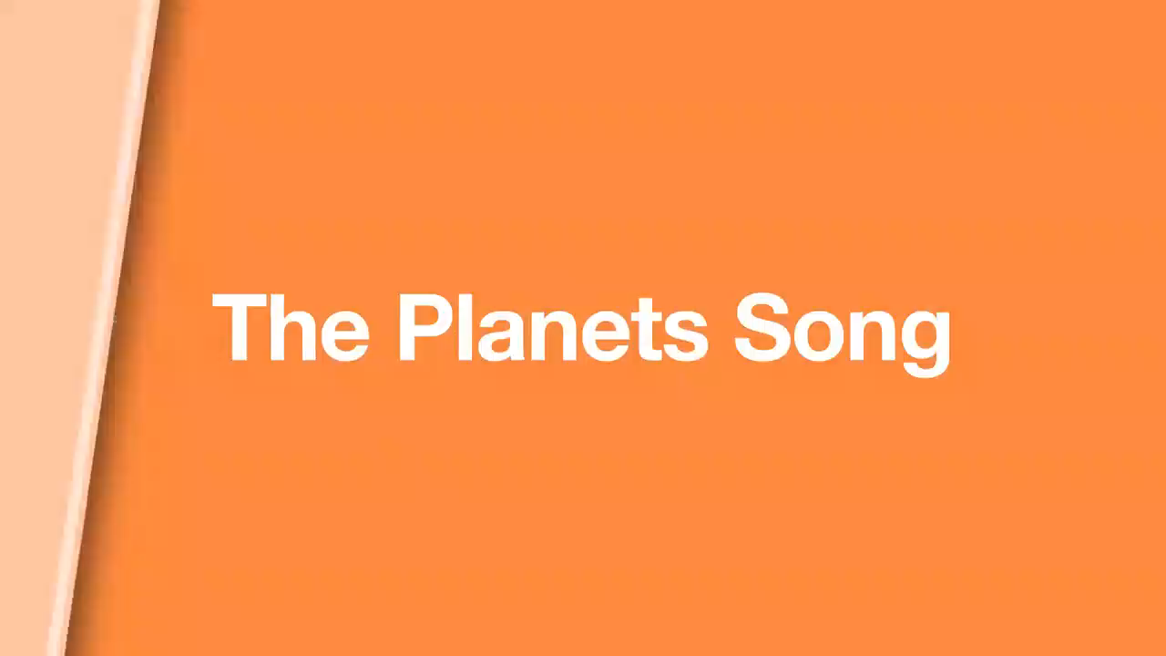
Watch and remember the order.

Slide 5
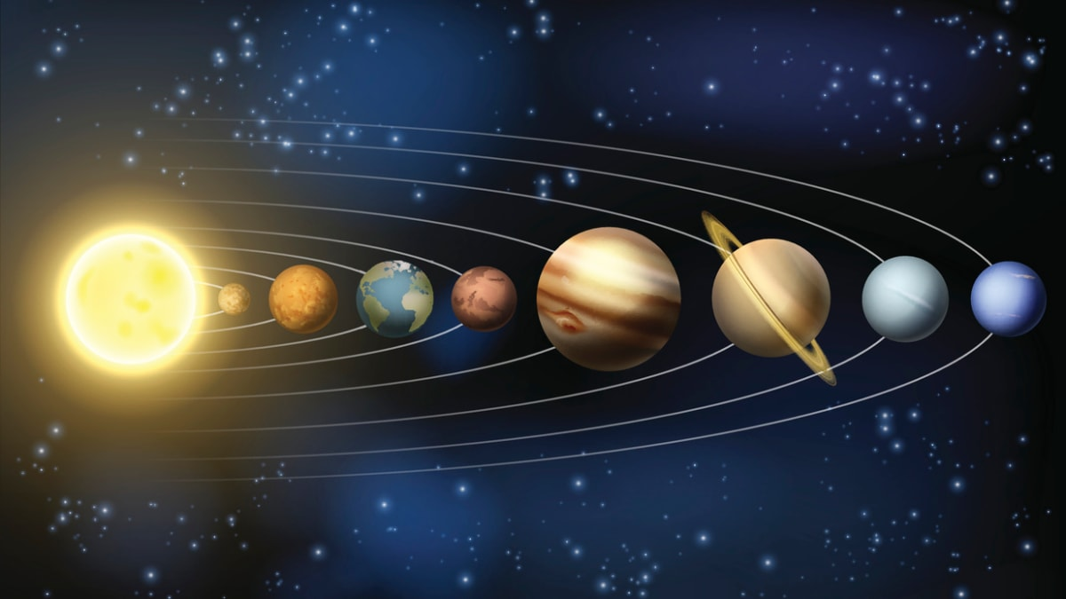
Ex 1. Put the planets in order from the closest to the farthest from the sun.
Earth Jupiter Mars Venus
Mercury Neptune Saturn Uranus
My Very Excellent Mother Just Served Us Noodles.
Mercury
Jupiter
1. __________
5. __________
Venus
Saturn
2. __________
6. __________
Earth
Uranus
3. __________
7. __________
Mars
Neptune
4. __________
8. __________

Slide 6
01
VOCABULARY

Slide 7
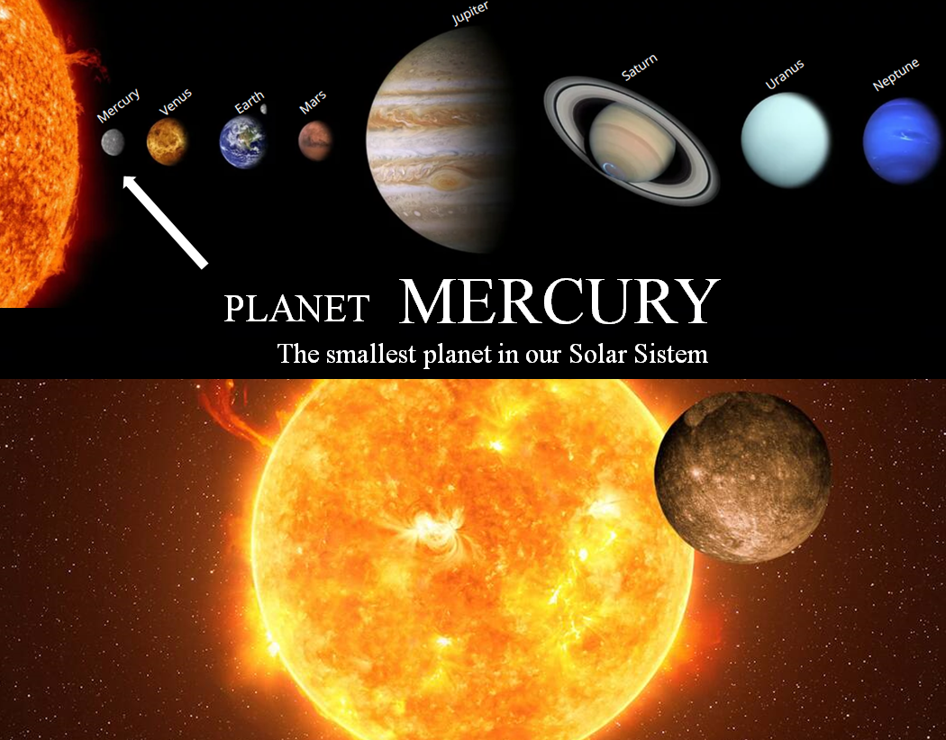

Mercury (n)
/ˈmɜː.kjə.ri/
Sao Thủy

Slide 8
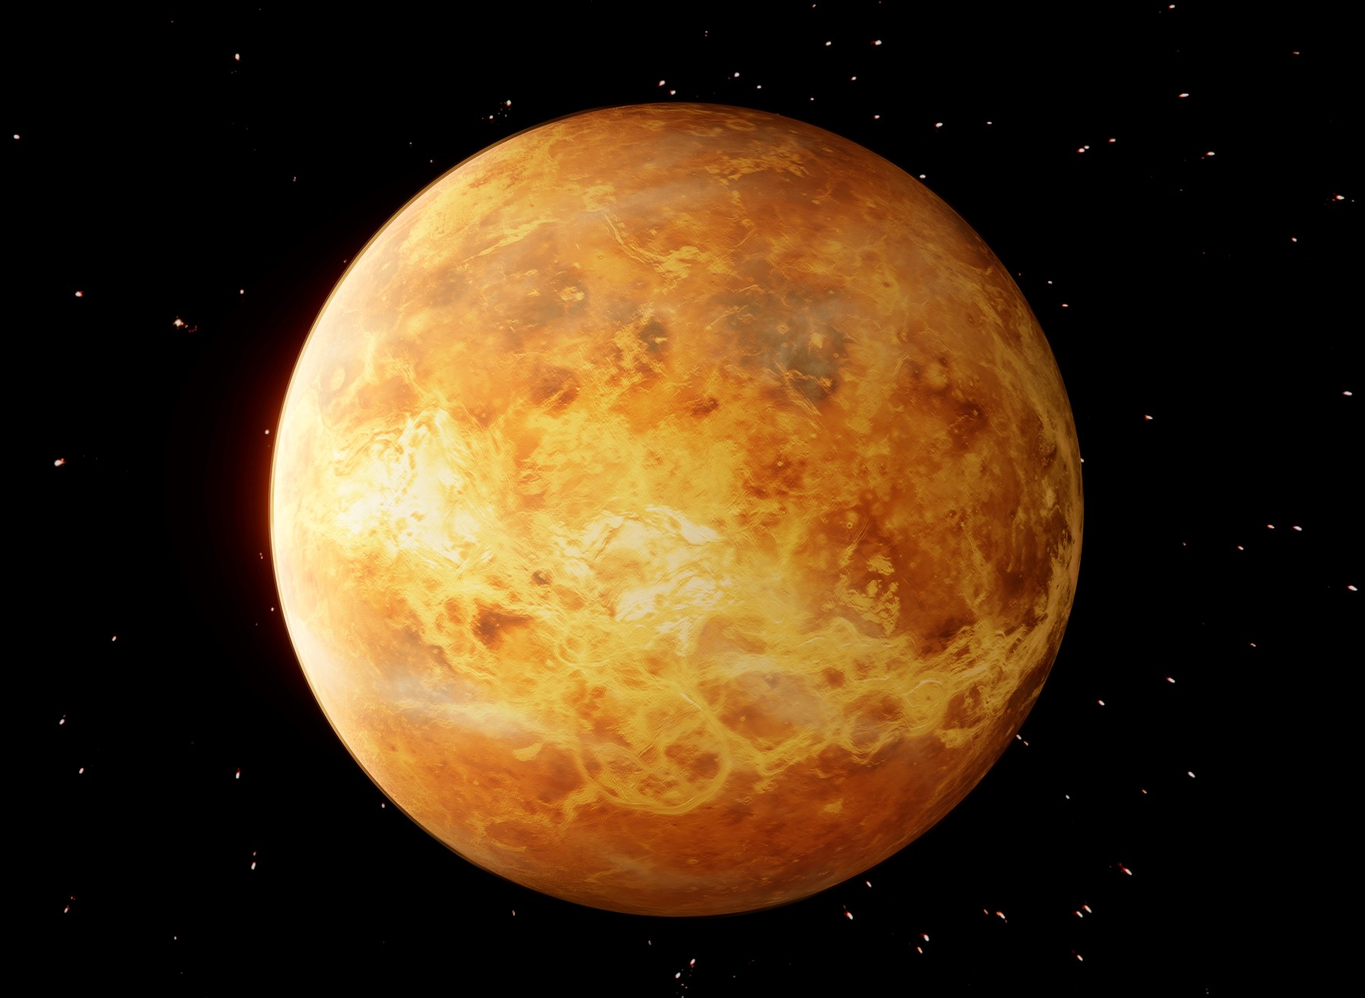
Venus (n)
/ˈviː.nəs/
Sao Kim

Slide 9
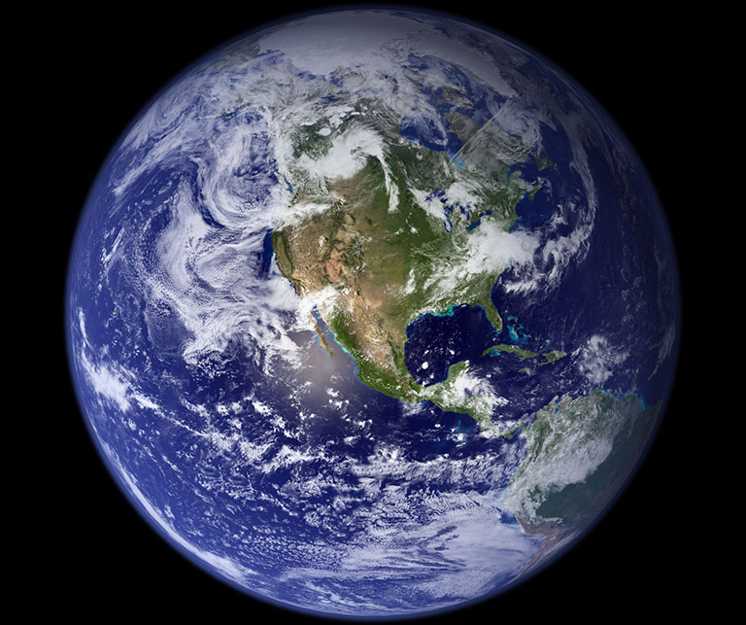
Earth (n)
/ɜːθ/
Trái đất

Slide 10
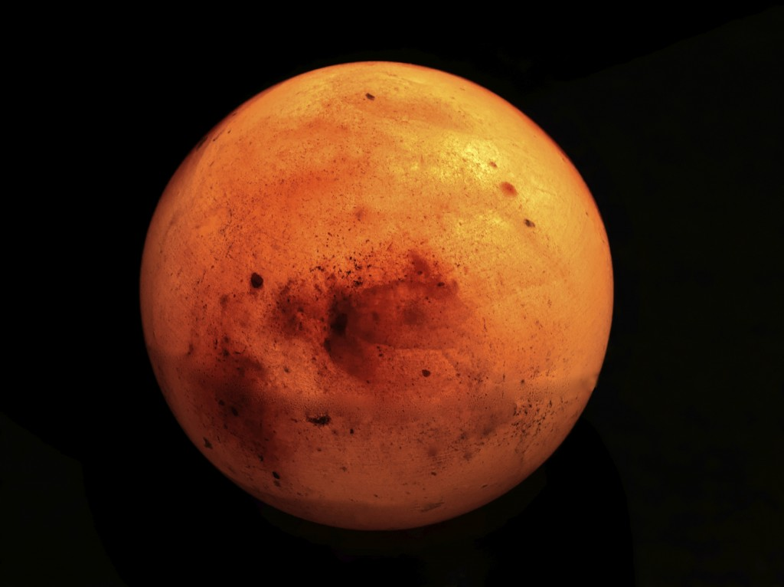
Mars (n)
/mɑːz/
Sao Hỏa

Slide 11
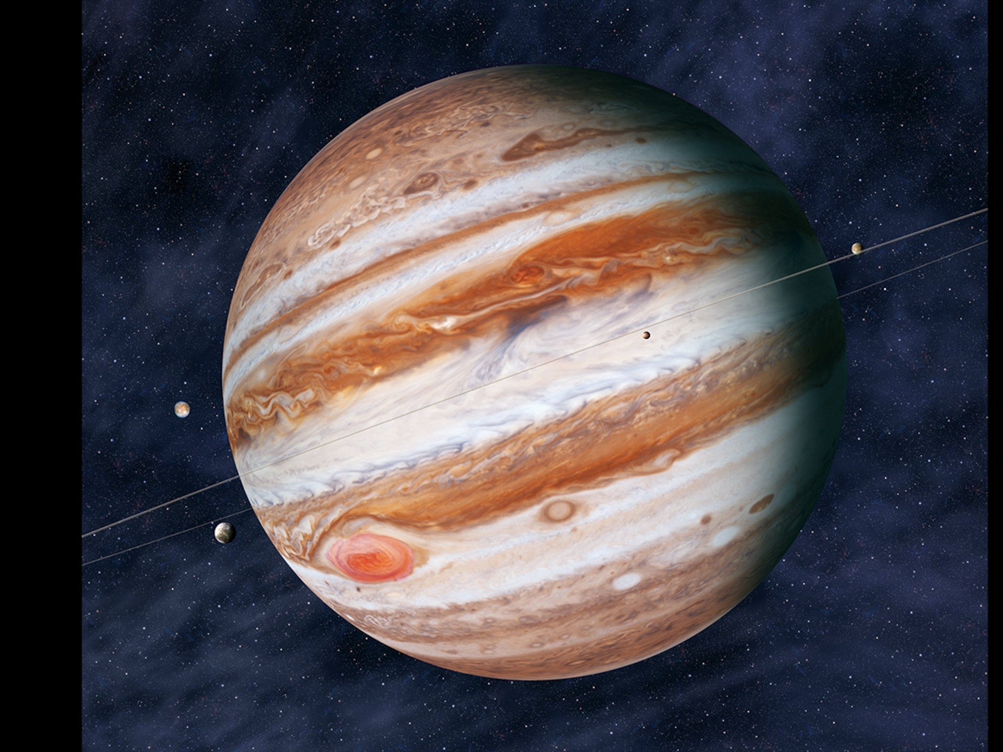
Jupiter (n)
/ˈdʒuː.pɪ.tər/
Sao Mộc

Slide 12
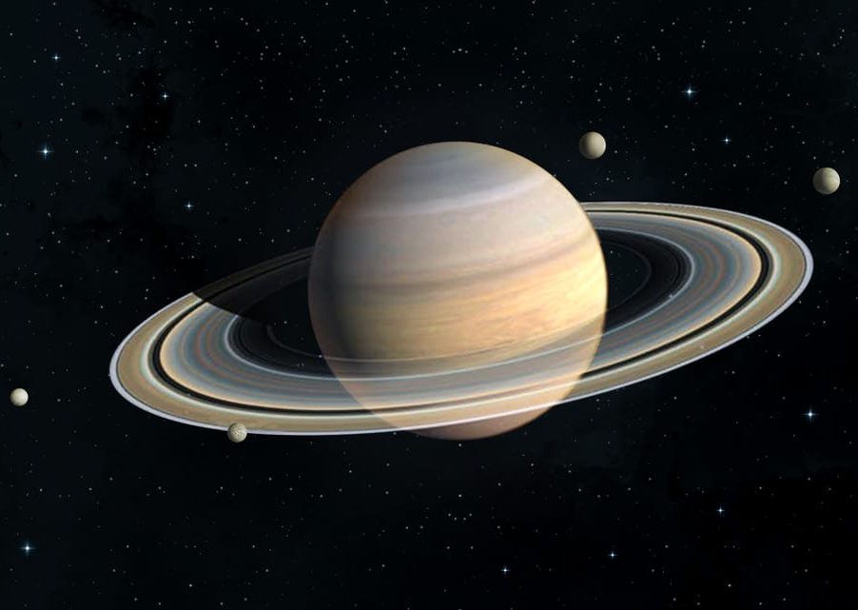
Saturn (n)
/ˈsæt.ən/
Sao Thổ

Slide 13
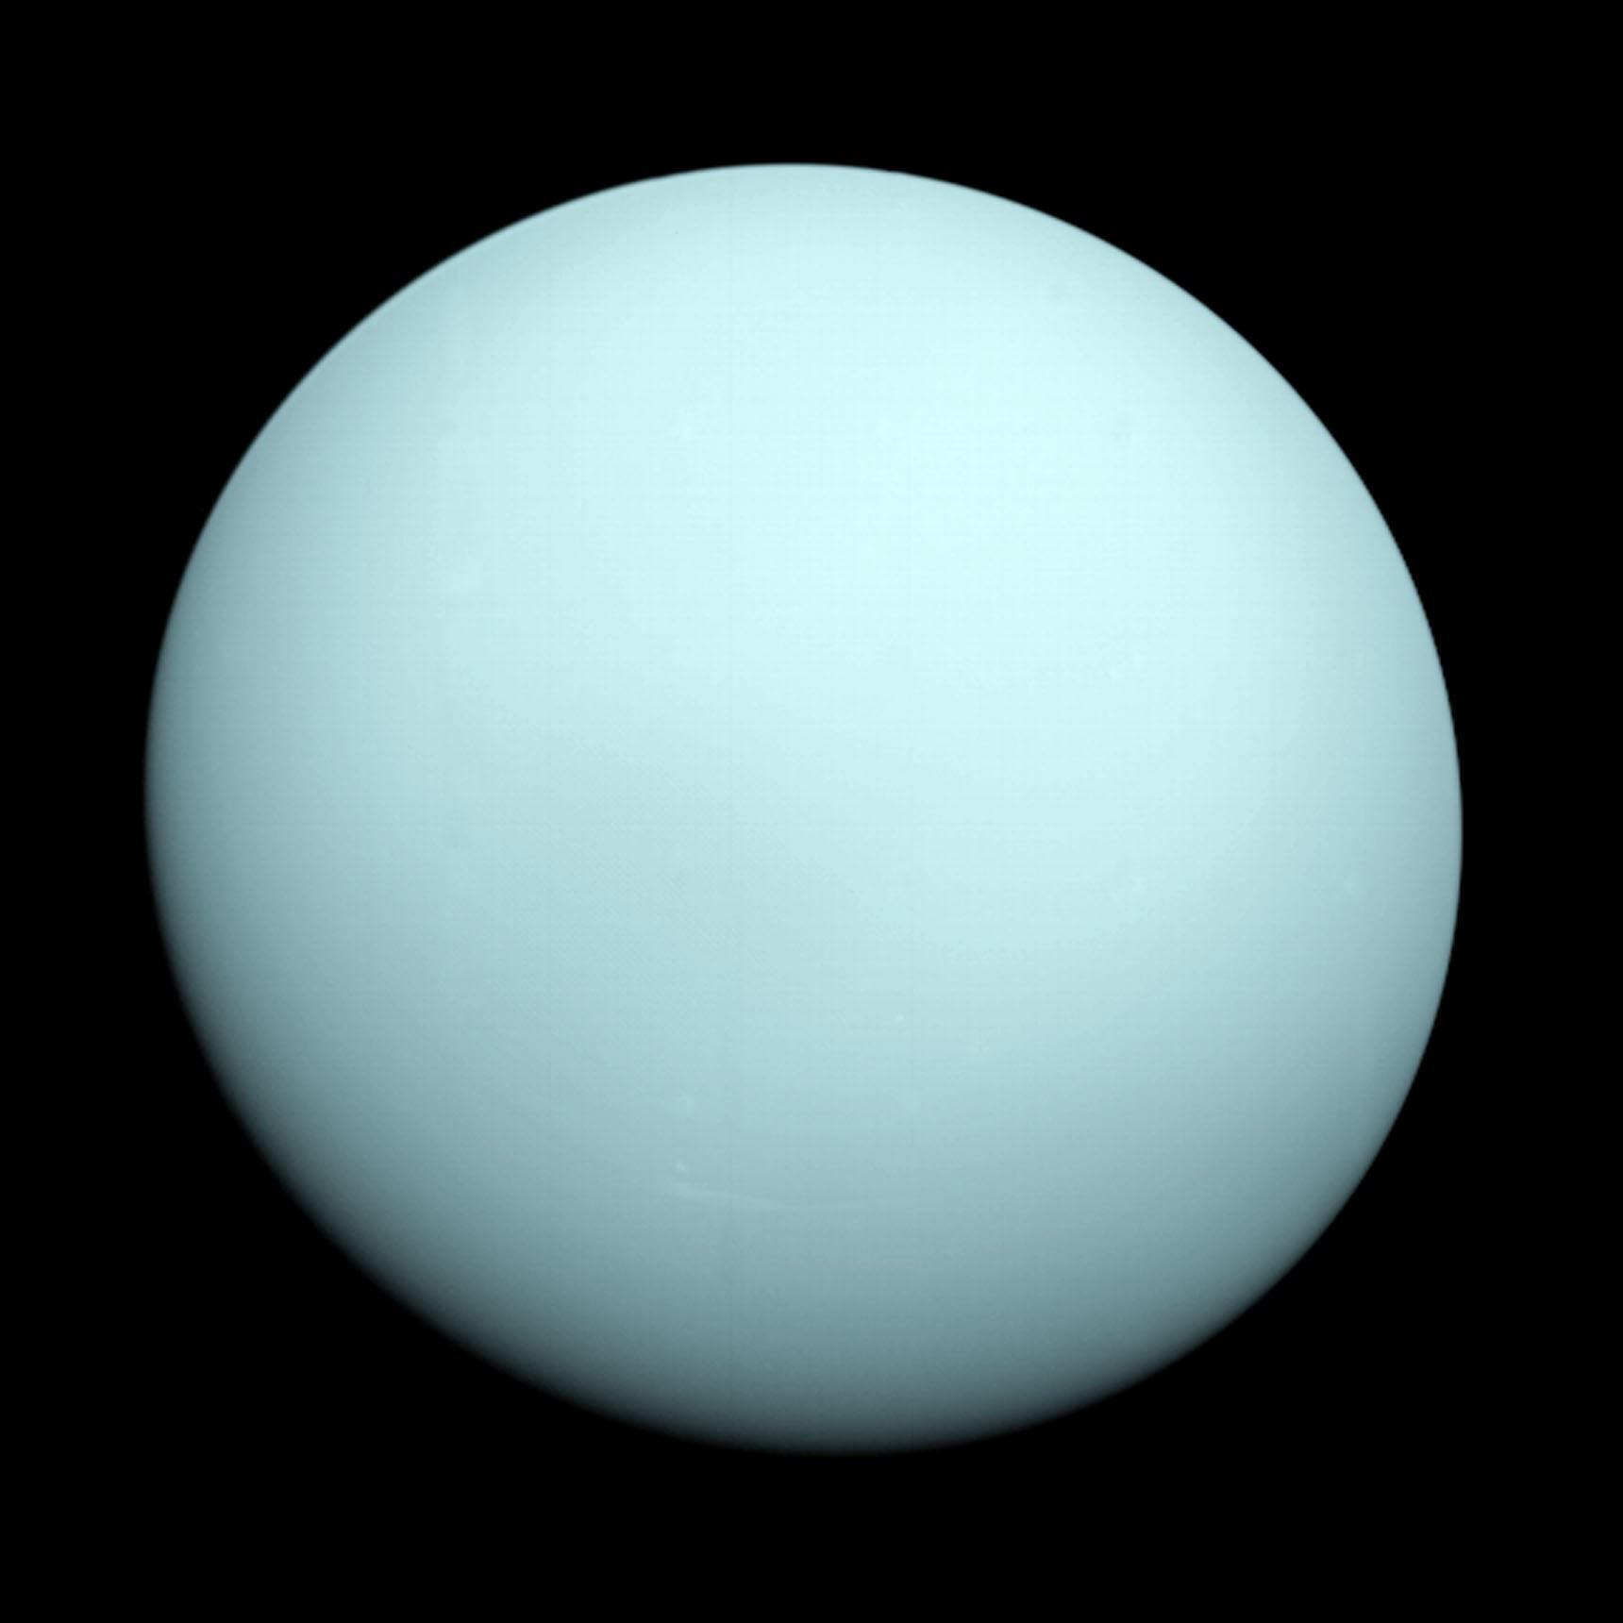
Uranus (n)
/ˈjʊə.rən.əs/
Sao Thiên Vương

Slide 14
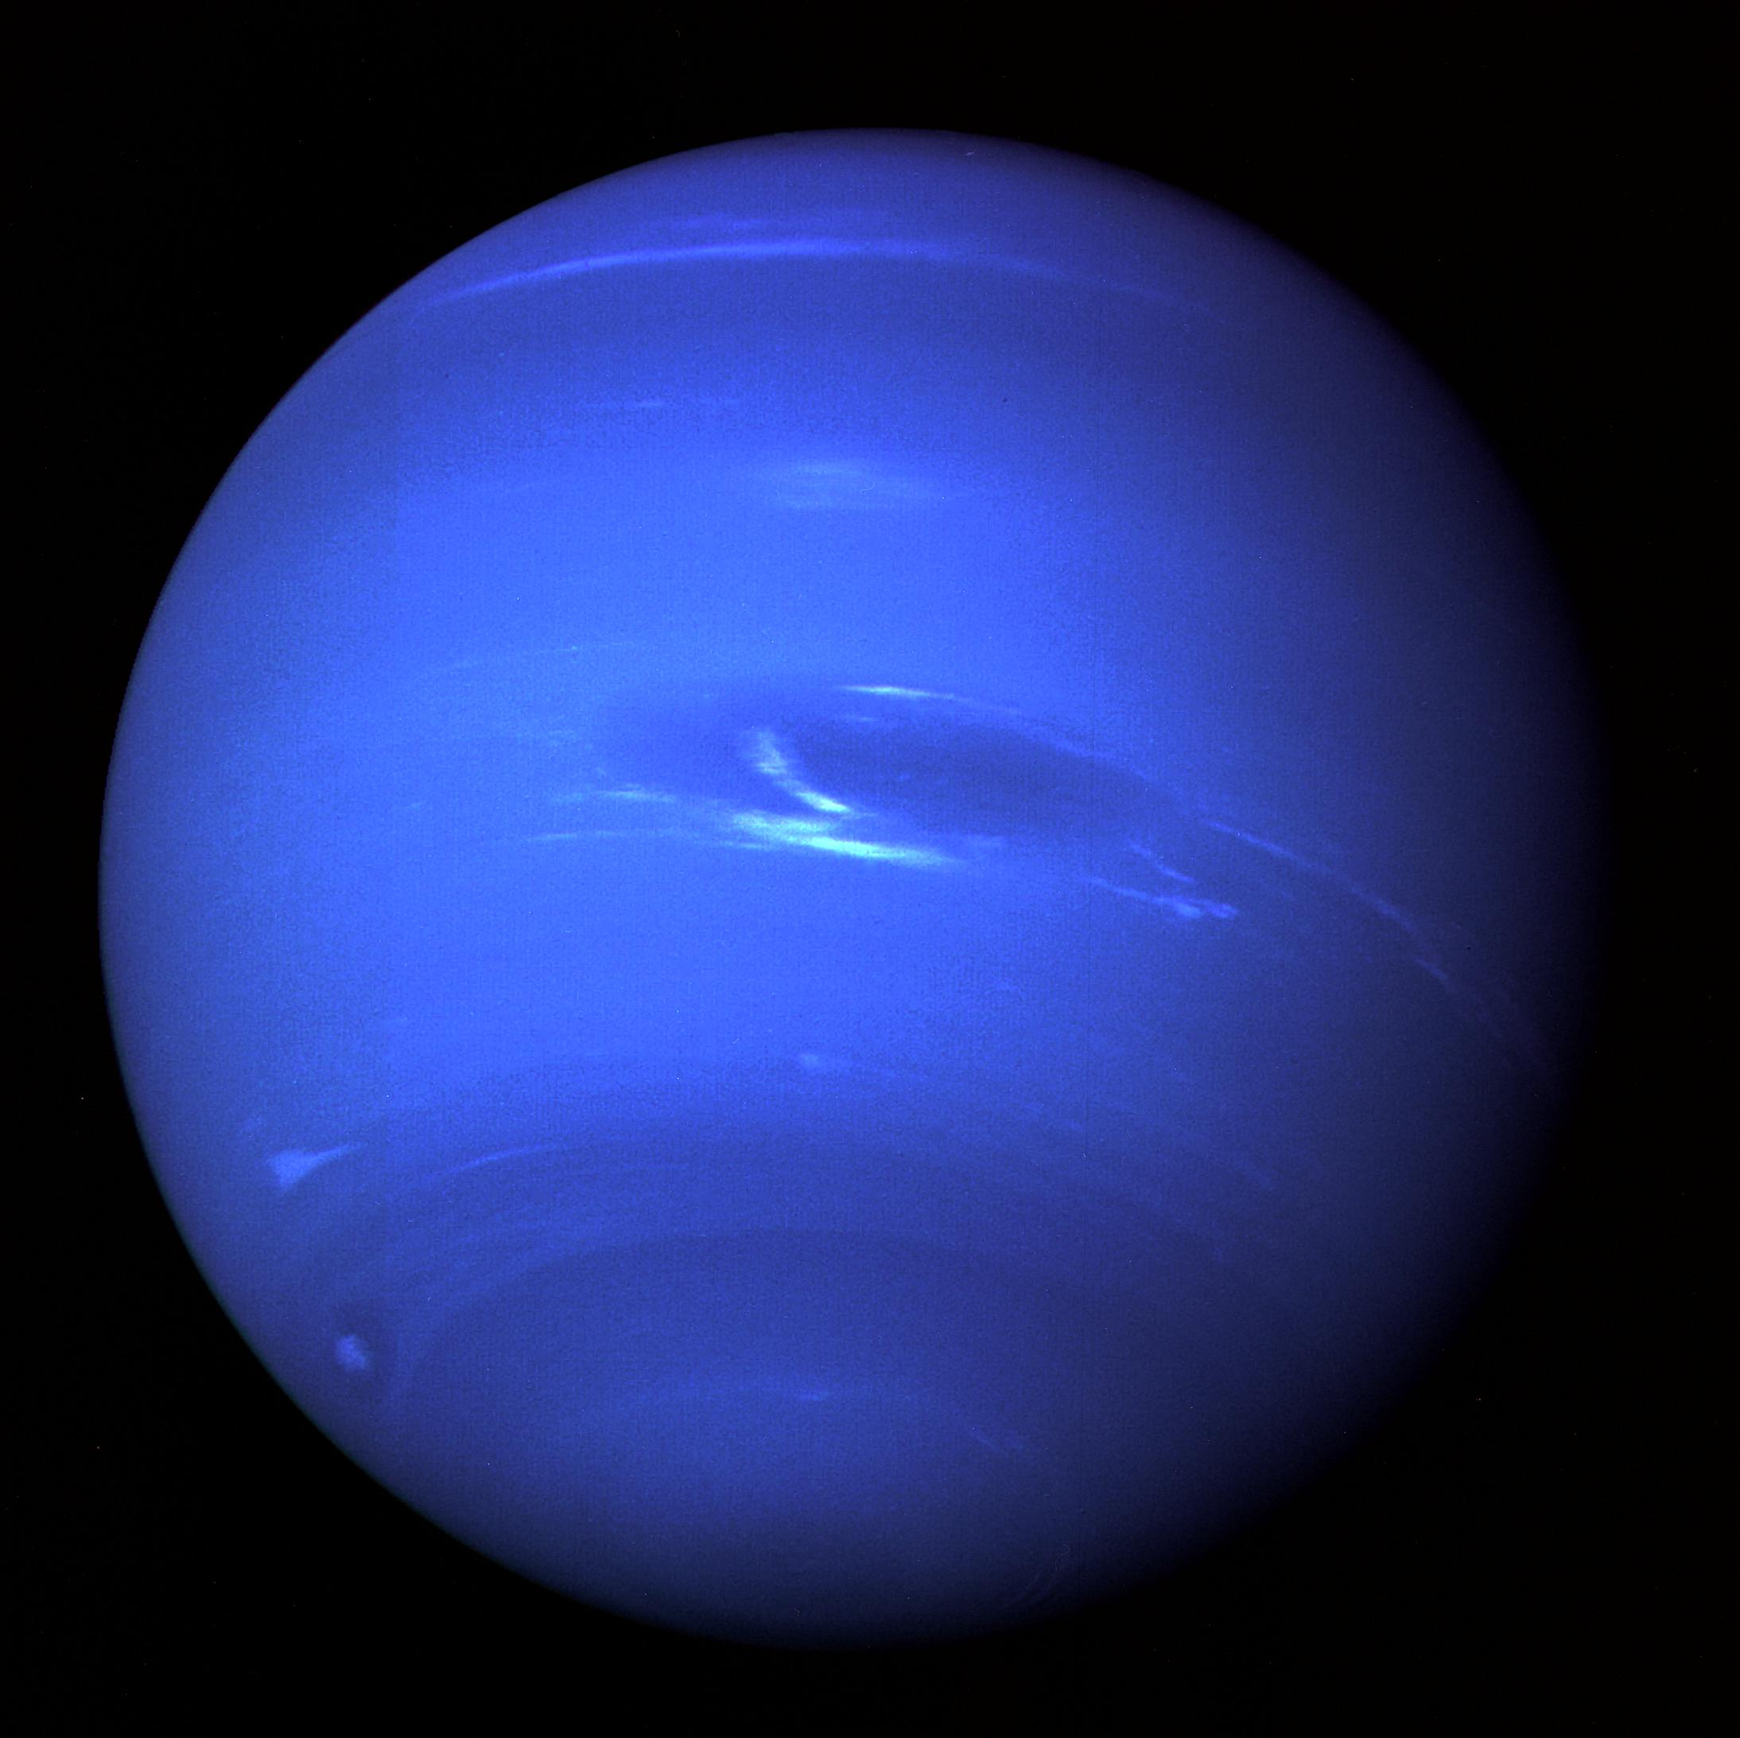
Neptune (n)
/ˈnep.tʃuːn/
Sao Hải Vương

Slide 15
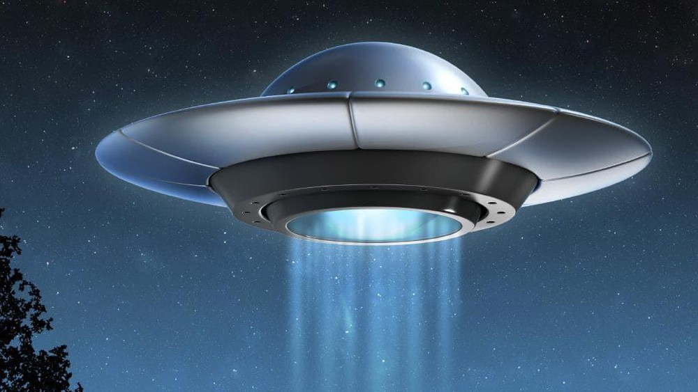
UFO (n)
/ˌjuː.efˈəʊ/
vật thể bay không xác định
Unidentified Flying Object

Slide 16
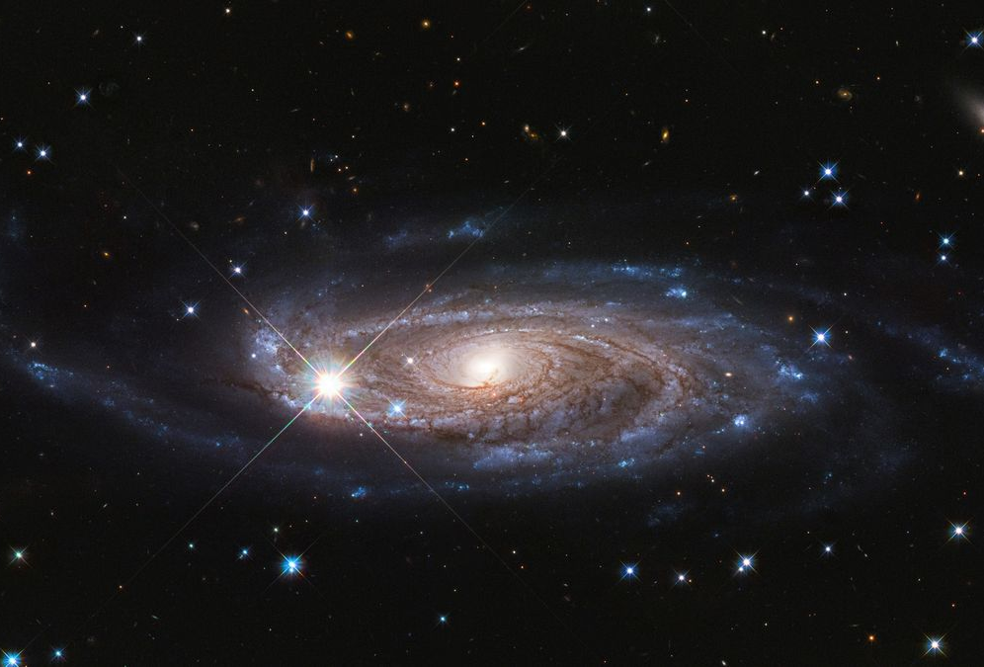
galaxy (n)
/ˈɡæl.ək.si/
thiên hà

Slide 17
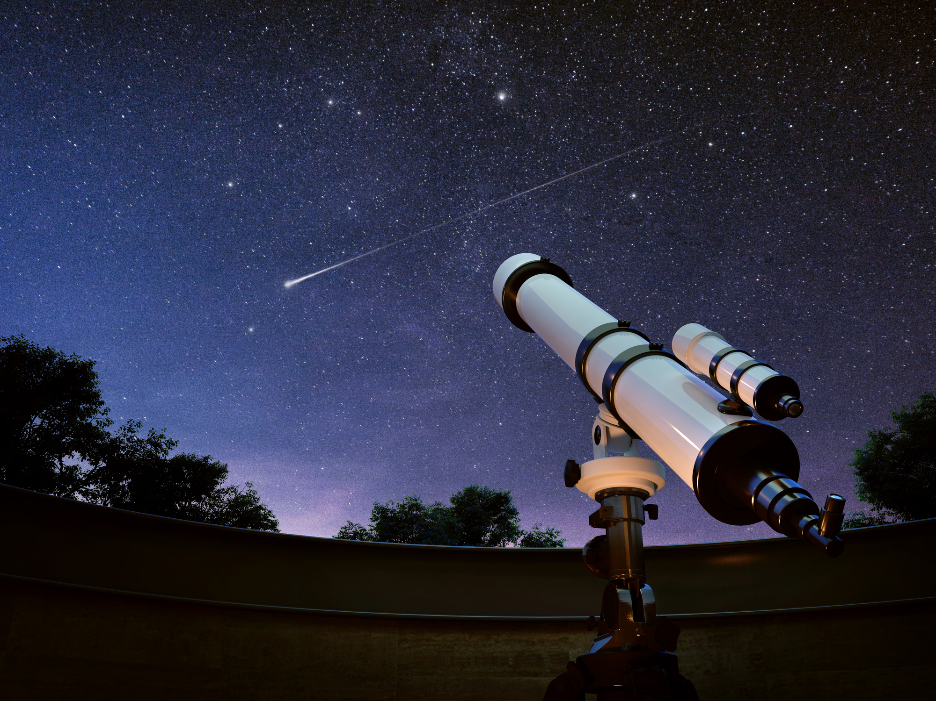
telescope (n)
/ˈtel.ɪ.skəʊp/
kính thiên văn

Slide 18
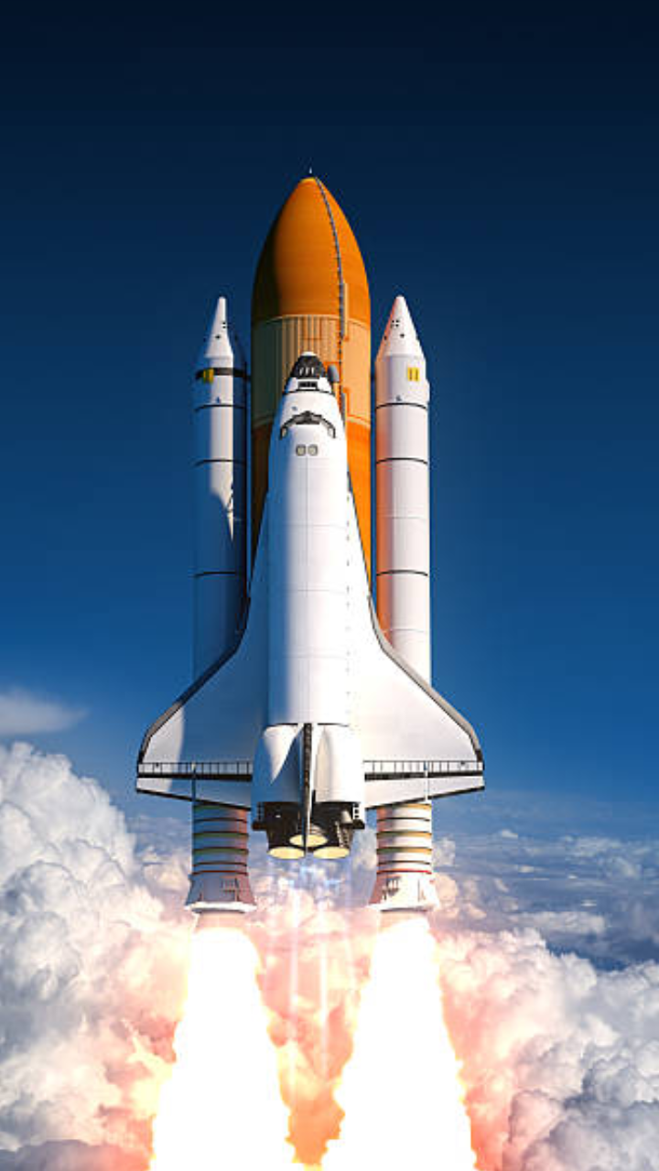
rocket (n)
/ˈrɒk.ɪt/
tên lửa

Slide 19
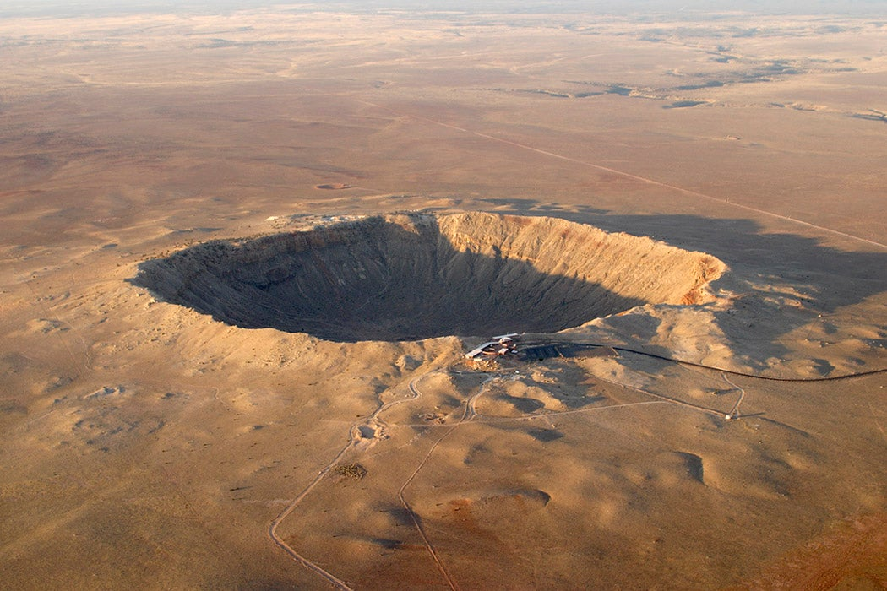
crater (n)
/ˈkreɪ.tər/
miệng núi lửa

Slide 20
VOCABULARY
Words | Pronunciation | Meanings
Mercury (n) | /ˈmɜː.kjə.ri/
Venus (n) | /ˈviː.nəs/
Earth (n) | /ɜːθ/
Mars (n) | /mɑːz/
Jupiter (n) | /ˈdʒuː.pɪ.tər/
Saturn (n) | /ˈsæt.ən/
Uranus (n) | /ˈjʊə.rən.əs/
Neptune (n) | /ˈnep.tʃuːn/
Sao Thủy
Sao Kim
Trái Đất
Sao Hỏa
Sao Mộc
Sao Thổ
Sao Thiên Vương
Sao Hải Vương

Slide 21
VOCABULARY
Words | Pronunciation | Meanings
UFO (n) | /ˌjuː.efˈəʊ/
galaxy (n) | /ˈɡæl.ək.si/
telescope (n) | /ˈtel.ɪ.skəʊp/
rocket (n) | /ˈrɒk.ɪt/
crater (n) | /ˈkreɪ.tər/
vật thể bay không xác định
thiên hà
kính thiên văn
tên lửa
miệng núi lửa

Slide 22
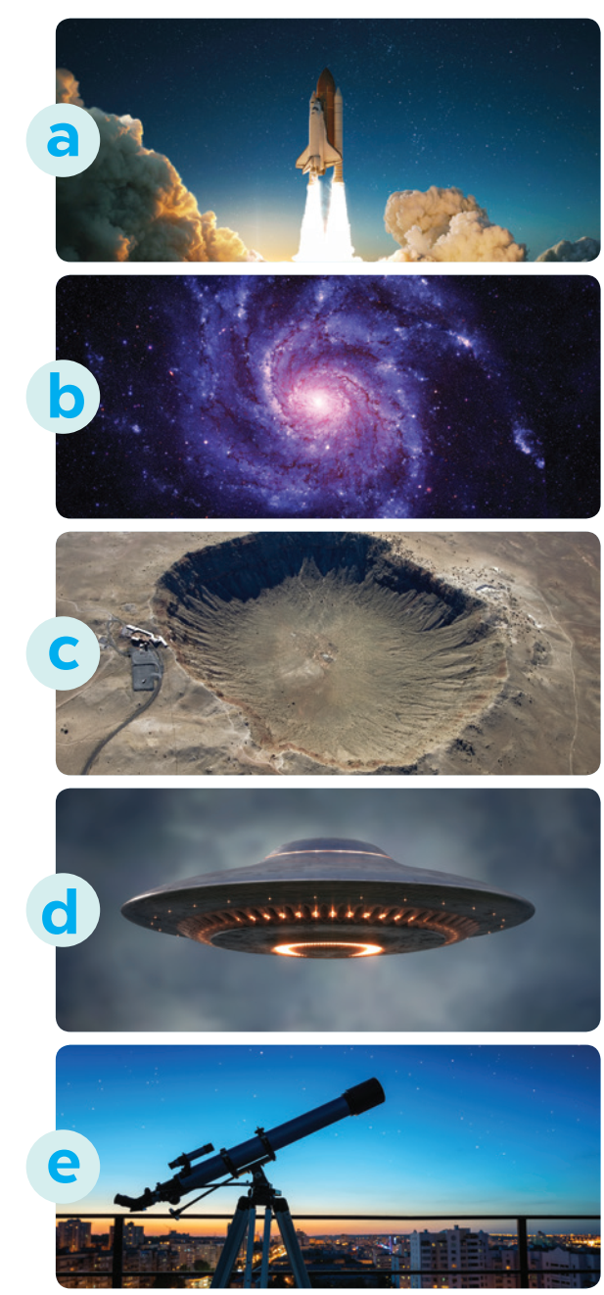
Ex 2. Match the words (1-5) with the pictures (a-e)
1. telescope
2. UFO
3. rocket
4. galaxy
5. crater
3. rocket
4. galaxy
5. crater
2. UFO
1. telescope

Slide 23
Ex 3. Complete the following sentences with the words from the box.
Venus
telescope
craters
rocket
galaxy
1. There are many _______ on the surface of the moon.
2. We use a _______, which is in the shape of a big tube, for travelling or carrying things into space.
3. We need to use a _________ to clearly see the surface of the moon.
4. The planet which is the second closest to the sun is _______.
5. The Milky Way is the _______ that includes our solar system.
many
on
surface of the moon
big tube
travelling
carrying
into space
clearly see
surface of the moon
planet
second closest
sun
Milky Way
includes
solar system

Slide 24


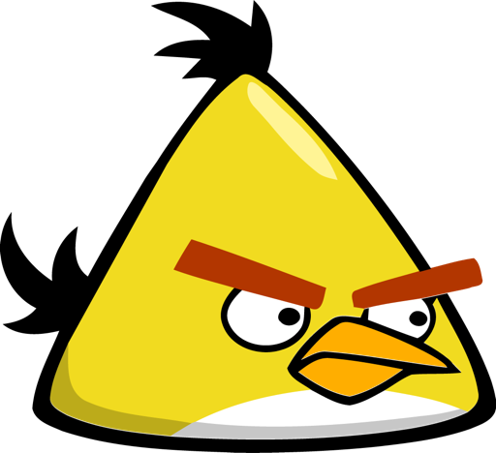




Slide 25

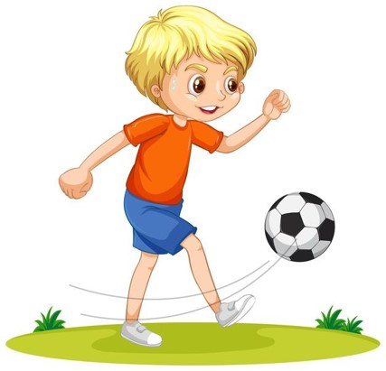


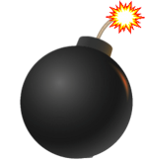
There are many _______ on the surface
of the moon
A. rocket
B. craters
-1
-1
+5
-1
C. telescope
D. Venus

Slide 26
2. We use a _______, which is in the shape
of a big tube, for travelling or carrying things
into space.
A. rocket
B. galaxy
-1
-1
+5
-1
C. telescope
D. Venus

Slide 27
3. We need to use a _________ to clearly
see the surface of the moon.
A. rocket
B. galaxy
-1
-1
+5
-1
c. telescope
D. Venus

Slide 28
4. The planet which is the second
closest to the sun is _______.
A. Venus
B. galaxy
-1
-1
+5
-1
C. telescope
D. rocket

Slide 29
5. The Milky Way is the _______ that
includes our solar system
A. rocket
B. galaxy
-1
-1
+5
-1
C. telescope
D. Venus

Slide 30
Ex 3. Complete the following sentences with the words from the box.
Venus
telescope
craters
rocket
galaxy
craters
1. There are many _______ on the surface of the moon.
2. We use a _______, which is in the shape of a big tube, for travelling or carrying things into space.
3. We need to use a _________ to clearly see the surface of the moon.
4. The planet which is the second closest to the sun is _______.
5. The Milky Way is the _______ that includes our solar system.
many
on
surface of the moon
rocket
big tube
travelling
carrying
into space
telescope
clearly see
surface of the moon
planet
second closest
sun
Venus
Milky Way
galaxy
includes
solar system
CHECK AGAIN

Slide 31
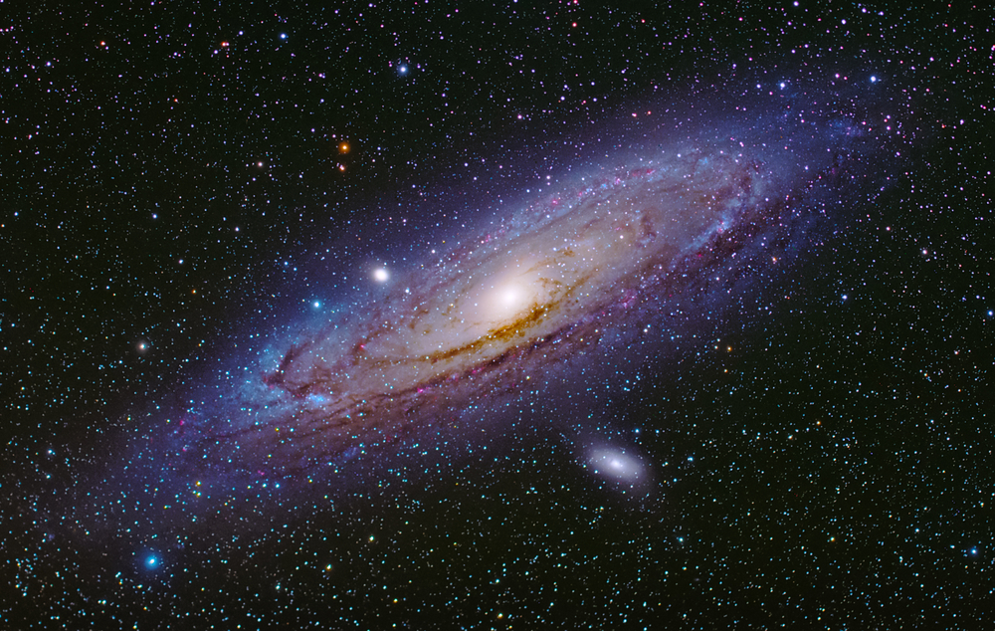
The Milky Way
“You are one of the billions of people on our Earth. Our Earth orbits the Sun in our Solar System. Our Sun is one star among the billions in the Milky Way Galaxy. Our Milky Way Galaxy is one among the billions of galaxies in our Universe. You are unique in the Universe!” - The NASA Night Sky Network
Notes:
optional

Slide 32
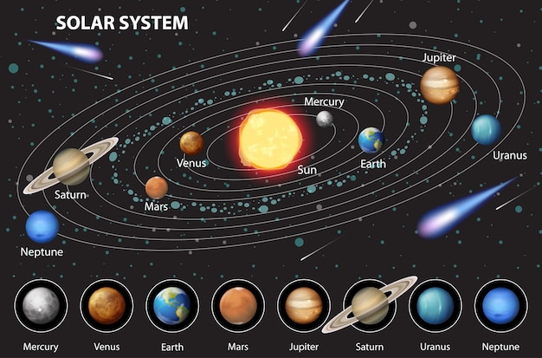
Can you say this sentence?
The solar system includes eight planets that go around the sun: Mercury, Venus, Earth, Mars, Jupiter, Saturn, Uranus and Neptune.

Slide 33
PRONUNCIATION
02
Intonation for making lists

Slide 34
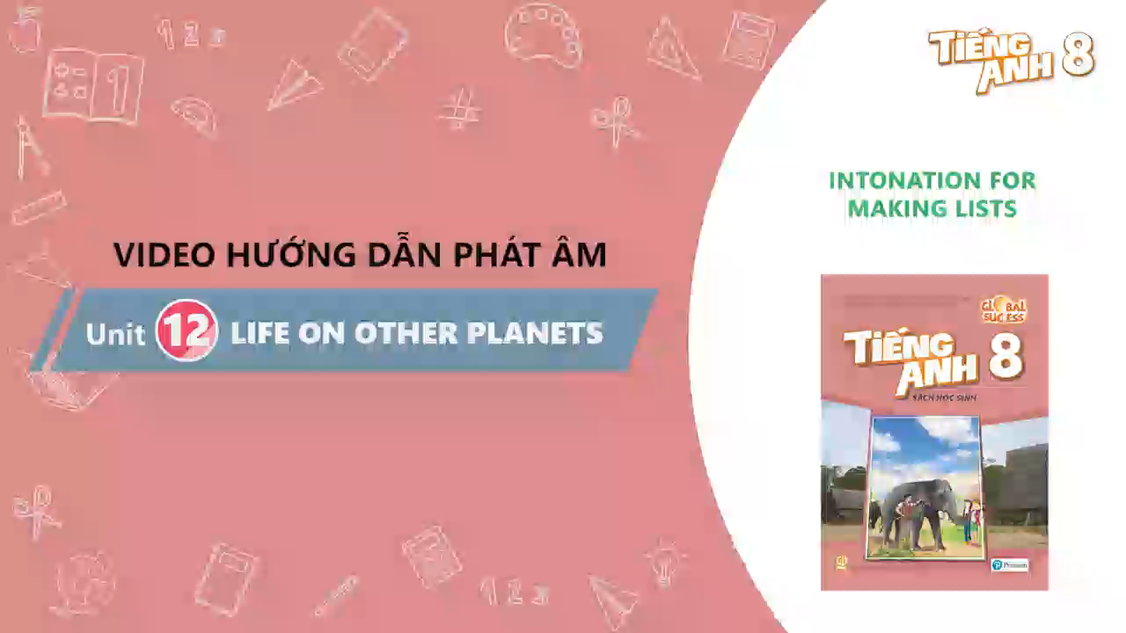
Listen and pay attention!

Slide 35
Intonation for making lists.
When we make a list, our voice slightly rises  on the previous items(s) and falls  on the last items.
Example:
- The inner planets are the four planets closest to the sun:
Mercury , Venus , Earth , and Mars .
- We’ve got bananas , apples , pears , and oranges .

Slide 36
Ex 4. Listen and repeat the sentences. Pay attention to the tones of the underlined words in each sentence.
1. I’d like some eggs, some milk, some cheese, and some bread, please.
2. My father can speak four languages: English, French, Russian, and Spanish.
3. My favourite sports are football, tennis, basketball, and volleyball.
4. My kitten is cute, smart, playful, and noisy.
5. The outer planets, which are made up mostly of gas, include Jupiter, Saturn, Uranus, and Neptune.

Slide 37
Ex 4. Listen and repeat the sentences. Pay attention to the tones of the underlined words in each sentence.
1. I’d like some eggs , some milk , some cheese , and some bread , please.
2. My father can speak four languages: English , French , Russian , and Spanish .
3. My favourite sports are football , tennis , basketball , and volleyball .
4. My kitten is cute , smart , playful , and noisy .
5. The outer planets, which are made up mostly of gas, include Jupiter , Saturn , Uranus , and Neptune .





















Slide 38
Ex 5. Listen to the conversations. Do you think the voice goes up or down on the underlined words in each second sentence? Draw a suitable arrow (↗ or ) on each underlined word.
1. A: Good evening! What can I get you, sir?
B: I’d like some pork, some chicken, some tofu, and some vegetables.
2. A: What did you buy at the clothing store yesterday?
B: I bought a T-shirt, a jumper, a tie, and a cap.
3. A: What music do you like?
B: I like pop, blues, country, and jazz.
4. A: What do you think we should bring with us to Mars?
B: I think we should bring food, water, clothes, and a tent.

















Slide 39
WRAP-UP
1. The planet which is the closest to the Sun is _____.
A. Venus B. Earth C. Mercury
2. With a good _____, you can see craters on the moon clearly.
A. UFO B. telescope C. glasses
3. Draw a suitable narrow   on each underlined words.
There are five planets I like most: Earth , Mars ,
Jupiter , Saturn , and Uranus .






Slide 40
Thanks!
Do you have any questions?

