Slide 1
OUR TET HOLIDAY
LESSON 3: A CLOSER LOOK 2

Slide 2
Lesson objectives
1
By the end of the lesson, students will be able to:
2
Use should/shouldn’t for advice
Use some/any for amount

Slide 3


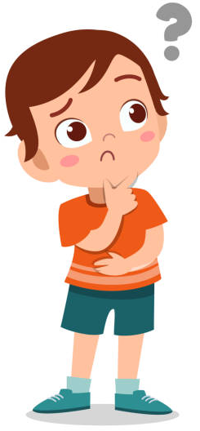


Grammar
What advice do you give him?
Hoang
You should stay at home.
You shouldn’t go to the countdown concert.
Notes:
Hoang wants to go to the concert but he can get covid-19. What advice do you give him?

Slide 4

should
We use ________ for things that are good to do.
We use ________ for things that are not good to do.
shouldn’t

Slide 5
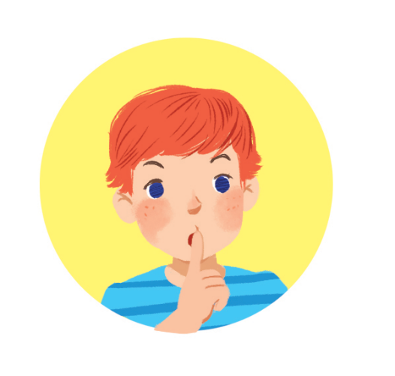

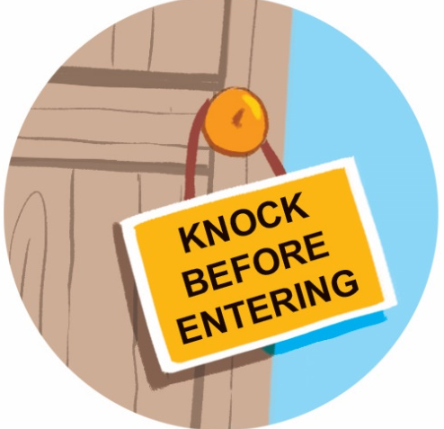
1. Look at the signs at the library and complete the sentences with should or shouldn’t.
should
shouldn’t
1. You __________ keep quiet.
2. You __________ eat or drink.
should
shouldn’t
3. You __________ knock before you enter.
4. You __________ run.

Slide 6
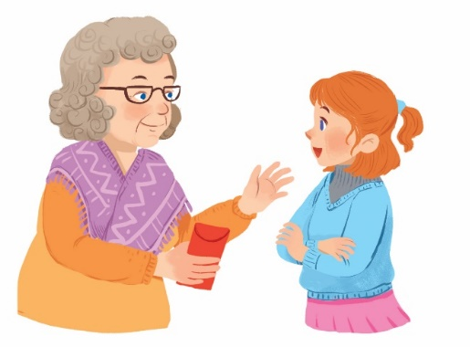
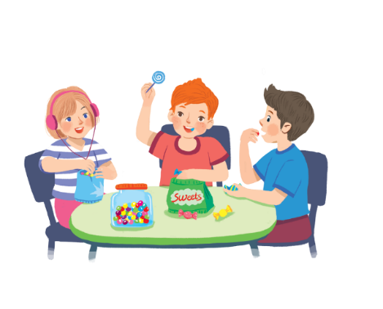
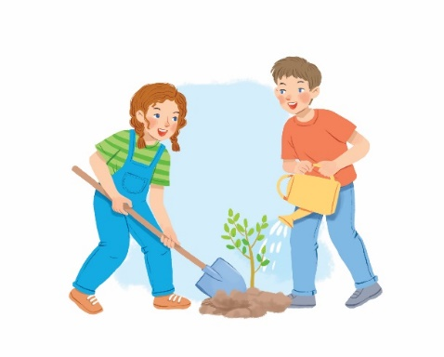
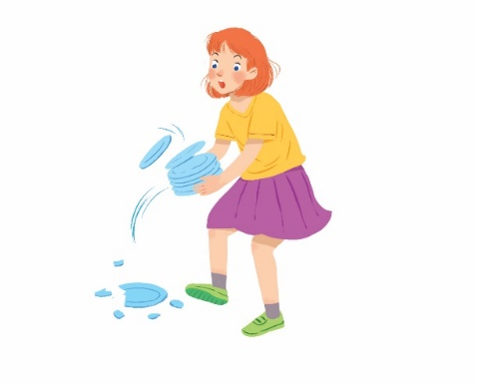
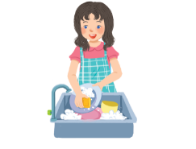
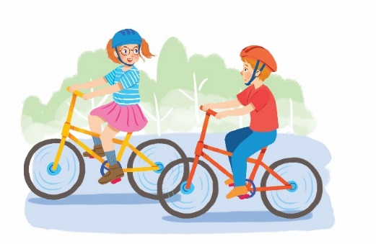
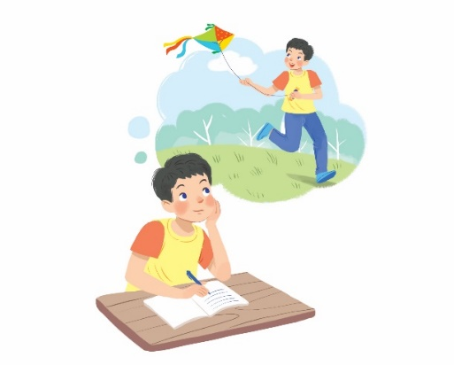
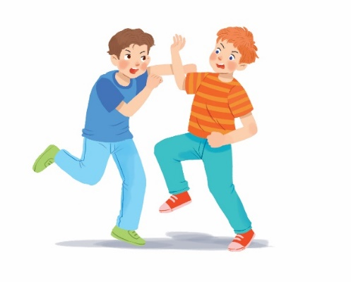
2. Tick () the activities children should do at Tet and cross (×) the ones they shouldn’t.
Thank you.




1.
behave well
2.
eat lots of sweets
3.
plant trees
4.
break things




5.
go out with friends
8.
help with housework
6.
make a wish
7.
fight

Slide 7
3. Look at the activities in 2. Take turns to say what you think children should / shouldn’t do.
Thank you.




1.
behave well
2.
eat lots of sweets
3.
plant trees
4.
break things




5.
go out with friends
8.
help with housework
Example:
6.
make a wish
7.
fight
- Children should behave well.
- Children shouldn’t eat lots of sweets.

Slide 8
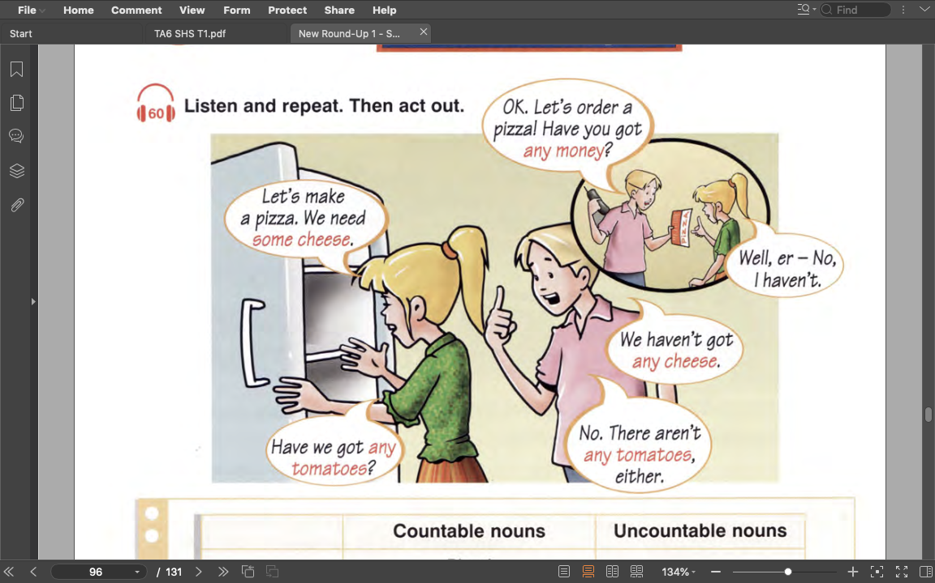

Listen and answer:
What are they talking about?
=> making and ordering pizza

Slide 9
Read and circle some or any
1. We use some / any for positive statements (+).
2. We use some / any for negative statements (-).
3. We use some / any for questions (?).

Slide 10
Some
any
(+) My mother bought some fruits.
(+) I need some milk for the cake.
(-) I can’t answer any questions.
(?) Do you have any sugar?

Slide 11
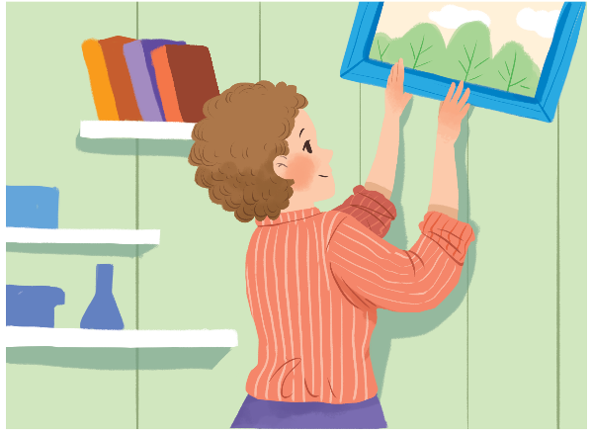
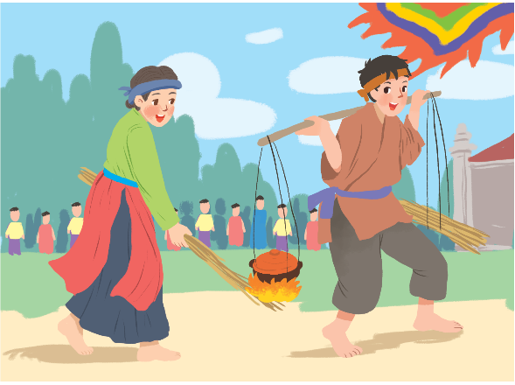
4. Complete the sentences with some or any.
1.
What do you need to decorate your room?
I need colour paper and pictures.
some
some
any
2.
Do you have free time for sports?
Yes, I do.
any
3.
Are there interesting activities here during Tet?
Yes, there are traditional games like human chess, running and cooking.
some

Slide 12
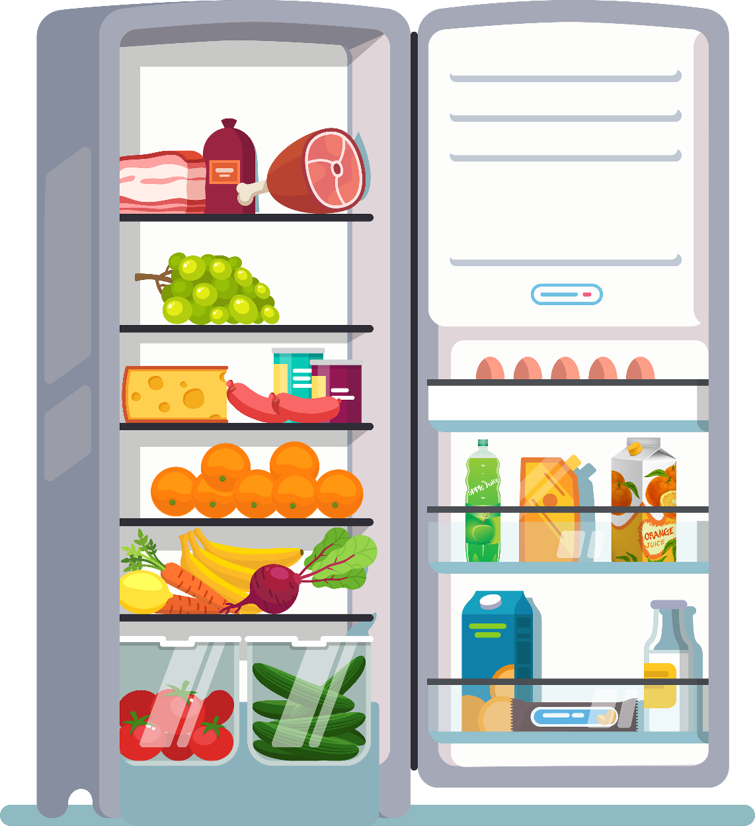
5. Work in pairs. Look at the fridge. Make sentences with the words / phrases provided, using some or any.
Example:
ice cream
There is not any ice cream.
cucumbers
There are some cucumbers.

Slide 13
5. Work in pairs. Look at the fridge. Make sentences with the words / phrases provided, using some or any.
1.
eggs
There are some eggs (in the fridge).
2.
fruit juice
There is some fruit juice.
3.
apples
There aren’t any apples.
4.
bread
There isn’t any bread.
5.
bananas
There are some bananas.
6.
cheese
There is some cheese.

Slide 14
What have we learned today?
Notes:
Use should/shouldn’t for advice
Use some (+)/any(-)(?) for amount

