Slide 1

WELCOME TO OUR CLASS!
Teacher: Vu Thi Trang

Slide 2
LET’S LISTEN
https://suno.com/s/5RV5O89ifFZ5mt4A

Slide 3
Unit 3
MY FRIENDS
Lesson 2: A Closer Look 1

Slide 4

OBJECTIVES
By the end of the lesson, students will be able to:
1
VOCABULARY
use the words about Personality.
2
PRONUNCIATION
correctly pronounce the sounds: /b/ and /p/

Slide 5
Vocabulary

Slide 6
GUESSING WORD
Look at the pictures and guess the words

Slide 7
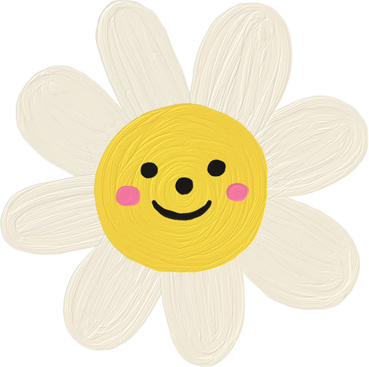
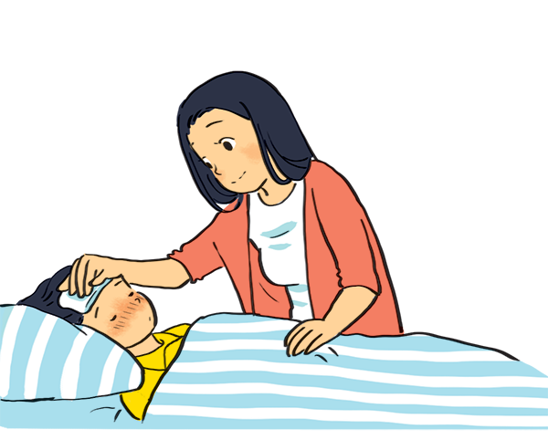

caring
i
n
g
c
a
r

Slide 8
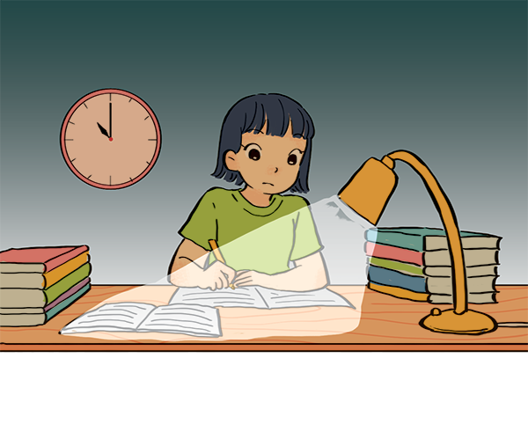

hard - working
d
r
h
a
k
i
n
g
w
o
r

Slide 9
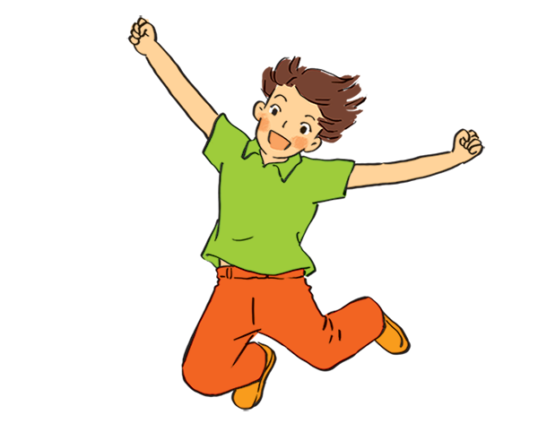
active
t
i
v
e
a
c

Slide 10
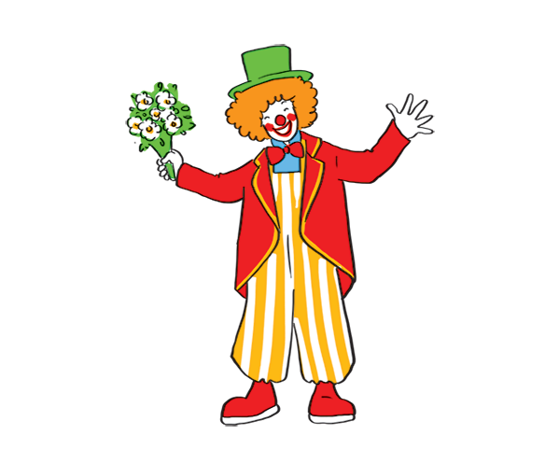
funny
y
n
f
u
n

Slide 11
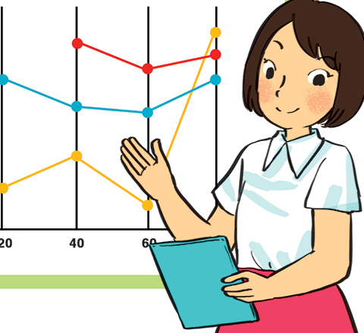
confident
d
e
n
t
f
i
c
o
n

Slide 12
Look at the words again
hard - working
confident
funny
caring
active

Slide 13
VOCABULARY
- hard-working (adj) | /ˌhɑːd ˈwɜːkɪŋ/ | chăm chỉ
- confident (adj) | /ˈkɒnfɪdənt/ | tự tin
- funny (adj) | /ˈfʌni/ | hài hước, vui vẻ
- caring (adj) | /ˈkeərɪŋ/ | quan tâm, chăm sóc
- active (adj) | /ˈæktɪv/ | năng động

Slide 14
Practice

Slide 15
2. Use the adjectives in the box to complete the sentences.
careful
shy
creative
clever
kind
friendly
1. Mina is very __________. She likes drawing pictures. She always has lots of new ideas.
2. Nam is __________. He likes helping his friends.
3. Minh Duc is __________. He likes meeting new people.
4. Kim is very _______. She pays attention to what she's doing.
5. Mai is __________. She learns things quickly and easily.

Slide 16

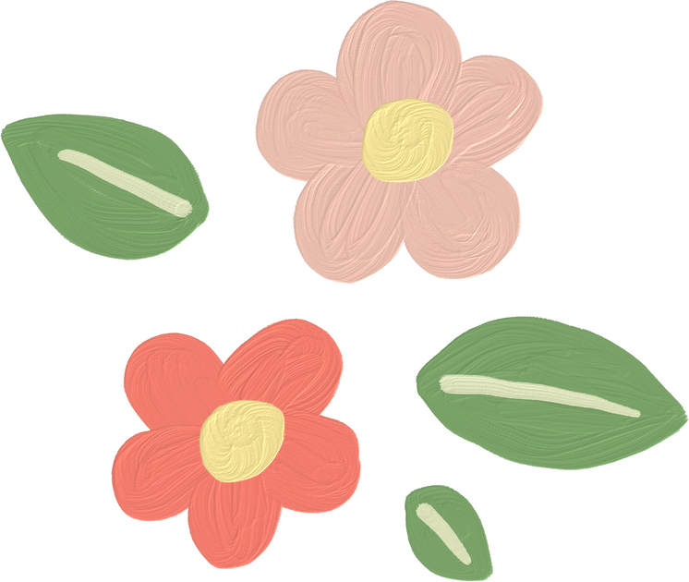

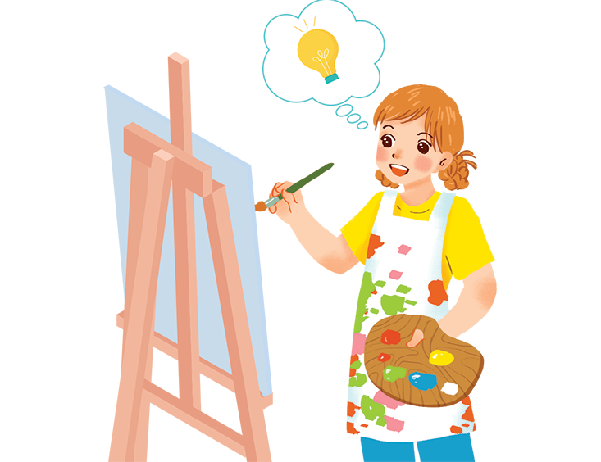

2. Use the adjectives in the box to complete the sentences.
careful
shy
creative
clever
kind
friendly
1. Mina is very __________. She likes drawing pictures. She always has lots of new ideas.

Slide 17
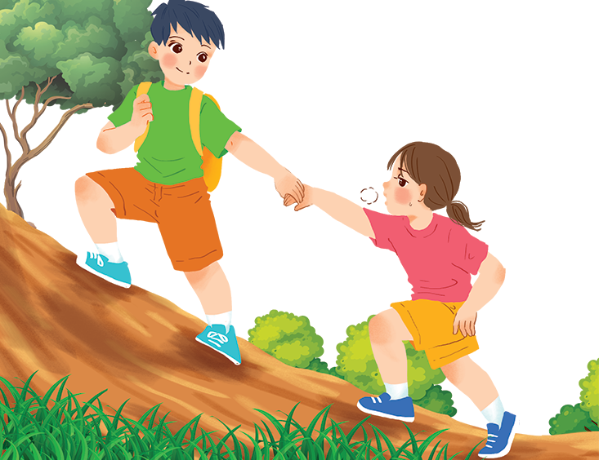
2. Use the adjectives in the box to complete the sentences.
careful
shy
clever
kind
friendly
2. Nam is __________. He likes helping his friends.

Slide 18
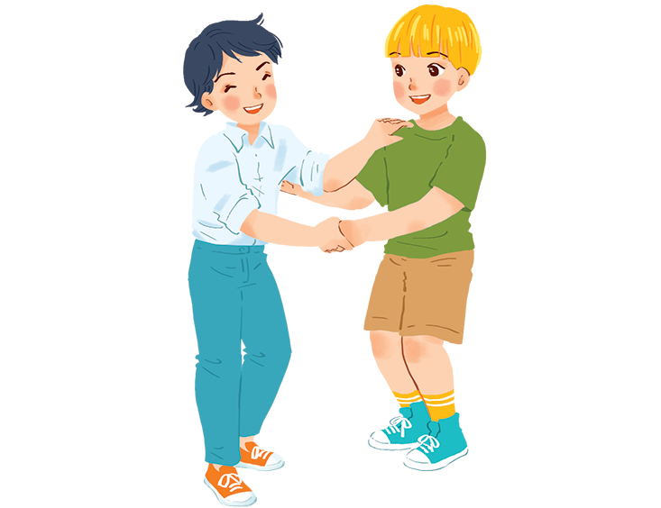
2. Use the adjectives in the box to complete the sentences.
careful
shy
clever
friendly
3. Minh Duc is __________. He likes meeting new people.

Slide 19
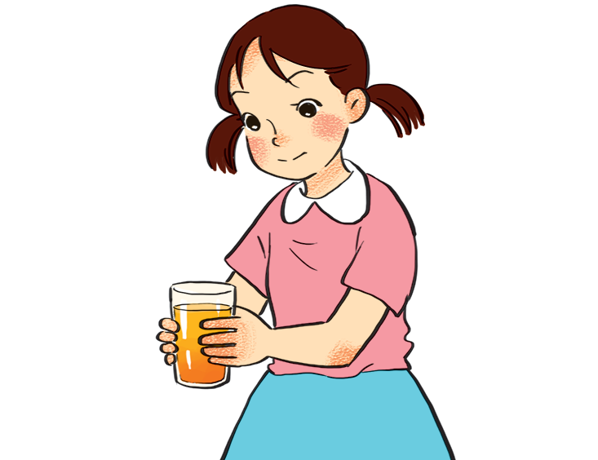
2. Use the adjectives in the box to complete the sentences.
careful
shy
clever
4. Kim is very __________. She pays attention to what she's doing.

Slide 20
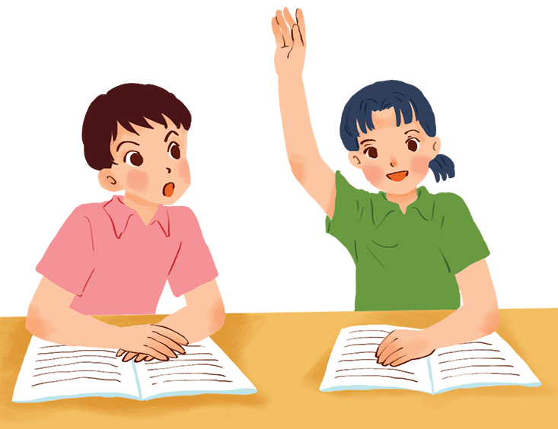
2. Use the adjectives in the box to complete the sentences.
shy
clever
5. Mai is __________. She learns things quickly and easily.

Slide 21
Look at the answers again.
1. Mina is very __________. She likes drawing pictures. She always has lots of new ideas.
2. Nam is __________. He likes helping his friends.
3. Minh Duc is __________. He likes meeting new people.
4. Kim is very __________. She pays attention to what she's doing.
5. Mai is __________. She learns things quickly and easily.
creative
kind
friendly
careful
clever

Slide 22

How well do you know your friends?
Groups of 5-6
Write 2 adjectives for each group member
(Example: Minh - friendly & clever)

Slide 23
Pronunciation

Slide 24
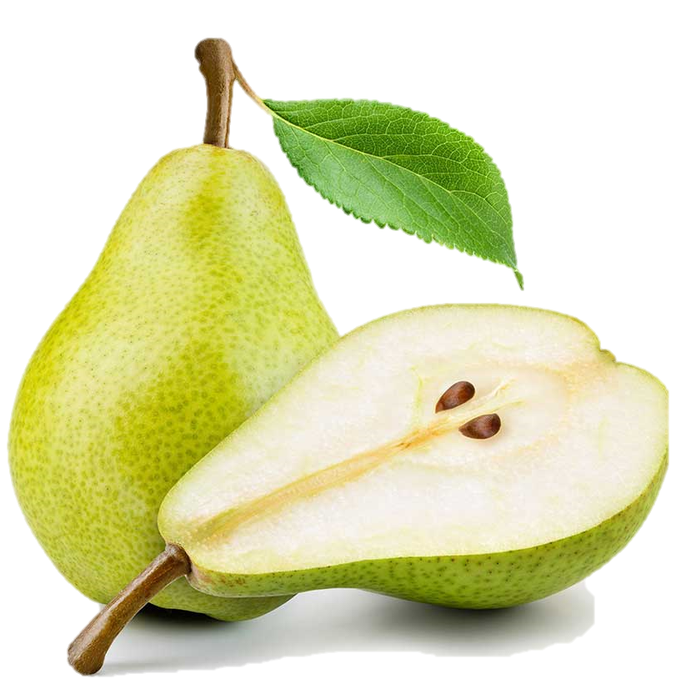
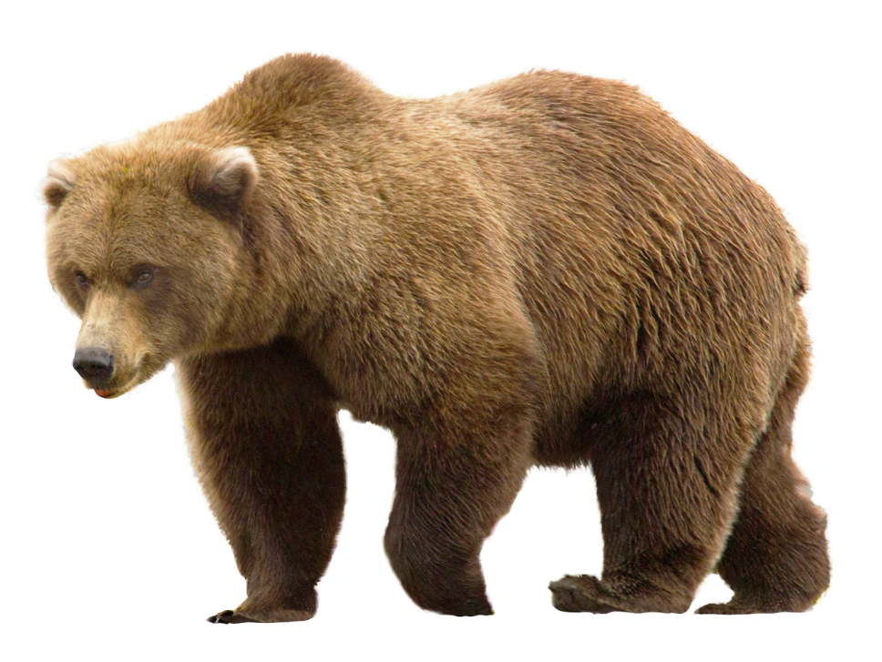
/b/ and /p/
bear
pear
/b/
/p/

Slide 25
Watch a video. Pay attention to the sounds /b/ and /p/

Slide 26
/b/ | /p/
big | pig
bear | pear
buy | pie
robe | rope
4. Listen and circle the words you hear. Then repeat.

Slide 27
5. Listen. Then practice the chant. Notice the rhyme.
We're having a picnic
We're having a picnic
Fun! Fun! Fun!
We're bringing some biscuits
We're bringing some biscuits
Yum! Yum! Yum!
We're playing together
We're playing together
Hurrah! Hurrah! Hurrah!

Slide 28
Wrap-up
T
H
A
N
K
S
What have we learnt in this lesson?
Vocabulary: The adjectives about personality
Pronunciation: The sounds /b/ and /p/ in words and sentences

Slide 29
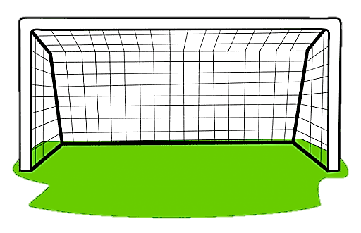
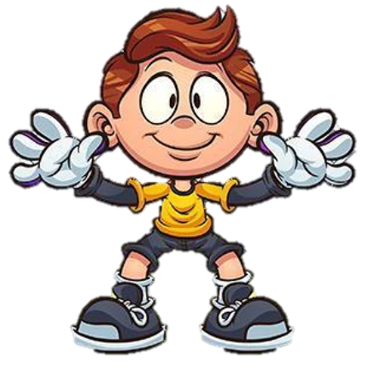

1. I’m not very ____ at Maths. I often make mistakes in calculators.
A. kind
B. creative
C. clever

Slide 30
2. Everyone is _____ to me. They often help me when I need.
A. kind
B. confident
C. funny

Slide 31
3. She is often _____ at school, she always gets good marks.
A. friendly
B. hard - working
C. shy

Slide 32
4. Choose the word which is pronounced differently from the rest.
A. chubby
B. pole
C. pig

Slide 33
5. Choose the word which is pronounced differently from the rest.
A. part
B. best
C. boring

Slide 34

HOMEWORK
- Learn by heart vocabulary
- Practice the sounds b/ and /p/
- Prepare for the next lesson: A Closer Look 2

Slide 35

THANK YOU!

