Slide 1

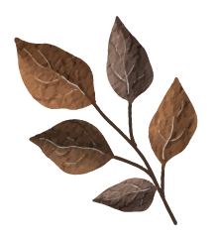





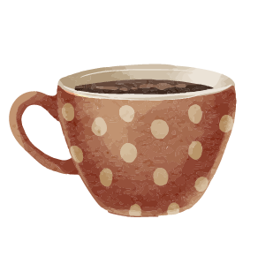
Unit 6
Lifestyles
LESSON 5: SKILLS 1

Slide 2


OBJECTIVES
Knowledge
Competences
- Read about Alaska;
- Talk about how people in their area maintain traditional lifestyles;
- Develop communication skills, teamwork skills and creativity

Slide 3
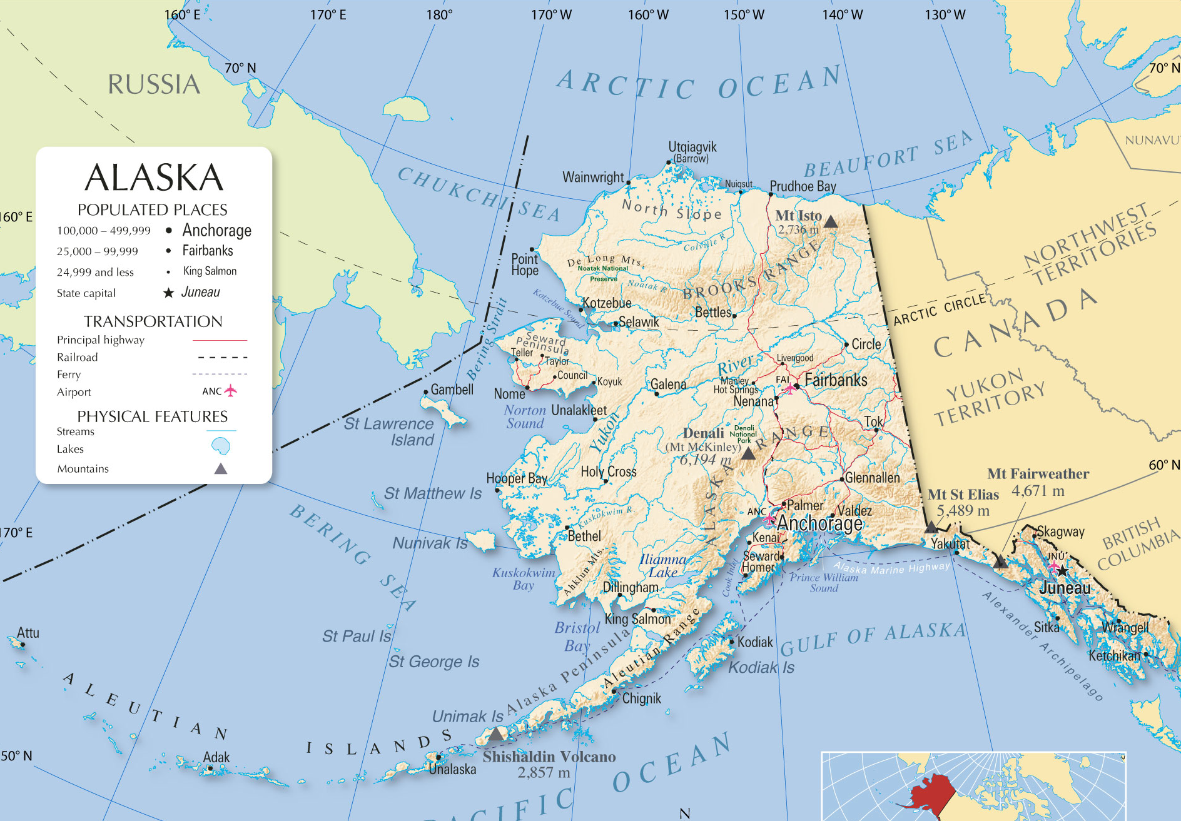
1. Which America state located between Canada and Russia is….
Alaska

Slide 4

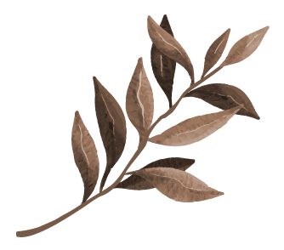
01
Reading
ALASKA

Slide 5



Let’s talk about Alaska
1. Work in groups. Look at the picture, and discuss what you know about Alaska.
Location?
Climate?
Native people?
Area?
Culture?
Northwest of North America
Oceanic climate, very cold
Alaskan Natives
1.7 km2
Tribal dance, drumming, native arts and crafts,…
Read the text and check your answers!
Notes:
+ Alaska: a state of the US (49th)
+ location: northwest of North America
+ population: over 700,000
+ climate: oceanic climate, very cold (ôn đưới hải dương)
+ native people: Alaskan Natives
+ languages: English 86.3%, Alaska Native languages

Slide 6
2. Match the highlighted words in the text with their meanings.
If you go to the American state of Alaska, you might find the traditional lifestyle there interesting. Although Alaska is quite large, with nearly 1.7 million square kilometres, it has a small population of about 730,000.
The native peoples in Alaska still maintain many of their traditions. They keep their old ways of making arts and crafts alive. Various native groups have their own special styles of carving or weaving as well as their unique tribal dances and drumming. Therefore, visitors to Alaska may experience some of their culture in their villages. They may see performances of traditional music and native art in galleries and museums.
Alaska is also known for its unusual method of transport - the dogsled. Today, dog sledding (= mushing) is more of a sport than a true means of transport. The best-known race is the Iditarod Trail Sled Dog Race, a 1,510 km race from Anchorage to Nome. Mushers from all over the world come to Anchorage each March to compete for cash and prizes.

Slide 7
2. Match the highlighted words in the text with their meanings.
1. maintain | a. Particular way of doing something
2. styles | ﻿b. people who drive dogs
3. experience | c. To do or feel something
4. musher | ﻿d. to keep, make something continue

Slide 8

Vocabulary
New words | Pronunciation | Meaning
1. maintain (v) | ﻿/meɪnˈteɪn/ | ﻿duy trì, gìn giữ
2. experience (v) | ﻿/ɪkˈspɪəriəns/ | ﻿trải nghiệm
3. style (n) | /﻿staɪl/ | phong cách
4. musher (n) | ﻿/ˈmʌʃə/ | ﻿người điều khiển xe trượt tuyết chó kéo

Slide 9
3. Read the text again and answer the questions.
﻿1. What is the population of Alaska?
﻿→ It is about 730,000 / 730 thousand.
2. Who have special styles of carving or weaving?
→ ﻿Various native groups have their own special styles of carving or weaving
3. Where can we find the culture of the native peoples in Alaska?
→ ﻿We can find it in their villages.
“Although Alaska is quite large, with nearly 1.7 million square kilometres, it has a small population of about 730,000.”
“Various native groups have their own special styles of carving or weaving as well as their unique tribal dances and drumming.”
“Therefore, visitors to Alaska may experience some of their culture in their villages..”

Slide 10
3. Read the text again and answer the questions.
﻿4. How long is the Iditarod Trail Sled Dog Race?
﻿→ It is 1,510 km (long).
5. Is the Iditarod Trail Sled Dog Race an international competition?
→ ﻿﻿Yes, it is.
“The best-known race is the Iditarod Trail Sled Dog Race, a 1,510 km race from Anchorage to Nome..”
“Mushers from all over the world come to Anchorage each March to compete for cash and prizes.”

Slide 11
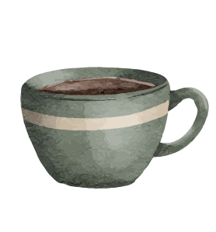
02
Speaking
Maintaining our traditional lifestyle

Slide 12
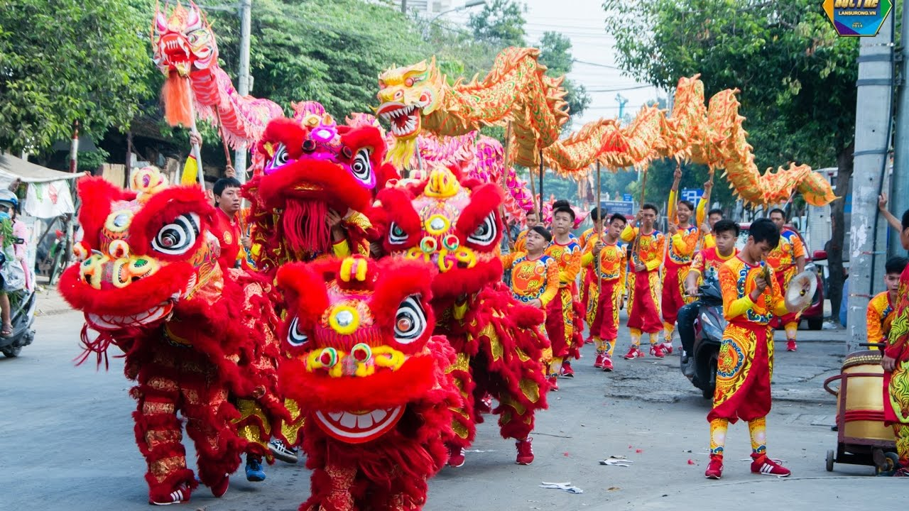
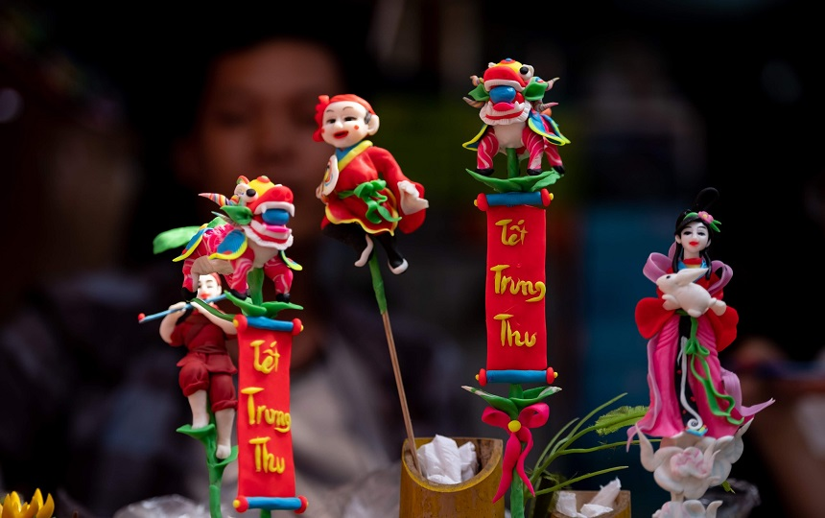
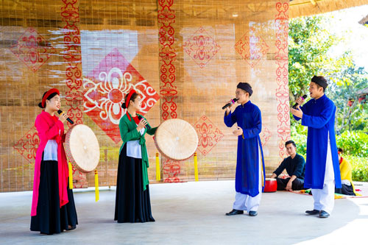
4. Work in pairs. Look at the pictures and use the cues to talk about what people in some places do to maintain their traditional lifestyle.
1. Chau An Village
2. Dam Vi Village
3. Son Ca Village
- Performing traditional dances
- Holding festivals
- Cooking and selling traditioanl food
- Making crafts
- Weaving clothing
- Singing folk songs

Slide 13
4. Work in pairs. Look at the pictures and use the cues to talk about what people in some places do to maintain their traditional lifestyle.
1. Chau An Village
SAMPLE
- Performing traditional dances
- Holding festivals
A: What do people in Chau An Village do to maintain their traditional lifestyle?
B: They perform traditional dances.

Slide 14
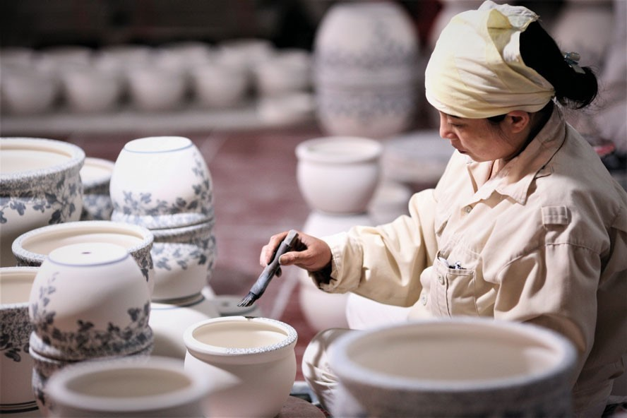
5. Work in pairs. Ask and answer about how people in your area maintain their traditional lifestyle. You can use the ideas in 4 and the reading text in 1.
SAMPLE
I live in Bat Trang, which is a pottery village not far from Ha Noi centre. To maintain the traditional lifestyle, local people will make pottery and paint on the ceramic statues. Then they will sell those pottery products to tourists. For me, it’s a great way for us to maintain our traditions yet still make ends meet.
Notes:
Encourage students to make a short talk instead of a conversation.

Slide 15
4. Work in pairs. Look at the pictures and use the cues to talk about what people in some places do to maintain their traditional lifestyle.
Sample analysis
1. place
2. Activities
3. Feelings
- Bat Trang: a pottery village not far from Ha Noi centre.
- Make pottery and paint on the ceramic statues. T
- Sell those pottery products to tourists.
a great way for us to maintain our traditions yet still make ends meet.

Slide 16
Present time
Maintaining our traditional lifestyle

Slide 17
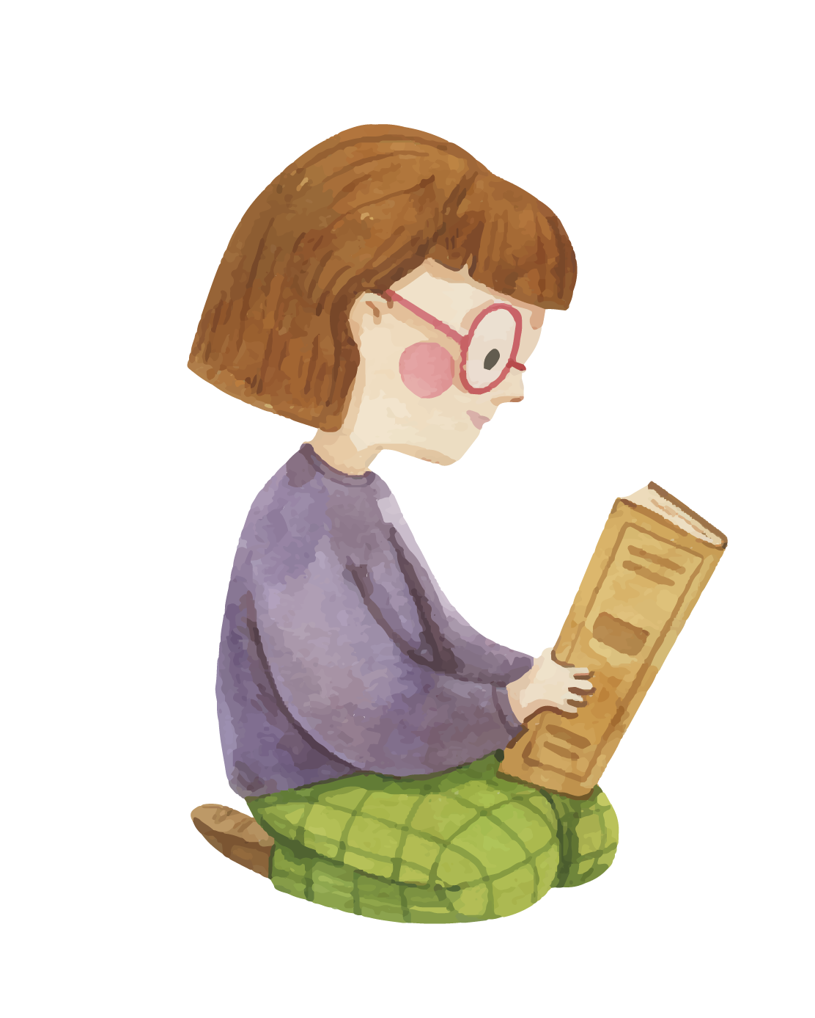
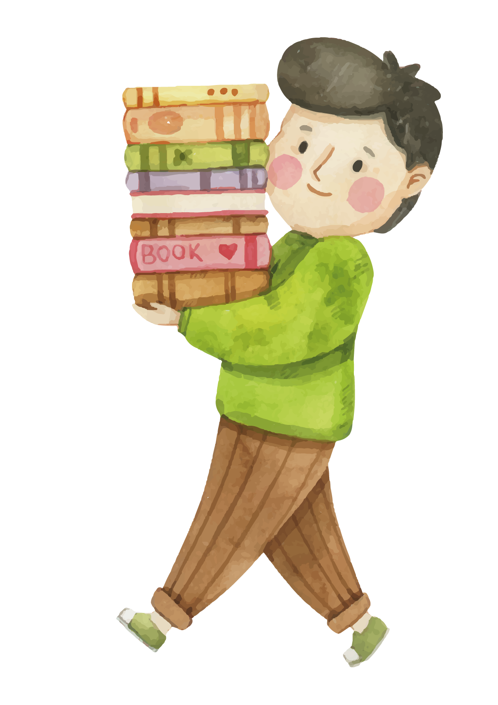
Let’s recap!
What have we learnt today
Reading
Speaking
Alaska
Maintaining our traditional lifestyle

Slide 18
03
Homwork:
Workbook part …
Thanks for listening!

