Slide 1

WELCOME TO OUR CLASS!
Teacher: …………………….

Slide 2
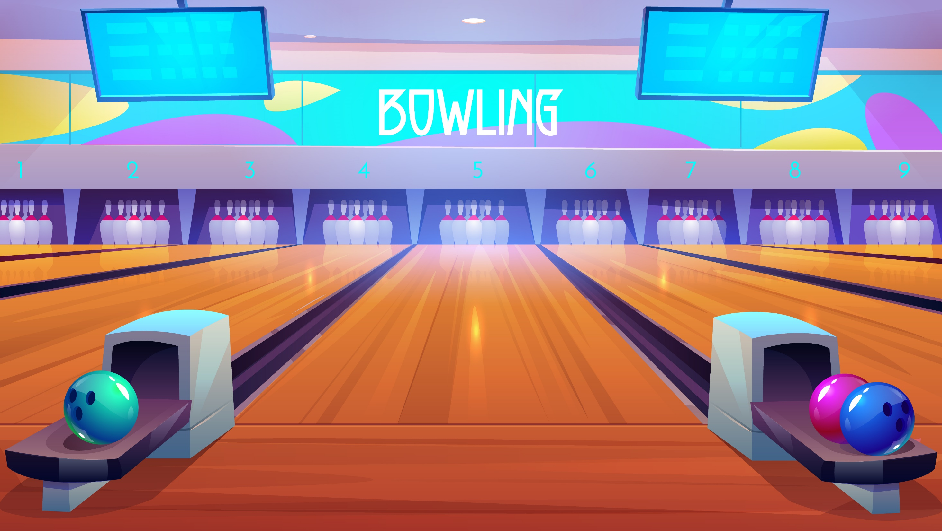
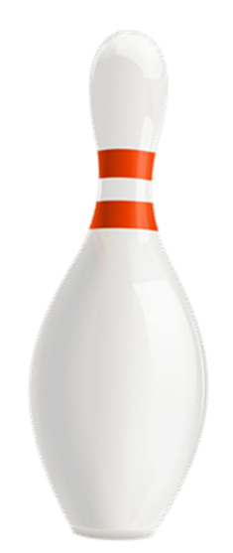



Slide 3
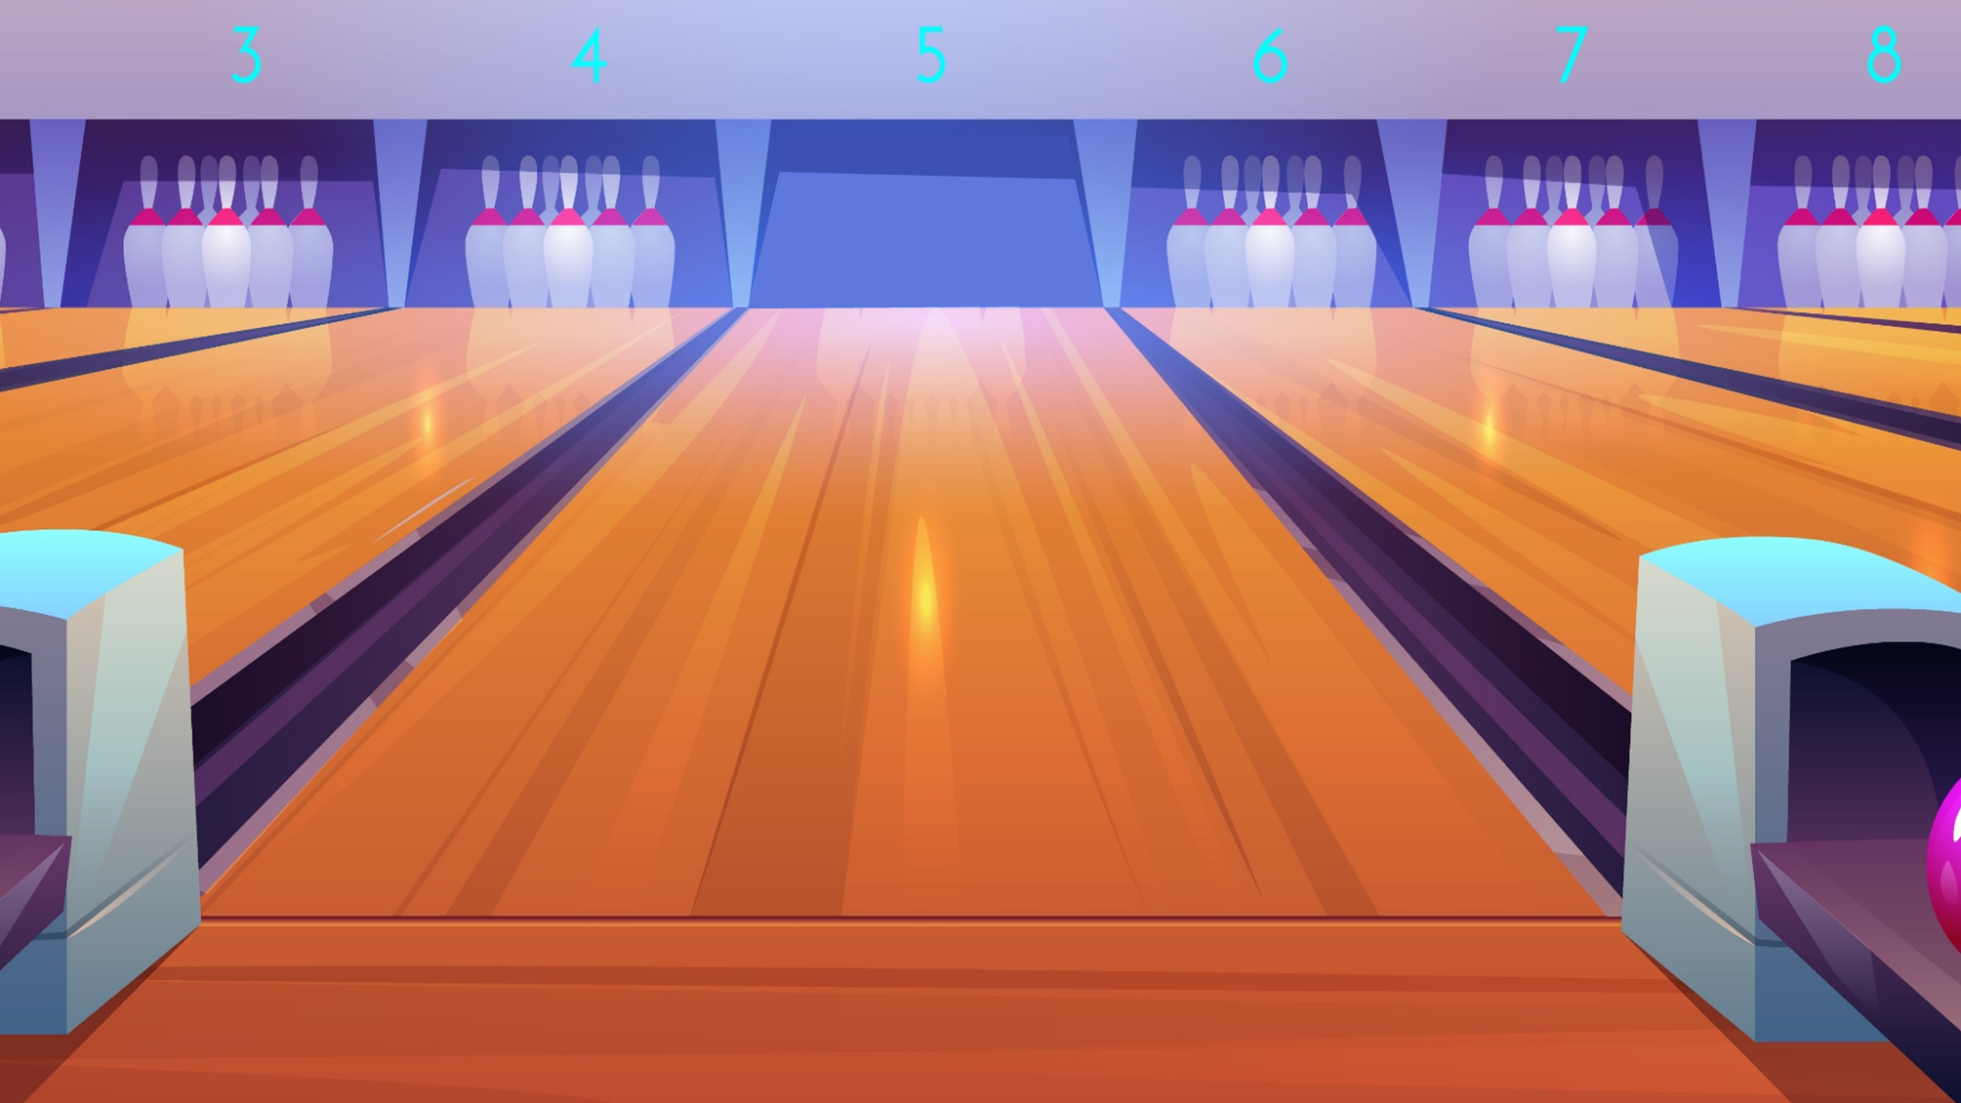

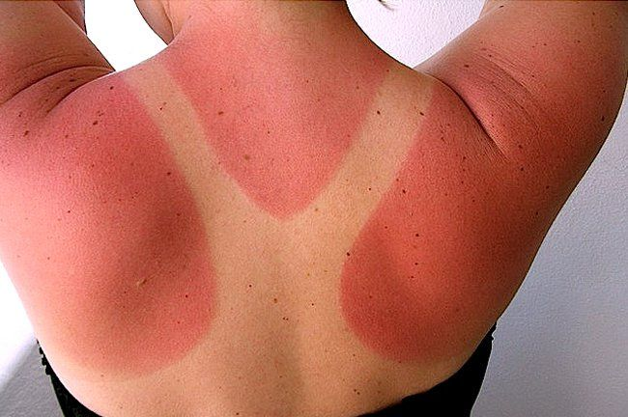


a. sunburn
b. suncream
Câu hỏi 1
c. chapped skin

Slide 4

a. suncream
b. vegetables
Câu hỏi 2
c. lip balm
Next

Slide 5
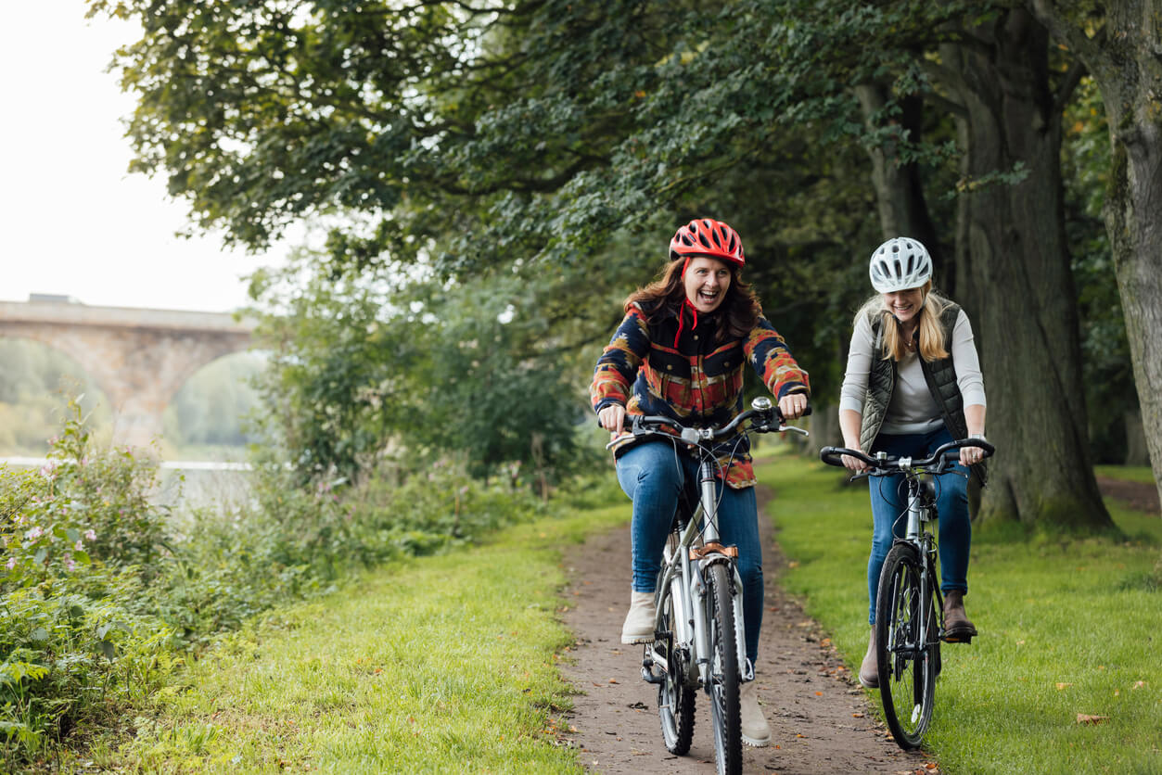
a. boating
b. cycling
Câu hỏi 3
c. jogging
Next

Slide 6
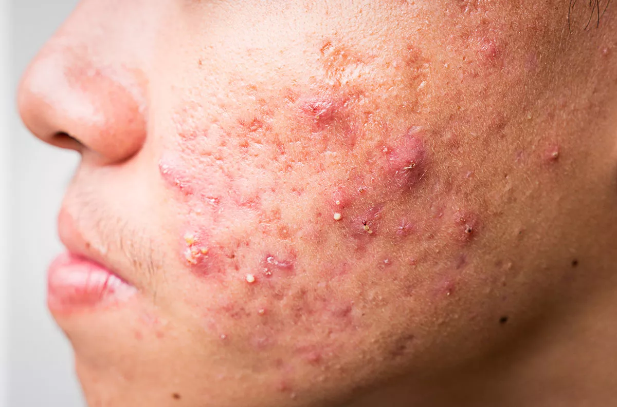
a. sunburn
b. chapped lip
Câu hỏi 1
c. acne

Slide 7

EXIT

Slide 8
Unit 2: HEALTHY LIVING
Lesson 7: Looking back

Slide 9
01
Vocabulary review

Slide 10
1. Complete the sentences with the verbs below.
are
avoid
affects
keep
exercise
keep
1. Healthy food and exercise help people ______________ fit.
2. Weather that is too cold or too hot ___________ your skin condition.
3. Children should ____________ fast food and soft drinks.
4. Bad habits like eating too much sweetened food and going to bed late ____________ harmful to our health.
5. We can _____________ indoors and outdoors.
affects
avoid
are
exercise

Slide 11
2. Write the words below next to their definitions
fit
dirty
tidy
healthy
active
1. always busy doing things, especially physical activities 2. good for your health 3. everything in order 4. in good shape 5. not clean
active
healthy
tidy
fit
dirty

Slide 12
02
Grammar review

Slide 13
3. Tick the simple sentences.
1. Asians eat a lot of rice, but Europeans don’t.
2. Most children love fast food and soft drinks.
3. There is a lot of fresh air in the countryside.
4. Eat less sweetened food, and you won't put on weight.
5. Hard-working people often stay fit.
S₁ V₁ S₂ V₂
✓
S V
✓
S V
S₁ V₁ S₂ V₂
✓
S V

Slide 14
4. Change the following sentences into simple ones.
1. You are active, and your brother is active too.
→ Both you and ______________________________.
2. Your room looks dark, and it looks untidy too.
→ Your room _________________________________.
3. The Japanese work hard, and they exercise regularly.
→ The Japanese _______________________________.
4. My mother eats a lot of fruit, and she eats a lot of vegetables too.
→ My mother eats _____________________________.
your brother are active
looks dark and untidy
work hard and exercise regularly
a lot of fruit and vegetable

Slide 15
Thank you See you next time

