Slide 1

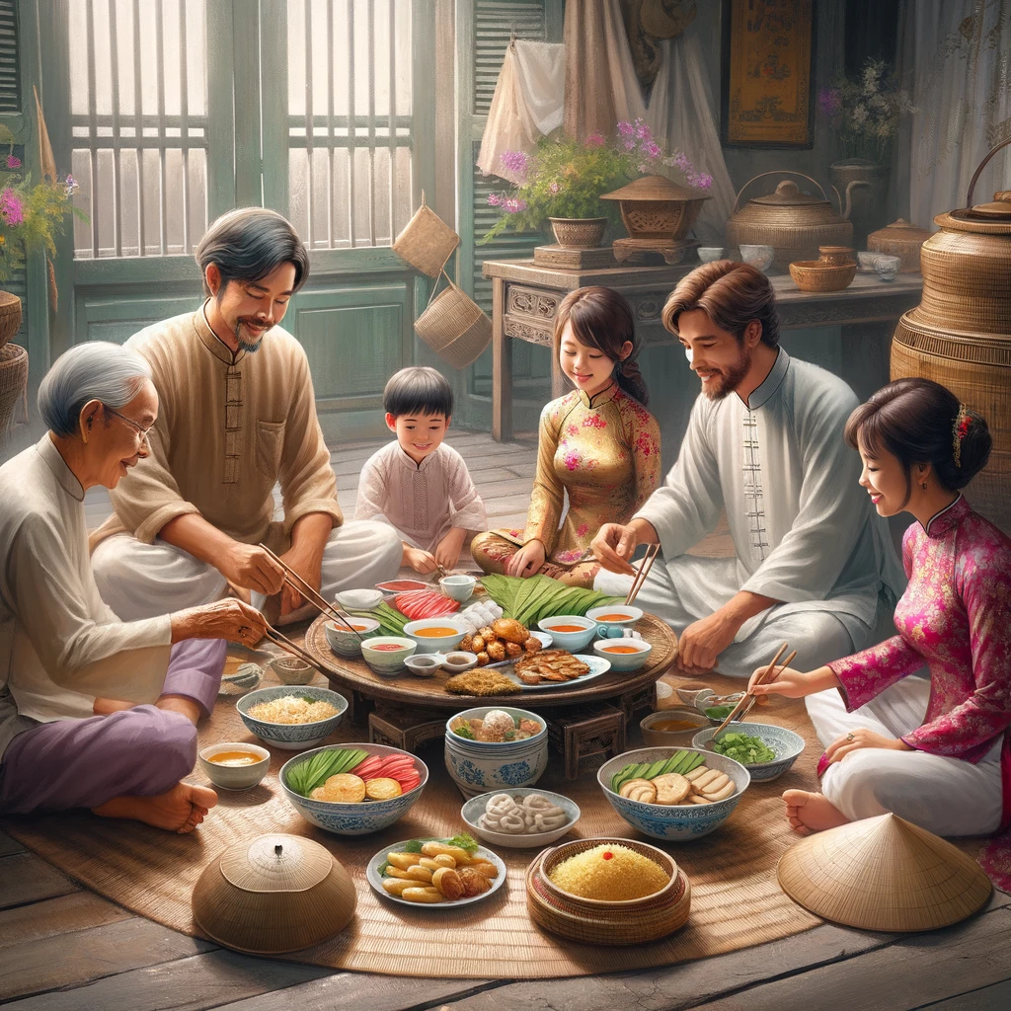
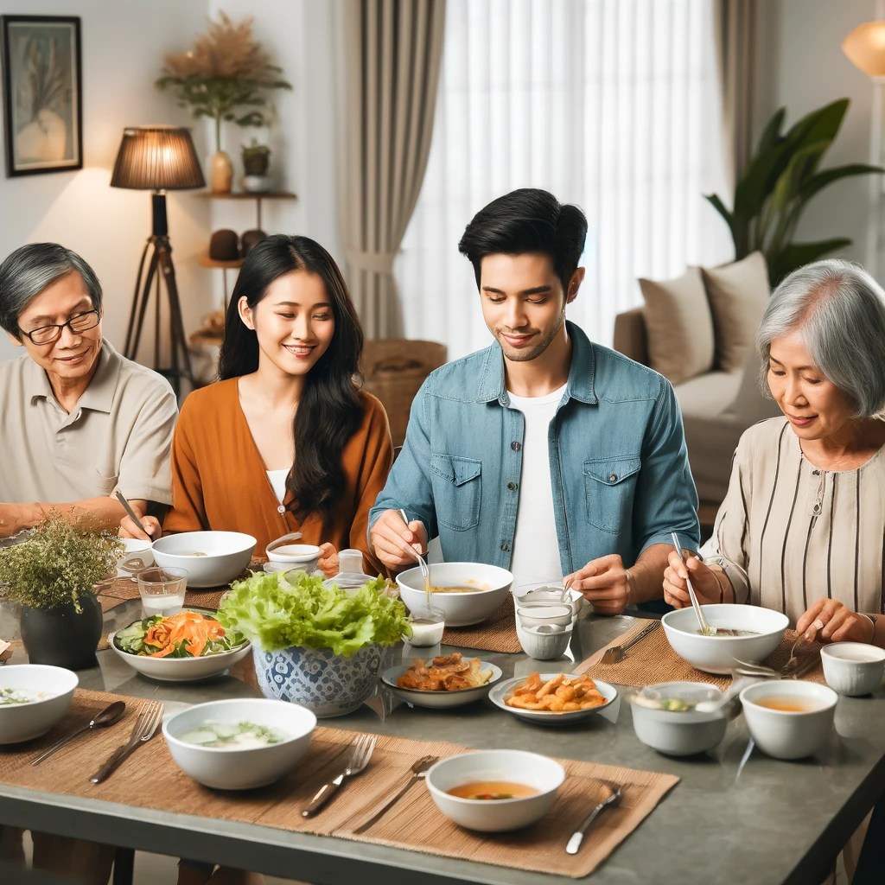
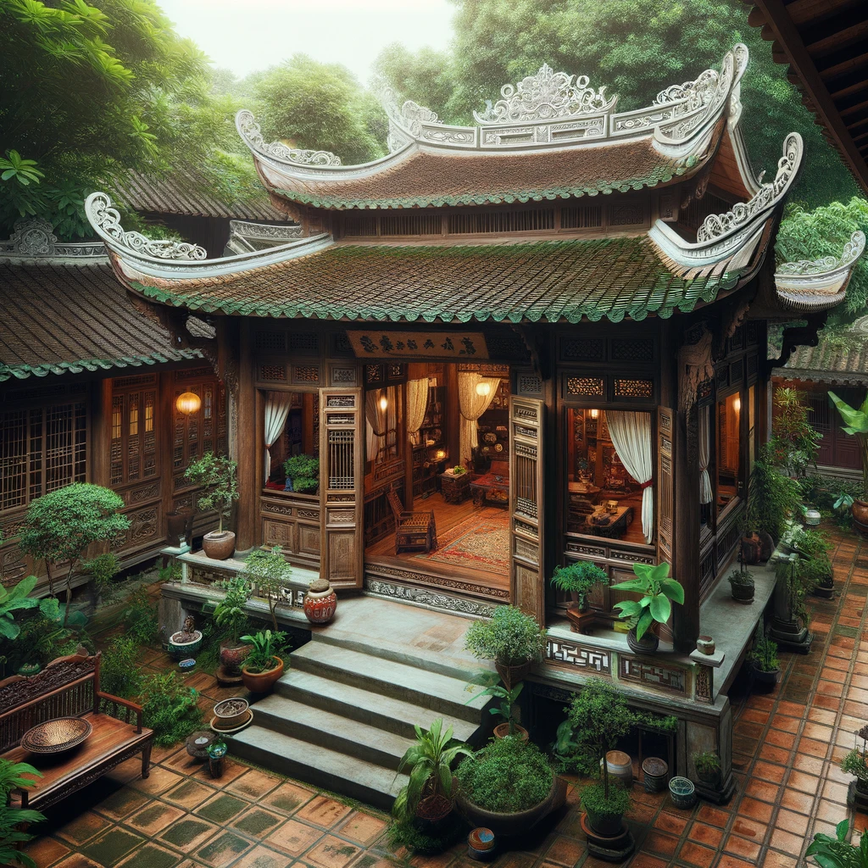
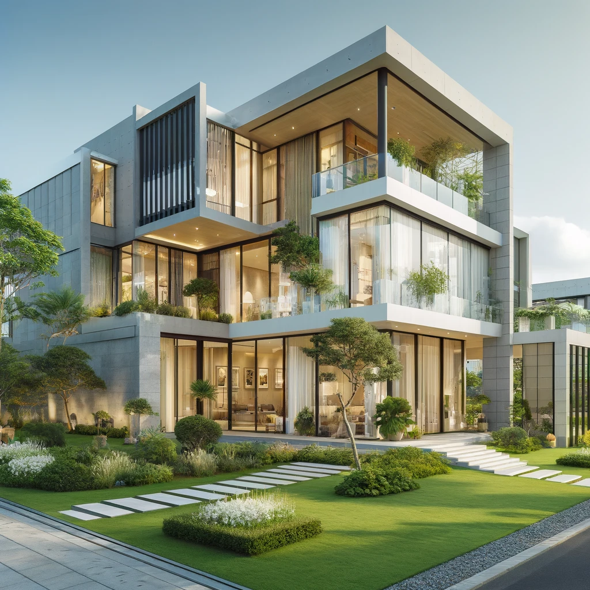
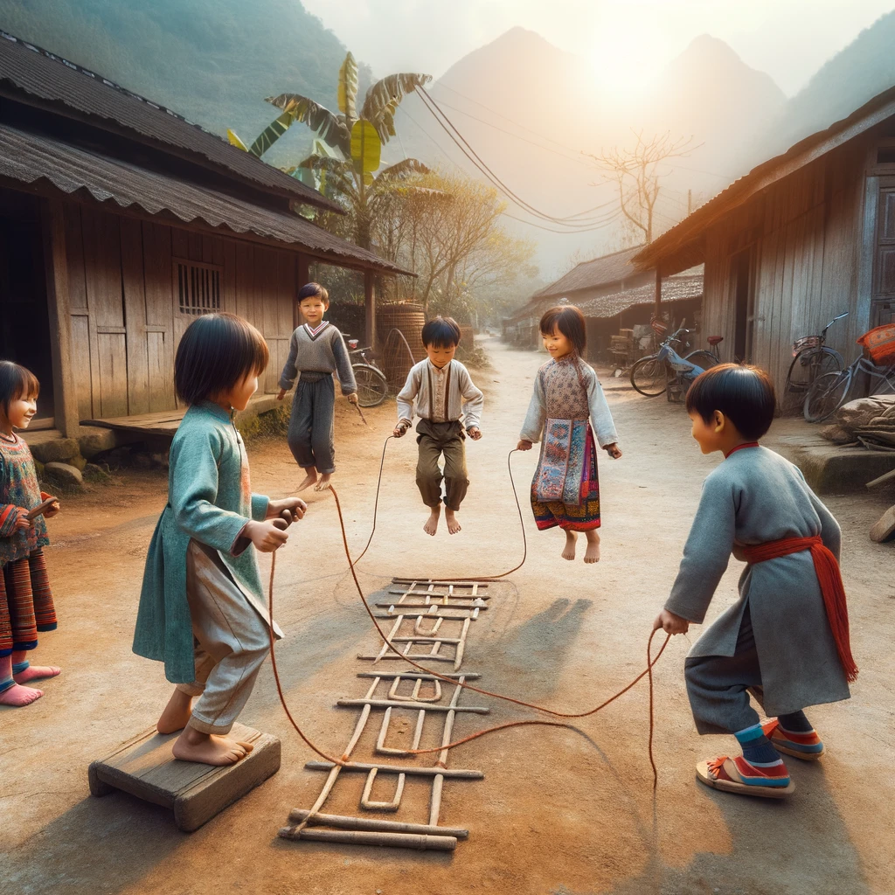
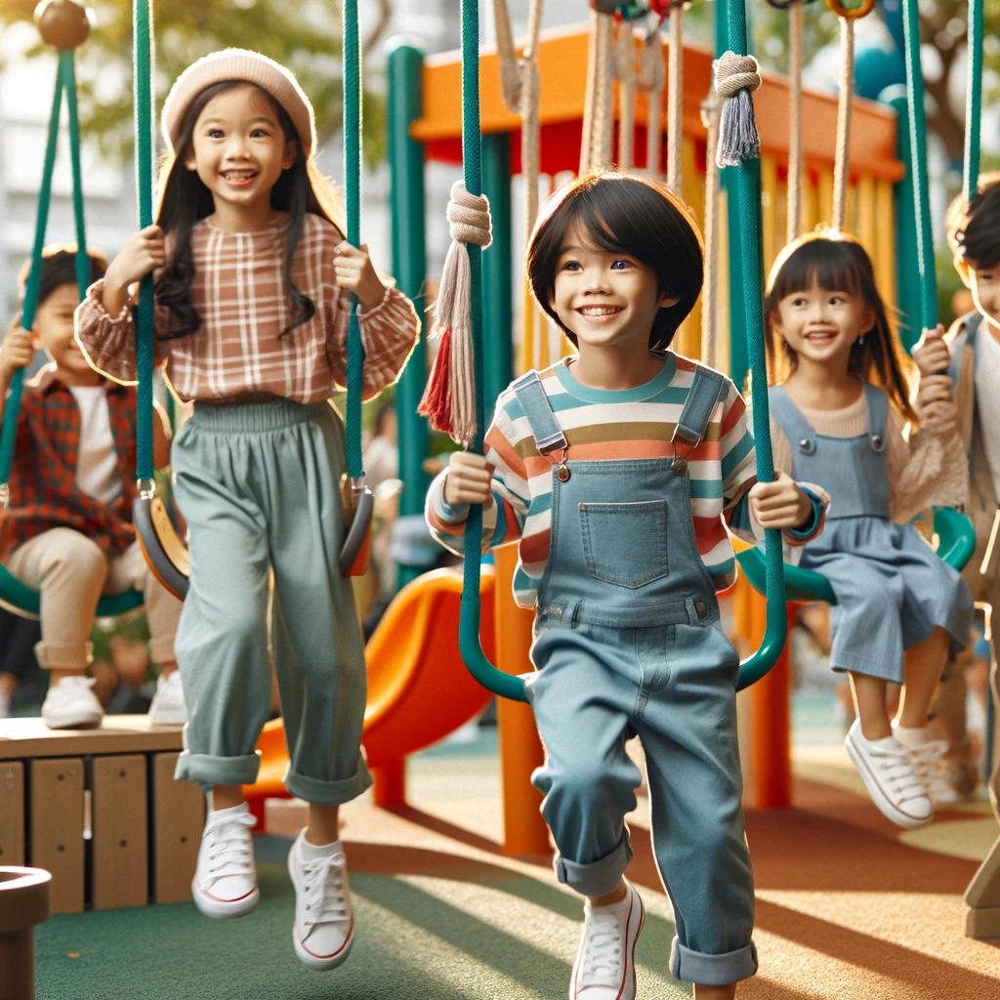
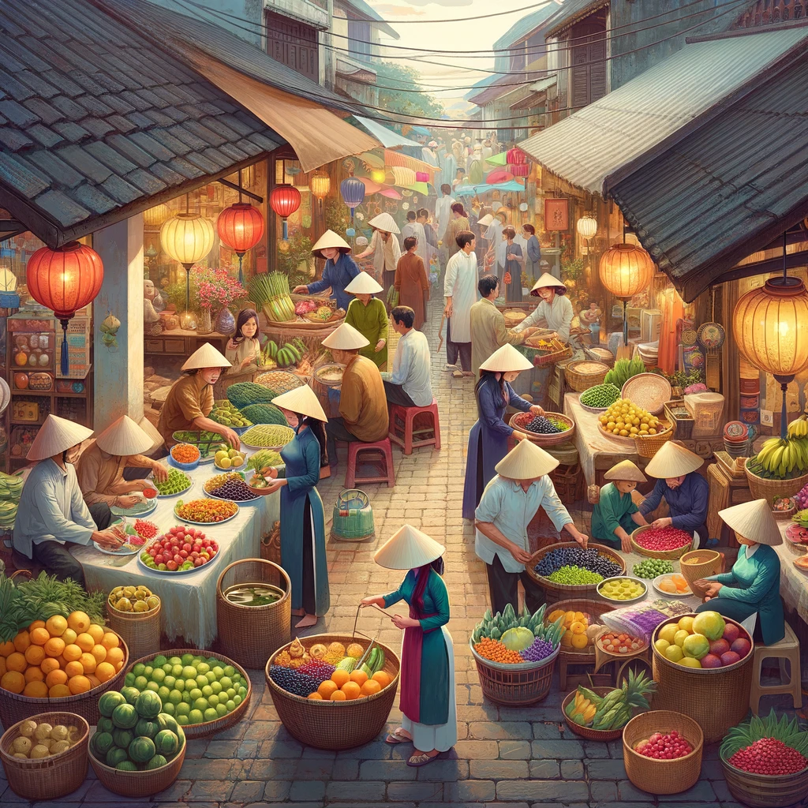
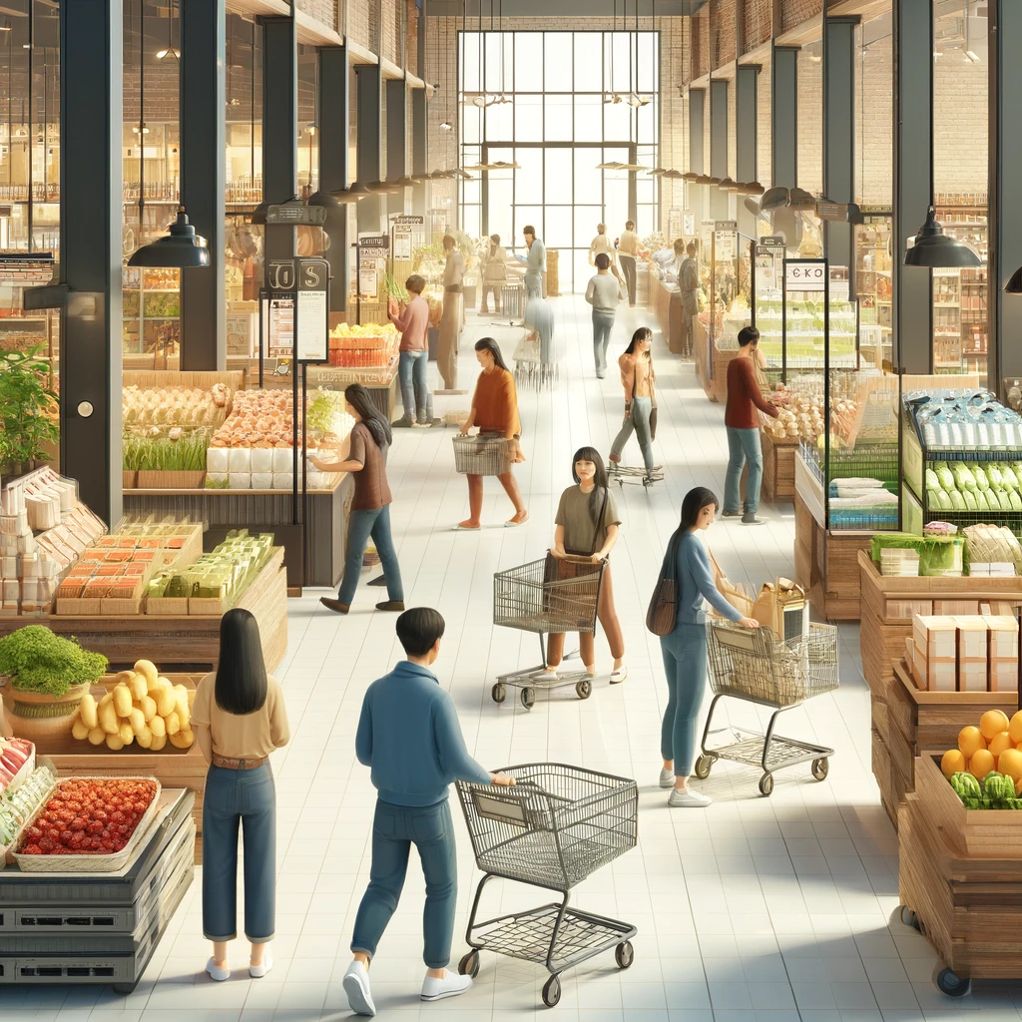
What can you see?
What are some differences you notice between the past and present in these pictures?
Nutrition
Rest
Sport
Mars is actually a very cold place
Venus has extremely high temperatures
Neptune is the farthest planet from the Sun
Stress
Checks
Relationships
Mercury is the closest planet to the Sun
Saturn is a gas giant and has several rings
Jupiter is the biggest planet of them all

Slide 2
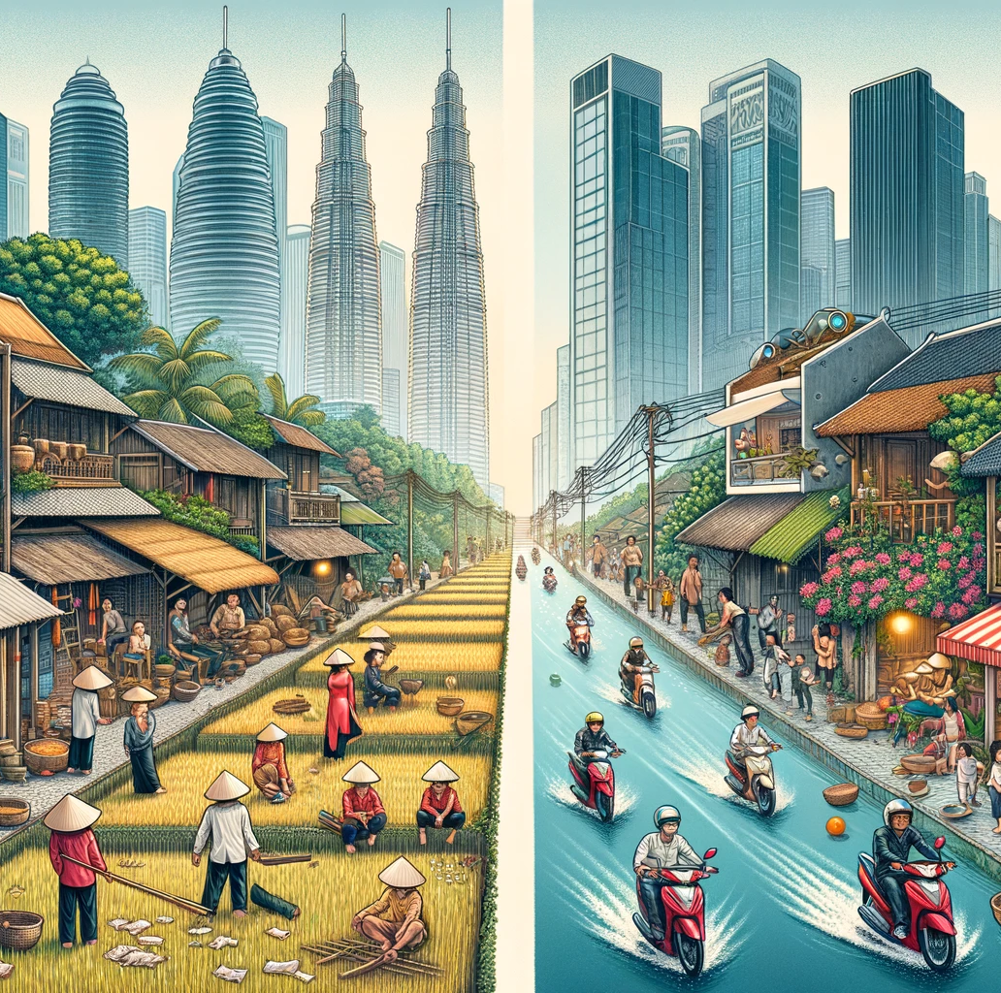
Unit 6.
Vietnamese lifestyle: then and now
9th grade
Lesson 1. Getting started

Slide 3
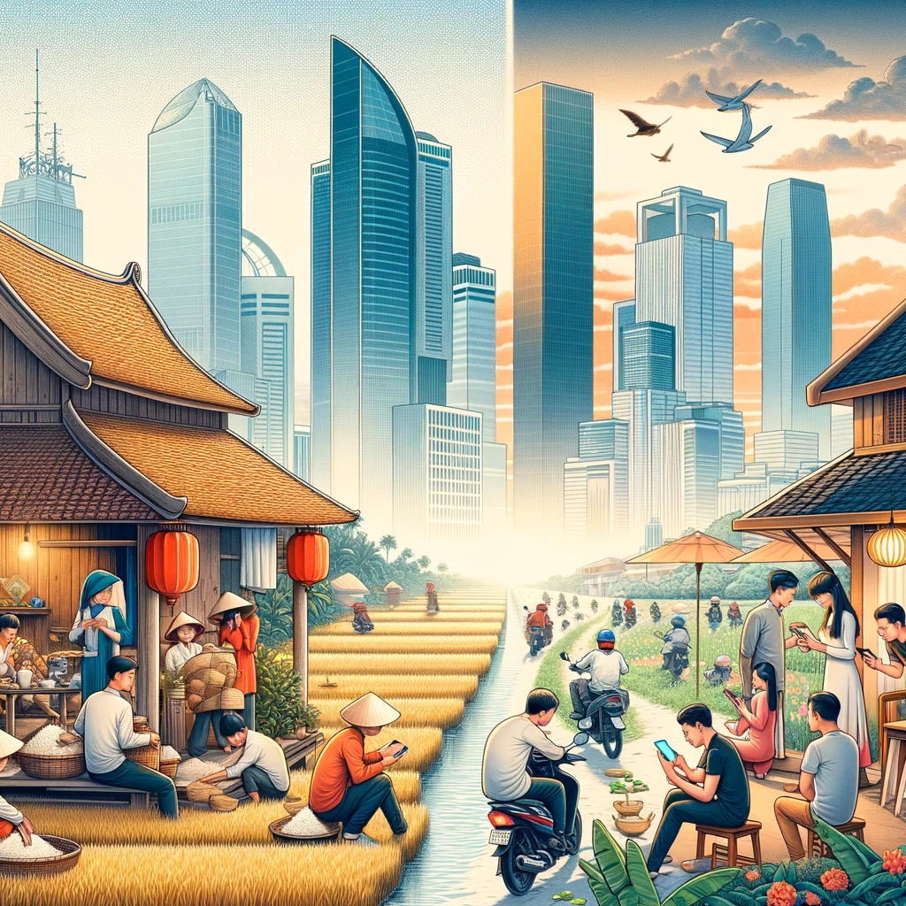
Objectives
01
02
Use the words related to lifestyle
Gain vocabulary to talk about changes in lifestyle

Slide 4
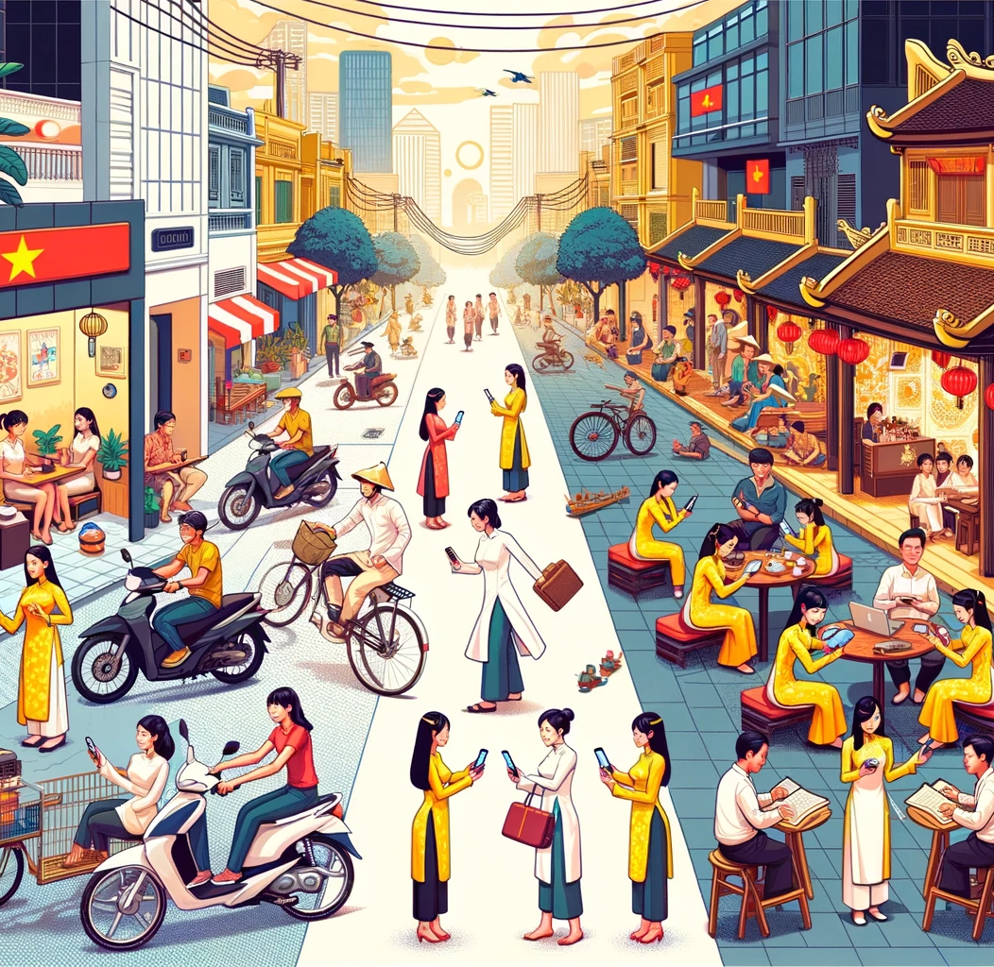
Vocabulary
Do you mind + V-ing?
= Would you mind + V-ing?
Bạn có phiền…?
Do you mind telling me how our lives are different from yours in the past?

Slide 5

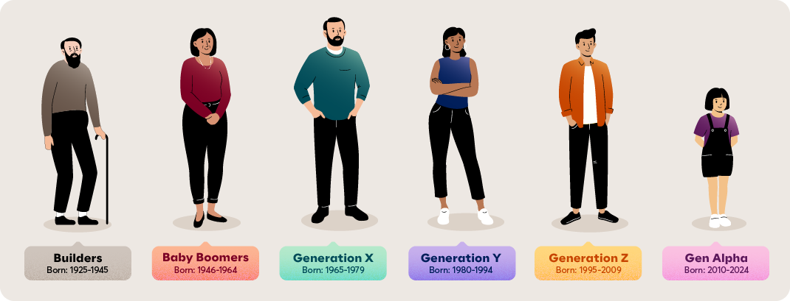
generation (n)
Vocabulary
all the people of about the same age within a society
/ˌdʒenəˈreɪʃn/
thế hệ

Slide 6

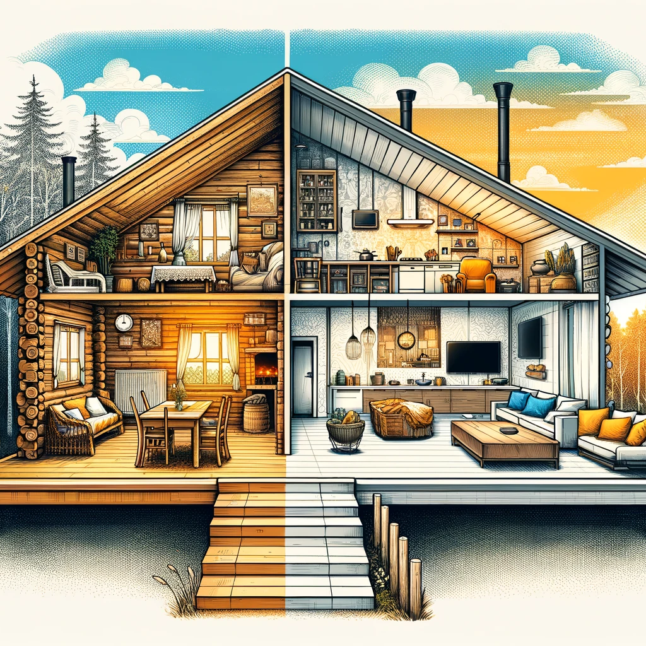
living condition
= standard of living
/ˈlɪvɪŋ kənˈdɪʃənz/
điều kiện sống

Slide 7
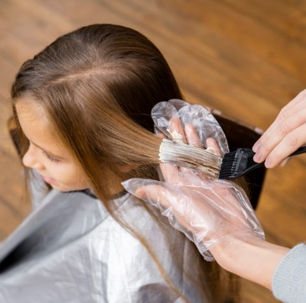
dye (v)
to change the colour of sth using a special liquid.
/daɪ/
nhuộm

Slide 8
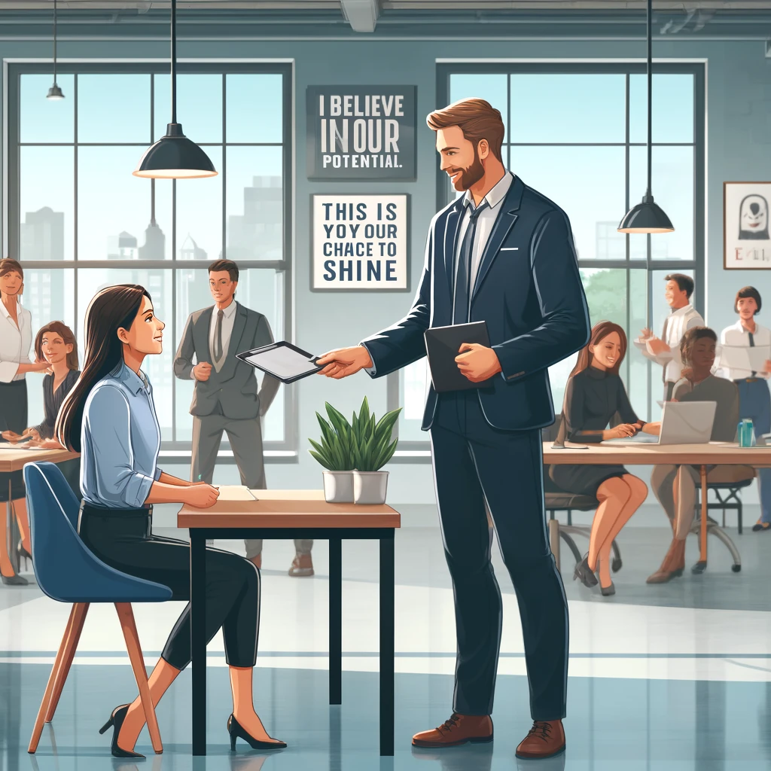
opportunity (n)
Because you deserve this project.
= chance (n)
/ˌɒpəˈtjuːnəti/
cơ hội

Slide 9
opportunity (n)
New words | Pronunciation | Meaning
cơ hội
/ˌɒpəˈtjuːnəti/
dye (v)
/daɪ/
nhuộm
living condition
/ˈlɪvɪŋ kənˈdɪʃənz/
điều kiện sống
/ˌdʒenəˈreɪʃn/
thế hệ
generation (n)
Bạn có phiền…?
Do you mind + V-ing?

Slide 10
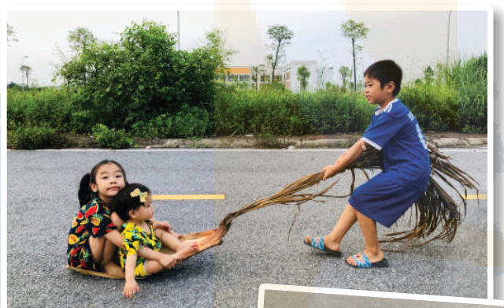
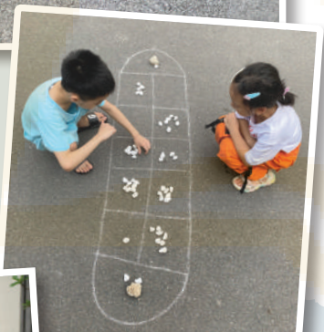
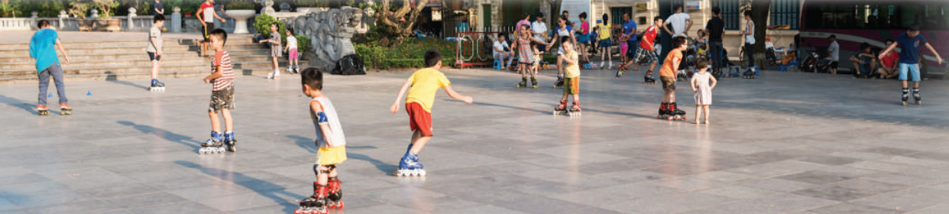
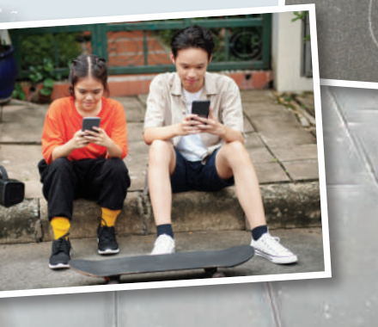
1. What activity are the children doing in these pictures?
2. Have you ever played these game? What are they called?
3. Do you think these games are still popular among children today? Why or why not?

Slide 11

We didn't do it in my day.
Phong: Grandpa, do you mind telling me how our lives are different from yours in the past?
Grandpa: Well, there are many differences. In my day, we mostly played outdoors. The games were simple and cost little. We made our own toys from natural materials.
Phong: That sounds interesting. Nowadays, most leisure games depend on electronic devices.
Grandpa: Right, but that is mostly true in the city only. Many children in the countryside still play traditional games. Phong: I know.
Grandpa: Another thing is that children nowadays have more freedom of choice. They wear short dresses and jeans with holes. They also dye their hair purple and green.
Phong: Ha ha... Not many, Grandpa.
Grandpa: Hm... And many children of my generation left school early to support their families. Moreover, there were not many schools then.
Phong: You mean we have more opportunities to learn now?
Grandpa: That's right.
Phong: Do you think these changes are for the better?
Grandpa: Yes, they mostly are. They have improved our living conditions.
Phong: Thank you, Grandpa.

Slide 12
Ex 2 (p 61). Read the conversation again and circle the correct answers.
1. Phong and his grandpa are talking about some differences between _______.
A. children in the city and the countryside
B. the living standards in the past and now
C. life in the past and now
D. past and present entertainment
some differences between
Phong: Grandpa, do you mind telling me how our lives are different from yours in the past?
C. life in the past and now

Slide 13
Ex 2 (p 61). Read the conversation again and circle the correct answers.
Well, there are many differences. In my day, we mostly played outdoors.
Another thing is that children nowadays have more freedom of choice.
And many children of my generation left school early to support their families.
2. Phong's grandpa mentions _______ differences.
A. two
B. three
C. four
D. five
differences
B. three

Slide 14
Ex 2 (p 61). Read the conversation again and circle the correct answers.
3. Phong's grandpa sees most of the changes as _______.
A. positive
B. negative
C. unnecessary
D. necessary
most
Phong: Do you think these changes are for the better?
Grandpa: Yes, they mostly are. They have improved our living conditions.
of the changes as
A. positive

Slide 15
Ex 3 (p 61). Write the expressions from the conversation in the correct column.
a. depend on electronic devices
The past
The present
b. leave school early
c. dye their hair
d. have more opportunities to learn
e. make toys from natural materials

Slide 16
Ex 4 (p 61). Complete the sentences with the words from the box.
opportunity
freedom
dyed
generation
materials
A few teenagers in my village have _______ their hair brown.
Young people's lifestyle today is different from that of the previous _______.
Nowadays, nearly all young people have a(n) _______ to go to school.
He wants to live green, so he uses products made from natural _______.
My parents give me _______ to pursue my own interests.

Slide 17
Ex 4 (p 61). Complete the sentences with the words from the box.
opportunity
freedom
dyed
generation
materials
A few teenagers in my village have ____________ their hair brown.
Young people's lifestyle today is different from that of the previous ______________.
Nowadays, nearly all young people have a(n) ___________________ to go to school.

Slide 18

Ex 4 (p 61). Complete the sentences with the words from the box.
opportunity
freedom
dyed
generation
materials
He wants to live green, so he uses products made from natural _______________.
My parents give me ______________ to pursue my own interests.
pursue
To follow or chase (someone or something)

Slide 19
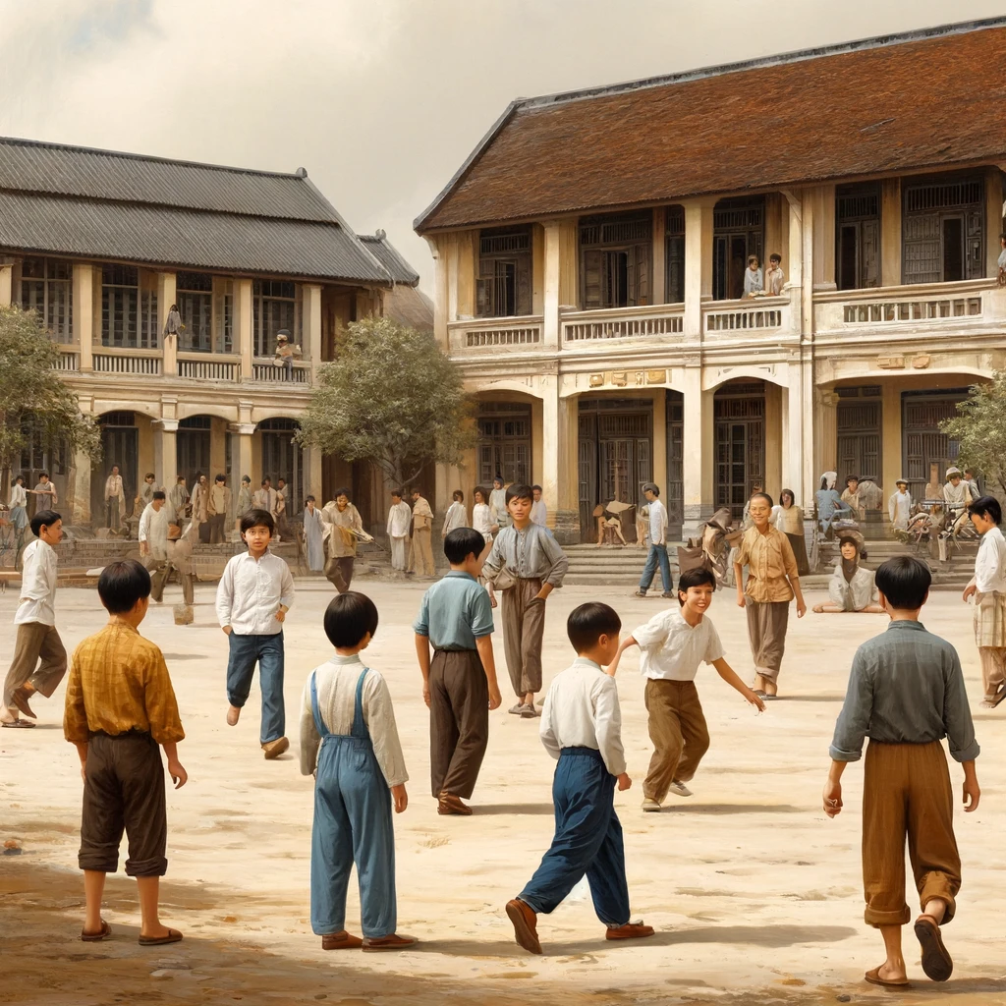
False
Ex 5 (p 61). QUIZ. Work in pairs. Decide if the statements below are true or false about life in Viet Nam 40 years ago. Share your answers with the class.
40 years ago, school children didn't wear uniforms.

Slide 20
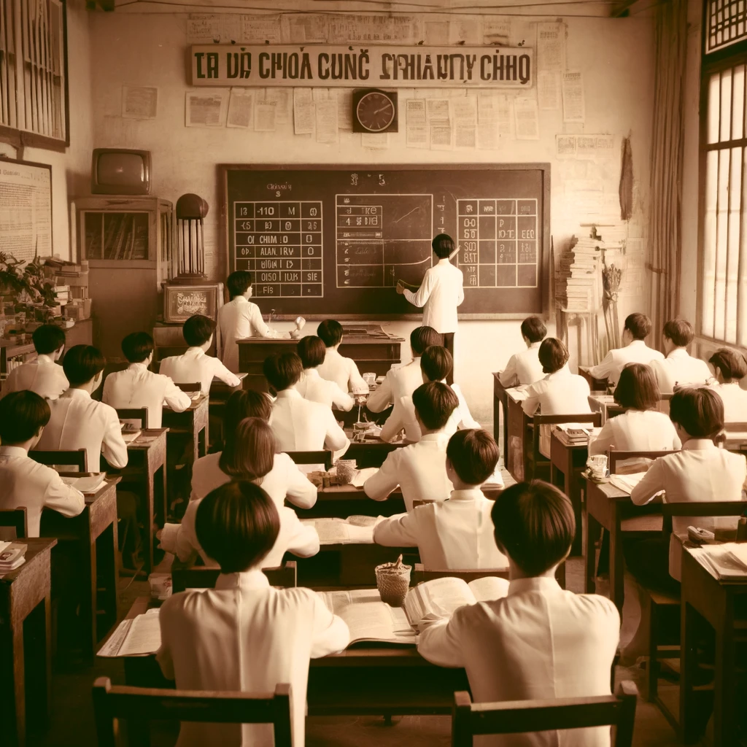
40 years ago, no Vietnamese student could go and study abroad.
False

Slide 21
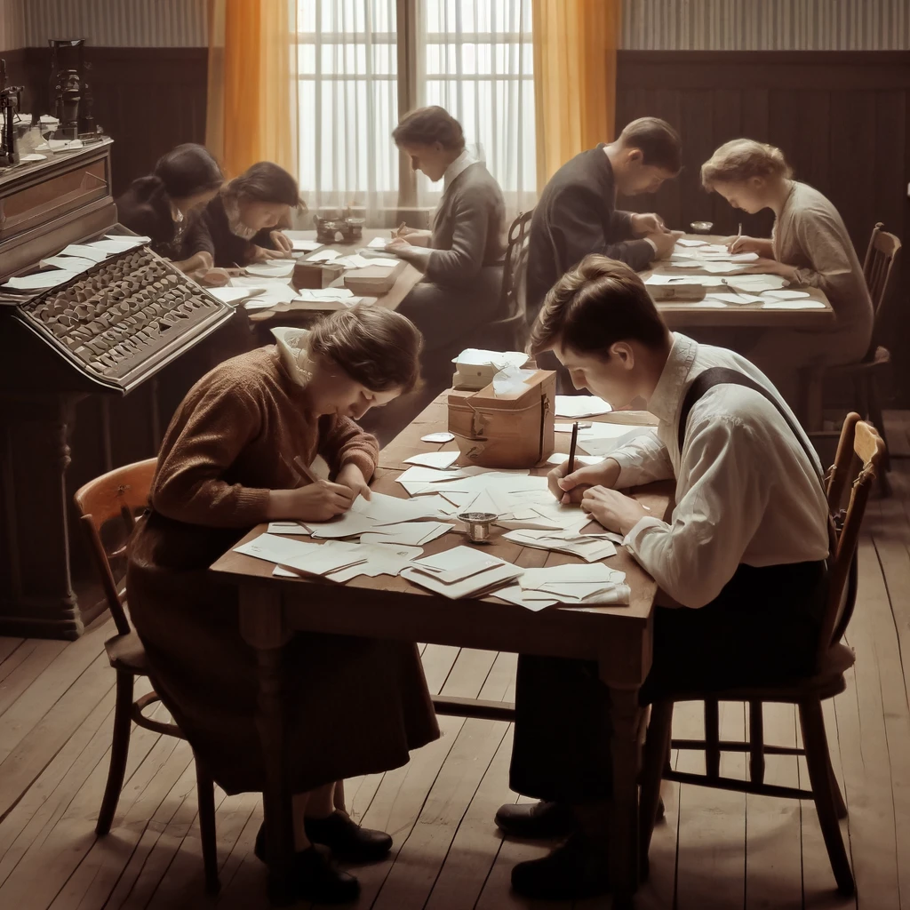
40 years ago, most people wrote letters instead of writing emails or texting messages.
True

Slide 22
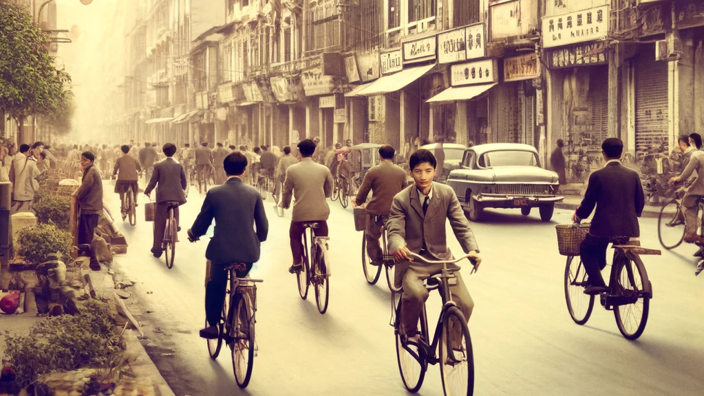
40 years ago, bicycles were the main means of transportation.
True

Slide 23
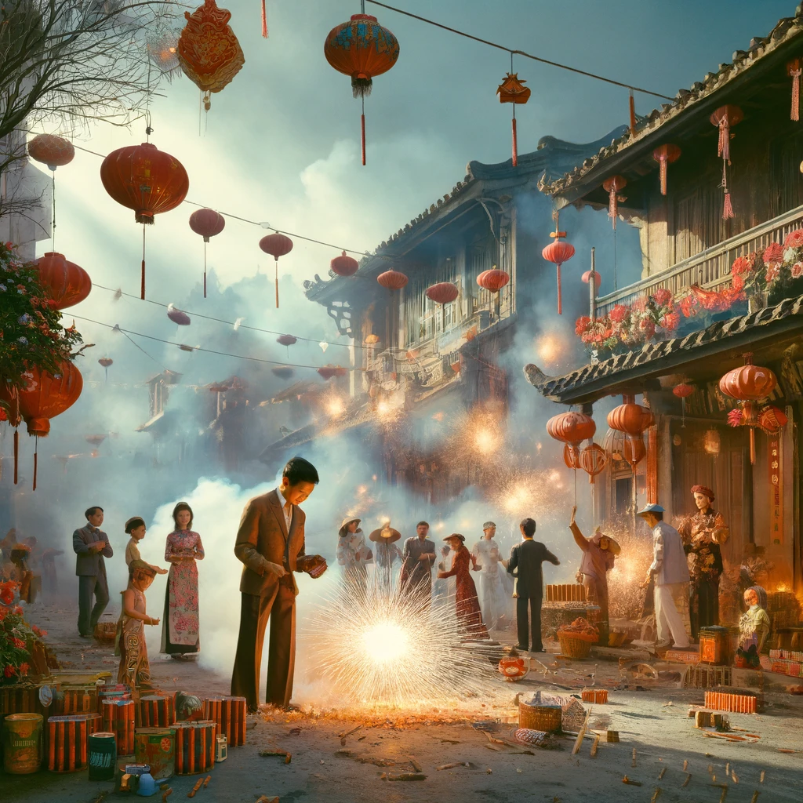
40 years ago, people lit firecrackers at Tet and weddings
true

Slide 24
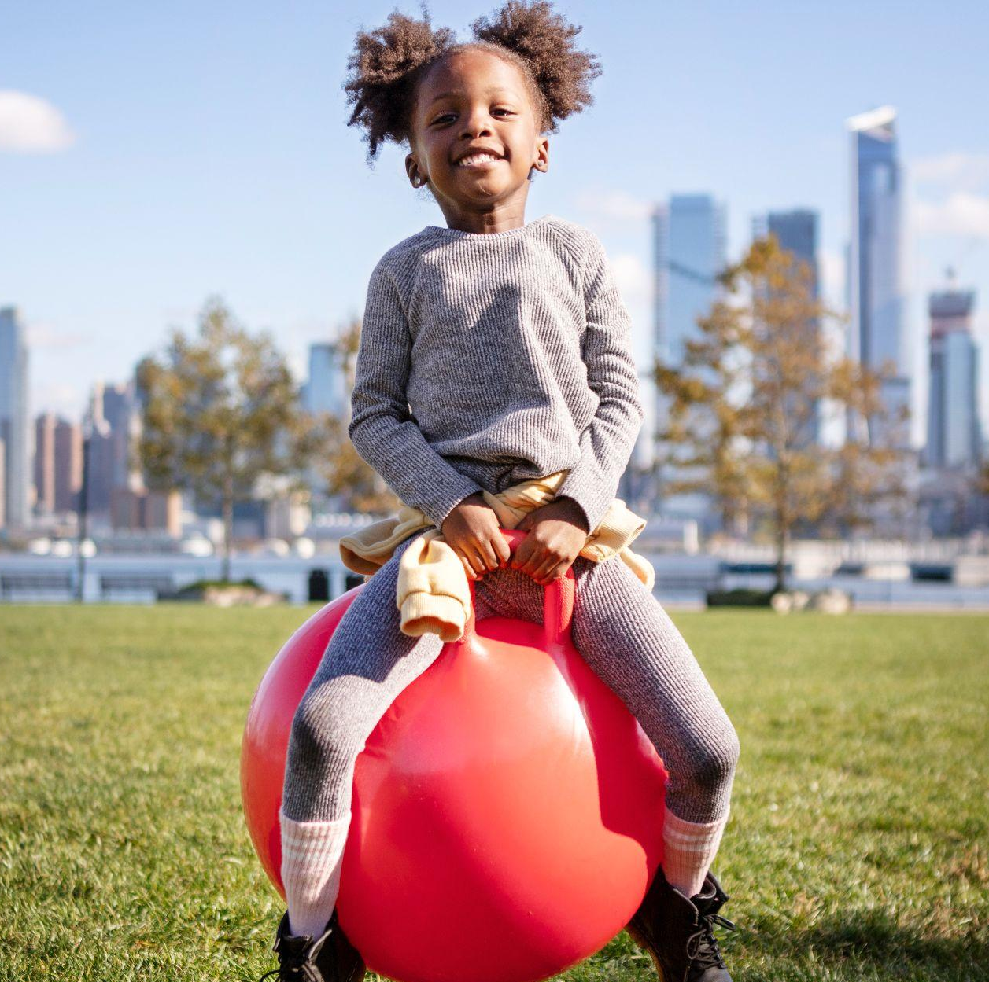
RECAP
What have you learnt today?
Words related to lifestyle
2. Changes lifestyle in the past and the present

Slide 25
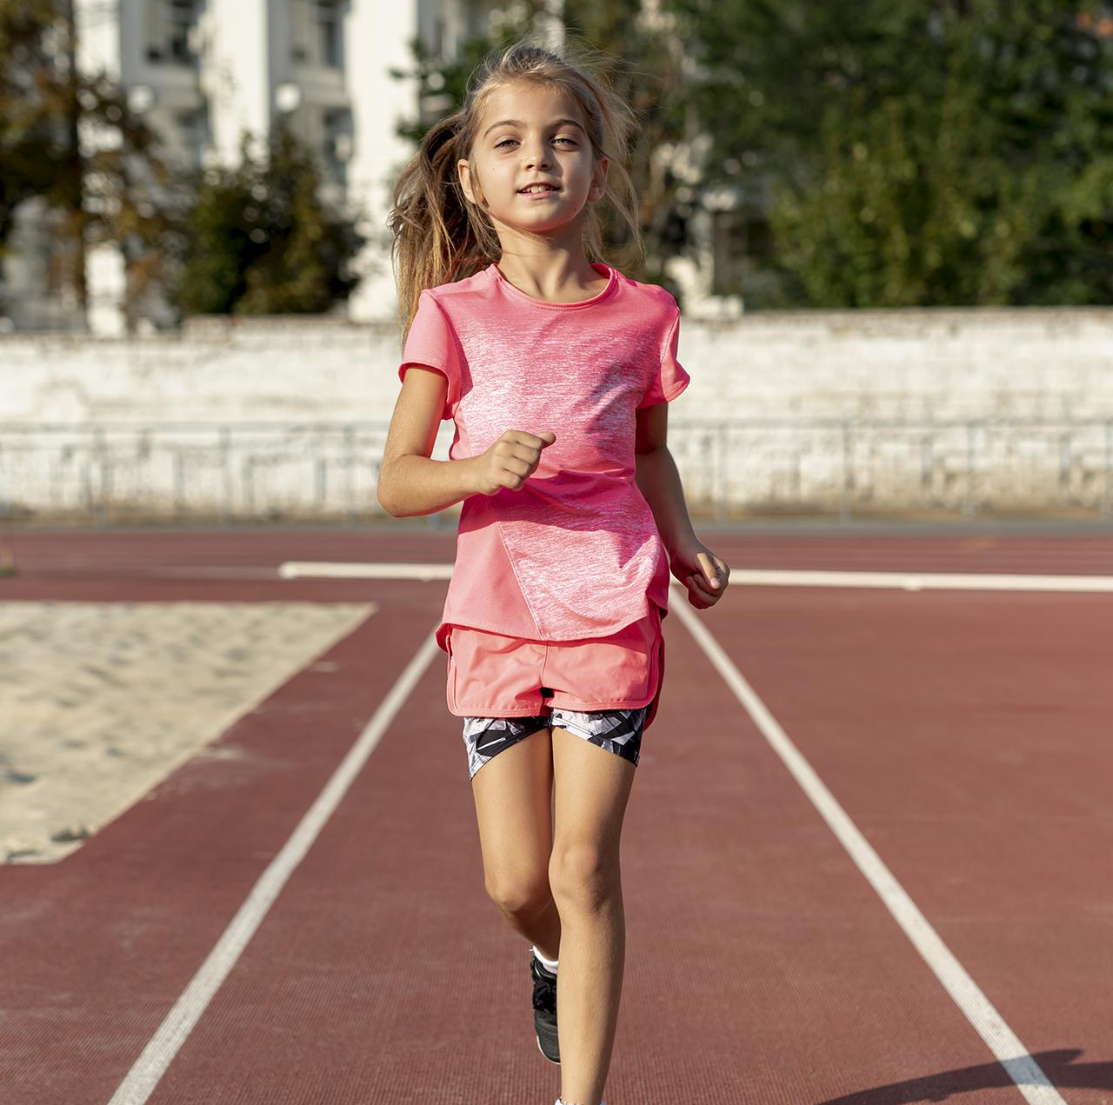
Thank you!
Do you have any question?

