Slide 1
Unit 2: LIFE IN THE COUNTRYSIDE
LESSON 7: LOOKING BACK

Slide 2
Vocab lary
LIFE IN THE COUNTRYSIDE:
paddy field, herd, load, combine harvester, harvest time, unloading rice, ploughing a field, milking cows, feeding pigs, catching fish, drying rice, cattle, crops, catch, orchard, etc.

Slide 3
PRONUNCIATION
/ə/
/ɪ/
Activity, hospitable, garden, picturesque, collect, about, majority, undo, family, mission, certain, special, lion, medium, condition, etc.
Pick, village, harvest, busy, cottage, begin, city, women, busy, crystal, physics, symbol, him, little, business, etc.

Slide 4
GRAMMAR COMPARATIVES FORMS OF ADVERBS
SO SÁNH VỚI TRẠNG TỪ NGẮN
S1 + V + adv – er + than + S2
Với trạng từ ngắn, thường là trạng từ chỉ cách thức có hình thức giống tính từ, ta thêm đuôi “er” vào sau trạng từ
Ex:
They work harder than I do. (Họ làm việc chăm chỉ hơn tôi.)
She runs faster than he does. (Cô ấy chạy nhanh hơn anh ấy.)
My mother gets up earlier than me. (Mẹ tôi thức dậy sớm hơn tôi.)

Slide 5
GRAMMAR COMPARATIVES FORMS OF ADVERBS
SO SÁNH VỚI TRẠNG TỪ DÀI
S1 + V + more/less adv + than + S2
Với trạng từ ngắn, ta thêm “more” (nhiều hơn) hoặc “less” (ít hơn) vào trước trạng từ.
“less” là từ phản nghĩa của more được dung để diễn đạt sự không bằng ở mức độ ít
Ex:
My father talks more slowly than my mother does.(Bố tôi nói chậm hơn mẹ tôi
Lan acts less responsibly than anyone here. (Lan hoạt động ít trách nhiệm hơn bất cứ ai ở đây.)

Slide 6
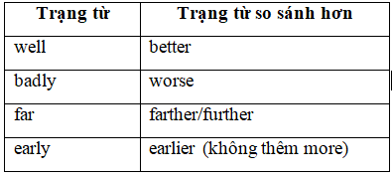
GRAMMAR COMPARATIVES FORMS OF ADVERBS
Một vài trạng từ ở dạng đặc biệt

Slide 7
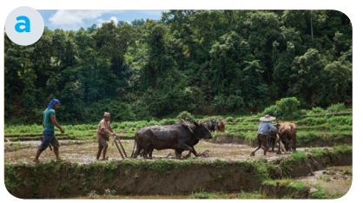
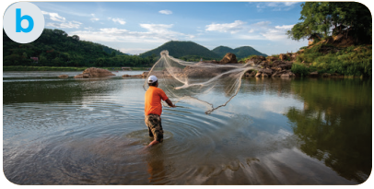
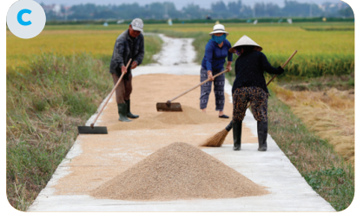
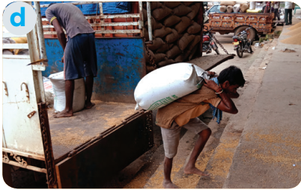
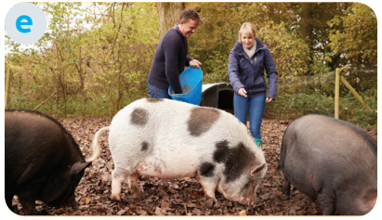
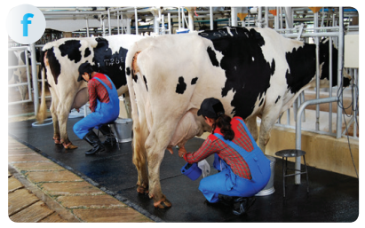
Write the phrase from the box under the correct picture.
1. unloading rice
2. ploughing fields
3. milking cows
4. feeding pigs
5. catching fish
6. drying rice
2. ploughing fields
5. catching fish
6. drying rice
1. unloading rice
4. feeding pigs
3. milking cows

Slide 8
Choose the correct answer A, B, or C.
1. There is a huge cloud ______ as far as the eye can see.
A. surrounded
B. stretching
C. vast
2. People in my village are really _______; they are always generous and friendly to visitors.
A. well-trained
B. funny
C. hospitable
3. The development of cities destroys ____________ areas of countryside.
A. vast
B. much
C. stretching
bao quanh
kéo dài
rộng lớn
Được đào tạo bài bản
Buồn cười
Hiếu khách
Rộng lớn
Nhiều
Kéo dài

Slide 9
Choose the correct answer A, B, or C.
4. The workers in our factory are very _______ because they took a lot of good training courses.
A. hospitable
B. kind
C. well-trained
5. The area around the village is famous for its ________ landscape.
A. picturesque
B. boring
C. dull
Hiếu khách
Tốt bụng
Được đào tạo bài bản
Đẹp như tranh vẽ
Nhàm chán
Buồn tẻ

Slide 10
Complete the sentences with the comparative forms of the adverbs in brackets.
1. Every morning Nick gets up ten minutes (early) ___________ than his sister.
2. I speak French (fluently) ____________ now than I did last year.
3. You'll find your way around the village (easily) ____________ if you have a good map.
4. It rained (heavily) ______________ today than it did yesterday.
5. If you work (hard) ______________ , you will do (well) ______________ in your exam.
earlier
more fluently
easier
heavier
harder
better
Cấu trúc so sánh hơn:
- Đối với tính từ ngắn: S + to be + adj + er + than + Noun/ Pronoun.
- Đối với tính từ dài: S + to be + more + adj + than + Noun/ Pronoun.

Slide 11
Underline the mistakes in the sentences and correct them.
1. I run faster as my brother does.
2. People in the city seem to react quicklier to changes than those in the country.
3. We need to work more hardly, especially at exam time.
4. You must finish harvesting the rice the earlier this year than you did last year.
5. As they climbed more highly up the mountain, the air became cooler.
→ than
→ more quickly / quicker
→ harder
→ earlier
→ higher

Slide 12
Thank you!

