Slide 1
UNIT 7: TRAFFIC
LESSON 2:
A CLOSER LOOK 2

Slide 2
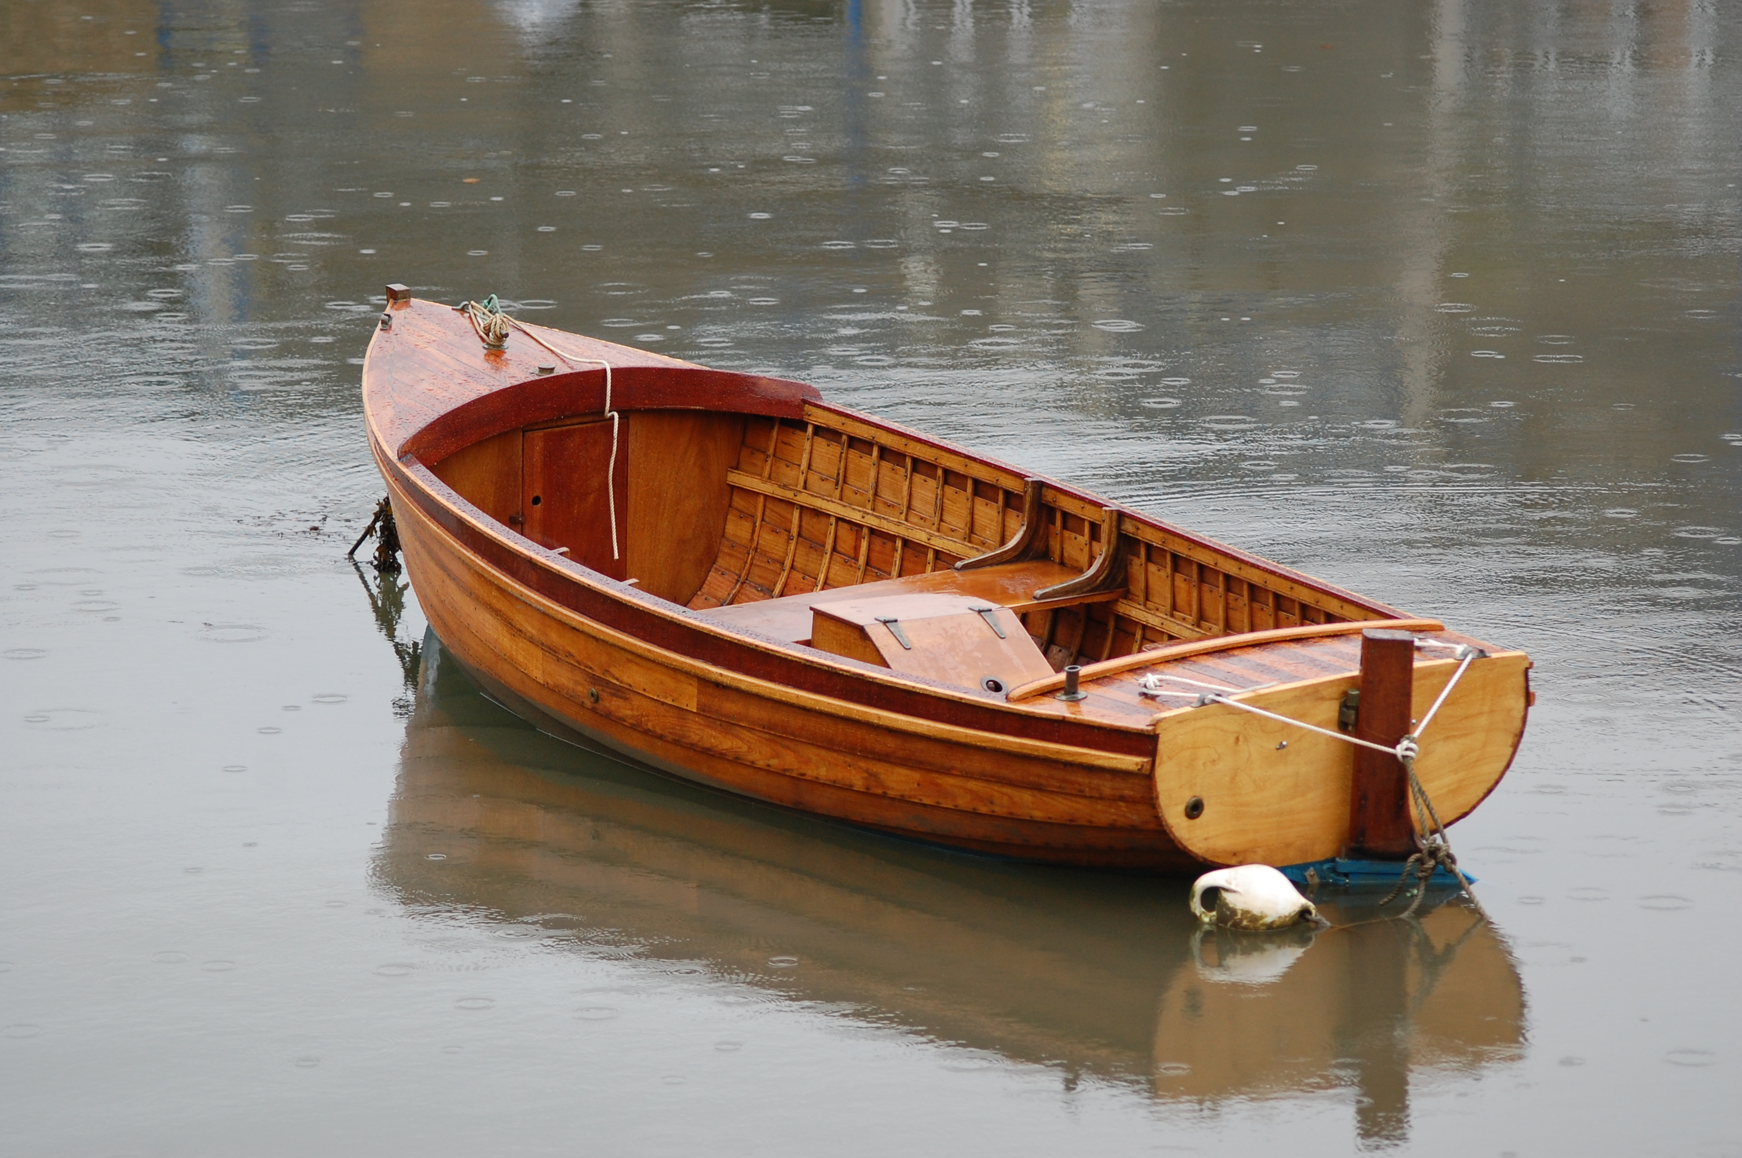
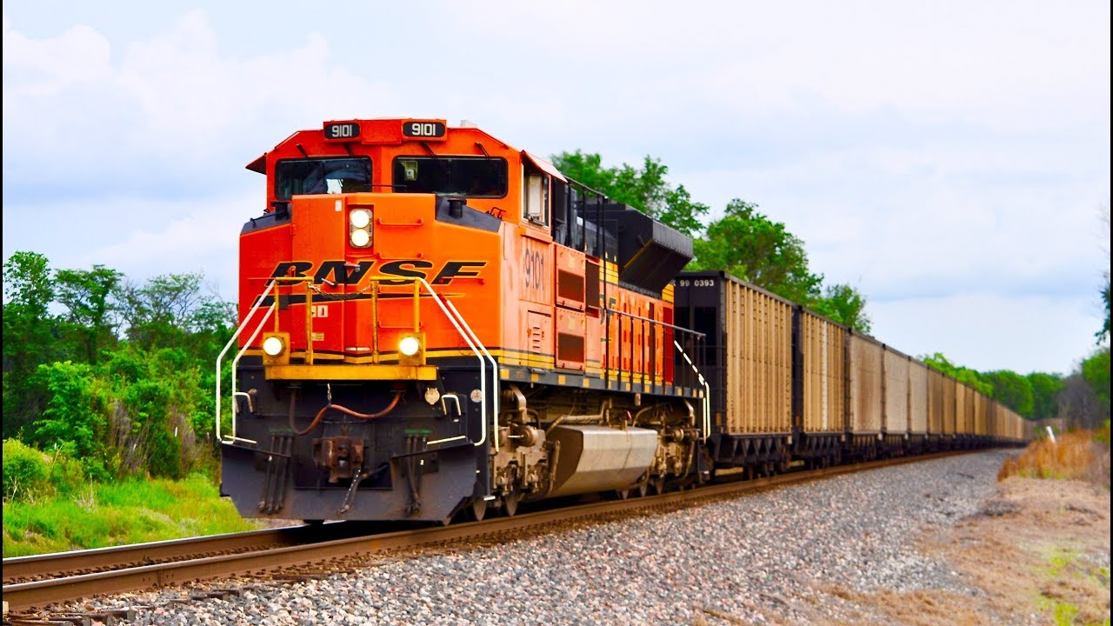
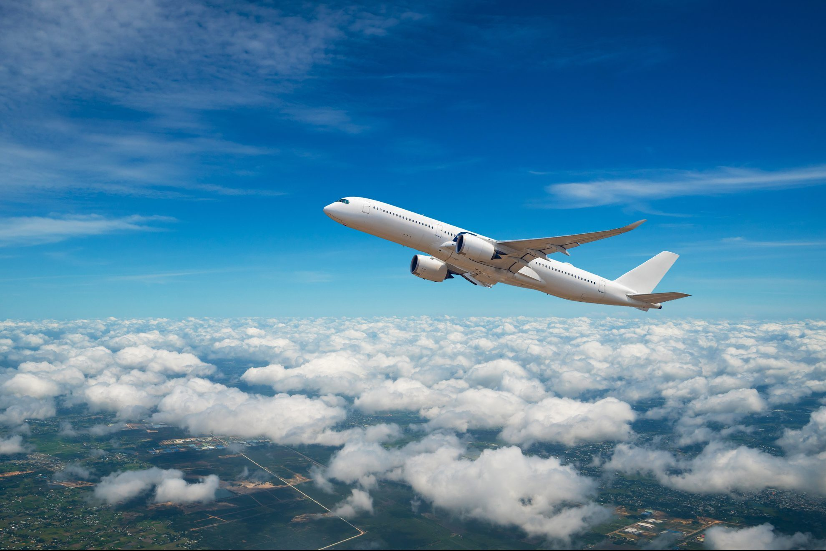
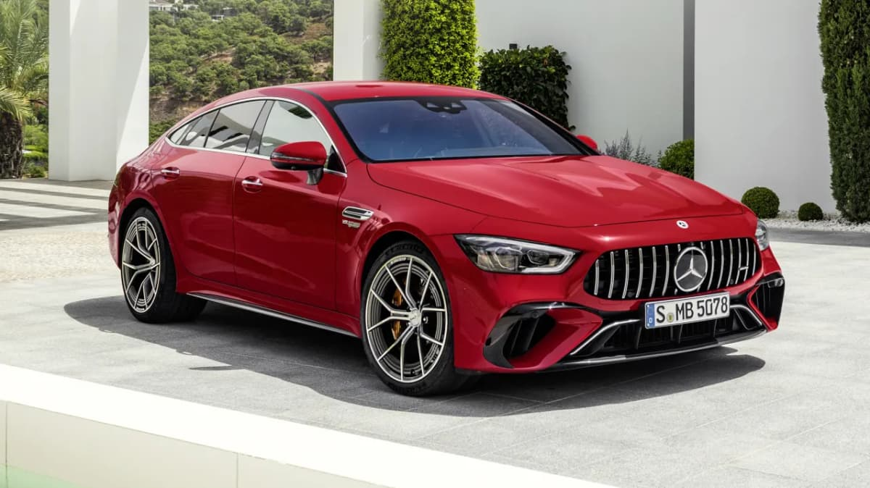
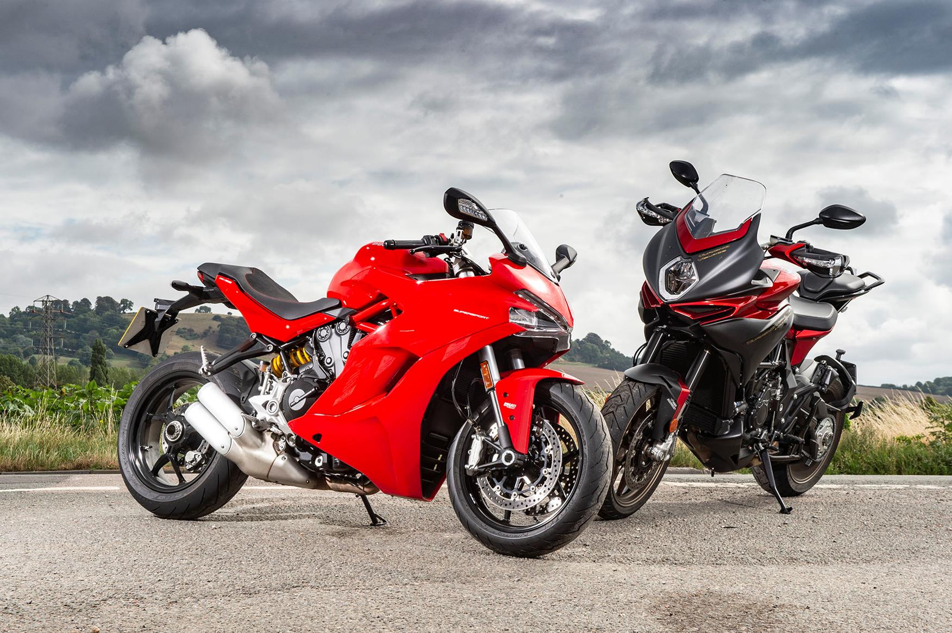
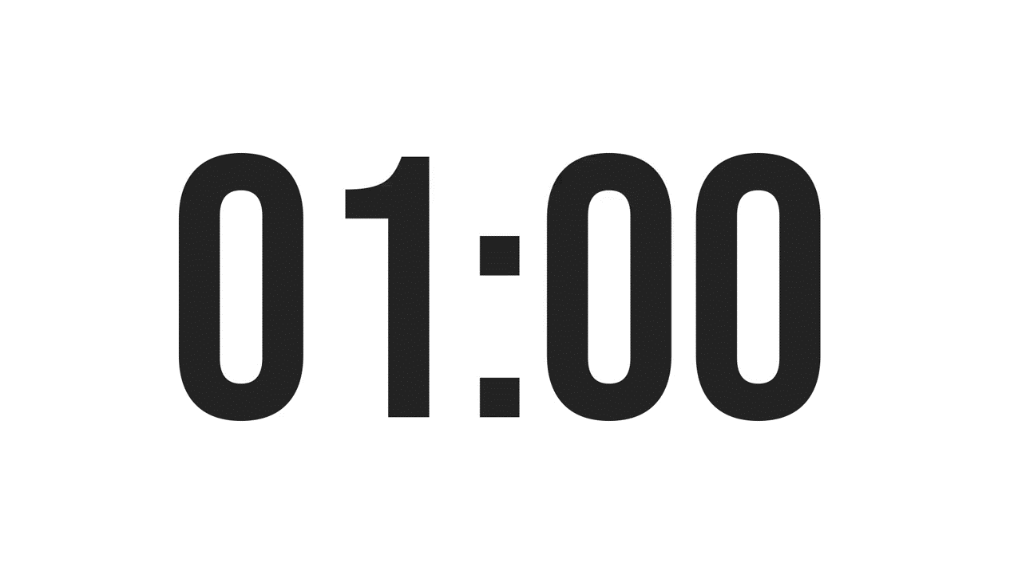
Look and rewrite
OTBA
ITANR
NPEILARA
ARC
OTMIROEKB

Slide 3
MEANS OF TRANSPORT
BOAT
AIRPLANE
OTBA
ITANR
NPEILARA
TRAIN
ARC
CAR
MOTORBIKE
OTMIROEKB

Slide 4
Ex 1. Make your own sentences
A
B
Example:
My father taught me how to ride a bike.
1. ride
c. a bike
2. drive
a. a car
3. sail
b. a boat
4. go
e. on foot
5. travel
d. by air

Slide 5
New words
New words | Pronunciation | Meaning
1. road sign (n.phr.) | /ˈrəʊd saɪn/ | biển báo giao thông
2. cycle lane (n.phr.) | /ˈsaɪkl leɪn/ | làn đường dành riêng cho xe đạp
3. traffic light (n.phr.) | /ˈtræfɪk laɪt/ | đèn giao thông

Slide 6

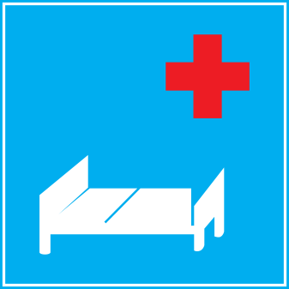



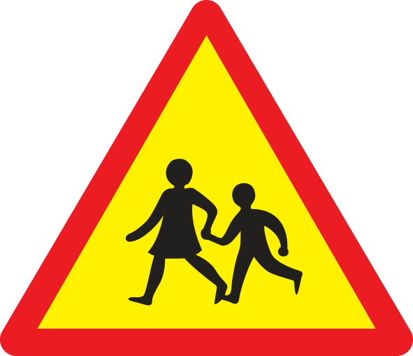
Ex 2. Look and write the correct phrases.
No right turn
Cycle lane
School ahead
Traffic lights
No cycling
Hospital ahead
Hospital ahead
No right turn
Traffic lights
Cycle lane
School ahead
No cycling

Slide 7


Ex 3. Work in pairs. Take turns to say which of the signs in 2 you see on the way to school.
On my way to school, there is a hospital, so I see a “hospital ahead” sign.
On the way to school, there are crossroads, so I see several traffic lights.

Slide 8

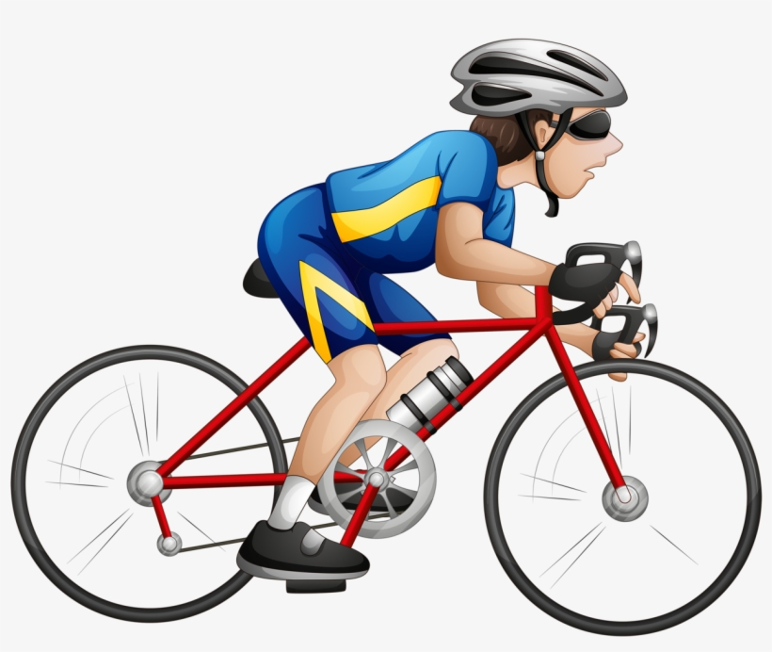

Guess the words
y
s_ _l
c_cle
a
i
/aɪ/
/eɪ/

Slide 9
2
PRONUNCIATION
/aɪ/
/eɪ/

Slide 10
Ex 4. Listen and repeat. Pay attention to the sounds /aɪ/ and /eɪ/.
/aɪ/ | /eɪ/
cycle | sail
fly | train
fine | plane
sign | station
motorbike | pavement

Slide 11
Ex 5. Underline the words with the sound /aɪ/ and circle the words with the sound /eɪ/.
1. The bus station is far from my house.
2. Remember to ride your bike carefully.
3. We must obey traffic rules for our safety.
4. You have to get there in time for the train.
5. Don’t ride on the pavement.

Slide 12
Ex 5. Listen, check and repeat.
1. The bus station is far from my house.
2. Remember to ride your bike carefully.
3. We must obey traffic rules for our safety.
4. You have to get there in time for the train.
5. Don’t ride on the pavement.

