Slide 1
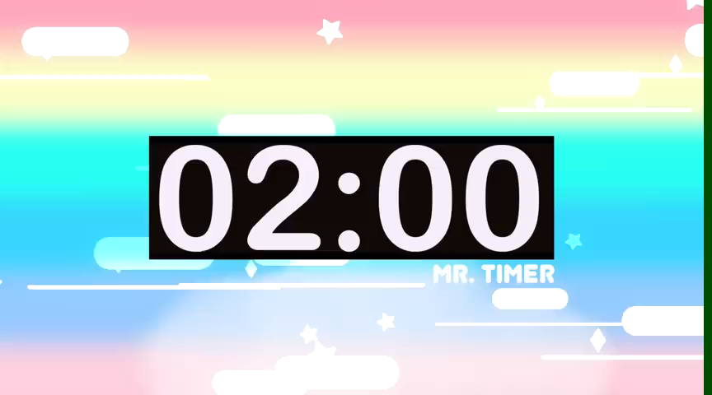
Jumbled words
TACIEV
ACTIVE
LFIEDRNY
FRIENDLY
FUNNY
UNFNY
INKD
KIND
RCUFEAL
CAREFUL
TOFCNDITEN
CONFIDENT

Slide 2
English 6 - Unit 3: My friends Lesson 6 – Skills 2

Slide 3
Content
01
02
Listening
Writing
Listen about best friends
Write a diary entry about best friends.

Slide 4
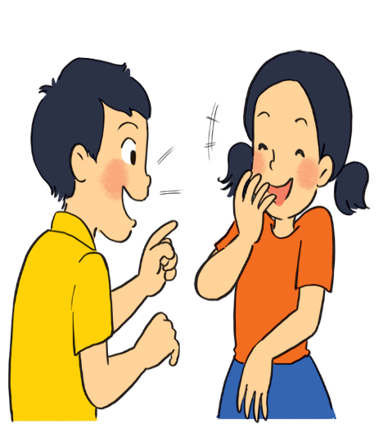
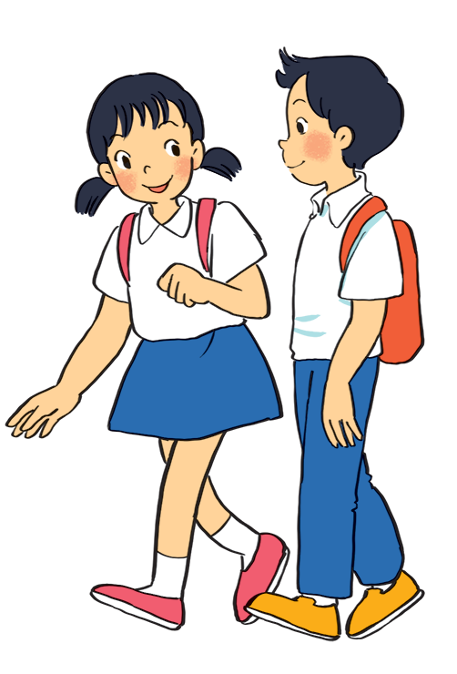
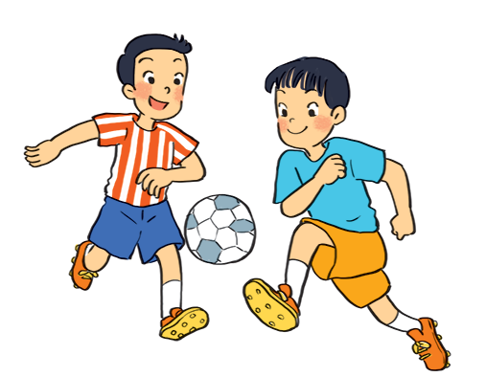
a
c
b
They are talking.
They are playing football.
They are walking.
What are the students doing in each picture?

Slide 5

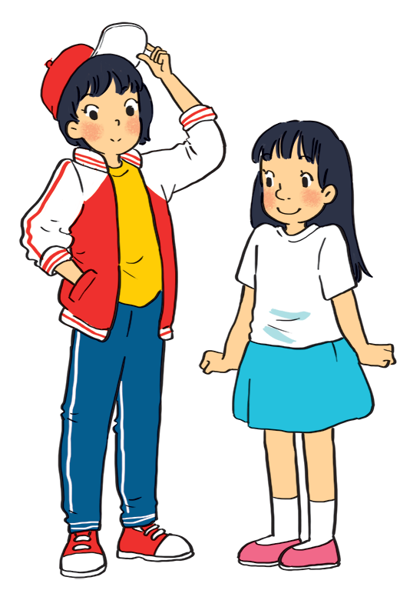




2. Listen to Mi and Minh talking about their best friends. Look at the picture below and say which one is Lan and which one is Chi.
Lan is the girl wearing
a red and white jacket and
a red cap.
Chi
Chi is the girl wearing
a white T-shirt and a blue skirt.
Lan

Slide 6
3. Listen to the talk again. Fill each blank with a word / number you hear.
6A
1.
Mi and Lan are studying in class ______
1.
black
mouth
2.
Lan has short _____hair and a small ______
friendly
3.
Lan is active and ________.
4.
Chi’s hair is long and black, and her nose is ________
big
5.
kind
Chi is__________ to Minh

Slide 7
Reorder the letters in italics to complete the paragraphs. - 2 minutes - reorder the words
BINGO!

Slide 8
Mi: My best friend is Lan. 6A studies me in She with class. She’s tall and slim. She black and mouth has hair a short small. She’s very active and friendly. and has many She friends playing likes sports. Look, she’s playing football over there! Minh: best is my friend Chi. We’re in class 6B. She’s short with and black hair nose a big long. me kind to I like because her she’s. She helps me with my English. She’s also hard-working. She always does her homework before class. Look, she’s going to the library.

Slide 9
ANSWER: Mi: My best friend is Lan. She studies with me in class 6A. She’s tall and slim. She has short black hair and a small mouth. She’s very active and friendly. She likes playing sports and has many friends. Look, she’s playing football over there! Minh: Chi is my best friend. We’re in class 6B. She’s short with long black hair and a big nose. I like her because she’s kind to me. She helps me with my English. She’s also hard-working. She always does her homework before class. Look, she’s going to the library.

Slide 10

II. Writing
Work in pairs. Ask and answer about your best friend. Use these notes to help you.
1. What’s his / her name?
2. What does he / she look like?
3. What’s he / she like?
4. Why do you like him / her?

Slide 11
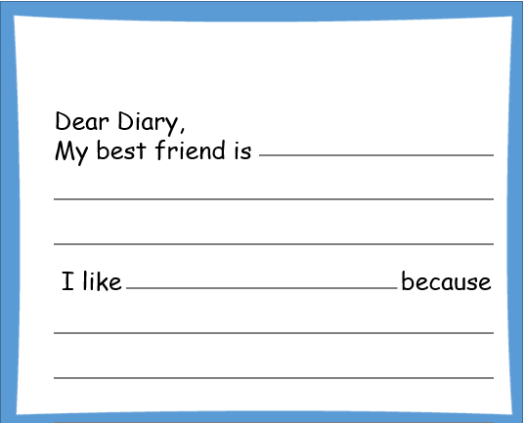
5. Write a diary entry of about 50 words about your best friend. Use the answers to the questions in 4.

Slide 12
Sample writing:
My best friend is Lan. She studies with me in class 6A. She’s tall and slim. She has short black hair and a small mouth. She’s very active and friendly. She likes playing sports and has many friends. I like being with her. I hope that in the future, we will still be best friends.

Slide 13
Wrap-up
Listening about best friends.
Reading about friends.
Writing about your best friend.

Slide 14
Homework
Prepare the next lesson.

Slide 15
Thank you for joining!

