Slide 1

Warm-up
Do you have a lot of friends?

Slide 2
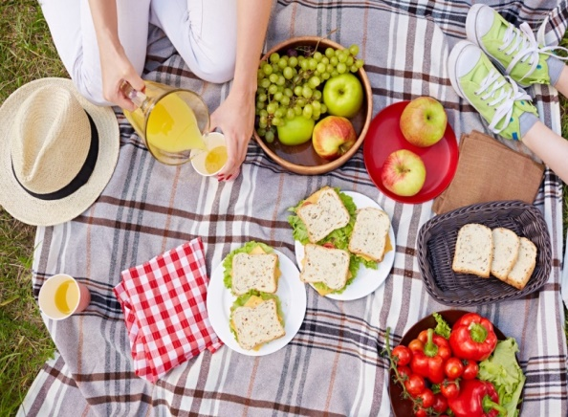
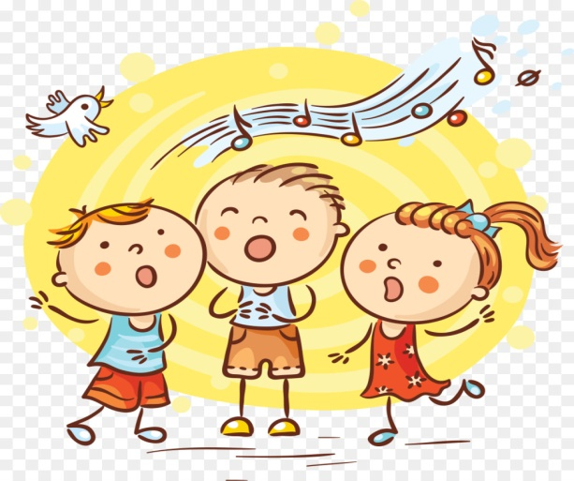

What can you do with your friends?
We can eat and drink together
We can play some games
We sing some songs

Slide 3
Unit 3:
MY FRIENDS
Lesson 1: Getting started

Slide 4
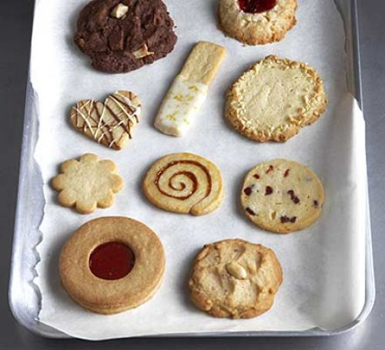

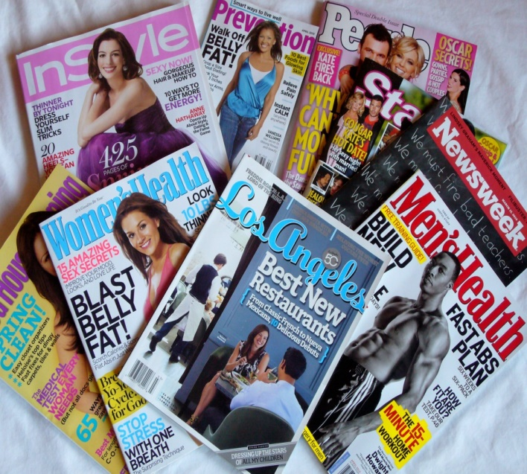
I. Vocabulary
1. biscuit (n):
bánh quy
2. pass (v) :
chuyển qua, đưa qua
3. glasses (n ) :
mắt kính
4. magazine (n):
tạp chí

Slide 5
Checking vocabulary
biscuit
pass
magazine
glasses

Slide 6
II.
Listen and read

Slide 7
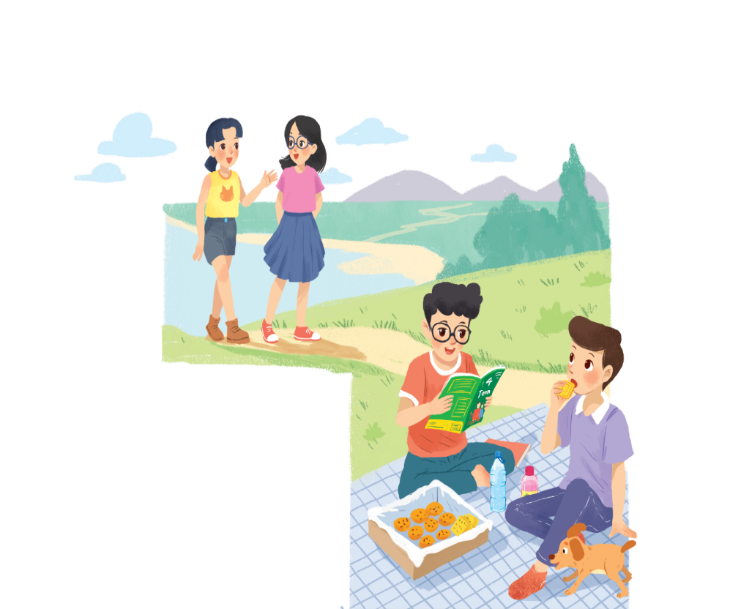

Phong: That was a great idea, Nam.
I love picnics!
Nam: Please pass me the biscuits.
Phong: Sure. Here you are.
Nam: Thanks. What are you reading, Phong?
Phong: 4Teen. It’s my favourite magazine!
Nam: Look! It’s Mai. And she is with someone.
Phong: Oh, who’s that? She has glasses and long black hair.
Nam: I don’t know. They’re coming over.
Mai: Hi there. This is my friend Chau.
Phong & Nam: Hi, Chau. Nice to meet you.
Chau: Nice to meet you, too.
Nam: Would you like to sit down? We have lots of food.
Mai: Oh, sorry, we can’t. We’re going to the bookshop.
Chau: Bye for now.
Phong & Nam : Bye bye.

Slide 8
Act.2: Fill the blanks with the words from the conversation.
picnic
1.
Phong and Nam are having a ___________.
favorite magazine
2.
4Teen is Phong’s _________________________.
3.
Mai
Chau
Phong and Nam see ________ and ________.
4.
glasses
long black hair
Chau has____________and_______________________.
5.
are going to
Mai and Chau__________________
the bookshop.

Slide 9
III.
Practice

Slide 10
Act.3: Label the body parts with the words in the box.

Slide 11
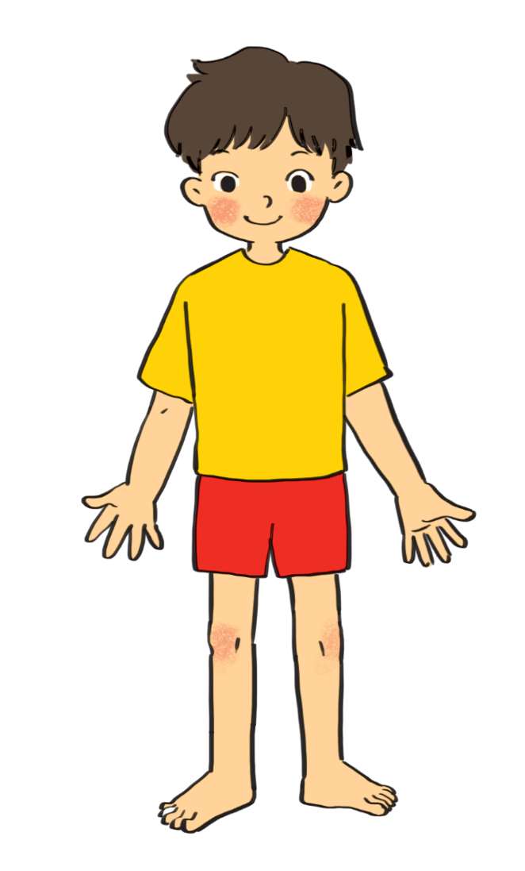
cheek
eye
hand
arm
mouth
cheek
eye
hand
arm
mouth
leg
shoulder
leg
nose
hair
foot
nose
hair
shoulder
foot
eye
hair
1.
10.
nose
9.
cheek
2.
mouth
shoulder
8.
3.
7.
arm
4.
hand
6.
foot
5.
leg

Slide 12
Do you know any other words for body parts?
Ears
Elbow (khủyu tay)
Knee: đầu gối
Face
Finger: ngón tay
Head
Neck
Chest (ngực)

Slide 13
Act.4: Work in groups. Complete the word webs.
arms
hair
nose
eyes
big / small
long / short
blonde
curly
hair

Slide 14
arms
hair
long / short
leg

Slide 15
nose
eyes
head
big / small
feet
hand
ears

Slide 16
blonde
curly
long/short
black
hair
wavy
straight

Slide 17
*Some other adjectives to describe appearance.
oval,
round,
long
face:
hair:
wavy,
pony tail,
fair (tóc vàng)
bald,
*Cấu trúc miêu tả ngoại hình:
S + have/ has……. (a/an) + adj + N
*Lưu ý:
kích thước + hình dáng + màu sắc
VD: She has long curly black hair.

Slide 18
Act.5: Work in groups. Take turns to describe a classmate. Other group members guess who
he/ she is.
A: She has long hair and big eyes.
B: Is that Lan?
A: That’s right.

Slide 19
Thank you
See you next time
Enter

