Slide 1
Unit 1. My new school
Lesson 4. Communication

Slide 2
Objectives
By the end of this lesson, students will be able to:
Use the lexical items related to the topic My new school.
Know how to introduce someone.
Ask appropriate questions when making friends at school, know what good qualities a good friend should have.

Slide 3
Lucky numbers
Rule:
Divide class into 2 teams.
Choose the number and guess the meaning in each suggestion.
The correct answer gets stars following each question.
The team with the most stars will win.

Slide 4
Lucky numbers
1
2
3
4
5
6
7
8
9
Notes:
Ấn vào chính giữa con số.

Slide 5


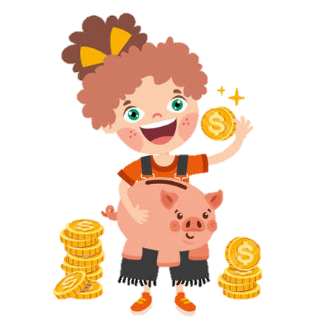

pocket money

Slide 6

go shopping

Slide 7


You get a star!

Slide 8
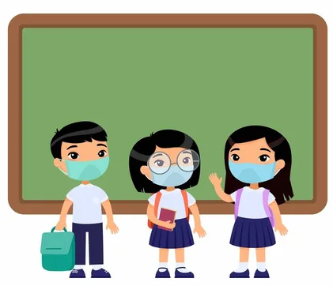
classmate

Slide 9


Lose half of your point ☺

Slide 10

share

Slide 11

Don’t tell anyone this story!
secret

Slide 12
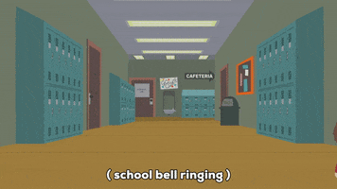
at break time

Slide 13
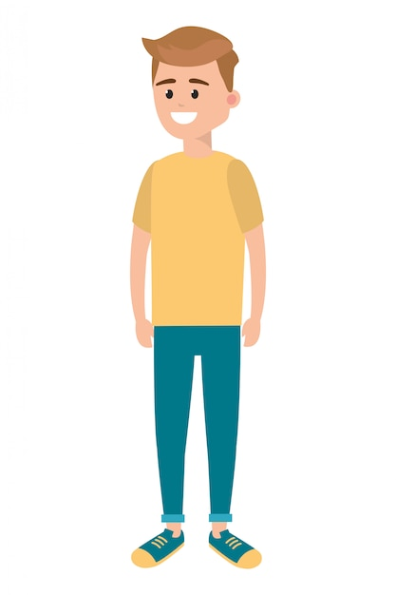
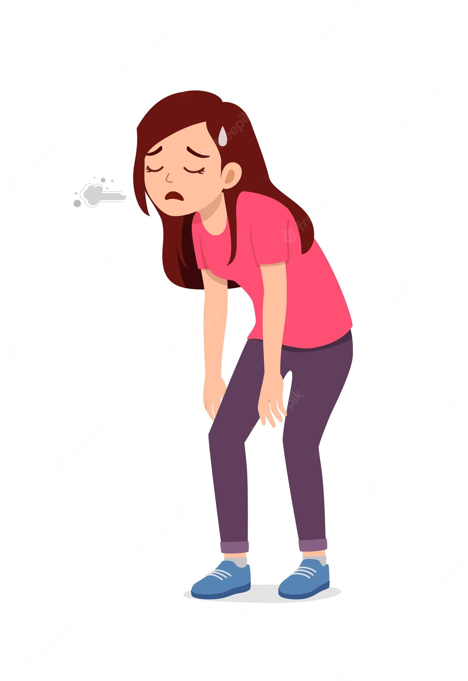
You should go to bed.
I’m tired.
advice

Slide 14

Vocabulary
New words | Pronunciation | Meaning
1. pocket money (n) | /ˈpɒkɪt mʌni/ | tiền tiêu vặt
2. go shopping (v) | /ɡəʊ ˈʃɒpɪŋ/ | đi mua sắm
3. classmate (n) | /ˈklɑːsmeɪt/ | bạn cùng lớp
4. share (v) | /ʃeə(r)/ | chia sẻ
5. secret | /ˈsiːkrət/ | bí mật
6. at break time | /ət ˈbreɪk taɪm/ | vào giờ nghỉ giải lao
7. advice (n) | /ədˈvaɪs/ | lời khuyên

Slide 15
Everyday English
Introducing someone

Slide 16

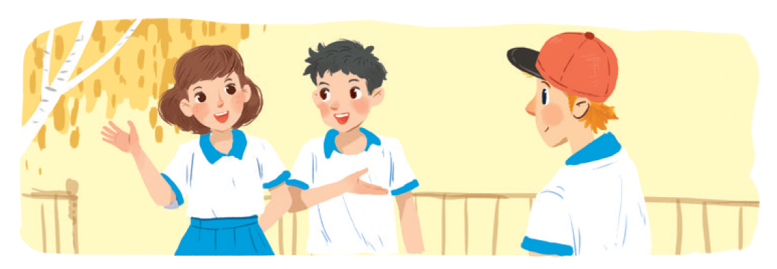

Ex 2. (p 11) Work in groups in 1 minute.
Practice introducing a friend to someone else.
Vy: Phong, this is Duy, my new friend.
Phong: Hi, Duy. Nice to meet you.
Duy: Hi, Phong. Nice to meet you, too.

Slide 17
01
New friends at school

Slide 18
Ex 3. (p 11) Read and tick the questions you think are suitable to ask a new friend at school?
1.
✓
Are you from around here?
2.
✓
Do you like music?
3.
How much money do you get?
4.
What is your favourite subject at school?
✓
5.
Are you hungry now?
Write two more questions on the paper.
6.
Do you play football?
✓
7.
How do you go to school every day?
✓
8.
Where do you often go shopping?

Slide 19

Ex 4. (p 11) Answer the questions.
4. Do you keep your friend’s secret?
1. Do you remember all your new classmate’s names?
5. Do you play with your classmates at break time?
2. Do you often listen to your friend’s advice?
6. Do you help your classmates with their homework?
3. Do you share things with your classmates?
7. Do you go to school with your friends?
8. Do you listen when your classmates are talking?

Slide 20

Ex 5. (p 11) Work in groups in 5 minutes. Take turns to interview the others. Use the questions above.
4. Do you keep your friend’s secret?
1. Do you remember all your new classmate’s names?
5. Do you play with your classmates at break time?
6. Do you help your classmates with their homework?
2. Do you often listen to your friend’s advice?
7. Do you go to school with your friends?
3. Do you share things with your classmates?
8. Do you listen when your classmates are talking?

Slide 21

Presentation!!! Tell about your good friend at school?

Slide 22
RECAP
What have you learnt today?
A
Talking about you at school.
B
Introducing someone –
talking about new friends at school.
B
Introducing someone –
talking about new friends at school.
C
Meeting new friends.

Slide 23
Thank you!

