Slide 1








Unit 6.
Vietnamese lifestyle: then and now
Lesson 2. A closer look 2
Teacher: Vu Thi Trang

Slide 2


Objectives
01
02
Use the lexical items related to the topic VIETNAMESE LIFESTYLE: THEN AND NOW
Pronounce the cluster /fl/ and /fr/ in words and sentences correctly.

Slide 3


I.
VOCABULARY

Slide 4


take note (v)
to write something down or remember it carefully
/teɪk nəʊt/
ghi chép

Slide 5
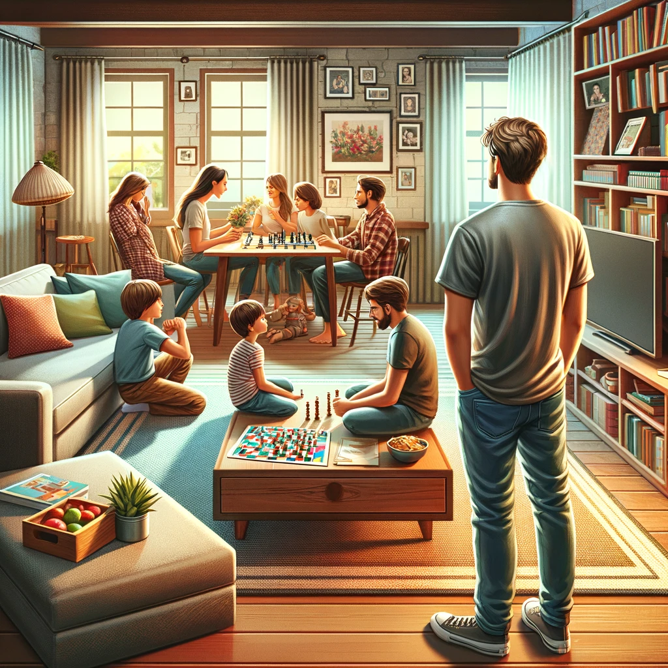
family-oriented (adj)
/ˈfæməli ˈɔrientɪd/
hướng về, coi trọng gia đình
being close to family members and support them in whatever they do.

Slide 6
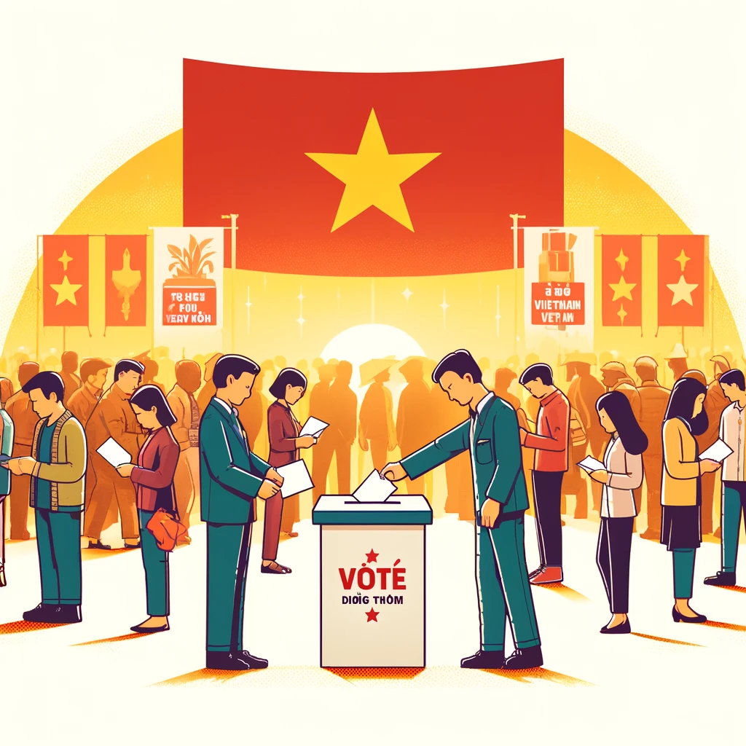
democratic (adj)
based on the principles of democracy.
/ˌdeməˈkrætɪk/
thuộc dân chủ

Slide 7

memorise (v)
/ˈmeməraɪz/
ghi nhớ
Hmm… Let’s me see!

Slide 8

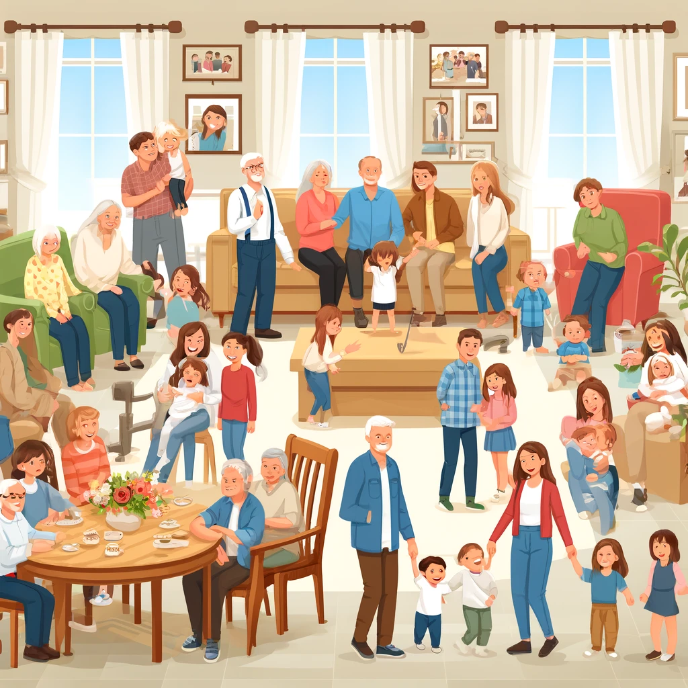
extended (adj)
a family that includes many generations.
/ɪkˈstendɪd/
nhiều thế hệ
(trong 1 gia đình)

Slide 9
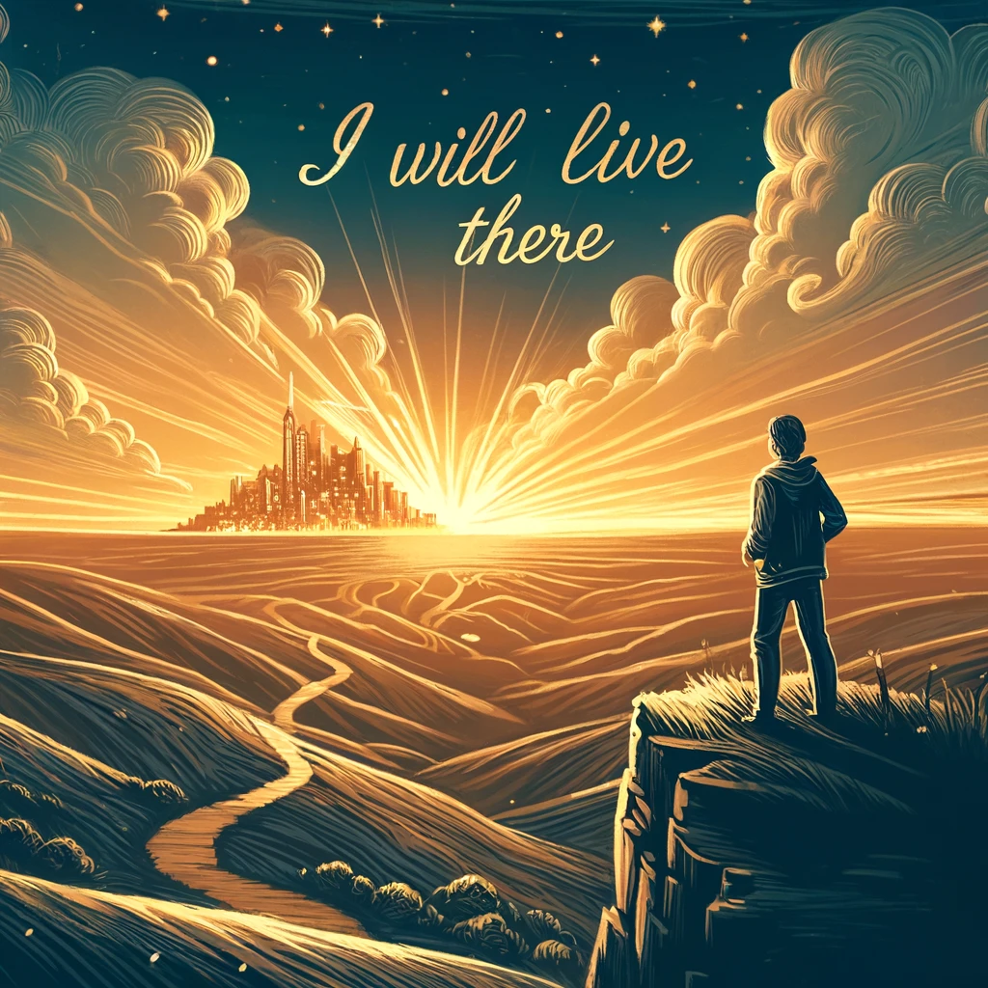
pursue (v)
to follow someone or something
/pəˈsjuː/
theo đuổi

Slide 10
Ex 1 (p 62). Match the verbs or phrasal verbs with their meanings.
A
B
1. take notes
a. learn something carefully so that you can remember it exactly.
remember
take the position
2. depend on
b. take the position of something / somebody
3. memorise
write down
key information
c. write down some key information when listening to a talk, a lecture.
4. pursue
d. rely on something /somebody
rely on
5. replace
try to achieve
e. try to achieve something over a period of time

Slide 11


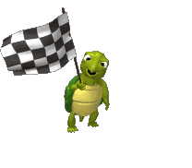


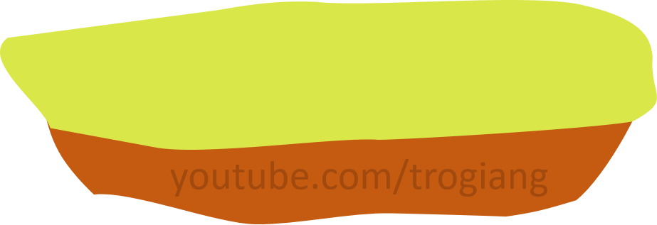

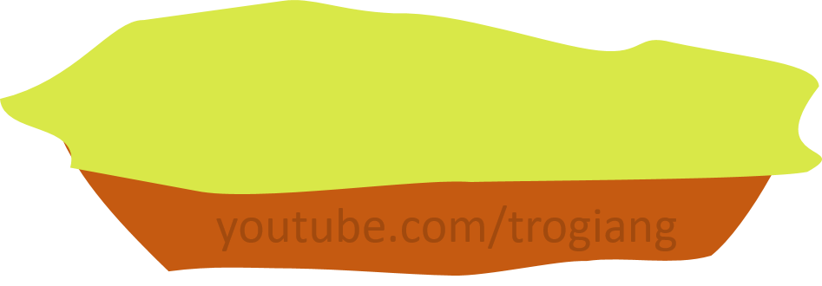


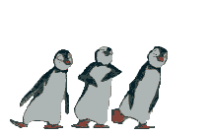
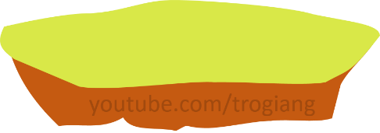
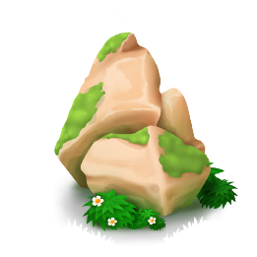

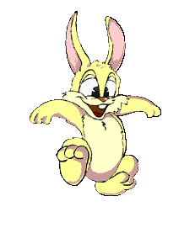

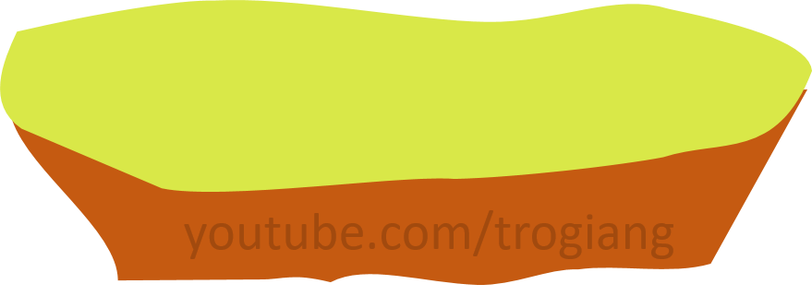


CONGRATULATIONS RABBIT TEAM
CONGRATULATIONS TIGER TEAM
5
5
4
4
3
3
2
Overtop
2
1
1

Slide 12

RABBIT TEAM
1. Four generations live in my house: my great grandparents, my grandparents, my parents, and me.
It’s a(n) ____________family.
extended

Slide 13
RABBIT TEAM
2. In our group, everybody has equal rights to speak and work.
We have a(n)____________relationship
democratic

Slide 14
RABBIT TEAM
3. Children in the past played a lot of traditional outdoor games such as hide-and-seek, tug of war, and marbles.
There were ____________outdoor games for children.
various

Slide 15
RABBIT TEAM
4. I don’t make public my telephone number, home address, or birthday
They are my ____________ information.
personal

Slide 16
RABBIT TEAM
5. He values his family and spends a lot of time with them.
He’s a(n)________________ person
family-oriented

Slide 17
TIGER TEAM
1. Four generations live in my house: my great grandparents, my grandparents, my parents, and me.
It’s a(n) ____________family.
extended

Slide 18
TIGER TEAM
2. In our group, everybody has equal rights to speak and work.
We have a(n)____________relationship
democratic

Slide 19
TIGER TEAM
3. Children in the past played a lot of traditional outdoor games such as hide-and-seek, tug of war, and marbles.
There were ____________outdoor games for children.
various

Slide 20
TIGER TEAM
4. I don’t make public my telephone number, home address, or birthday
They are my ____________ information.
personal

Slide 21
TIGER TEAM
5. He values his family and spends a lot of time with them.
He’s a(n)________________ person
family-oriented

Slide 22
Ex 3 (p 62). Circle the correct answer A, B, C, or D to complete each sentence.
1. Most of the events at the fair are _______, i.e. they are designed for the family.
A. family-oriented B. exciting C. democratic D. various
2. In the past, girls had little opportunity to _______ their interests.
A. know B. replace C. pursue D. promise
3. Hi-tech appliances used for housework have _______ our old-fashioned tools.
A. made B. replaced C. stopped D. given up
4. The relationship between parents and children is now more _______ than in the past.
A. Independent B. private C. democratic D. extended
5. Protect your personal _______ online by using strong and unique passwords.
A. taste B. experience C. opinions D. privacy

Slide 23
1. Most of the events at the fair are _______, i.e. they are designed for the family. A. family-oriented B. exciting C. democratic D. various 2. In the past, girls had little opportunity to _______ their interests. A. know B. replace C. pursue D. promise
Ex 3 (p 62). Circle the correct answer A, B, C, or D to complete each sentence.

Slide 24
3. Hi-tech appliances used for housework have _______ our old-fashioned tools. A. made B. replaced C. stopped D. given up 4. The relationship between parents and children is now more _______ than in the past. A. independent B. private C. democratic D. extended 5. Protect your personal _______ online by using strong and unique passwords. A. taste B. experience C. opinions D. privacy
Ex 3 (p 62). Circle the correct answer A, B, C, or D to complete each sentence.

Slide 25
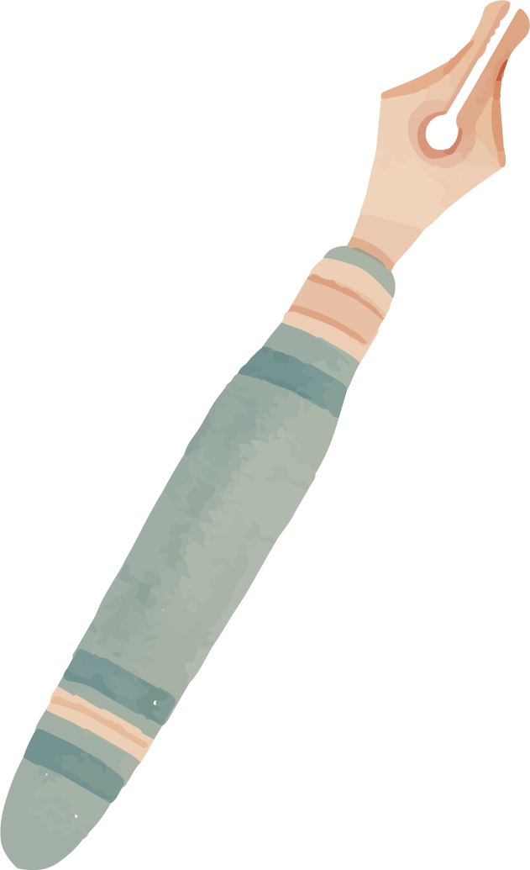

II. Pronunciation
/fl/ & /fr/

Slide 26


Ex 4 (p 62). Listen and tick the words you hear. Then listen again and repeat.
1 | Fruit | Flute
2 | Frame | Flame
3 | Free | Flea
4 | Fright | Flight
5 | Fresh | Flesh
6 | Frog | Flog

Slide 27
Ex 5 (p 62). Listen and repeat the sentences. Pay attention the underlined words.
1. The photos of their fight for freedom are on the second floor.
2. Who suffers most from generation conflicts?
3. The man is reflecting on his frightening trip.
4. How does the past influence your friends?
5. When I was small, I caught the flu frequently.

Slide 28


- Devide class into 2 teams. - Take turn writing on board all vocabularies you have leanrt in this lesson in 5 minutes.

Slide 29




Thank you ♥

