Slide 1



9TH GRADE
UNIT 3
HEALTHY LIVING
FOR TEENS
TEACHER: VU THI TRANG

Slide 2


OBJECTIVE
After this lesson, SS will be able to:
use modal verbs in conditional sentence type 1

Slide 3


UNSCRAMBLE THE SENTENCE
time/ teens/If/ manage/ effectively/their/,
If teens manage their time effectively,
achieve/ results/ will/ academic/ they/ better
they will achieve better academic results.

Slide 4
WHAT TYPE OF SENTECE IS IT?
If teens manage their time effectively,
they will achieve better academic results.
CONDITIONAL TYPE 1
Instead of will, we can use modal verbs, such as can, must, may, might should, etc. in the main clause to express ability, permission, necessity, possibility, advice, etc.

Slide 5

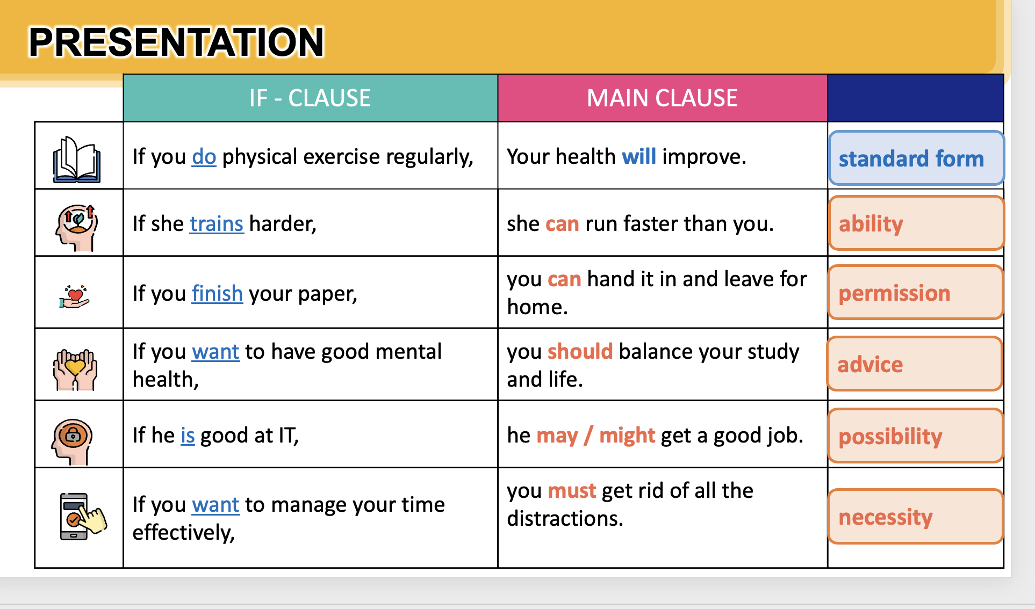
 | If - clause | Main clause | Use
If you do physical exercise regularly,
your health will improve.
standard form
1
ability
2
If she trains harder,
she can run faster.
permis-sion
If you finish your paper,
you can leave for home.
3

Slide 6
 | If - clause | Main clause | Use
If you want to have good mental healh,
you should balance your study and life.
advice
4
he may/might get a good job.
possibi-lity
5
If he is good at IT,
necessity
If you want to manage your time effectively,
you must get rid of all the distractions.
6

Slide 7
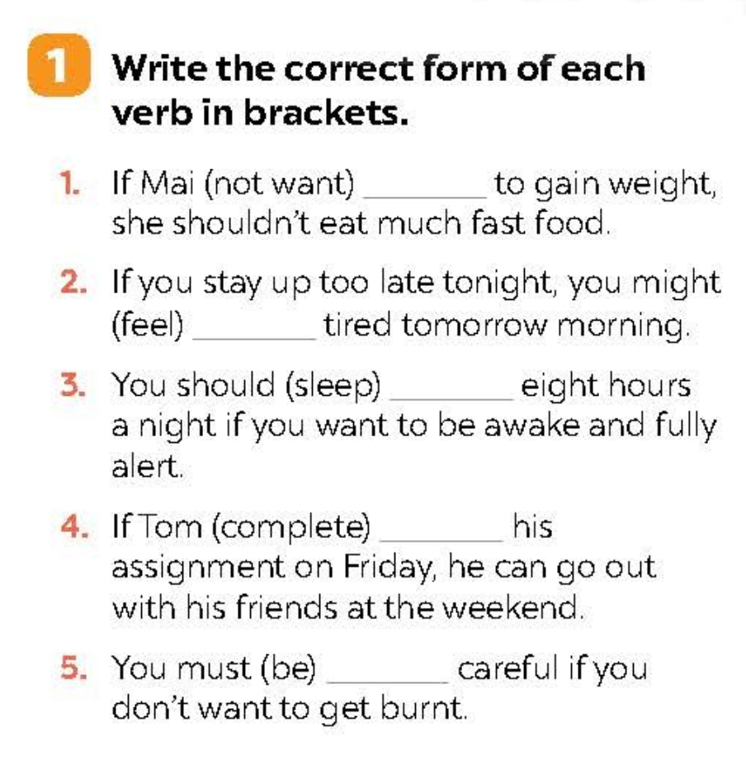

Ex 1. Write the correct form of each verb in brackets.
Hello
1. If Mai (not want) ______________to gain weight, she shouldn't eat much fast food.
2. If you stay up too late tonight, you might (feel) ______________ tired tomorrow morning.
3. You should (sleep) ______________ eight hours a night if you want to be awake and fully alert.
4. If Tom (complete) ______________ his assignment on Friday, he can go out with his friends at the weekend.
5. You must (be) ______________ careful if you don't want to get burnt.

Slide 8
CHECK YOUR ANSWER
Hello
Structure: If + V(s/es), S+ will/may/might/ can … + V
doesn’t want
1. If Mai (not want) ______________to gain weight, she shouldn't eat much fast food.
2. If you stay up too late tonight, you might (feel) ______________ tired tomorrow morning.
3. You should (sleep) ______________ eight hours a night if you want to be awake and fully alert.
feel
sleep

Slide 9
CHECK YOUR ANSWER
Hello
Structure: If + V(s/es), S+ will/may/might/ can … + V
completes
4. If Tom (complete) ______________ his assignment on Friday, he can go out with his friends at the weekend.
5. You must (be) ______________ careful if you don't want to get burnt.
be

Slide 10
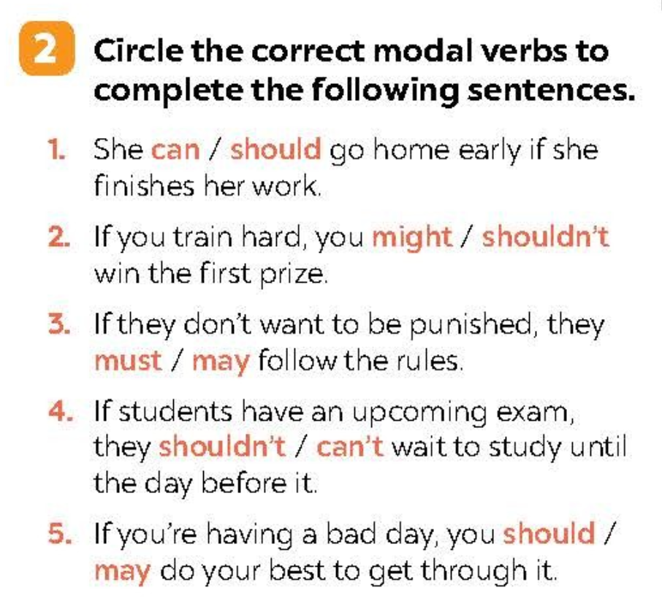
Ex 2. Circle the correct modal verbs to complete the following sentences.
1. She can / should go home early if she finishes her work.
2. If you train hard, you might / shouldn’t win the first prize.
3. If they don’t want to be punished, they must / may follow the rules.
4. If students have an upcoming exam, they shouldn’t / can’t wait to study until the day before it.
5. If you’re having a bad day, you should / may do your best to get through it.

Slide 11
CHECK YOUR ANSWER
1. She can / should go home early if she finishes her work.
2. If you train hard, you might / shouldn’t win the first prize.
3. If they don’t want to be punished, they must / may follow the rules.
Permission (sự cho phép)
possibility (khả năngxả ra)
necessity (sự cần thiết)

Slide 12
CHECK YOUR ANSWER
4. If students have an upcoming exam, they shouldn’t / can’t wait to study until the day before it.
5. If you’re having a bad day, you should / may do your best to get through it.
advice (lời khuyên)
advice (lời khuyên)

Slide 13
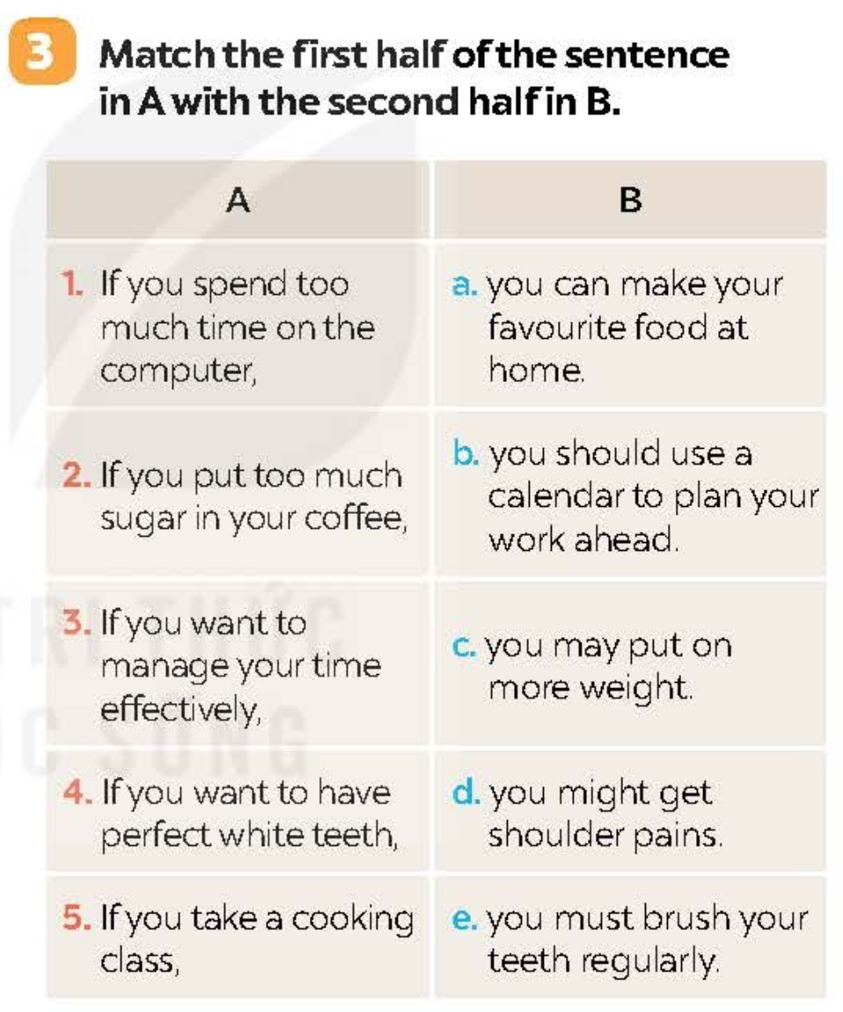
Ex 3. Match the first half of the sentence in A with the second half in B.
1. If you spend too much time on the computer,
a. you can make your favourite food at home.
2. If you put too much sugar in your coffee,
b. you should use a calendar to plan your work ahead.
3. If you want to manage your time effectively,
c. you may put on more weight.
4. If you want to have perfect white teeth,
d. you might get shoulder pains.
5. If you take a cooking class,
e. you must brush your teeth regularly.

Slide 14
CHECK YOUR ANSWER
1. If you spend too much time on the computer,
a. you can make your favourite food at home.
2. If you put too much sugar in your coffee,
b. you should use a calendar to plan your work ahead.
3. If you want to manage your time effectively,
c. you may put on more weight.
4. If you want to have perfect white teeth,
d. you might get shoulder pains.
5. If you take a cooking class,
e. you must brush your teeth regularly.

Slide 15
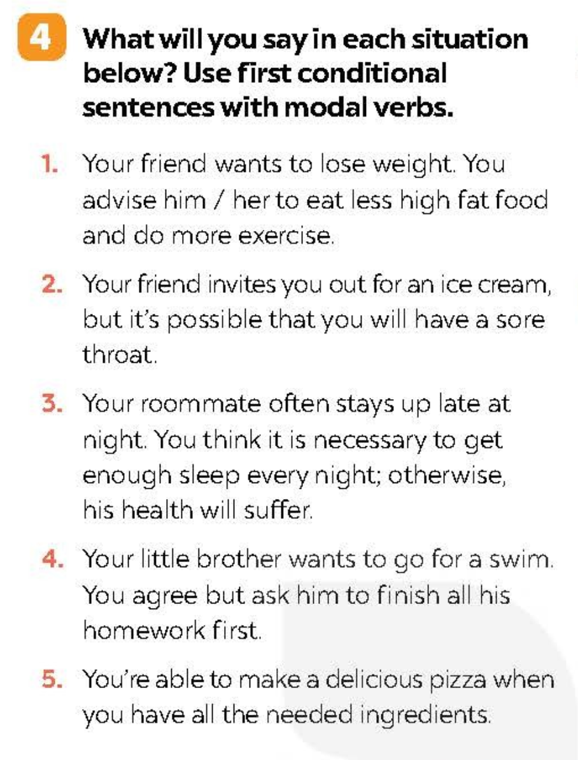

Ex 4. What will you say in each situation below? Use first conditional sentences with modal verbs.
If you want to lose weight, you should eat less high fat food and do more exercise.
Your friend wants to lose weight. You advise him/her to eat less high fat food and do more exercise.

Slide 16
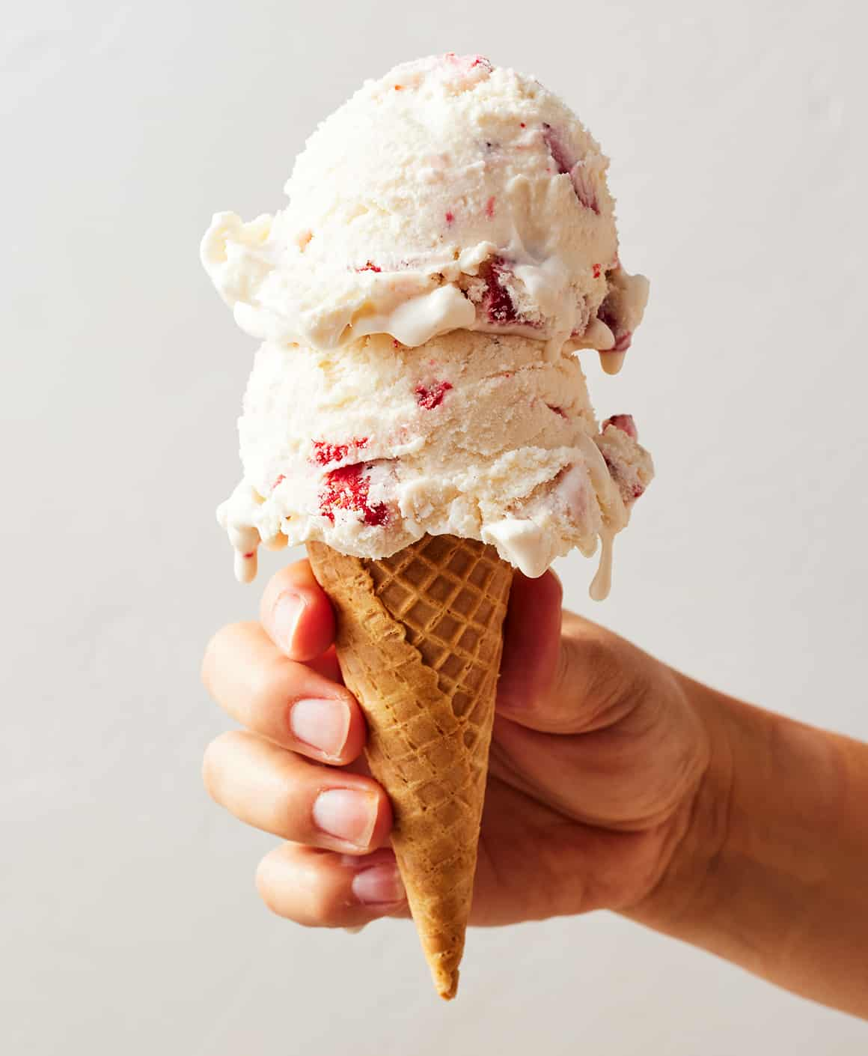

Ex 4. What will you say in each situation below? Use first conditional sentences with modal verbs.
If I have an ice cream, I may have a sore throat.
Your friend invites you out for an ice cream, but it’s possible that you will have a sore throat.

Slide 17
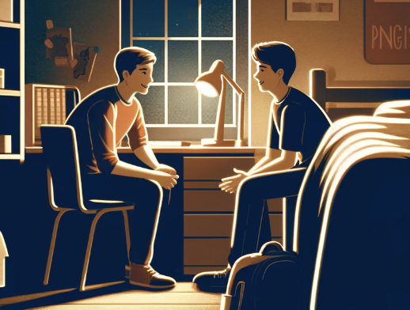
Ex 4. What will you say in each situation below? Use first conditional sentences with modal verbs.
If you want to have good health, you must get 8 hours of sleep per night.
Your roommate often stays up late at night. You think it is necessary to get enough sleep every night; otherwise, his health will suffer.

Slide 18

Ex 4. What will you say in each situation below? Use first conditional sentences with modal verbs.
You can go for a swim if you finish all your homework.
Your little brother wants to go for a swim. You agree but ask him to finish all his homework first.

Slide 19
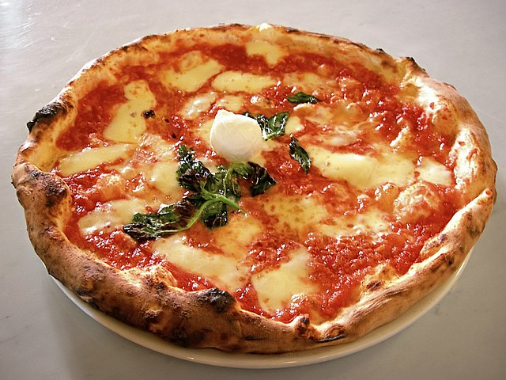

Ex 4. What will you say in each situation below? Use first conditional sentences with modal verbs.
If I have all needed ingredients, I can make a delicious pizza.
You’re able to make a delicious pizza when you have all the needed ingredients.

Slide 20

WRAP UP After this lesson, students have been able to
GRAMMAR
use correct modal verbs in conditional sentences type 1

Slide 21
THANKS FOR YOUR ATTENTION!

