Slide 1

Unit 6
DESCRIBING PEOPLE
LESSON 3.2 - PAGE 85

Slide 2
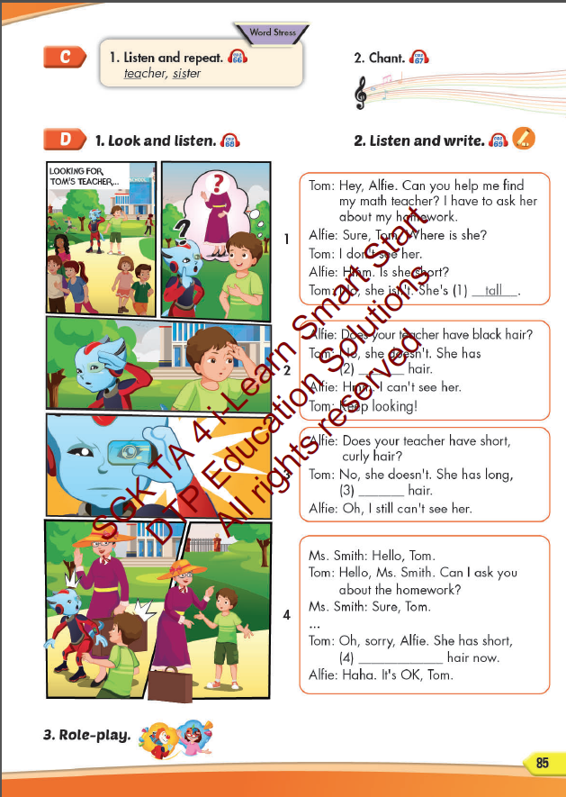
Lesson Outline
Warm-up
Listening
Consolidation
Wrap-up

Slide 3
Objectives
By the end of this lesson, students will be able to identify the word stress and practice the conversations.
Vocabulary: teacher, sister
Word stress: two-syllable nouns

Slide 4

WARM UP

Slide 5

Read and answer

Slide 6
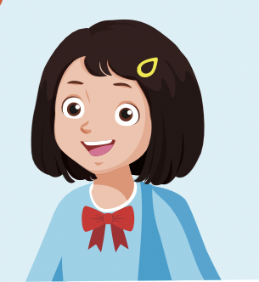
Next
CHECK
Does she have short, black hair?
Yes, she does.
…………….………………….

Slide 7
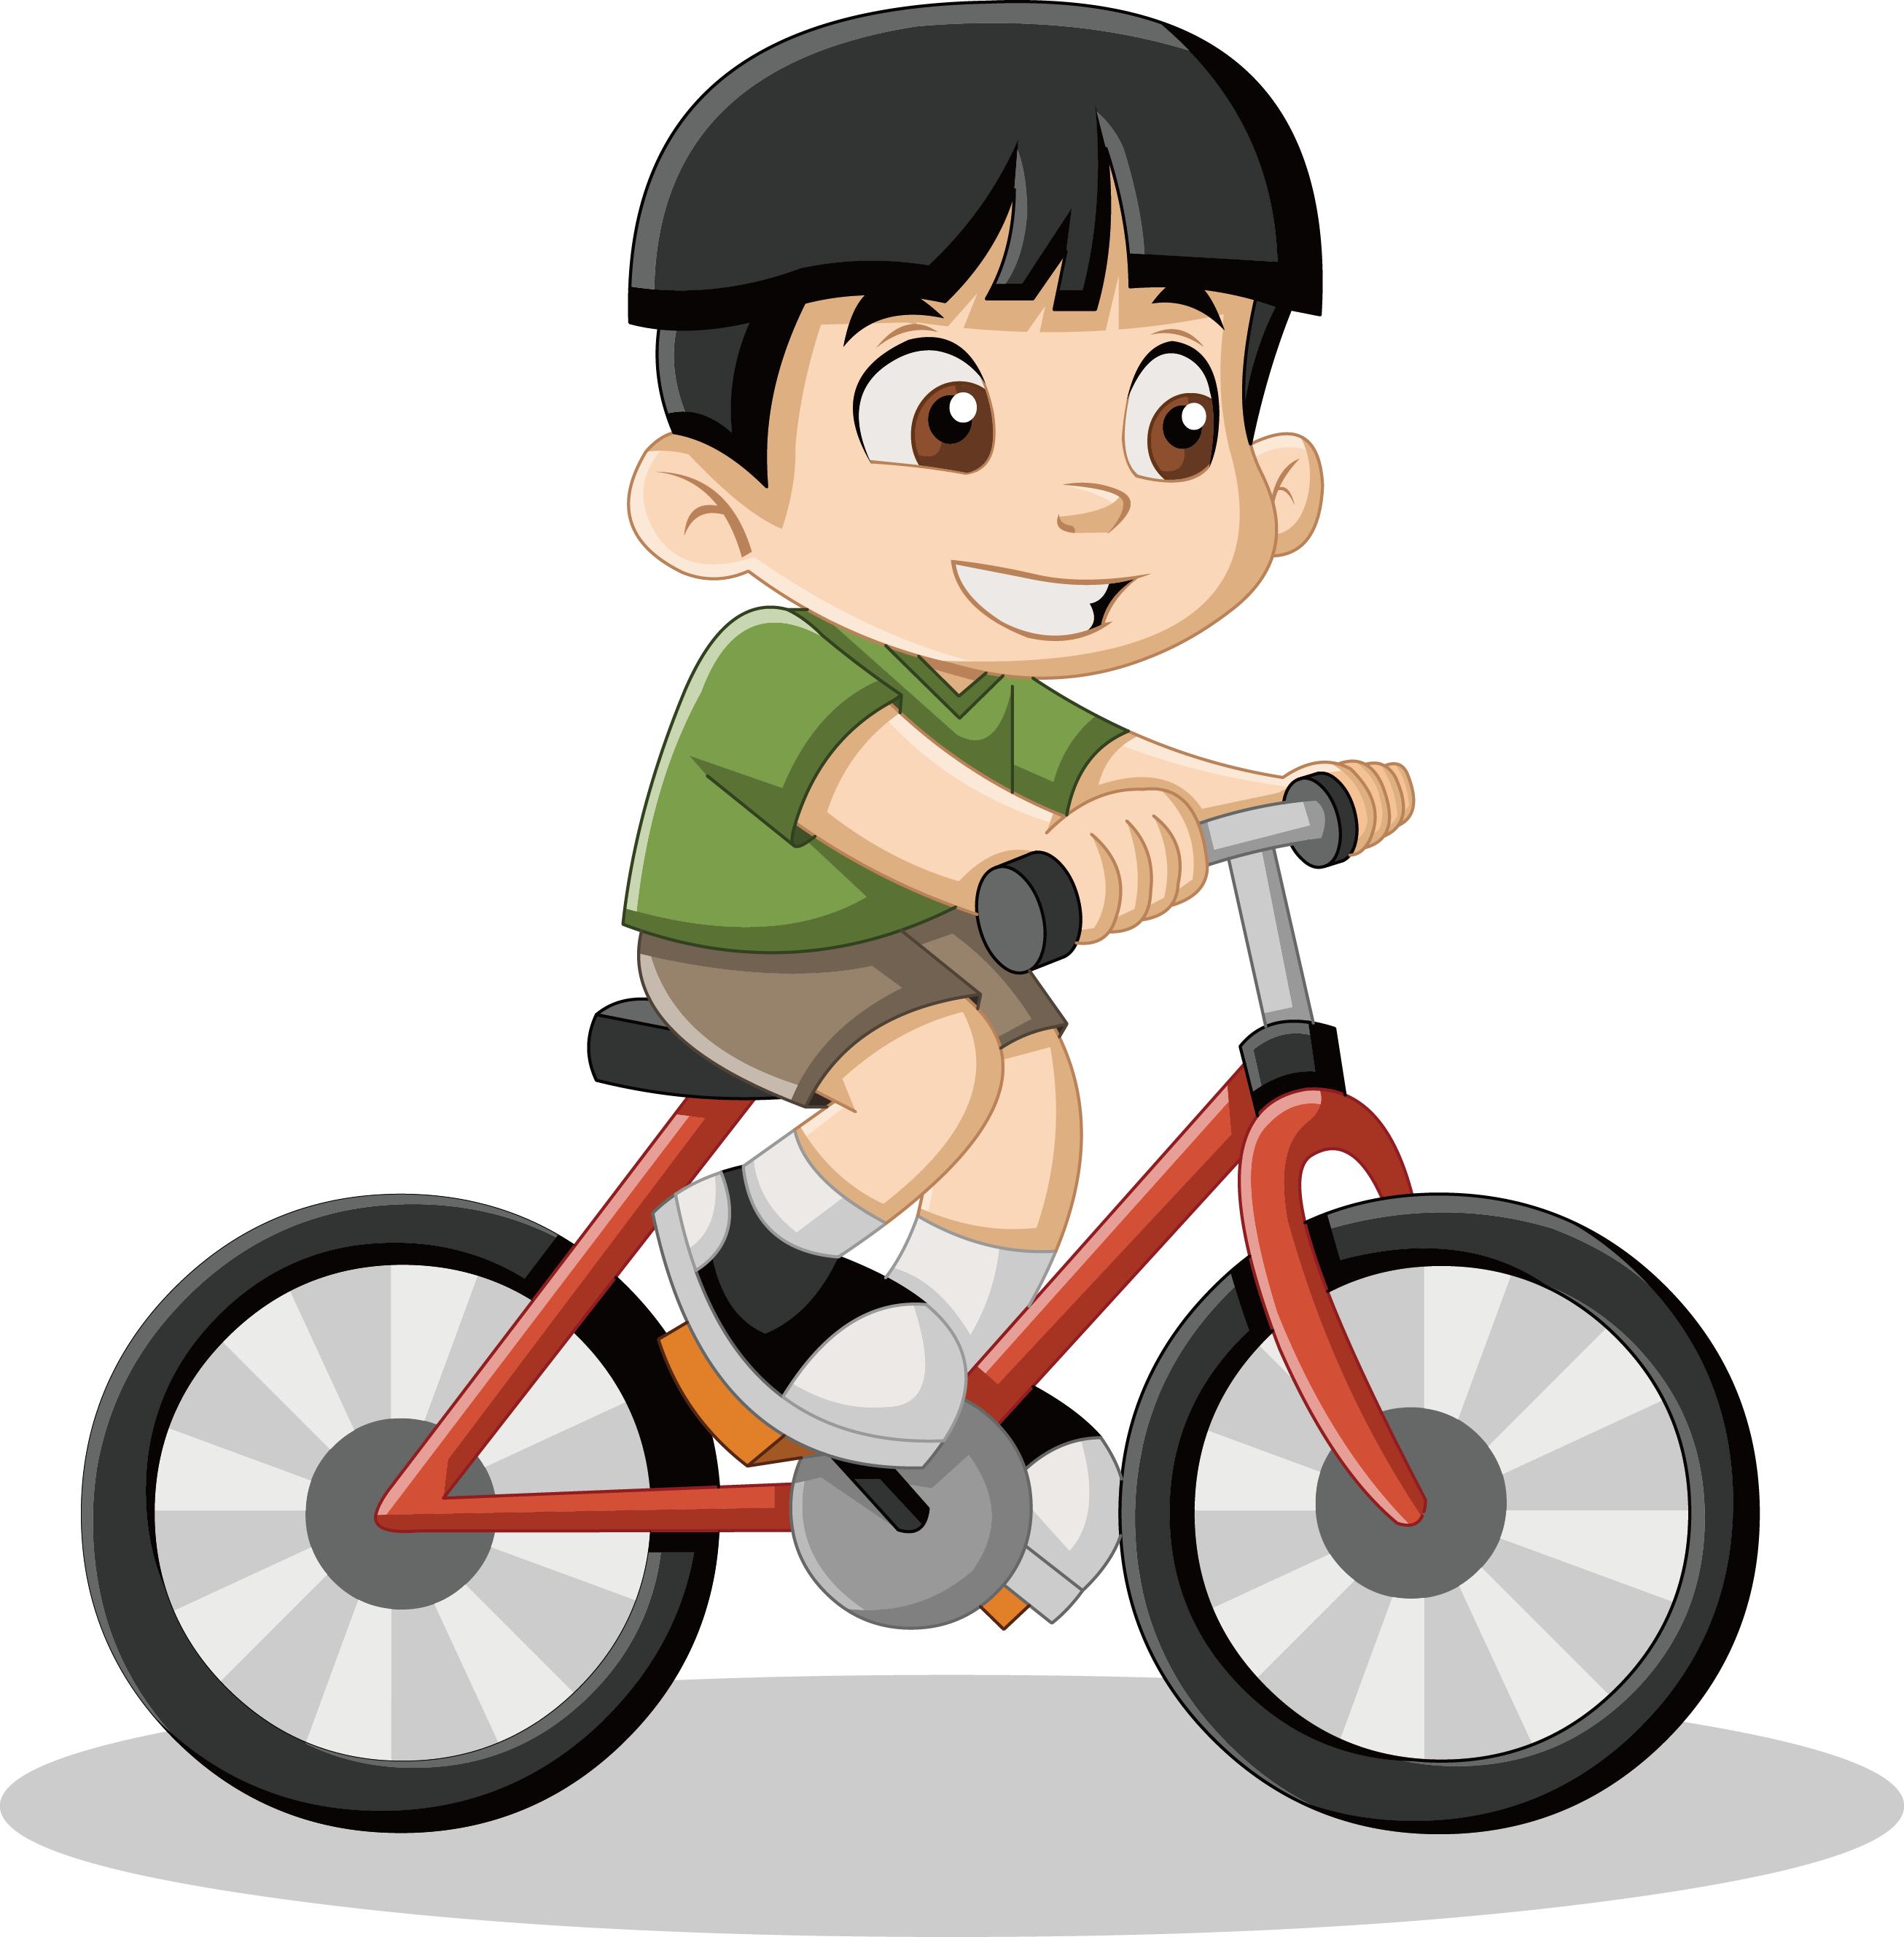
Next
CHECK
Does he have long, black hair?
No, he doesn’t.
…………….………………….

Slide 8
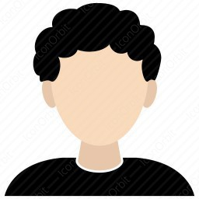
Next
CHECK
Does Tom have curly, black hair?
Yes, he does.
…………….………………….

Slide 9
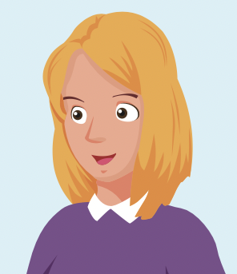
Next
CHECK
Does your friend have curly, blond hair?
No, she doesn’t.
…………….………………….

Slide 10

It’s time to learn …

Slide 11

Word stress
two-syllable nouns

Slide 12

Presentation

Slide 13
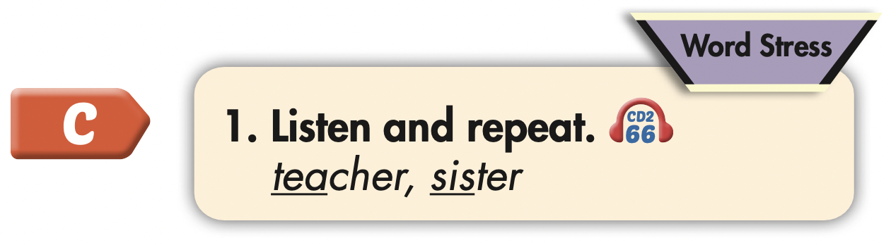

Click the icon to hear the sound.
teacher
sister
/ˈtiːtʃɚ/
/ˈsɪstɚ/

Slide 14

Practice

Slide 15



Slide 16
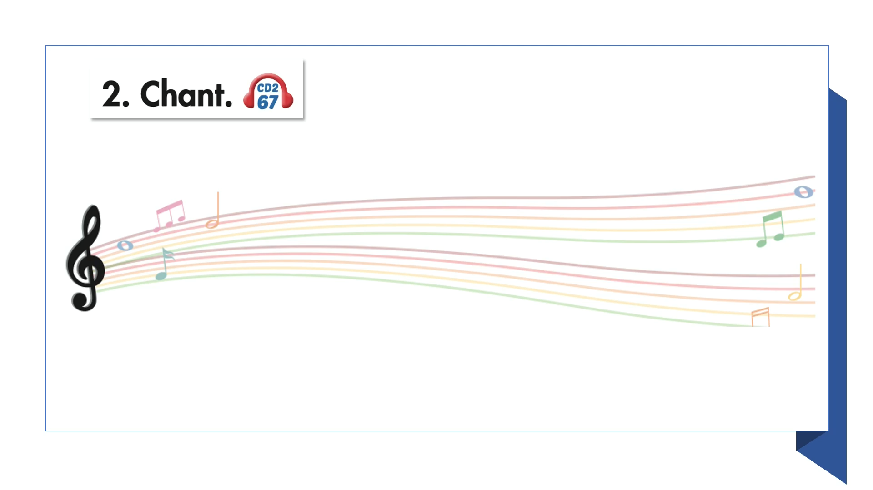

Slide 17

Speaking

Slide 18
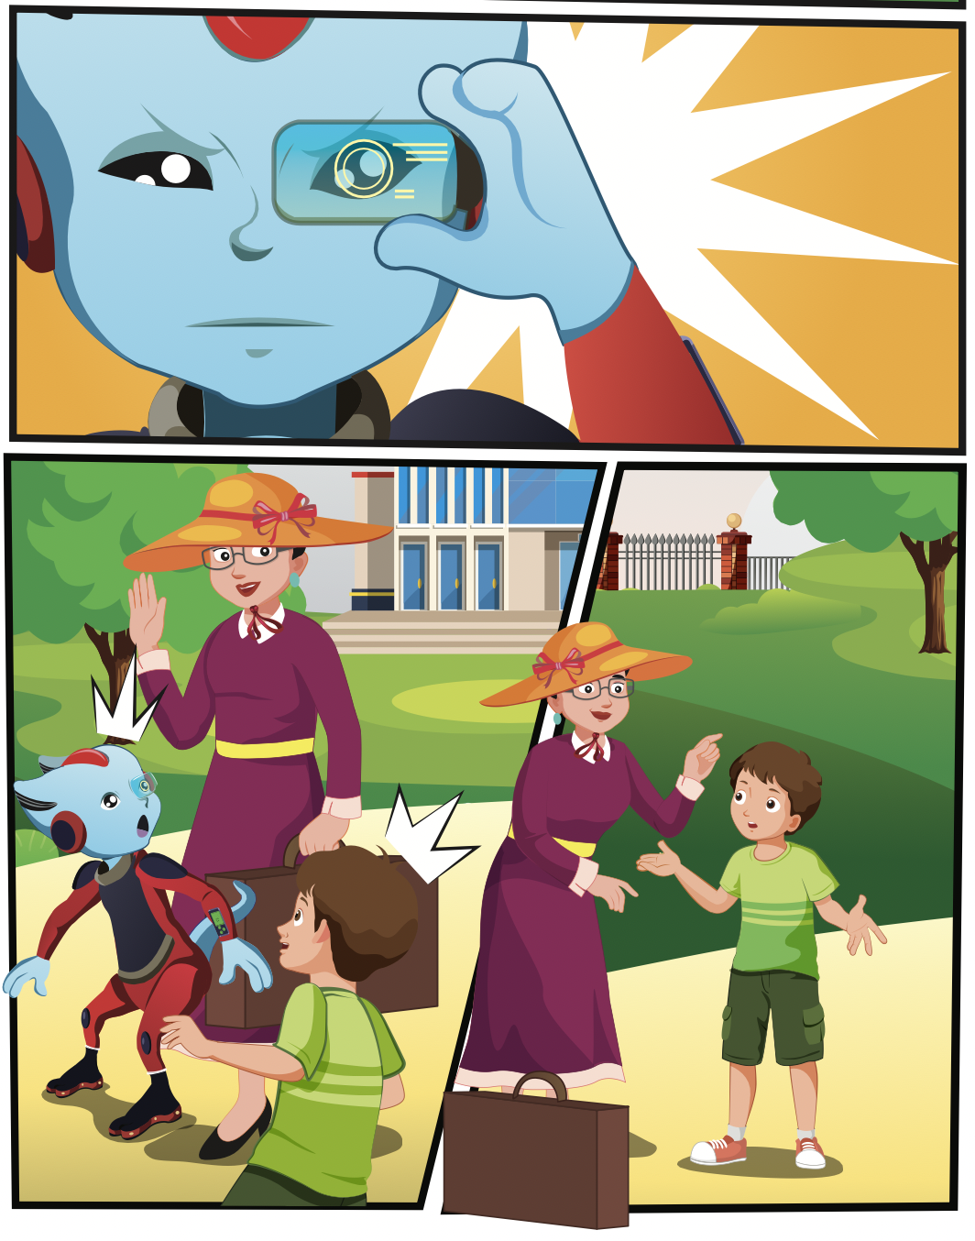
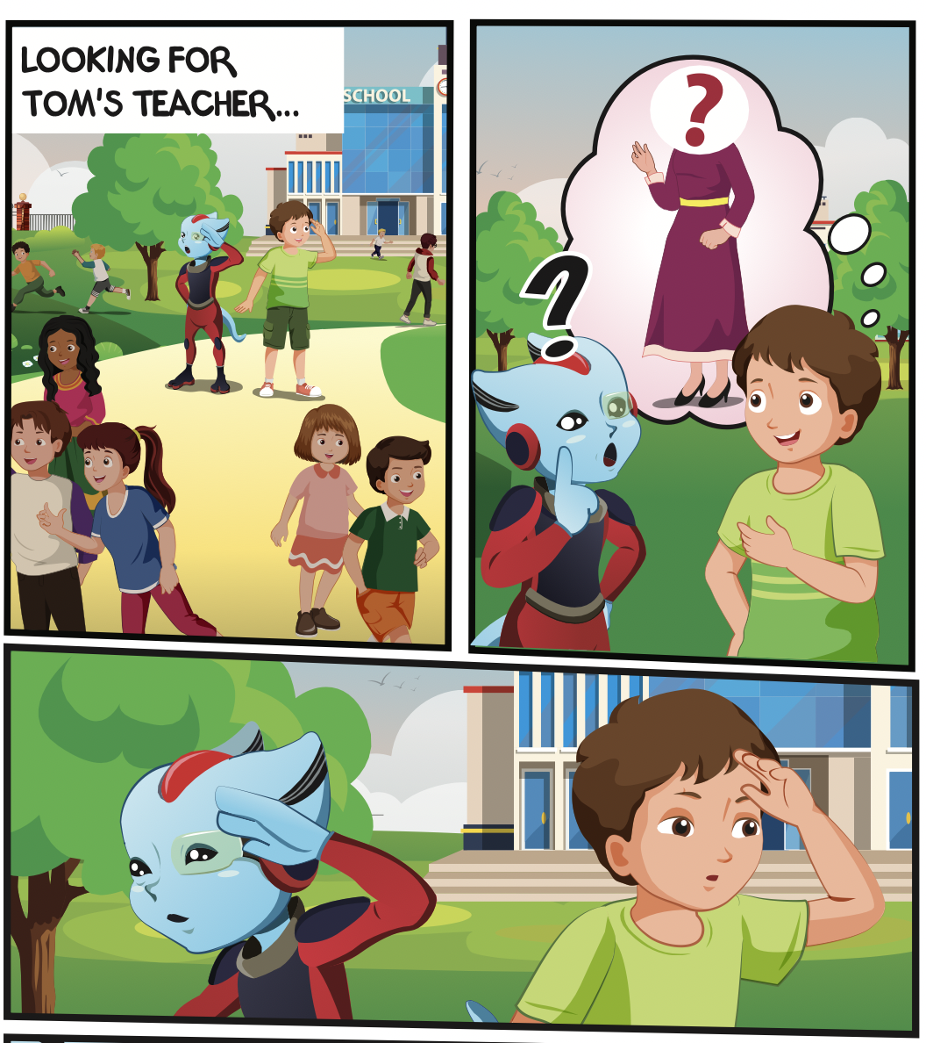
Who are they looking for?
Who is talking?
Who can you see?

Slide 19

Listening

Slide 20


Slide 21
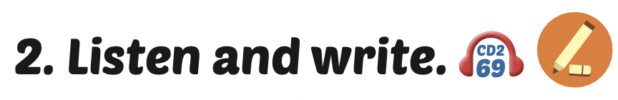
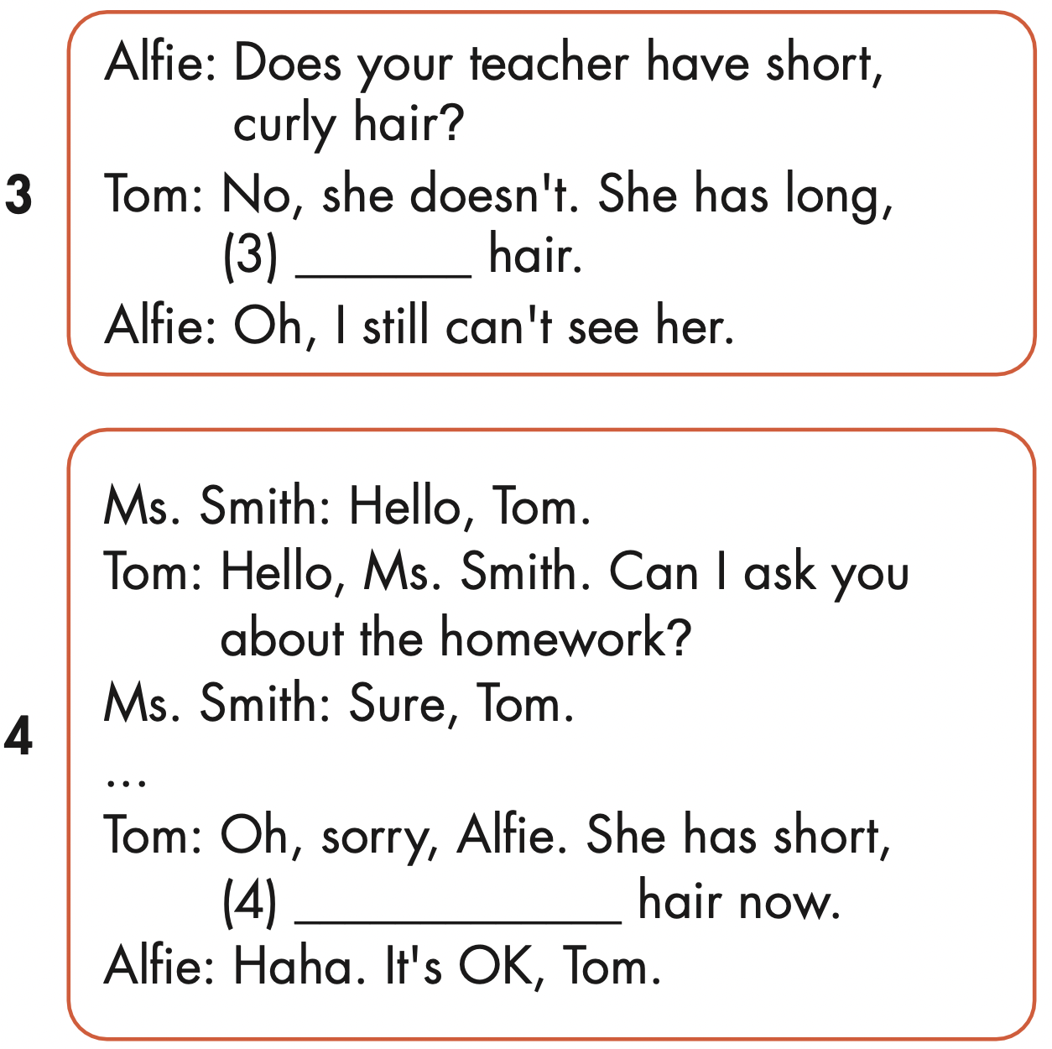
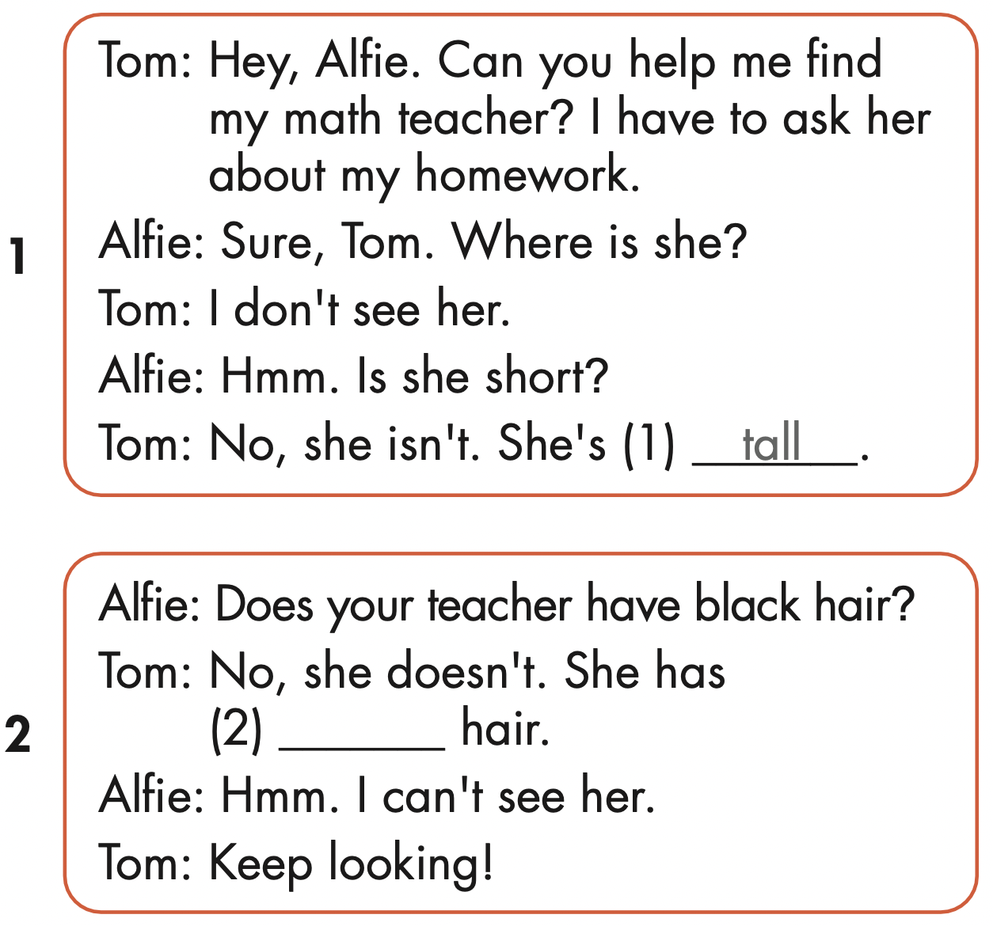
straight
blond
black

Slide 22

Speaking

Slide 23

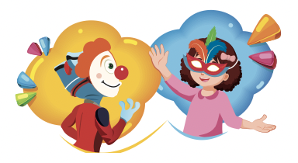

Slide 24

Writing

Slide 25
MAKE YOUR OWN STORIES

Slide 26

CONSOLIDATION

Slide 27

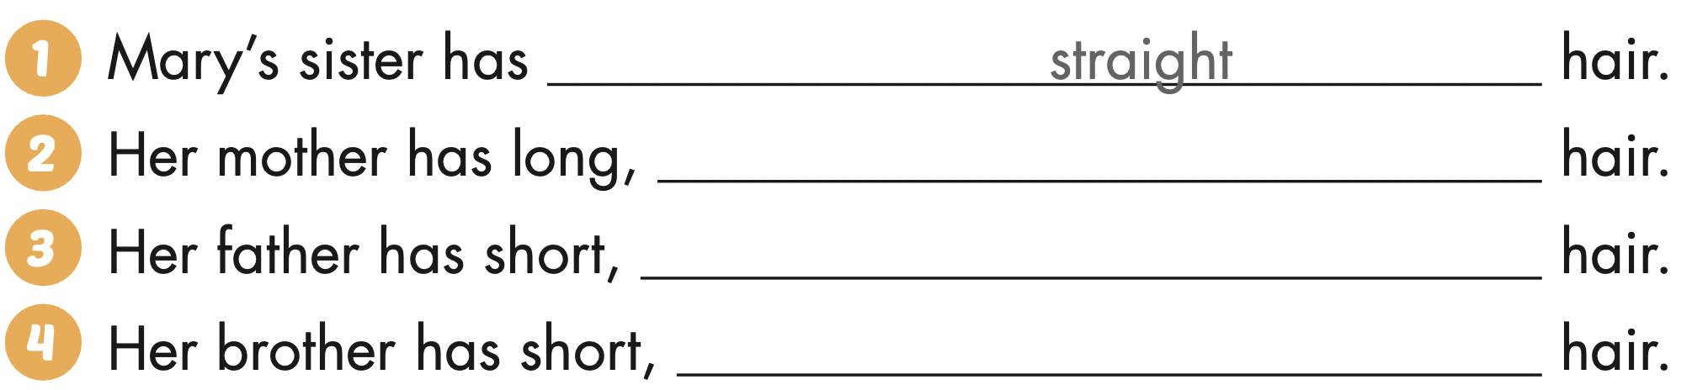
Extra Practice
WB, page 57
curly
brown
blond

Slide 28

WRAP-UP

Slide 29
Today’s lesson
Word stress
two-syllable nouns
Structures/ Sentence patterns
Does your teacher have black hair?
No, she doesn't. She has blond hair.

Slide 30
Homework
Practice the vocabularies and structure; and make sentences using them.
Do the exercises in Tiếng Anh 4 i-Learn Smart Start WB (page 57).
Do the exercises in Tiếng Anh 4 i-Learn Smart Start Notebook (page 36).
Prepare the next lesson (page 86 SB).
Play the consolidation games in Tiếng Anh 4 i-Learn Smart Start DHA App on www.eduhome.com.vn

Slide 31
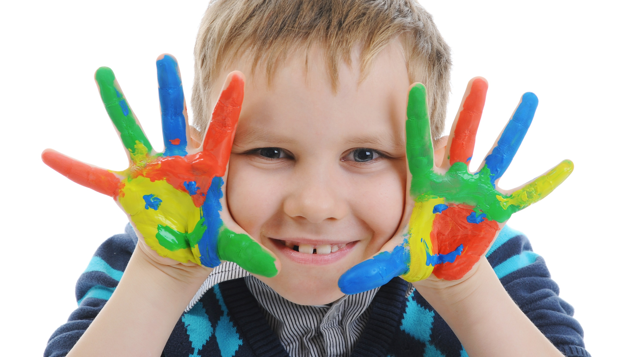
Enjoy your day!

