Slide 1

Unit 6: FOOD AND DRINKS
Review 1
Page 90

Slide 2
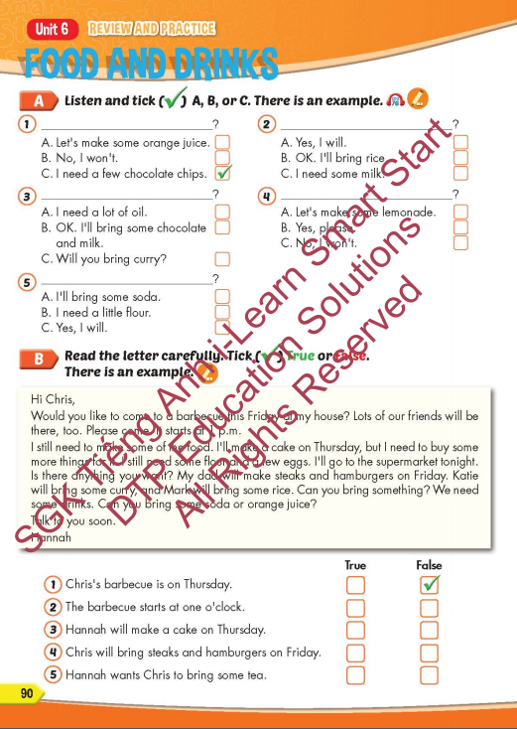
Lesson Outline
Warm-up
Listening
Reading
Speaking
Wrap-up

Slide 3
Objectives
By the end of this lesson, students will be able to review the target language presented in unit 6 and practice Listening, Reading and Writing.
Vocabulary: unit 6
Structure: unit 6

Slide 4

WARM-UP

Slide 5

Let’s play!
Let’s Dance Game

Slide 6
How To Play
Students must take turns to read the words in order.
Each time a student can choose to say the words in 1 square, 2 squares or a maximum of 3 squares.
The student who says the last word must dance!

Slide 7

BREAD
CAKE
MEAT
SUGAR
MILK
BUTTER
FLOUR
CHOCOLATE CHIPS
SODA
OIL
SMOOTHIE
TEA
DANCE!!
LEMONADE
JUICE
HOT CHOCOLATE
HAMBURGER
SANDWICH
STEAK
PIE
RICE
CURRY
DINNER
BREAKFAST
FISH
LUNCH
BREAD
CEREAL
FRIES
VEGETABLES
COFFEE

Slide 8

It’s time to learn …

Slide 9

Review

Slide 10

Listening

Slide 11
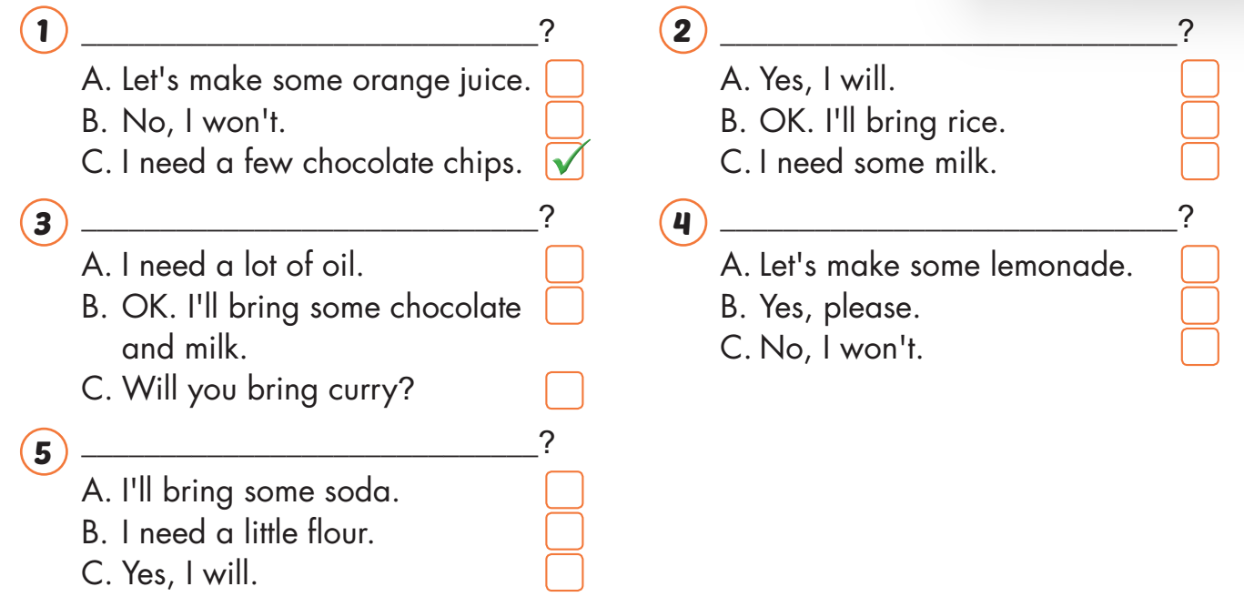
Listening

Slide 12
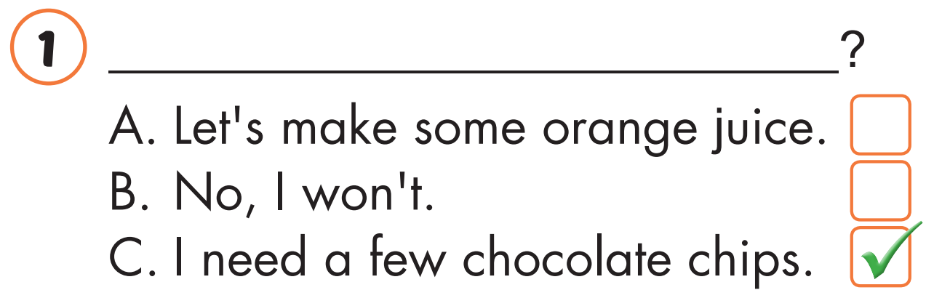
What do you need?
Listening

Slide 13
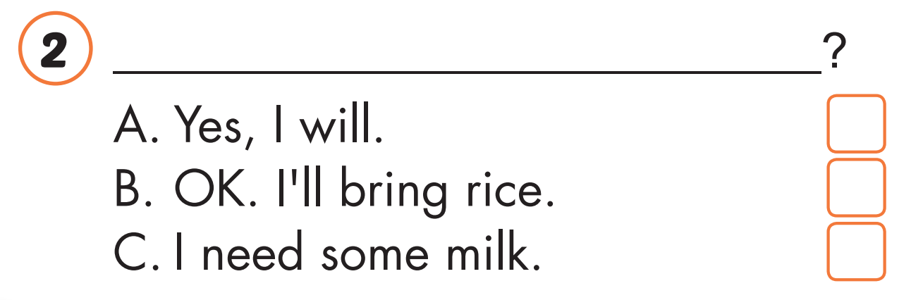

Will you bring pies, Sue
Listening

Slide 14
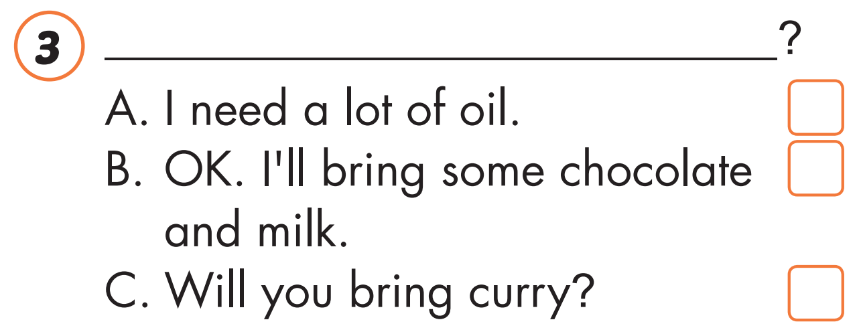
Let’s make some hot chocolate.

Slide 15
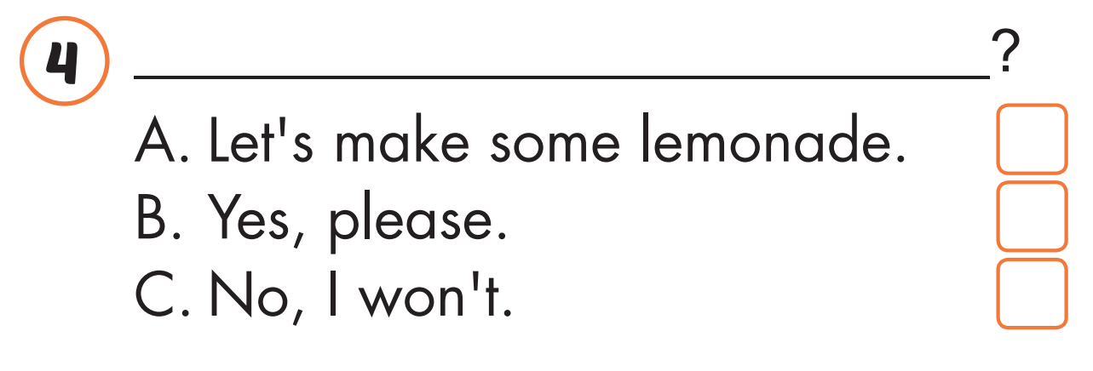
Will you bring hamburgers, Nick
Listening

Slide 16
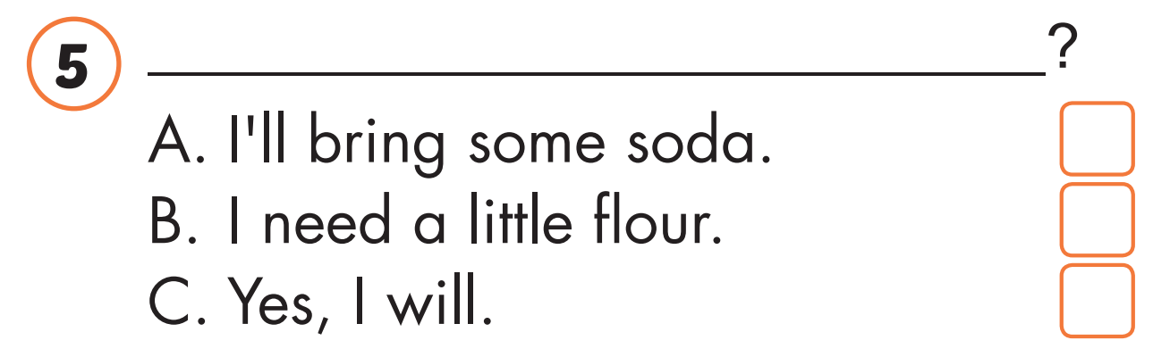
Oh, you're making a cake.
What do you need

Slide 17

Reading

Slide 18

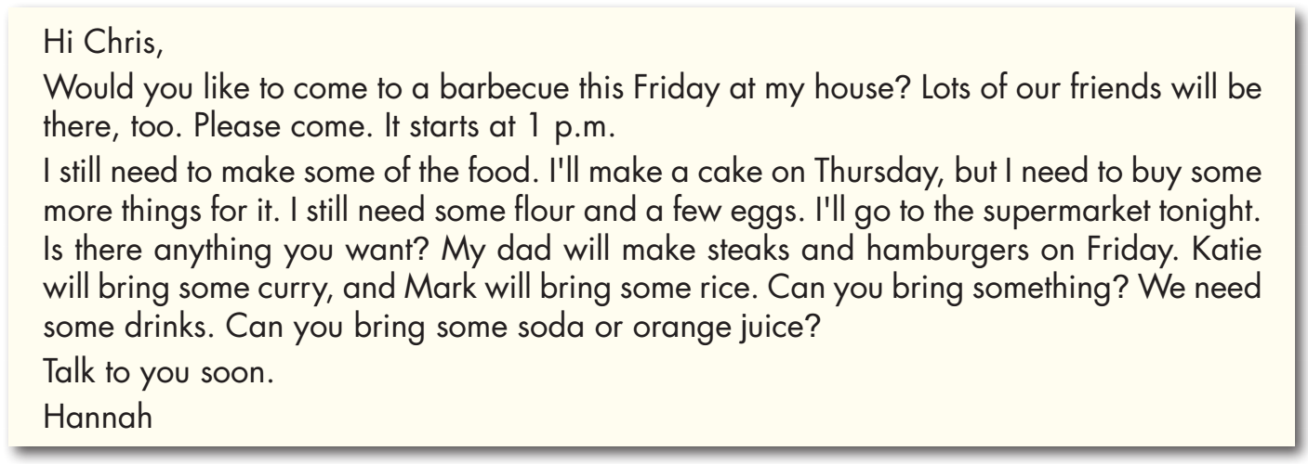

Slide 19
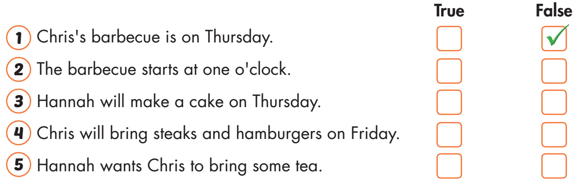

Slide 21

Speaking

Slide 22
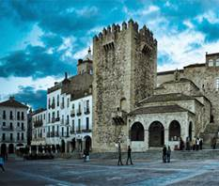
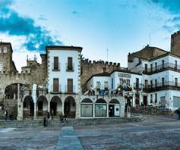
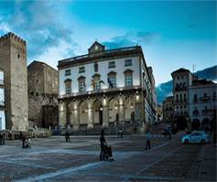

WHAT IS IT?
PHOTO PUZZLE

Slide 23

WHAT IS IT?
Turn around as many colored boxes as you can within the time limit (5 seconds) and say what it is in the picture.

Slide 24

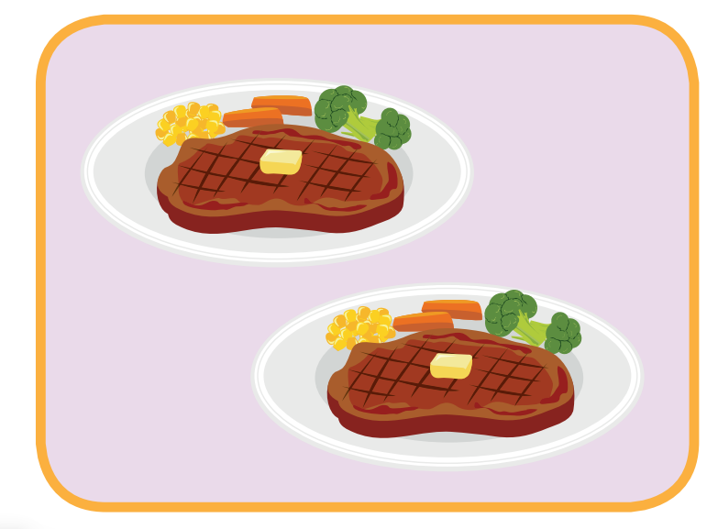
I will bring steak.
T
I
M
E
I
S
U
P
CHECK
NEXT
Click on the colored boxes to turn them around

Slide 25
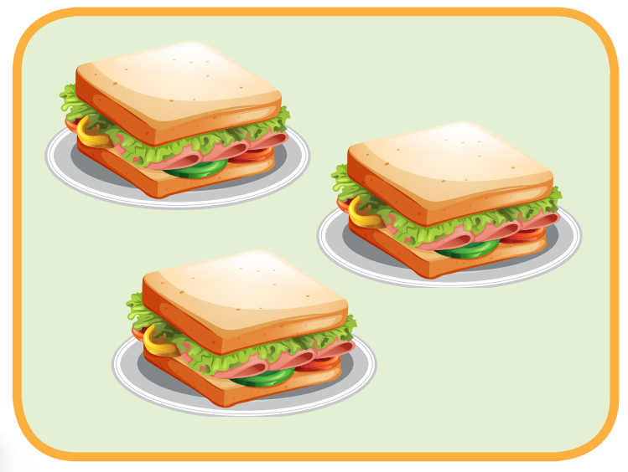
I will bring sandwiches.
T
I
M
E
I
S
U
P
CHECK
NEXT
Click on the coloured boxes to turn them around

Slide 26
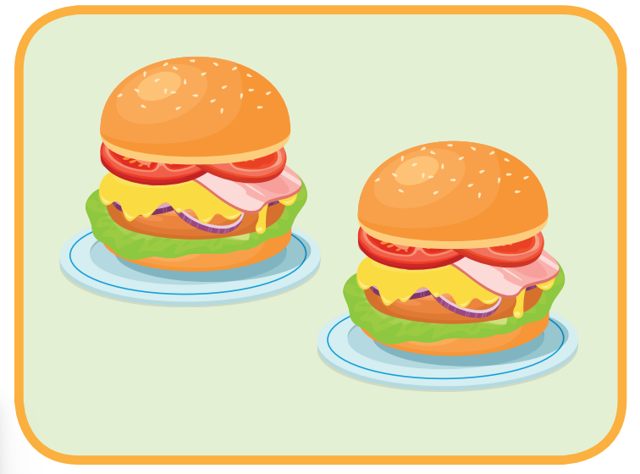
I will bring hamburgers.
T
I
M
E
I
S
U
P
CHECK
NEXT
Click on the colored boxes to turn them around

Slide 27


lunch
What is it?
T
I
M
E
I
S
U
P
CHECK
NEXT
Click on the colored boxes to turn them around

Slide 28
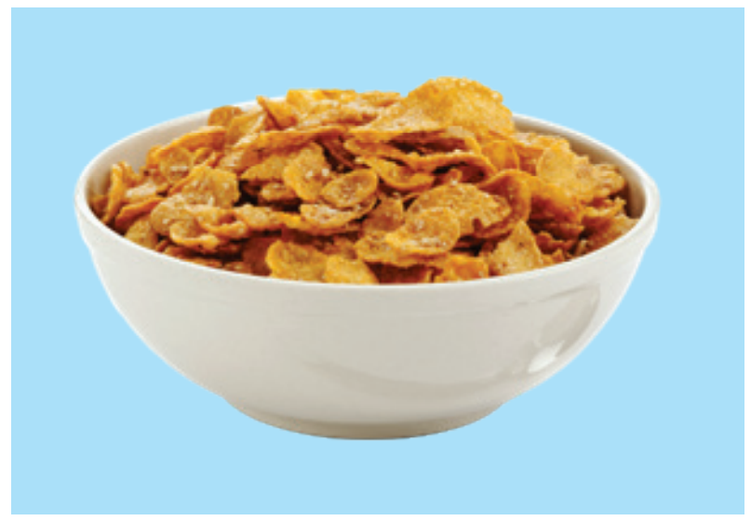
cereal
T
I
M
E
I
S
U
P
CHECK
NEXT
Click on the colored boxes to turn them around

Slide 29

curry
T
I
M
E
I
S
U
P
CHECK
END
Click on the colored boxes to turn them around

Slide 30

hot chocolate
T
I
M
E
I
S
U
P
CHECK
END
Click on the colored boxes to turn them around

Slide 31

CONSOLIDATION

Slide 32



Extra Practice
WB, page 60

Slide 33



Slide 34
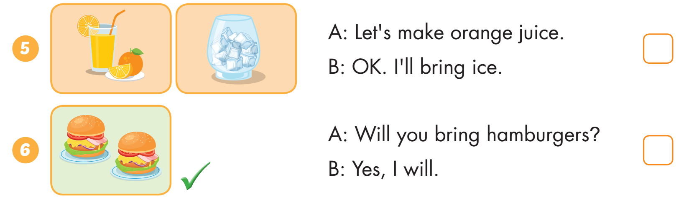

Slide 35
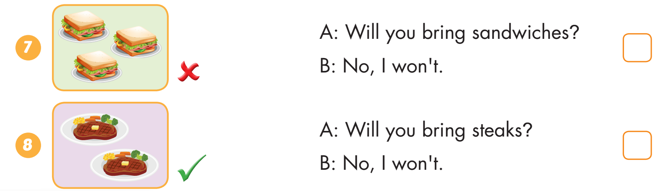

Slide 36

WRAP-UP

Slide 37
Today’s lesson
Vocabularies
Unit 6
Structures/ Sentence patterns
Unit 6

Slide 38
Homework
Practice the vocabularies and structure, and make sentences using them.
Do the exercises in Tiếng Anh 5 i-Learn Smart Start WB (page 50).
Do the exercises in Tiếng Anh 5 i-Learn Smart Start Notebook.
Prepare the next lesson (page 77 SB).
Play the consolidation games in Tiếng Anh 5 i-Learn Smart Start DHA App on www.eduhome.com.vn

Slide 39

Enjoy your day!

Slide 40

Lesson 3
Stay positive and have a nice day!

